Slide 1
Bash Tips
Biweekly
Yumika Shiba
2023/06/08
/cluster/projects/kumargroup/yumika_v2/Biweekly_20230608
Notes:
Source: The Biostar Handbook The Biostar Handbook: 2nd Edition

Slide 2
Wildcards
ls *.txt
Notes:
? can represent any single character

Slide 3
Wildcards
ls *.txt # match anything with the extension .txt
Notes:
? can represent any single character

Slide 4
Wildcards
ls *.txt # match anything with the extension .txt
ls *rna*
Notes:
? can represent any single character

Slide 5
Wildcards
ls *.txt # match anything with the extension .txt
ls *rna* # match anything that contains “rna” in filename
Notes:
? can represent any single character

Slide 6
Wildcards
ls *.txt # match anything with the extension .txt
ls *rna* # match anything that contains “rna” in filename
ls human.rna.?.fa
Notes:
? can represent any single character

Slide 7
Wildcards
ls *.txt # match anything with the extension .txt
ls *rna* # match anything that contains “rna” in filename
ls human.rna.?.fa # match anything with the pattern where ? can be any single character
Notes:
? can represent any single character

Slide 8
Wildcards
ls *.txt # match anything with the extension .txt
ls *rna* # match anything that contains “rna” in filename
ls human.rna.?.fa # match anything with the pattern where ? can be any single character
Notes:
? can represent any single character

Slide 9
Wildcards
ls *.txt # match anything with the extension .txt
ls *rna* # match anything that contains “rna” in filename
ls human.rna.?.fa # match anything with the pattern where ? can be any single character
ls human.rna.??.fa
Notes:
? can represent any single character

Slide 10
Wildcards
ls *.txt # match anything with the extension .txt
ls *rna* # match anything that contains “rna” in filename
ls human.rna.?.fa # match anything with the pattern where ? can be any single character
ls human.rna.??.fa # match anything with the pattern where each of ? can be any single character
Notes:
? can represent any single character

Slide 11
Pressing “Tab”
\t # tab completion

Slide 12
Ctrl + (A or E)
Ctrl + A

Slide 13
Ctrl + (A or E)
Ctrl + A # move cursor to the beginning

Slide 14
Ctrl + (A or E)
Ctrl + A # move cursor to the beginning
Ctrl + E

Slide 15
Ctrl + (A or E)
Ctrl + A # move cursor to the beginning
Ctrl + E # move cursor to the end

Slide 16
history
history 5
Notes:
history # record commands run from the terminal session

Slide 17
history
history 5 # show the last 5 commands
Notes:
history # record commands run from the terminal session

Slide 18
history
history 5 # show the last 5 commands
history
Notes:
history # record commands run from the terminal session

Slide 19
history
history 5 # show the last 5 commands
history # show the last 1000 commands run
Notes:
history # record commands run from the terminal session

Slide 20
history
history 5 # show the last 5 commands
history # show the last 1000 commands run
history | grep sbatch # show past sbatch commands
Notes:
history # record commands run from the terminal session

Slide 21
history
history 5 # show the last 5 commands
history # show the last 1000 commands run
history | grep sbatch # show past sbatch commands
Notes:
history # record commands run from the terminal session

Slide 22
!_SMTH_
!salloc
Notes:
# run the last command that starts with _SMTH_

Slide 23
!_SMTH_
!salloc # run the last run salloc command
Notes:
# run the last command that starts with _SMTH_

Slide 24
!_SMTH_
!salloc # run the last run salloc command
!sbatch # run the last run sbatch command
!sbatc
!sbat
Notes:
# run the last command that starts with _SMTH_

Slide 25
!_SMTH_
!salloc # run the last run salloc command
!sbatch # run the last run sbatch command
!sbatc
!sbat
Notes:
# run the last command that starts with _SMTH_

Slide 26
rm -i
rm -i kumarlabMembs.txt kumarlabAlum.txt kumarlabDel.txt # confirmation are asked
Notes:
rm -i # asks for confirmation before deleting anything

Slide 27
rm -i
rm -i kumarlabMembs.txt kumarlabAlum.txt kumarlabDel.txt # confirmation message displayed
Notes:
rm -i # asks for confirmation before deleting anything

Slide 28
grep flags
-i # ignore case when matching
-w # only match whole words
-v # show lines that don’t match a pattern
--color=AUTO # highlight the match

Slide 29
grep was opening_lines.txt output?
opening_lines.txt
1 Now is the winter of our discontent.
2 All children, except one, grow up.
3 The Galactic Empire was dying.
4 In a hole in the ground there lived a hobbit.
5 It was a pleasure to burn.
6 It was a bright, cold day in April, and the clocks were striking thirteen.
7 It was love at first sight.
8 I am an invisible man.
9 It was the day my grandmother exploded.
10 When he was nearly thirteen, my brother Jem got his arm badly broken at the elbow.
11 Marley was dead, to begin with.”
Notes:
Source: The biostar handbook

Slide 30
grep was opening_lines.txt output?
1 Now is the winter of our discontent.
2 All children, except one, grow up.
3 The Galactic Empire was dying.
4 In a hole in the ground there lived a hobbit.
5 It was a pleasure to burn.
6 It was a bright, cold day in April, and the clocks were striking thirteen.
7 It was love at first sight.
8 I am an invisible man.
9 It was the day my grandmother exploded.
10 When he was nearly thirteen, my brother Jem got his arm badly broken at the elbow.
11 Marley was dead, to begin with.”
Notes:
Source: The biostar handbook

Slide 31
grep was opening_lines.txt output
Output
3 The Galactic Empire was dying.
5 It was a pleasure to burn.
6 It was a bright, cold day in April, and the clocks were striking thirteen.
7 It was love at first sight.
9 It was the day my grandmother exploded.
10 When he was nearly thirteen, my brother Jem got his arm badly broken at the elbow.
11 Marley was dead, to begin with.”
Notes:
Source: The biostar handbook

Slide 32
grep WAS opening_lines.txt output?
opening_lines.txt
1 Now is the winter of our discontent.
2 All children, except one, grow up.
3 The Galactic Empire was dying.
4 In a hole in the ground there lived a hobbit.
5 It was a pleasure to burn.
6 It was a bright, cold day in April, and the clocks were striking thirteen.
7 It was love at first sight.
8 I am an invisible man.
9 It was the day my grandmother exploded.
10 When he was nearly thirteen, my brother Jem got his arm badly broken at the elbow.
11 Marley was dead, to begin with.”
Notes:
Source: The biostar handbook

Slide 33
grep WAS opening_lines.txt output
Output
Notes:
Source: The biostar handbook

Slide 34
grep -i WAS opening_lines.txt output?
opening_lines.txt
1 Now is the winter of our discontent.
2 All children, except one, grow up.
3 The Galactic Empire was dying.
4 In a hole in the ground there lived a hobbit.
5 It was a pleasure to burn.
6 It was a bright, cold day in April, and the clocks were striking thirteen.
7 It was love at first sight.
8 I am an invisible man.
9 It was the day my grandmother exploded.
10 When he was nearly thirteen, my brother Jem got his arm badly broken at the elbow.
11 Marley was dead, to begin with.”
Notes:
Source: The biostar handbook

Slide 35
grep -i WAS opening_lines.txt outputs?
Output
3 The Galactic Empire was dying.
5 It was a pleasure to burn.
6 It was a bright, cold day in April, and the clocks were striking thirteen.
7 It was love at first sight.
9 It was the day my grandmother exploded.
10 When he was nearly thirteen, my brother Jem got his arm badly broken at the elbow.
11 Marley was dead, to begin with.”
Notes:
Source: The biostar handbook

Slide 36
grep -vi was opening_lines.txt output?
opening_lines.txt
1 Now is the winter of our discontent.
2 All children, except one, grow up.
3 The Galactic Empire was dying.
4 In a hole in the ground there lived a hobbit.
5 It was a pleasure to burn.
6 It was a bright, cold day in April, and the clocks were striking thirteen.
7 It was love at first sight.
8 I am an invisible man.
9 It was the day my grandmother exploded.
10 When he was nearly thirteen, my brother Jem got his arm badly broken at the elbow.
11 Marley was dead, to begin with.”
Notes:
Source: The biostar handbook

Slide 37
grep -v was opening_lines.txt output?
1 Now is the winter of our discontent.
2 All children, except one, grow up.
3 The Galactic Empire was dying.
4 In a hole in the ground there lived a hobbit.
5 It was a pleasure to burn.
6 It was a bright, cold day in April, and the clocks were striking thirteen.
7 It was love at first sight.
8 I am an invisible man.
9 It was the day my grandmother exploded.
10 When he was nearly thirteen, my brother Jem got his arm badly broken at the elbow.
11 Marley was dead, to begin with.”
Notes:
Source: The biostar handbook

Slide 38
grep -v was opening_lines.txt outputs?
Output
1 Now is the winter of our discontent.
2 All children, except one, grow up.
4 In a hole in the ground there lived a hobbit.
8 I am an invisible man.
Notes:
Source: The biostar handbook

Slide 39
This command doesn’t work… How can we fix this?
tail -n +6 chess3.0.1.gtf | cut -d '\t' -f 3 | sort | uniq -c | sort -rn

Slide 40
Tail -n +X, cut, sort uniq
tail -n +6 chess3.0.1.gtf | cut -d$'\t' -f 3 | sort | uniq -c | sort -rn
tail -n +X # print from the Xth line to the end of the file
cut with delimiter longer than 1 character
sort uniq
# -c: prefix lines by no. of occurrences
# -r: reverse the result of comparisons
# -n: numeric sort

Slide 41
for loop using numbers
for i in {1..7}; do wc -l refseqgene.${i}.genomic.fna; done
for i in {1,4,5,7}; do wc -l refseqgene.${i}.genomic.fna; done

Slide 42
wc on multiple files
wc -l refseqgene.*.genomic.fna
wc -l on multiple files # count number of lines for multiple files

Slide 43
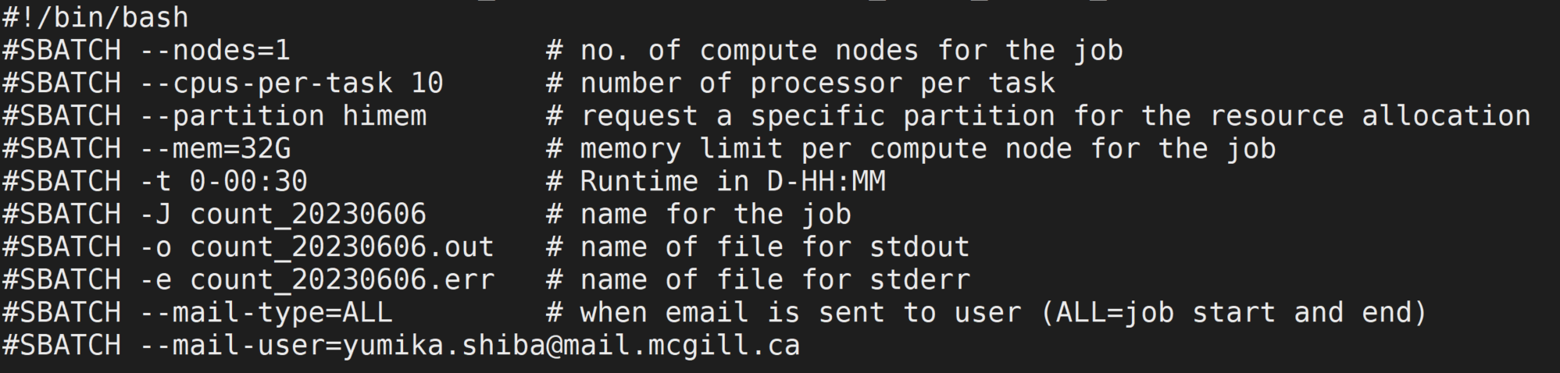
Slurm flags
Notes:
What is a node?
What is a CPU?
What is a partition?
Reference:
https://support.rowan.edu/kb_view.do?sys_kb_id=6db58169dbec5b88873cf6e9af961934&sysparm_media=print

Slide 44
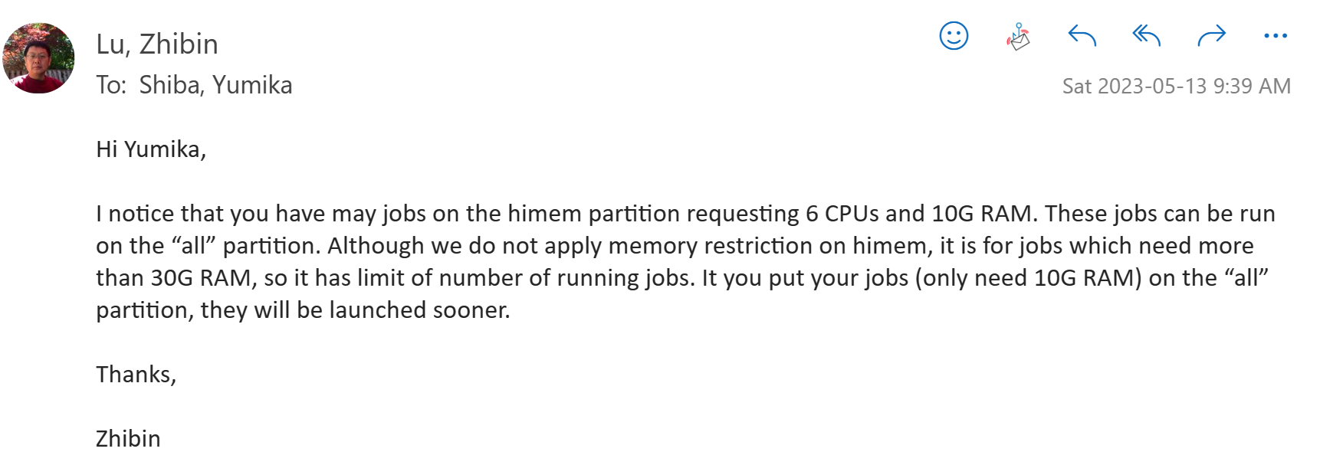
Use “all” partition to run more lower-memory jobs at a given time

Slide 45
Demo - running jobs in parallel (+ recording time it took to run a job)
Hi! My name is ____name_____.
I am a member of the Kumar Lab!
Notes:
sbatch parallel_demo.sh kumarlabMembs.txt
for file in parallel_demo_90189*.out; do echo ===============; cat $file; done

Slide 46
Using GPU (H4H)
sbatch -A kumargroup_gpu -p gpu --mem 3G --gres=gpu:1 run_make_and_spectrus.sh
-A
account
--gres=<list>
Specifies a comma-delimited list of generic consumable resources.
"name[[:type]:count]"
name: type of consumable resource (e.g. gpu).
type: optional classification for the resource (e.g. a100).
count: number of those resources (default value 1)
Notes:
What does -A mean?
sbatch parallel_demo.sh kumarlabMembs.txt
for file in parallel_demo_90189*.out; do echo ===============; cat $file; done
Source: https://slurm.schedmd.com/sbatch.html

Slide 47
Demo - running jobs in parallel (+ recording time it took to run a job)
Scheduling time of submission
https://tldp.org/LDP/intro-linux/html/sect_04_04.html

Slide 48
Anything you want to share with the group?

