Slide 1
Application for securing messages in social networks
Bachelor Project – September 2016
Alexandru Budău
alex.budau@yahoo.com
Sl.dr. ing. Mihai Bucicoiu

Slide 2
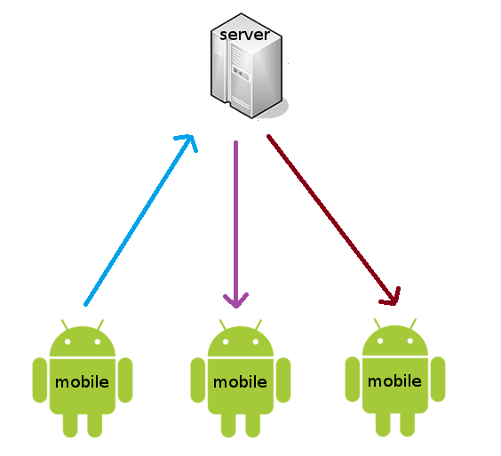


What it is about…
Bachelor Project - September 2016

Slide 3

Motivation
Need for communication over long distances
Need for mobility
Need for real time messaging
Need for privacy over internet
Bachelor Project - September 2016

Slide 4
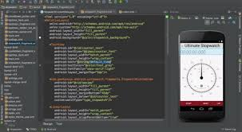





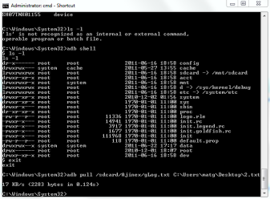





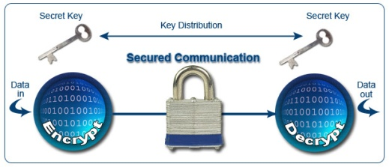
Background
Android Studio & SDK
Bachelor Project - September 2016

Slide 5
Functionalities
  connect to a local server
  log in and out
  register users
  send and receive messages, typing status
  send and receive presence status
  encrypt messages using the OTR protocol
Bachelor Project - September 2016

Slide 6
Challenges(1)
Created an active process to handle XMPP events -> Android Service
Communication between the Main Activity and the Service -> Broadcast Intents
Sending notifications to the Operating System -> Android Notification Manager
Dynamic loading graphical layouts -> Android Fragments
Bachelor Project - Month Year

Slide 7
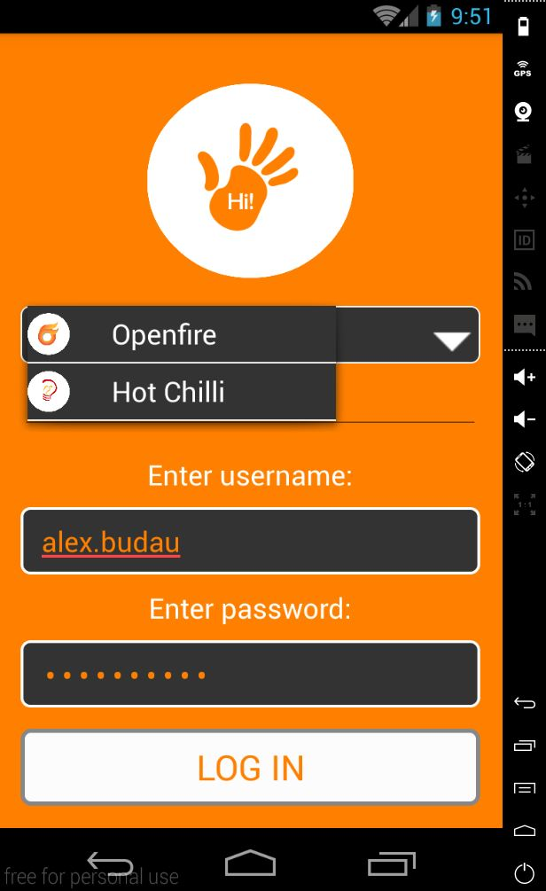
Challenges(2)
Friendly and modern user interface
  Customized buttons
  Customized drop-down list
  Logo image
Bachelor Project - Month Year

Slide 8
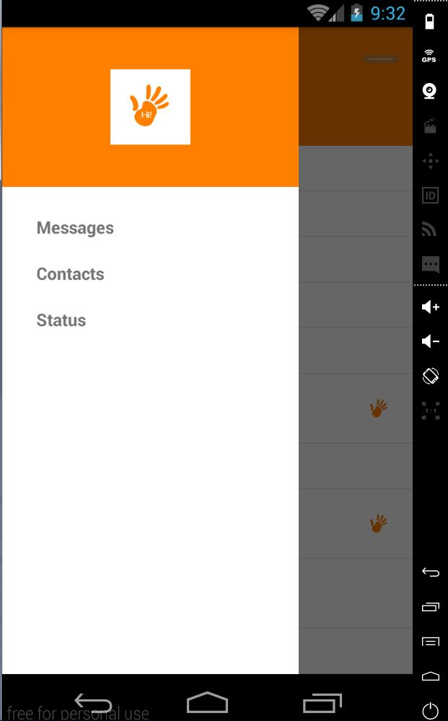
Challenges(3)
Friendly and modern user interface
  Drawer menu
Bachelor Project - Month Year

Slide 9
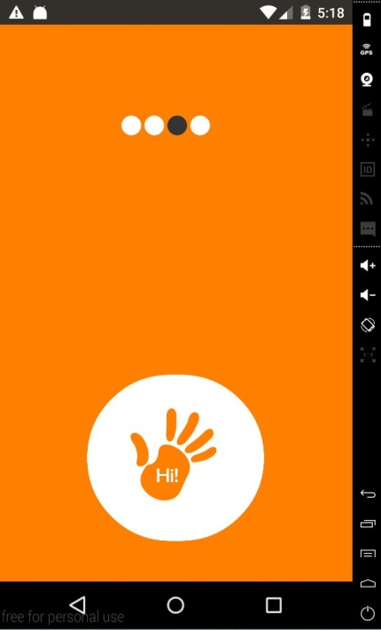
Challenges(4)
Friendly and modern user interface
  Loading animation
Bachelor Project - Month Year

Slide 10
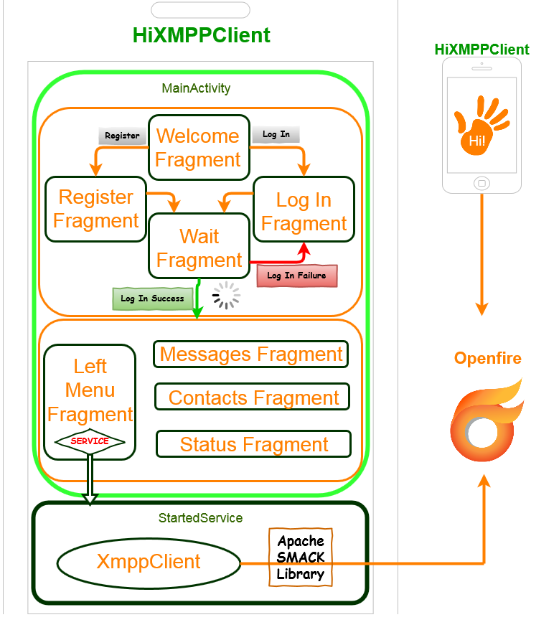
Implementation (1)
Bachelor Project - September 2016

Slide 11
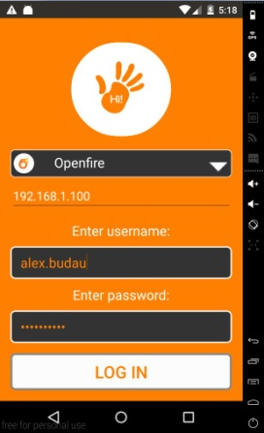
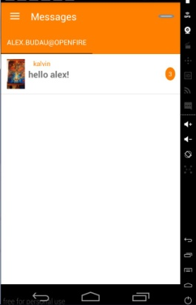
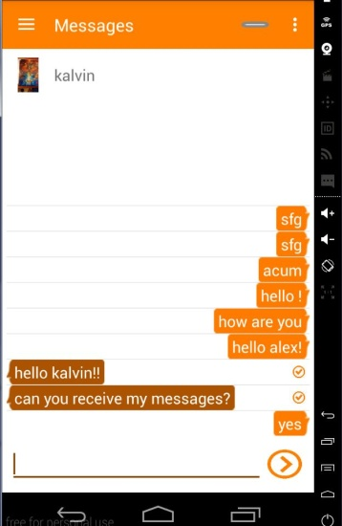
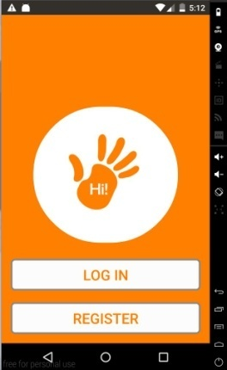


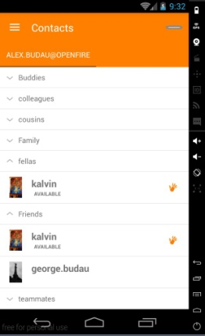
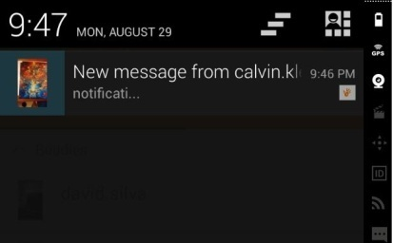
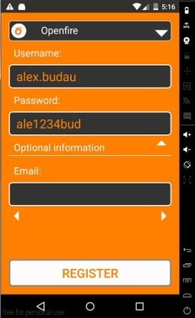
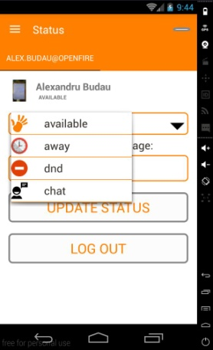
Implementation (2)
Log In
Register
Log In Success
Bachelor Project - September 2016

Slide 12
Implementation (3)
Bachelor Project - September 2016

Slide 13

Conclusion
Created an Android application from scratch
Bachelor Project - September 2016

