Slide 1
Overlap Calculations Using Libra/Libint
Mohammad Shakiba
SUNY Buffalo
Akimov Research Group

Slide 2
Motivation
Computation of the MO time-overlaps is an important component in nonadiabatic dynamics.
For computing the MO overlap integrals, usually a "double-molecule" approach is adopted which is done by requesting the quantum chemistry package to compute the AO overlap matrix for two nearby geometries in the MD trajectory.
This procedure is used by different nonadiabatic dynamics codes such as SHARC, Newton-X, and pyUnixMD with ORCA, OpenMolcas, and DFTB+.
For large or periodic structures this approach is not efficient and might cause errors when quantum chemistry software generates the neighbor list.
Plasser, F. et al. J. Chem. Theory Comp. 2016, 12, 1207-1219

Slide 3
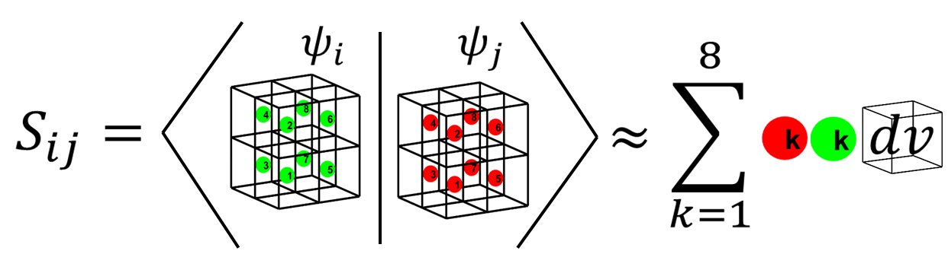
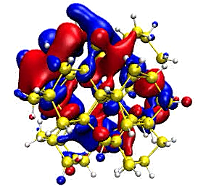
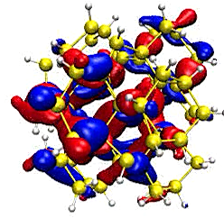
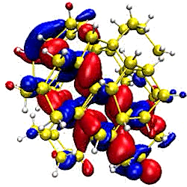
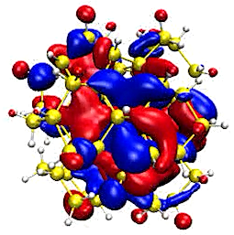


Molecular orbital integrals
$$S_{ij}=\int_{−∞}^{∞}{ψ_{i}^{∗}ψ_{j}dv}$$
Grid-based approach using .cube files
Easy to implement
Most codes can output these file
Not suitable for large structures with large number of states
Analytical approach
Suitable for large systems and large number of states
One interface cannot directly be used for many codes
$$S^{MO}=c^{T}S^{AO}c$$
$$S^{AO}= \left[\begin{matrix}〈ψ_{1}|ψ_{1}〉 & ⋯ & 〈ψ_{1}|ψ_{n}〉 \\ ⋮ & ⋱ & ⋮ \\ 〈ψ_{n}|ψ_{1}〉 & ⋯ & 〈ψ_{n}|ψ_{n}〉\end{matrix}\right]$$
Smith, Shakiba, Akimov, J. Chem. Theory Comp. 2021, 17, 678–693
Shakiba, Stippel, Akimov, J. Chem. Theory Comp. 2022, DOI: 10.1021/acs.jctc.2c00297

Slide 4
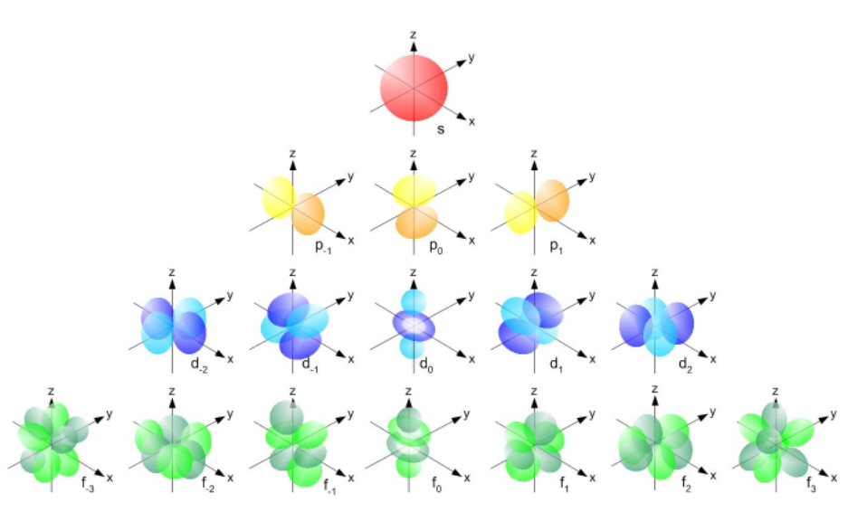
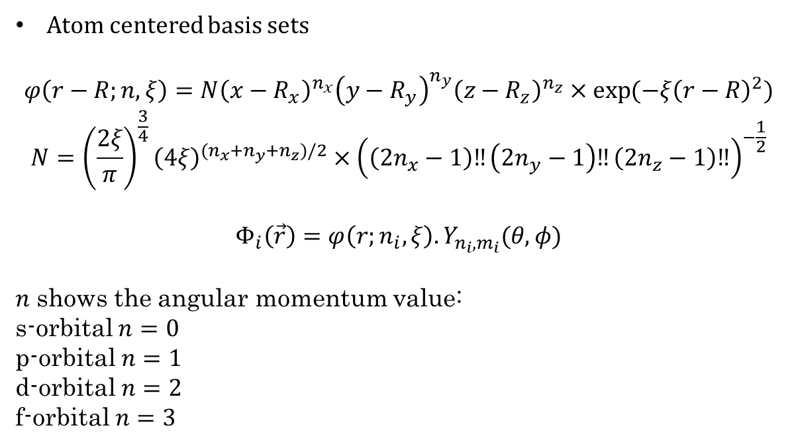
Gaussian type orbitals (GTO)
Atom centered basis sets
$$φ\left(r−R;n,ξ\right)={N\left(x−R_{x}\right)}^{n_{x}}{\left(y−R_{y}\right)}^{n_{y}}{\left(z−R_{z}\right)}^{n_{z}}×\exp{(−ξ{\left(r−R\right)}^{2})}$$
$$N={\left(\frac{2ξ}{π}\right)}^{\frac{3}{4}}{\left(4ξ\right)}^{(n_{x}+n_{y}+n_{z})/2}×{\left(\left(2n_{x}−1\right)‼\left(2n_{y}−1\right)‼\left(2n_{z}−1\right)‼\right)}^{−\frac{1}{2}}$$
$$Φ_{i}\left(\vec{r}\right)=φ\left(r;n_{i},ξ\right).Y_{n_{i},m_{i}}(θ,φ)$$
$n$ shows the angular momentum value:
s-orbital $n=0$
p-orbital $n=1$
d-orbital $n=2$
f-orbital $n=3$
S. F. Boys, Proc. R. Soc. London Ser. A 200, 542 (1950)

Slide 5

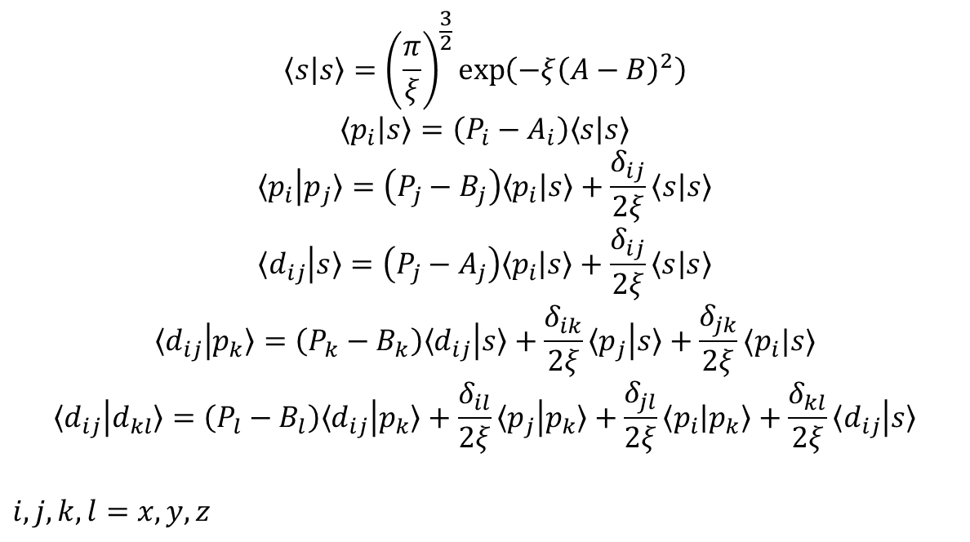
Recurrence relations between GTOs
$$〈s | s〉={\left(\frac{π}{ξ}\right)}^{\frac{3}{2}}\exp\left(−ξ{\left(A−B\right)}^{2}\right)$$
$$〈p_{i} | s〉=\left(P_{i}−A_{i}\right)〈s | s〉$$
$$〈p_{i} | p_{j}〉=\left(P_{j}−B_{j}\right)〈p_{i} | s〉+\frac{δ_{ij}}{2ξ}〈s | s〉$$
$$〈d_{ij} | s〉=\left(P_{j}−A_{j}\right)〈p_{i} | s〉+\frac{δ_{ij}}{2ξ}〈s | s〉$$
$$〈d_{ij} | p_{k}〉=\left(P_{k}−B_{k}\right)〈d_{ij} | s〉+\frac{δ_{ik}}{2ξ}〈p_{j} | s〉+\frac{δ_{jk}}{2ξ}〈p_{i}|s〉$$
$$〈d_{ij} | d_{kl}〉=\left(P_{l}−B_{l}\right)〈d_{ij} | p_{k}〉+\frac{δ_{il}}{2ξ}〈p_{j} | p_{k}〉+\frac{δ_{jl}}{2ξ}〈p_{i} | p_{k}〉+\frac{δ_{kl}}{2ξ}〈d_{ij} | s〉$$
$i,j,k,l=x,y,z$
Open-source and OpenMP parallelized code for computing integrals between GTOs
Obara, and Saika, J. Chem. Phys. 1986, 84, 3963-3974.
Obara, and Saika, J. Chem. Phys. 1988, 89, 1540-1559.
Libint, Version 2.6.0 Edward F. Valeev, http://libint.valeyev.net.

Slide 6
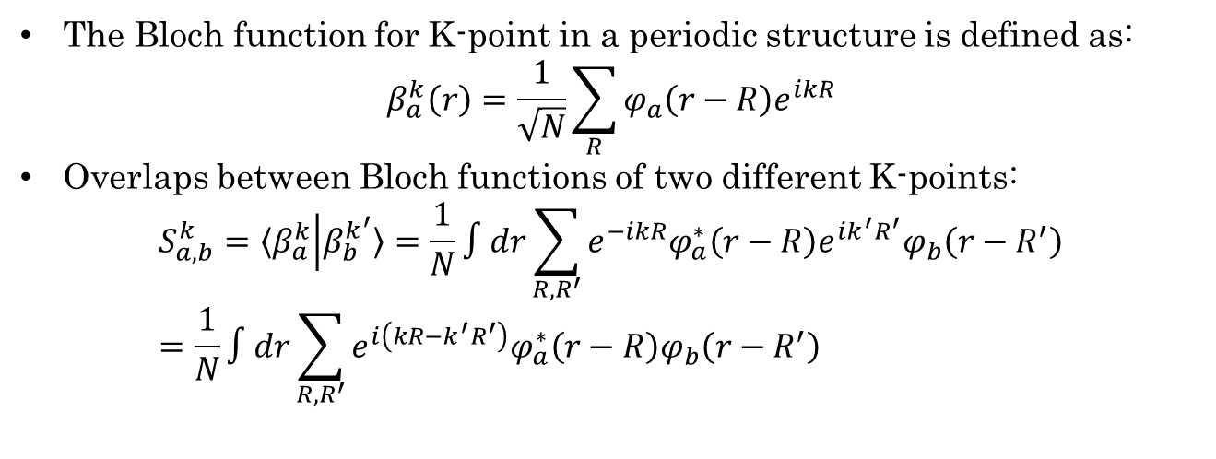
Periodic basis functions
The Bloch function for K-point in a periodic structure is defined as:
$$β_{a}^{k}\left(r\right)=\frac{1}{\sqrt{N}}\sum_{R}{{φ_{a}\left(r−R\right)e}^{ikR}}$$
Overlaps between Bloch functions of two different K-points:
$$S_{a,b}^{k}=〈β_{a}^{k} | β_{b}^{k^{′}}〉=\frac{1}{N}∫dr\sum_{R,R^{′}}{e^{−ikR}φ_{a}^{∗}\left(r−R\right)e^{ik^{′}R^{′}}φ_{b}\left(r−R^{′}\right)}=\frac{1}{N}∫dr\sum_{R,R^{′}}{e^{i\left(kR−k^{′}R^{′}\right)}φ_{a}^{∗}\left(r−R\right)φ_{b}\left(r−R^{′}\right)}$$
Central
cell
MIL-125-NH₂
Aradi, Hourahine, Frauenheim, J. Phys. Chem. A 2007, 111, 5678–5684
Shakiba, Stippell, Li, Akimov, J. Chem. Theory Compu. 2022, DOI: 10.1021/acs.jctc.2c00297

Slide 7
How Libra computes the MO overlap?
Libra uses ‘molden’ file formats to read the molecular orbital coefficients, energies, occupation, spin, atomic coordinates, and basis set although it can use other file formats as well including MOLog printed out by CP2K.
Can we use this method for ‘molden’ files produced by other quantum chemistry packages like ORCA or OpenMolcas?!

Slide 8
import os
import numpy as np
import matplotlib.pyplot as plt
from liblibra_core import *
from libra_py import CP2K_methods,molden_methods, data_conv, units
# Molden file name
molden_file_name = 'test.molden'
# Number of processors
nprocs = 16
# Spherical or Cartesian coordiantes? Spherical!
is_spherical = True
# The integration shells and angular momentum values
shell_1, l_vals = molden_methods.molden_file_to_libint_shell(molden_file_name, is_spherical)
# All of the eigenvectors and energies of the system
eig_vect_1, energies_1 = molden_methods.eigenvectors_molden(molden_file_name, nbasis(shell_1), l_vals)
# Resorting the molden indices
new_indices = CP2K_methods.resort_molog_eigenvectors(l_vals)
eigenvectors_1 = []
for j in range(len(eig_vect_1)):
# the new and sorted eigenvector
eigenvector_1 = eig_vect_1[j]
eigenvector_1 = eigenvector_1[new_indices]
# append it to the eigenvectors list
eigenvectors_1.append(eigenvector_1)
eigenvectors_1 = np.array(eigenvectors_1)
# Alpha and Beta spin eigenvectors
# alpha -> even indices
alpha_eig_vects = eigenvectors_1[0::2]
alpha_eig_vals = energies_1[0::2]
# beta -> odd indices
beta_eig_vects = eigenvectors_1[1::2]
beta_eig_vals = energies_1[1::2]
# Compute AO overlap matrix
AO_S = compute_overlaps(shell_1, shell_1, nprocs)
# Converting to numpy array
AO_S = data_conv.MATRIX2nparray(AO_S)
print('The shape of the AO matrix...\n', AO_S.shape)
S_alpha = np.linalg.multi_dot([alpha_eig_vects, AO_S, alpha_eig_vects.T])
S_beta = np.linalg.multi_dot([beta_eig_vects, AO_S, beta_eig_vects.T])

Slide 9
Periodic calculations with K-points
# For a single K-point
AO_S = compute_overlaps(shell_1,shell_1,nprocs)
if is_periodic:
cell = []
cell.append(params['A_cell_vector'])
cell.append(params['B_cell_vector'])
cell.append(params['C_cell_vector'])
cell = np.array(cell)*units.Angst
# Generating translational vectors
translational_vectors = params['translational_vectors']
for i1 in range(len(translational_vectors)):
translational_vector = np.array(translational_vectors[i1])
shell_1p, l_vals =
molden_methods.molden_file_to_libint_shell(molden_filename,is_spherical,is_periodic,cell,
translational_vector)
arg = 2*np.pi*np.dot(kpoint, translational_vector)
AO_S += compute_overlaps(shell_1,shell_1p, nprocs) * (np.cos(arg)+1j*np.sin(arg))

Slide 10


Libra/…
 | Finite systems | Extended systems | K-Points
CP2K
DFTB+
Gaussian
ORCA
OpenMolcas

Slide 11


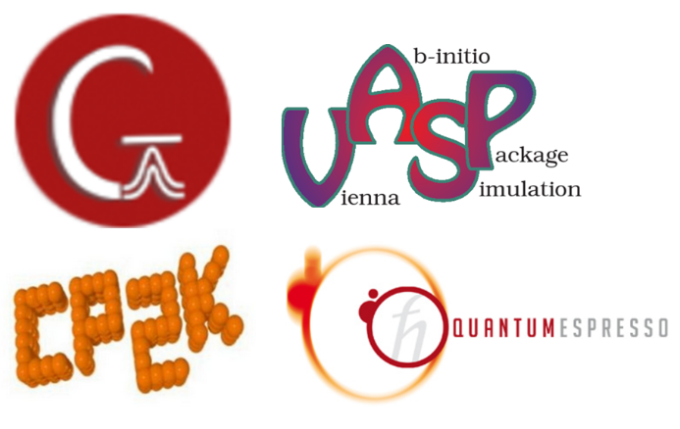


Summary
Akimov J. Comput. Chem. 2016, 37, 1626–1649

Slide 12
Thank You! Questions?

