Slide 1
Quantum Mechanics
and
Quantum Chemistry
Part 1: Intro & Mathematics
by Alexey V. Akimov

Slide 2
Preamble
These notes are specifically designed for the people who want to know. If you don’t – this may be too much for you.
If you do - my goal is to help you to get started and give some general (sometimes a bit philosophical) and
more specialized guidance in the topic of quantum mechanics.
This course is a bare minimum anyone who wants to study quantum mechanics seriously needs to know.
If your ultimate goals are different, you don’t have to dive into each detail.
These notes were originally created for the first undergraduate Q Chem class I taught and have been extended further.
This set will be used in the following years, although not all topics will be required for the general class or will be
taught in a simplified form, but this document is not for the Q Chem class only!
This smaller text (and maybe annotations) are for the online reader, not if you look at the presentation in class.
This document will be constantly updated, but all the version should be available at the GitHub

Slide 3
The Resources
Lecture notes: learn to create your own conspectus!
Even though you now have this document, one point of the class is for you to learn to comprehend and compile
new information, organize it, assess the relative importance of different points, find out the connections and take
your own notes on how you understand the topic
Books: no reading – no progress!
You may be familiar with the “no pain – no gain” concept. Reading books may be hard, especially these days, but
this is an ultimate source of your knowledge. No one but you can make a qualitative change in your mind that is
called the “understanding”. For the qualitative changes to occur, it is important to have
Office hours: make sure you understand!
The point of the office hour is for you to make sure you correctly understand the concepts and to help you to
overcome some barriers
My notes:
Derivatory
Universal notes
https://github.com/alexvakimov/Derivatory
https://github.com/alexvakimov/Universal_Lecture_Notes
YouTube: check out my Live sessions (requests are considered)
https://www.youtube.com/channel/UCMYtg3EQNsVZK4qah6rhXTQ

Slide 4
Math revision
…
Tools hierarchy
Chemistry
Chemistry rules the world ☺
Physics
Physics is a tool in chemists’ hands
Mathematics
Math is a tool in physicists’ hands
Why do we need mathematics?
Mathematics helps to operate with physics constructions and concepts (not to understand physics!)
Physics (from the Greek, meaning “Nature”) is what really happens. This is where the actual understanding is needed.
Chemistry can not be fully understood without Physics. Well, one can stay at the myphological/alchemical, intuitive or
simply pragmatic level, but the modern Chemistry is not possible without Physics. By the way, knowing that molecular
orbitals exist being able to use them to rationalize chemistry, but not knowing what they actually are and what one can
do with them and how to obtain them is still an alchemical level of understanding. IMHO.

Slide 5
Derivatives
This little cute sign is the differential sign.
It is quite useful. It is a pure pleasure to compute
You can differentiate practically any function without efforts – the formulae are easy to remember and will save you many times.
Definitely, the differential is your bro.

Slide 6
Derivatives: Geometric Meaning
Meaning: slope
How fast the function
changes in a given point
You find derivative in a point
Positive: function
increases
Negative: function is
decreasing
Zero: function doesn’t change
constant

Slide 7
Derivatives: Basic formulas
- Hey, function, I’ll differentiate you
- I am exp(x)
- But, I’m d/dy, ha-ha
You have to memorize
these results
Can you derive some of these results?

Slide 8
Derivatives: Rules
Practice with the last

Slide 9

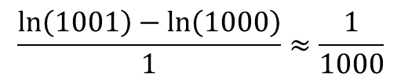



Examples
Ex #1: Compute approximately ln(1.001) using the rules of differentiation and involving the
geometric meaning of the derivative.
Solution:
$$\ln\left(1.001\right)=\ln\left(\frac{1001}{1000}\right)=\ln\left(1001\right)−\ln\left(1000\right)=\frac{\ln\left(1001\right)−\ln\left(1000\right)}{1}$$
Since 1 is much smaller than 1000, it can be considered an infinitesimally small value
(small and large are not the absolute concepts – they are always with respect to something).
That is we have
$\lim_{dx→0}{\frac{f\left(x+dx\right)−f\left(x\right)}{dx}}$
with
$$x=1000, dx=1, f\left(x\right)=ln⁡(x)$$
So we find that our expression above is the approximate derivative of
$$ln⁡(x)$$
$$\frac{\ln\left(1001\right)−\ln\left(1000\right)}{1}≈\frac{1}{1000}$$
in the point
$$x=1000$$
so,
A direct calculation gives: ln(1.001) = 0.0009995
so our approximation is pretty good

Slide 10




Derivatives: Where we use them
Taylor series:
It is said that the function f is expanded in the Taylor series around the point $x_{0}$
Functions approximation
(Note: here we expand the square root function around $x_{0}=1$)
E.g.
$${\left(x_{0}+dx\right)}^{\frac{1}{2}}≈{\left(x_{0}\right)}^{\frac{1}{2}}+\frac{1}{2}{\left(x_{0}\right)}^{−\frac{1}{2}}dx+…$$
$√$ $1.01≈1^{\frac{1}{2}}+\frac{1}{2∗1^{\frac{1}{2}}}0.01+…=1+0.005=1.005$
Explicit calculations give:
$√$ $1.01=1.0049875…$
Analysis of function properties
Whether the function is increasing or decreasing, maxima and minima, etc.

Slide 11
Integrals
This concentrated evil, right from the middle of hell,
will troll you all your life.
The calculations will take priceless years of your life and
kilometers of paper.
The sign looks like a torture tool, which it is.
Run away from it in fear – it is not your bro.
But still, don’t be afraid.

Slide 12
Integrals
Essentially – an inverse of the differential
if
then
Indefinite integral

Slide 13
Integrals: Meaning
Area
a
b
definite integral

Slide 14
Integrals: Basic formulas
Again,
memorize these
Hint: in principle, if you remember
derivatives, these formula can be
recalled

Slide 15
Integrals: Rules
Practice with the last

Slide 16
Methods of integration
Change of variables
This is why you need
to remember the basic
differentiation formula

Slide 17
Where we need it: Solving ODE
Homogeneous ODE, formal solution. Trivial case
Important!!!: limits of integration

Slide 18
Types of limits
Boundary conditions
Initial conditions
How X changes in time
Solve EOM ODE =
integrate EOM

Slide 19
Homogeneous ODE:
separation of variables

Slide 20
Nonhomogeneous ODE:
Variation of integration constant
First solve homogeneous ODE
A – is the integration constant
Then assume A – is not constant A = A(x)
and…

Slide 21
Second order homogeneous ODE:
Characteristic polynomial
Ansatz
Two roots:
Two specific solutions:
General solution = superposition
Think about: Particle in the box (or general SE)

Slide 22
Linear algebra
Why bother? Quantum mechanics IS linear algebra
In principle, QM can be formulated as an abstract
mathematical theory
Born-Heisenberg-Jordan (“matrix mechanics”)
New way of thinking: a bit like religion

Slide 23
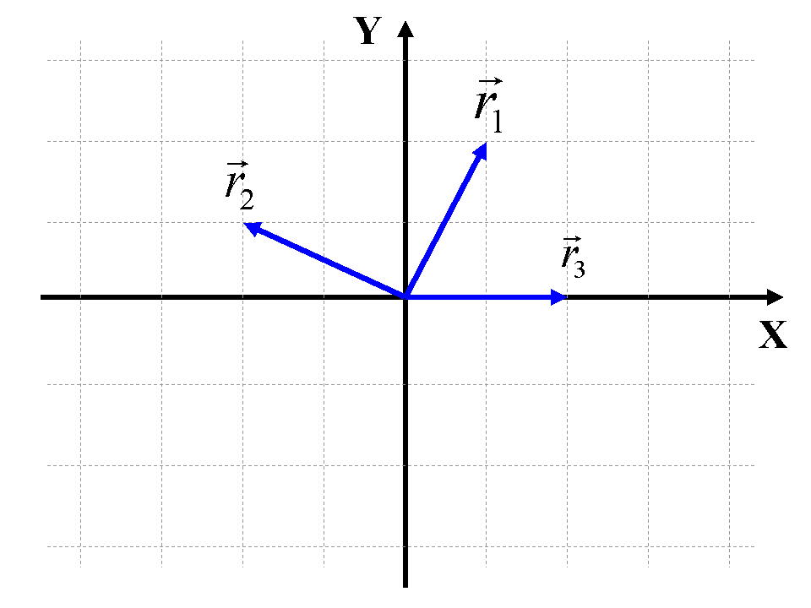
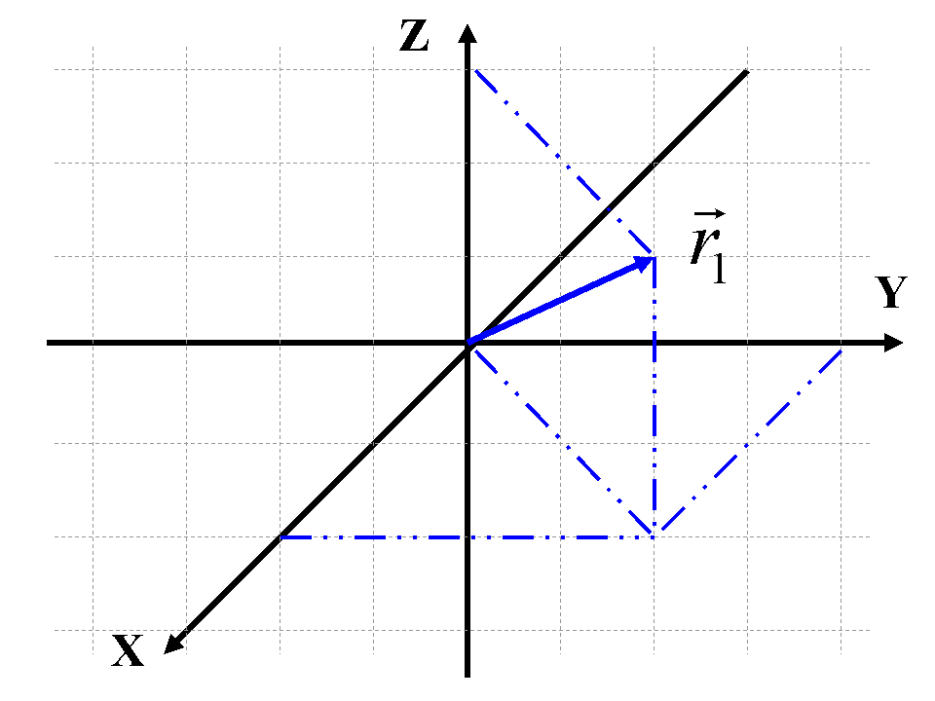
Vectors
Vector (mathematics) = list (programming) =
ordered set of numbers
projections (components)
2D
3D

Slide 24
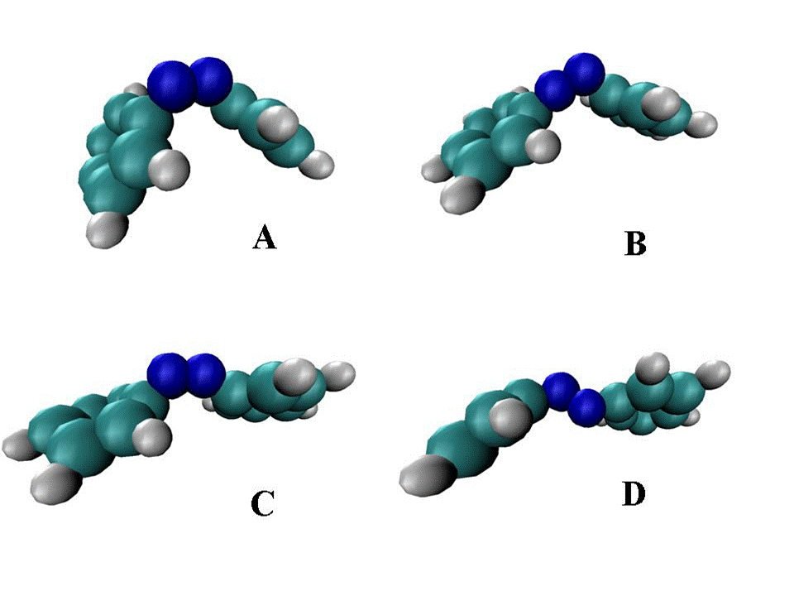
Multidimensional vectors

Slide 25
Vector spaces
All vectors + vector addition + scalar multiplication = vector space
Examples:

Slide 26
Linear dependence
linearly independent if
only if

Slide 27
Basis, dimensionality
Dimensionality of a vector space =
# of linearly-independent vectors
Basis vectors
Important:
Basis vectors can be arbitrarily chosen (transformations)
Other vectors of the linear space can be expressed as:
superposition
If any = linear space is complete

Slide 28
Euclidian spaces
Scalar product (metric)
Examples:
Norm

Slide 29
Matrices
Recipe:
=
X

Slide 30
Matrix multiplication
N x K
X
K x M
=
N x M

Slide 31
Matrix multiplication
Scalar (number)
1x1 matrix
X
=
Question: write down the
expression for the scalar
N x N matrix
X
=
Question: what is each matrix element?

Slide 32
Matrix operations
transpose
complex conjugate
adjoint =
Hermitian conjugate

Slide 33
Product of sums
For example:
This indices are independent

Slide 34
Matrix Determinant
det
=

Slide 35
Properties Determinant
-
det
=
det
As a consequence:
det
= 0
Think about:
Slater determinant
Pauli exclusion principle

Slide 36
Other properties
P = permutation of [1, 2, 3, …, N]. Total, there are N!
[P] = parity of the permutation
Think about: Hartree-Fock theory

Slide 37
Matrix Trace
Prove this: using indexing conventions
Cyclic permutations

Slide 38

Elements of field theory
Scalar field
Vector field
???

Slide 39
Gradient
Think about: Newton’s equations of motion
QM operators, e.g. momentum operator

Slide 40
Divergence
This is just a scalar product of two “vectors”. Show
Think about: Kinetic energy operator in QM

Slide 41
Laplacian
This is just a scalar product of two “vectors”
Think about: Kinetic energy operator in QM

Slide 42
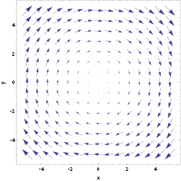
Rotor (Curl)
Just a vector (cross)
product of two “vectors”
Think about: Angular momentum operators in QM

Slide 43


Operators
A generic recipe (mapping)
to convert
something into something else
A “monk” operator (AOE)
:
enemy
friend

Slide 44
Operators: classification
Function =
Scalar (number) to scalar
Functional =
Function to scalar
Super operator =
Operator to operator

Slide 45
Linear Operators

Slide 46
The meaning of
Think about: Theorem about the commuting operators

Slide 47


Commutation
Another example:

Slide 48
Commutator and anti-commutator
How to compute: Need an auxiliary function
NOT

