Slide 1
Quantum Mechanics
and
Quantum Chemistry
Part 2: Classical and quantum mechanics
by Alexey V. Akimov

Slide 2
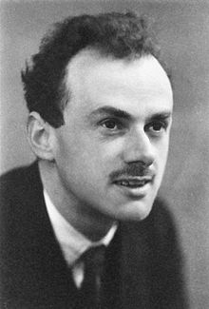
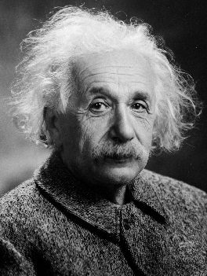
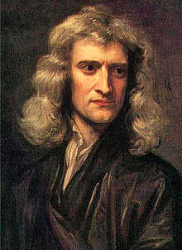
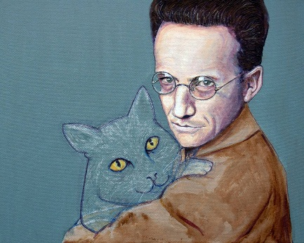
Domains of dynamics
but
but

Slide 3
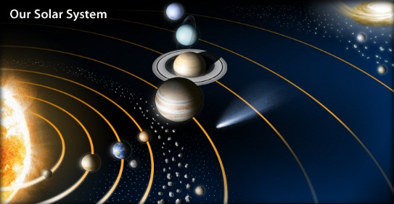
Basic terminology: of classical mechanics
Material point = neglect size
Equations of motion
(EOM)
Coordinate system
Trajectory
…for all particles

Slide 4
Newton’s (vector) Mechanics
1.
Existence of inertial system of coordinates
mass: inertia measure
2.
This is NOT how to compute force
force: measure of action of one
object on another
Action - reaction
3.

Slide 5
Forces: They just exist
Keeps the nucleus together
Neutron to proton (beta-decay)
Range Strength
Strong interactions: Quarks
Weak interaction: Quarks, Leptons
Electromagnetic: Charged particles
Gravitational: Mass particles
100
0.001
1

Slide 6
Closer look
In atomic units: C = 1
j
i
+
+

Slide 7
Conservation laws and
Integrals (invariants) of motion
1.
Total momentum (if no total forces)
prove
Total angular momentum
(if no total torques) prove
2.

Slide 8
Work and internal energy
Example:
h
Sign: the matter of convention

Slide 9
Potential forces
If:
potential
potential forces
B
A
U - function of state

Slide 10
Forces
Where to get U? Quantum Mechanics

Slide 11
Analysis of the dynamics
Derivative = negative
Force = positive
Result = acceleration in positive x
Derivative = positive
Force = negative
Result = deceleration in positive x

Slide 12
Lagrangian (analytic) mechanics
Note that:
Define:
Lagrange function

Slide 13
Example: Normal modes
m
M
m

Slide 14
Search in the form:

Slide 16
Normal modes
(translation)

Slide 17
Importance
All is derived from a scalar function
Can be formulated in any variables
Can incorporate constraints
Can generalize forces

Slide 18



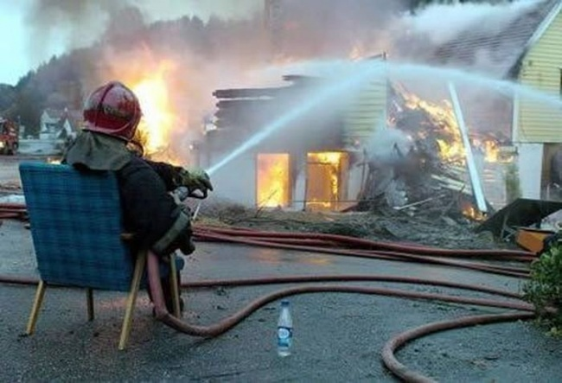

Slide 19
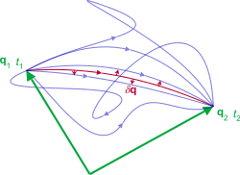
Hamilton’s principle
Least action principle
action

Slide 20
Because:

Slide 21
Hamiltonian mechanics
Legendre transform
Hamilton’s function (Hamiltonian)
also note: generalized coordinates

Slide 22
Example

Slide 23
Hamiltonian

Slide 24
Hamiltonian equations
of motion (EOM)
Momenta conjugate to
coordinate

Slide 25
Hamiltonian equations
of motion (EOM)
then
Classical Poisson
bracket

Slide 29
Performing MD simulations: Intra-molecular potential
All parameters are
taken from the
UFF force field
Used only in last
Parameter sets
Charges are calculated using charge
equilibration method of Rappe et. al.

Slide 30
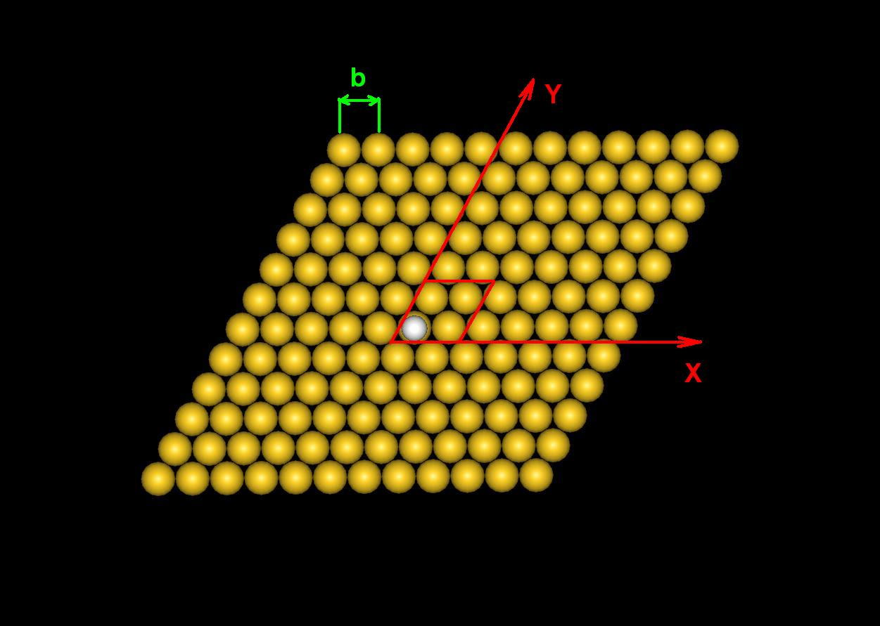
Performing MD simulations: Surface-molecule potential
Physisorption: All atoms, except S
Chemisorption: S atom
Special care about discontinuities
b=2.878 Å

Slide 31
Class I (diagonal), Class II (+ cross-terms)

Slide 32
Canonical structure matrix

Slide 33
Verlet algorithm
Velocity Verlet

Slide 34
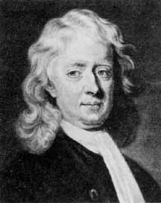
Molecular Dynamics (MD)
Algorithm:
Initialization:
Get forces:
Move atoms and update velocity:
Dynamical equations

Slide 35
Experimental foundations of QM
Energy levels (quantization)
Wave-particle duality
Atomic spectra
Black body radiation
Interference
Photoeffect

Slide 36
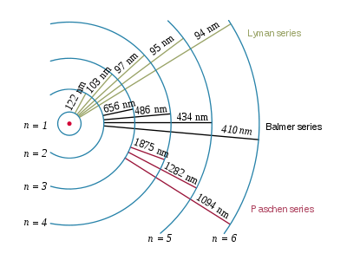
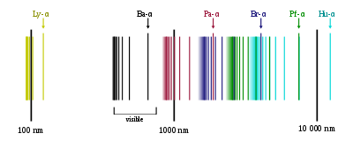
Spectral lines of H atom
1885, Balmer
Rydberg
Lyman, Balmer, Paschen (Ritz), Bracket, Pfund, Hampfrey

Slide 37

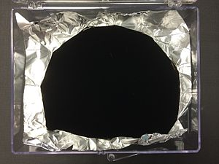

Black body (BB)
Absorbs everything (at all wavelengths)
Vantablack = vertically aligned nanotube arrays
Absorbs: 99.965% of the incident light
… but can radiate (so has a color). This
is determined only by T

Slide 38
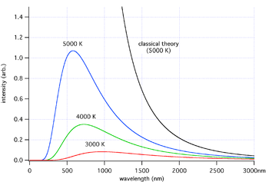
Energy density of BB radiation
First Wien’s law - general
Second Wien’s law (high frequency)
Rayleigh-Jeans (low frequency)
Ultraviolet catastrophe

Slide 39
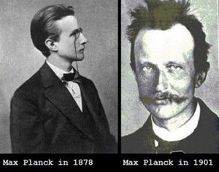
Planck, 1900
so:
Average energy of the (equilibrium!) EM radiation:
Probability:
Predicted:
Boltzmann const. and Avogadro #

Slide 40
Bohr’s (planetary) model
Problem: continuous radiation and atom instability
Postulated: Stationary states
Postulated: Angular momentum is quantized
centripetal force
Coulombic force

Slide 41
“orbital” radius
Total energy
Rydberg constant
Energy of H atom in the
ground state
Bohr –Zommerfeld (action-angle)

Slide 42

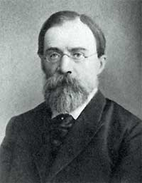
Photoeffect
Stoletov laws
1-st law :
2-nd law :
3-rd law :

Slide 43
Photoeffect
1905 Einstein
Nobel Prize
Light is composed of “particles”
that concentrate energy
“particles” = photons
Modern explanation
A – the workfunction
vacuum level

Slide 44
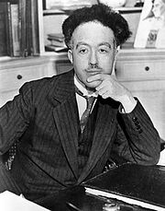
De Broglie’s waves
Louis-Victor-Pierre-Raymond, 7ème duc de Broglie, Louis de Broglie
1924 De Broglie
Wave-particle dualism established for photons is
true for all other particles (Nobel Prize)
so, same equations hold:
so
so
Large m, v ➔ small wavelength
(wave-like properties can not be observed)
1927 – Davisson & Thompson – electron diffraction on crystals – found the interference pattern, so electrons have wavelike properties. (also got a Nobel Prize)

Slide 45
Wave-particle duality
All “particles” propagate as waves but interacts as a particles
Thesis + Anti-thesis = Synthesis
Need a theory that combines both

Slide 46
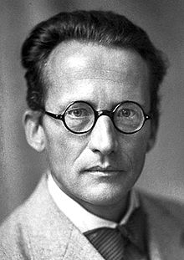
Ger Manches rechnet Erwin schon
Mit Seiner Wellenfunction
Nur Wissen Mocht’man wohl
Was man sich dabei vorstell’n soll?
Erwin with his psi can do Calculations quite a few. But one thing has not been seen: Just what does psi really mean?
Erwin Rudolf Josef Alexander Schrödinger

Slide 47
“Derivation” of the Schrodinger’s equation
Free particle:

Slide 48
Generalize the SE
Hamiltonian

Slide 49
Postulates of QM
1. Existence of wavefunction
defines a state
2. Superposition principle
3. Expectation values, operators,
observables
4. TD-SE

Slide 50
Postulate #1: Wavefunction
Contains all information about the system
Doesn’t have physical meaning on its own
Probability to find
in dV at time t
Probability to find anywhere at any time t
Normalization
Probability density
Requirement of the form of WFC:

Slide 51
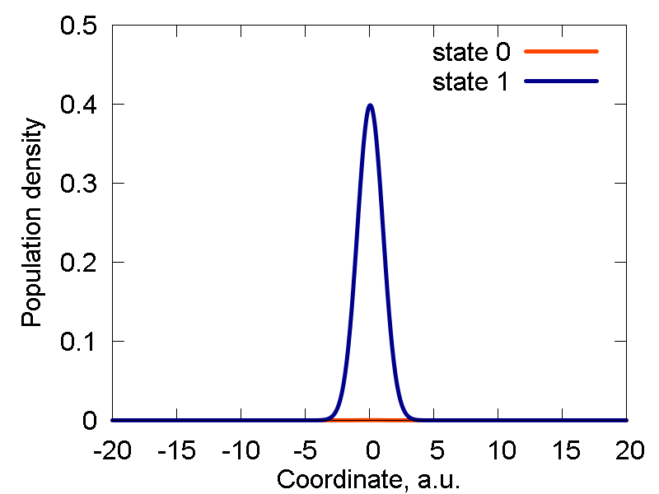
Probability to find it
in there = area under
the curve

Slide 52
Dirac bra-ket notation for states
Abstract state i (whatever it is)
KET
Misleading
Better = OK
This is what you really mean
(coordinate/position representation)
FT
Momentum representation

Slide 53
Dirac bra-ket notation for states
Abstract state i (whatever it is)
BRA
Overlap = scalar product

Slide 54
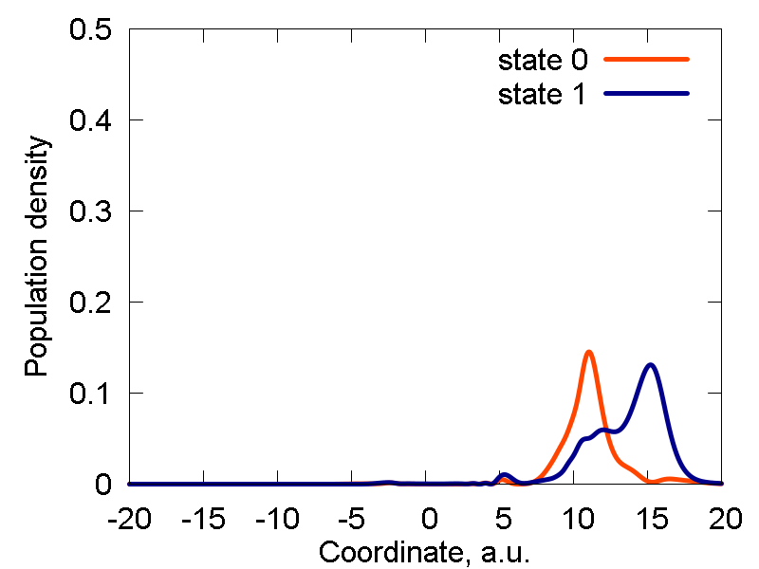
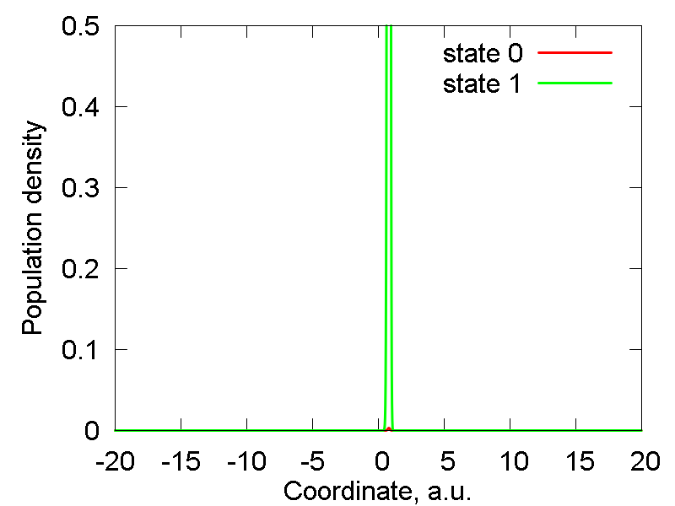
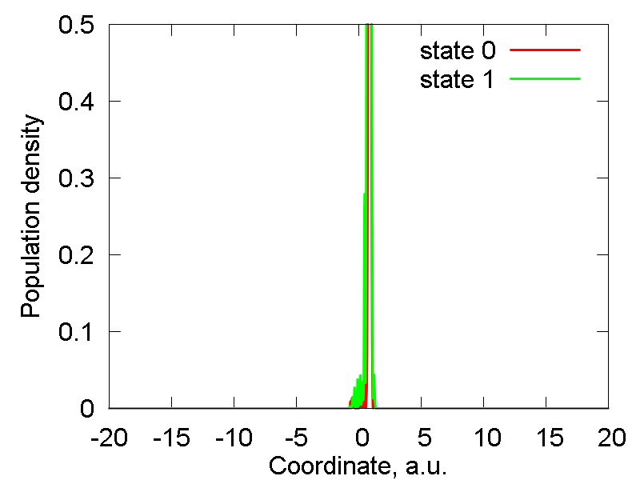
Show animation

Slide 55
Dirac Delta-function and representations
“grid states”
(Dirac) Delta-function
Is a functional!
Representations of the delta-function

Slide 56
As a Fourier transform
functional
operator

Slide 57
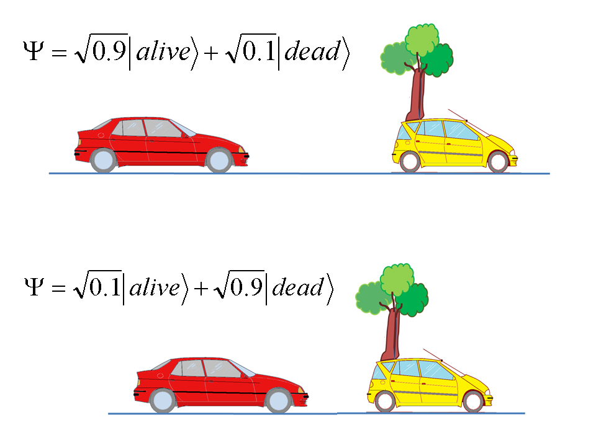
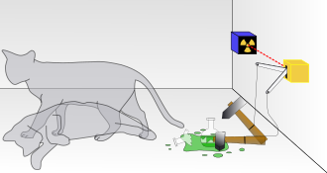
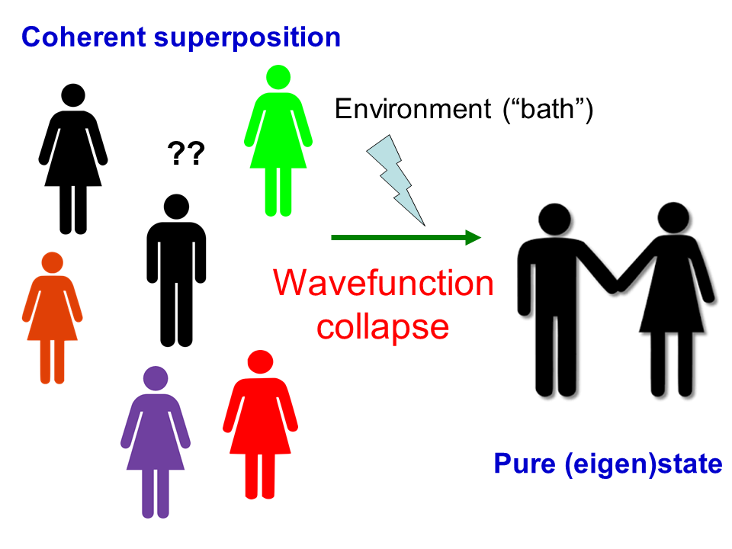
# 2 Superposition principle
Pure
Mixed
(coherent superposition)

Slide 58
Projections (wfc collapse)

Slide 59
# 3 Operators
In position
representation
that is:
In momentum
representation
that is:

Slide 60
# 3 Operators
Overlap = scalar product
Matrix element = “dress” the operator
Practical way

Slide 61
Operators acting backwards
Original = acts forward
Adjoint = acts backward
Hermitian = acts both ways the same

Slide 62
Outer product of state vectors
What is this?
Lets “act by it” on
from the left
So this is an operator!!!
Projector

Slide 63
Resolution of identity and Hamiltonian
If
then
corresponds to
the identity matrix
Compute the matrix element

Slide 64
Why p is Hermitian?

Slide 65
Eigenvalues and eigenfunctions
functional
form
eigenstate
eigenvalue
matrix
representation
Example:

Slide 66
Finding the Eigenvalues and Eigenfunctions
if orthogonal basis
secular equation

Slide 67

Thinking of
quantum
mechanics…

Slide 68
Theorems about Hermitian operators
1. Eigenvalues of Hermitian op are real
2. Non-degenerate eigenstates of Hermitian op
that correspond to different eigenvalues are orthogonal

Slide 69
Proof
Eigenvalues of Hermitian op are real

Slide 70
Theorems about commuting operators
If two operators commute with each other,
they have a common set of eigenvectors
2. If two operators have a common set of eigenvectors,
they commute with each other

Slide 71
Proof
then

Slide 72
Proof
then
is an eigenstate of the operator A
corresponding to the eigenvalue a
that describes the same state as
and is the eigenstate of A:
Thus

Slide 73
Time-dependent Schrodinger equation
(TD-SE)
Separation of variables
Depends only
on t
Depends only
on R

Slide 74
When is this possible?

Slide 75
Time-dependent part of TD-SE
Phase factor

Slide 76
Stationary SE
Produces energy spectrum at fixed positions
Excited state
Ground state

Slide 77
Chemical Dynamics
Solve for

Slide 78
Stationary SE: Particle in the Box
1D
Model problem (Hamiltonian)
E
0 L

Slide 79
Stationary SE: Particle in the Box
Because of the
infinite potential
Particle confinement ➔ quantization
Spectrum: energy spacing quadratic
Eigenstates: nodal structure

Slide 80
Applications: Quantum Dots and Linear Polyenes

Slide 81
Tunneling
2 Cases:
E < V
E > V
0 L L+d D

Slide 82
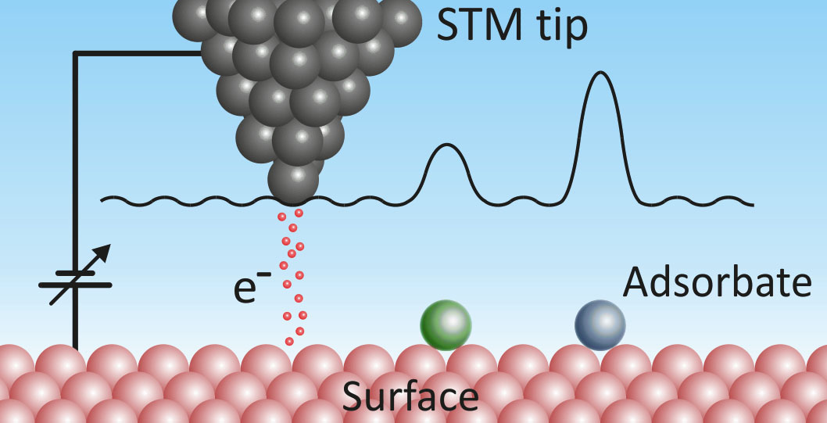
Solve. Applications: STM

Slide 83
The “WIN COURSE”
0 L
G
L+d D
1) Get eigenstates of the problem above
adiabatic basis
2) Get eigenstates of the problem Donor and Acceptor boxes
diabatic basis

Slide 84
3) Start in a given acceptor state, n, (with energy below the barrier)
4) This initial state can be expressed in the adiabatic basis, initially:
5) … or at any time t:
6) To find the evolution of the coefficients, solve the TD-SE (see before)
7) To find how the population of the acceptor state, m, at any time t:

Slide 85
Vibrational motion: Harmonic Oscillator
Reading assignment: Chapter 6
Prof. Autschbach Notes

Slide 86
Harmonic Oscillator: Another approach
Introduce:
so:
and:

Slide 87
Raising and lowering operations
If:
then:
Prove it?
Raising/Creation operator:
new state with energy
Lowering/Annihilation operator:
new state with energy

Slide 88
The Ground state
There a state, for which the energy is minimal
When acting on will try to lower its energy, but since there is no such
state, the result is zero
Solve it?
Solution:
normalization:

Slide 89
All other states
The normalization of the operators (and switching to bra-ket)

Slide 90
Many variables: Factorization
And:
Then for the operator:
is the eigenfunction
is the eigenvalue
Prove it!

Slide 91
Example
Room for degeneracies (symmetries!)

Slide 92
Particle in a spherically-symmetric potential
Spheric symmetry
Forces are called central
z
Change of coordinate system:
spherical polar coordinates
y
x

Slide 93
Coordinates Transformations
so, using the chain rule

Slide 94
Transformations and Jacobian
that is
For all components:
Jacobian

Slide 95
Laplacian and Angular momentum
so:
Then:

Slide 96
Kinetic energy and Classification
Operator factorization: separation of radial and angular components
Particle in a Sphere
Particle on a Sphere
(a.k.a rigid rotor)
Hydrogen-like
atoms
with
common form of solution

Slide 97
The difference in the Radial component
(a summary in advance)
Rigid rotor Particle-in-a-sphere Hydrogen-like atoms
Spherical Bessel
functions of order l
Laguerre polynomial
and
exponent

Slide 98
Angular kinetic energy
Kinetic energy of rotational motion
I – moment of inertia
More general case:
Lets looks at the commutation relationships first

Slide 99
Commutation of angular momentum components
Using:
Mnemonics: cyclic permutations
Show that
X
Z
Y

Slide 100
Commutation with the total angular momentum
Same for other components

Slide 101
Summary: Quantization of Rotational DOF
What does that mean?
What does that mean?
Z
eigenvalue
eigenvalues

Slide 102
Back to the angular equation
We can separate variables then:
Because
is also an eigenfunction of
which leads to

Slide 103
Azimuthal part of wfc
Periodic boundary conditions:
Normalize!

Slide 104
Polar part of the wfc
The solution is: associated Legendre polynomial

Slide 105
Overall solution: Spherical Harmonics
The functions are complex-valued, but one can use real-valued linear
combinations
Symmetries:
Orthonormalization:
Note how the scalar product is defined
(it contains an extra sin(theta))!
Eigenvalues:

Slide 106
Some important points
Defines the magnitude of the vector
Defines the projection of the vector
so:
there are 2l+1 degenerate
states for a given l
Total magnitude is always a bit large than the max. projection
(uncertainty principle in action!!!)

Slide 107
Linear combinations of spherical harmonics
“pre-Atomic orbitals”
S-states (spherically-symmetric)
P-states

Slide 108
Raising/Lowering operators
same is for
do not change L

Slide 109
is an eigenstate of
corresponding to m+/- 1

Slide 110
Spin
Non-collinear

