Slide 1
Ultimate Macroeconomics Dashboard
An AI-powered research platform for modern economic analysis

Slide 2
Agenda
01 Goal
02 Target Audience
03 Data Sources
04 Technical Solutions
05 Architecture
06 Core Functionality
07 Advantages
08 Limitations
09 Future Development
10 Q&A

Slide 3
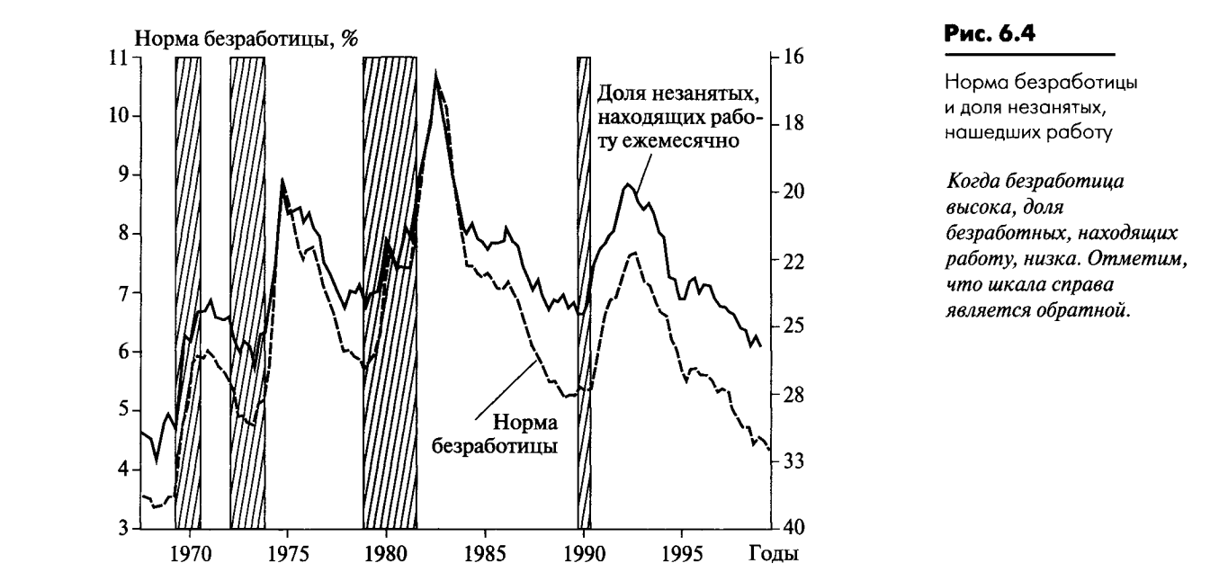
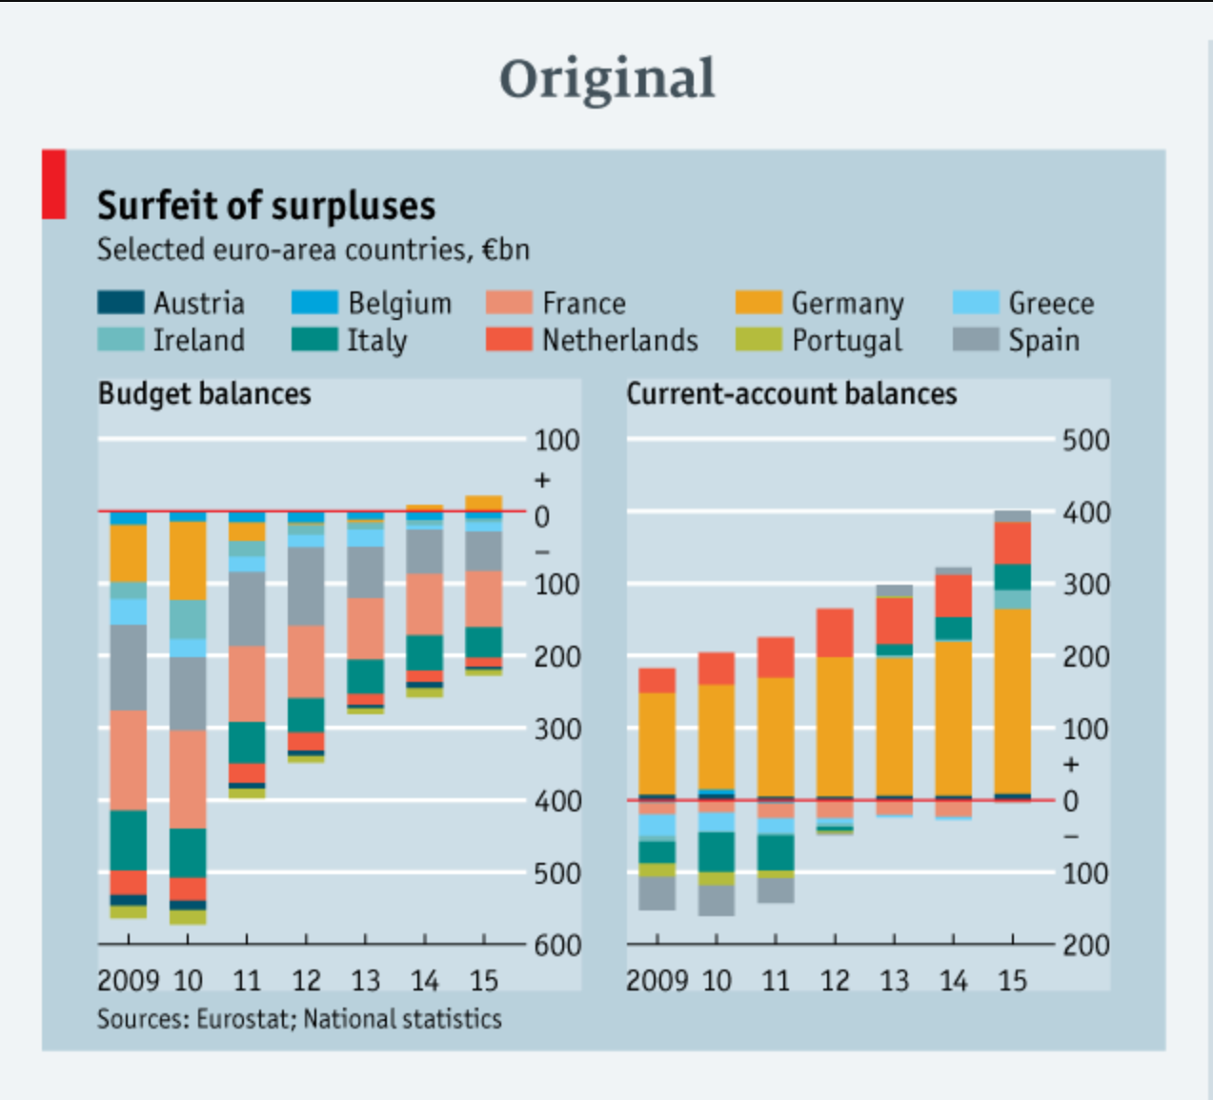
The Problem
Existing macroeconomic visualizations often fall short — they are static, fragmented, and hard to interpret.
Source: O. Blanchard, "Macroeconomics"
Source: link
The opportunity: build a unified, interactive, AI-augmented research tool for macroeconomists

Slide 4
Project Goal
01 A multi-functional research tool
Deliver a single platform that helps researchers generate and test macroeconomic hypotheses.
02 High-quality, interactive visualizations
Replace static, scattered charts with clean, configurable, comparable views across countries and indicators.
03 AI agentic system, grounded in data
Use modern AI agents to support fact-based research with minimal hallucinations.

Slide 5
Target Audience
Macroeconomic researchers
Academics, analysts and students seeking a fast way to explore indicators, test hypotheses and compare countries across time.
Decision-makers and curious professionals
Anyone who needs a high-level overview of the global macroeconomic landscape without building bespoke dashboards from scratch.

Slide 6
Data Sources
Multiple open data sources, combined into one dashboard
Diverse, complementary data sources give a richer and more reliable understanding of the global macroeconomic picture.
World Bank
Webz.io News
Yahoo Finance
Each source is detailed on the following slides.

Slide 7
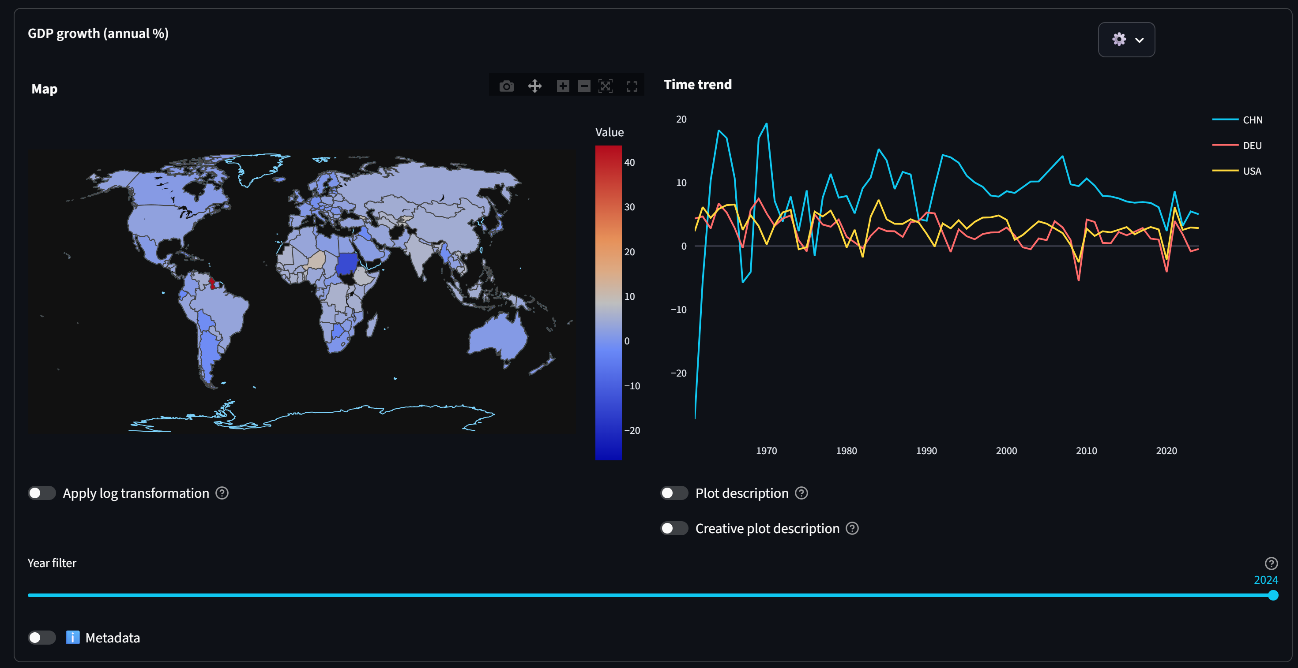
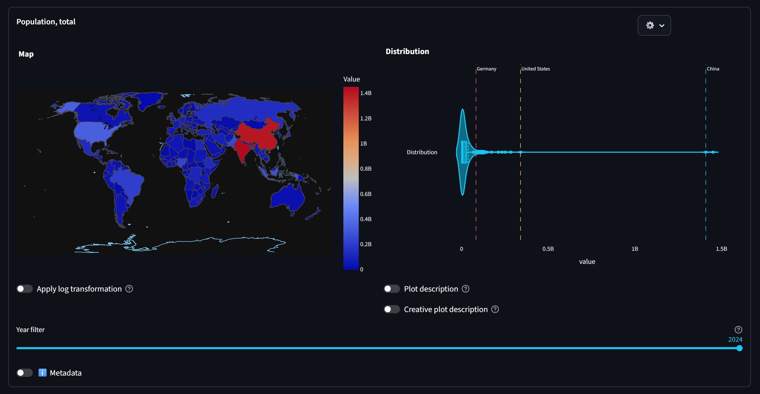
Data Sources / World Bank
The primary source of long-run macroeconomic indicators — GDP, inflation, employment and more, by country and year.

Slide 8
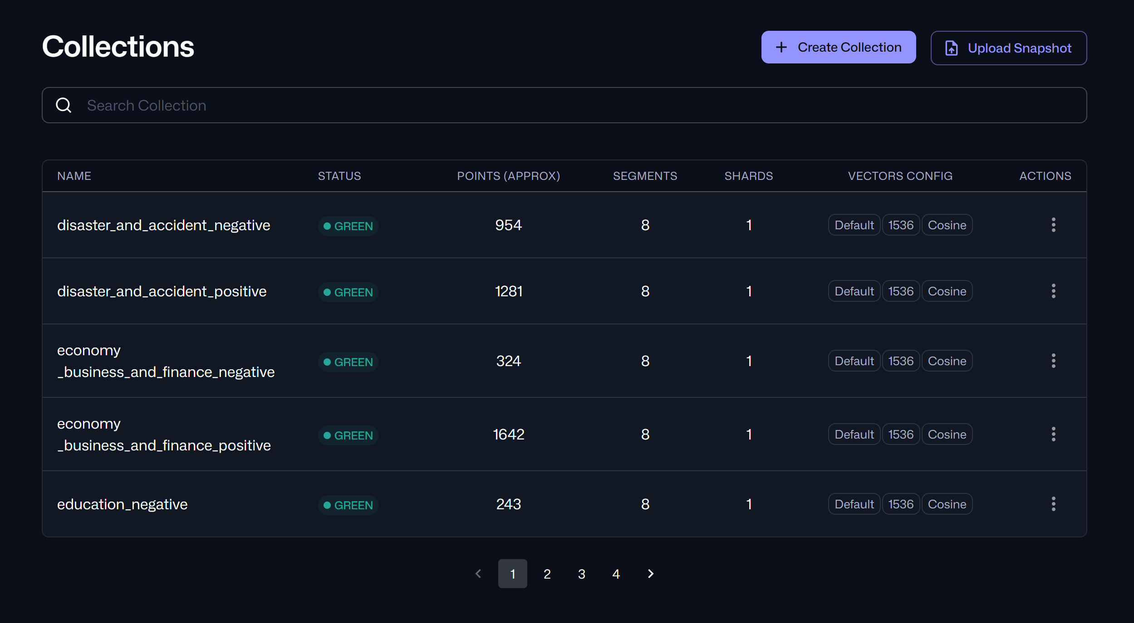
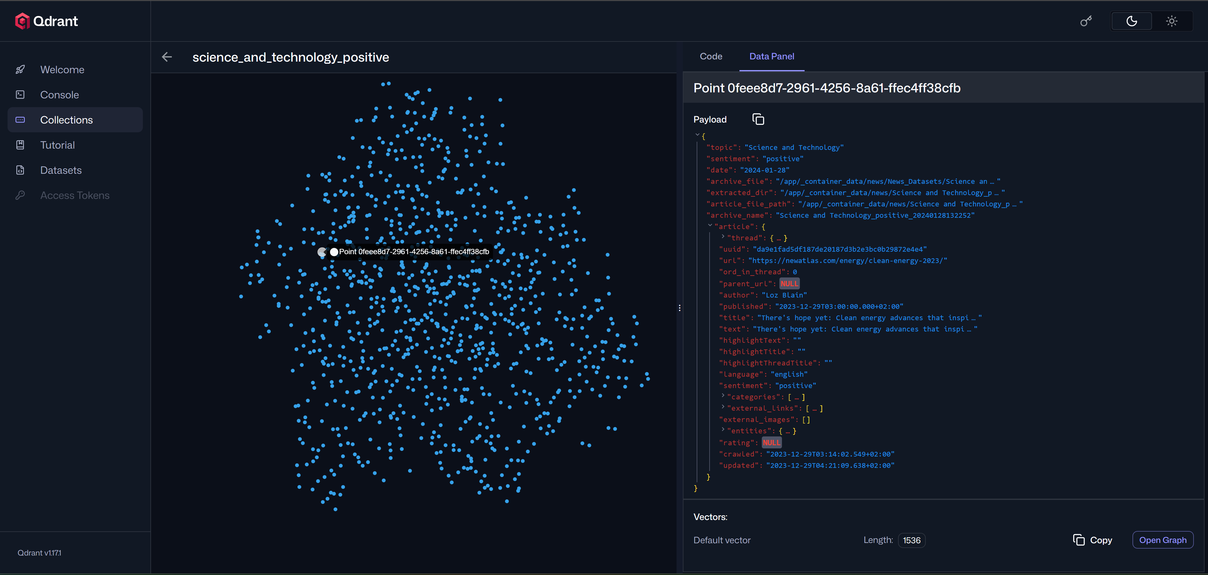
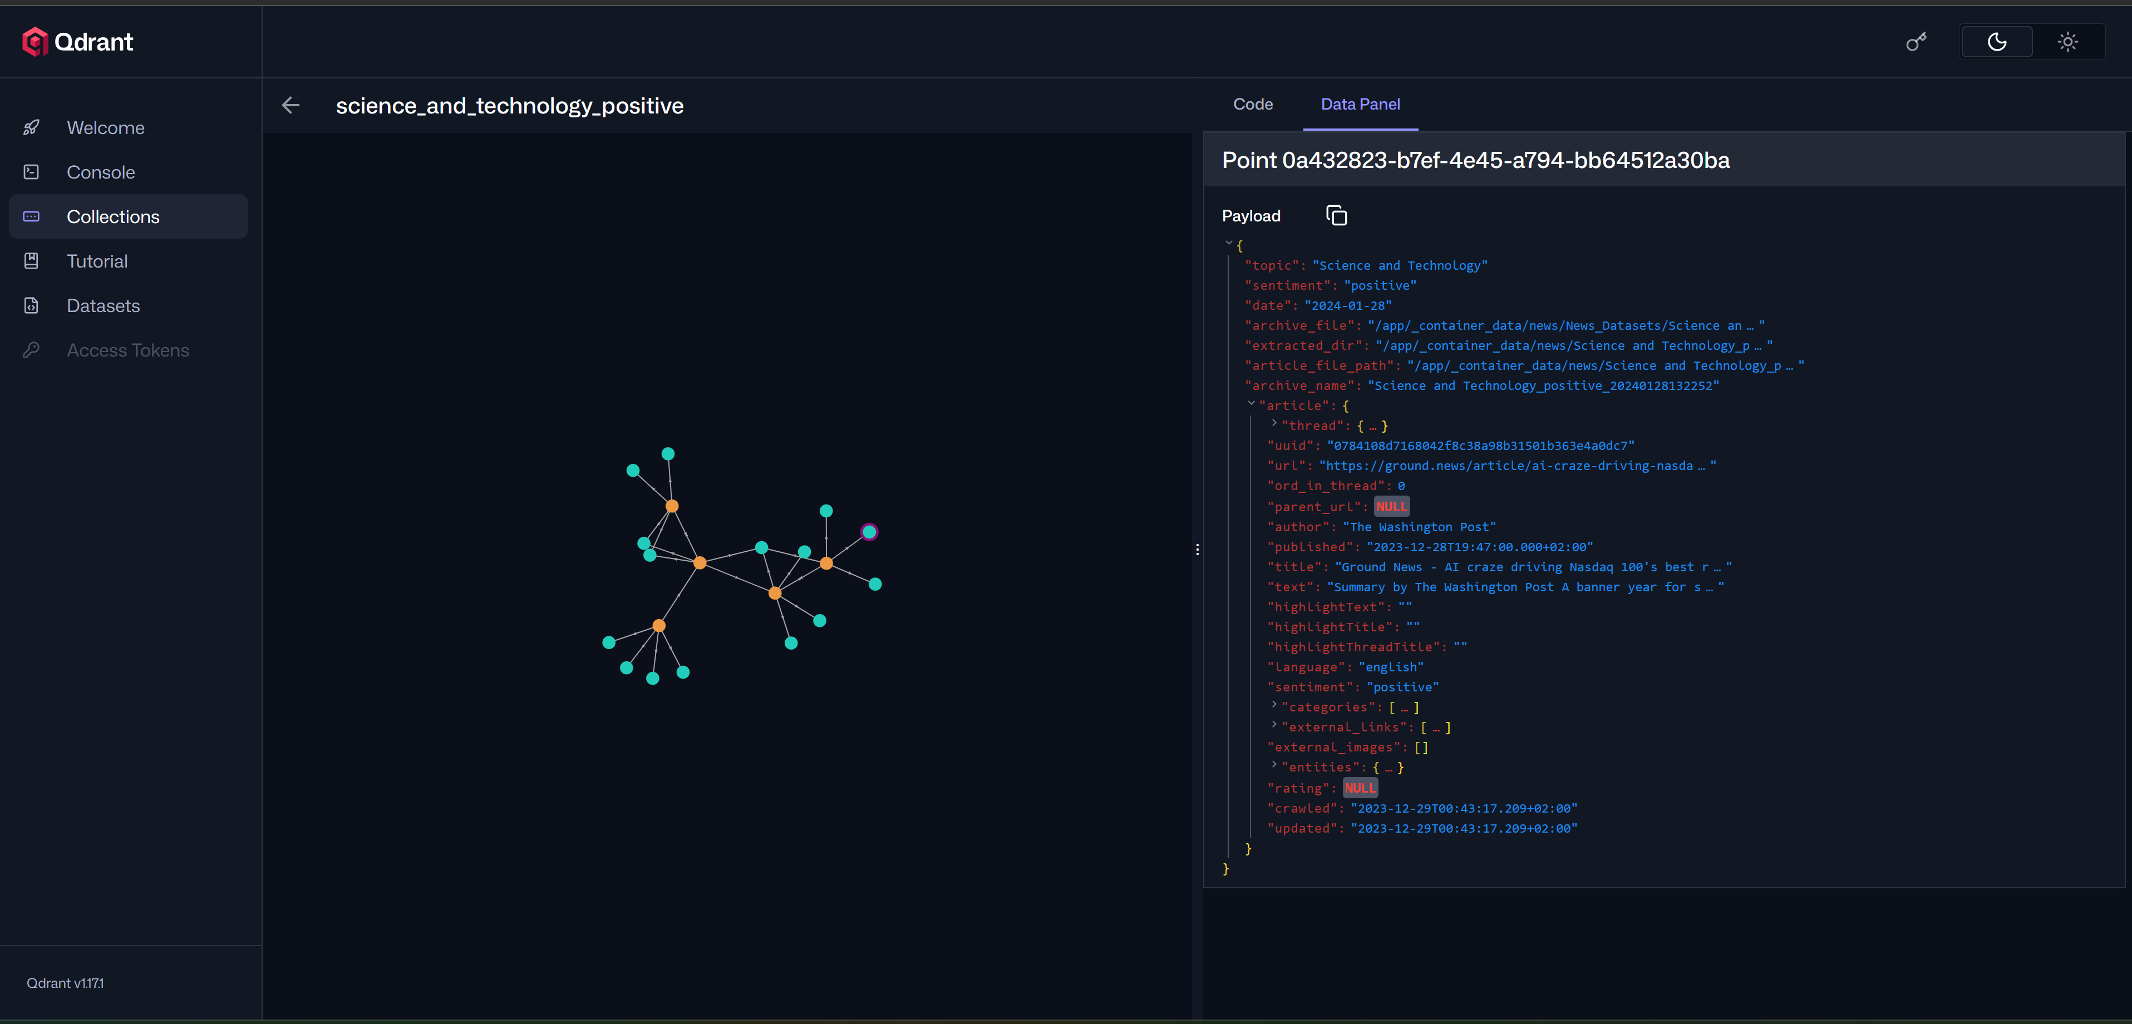
Data Sources / Webz.io News
News dataset repository — adds qualitative context and timely signals on top of structured macro data.

Slide 9
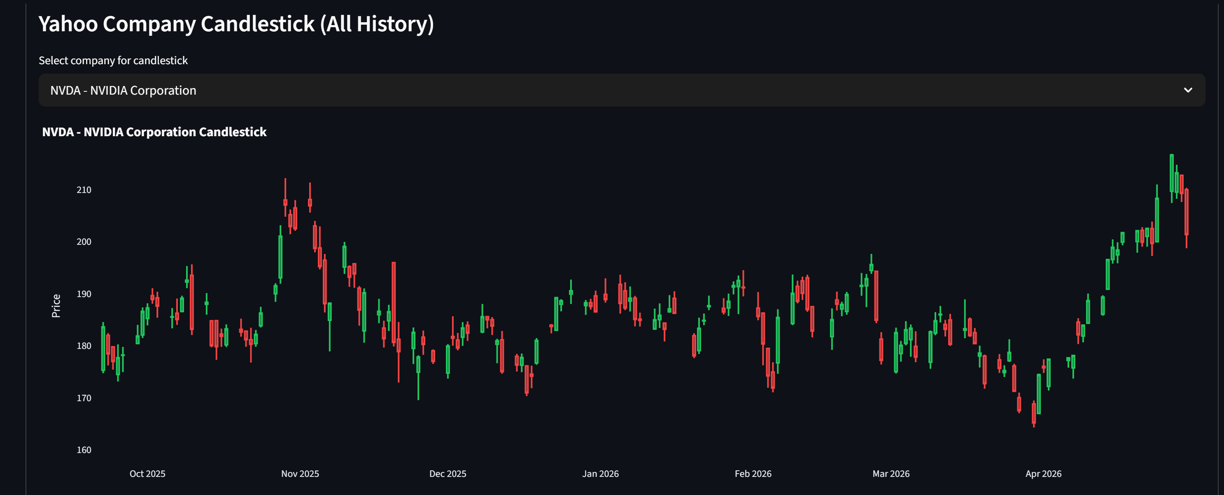
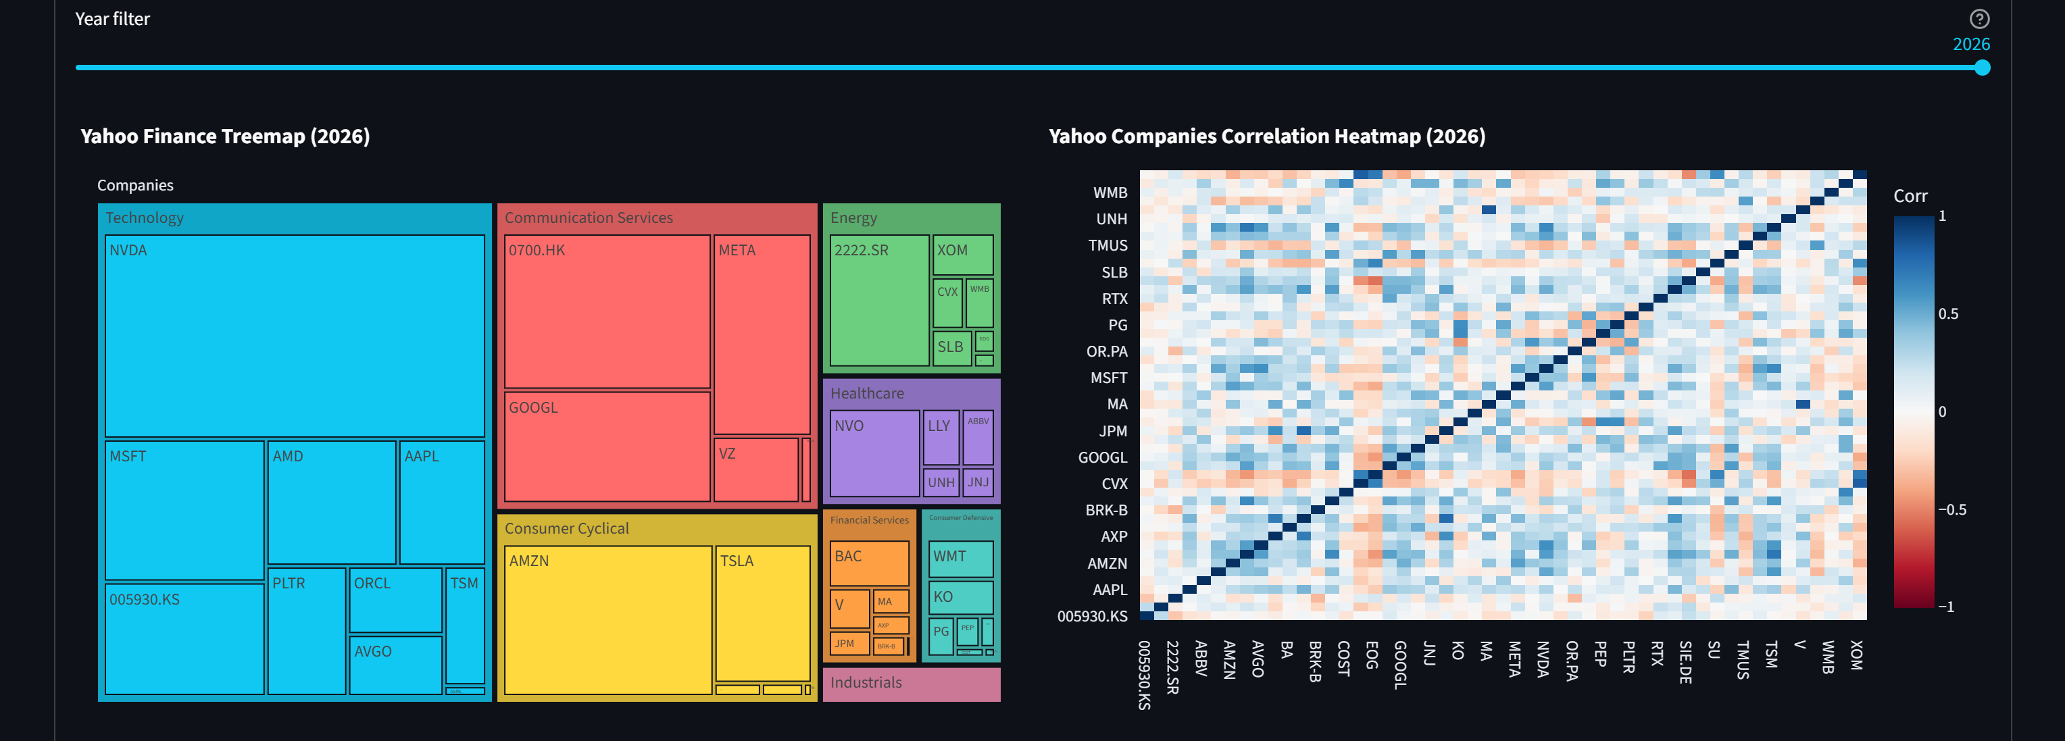
Data Sources / Yahoo Finance
Market data — equities, currencies, commodities — providing the financial-markets layer of the dashboard.

Slide 10
Technical Solutions
Multi-page dashboard the main application, inspired by Apache Superset.
Python-first codebase the bulk of the platform is written in Python.
Microservice architecture components are decoupled and independently deployable.
Active use of ML models for indicator forecasting and signal extraction.
AI agentic system for natural-language research workflows on top of the data.
Two delivery modes a local-usage build and a deployable hosted version.

Slide 11
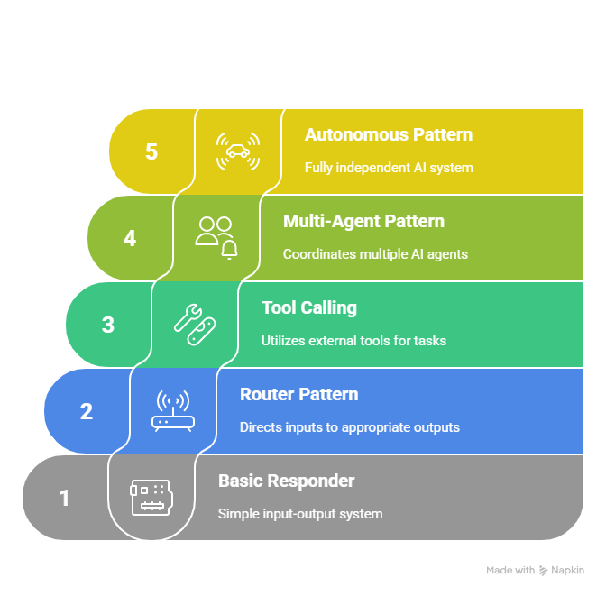
Technical Solutions / Agentic Trade-offs
Higher task complexity unlocks more value but increases the risk of unexpected agent behaviour.
Advantages
Real-world problems and tasks are actually solved
Autonomy — the agent decides how to reach the goal
Scales naturally as task complexity grows
Risks
Higher probability of unexpected behaviour
Debugging incorrect agent actions is difficult
Quality depends on prompt and tool design

Slide 12
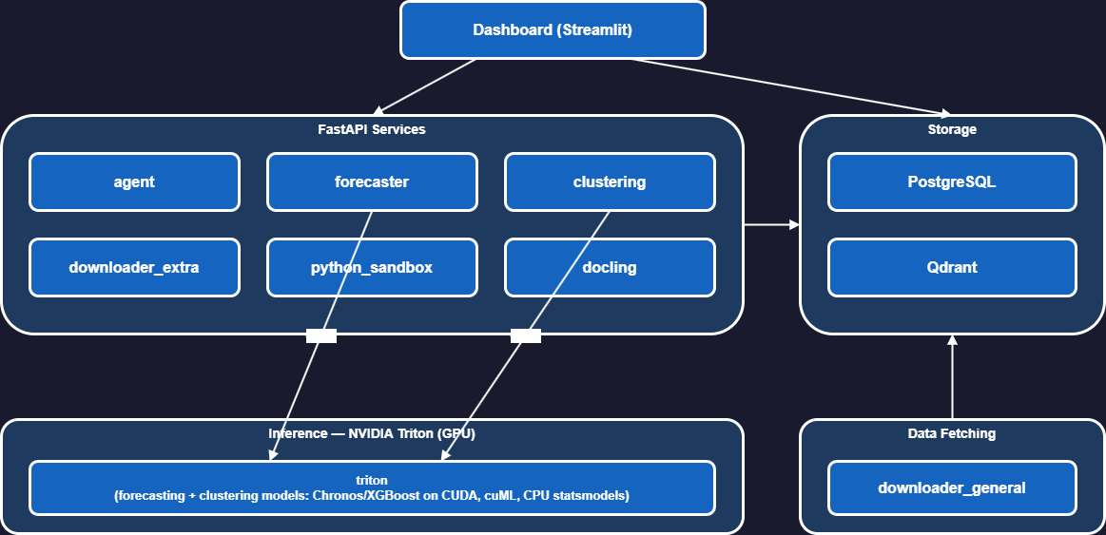
Architecture / System Diagram

Slide 13
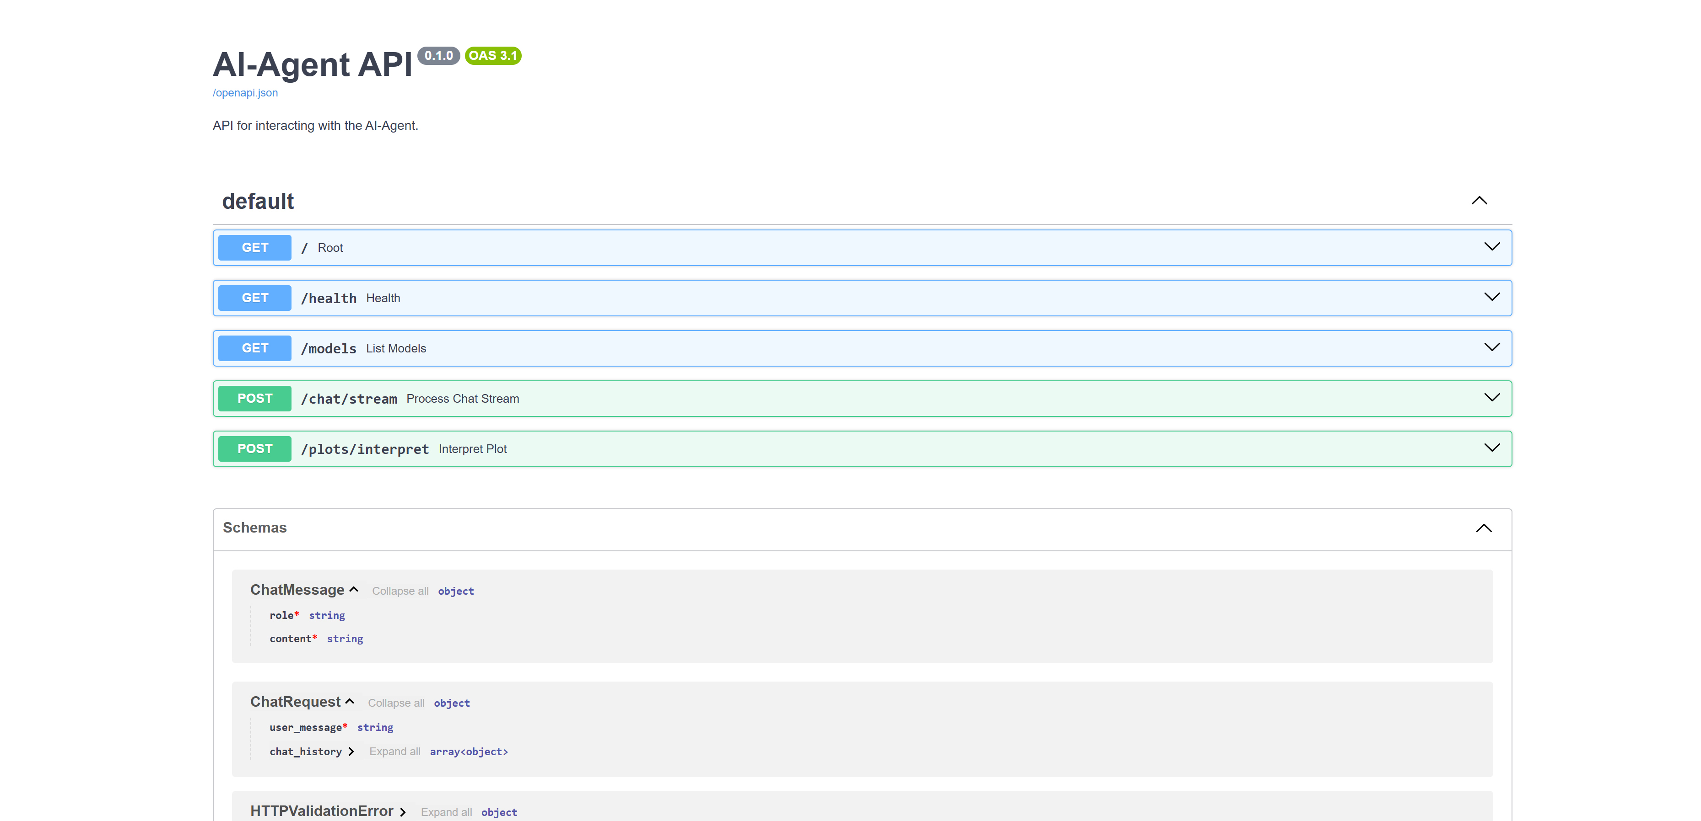
Architecture / Documented APIs
APIs are documented
Every microservice exposes an OpenAPI specification, making the system easy to integrate, test and extend.
Auto-generated docs from FastAPI / Swagger.

Slide 14








Architecture / Technical Stack
Backend, ML, infrastructure and tooling that power the platform.

Slide 15

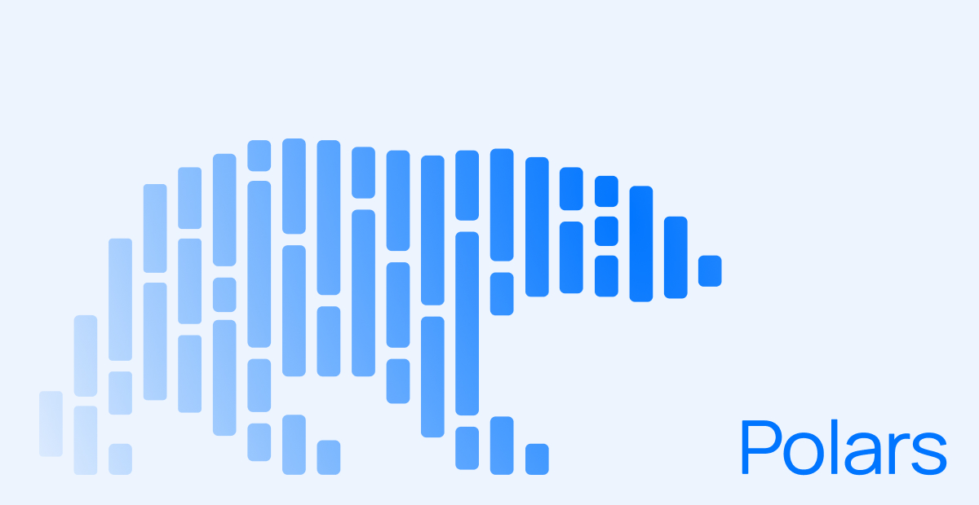






Architecture / AI & Data Layer
Models, vector storage, agent orchestration and the supporting data services.

Slide 16
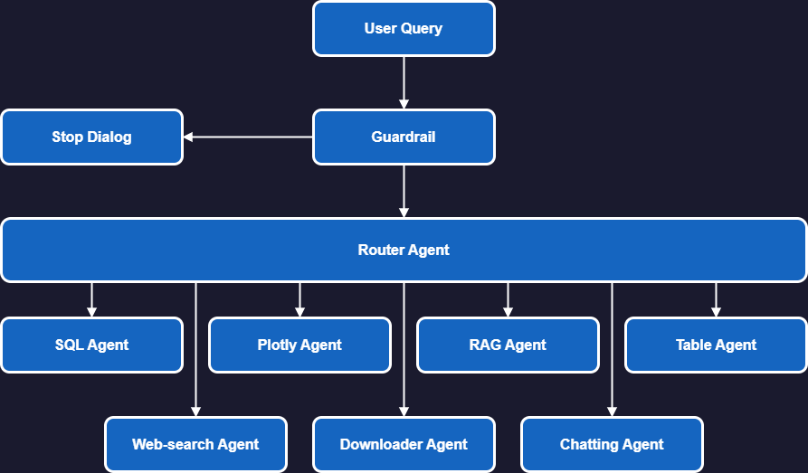
Architecture / AI Agent Diagram

Slide 17
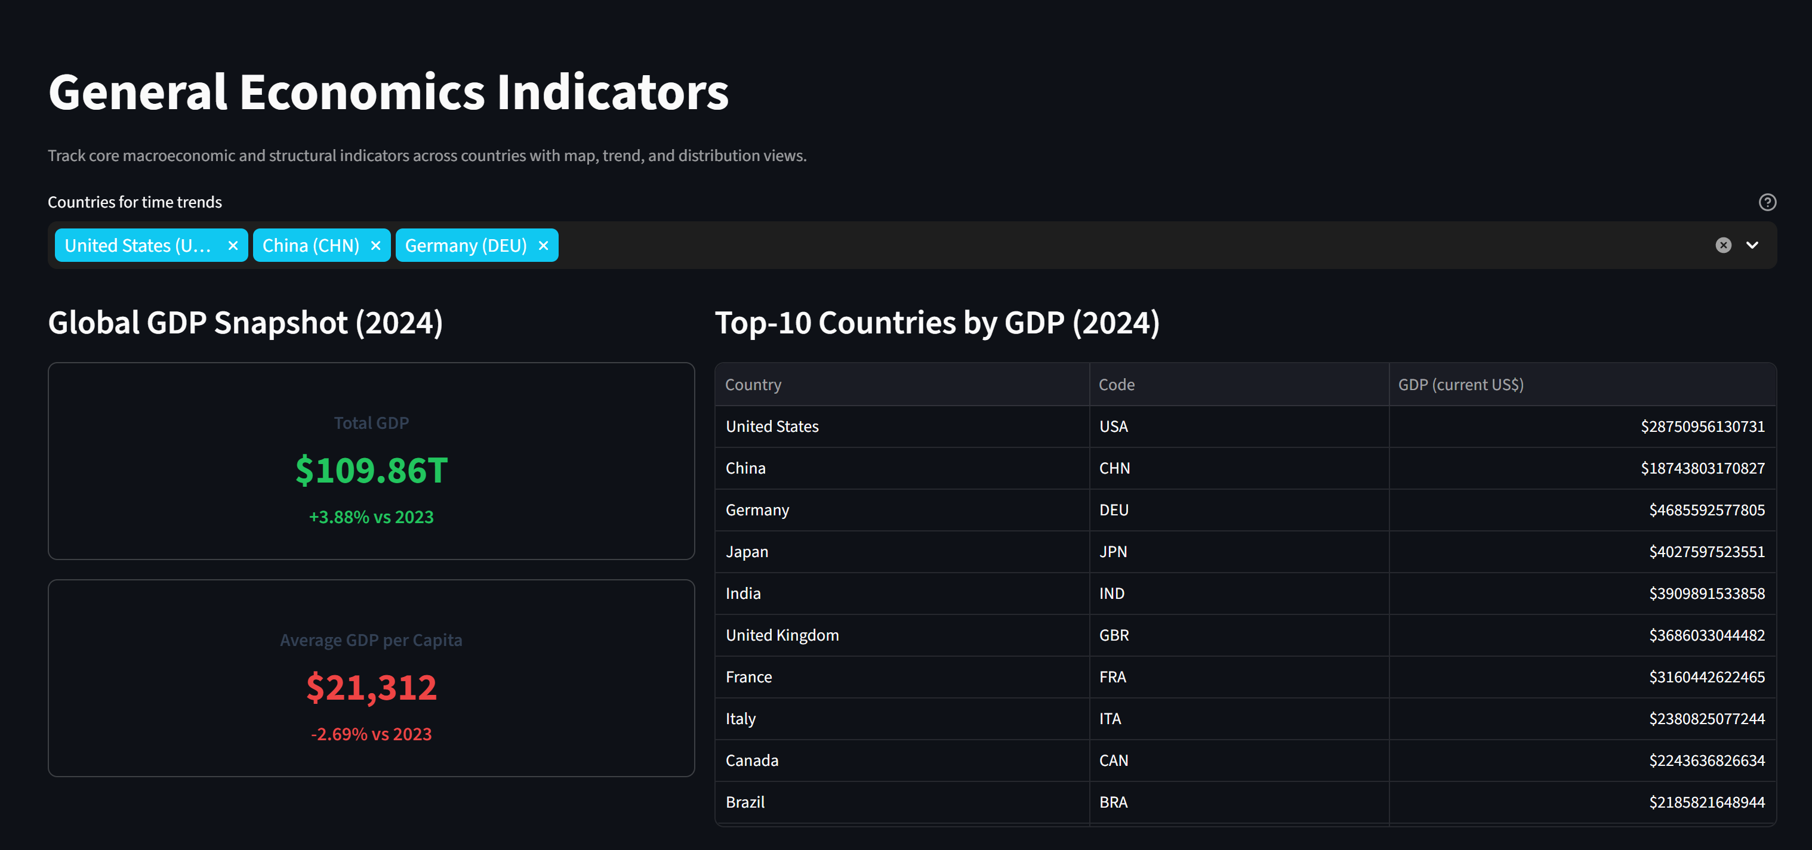
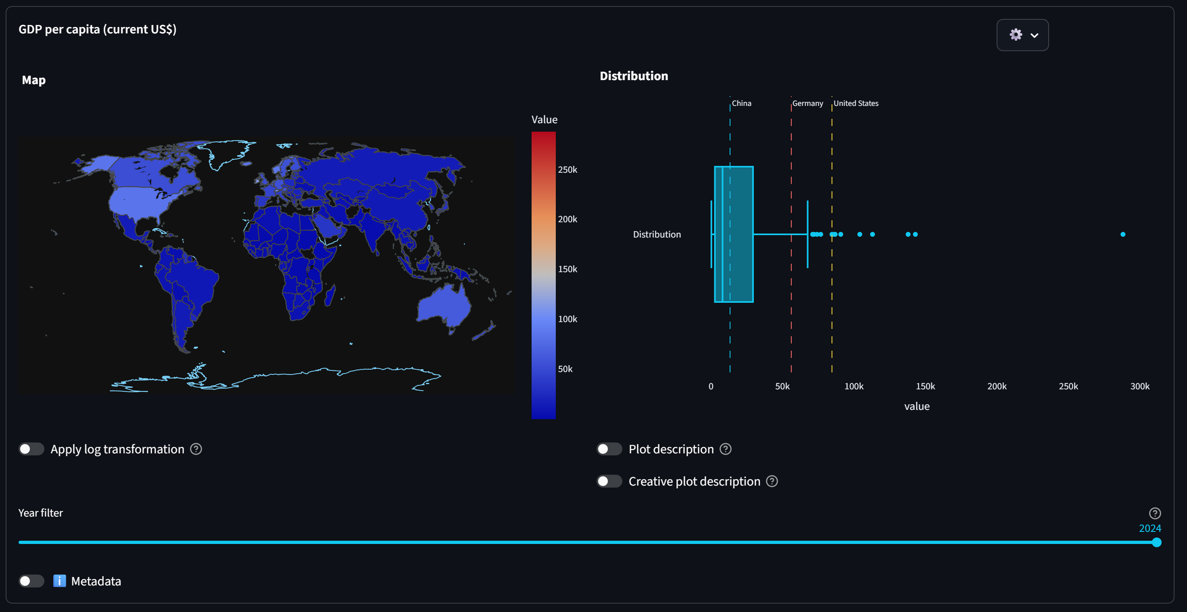
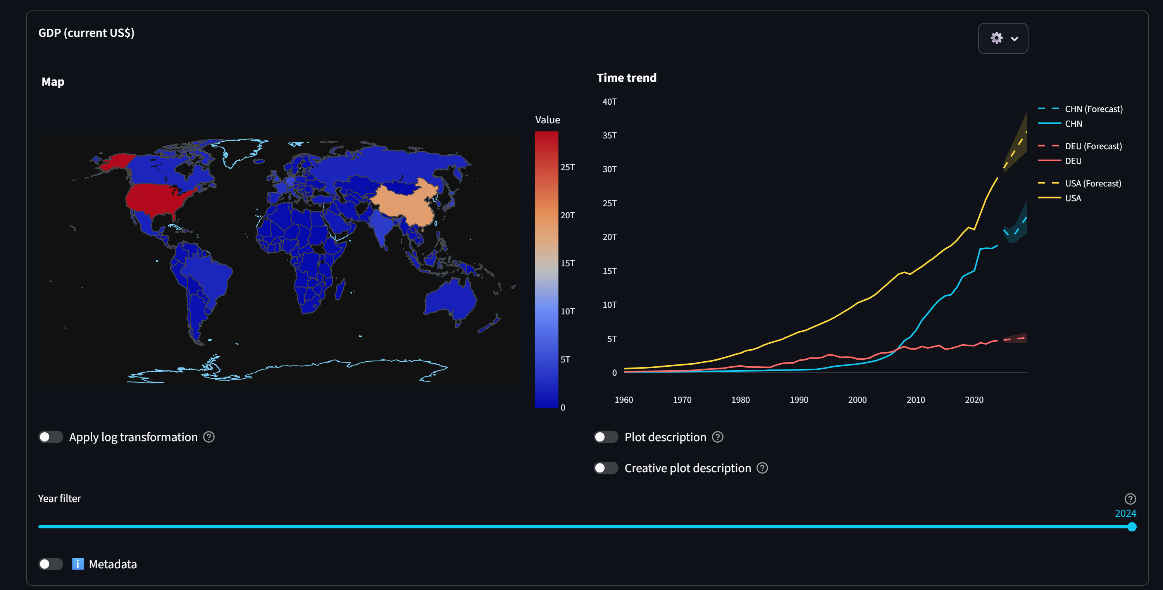
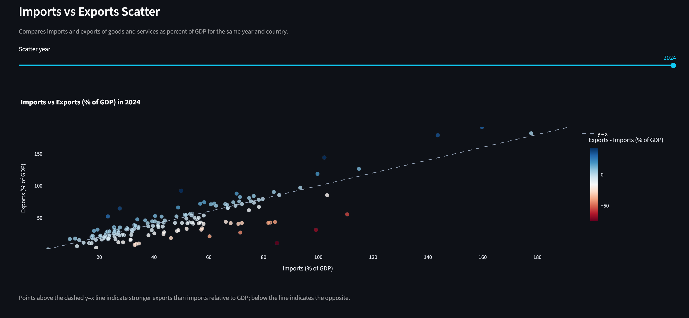
Core Functionality / World Bank Data
Browse, filter and compare key macroeconomic indicators across countries and time.

Slide 18
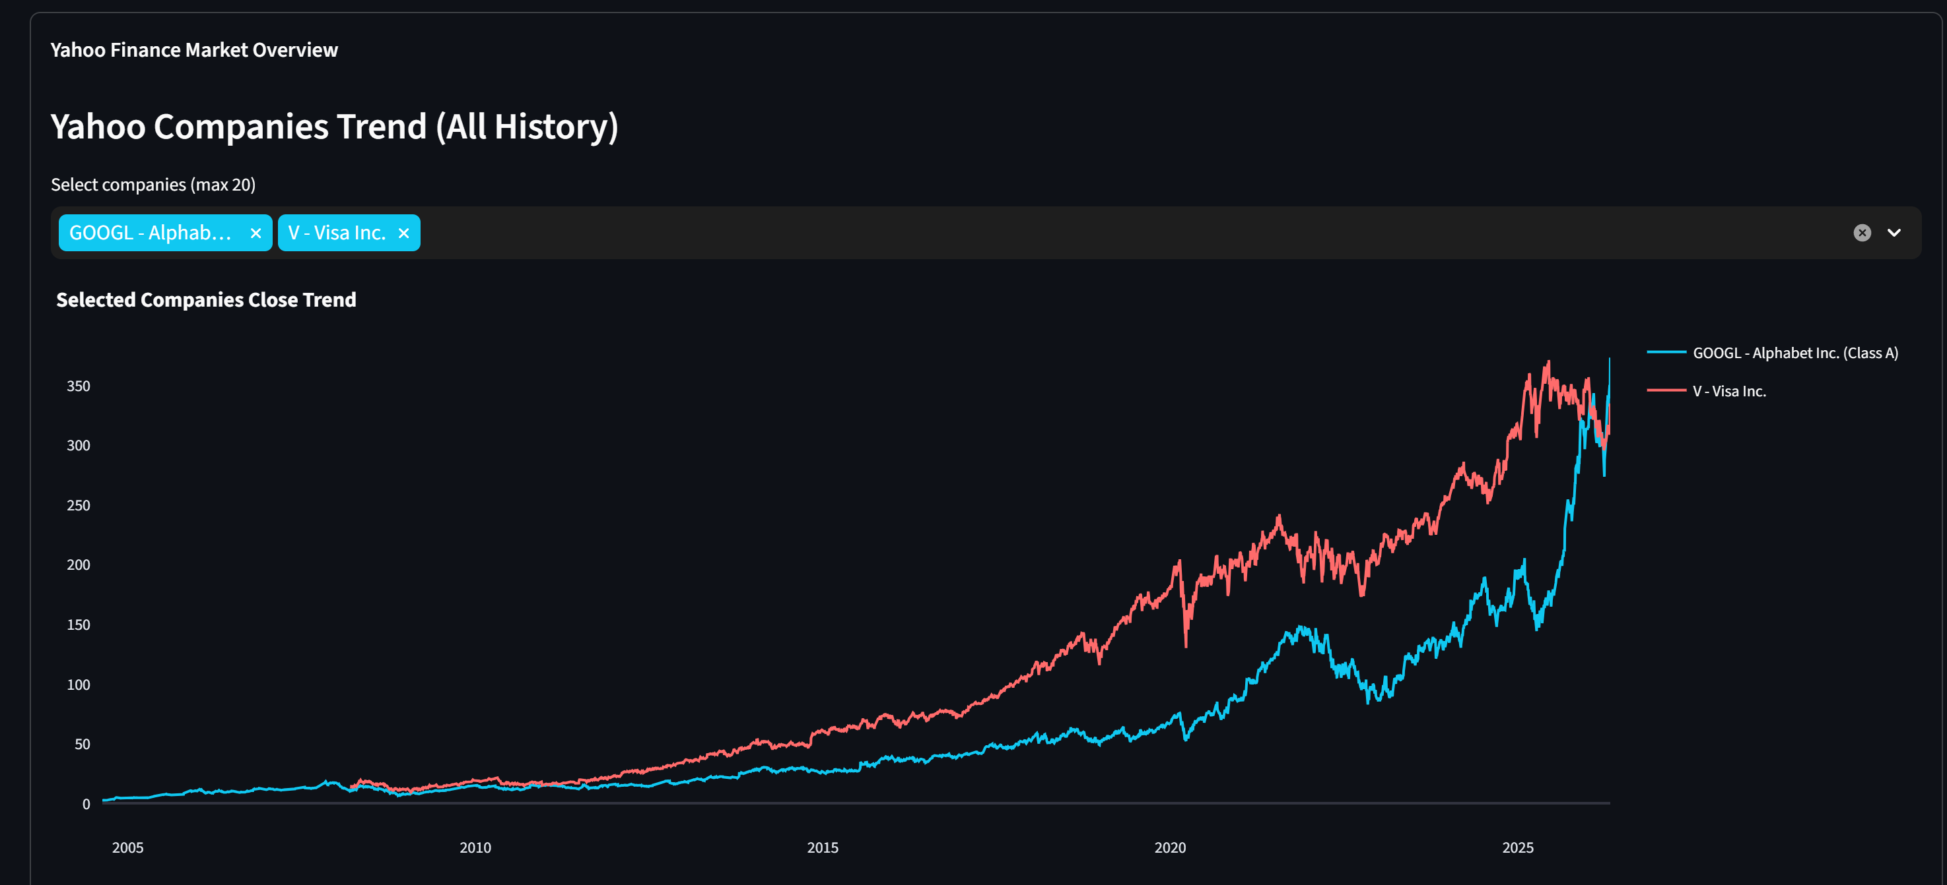
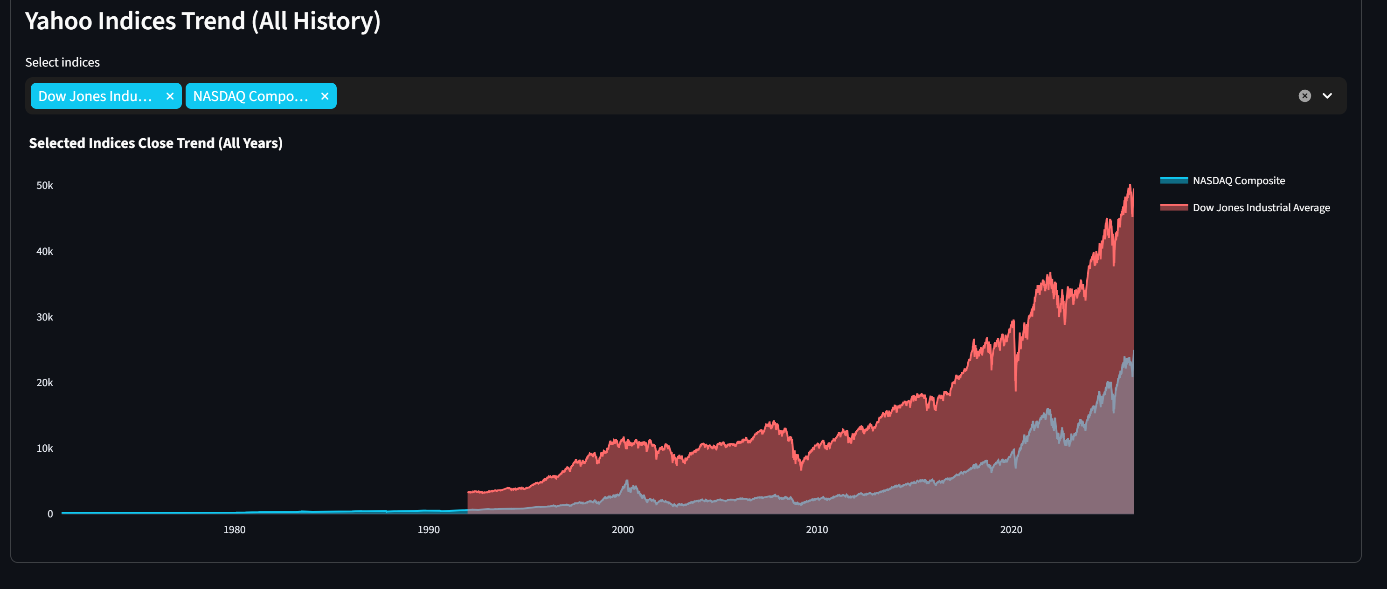
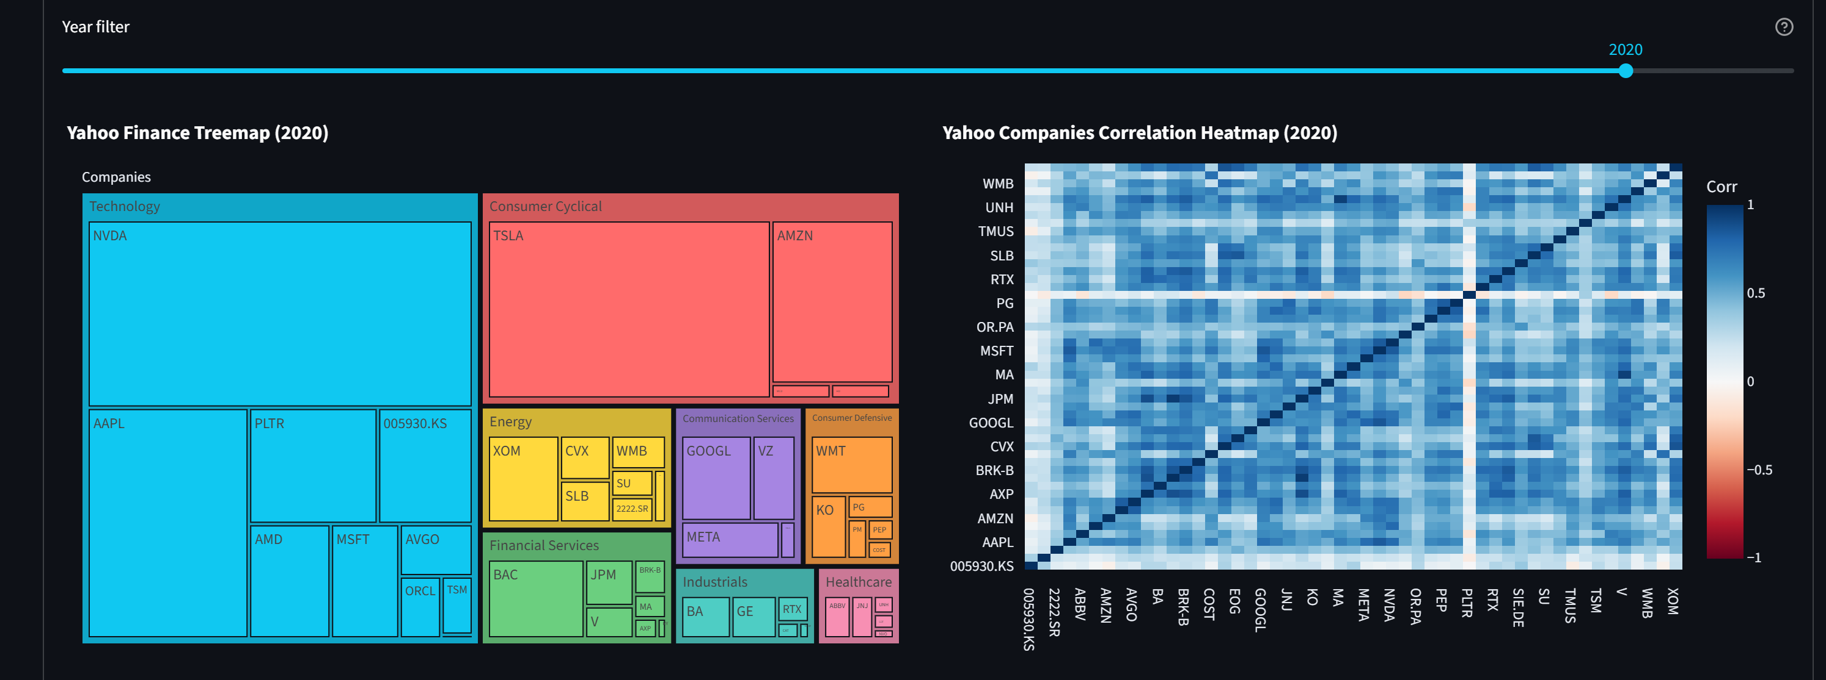
Core Functionality / Yahoo Finance

Slide 19
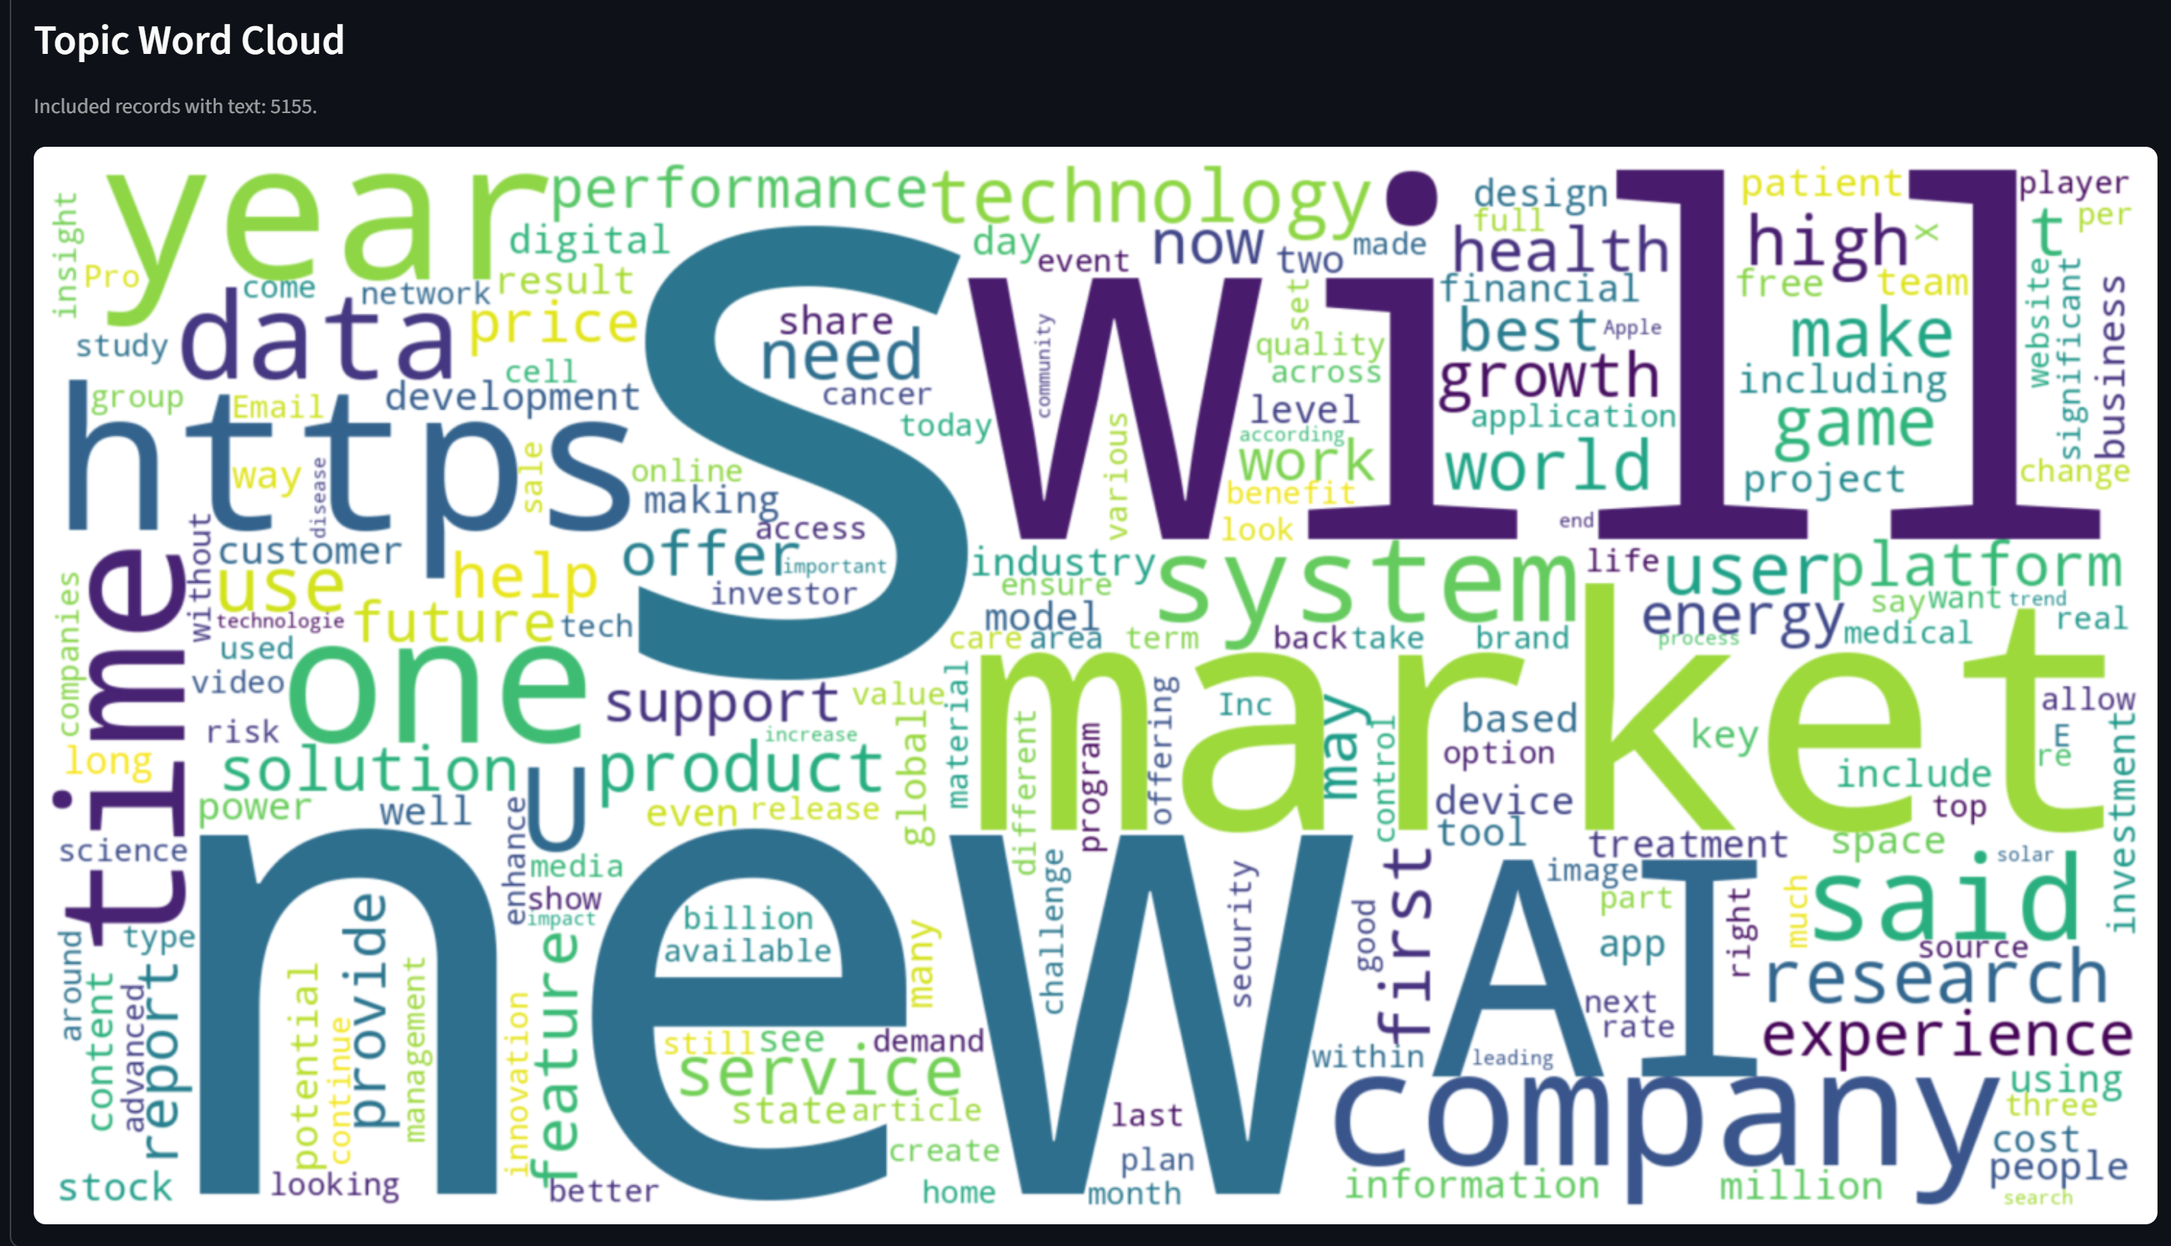
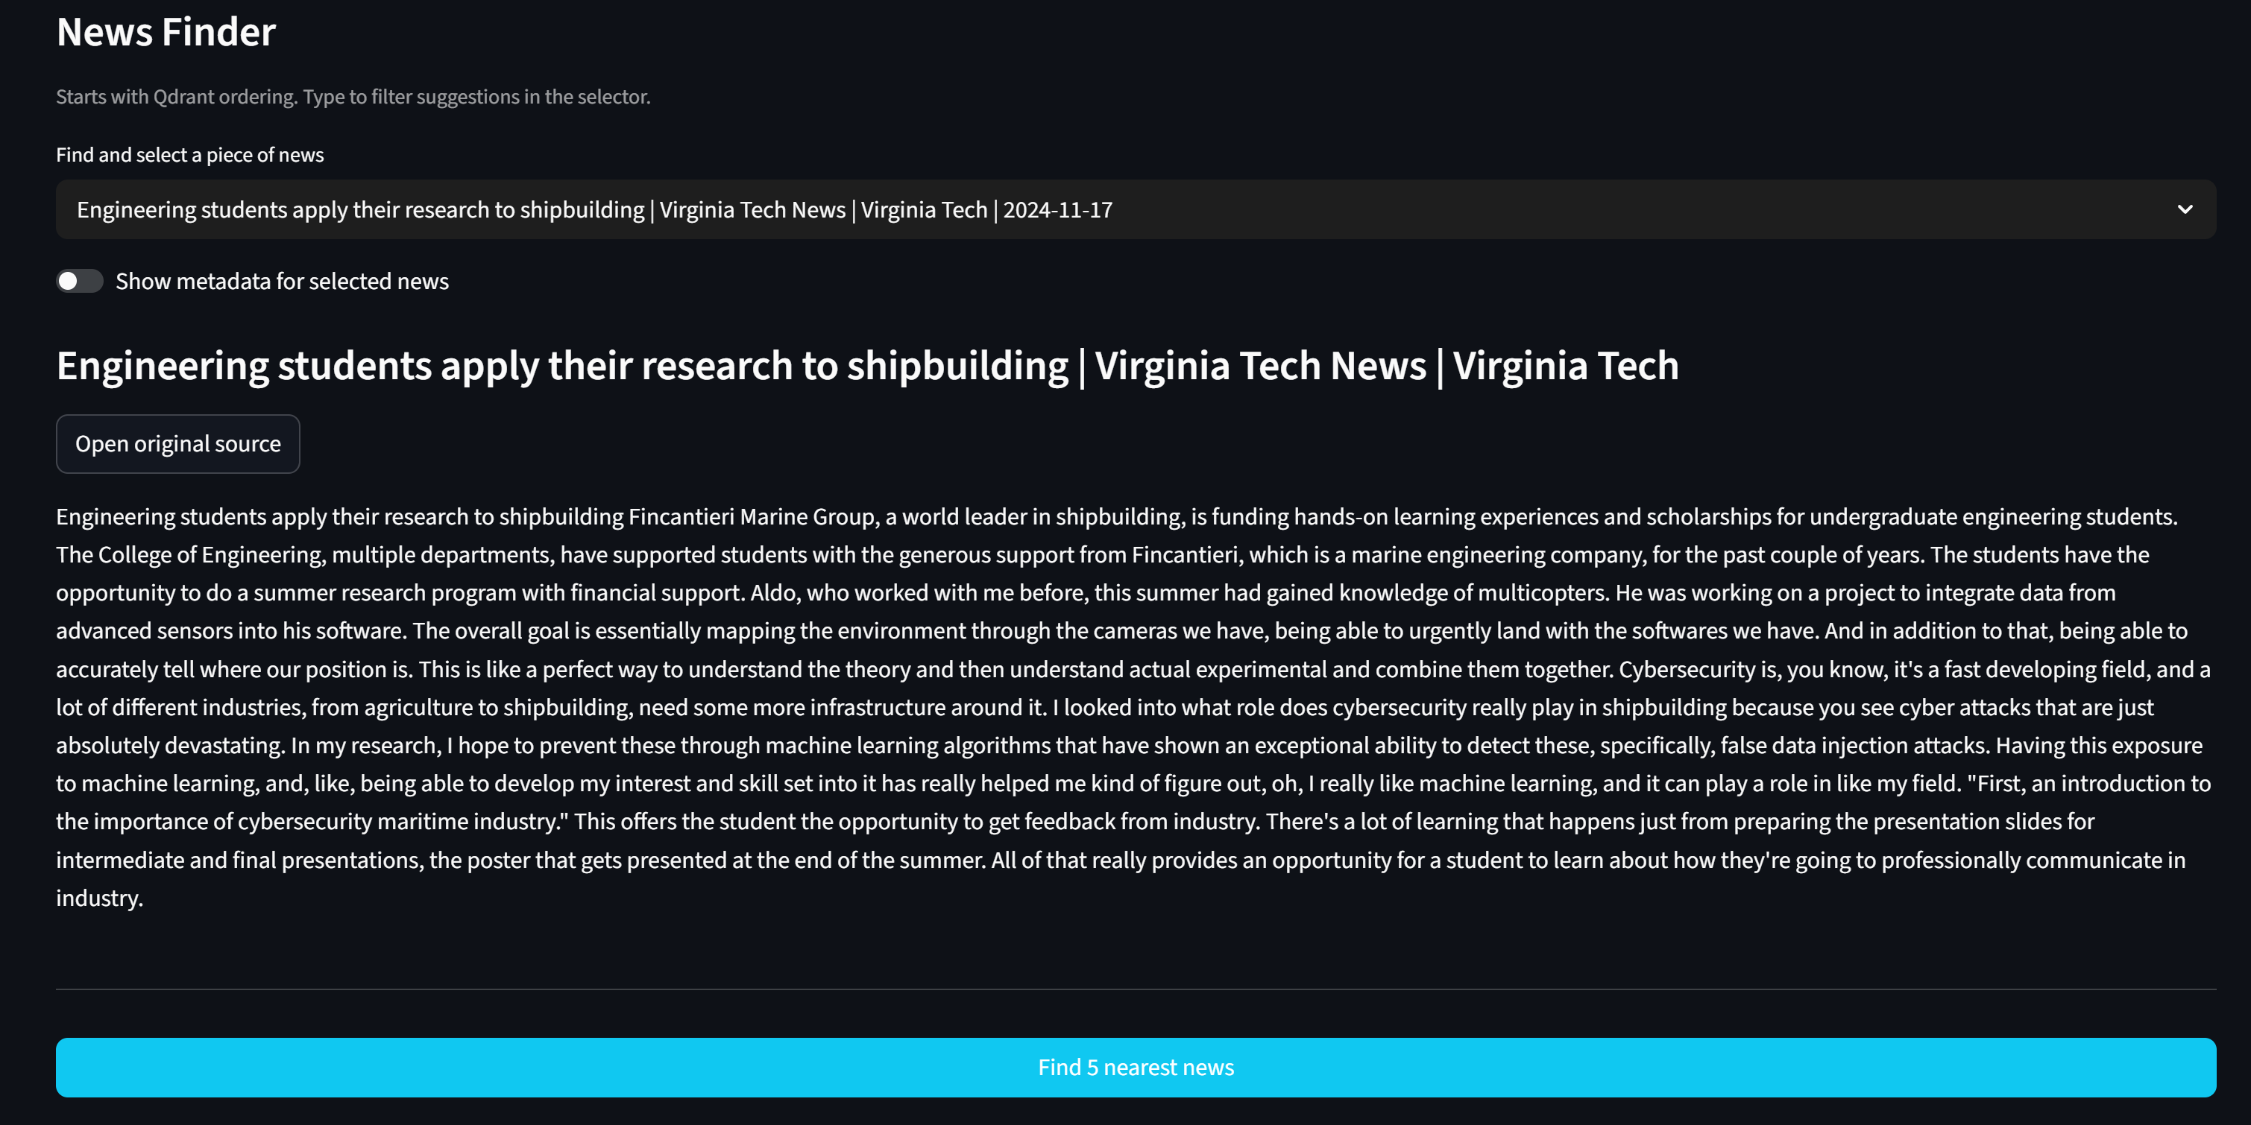
Core Functionality / News & RAG

Slide 20
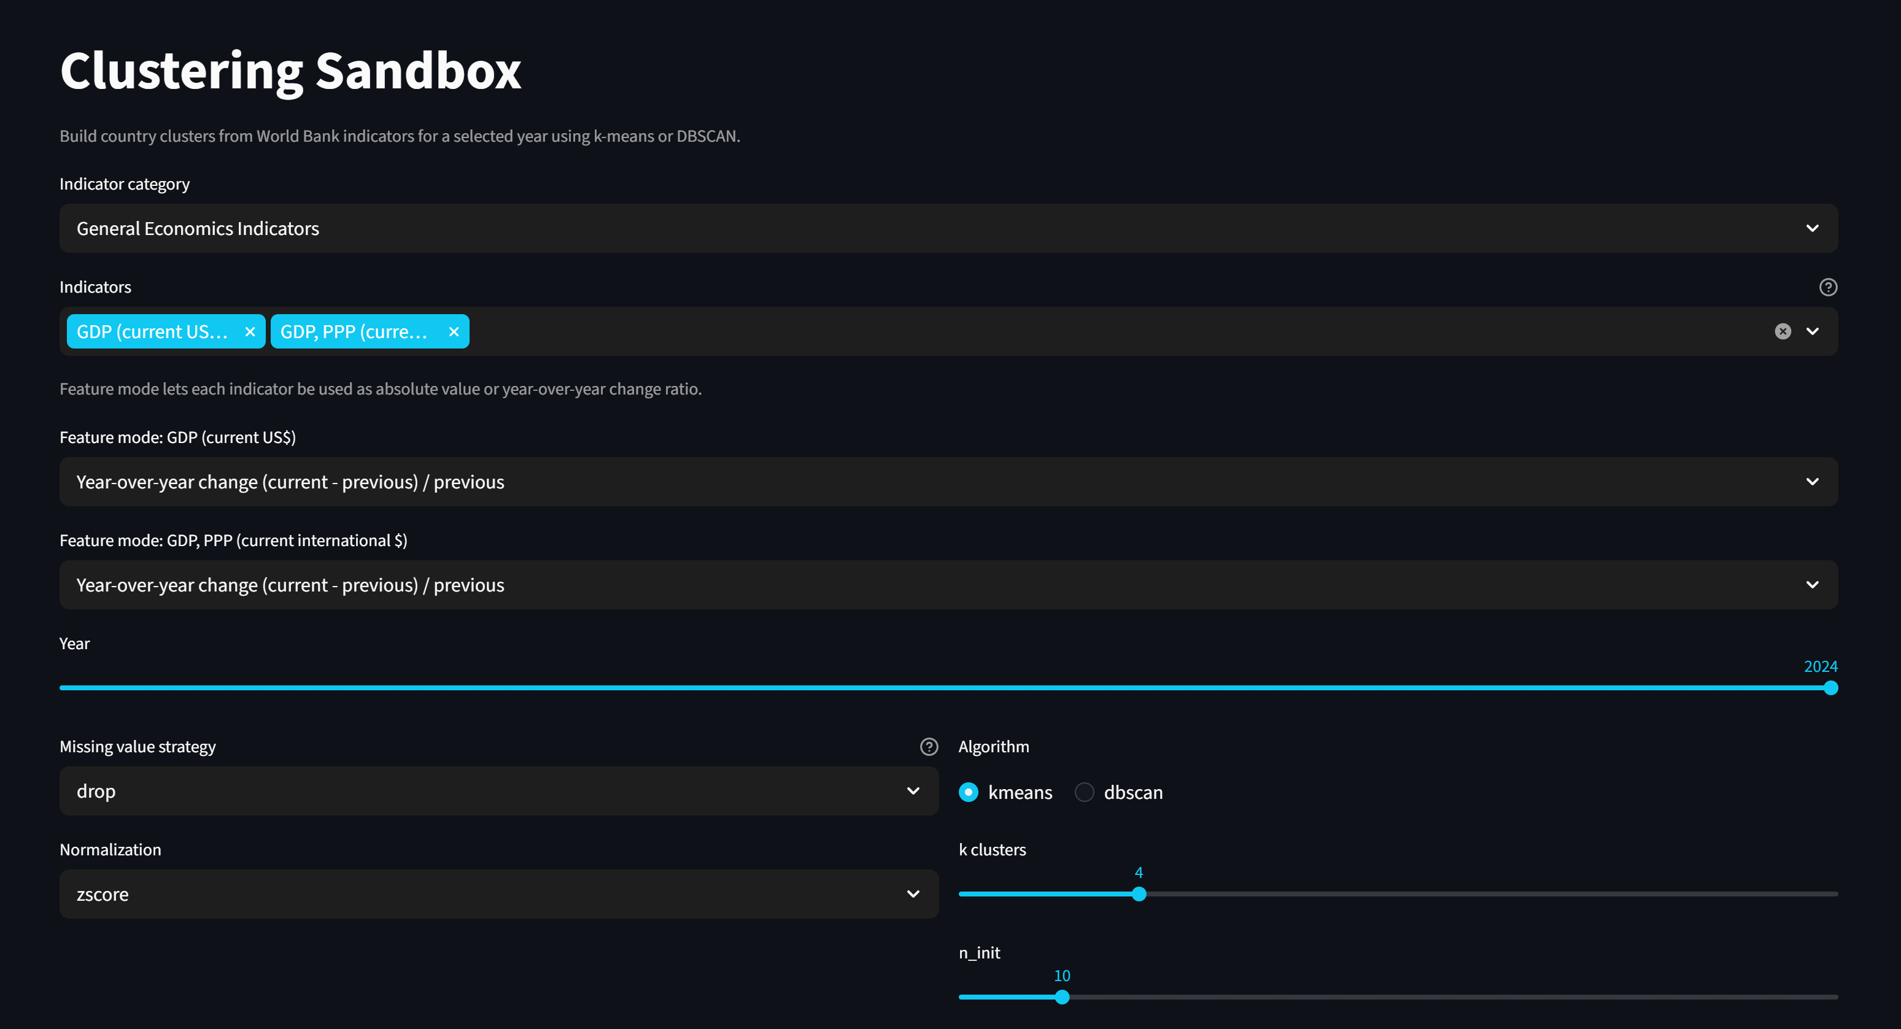
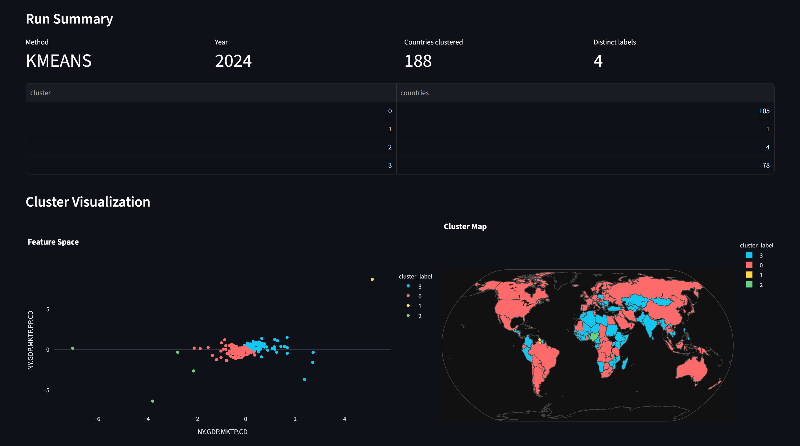
Core Functionality / Clustering
Configurable clustering for better understanding differences between groups of countries

Slide 21
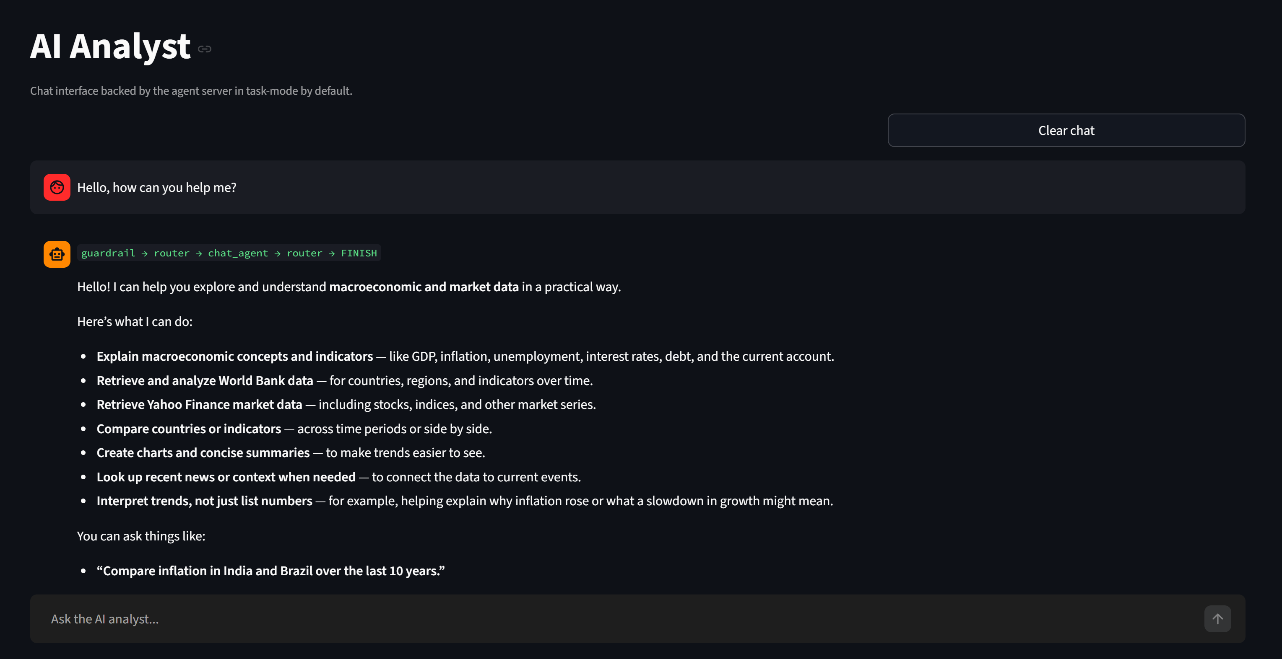
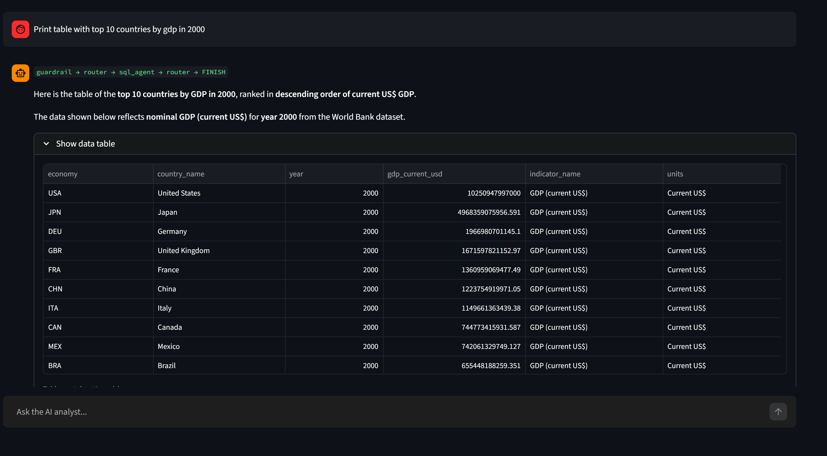
Core Functionality / Chatting & Tables
Agent use-cases

Slide 22
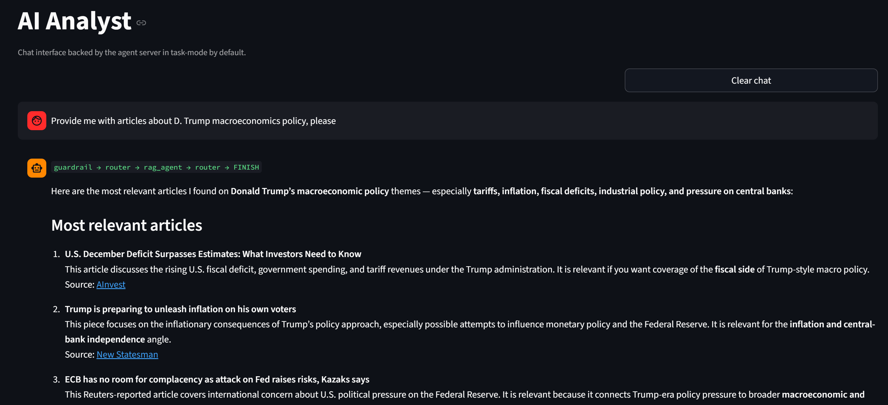
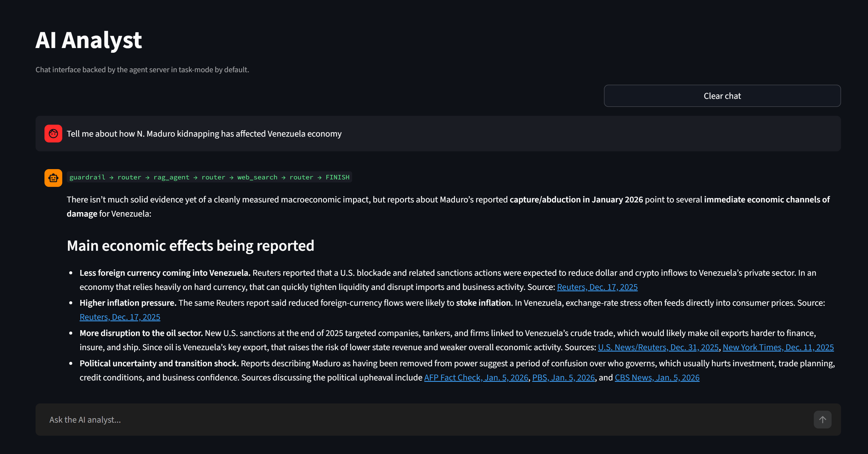
Core Functionality / Retrieval-Augmented Generation
The agent first tries to find data in local RAG and then, if needed, uses web-search tool

Slide 23
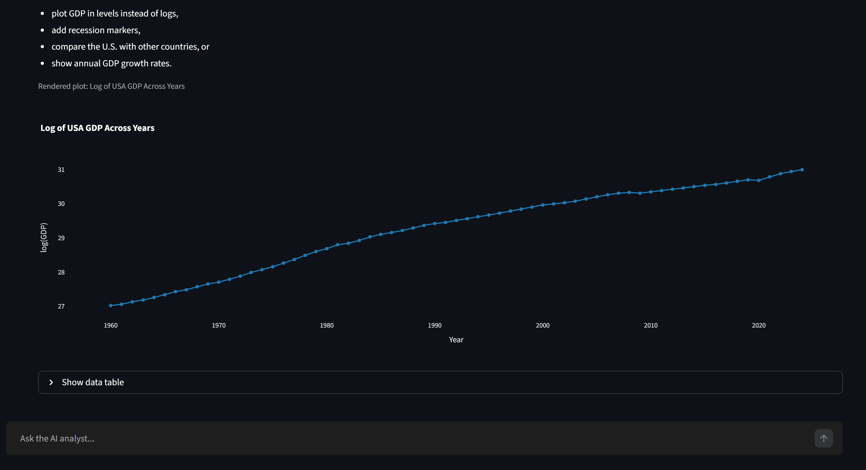
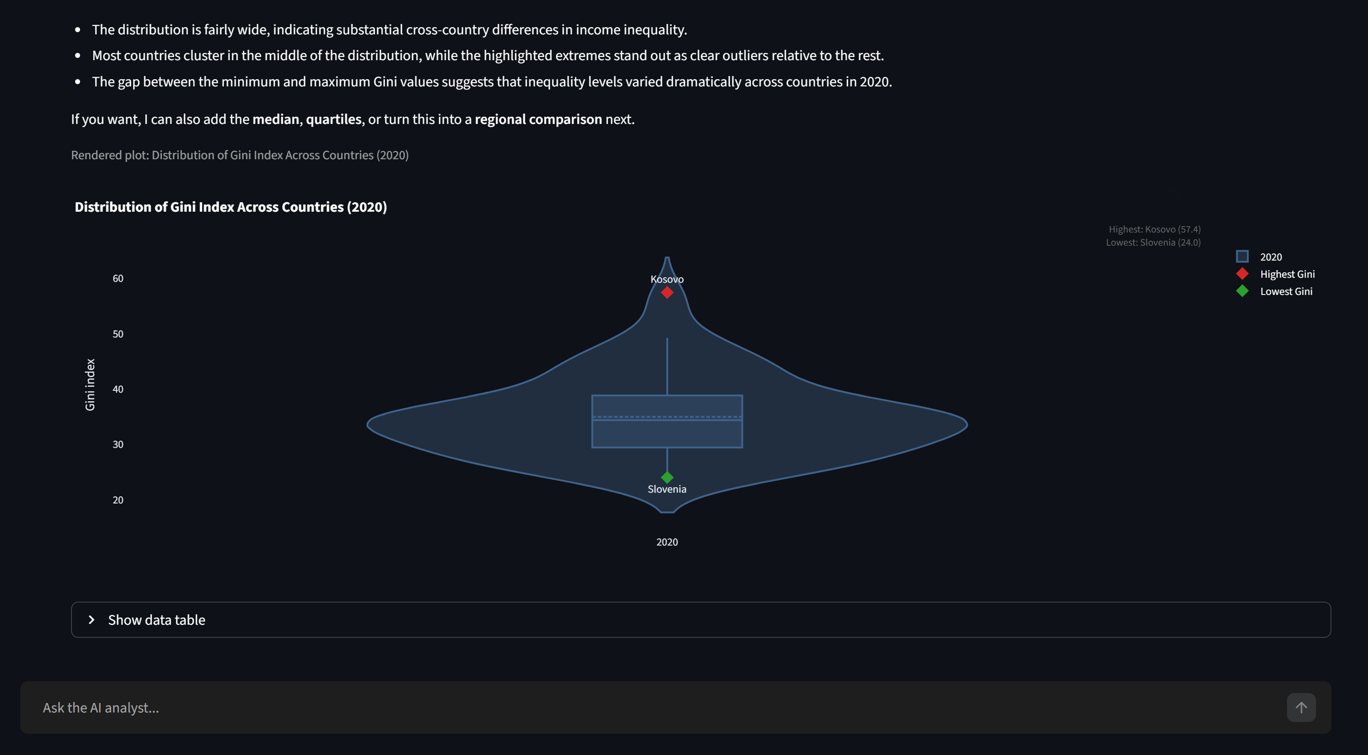
Core Functionality / Plots
PROMPT Plot the logarithm of USA GDP across years.
PROMPT Plot the distribution of Gini across countries in 2020 as a violin plot, highlighting countries with the highest and lowest index.

Slide 24
AI Tools Used in Development
Gemini
Architectural decisions, framework selection and overall structure design.
GitHub Copilot
In-editor assistance for boilerplate, refactoring and routine coding tasks.
Claude Code
Targeted implementation, debugging and complex agentic-system development.

Slide 25
Project Advantages
A wide variety of indicators
Long-run macro data, news flow and financial-markets feeds, all in one place.
A complete macroeconomic outlook
Quantitative, qualitative and market signals combined into a single view.
A multi-functional AI agentic system
Natural-language research workflows that go beyond static dashboards.
Production-ready and configurable
Flexible deployment options and a clean set of user-side configuration controls.

Slide 26
Project Limitations
Codebase needs further refactoring
Some modules grew organically and would benefit from a more disciplined cleanup pass.
Agent system requires more testing
Reliability under edge-case prompts and adversarial inputs is not yet fully proven.
Latency on long agent responses
Even with paid APIs, complex multi-step reasoning can be slow for end users.

Slide 27
Future Development
01 Stabilization
Fix outstanding bugs and harden core platform components.
02 Agent reliability
Improve agentic logic and the backend that supports it; reduce the probability of unexpected behaviour.
03 Comprehensive agent testing
Build a structured test suite covering complex multi-step prompts and edge cases.
04 AI-generated PDF reports
Add a feature that produces fully-formatted, citation-rich PDF reports written by the LLM.
05 User accounts and personalization
Saved dashboards, watchlists and shareable research workspaces.

Slide 28
Q & A
Feel free to ask any questions

Slide 29
Thank you.
Ultimate Macroeconomics Dashboard
An AI-powered research platform for modern economic analysis

