Slide 1



Chapter 6 WORK
Liza Hossain
Alex Viet, Rayan

Slide 2

6.1 Fears and questions
Computers brought fears into the work place.
Many social critics, social scientists, politicians, unions, and activists saw virtually all potential effects of companies on work as highly threatening.
They foresaw mass unemployment due to increased efficiency.
Notes:
Since the beginning of the Industrial Revolution, technology has generated fears of mass unemployment.
The inroducrion of computers into the workplace generated many fears.
some argued that money spent on computers was a waste because computer decreased human efficiency. They saw telecommuting as bad for workers and society. Many oppsed off shoring, arguing that it will eliminate a huge number of jobs.

Slide 3
6.1 Fears and questions
Computers and communications networks are causing changes in the size of businesses and the number of people who are self-emplyed.
Computers are giving emplyers increased power to monitor the work, communications, movements, and web activity of emplyees. These changes affect productivity, privacy, and morale.
Notes:
Many of the fears expressed only a few years ago about the expected impact of computer on work, such as mass unemployment. Ex. Offshoring of jobs.

Slide 4
6.2 The Impact on Employment
Early prediction and the realization
The number of bank tellers dropped by about 37% between 1983 and 1993.
The number of telephone switchboard operators dropped from
421,000 in 1970 to 164,000 in 1996.
The jobs of 35,000 electric meter readers disappeared as utility companies installed electronic devices that broadcast meter readings to company computers.
The jobs of building, and repairing typewriters have disappeared.
Railroads computerized their dispatch operations and eliminated hundreds of employees.
The New York Srock Exchange climinared the last 150 of its floor couriers who carried messages between brokers.
Travel agencies dosed as consumers made airplane reservations online.
Notes:
In the early 1800s the Luddites (of whom we say more in Chapter 7) burned weaving looms because they feared the looms would eliminate their jobs. During the early 1990s, newspapers were full of headlines about layoffs and corporate downsizing.

Slide 5
The Impact on Employment continues…
IBM, General Motors, cars and other big companies laid off of thousands of workers.
Digiral cameras put film processors out of work. (Kodak laid off thousands of employees)
Shopping on the internet and self-service checkout systems in stores have reduced the need of self clerk.
As people bought or copied more music online, Tower Records went out of business in 2006 and laid off 3000 employees.
Notes:
Loss of job continues in the year 2000s.

Slide 6
…and then technology creates jobs
A successful technology eliminates some jobs, but creates others.
Examples:
Rather than loss of jobs, the sewing machine meant a reduction
in the price of clothes, more demand, and ultimately hundreds
of thousands of new jobs.
By 1997 more than 109,000 people worked in the cellular
communications industry in the United States.
By 1998 the Semiconductor lndusuy Association responed that chip makers, employed 242,000 workers, directly in the U.S. and 1.3 million workas indirecrtly.
Notes:
*Web sites that created a new phenomenon, the new devices and services all represent new jos.
*The World wide Web conrributcd to the creation of cabout 100.000 new Internet-relatcd jobs in 1996.
*The chip indusrry, which did not exist before the microprocessor was invented in the 1970s, ranked founh among U.S. industries by annuaJ revenue.

Slide 7
What happens to music ?
Drastic changes in music
Automated piano players and recordings replaces the live piano players.
Juke boxes replaces live bands in bars.
Recorders and CDs replaced live orchestras and bands at Broadway shows, dance performances, and weddings.
Notes:
A few hundred years ago listening co music was rare luxury for most people. Only the wealthy could hire profcssional musicians to perform for them. Technology, induding electricity. radio, CDs. DVDs, iPocis, data-compression algorithms, and the Web, brought the cost of an individual "performance" in a private home (or our on a hiking trail) down so low [hal music available to almost anyone.

Slide 8
Overall…
In the U.S. between 1993 and 2002, 309.9 million jobs ended but 327.7 million jobs were added in the same period, for a net increase of 17.8 million jobs.
30 million jobs opening and closing each year is typica1 of a flexible economy.
The BLS(Beueau of Labor Statistics) projects that the net increase in jobs for the period of 2004 to 2014 will be 18.9 million.
Notes:
What is the overall effect of computerization on employment rate? Does it create more jobs then it destroys?

Slide 9
Technology, economic factors, and employment
OECD (organization for economic co-operation and development) concluded that the unemplyment stems from policies, which have made economies rigid, and stalled the ability to adapt.
The OECD report says that history has shown that when technological progress accelerates, so do growth, living standards, and emplyment.
Average hourly pay of manufacturing workers quadrupled between 1909 and the mid 1970s.
Wages appeared to decline as much as 10% after 1970.
Notes:
Uncmploym.cllt rates fluctuate. We SolW that new technology cmploymcm ill specific .lre-a.'" and in shorr term. but it is obvious (hat computer [e(hoolog), did not· cause Illass unemployment. ]·host.· who continually predict mass uncmploymcllr sec onl), che old, preexisting jobs thar are lost.
The study suggested thar "unemploymenr sho uld be addressed nor by seeking ( 0 slow the pace of change. but rather by resroring economics' and societies' capaciry to adapt to it," Unemployment in man)' European countries is much highl'r than in the U.S. and has bl'Cn for a long cime. BUI Europe is nor more technologicall)' advanced or computerized than the 'United Scarcs.

Slide 10
Technology, economic factors, and employment
Audiences at operas and symphonies doubled (per person)
Recreation spending more than tripled (per person).
spending on toys quadrupled (per chitd).
The data indicate that, while computerization increased, so did many measures of real income and quality of life.
Notes:
Two researchers, Michael Cox and Richard AIm. Decided to avoid the problems of using income and inflation data and. insrcad. look at dirccr measures of consumption and lisure.
includes a sampling of data they collected from a variety of govcrmncnt and indusuy sources.

Slide 11
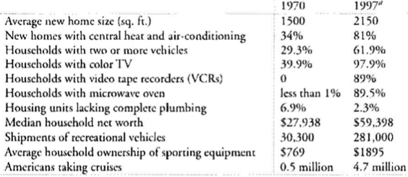
Living standard and leisure in the computer age

Slide 12
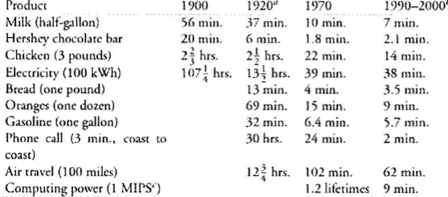
Declining cost measured in working time.

Slide 13
Question
Why do emplyers monitor emplyees? Should monitoring be limited?

Slide 14
A Global Workforce section 6.2.3
Offshoring
Transportation and Communication improvements
Jobs moved to less wealthy countries
Low pay rates compensates
Web and information work
Transportation cost is zero
Countries offshored to
India (most popular)
Canada
China
Brazil
Offshoring improved poor countries economy
Ireland became one of the richest countries in the European Union in the 90’s
Brazil now has an Apple factory
Knowledge work could be threatened in the US

Slide 15
Impact of offshoring
Computer hardware went offshore early
Negative
Job loss
Fewer positions (specially manufacturing)
Elimination of current positions
Positive
Job creation
Innovation

Slide 16
Problems and side effects of offshoring
Customer-service call centers
Accent
Personnel are unfamiliar with product or service
Time zones
Demand for high skilled workers in foreign countries has already forced salaries up

Slide 17
Ethics of hiring foreign workers
Grey area
Depends on the circumstances

Slide 18
Getting a job section 6.2.4
New technology may eliminate jobs but it also creates new jobs
Web made job search easier
Before was done using library and telephone
Monster.com
Relevancy
Search engines

Slide 19
Learning about applicants and employees
Social media
Applicants try to clean their online persona
Massive data collection for criminal-background check
ChoicePoint Inc.

Slide 20
Job dispersal and telecommuting section 6.3.1
Better dynamics
Home based business
Benefits
Reduce overhead for employers
Increase productivity
Smaller physical space (less rent)
Easy communication with clients
Problems
Resentment from employees that must go to the office
No immediate supervision
Less Productive
Security risk by using home computer

Slide 21
Question
What is your opinion on what ever you have an opinion about?

