Slide 1
Medieval
Sacred

Slide 2
Rise of Monophonic and Acapella music;
Gregorian Chants were very popular, and where written in Latin witch is consider A more divine language;
Only boys and man are allowed to participate;
The boys underwent castration to achieve higher vocal pitch;
The music was mostly appreciated by the clergy;

Slide 3
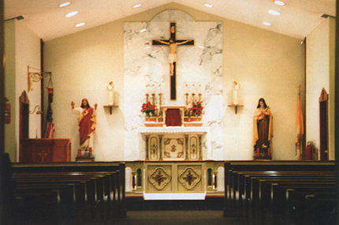
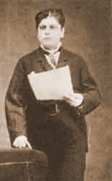

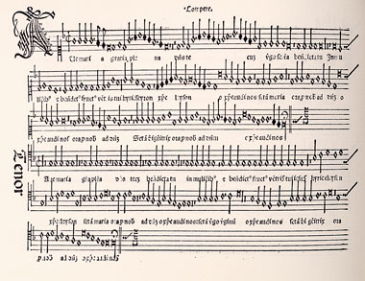
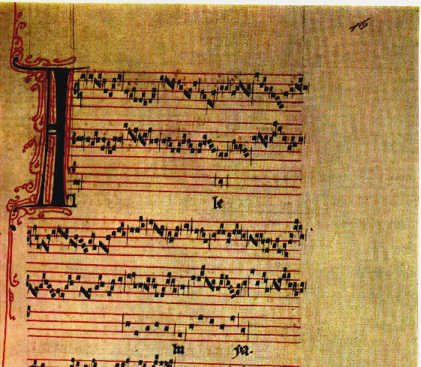

Slide 4
Medieval
Secular

Slide 5
Man and women participate in music making;
Lyrics are based on love;
Dance in incorporated in music;
Alcohol plays a big roll in the parties;
Instruments are also brought into the culture;

Slide 6
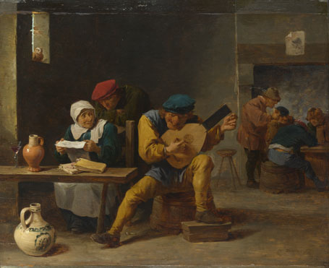
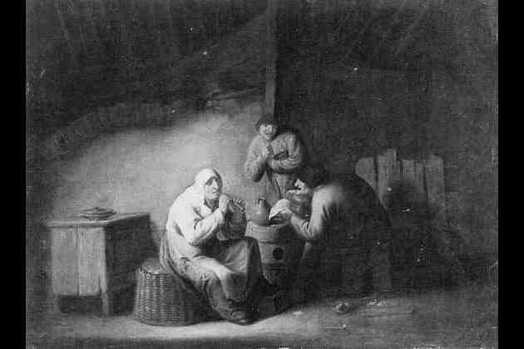
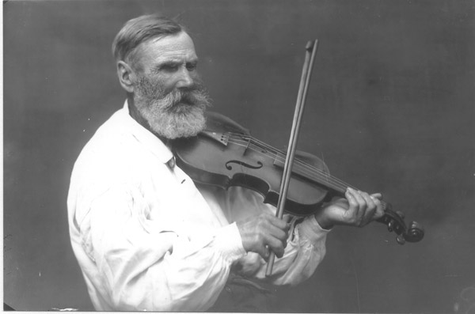

Slide 7
Renaissance
Secular

Slide 8
number of choral musical compositions gives birth to Motet;
The concept of staggered entrances and Polyphony emerges;
Palestrina, 16 century composer that left hundreds of compositions, including 105 masses, 68 offertories, at least 140 madrigals and more than 300 motets;
Josquin des Prez was the most famous European composer between Guillaume Dufay and Palestrina;

Slide 9
