Slide 1
- Miguel Alejandro Villa Guerrero
IOT Project

Slide 2

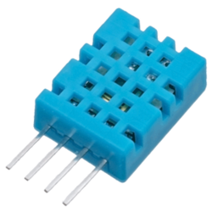



How it works?

Slide 3
Technology used
- Temperature and humidity sensor DHT11
- Raspberry pi 3
- Cloudant DB
- IOT Service
- Python Cloud Foundry App

Slide 4
DEMO

