Slide 1
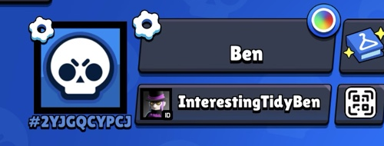
Brawl Stars Player Card
First mini app: type a Player Tag → see a cool profile card
How the app works
1. Type tag Paste #2YJGQGYPCJ
2. Click button “Show my card”
3. Ask API safe server calls API
4. See card trophies + brawlers
→
→
→
Ben’s tag: #2YJGQGYPCJ
What you learn
Secret rule
HTML makes the page
CSS makes it beautiful
JavaScript talks to the server
The API returns real game data
The API token is like a password.
Never put it inside browser JavaScript.
Use a tiny safe backend file.
Result: a real “Player Card” that Ben can test immediately with his own tag.

