Slide 1
Preact
Preact, Hooks, Tailwind

Slide 2
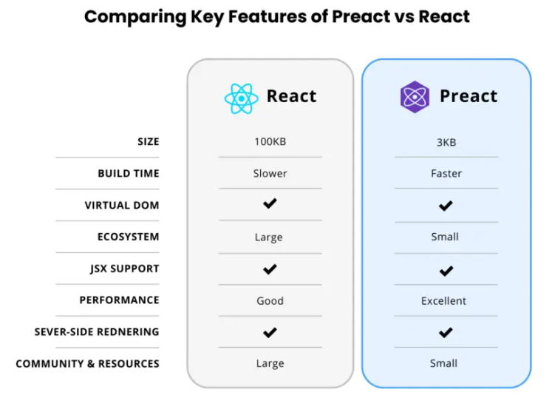
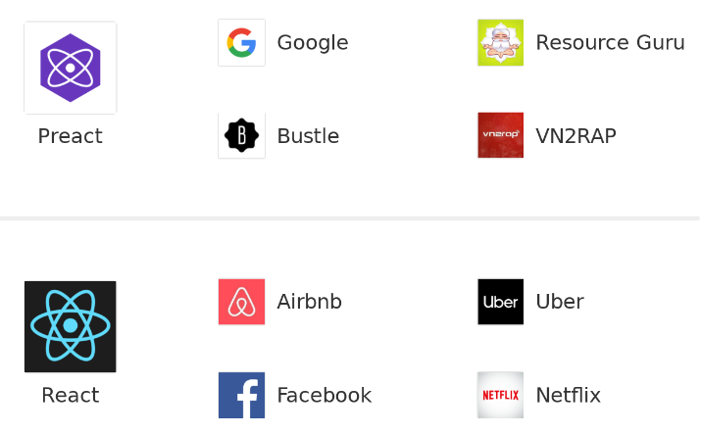
Motivation – Preact vs React
https://preactjs.com/
https://github.com/preactjs/preact-cli

Slide 3
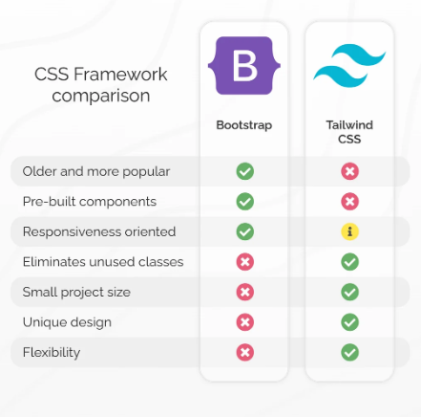
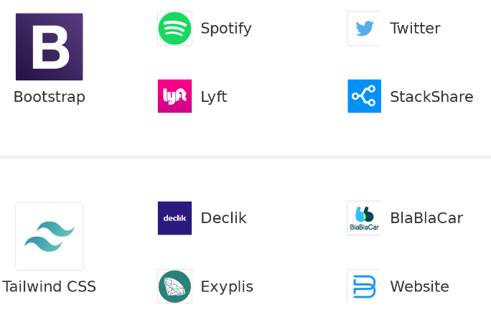
Motivation – Tailwind vs Bootstrap
https://tailwindcss.com/

Slide 4
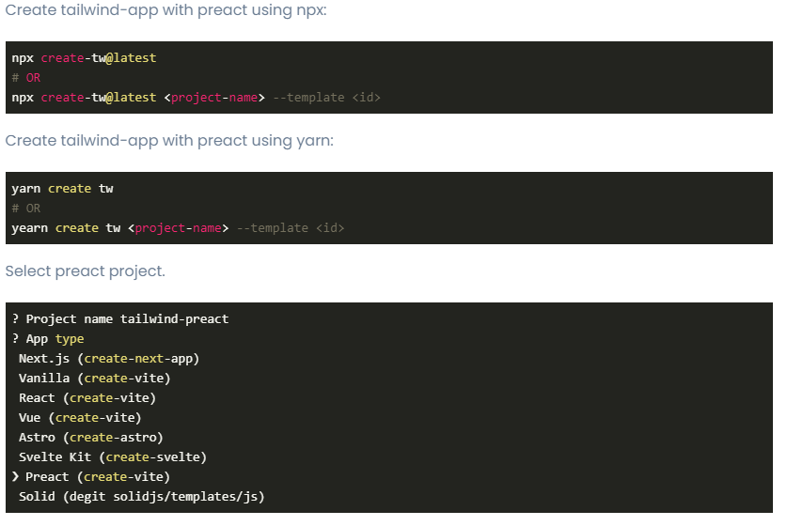
Create Tailwind-app with Preact

Slide 5
Live Example – Crypto Market
Preact JS and Tailwind demo application
Example usage of the main hooks:
useState
useEffect
useReducer
useContext
useRef
Cryptocurrency market data – https://www.morethanwallet.com/appStore/apidoc
Git repository:

Slide 6
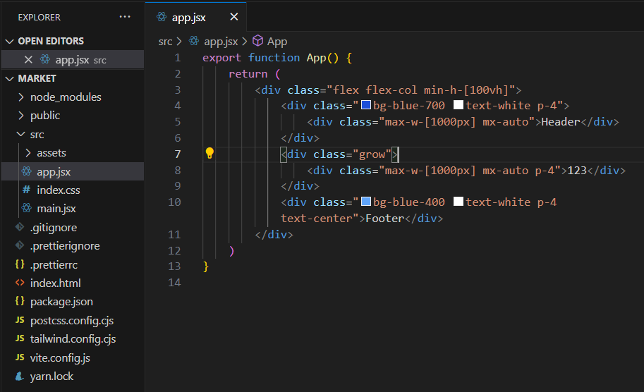
Page Layout - A

Slide 7
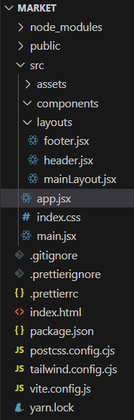
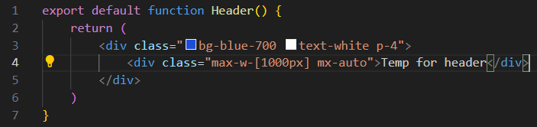
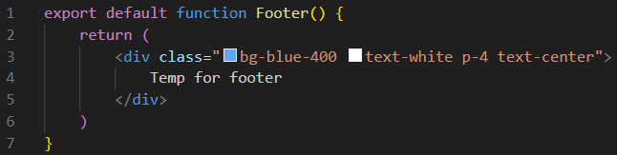
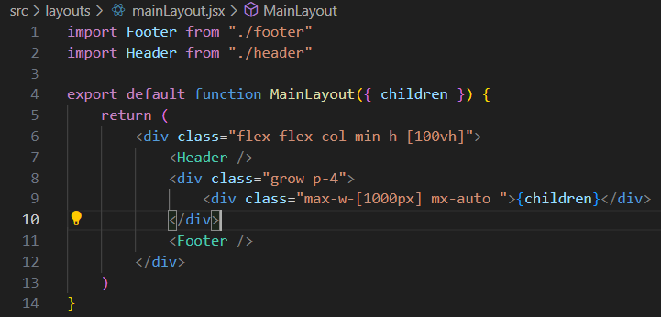
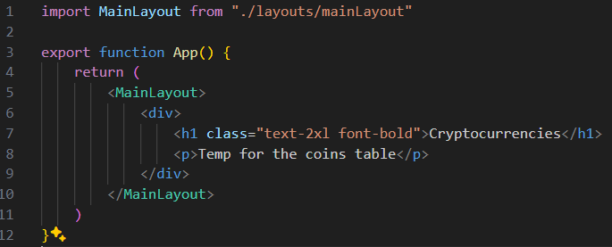
Page Layout - B
Layout and decomposition

Slide 8
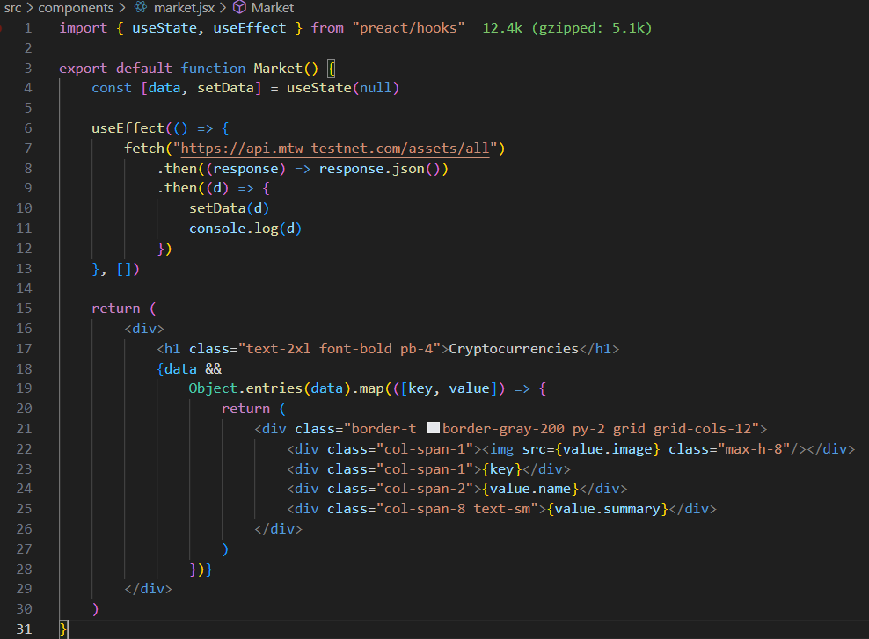
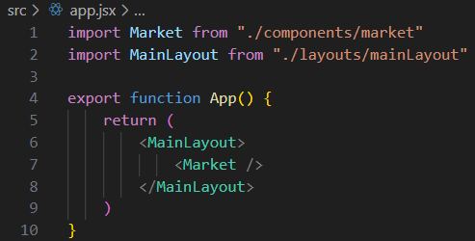
Market Page - A
useState
useEffect

Slide 9
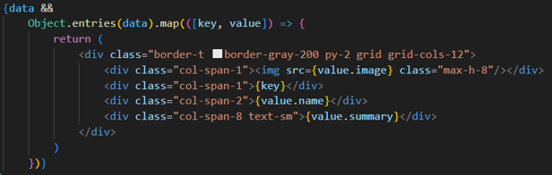
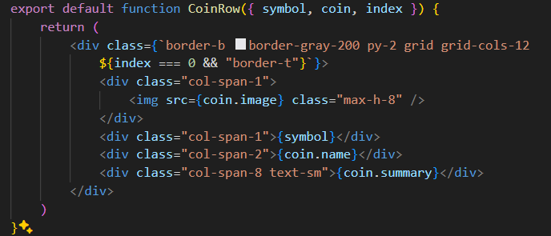
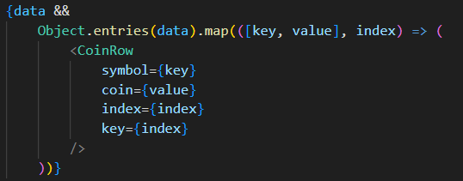
Market Page - B
Decomposition and
component properties

Slide 10
Hooks
React hooks are a powerful feature in React that allow you to add state and other features to functional components
useState hook allows to add state to a functional component.
It takes an initial value as an argument and returns an array with two elements: the current state value and a function to update it.
useEffect hook allows to perform side effects in a functional component.
Side effects include things like fetching data from an API, updating the DOM, or subscribing to an event.
useContext hook allows to access a context object in a functional component.
Context is a way to pass data down the component tree without having to pass props manually.
useReducer hook allows to manage complex state in a functional component.
It’s similar to the useState hook, but instead of a simple value, it takes a reducer function and an initial state.
useRef hook allows to create a mutable ref object that persists for the lifetime of the component.
You can use it to store and access values that don’t trigger a re-render.

Slide 11
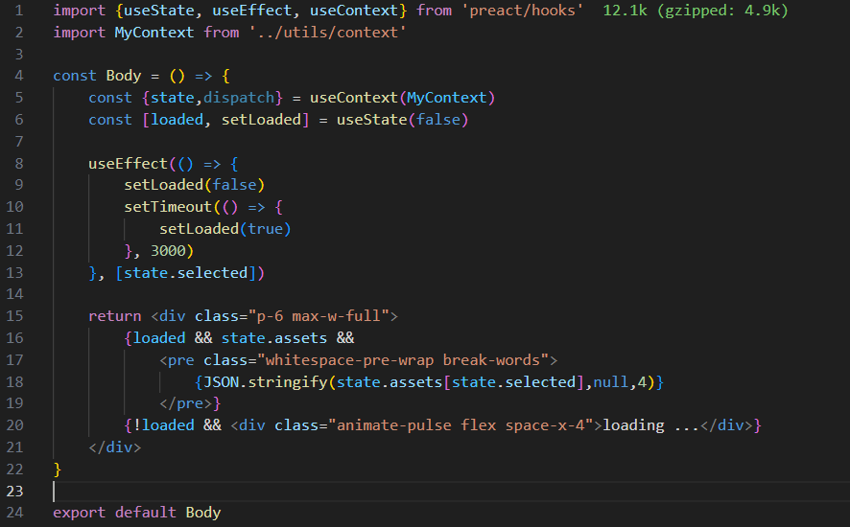
Hooks: useState, UseEffect

Slide 12
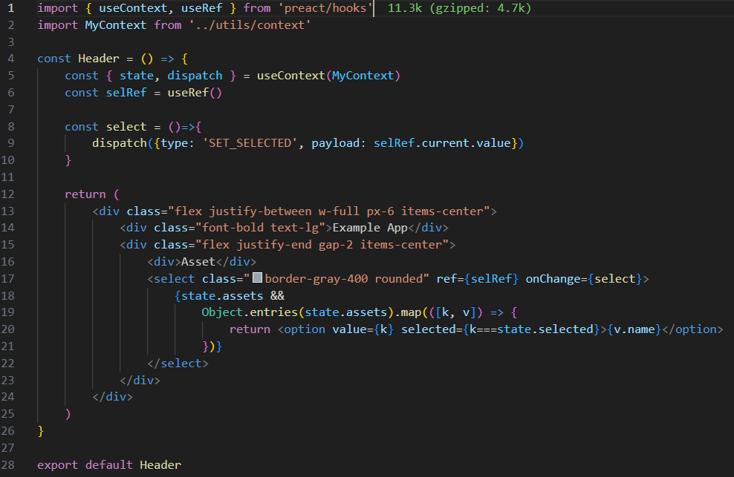
Hooks: USEREF

Slide 13
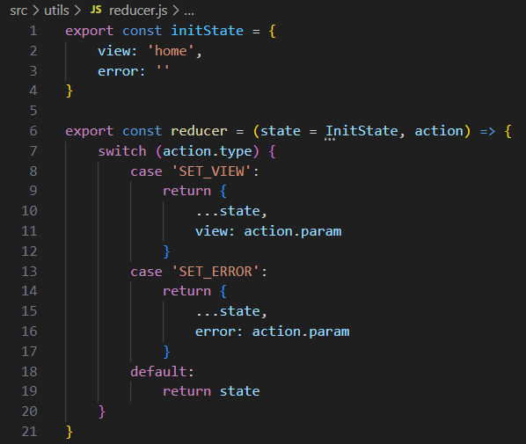
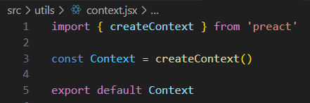
Reducer and Context

Slide 14
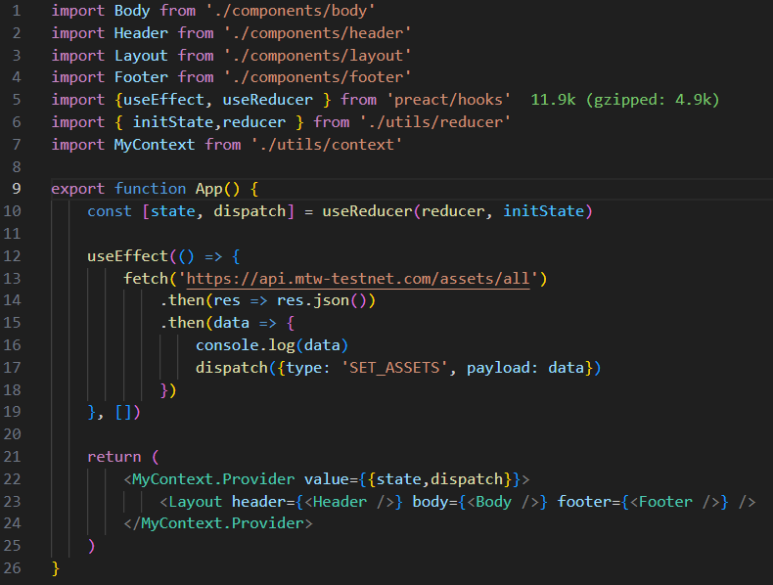
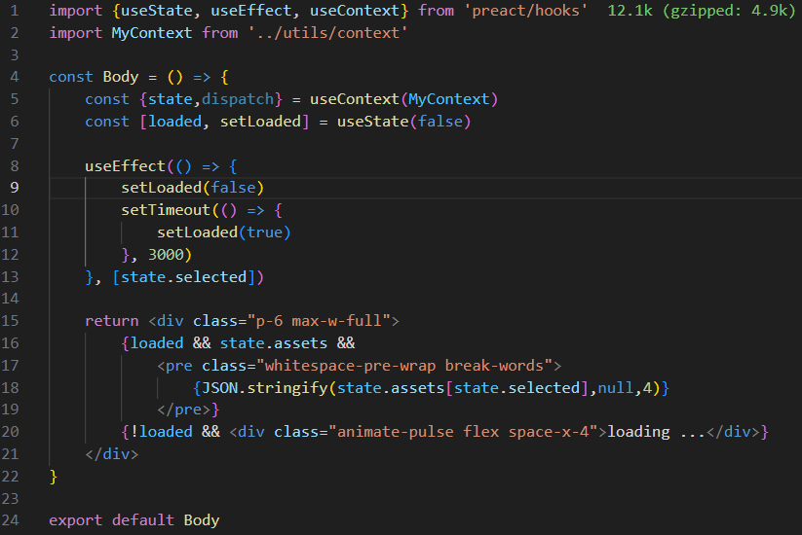
useReducer and useContext

Slide 15
Wallet Example
Multicurrency wallet (BTC, ETH), providing the following functionality:
1. Wallet open/new/restore operations
Create new wallet (using ethers.js)
Open existing wallet (by name and password)
Import existing wallet (by mnemonic phrase)
2. The wallet data must be stored in localStorage encrypted with SHA-256 algorithm
3. After opening the wallet (by name and password) the dashboard page will show the wallet accounts data (addresses and private keys by currency)

Slide 16
References
Frameworks:
https://tailwindcss.com/
https://preactjs.com/
https://larainfo.com/blogs/install-tailwind-css-in-preact
Example code:
https://github.com/alexvirtech/hdwallet2

