Slide 1

WEBRTC

Slide 2
What is WebRTC?
Web Real-Time Communication is introduced in 2011 by google.
WebRTC allows web apps to create Peer-To-Peer communication.
Enable real-time audio, video, and data transmission across the web and native browsers.
Free and open source..

Slide 3
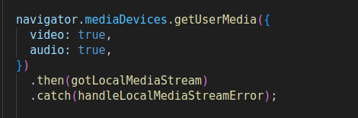
JavaScript APIs in WebRTC
Media Stream :
Using this API allows you to get access to input devices such as the microphone and the web camera.

Slide 4
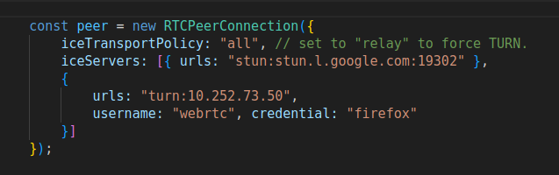
RTCPeerConnection :
Send the captured stream of audio and video in real-time across the internet to another WebRTC endpoint.
Maintain and monitor the connection between peer connections.
RTCDataChannel :
Transmit arbitrary data. Each data channel is associated with an RTCPeerConnection

Slide 5
Components of WebRTC connection
Network Address Translation (NAT)
Session Traversal Utilities for NAT (STUN) server
Traversal Using Relays around NAT (TURN) server
Session Description Protocol (SDP)
Signaling server
Interactive Connectivity Establishment protocol (ICE)

Slide 6
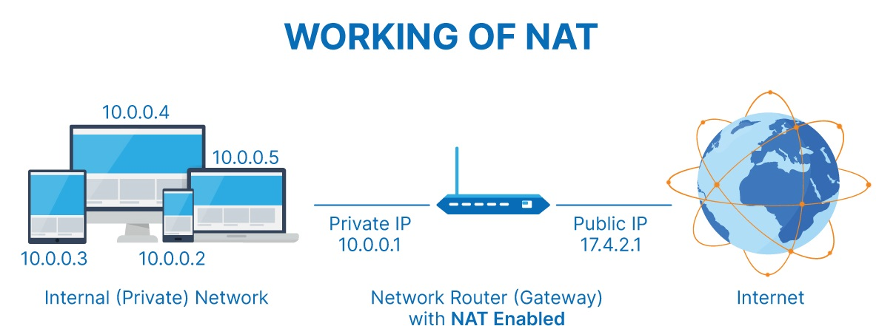
Network Address Translation
NAT is used to give your device a public IP address.
Requests will be translated from the device's private IP to the router's public IP with a unique port.

Slide 7
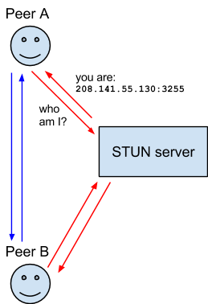
Session Traversal Utilities for NAT
STUN is a protocol to discover your unique public address with a specific port.
Doesn't require any credentials.
Examples: stun1.l.google.com:19302 stun2.l.google.com:19302

Slide 8
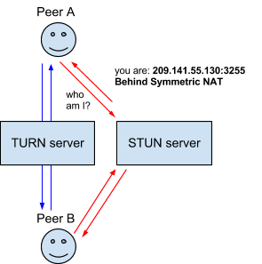

Traversal Using Relays around NAT
TURN acts as a relay when the STUN fails to establish connection between peers.
Create a connection with a TURN server and tell all peers to send packets to the server.
Examples:

Slide 9
Session Description Protocol (SDP)
SDP is a standard for describing the multimedia content.
This contains resolution, formats, codecs, encryption, etc.
Both the peers will generate their session description to share their media information with each other.

Slide 10
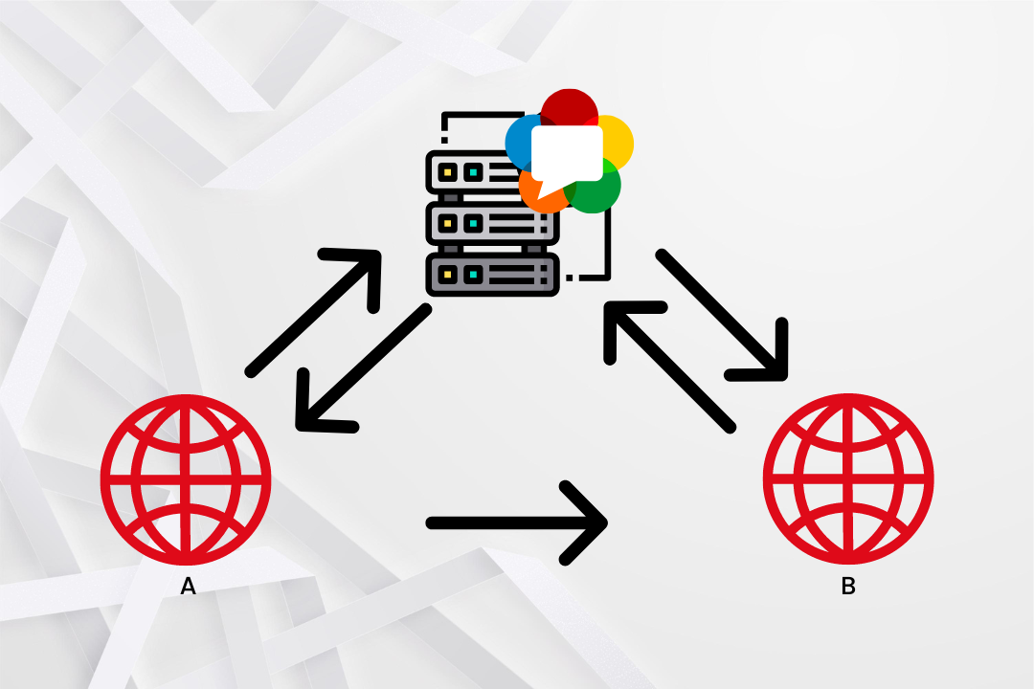
Signaling server
WebRTC can't create connections without signaling server.
It helps to exchange the offers and answers (SDPs).
Only required to in the initial stage of peer connection
Server can be created using sockets, firebase etc..

Slide 11
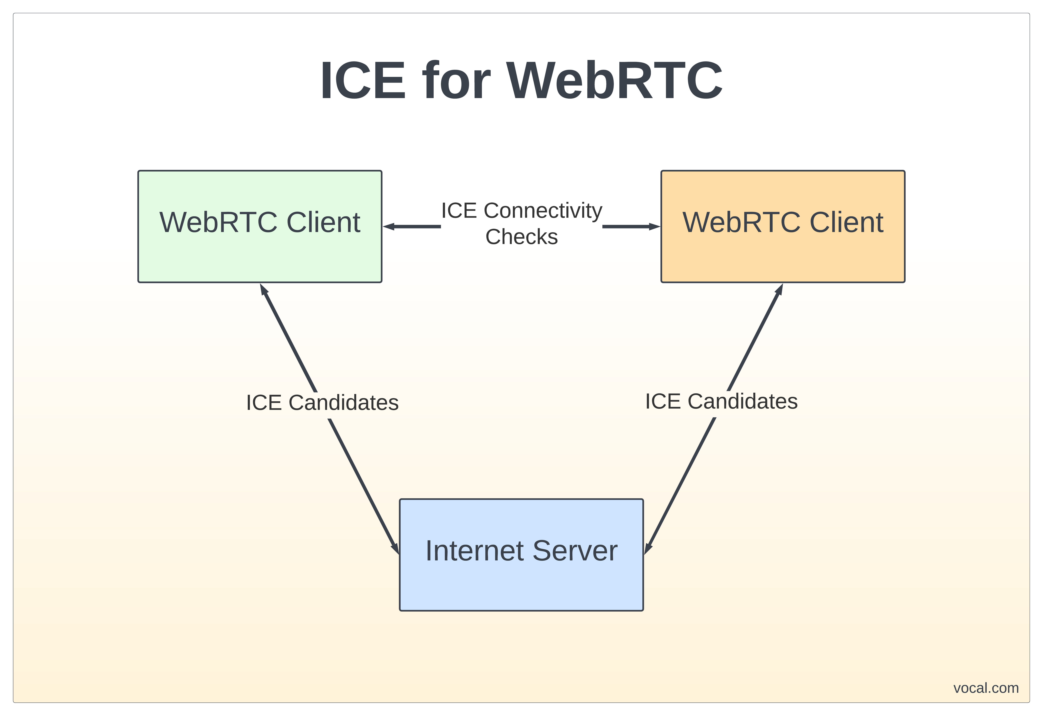
Interactive Connectivity Establishment
ICE is used to establish connections between devices over the Internet
They are emitted across the internet to find optimal route for communication
Trickle ICE will start sending along with the offer/answer

Slide 12
Step in WebRTC connection
Configure the STUN and TURN servers.
Create RTCPeerConnection with configurations.
Connect the peers through signalling server,
Exchange the SDP offers, answers and icecandidates.
Stream media from peer to peer after connection established.
Relay through TURN if unable to connect through STUN server

Slide 13
Configure servers and PeerConnection
Choose the server url that are stable and trusted like google servers.
TURN require credentials and passowrd.
If STUN server is unable to connect to peer, TURN server transports the media stream.
Pass the server configurations while creating the RTCPeerConnection.

Slide 14
Contd...
If no server is passed, RTCPeerConnection is created by using the default servers chosen by browses.

Slide 15
Connect peers
Connect the peers to an signalling server.
Exchange the SDP information to know the media constrains of each other peer.
Example
Peer1 : Send the offer through signal server.
Peer 2 : Create answer for the offer and send to Peer 1.
Peer 2 : ICE candidates are ready for connection from peer 1.
Peer 1 : Receive answer and ICE candidates from Peer 2.

Slide 16
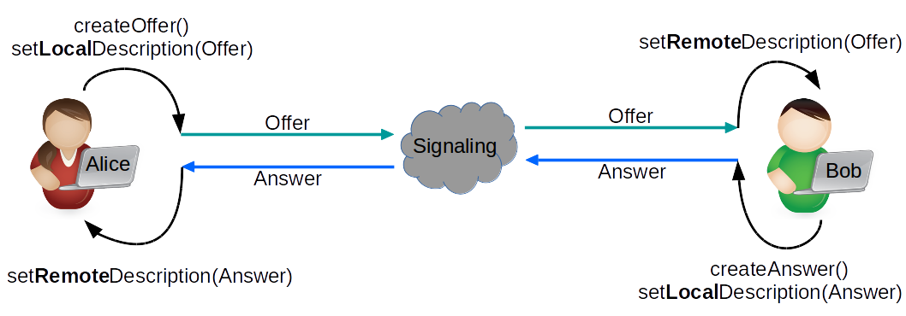
Contd...

Slide 17
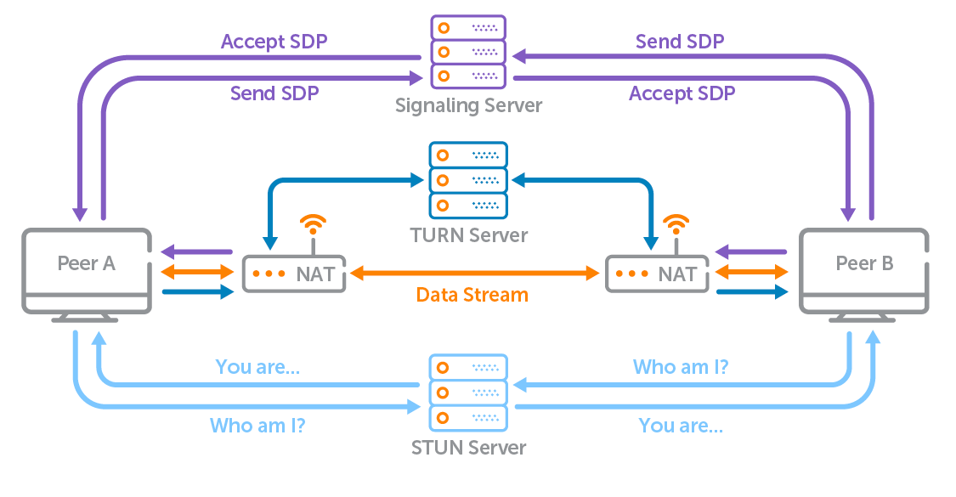
How WebRTC works?

Slide 18
Thank You

