Slide 1

IP-XACT Register Map Generator
by
Onur BALCI
Engineering Project Presentation
Yeditepe University
2014
Notes:
Hello, my name is Onur BALCI and I will present my engineering project. The topic of my project is “IP-XACT Register Map Generator”

Slide 2
Outline
Introduction
Background
Design & Implementation
Test & Results
Conclusion
Notes:
My presentation consists of 5 section. Firstly I will talk about current electronic devices,
then I will explain what is IC and IP-XACT, and I will present industry problem, of course a solution for it
After that Design & implementation of system will be our topic
Then Test & result of final product.
And finally I will conclude about topic

Slide 3



Introduction
Electronic devices are getting smarter
Notes:
Today electronic devices are everywhere in our life, and they’re capable to doing more and more complex tasks every day.
It happens because the companies use each other component designs for their chip. But let me explain how this process happen.

Slide 4
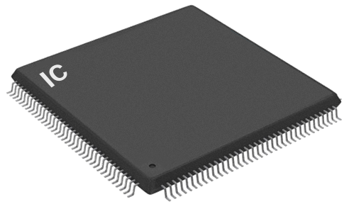
Background
Integrated Circuits
Notes:
All electronic devices got their computation power from an Integrated circuit. IC can be defined as a circuit which elements are inseparably connected for specific purpose. Most popular example is probably CPUs.

Slide 5
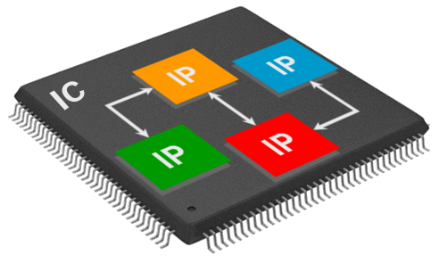
Background
Intellectual Property Cores
Notes:
As it defined, ICs consist of some components. These components are generally developed for later use, for example USB, Ethernet or FFT unis. Lots of vendors design these kind of components and sell their design. These designs are named as IP cores. So basically IP cores are the functional hardware modules which can be reused for more complex ICs. But some problem occurs when companies exchange IP cores.

Slide 6
Background
Document formatted components are problem
Not standardized
Hard to exchange components among vendors
Compatibility problems between tools
Notes:
The problem is mostly happen because IP cores are documented as word, excel or pdf file.
Why documentation is create problem?
Because, these files don’t have consistent standard between companies so they experience some problem when using it.
And also these documents are not compatible between tools. One file can work with one tool but not the other.

Slide 7
Background
IP-XACT (IEEE 1685-2009) allows
Exchanging components between vendors
Compatible components between EDA tools
Notes:
Vendors realize there are problems with multi-vendor system design, and launch SPIRIT consortium at 2003. After 6 six years of study, they come up with a an XML based standard which called IP-XACT. It solves all problem which caused by documents. Due to structure of IP-XACT, it can be easily interpreted by tools. As a result of this, IP cores are become compatible with tools. And vendors can exchange cores without experiencing any error.

Slide 8






Problem
Old IP cores must be translated
Register Files is most problematic
Spreadsheets as input
Processing
Notes:
However, IP-XACT didn’t solve all problems. New IP cores are stored in IP-XACT format but not the old ones. When a company uses old ones, still have troubles. Dialog Semiconductor propose a project to our school which translate old IP cores to IP-XACT format. After meeting with them, we decided convert register files first since they’re most problematic ones for industry. And the tool must use spreadsheet files as input. Briefly the idea is developing a tool, which takes spreadsheet files and generate proper IP-XACT file.

Slide 9
Difficulties
Not familiar with
Chip design flow
IP-XACT
Lots of spreadsheet format
Not having real IP Core
Notes:
There are some difficulties with this project. Firstly I’m not at all familiar with chip design and IP-XACT and I need to learn these. Another problem is there are lots of spreadsheet formats like xls and xlsx. Finally since the IP cores are expensive, companies, including the Dialog hesitate to sharing it. I spent almost 2 month to build a template for spreadsheet.

Slide 10
Design & Implementation
Template of Spreadsheet
register name | register address |  |  |  | register description
 | field name | field range | field reset | field access | field description
Notes:
That’s the template what we decide with Dialog after 2 month. There are 2 type of rows, register and field. For register row name, address and description. And for the field rows name, name of field, reset value, access type, and descriptions can be defined. The bold cells are the mandatory ones for generating IP-XACT file. Register and field rows can be distinguished with first column. If it’s not empty, the row is about register otherwise, a register field.

Slide 11
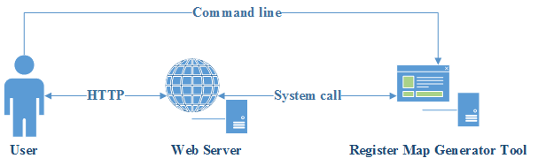
Design & Implementation
Notes:
The system designed consist of 2 part a web server which serves the user interface, and a register map generator that handles all calculations. User can use the tool on web user interface or command line.

Slide 12
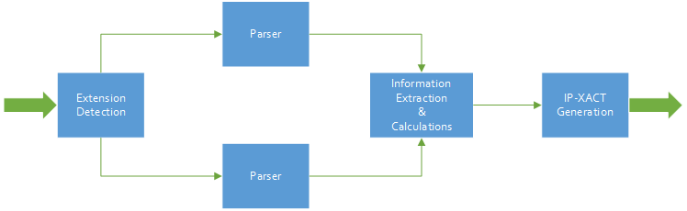


Design & Implementation
Notes:
How the tool work?
Firstly, it take an spreadsheet and detect its extension since there are many.
After that file parsed with using proper parser library. It’s necessary because every spreadsheet format, have unique file structure and we cannot use single parser for all format.
Because of spreadsheet formats are designed for human readable, all necessary information for IP-XACT cannot be taken from a cell. The tool must be calculate some values like register offset, size and reset values.
After this calculations we have all information for generating IP-XACT file.

Slide 13
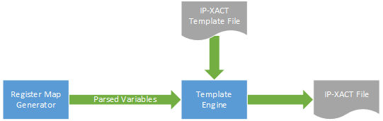
Design & Implementation
Notes:
The tool use a template engine for generating IP-XACT file. It transfer all parsed variables and an abstract IP-XACT file to template engine, and the template engine combine these data and produce an IP-XACT file.

Slide 14
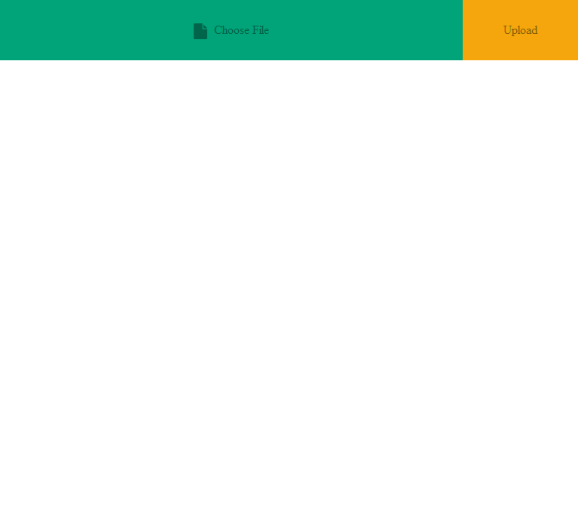
Design & Implementation
Notes:
Web user interface designed very simple. When you open it first time, you will see only 2 button for selecting spreadsheet file and uploading it to server.

Slide 15
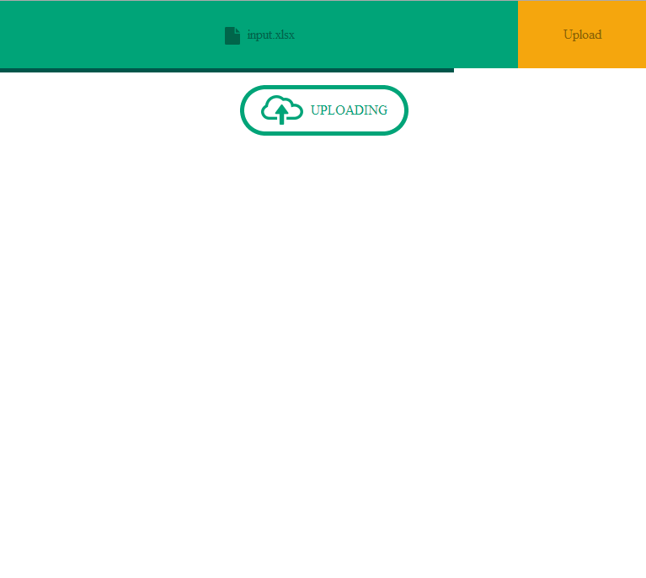
Design & Implementation
Notes:
After pressed upload button, the progress of upload will shown to user.

Slide 16
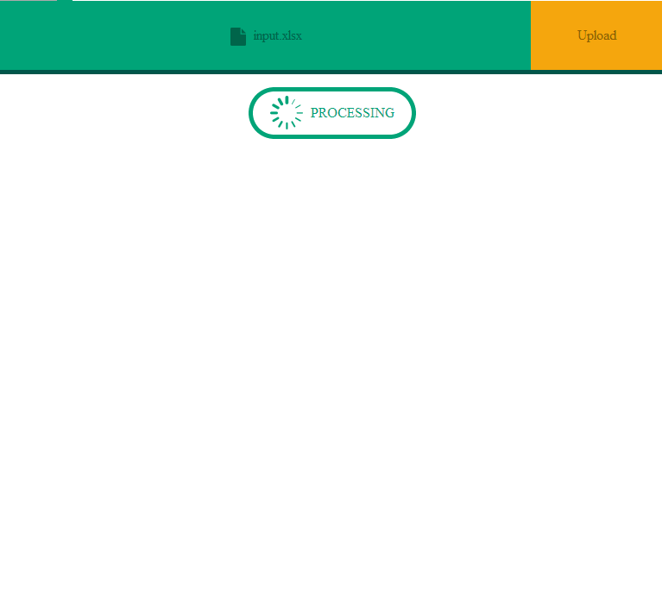
Design & Implementation
Notes:
When uploading complete, the register map generator start to process data.

Slide 17
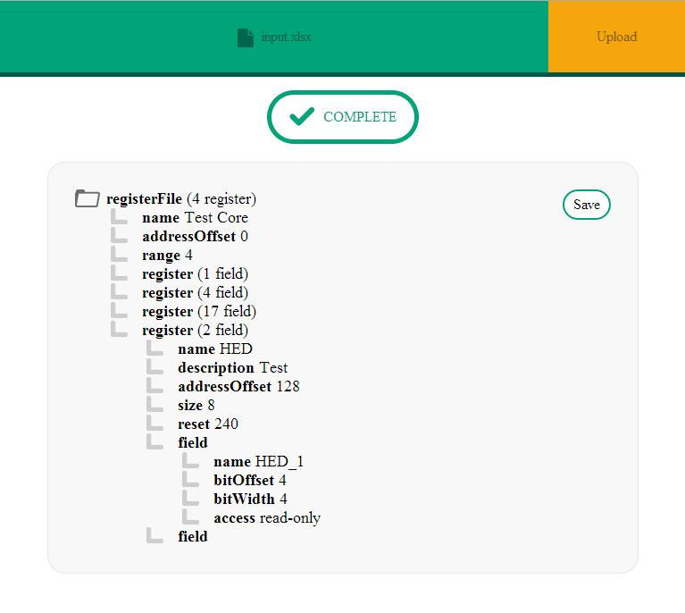
Design & Implementation
Notes:
When conversion complete successfully, user is able to see IP-XACT file as a tree. It shown like that because XML is not very human readable and user might want to quick look at some field values.
If user want, he can save IP-XACT file to his computer.

Slide 18
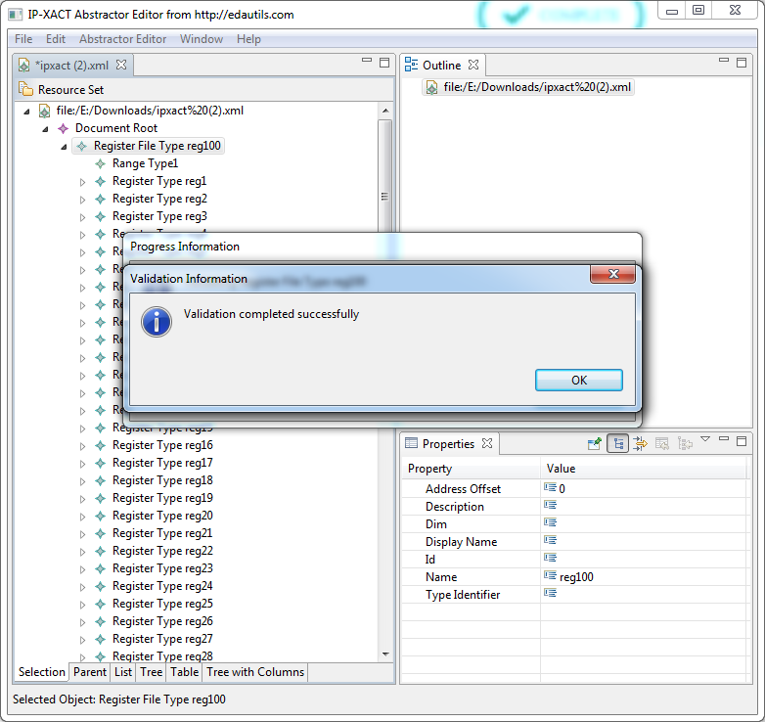
Test & Results
Validation of IP-XACT
Notes:
Since IP-XACT an IEEE standard it have lots restriction and these restriction must be checked for reusability. I use a third party tool for checking it. It designed for industrial use, that mean its validation result are trustable enough for us. As you can see, the generated IP-XACT files are validated successfully.

Slide 19
Test & Results
Notes:
Since the tool will be used in an automation process it must generate result in a reasonable time which is assumes about 1 sec for average register file. I tested tool with different input size. For the input which have less than thousand line, the tool generate output about half second. For the big files like 5000 row, I’m not even sure is there a real register file that big, it took about 2.5 second.

Slide 20
Test & Results
Memory Usage
Spreadsheet size (rows) | Memory Usage (MB)
50 | 15.9
250 | 17.0
500 | 18.3
5000 | 49.5
Notes:
And my final test is about memory usage. For average input, the tool consume about 20 MB memory which is acceptable.

Slide 21
Conclusion
The tool is
Fast
Reliable
For the future
Other IP cores can be translated
Notes:
Based on the test the tool is fast and reliable solution for industry.
For the future a algorithm can be developed for other IP cores like CPU, or interfaces any component which is covered by IP-XACT

Slide 22
Thank you for listening

