Slide 1
Bei den Daten muss ein Komma , statt Punkt . Stehen
Sonst steht da immer 0 -.-

Slide 2


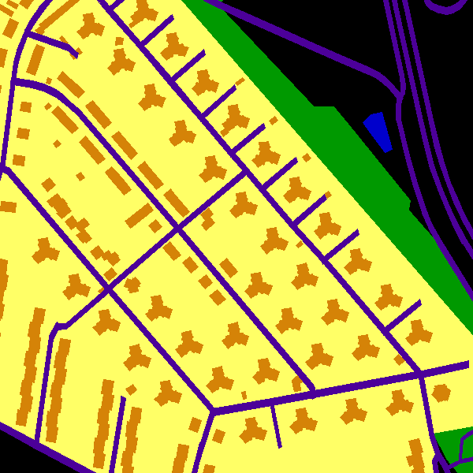
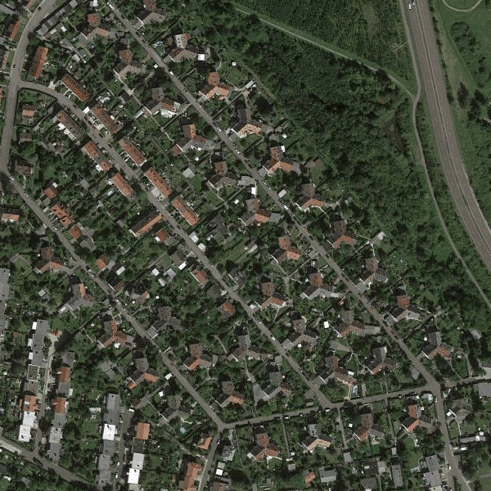
OSM DATA GENERATOR
1.) Generate Training Datasets
groundtruth images
satellite images
2.) Train ConvNet Models
Model A
Model B
Model C

Slide 3
OSM DATA GENERATOR
1.) Generate Training Datasets
groundtruth images
satellite images
2.) Train ConvNet Models
Model A
Model B
Model C

Slide 4



Extract map features
Load aerial images
OSM DATA GENERATOR
1.) Generate Training Datasets
8000
Image pairs
2.) Train ConvNet Models to
predict roads, buildings…
Model A
satellite images
ground-truth
Model B
Model C

Slide 5
Extract map features
Load aerial images
OSM DATA GENERATOR
1.) Generate training datasets:
satellite/ground-truth
image pairs
dataset
2.) Train ConvNet models to
recognize roads, buildings…
on aerial images:
Model A
Bad results: Only regions without
details predicted
ground-truth
Model B
goal:
Better results: Buildings and woods
can be recognized
Model C
Good results: All features can be
detected. Precision to be optimized

Slide 6
Extract map features
Load aerial images
OSM DATA GENERATOR
1.) Generate training datasets:
satellite/ground-truth
image pairs
2.) Train ConvNet models to
recognize roads, buildings…
on aerial images:
Model A
(input)
satellite img
Bad results:
Only regions without
details predicted
(goal)
ground-truth
Model B
Better results:
Buildings and woods
can be recognized
Model C
Good results:
All features can be
detected. Try to optimize!

Slide 7
Extract map features
Load aerial images
OSM DATA GENERATOR
satellite/ground-truth
image pairs
SegNet
(input)
satellite img
Bad results:
Only regions without
details predicted
(goal)
ground-truth
ICNet
Better results:
Buildings and woods
can be recognized
Deeplab
Good results:
All features can be
detected. Try to optimize!

Slide 8
Flos Vorschlag
Extract map features
Load aerial images
OSM DATA GENERATOR
(input)
satellite img
(goal)
ground-truth
Model

Slide 9

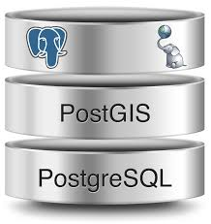

Slide 10
Vehicles Large

Slide 11
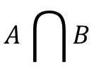

A
B
$$A \bigcap{B}$$
$$A\bigcup{B}$$

