Slide 1

Welcome to BEMER
Change your life.
For you. For life. For Energy.
Notes:
This slide should already be displayed at the beginning when the doors are opened.
Please make sure that participants take their seats quickly.
Please always begin punctually.
Short intro to the topic: Restoring and preserving health

Slide 2
Compensation PLAN Award-Winning
Best Marketing & Incentive Plan
Award-Winning, World Wide
Combining the Best Comp Features of:
Direct Sales
Affiliate Marketing
Management—Leadership
Bonus Incentives

Slide 3


Slide 4


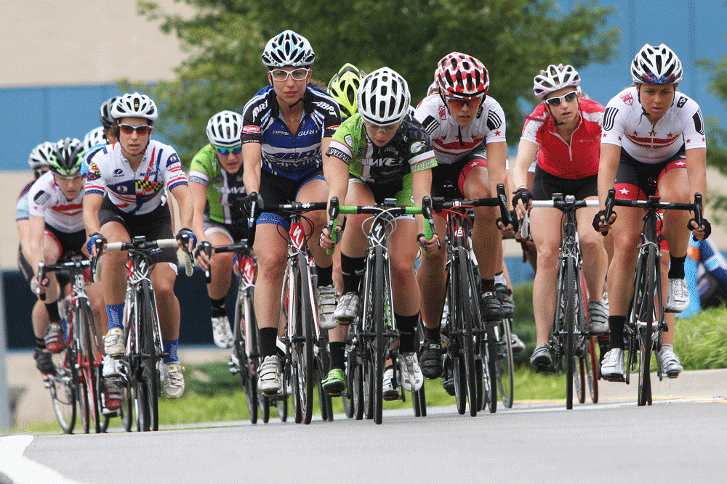



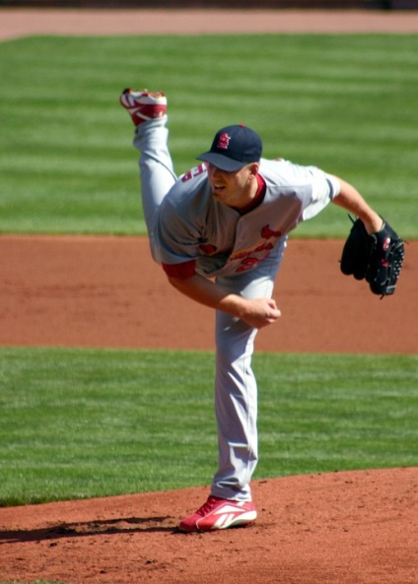

Multi-Billion Dollar Markets
Athletes . . .
78 Million Baby Boomers . . .

Slide 5
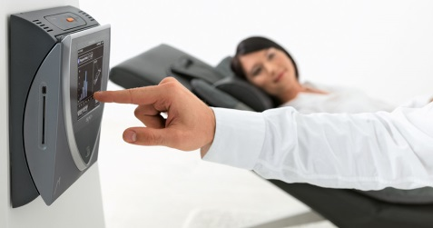



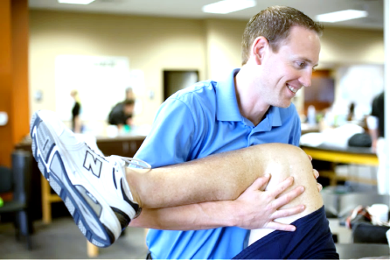

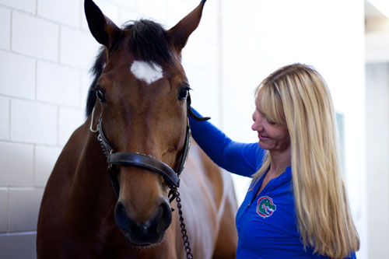

Billion Dollar Markets
Multi-Billion Dollar Markets
Health Care Professionals . . .
Animal Lovers & Veterinarians . . .

Slide 6
To Earn Commission . . .
$290
Distributor
Registration
OPTION 1
OPTION 2
BUY A BEMER*
$5,990
(Keep ALL commissions on sales after your own purchase
SELL A BEMER
1st Trainee Retail Sale
(1st Sale Commission goes to Sponsor)
* Purchasing a BEMER is optional.

Slide 7
Direct sales
Distributor: $ 290 ($ 200 academy)
Classic Set $ 4290 1000 pts
Pro Set $ 5990 1500 pts
Vet Unit $ 4950 1350 pts
17 % $ 1000. + 5001 pts. +
25 % $ 1500 +
Sell 2-4 units per mo. $ 2000 -6000
$ 36,000 to $ 72,000 a year potential BEMER

Slide 8
Affiliate Levels
AFFILIATE 1 8% $ 480 +
AFFILIATE 2 3% $ 180 +

Slide 9
Affiliate Levels / Combine Direct Sales
DIRECT / Affiliate Sales
4 SALES X 1500.00 = $ 6,000
3 REPS X 2 SALES
6 X $ 480.00 $ 2880
TOTAL $ 8880
YEARLY INCOME $ 106,000
Potential 6 Figure Income
Part-time or Full-time

Slide 10
Additional Benefits of Direct Sale and Affiliate program
Control Income with or without group +
No Monthly Requirements +
No Auto-ships +
Residual Income upfront and on-going +
Small Group / Potential 6-Figure Income +

Slide 11
LEADERSHIP / MANAGEMENT
GROUP LEADER
5 Seniors (25%)
20 Total Distributors
Bonus of 1.5 % everyone in group +
$ 90.00 Bonus on every sale
Unlimited levels / start at 1st level +
25 to 26.5 / 8 to 9.5 / 3 to 4.5 / 1.5 % on
*(1.5 % infinity or until another GL)
BEMER

Slide 12
GL/ Differential Bonus
GL receives 2 % or $ 120 on all first 4 sales of any rep in their entire group +
GL receives 1 % or $ 60 on all first 4 sales +

Slide 13
TEAM MANAGER
10 Personal Seniors
One GL in Affiliate Tier (2)
Educational Training
Bonus 3 % / $ 180 +
Starting at the 25 % level
25 to 28 / 8 to 11 / 3 to 6 / 3 %
3 % to Infinity until next TM
Key – no split once you have GL at 1.5%

Slide 14
TM/ Differential Bonus
TM receives 4 % or $ 240 on all first 4 sales of any rep in their entire group +
Plus the $ 180 or $ 420 on all first 4 sales of any rep in the entire group +

Slide 15
SUMMARY
Direct Sales Program (Pro)
Share—Sell– Paid $ 17-25 %
approx. $ 1000-1500
Affiliate Marketing
Distributors 2 levels 8 % & 3 %
approx. $ 480 & $ 180
Managers/Leadership
Group Leader extra 1.5 % / $ 90
Team Manager extra 3.0 % / $ 180
Bonus for Team Managers 2-4.0 % / $ 120.-240

Slide 16
+ 17 Strong positives
Attracts all walks of life
Professional Sales Reps
Management and Executives
Recruiter and Organizational Builders
Practitioners
Everyday person that wants to share
Part or Full Time – Career Path

Slide 18

What’s Our Vision?
a BEMER USER in Every Home!

