Slide 1

SWEN1005
Mobile Web Programming

Slide 2
Session Three
HTML5 Elements
  Head – Title, Link, Style, Script, meta
CSS

Slide 3
Session One Review
More on HTML5 Responsive Site

Slide 4
Responsive vs Adaptive
Responsive sites and adaptive sites are the same
  they both change appearance based on the browser environment they are being viewed on (the most common thing: the browser's width).
However
the difference between responsive sites and adaptive is that
  Responsive sites have smooth transition and
  Adaptive sites have a snap transition.

Slide 5
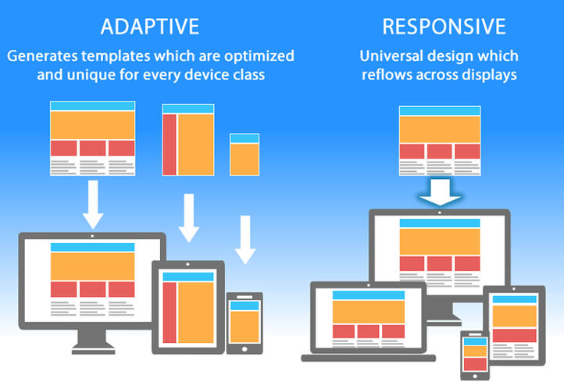
Responsive vs Adaptive

Slide 6
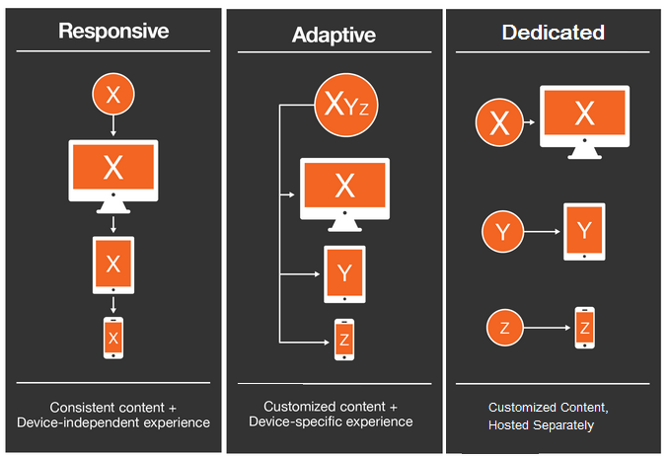
Responsive vs Adaptive (or Dedicated)

Slide 7
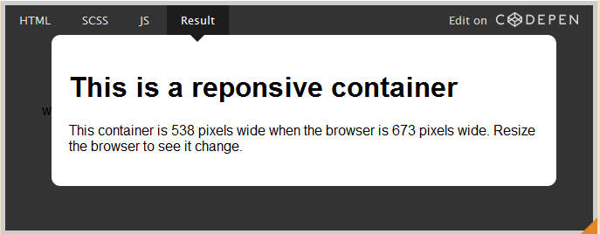
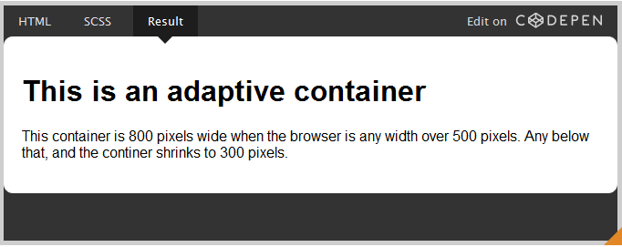
Responsive vs Adaptive

Slide 8

Responsive at the top and adaptive at the bottom

Slide 9
Responsive websites
Responsive websites respond to the size of the browser at any given point.
Is the browser 300px wide or 30000px wide? It doesn't matter because the layout will respond accordingly. No matter what the browser width may be, the site adjusts its layout (and perhaps functionality) in a way that is optimized to the screen.
Responsive design is smooth because the layout fluidly adjusts regardless of what device it is viewed on

Slide 10
Adaptive websites
Adaptive websites adapt to the width of the browser at a specific points.
In other words, the website is only concerned about the browser being a specific width, at which point it adapts the layout.
Adaptive design, snaps into place because the page is serving something different because of the browser or device it is viewed on.

Slide 11
Creating a Responsive Website
Viewport

Slide 12
What is Responsive Web Design?
Responsive web design makes your web page look good on all devices.
Responsive web design uses only HTML and CSS.
Responsive web design is not a program or a JavaScript.
… when you use CSS and HTML to resize, hide, shrink, enlarge, or move the content to make it look good on any screen.

Slide 13
The Aim
Web pages can be viewed using many different devices: desktops, tablets, and phones.
Your web page should look good, and be easy to use, regardless of the device.
Web pages should not leave out information to fit smaller devices, but rather adapt its content to fit any device.

Slide 14
How do we start?
<!DOCTYPE html>
<html lang="en-us">
<head>
<meta name="viewport" content="width=device-width, initial-scale=1.0">
<style>
* {
box-sizing:border-box;
}
</style>
</head>…
</html>

Slide 15
What is the <meta … > element
snippets of text that describe a page's content
they don't appear on the page itself, but only in the page's code.
little content descriptors that help tell search engines what a web page is about.
provides metadata about the HTML document
  page description
  Keywords
  author of the document
  last modified
  other metadata.

Slide 16
Attributes of the <meta> element
Attribute | Value | Description
charset | character_set | Specifies the character encoding for the HTML document
content | text | Gives the value associated with the http-equiv or name attribute
http-equiv | content-type default-style refresh | Provides an HTTP header for the information/value of the content attribute
name | application-name author description generator keywords viewport | Specifies a name for the metadata

Slide 17
Example and tips
<head>
<meta charset="UTF-8">
<meta name="description" content="Free Web tutorials">
<meta name="keywords" content="HTML,CSS,XML,JavaScript">
<meta name="author" content="John Doe">
<meta name="viewport" content="width=device-width, initial-scale=1.0">
</head>
<meta> tags always go inside the <head> element.
Metadata is always passed as name/value pairs.
The content attribute MUST be defined if the name or the http-equiv attribute is defined.
  If none of these are defined, the content attribute CANNOT be defined.

Slide 18
<meta name="viewport“ content="width=device-width, initial-scale=1.0">
A <meta> viewport element gives the browser instructions on how to control the page's dimensions and scaling.
The width=device-width part sets the width of the page to follow the screen-width of the device (which will vary depending on the device).
The initial-scale=1.0 part sets the initial zoom level when the page is first loaded by the browser.

Slide 19
Setting The Viewport
HTML5 introduced a method to let web designers take control over the viewport, through the <meta> tag.
The viewport is the user's visible area of a web page. It varies with the device, and will be smaller on a mobile phone than on a computer screen.

Slide 20
<meta charset="UTF-8">
For HTML5, the default character encoding is UTF-8.
The default character set for HTML5 is UTF-8.
All HTML 4 processors support UTF-8.
All HTML5 and XML processors support both UTF-8 and UTF-16.

Slide 21
UTF-8 and UTF-16
Character-set | Description
UTF-8 | A character in UTF8 can be from 1 to 4 bytes long. UTF-8 can represent any character in the Unicode standard. UTF-8 is backwards compatible with ASCII. UTF-8 is the preferred encoding for e-mail and web pages
UTF-16 | 16-bit Unicode Transformation Format is a variable-length character encoding for Unicode, capable of encoding the entire Unicode repertoire. UTF-16 is used in major operating systems and environments, like Microsoft Windows, Java and .NET.

Slide 22
The HTML <head> Element
The <head> element is a container for metadata (data about data) and is placed between the <html> tag and the <body> tag.
HTML metadata is data about the HTML document. Metadata is not displayed.

Slide 23
The HTML <head> Element
Metadata typically define the document title, character set, styles, links, scripts, and other meta information.
  <title>
  <style>
  <meta>
  <link>
  <script>
  <base>.

Slide 24
The HTML <title> Element
The <title> element defines the title of the document, and is required in all HTML documents.
The <title> element:
  defines a title in the browser tab
  provides a title for the page when it is added to favorites
  displays a title for the page in search engine results

Slide 25
The HTML <style> Element
The <style> tag is used to define style information for an HTML document.
Inside the <style> element you specify how HTML elements should render in a browser.
Each HTML document can contain multiple <style> tags.

Slide 26
There are three ways of styling
External style sheet
Internal style sheet
Inline style

Slide 27
The HTML <style> Element
To link to an external style sheet, use the <link> tag.
If the "scoped" attribute is not used, each <style> tag must be located in the head section.
The <style> tag also supports the Global Attributes in HTML.
The <style> tag also supports the Event Attributes in HTML.

Slide 28
The HTML <style> Attributes
Attribute | Value | Description
media | media_query | Specifies what media/device the media resource is optimized for
scoped | scoped | Specifies that the styles only apply to this element's parent element and that element's child elements
type | text/css | Specifies the media type of the <style> tag

Slide 29
The HTML Global Attributes
Attribute | Description
accesskey | Specifies a shortcut key to activate/focus an element
class | Specifies one or more classnames for an element (refers to a class in a style sheet)
contenteditable | Specifies whether the content of an element is editable or not
contextmenu | Specifies a context menu for an element. The context menu appears when a user right-clicks on the element
data-* | Used to store custom data private to the page or application
dir | Specifies the text direction for the content in an element
draggable | Specifies whether an element is draggable or not
dropzone | Specifies whether the dragged data is copied, moved, or linked, when dropped

Slide 30
The HTML Global Attributes
Attribute | Description
hidden | Specifies that an element is not yet, or is no longer, relevant
id | Specifies a unique id for an element
lang | Specifies the language of the element's content
spellcheck | Specifies whether the element is to have its spelling and grammar checked or not
style | Specifies an inline CSS style for an element
tabindex | Specifies the tabbing order of an element
title | Specifies extra information about an element
translate | Specifies whether the content of an element should be translated or not

Slide 31
The <link> tag
Is a singleton tag
The <link> tag defines a link between a document and an external resource.
The <link> tag is used to link to external style sheets.
Example
<head>
<link rel="stylesheet" type="text/css" href="theme.css">
</head>

Slide 32
The <link> tag Attributes
Attribute | Value | Description
crossorigin | anonymous use-credentials | Specifies how the element handles cross-origin requests
href | URL | Specifies the location of the linked document
hreflang | language_code | Specifies the language of the text in the linked document
media | media_query | Specifies on what device the linked document will be displayed
sizes | HeightxWidth any | Specifies the size of the linked resource. Only for rel="icon"
target | _blank _self _top _parent frame_name | Not supported in HTML5. Specifies where the linked document is to be loaded
type | media_type | Specifies the media type of the linked document

Slide 33
The <link> tag Attributes
Attribute | Value | Description
rel | alternate author dns-prefetch help icon license next pingback preconnect prefetch preload prerender prev search stylesheet | Required. Specifies the relationship between the current document and the linked document
rev | reversed relationship | Not supported in HTML5. Specifies the relationship between the linked document and the current document

Slide 34
HTML <script> Tag
The <script> tag is used to define a client-side script (JavaScript).
The <script> element either contains scripting statements, or it points to an external script file through the src attribute.
Common uses for JavaScript are image manipulation, form validation, and dynamic changes of content.

Slide 35
HTML <script> Tag
If the "src" attribute is present, the <script> element must be empty.
There is also the <noscript> element for users that have disabled scripts in their browser, or have a browser that doesn't support client-side scripting.
There are several ways an external script can be executed:
  If async="async": The script is executed asynchronously with the rest of the page (the script will be executed while the page continues the parsing)
  If async is not present and defer="defer": The script is executed when the page has finished parsing
  If neither async or defer is present: The script is fetched and executed immediately, before the browser continues parsing the page

Slide 36
HTML <script> Tag
Example
<script>
document.getElementById("demo").innerHTML = "Hello JavaScript!";
</script>

Slide 37
HTML <script> Tag –jQuery reference
Example
<script src="https://ajax.googleapis.com/ajax/libs/jquery/3.1.1/jquery.min.js"></script>
<script>
$(document).ready(function(){
$("button").click(function(){
$("p").hide();
});
});
</script>

Slide 38
HTML <script> Tag
Attribute | Value | Description
async | async | Specifies that the script is executed asynchronously (only for external scripts)
charset | charset | Specifies the character encoding used in an external script file
defer | defer | Specifies that the script is executed when the page has finished parsing (only for external scripts)
src | URL | Specifies the URL of an external script file
type | media_type | Specifies the media type of the script

Slide 39
The HTML <base> tag
The <base> tag specifies the base URL/target for all relative URLs in a document.
There can be at maximum one <base> element in a document, and it must be inside the <head> element.
Put the <base> tag as the first element inside the <head> element, so that other elements in the head section uses the information from the <base> element.
If the <base> tag is present, it must have either an href attribute or a target attribute, or both.

Slide 40
The HTML <base> tag
The <base> tag specifies the base URL/target for all relative URLs in a document.
There can be at maximum one <base> element in a document, and it must be inside the <head> element.
Put the <base> tag as the first element inside the <head> element, so that other elements in the head section uses the information from the <base> element.
If the <base> tag is present, it must have either an href attribute or a target attribute, or both.

Slide 41
Web Standards
CSS – Cascading Style Sheets

Slide 42
What is CSS?
CSS stands for Cascading Style Sheets
CSS describes how HTML elements are to be displayed on screen, paper, or in other media
CSS saves a lot of work. It can control the layout of multiple web pages all at once
External stylesheets are stored in CSS files

Slide 43

CSS Syntax
A CSS rule-set consists of a selector and a declaration block:
The selector points to the HTML element you want to style.
The declaration block contains one or more declarations separated by semicolons.
Each declaration includes a CSS property name and a value, separated by a colon.
A CSS declaration always ends with a semicolon, and declaration blocks are surrounded by curly braces.

Slide 44
CSS Selectors
CSS selectors are used to "find" (or select) HTML elements based on their element name, id, class, attribute, and more.
Example (class)
.flex-item
{
background-color: cornflowerblue;
width: 100px; height: 100px; margin: 10px;
}

Slide 45
The element Selector
The element selector selects elements based on the element name.
Example
body { background-color: lightblue;}
h1 {
color: navy;
margin-left: 20px;
}

Slide 46
The id Selector
The id selector uses the id attribute of an HTML element to select a specific element.
The id of an element should be unique within a page, so the id selector is used to select one unique element!
To select an element with a specific id, write a hash (#) character, followed by the id of the element.

Slide 47
The id Selector
Example
#para1
{
text-align: center;
color: red;
}

Slide 48
The class Selector
The class selector selects elements with a specific class attribute.
To select elements with a specific class, write a period (.) character, followed by the name of the class.
In the example below, all HTML elements with class="center" will be red and center-aligned:

Slide 49
Example
.center {
text-align: center;
color: red;
}

Slide 50
The class Selector – element specific
You can also specify that only specific HTML elements should be affected by a class.
Example
p.center
{
text-align: center;
color: red;
}

Slide 51
Example – Grouping Selectors
h1, h2, p
{
text-align: center;
color: red;
}

Slide 52
CSS Comments
Comments are used to explain the code, and may help when you edit the source code at a later date.
Comments are ignored by browsers.
A CSS comment starts with /* and ends with */.

Slide 53
Example
p {
color: red;
/* This is a single-line comment */
text-align: center;
}
/* This is
a multi-line
comment */

Slide 54
The End
Session Three

