Slide 1
Certified Circuit Reconstruction for QBF
Supervisor: Dr. Friedrich Slivovsky
Student: Weng Mihai-Alexandru

Slide 2


What are QBFs?
Quantified
Boolean Formulas
$$∀x∃yz$$
$$(x∧y)∨(¬x∧¬y∧z)$$
When a QBF is SAT/UNSAT?
$$∀x∃yz\left(x∧y\right)∨\left(¬x∧¬y∧z\right)→∃yz\left(0∧y\right)∨\left(¬0∧¬y∧z\right)∧∃yz\left(1∧y\right)∨\left(¬1∧¬y∧z\right)$$

Slide 3
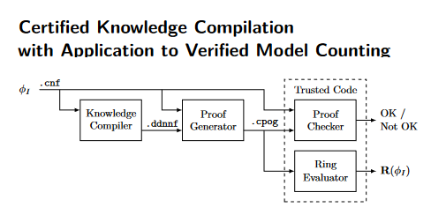
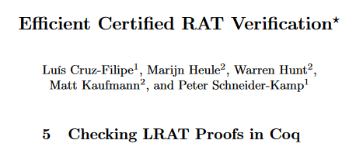
Verification tools
QBF
QBF Solver
QBF Proof
(valid / not)
Checker
Is the proof correct?
Can we trust the output?
File
Program

Slide 4
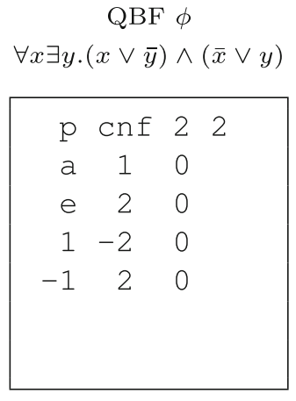
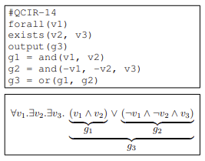
QBF formats
QDIMACS
QCIR

Slide 5
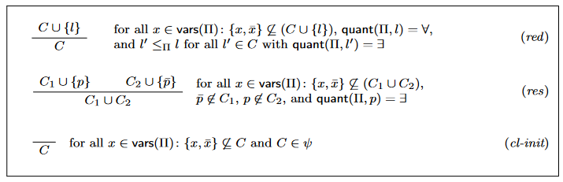
QBF proof format – Q Resolution

Slide 6

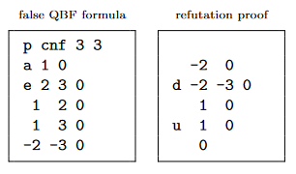
QBF proof format – QRAT

Slide 7
Problem
Trust?
QBF in QDIMACS format
QDIMACS to QCIR
QBF in QCIR format
File
Program

Slide 8
Proposed solution
QBF in QDIMACS format
QDIMACS to QCIR
QBF in QCIR format
Generate initial proof
QRAT proof for original input
File
Program

Slide 9
Proof Reconstruction
QBF in QDIMACS format
Checker
Is the proof correct?
QRAT proof for original input
Our conversion was correct.
Proof for initial formula from QBF solving the converted formula.
File
Program

Slide 10
Proof Reconstruction - Workflow
QBF in QDIMACS format
QDIMACS to QCIR
QBF in QCIR format
CNF Encoder
CNF encoding
QBF Solver
(based on QCDCL)
Q Resolution proof to QRAT
Q Resolution Proof
QRAT Proof
Initial Proof
QRAT proof for original input
File
Program

Slide 11
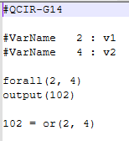
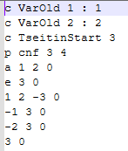
Proof Reconstruction – CNF Encoder
QBF in QCIR format
CNF Encoder
CNF encoding
File
Program

Slide 12

Proof Reconstruction – QRAT Proof
CNF encoding
QBF Solver
(based on QCDCL)
Q Resolution proof to QRAT
Q Resolution Proof
QRAT Proof
File
Program

Slide 13
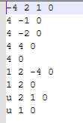



Proof Reconstruction – Initial Proof
QBF in QDIMACS format
Initial Proof
QRAT proof for original input
CNF encoding
QRAT Proof
File
Program

Slide 14
Thank you!

