Slide 1
Certified Circuit Reconstruction for QBF
Supervisor: Dr. Friedrich Slivovsky
Student: Weng Mihai-Alexandru
Notes:
Welcome! Today I will present my abstract for my thesis.
From the beginning, we can see that the main topic is regarding QBFs.

Slide 2


What are QBFs?
Quantified
Boolean Formulas
$$∀x∃yz$$
$$(x∧y)∨(¬x∧¬y∧z)$$
Why are QBFs interesting?
QBF solvers can be seen as a universal PSPACE solver. (where SAT solvers are for NP problems)
Notes:
The first question that comes is for definition of a QBF. So, what are QBFs?
Well, the last two letters stand for Boolean Formulas, these are, basically, variables connected by Booleans operators, and each of this variable can be assigned a true of false value in order to evaluate its value.
(Click) And Q stands for the Quantified version of Boolean Formulas. So, for each variable we can add an existential or a universal quantifier.
(Click) With the syntax in mind, let’s see why we QBFs are interesting in contrast with simple Boolean formulas. First, we can see that Boolean formulas are just a restricted form of a QBFs, where all the variables are existential quantified. Second, a quantified Boolean formula can be transform in logical equivalent Boolean formula, by talking all the cases for variables in quantified version, but this will end up in a huge formula.
For applications, we keep it briefly, we all know the application for a SAT solver where we can encode an NP hard problem and use it a SAT solver instead, due to their ongoing improvements. In a similar way we can encode problems in QBF form and use its solver. The complexity for the decision problem in QBF is in PSPACE in contrast with SAT that is in NP.

Slide 3
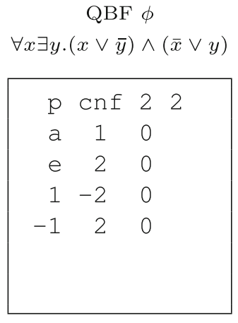
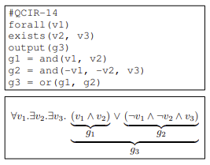
QBF formats
QDIMACS
QCIR
Notes:
For us to use a QBF as an input to a solver, we need to provide it in a specific format accepted by the solver.
Again, due to the interest in SAT, where formulas can be encoded in a CNF form (with Tseitin transform that takes a general formula and give a logical equivalent CNF form), and written in a text file for the computer to understand the CNF. This format is called DIMACS, (show pointer) and we can see here 1 is variable 1 and -2 negation of variable 2. In a similar way, we can encode Prenex CNF for QBFs, and the format will be QDIMACS, and do not differ much, (show pointer) we can see that, we are just adding the quantifier for each variable.
(click) Tseitin transform have some drawbacks for QBFs, sometimes a formula that is trivially provable by the solver, can take exponential time due to simple Tseitin transform. So, a circuit form as input is defined to be use by solvers. Here, (show pointer) we can see that, again we quantify before each variable, but we make use of gates (show pointer), and have a much more flexible syntax.

Slide 4
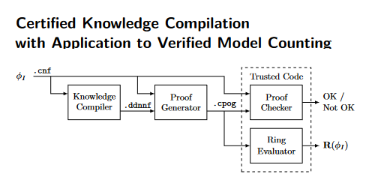
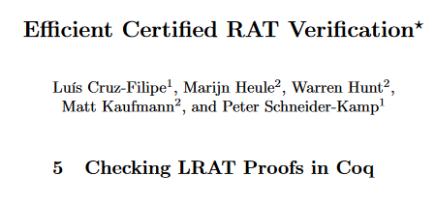
Verification tools
QBF
QBF Solver
QBF Proof
(valid / not)
Checker
Is the proof correct?
Can we trust the output?
File
Program
Notes:
Now, what are we interested in a QBF solver to do. Basically, we need it to tell us if the input formula can respect every existential and universal symbol, so the validity of the formula. In case of Boolean formulas, where every variable is existential quantified, in the case it was valid, a simple assignment for variables was enough, but in the case of unsat, we needed to have a proof that can derive empty caluse. Similarly, for QBFs that are not valid provide a refutation proof, so a step by step usage of a proof system rules to derive empty clause. But for the validity it’s a bit tricky because of the univerisal quantifier, it will be require also to output a satisfaction proof, that can derive empty set of clauses using a proof system. So having a solution, yay we can tell if its valid or not, but this proof can be huge to check by hand to check if its really a proof for the input.
(click) So, let’s make a checker that do it for us, problem solved. Not, really. (click) Can we really trust the checker?
(click) To solve this problem, people started to certify, basically rigorously validate some steps of the process. Some example, are those 2 for SAT (click). Where people implemented some checker in proof assistant and make it trusted code (click).

Slide 5
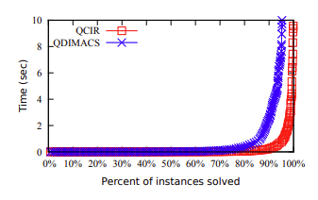
Motivation
On this benchmark, QBF solver performed better for inputs in QCIR than QDIMACS.
Let’s transform a proof for QCIR into one for QDIMACS, thus using the solver only on QCIR inputs.
A possible speed up for a proof in QDIMACS.
Extra assurance for correctness in format transformation.
Notes:
With some background in place, let’s see the motivation of my thesis.
(click) Based on this particular benchmark we can that, QCIR format can perform better than QDIMACS. This makes us think, there are some particular cases where circuit based solver is preferable.
(click) So, the first thing we can do, it’s to make a transformation of a QDIMACS to a QCIR, which is available in literature, and make use of a circuit based solver.
(click) This, can leads us to possible speed up in proof. But the main contribution of my thesis will be the second point, that is, giving extra way to certify the transformation of CNF for to a circuit form.

Slide 6
QDIMACS Proof Reconstruction - Workflow
QBF in QDIMACS format
QDIMACS to QCIR
QBF in QCIR format
QBF solver
(QCIR)
Q-Resolution proof
QCIR proof (in QRAT)
to
QDIMACS proof (in QRAT)
CNF encoding
QRAT proof for original input
File
Program
Notes:
Here, I want to present a rough sketch of the process I am aiming to.

Slide 7
QDIMACS Proof Reconstruction - Verification
QBF in QDIMACS format
Checker
Is the proof correct?
QRAT proof for original input
File
Program
Notes:
And the output of the previous slide, the QRAT proof for the original input can be use in a checker together with the first QDIMACS, and if this proof is correct, we can be confident that, the transformation of QDIMACS to QCIR program was correct.

Slide 8
Plan
Better understanding of the tools involved in the process.
Devise test samples for checking various edge cases.
Automate the workflow.
Modify a QCIR QBF (QCDCL) solver to output the CNF encoding.
Implement conversion from Q-resolution proof to QRAT.
Implement a program for getting a (Q)RAT derivation of the CNF encoding using a SAT solver.
Verify against the test sample.
Using common benchmarks for testing.

Slide 9
Thank you!

