Slide 1
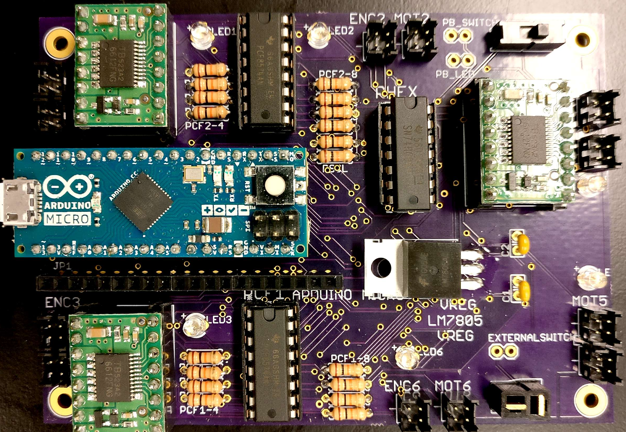
LED
IO Expander Board (PCF8574AN)
Hex Inverter (SN74HC04N)
Switch
Motor Driver
(TB6612FNG)
(Direction and speed control for motors
Motor Head plugs (Male)
Motor Driver
(Direction and speed control for motors
Arduino
(Robot controller)
Capacitor (Voltage buffer)
Voltage Regulator (LM7805AC)
Motor Driver
(TB6612FNG)
(Direction and speed control for motors
Power connector (Mini Deans Head)
Resistors (Pull Up) 10 k Ω
Resistors (Pull Up) 10 k Ω

