Slide 1
FreEzMenu:
A Customizable User Interface Menu Application System for Food Service Industry
Gomez, Algilbert T. Mojar, Justine Ian Carlos M. Ortega, Ben Androz Seva, Kenneth B.

Slide 2
Intro
In today's modern dining experience, the convergence of technology, changing consumer preferences, and evolving culinary trends has transformed the way we dine. From the moment we step into a restaurant, cafe, or any food service establishment, we encounter a dynamic environment that embraces innovation and convenience. Cutting-edge technologies, such as digital menus, interactive ordering systems, and personalized dining experiences, have become integral parts of the dining landscape.

Slide 3
Problems to address:
Costly and expensive - Software development costs: professionals, infrastructure, research, testing, updates, support.
The challenge of acquiring developers for the purpose of designing and developing a digital menu or kiosk
Designing and developing a digital menu or kiosk requires a considerable amount of time and effort - Menu design: planning, elements, revisions for effective communication.

Slide 4
Solutions to said problems:
Free to use application.
There is no need to require the services of developers or programmers to design and develop a digital menu or kiosk, as the software being developed by the researchers prioritizes user-friendly functionality.

Slide 5
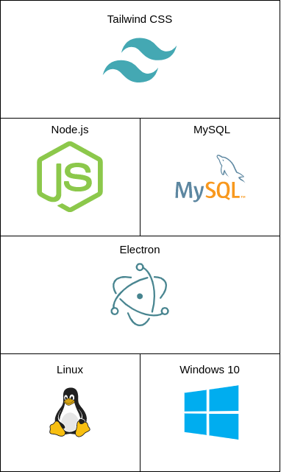
METHODS
“Manage” Application
Linux and Windows 10 Operating System.
Electron to develop cross-platfrom destkop applications.
MySQL for database.
Node.js for server-side programming.
Tailwind CSS for responsive user interface

Slide 6
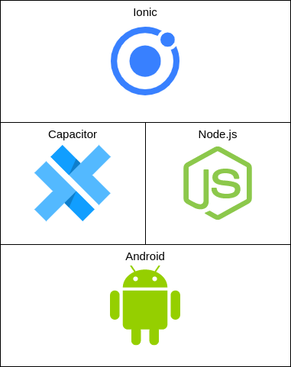
METHODS
“Order” Application
Android Operating System.
Capacitor to develop the mobile application and access to device functionalities.
Node.js for server-side programming.
Ionic for UI components.

Slide 7
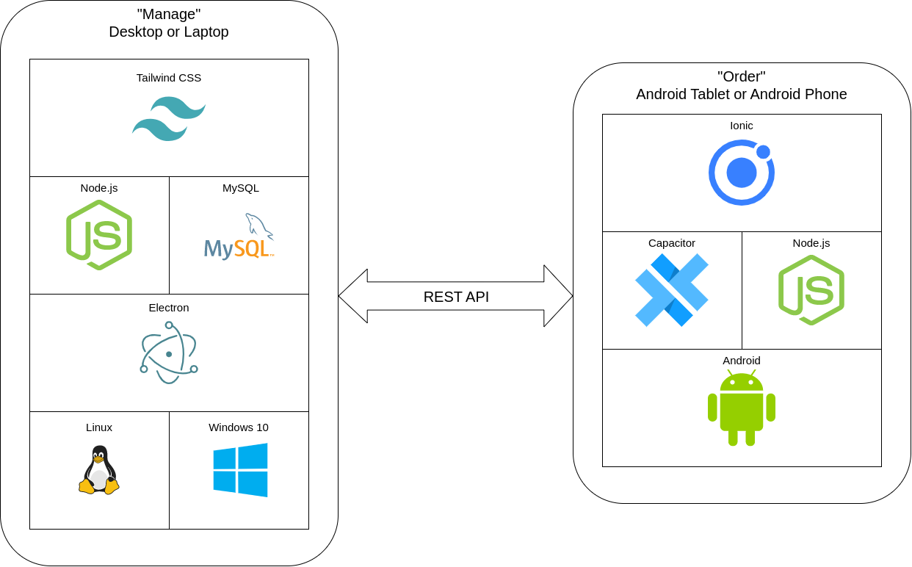
METHODS

Slide 8
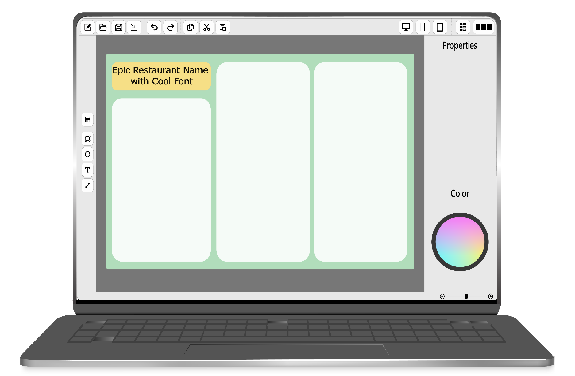
PROTOTYPES

Slide 9
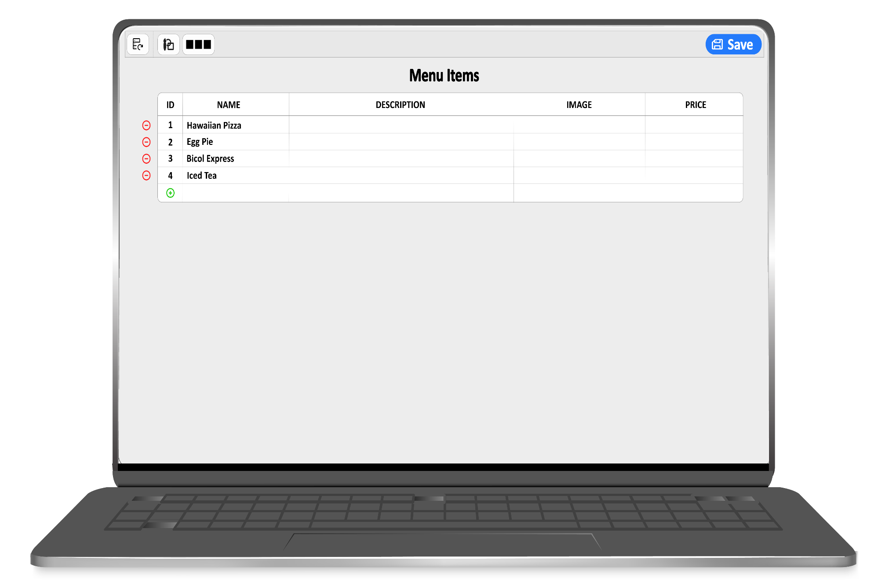

Slide 10
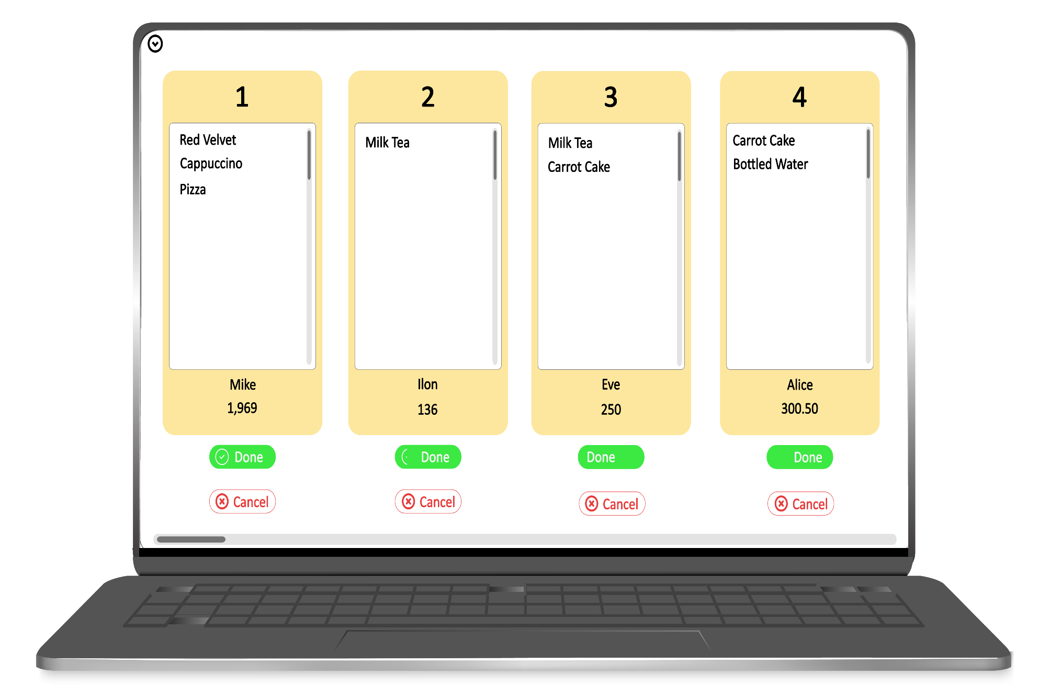

Slide 11
