Slide 1
CP1402 – Internet Fundamentals
Number Systems

Slide 2
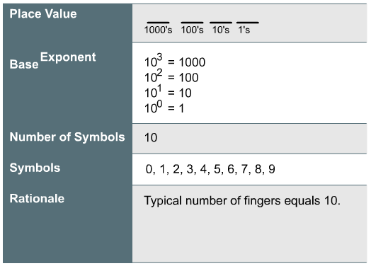
Base 10 Numbers

Slide 3
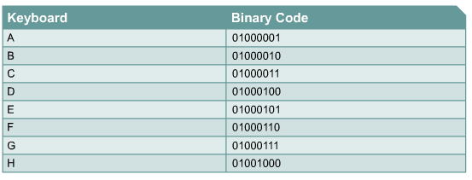
Binary Number System

Slide 4
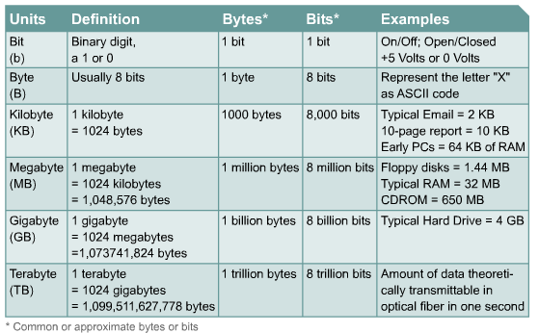
Bits and Bytes
Typical Cache memory = 4MB
Typical RAM = 8GB

Slide 5
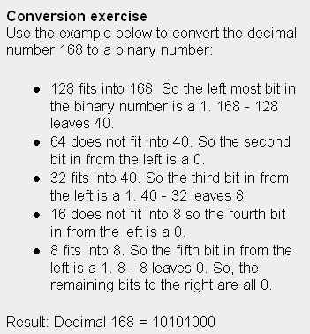
Converting Decimal to Binary

Slide 6
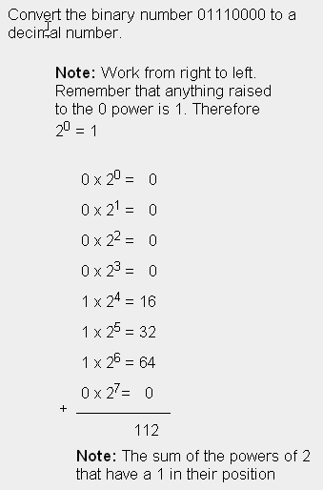
Converting Binary to Decimal

Slide 7
Boolean Logic
AND
OR
NOT
XOR

Slide 8
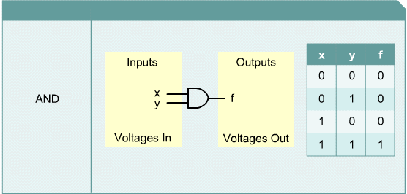
Boolean Logic - AND

Slide 9
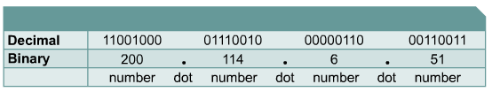
Four-Octet Dotted-decimal

Slide 10
The subnet mask and AND
Subnet Mask is ANDed with the IP address to determine the network portion of the IP Address
“Is this IP address on the same subnet as me?”
We will look into this in more detail down the track

Slide 11
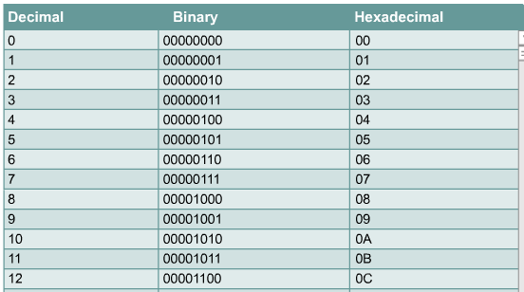
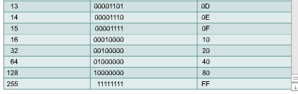
Hexadecimal

Slide 12
Decimal to Hexadecimal
Convert Decimal 1000 to Hexadecimal example-
Base | Decimal | Hexadecimal
16 | 1000
8
1000/16 = 62 remainder 8
62
62/16 = 3 remainder 14 (E in Hex)
E
3
3/16 = 0 remainder 3
3
= 3E8

Slide 13
Extras – Binary Numbers
Binary numbers in 60 seconds
http://www.youtube.com/watch?v=qdFmSlFojIw
Binary - So Simple a Computer Can Do It
http://www.kerryr.net/pioneers/binary.htm
Cisco Binary Game
http://forums.cisco.com/CertCom/game/binary_game_page.htm

