Slide 1
Beyond Translation:
Why linguistic study of sign language empowers Deaf communities
Alex Lu – Microsoft Research
lualex@microsoft.com

Slide 2
Talk goal: convince the community to broaden collective scope of research
Sign language AI research overwhelmingly focuses on translation
Areas of study critical to language equity and rights are overlooked
AI can accelerate study of low resource sign systems
Notes:
I’m really honored to be invited to give this talk, in front of some of the most talented researchers in the field. I’m a researcher, but I’m also a member of the deaf community, so I spent a lot of time thinking about what I could say to most bring impact back to the deaf community. I decided the goal of my talk today would be to try to convince this research community to broaden our collective scope of research. To do this, I’m going to argue for three key points. First, I’m going to show you that sign language AI research currently overwhelmingly focuses on translation. Second, I’m going to argue that areas critical to language access and rights are being overlooked. Third, I’m going to show you some concrete examples of how we can move forward. I’m going to show you some of our research using AI to accelerate the study of low resource sign systems.

Slide 3
Sign language AI research is largely driven by hearing, non-signing researchers
Notes:
Sign language AI research is largely driven by hearing, non-signing researchers. I want to be careful about saying this. I know many folks in the audience may come from this perspective. To be clear, there is nothing wrong with that. In fact, collaboration with hearing researchers is critical to progress – deaf researchers alone cannot drive progress alone. We don’t have the numbers, and barriers in training pipelines mean our collective expertise is currently skewed in a way that demands collaboration.

Slide 4
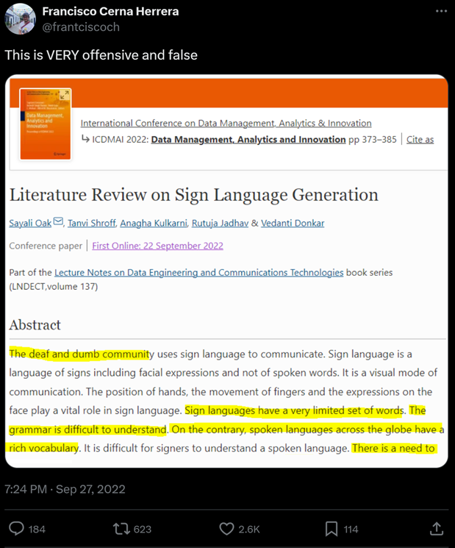
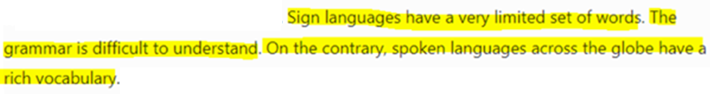
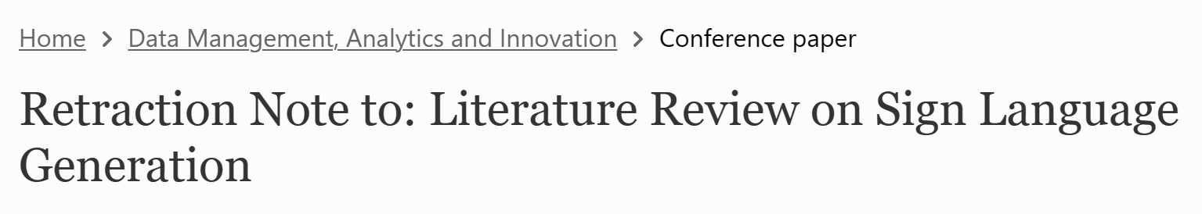
Sign language AI research is largely driven by hearing, non-signing researchers
Overt issues when
individual researchers
lack cultural sensitivity
Notes:
At the same time, we should recognize the kinds of issues that this introduces. Hearing researchers are less likely to be exposed to deaf culture. This literature review, published in 2022, is an example that stands out to me, because when it came out, it created an uproar on deaf twitter. (Animation). I’m not going to read this out loud, you can read it for yourself (pause). Ultimately, the response to this paper was so strong, it was retracted (animation). This is one example, but this is common enough that there are many research papers that document these problems and provide recommendations on how to do better. So while works like these are not okay, I remain optimistic because they’re easy to fix. Individual researchers simply need to read these educational resources.

Slide 5
Sign language AI research is largely driven by hearing, non-signing researchers
Overt issues when
individual researchers
lack cultural sensitivity
But what systemic issues emerge as researchers behave in collective?
Notes:
Instead, I’ve spent my time thinking about a problem that is much harder to solve – what systemic issues emerge as researchers behave in collective? Our personal backgrounds impact what problems we think are important, exciting, and that we can solve. This is not about right or wrong – it’s about taste. It could be that on an individual level, researchers are doing respectful work. But if collectively, the problems that they’re seeking to solve do not align with the problems that deaf communities want solved – then we still have a problem, because it means our work is not beneficent to the community it seeks to serve.

Slide 6

We conducted one of the most comprehensive reviews of sign language AI literature
Motivation
Data
101 sign language AI papers
Aashaka Desai
PhD Candidate
University of Washington
Labels
Models
Systemic Biases in Sign Language AI Research:
A Deaf-Led Call to Reevaluate Research Agendas
Notes:
To assess if this was really happening, two years ago, we conducted one of the most comprehensive review of sign language AI literature to date. This review was led by Aashaka Desai at the University of Washington, and was exceptional because it was conducted by an all deaf team of experts across disciplines. All together, we did a deep dive into 101 recent sign language AI papers. We analyzed factors like how papers motivate their work, what data they use,how they label data, and their modeling approaches. This was a very deep analysis, and I’m only going to be able to touch on it on a surface level today – I would encourage you to read the paper if you haven’t done so.

Slide 7
An overwhelming majority of papers focus on translation
86 of 101 papers
focus on translation between sign language and spoken languages
Notes:
But what we discovered as our main insight, was that an overwhelming majority of papers focus on translation. 86 out of 101 papers focus on translation between sign language and spoken language. When I saw this number, I thought this was ironic because many of these papers will open with sentences like “sign languages are real and rich languages.” Well, English is also a real and rich language, but it’s not like 85% of natural language processing papers regarding English are about translation to Spanish or Chinese.

Slide 8
Most paper motivate as solving accessibility barriers
86 of 101 papers
focus on translation between sign language and spoken languages
64 of 101 motivate as addressing barriers between deaf individuals and hearing society
Notes:
To explain why, we next looked at the way papers motivate their works. 64 out of 101 papers motivate as addressing accessibility barriers between deaf individuals and hearing society.

Slide 9
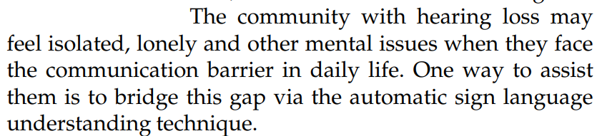
Most paper motivate as solving accessibility barriers
64 of 101 motivate as addressing barriers between deaf individuals and hearing society
Notes:
Across almost all these papers, we read, over and over again, statements like this – I’ll let you read that (pause). So – this is not wrong. Accessibility barriers are part of the deaf experience. I experience barriers every single day, and it is absolutely frustrating. But it is really only a small part of the experience. I work in a majority hearing setting, and while I love it, it can be exhausting. Every day, I go back home to my community, who all sign, and that’s what refreshes me. It feels liberating being able to communicate in a language where there are no barriers. We produce art. We produce poetry. There is so much joy and culture in our communities. But when I read sign language AI papers – those kinds of narratives are almost entirely absent. And so that’s how we know the imbalance in hearing versus deaf researchers is causing this imbalance in research topics. Because the tiny part of the deaf experience concerning accessibility barriers is the only part that hearing non-signing researchers can easily see. I can tell them about the linguistic aspects, the cultural aspects, the aspects of joy – but they can’t directly experience it for themselves. My point is – this is not wrong. As researchers, we gravitate more towards topics we know and are comfortable with. But hopefully, you can see how these individual tastes compound into larger systemic biases.

Slide 10
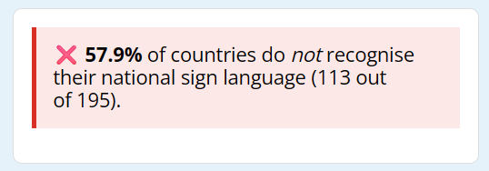
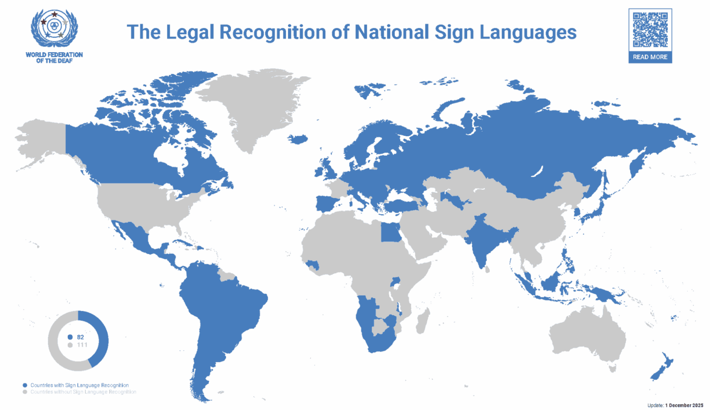
Sign languages lack legal recognition
Source:
World Federation
of the Deaf
Notes:
My discomfort with these research biases is because I feel that they have practical impacts on deaf people. The vision behind access technologies is really individual. We’re envisioning solving problems for people who go up to a bank, a store, a doctor, and are not provided with communication resources. But this is a systemic problem. Why is it that I can go to these places and not be provided with an interpreter? One reason is because nearly 60% of countries still do not recognize their national sign language – including the country we’re currently in, the United States of America. I grew up in Canada, and my communities were heavily invested in the legal process there – because that would mean that every single government service would be mandated to provide services in ASL and LSQ. So it is critical for us to look not just at individual access inequities – but where these inequities stem from.

Slide 11
Deaf children lack access to sign languages, often for ideological reasons
Less than 2% of the
34 million deaf children worldwide receive childhood exposure to sign language
Medical professionals recommend deaf children not be exposed to sign language, despite evidence
(Murray, Hall and Snoddon 2019)
(Humphries et al. 2025)
Notes:
This is even assuming that deaf people are given access to sign language. It is currently estimated that less than 2% of the 34 million deaf children worldwide receive childhood exposure to sign language. (Animation) A reason why is because medical professionals continue to recommend deaf children not be exposed to sign language, under the myth that it’ll harm spoken language acquisition. This is personal – when I was growing up, my parents were given the same advice by doctors. As a result, I really had a traumatic experience growing up. For my full education, I couldn’t really communicate with any of my peers, and I was totally isolated. And I’m still one of the lucky ones. I still had some pathways to acquisition of spoken language – and not everyone has that. When that happens, that leads to language deprivation – which can seriously impact a person’s cognitive ability for the rest of their lives.

Slide 12
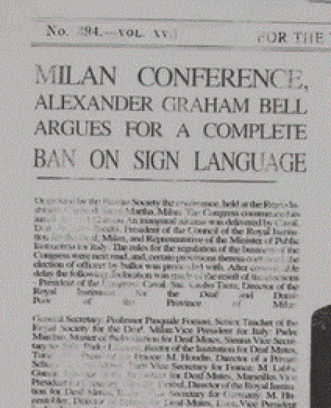
The lack of recognition of sign languages stems from their historic suppression
Milan Conference of 1880
…The Convention, considering the incontestable superiority of articulation over signs in restoring the deaf-mute to society
Resulted in ban in sign language in schools in Europe and North America
Notes:
These issues that I raised – they were not simply a nature outcome, but a consequence of deliberate decisions. In the 1800s, deaf schools were in fact, thriving. But what set back progress was an event called the Milan Conference of 1880 – widely considered to be a black mark on deaf history. This conference was the first international gathering of educators worldwide, all of which were hearing, who decided on the trajectory of deaf education moving forward. (Animation) The consequence of the Milan conference was sign language was banned in schools in Europe and North America. And as a result, the representation of deaf people in professional fields, in writing, in art, in law – steeply plummeted for centuries after.

Slide 13
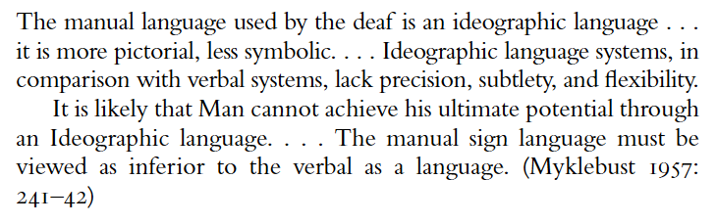
Sign language linguistics research has only recently been legitimized for study
(From Armstrong and Karchmer 2009)
These attitudes only began to shift past 1960, when
William C. Stokoe documented ASL has phonetic structure
Notes:
The Milan conference did not only impact deaf education – it also impacted sign languages as legitimate topics of study. I have a snippet here from Gallaudet in 1957 – I’ll let you read that (pause) To summarize – sign languages were, without any evidence, considered rudimentary, pictoral languages that did not permit full expression. They were not worthy of academic study. (Animation) And these attitudes only slowly began to change in 1960, when William C. Stokoe documented that ASL has phonological structure, similar to spoken languages.

Slide 14
Linguistic study of sign language gives Deaf communities evidence to advocate for equal language status.
Notes:
So let me tie these previous points together. What this means that everything we know about the linguistics of sign language has emerged in the past 50 years. When deaf activists talk to politicians to try to gain legal recognition – they need to produce evidence that their national sign languages are equally as expressive as spoken languages. When activists talk to medical professionals – they need to produce evidence that acquisition of sign language does not conflict with acquisition of written language. But they’re playing on uneven territory – because the evidence that they need has been suppressed for centuries. That brings me to the central thesis of my talk today, and what I think we need to be doing as AI researchers in sign language – supporting the linguistic study of sign language gives deaf communities the evidence that they need to advocate for equal language status.
(12 minutes)

Slide 15


Studying home-signers reveals how languages emerge
Annemarie Kocab
Assistant Professor
John Hopkins University
Notes:
Hopefully, I’ve made that point clear. Now I want to make that point more concrete, by showing you an example of some of the research I do in this area. I collaborate with Annemarie Kocab. Her research focuses on how humans develop language systems. She focuses on sign language, because it provides natural settings for that study. 95% of deaf children are born to hearing parents. When these children are growing up in a setting where they may have limited educational resources or community, that means they have no established sign languages they can use. Instead, what they have to do is develop their own signing systems, so they can communicate with their parents – we call that home-signing. Home signers are fascinating to study because they provide us with insights on how languages emerge – and this is a terrific example of insights that sign languages give us that spoken languages cannot.

Slide 16




Longitudinal studies measure the properties and agreement of signs
1998
2002
2013
Are signs becoming more concise and standardized?
Home-
Signer
Are relatives agreeing with homesigner?
Relative
Notes:
To study homesigners, researchers like Annemarie collect videos, over the years, showing the signs individuals assign to the same prompts. A question might be (animation) – are signs becoming more concise and standardized over time? Because that suggests the homesigning system is becoming more language-like. (Animation) They’ll also collect videos of relatives of the homesigner. (Animation) And they might ask questions like – are relatives agreeing more and more with the homesigner over time? Because that suggests signs are evolving from individual gestures to more formal signs.

Slide 17
Quantification relies upon time-consuming and biased manual annotation
1998
2002
2013
Home-
Signer
Handshape:
bent b
Major Location:
head
Minor Location:
forehead
Contact:
no
…
Relative
Handshape:
bent b
Major Location:
head
Minor Location:
chin
Contact:
no
…
Notes:
One bottleneck of this research is the analysis of the videos is time-consuming and biased. Let’s say you want to quantify the degree of similarity between a homesigner and their parent. (animation) You would have to manually annotate many, many different parameters of the sign. (animation) And then you can quantify how many parameters are shared versus distinct. There is a lot of bias here. For example, researchers may try to port over parameters established for well-studied languages like ASL to guide annotation. But there is no guarantee home signers really use parameters from a completely different, formalized sign system.

Slide 18

AI can help with quantification – but require unsupervised zero-shot methods
2002
2013
1998
Embeddings
Notes:
How can AI accelerate? This is not a supervised prediction problem. Each home signer will use different signs, so we can’t train a classifier. We likewise don’t want to train a model to predict phonological parameters – we have no guarantee that established phonological systems apply to home signers. Instead, we treat this as a zero-shot embedding problem. When given a training problem, AI models learn to extract information from input data that helps them solve that problem. We work with a frozen model, that was originally trained for some other purpose. (Animation) Instead of taking the final output prediction of a model, we can extract its immediate output (Animation). That produces a quantitative vector of the information the AI is extracting from the input videos, called an embedding. (Animation) These embeddings project data into a high-dimensional latent space. (Animation) So let’s say that we have, over multiple years, videos of a homesigner, purple, and their parent, blue. (Animation) We can measure how similar their signing becomes over the years, by measuring if distance in the latent space becomes smaller over time.

Slide 19
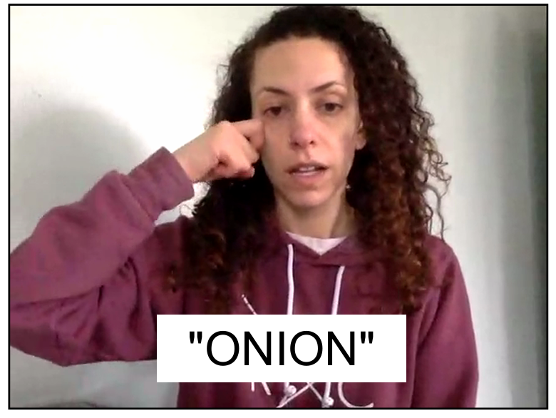
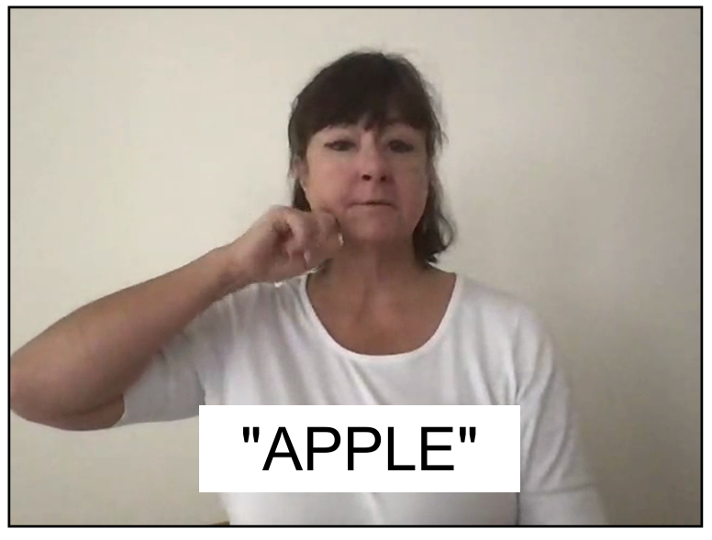

We use minimal pairs in ASL to probe zero-shot capabilities of sign language recognition models
Kayo Yin
PhD Candidate
Berkeley
Notes:
The slide I showed you before is an idealized scenario. For this to work, we need to identify an AI model that is sensitive to sign language phonology. This is hard to test for homesigners because we don’t have strong confidence in phonological annotations, so we decided to invent a test in a more established sign language – ASL. Our test relies upon minimal pairs. These are pairs of signs that have a single difference in phonology. For example, the signs “ONION” and “APPLE” differ only in where they are in the body. But their handshape, motion, and other parameters are the same. Exploiting minimal pairs, we designed an evaluation that tests if models are sensitive to specific kinds of phonological changes. This work was led by Kayo Yin, a PhD candidate at Berkeley.

Slide 20


We test if zero-shot embeddings from models can distinguish minimal pairs
“ONION”
“APPLE”
Notes:
Here’s how our test works. You start with multiple videos of both signs, produced by different signers. We take a candidate AI model, and use it to embed these videos into a latent space.

Slide 21
We test if zero-shot embeddings from models can distinguish minimal pairs
If the distance between people performing the same sign
is bigger than people performing different signs...
Minimal pair is distinguishable
Notes:
Next, we can measure the distance between people producing the same sign – in blue (animation). And then we can compare that to the distance for people producing different signs – in orange (animation). If the blue distances are smaller than the orange distances, that means the model can distinguish the minimal pair.

Slide 22
We test if zero-shot embeddings from models can distinguish minimal pairs
If the distance between people performing the same sign
is the same or smaller than people performing different signs...
Minimal pair is
not distinguishable
Notes:
In contrast, if the distance (animation) between the blue is the same or smaller than the orange this implies that the embeddings cannot distinguish the minimal pair.

Slide 23
Training on sign language recognition is essential to sensitivity to phonological changes
We test 178 minimal pairs identified by a deaf language expert
Distinguishability formalized as t-test between intra-sign and inter-sign distances:
Larger t-stats indicate greater model distinguishability
 | I3D Random | I3D Kinetics | I3D ASL Citizen | STGCN Random | STGCN ASL Citizen
All Minimal Pairs (avg) | 0.13 | 0.12 | 5.00 | 0.23 | 6.08
Notes:
In total, we test 178 minimal pairs identified by a deaf language expert. We use videos from the ASL Citizen dataset, one of the largest isolated sign language datasets for ASL, but we hold out all videos of these signs to retrain classification models. We formalize the idea of distinguishability as a t-test between intra-sign and inter-sign differences. This means that the larger the t-statistic is, the more the model distinguishes a minimal pair. In this table, I report the average t-statistic, across different models. We test two types of models – a vision-based I3D model and a pose-based STGCN model. We test models with different degrees of training – randomly initialized models, models trained on a general action video recognition dataset called kinetics, and models trained on ASL citizen. We find that training on sign language recognition is essential to sensitivity to phonology.

Slide 24
Minimal pairs have high variability in distinguishability
T-statistic
181 of 259 minimal pairs are distinguished by the
ASL Citizen I3D model
Notes:
The numbers I showed you in the previous slides are averages. Here, I’m showing you the t-stat per minimal pair. There is a lot of variability. Pairs that are not significantly distinguished are above the axis, while pairs that are, are below the axis. Overall, the ASL Citizen I3D model distinguishes 181 of 259 minimal pairs.

Slide 25
Models do not reliably distinguish highly human-discriminated pairs
T-statistic
34 of 78 (44%)
69 of 181 (38%)
Minimal pairs scored as not similar by human annotator
No significant difference (Fisher exact test p = 0.4107)
Notes:
What’s surprising, however, is there is no correlation between pairs that are distinguished and human perceptual judgment. We had a human annotator score pairs on their similarity. For pairs scored as not similar – there is no significant difference between pairs distinguished by the model versus not.

Slide 26
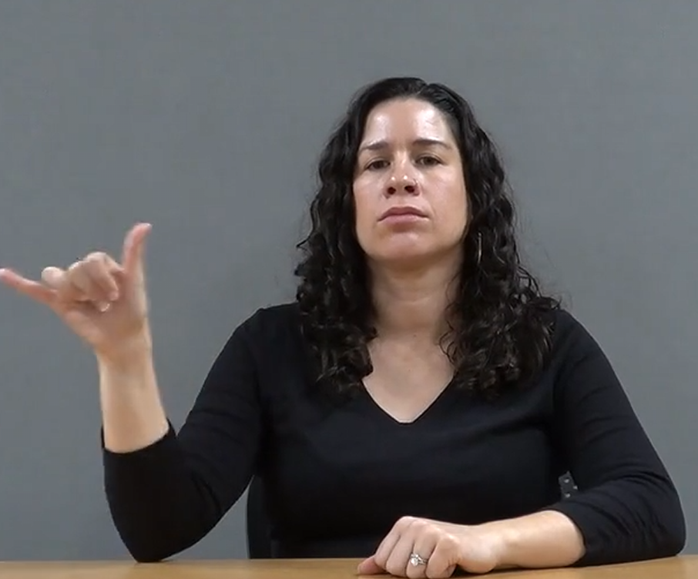
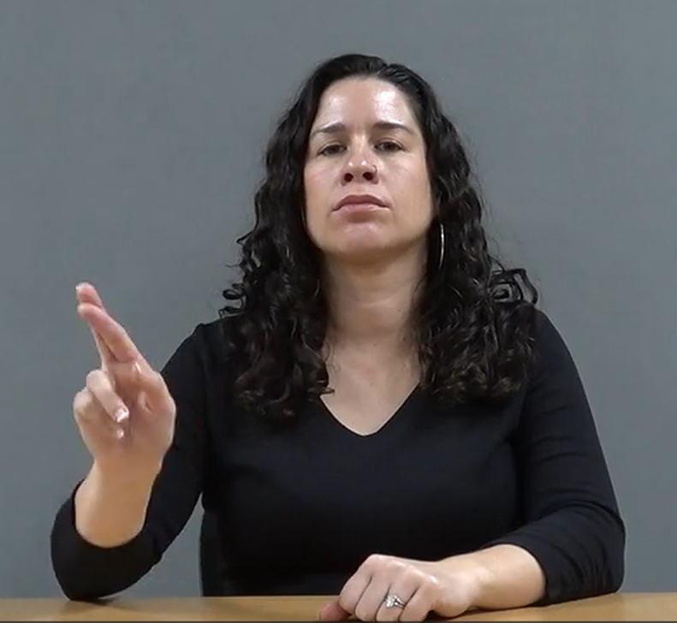
We compared model perceptions of handshape similarity to human perception
Notes:
The previous slide showed that although models trained on sign language recognition distinguish most minimal pairs – their perceptual similarity of signs is not consistent with human perception. We thought this was interesting – so we dug into this more. We compared, for different handshapes, how similar humans perceived them versus how similar they were perceived by our models. How we executed this was somewhat complicated, and involved a brand new dataset – I won’t be able to unpack all the details in a short talk, so read our preprint for details, but the high-level is that we can derive a score for human perceptual similarity between different handshape pairs, and compare to a score for model perceptual similarity.

Slide 27
SLR models have limited alignment with human perception of handshapes
Correlation between
signer vs. non-signer
perception:
Correlation between
signer vs. I3D:
Correlation between
signer vs. STGCN:
Correlation between
signer vs. hand keypoint angles:
0.89
0.31
0.49
0.53
Models competently recognize signs without
developing human-like phonological perception!
Notes:
Our finding is that sign language recognition models have limited alignment with human perception of handshapes. First as a baseline, we measured the correlation in human perception of handshape similarity for signers versus non-signers. This is very high – which is not surprising because although signers do develop some specialized skills, sign recognition builds upon and is constrained by human visual systems. (Animation, Animation) Next, we measured the correlation of our ASL Citizen trained models against human signer perception. The correlations are now much lower, although the pose-based STGCN is somewhat higher. (Animation) To contextualize these numbers, we then calculated the correlation between human signer perception and angles between hand keypoints extracted by the pose estimator used to generate inputs to the STGCN. Surprisingly, this is actually higher than the STGCN, which tells us that training on sign language recognition does not improve perceptual alignment more than what’s already present in the input. (Animation) So to summarize – this tells us that models are learning to competently recognize signs without developing human-like phonological perception.

Slide 28
Disagreement with human-like phonological perception predicts models are brittle to distribution shifts
 | I3D ASL Citizen | STGCN ASL Citizen
Minimal Pairs (ASL Citizen) | 5.00 | 6.08
 | I3D ASLCitizen | STGCN ASL Citizen
Minimal Pairs (Sem-Lex) | 2.47 | 2.76
Notes:
Why is this important? Remember – signs don’t come from nowhere. They’re proposed based upon what human perceptual systems can reliably detect. If a model disagrees with human perception, that predicts that the model is going to be brittle to distribution shifts, because sign language vocabularies evolve to be understandable by human perceptual systems even when it’s dark, when signers are far away, or partially occluded. (Animation) As evidence of this, we applied our minimal pairs test, to minimal pairs in a distinct dataset with a slightly different data collection procedure, called Sem-Lex. And you can see, the distinguishably tanks. To bring this talk full circle – I tried to convince many of you to expand your scope outside of translation. Maybe I haven’t succeeded. But even if so, I hope you can see how linguistics can shine light on where translation models will fail.

Slide 29
In conclusion…
Sign language AI research overrepresents translation due to biases in who conducts the research
Linguistic study of sign language can be accelerated by AI, and supports Deaf community calls for equal language status
Linguistic analyses can improve translation models
Notes:
To conclude – today, I showed you that sign language AI research overrepresents translation due to biases in who conducts the research. I argued that linguistic study of sign language can be accelerated by AI, and supports Deaf community calls for equal language access. And finally, in addition to being interesting topics in their own right that empower deaf communities, I showed you that linguistic analyses can improve translation models
(12 minutes)

Slide 30

Come work with us!
Annemarie Kocab
Assistant Professor
John Hopkins University
Alex Lu
Senior Researcher
Microsoft Research
We jointly supervise students and are recruiting PhD students and postdocs at JHU.
Notes:
If any of this talk caught your attention – come work with us or collaborate with us. I co-own this research agenda with Annemarie Kocab at JHU. Please email us any time if you would like to participate in any of this. Although I can’t host students at Microsoft Research, Annemarie can in her lab – and we are recruiting PhD students and postdocs. So please contact us if you would like to learn about those opportunities.

