Slide 1
Advancing generative genomics models with evolution
Alex Lu – Microsoft Research
lualex@microsoft.com

Slide 2
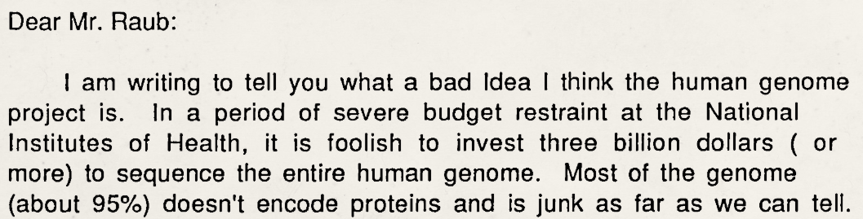
Three decades ago, genomes were largely thought of as “bags of genes”…
March 29, 1990
Virtual exhibit from the NHGRI
genome.gov/virtual-exhibits/human-genome-project-is-simply-a-bad-idea
Notes:
Three and a half decades ago, the Human Genome Project was just kicking off. I was recently reading letters in opposition to the project. This letter is an example of some of the main critiques - the last line reads “most of the genome (about 95%) doesn’t encode for proteins and is junk as far as we can tell.” My goal in showing this is not to criticize this specific letter writer, but to emphasize this was a leading scientific consensus just three decades ago – that genomes were just passive bags of genes.

Slide 3
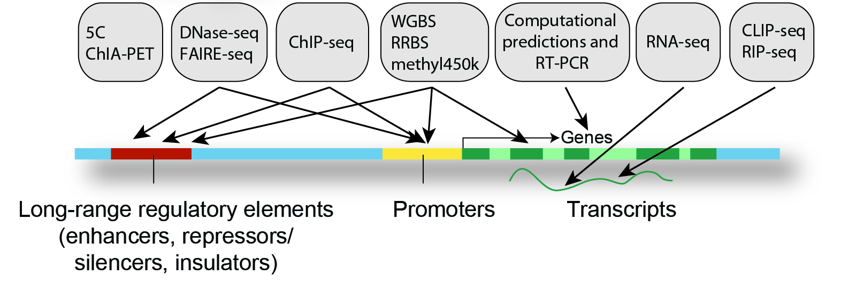
Systematic screens reveal extent of human genome dedicated to regulation
2,348,854 elements
19,433
protein-coding genes
ENCODE Project
Notes:
Within a few decades, our consensus around how genomes operate has dramatically shifted. This was cumulation of many things, but among them, projects like ENCODE, which systematically catalogue regulatory elements in the non-coding genome, were instrumental. These projects have exposed just how much of eukaryotic genomes are dedicated to regulation. In the human genome, there are about 20,000 protein-coding genes. In contrast, the latest version of ENCODE has identified over 2.3 million cis-regulatory elements – two orders of magnitude more. This led to a greater awareness of just how much of our genome was dedicated not to coding proteins –– but precisely controlling when, where, and how much these proteins get expressed.

Slide 4
Much remains to be discovered about the genomic regulatory code
How do genomic sequences encode precise responses to different contexts?
Enhancer (50-1500 bp)
Notes:
This means we are at a very exciting age for discovery in genomics. Even as projects like ENCODE have catalogued cis-regulatory elements, we still don’t have a complete understanding of how sequences encode the precise level of response they have to different contexts, or as short-hand, the “genomic regulatory code”. It’s difficult to summarize the current extent of our knowledge in a single slide, because there are so many layers to regulation. But even focusing on the most atomic unit – individual cis-regulatory elements – there is still much to be understood. Take, for example, enhancers, which are short sequences of a few hundred base pairs that can increase the transcriptional rate of genes.

Slide 5
Much remains to be discovered about the genomic regulatory code
How do genomic sequences encode precise responses to different contexts?
Transcription Factor Binding Sites
Enhancer (50-1500 bp)
Notes:
Enhancers usually contain tens of binding sites for transcription factors, each of which may recruit different kinds of transcription factors. Often these are encoded in the sequences as motifs, short sequence patterns, that have affinity for these proteins.

Slide 6
Much remains to be discovered about the genomic regulatory code
How do genomic sequences encode precise responses to different contexts?
Transcription Factor Binding
in Cell State A
Enhancer (50-1500 bp)
Notes:
Depending upon factors like what transcription factors are expressed in a specific cell state or the affinity of the sequence for these transcription factors, different sets of transcription factors may be bound at any given time. For example, in one cell state it might look like this…

Slide 7
Much remains to be discovered about the genomic regulatory code
How do genomic sequences encode precise responses to different contexts?
Transcription Factor Binding
in Cell State B
Enhancer (50-1500 bp)
Notes:
Whereas in another cell state, it might look something like this.

Slide 8
Much remains to be discovered about the genomic regulatory code
How do genomic sequences encode precise responses to different contexts?
Small differences
can lead to vastly
different outcomes!
Enhancer (50-1500 bp)
Notes:
Small differences can lead to very different outcomes. This is because transcription factors can cooperate and compete with each other – so we should not assume that these regulatory states behave in any linear way.

Slide 9
Much remains to be discovered about the genomic regulatory code
How do genomic sequences encode precise responses to different contexts?
Small differences
can lead to vastly
different outcomes!
Enhancer (50-1500 bp)
Notes:
Anecdotally, we know for some enhancers, if we shift a single transcription factor binding site even 2-5 base pairs, that can invert the function of the enhancer. This is all to say – even for individual elements, the regulatory code can be complex. Because of this – for most enhancers, we do not understand their sequence-to-function logic. And again – this is just the most atomic level of the regulatory code, before we even get into questions about how multiple cis-regulatory elements may interact, how their properties are modified by epigenetics, or how does the 3D structure of DNA interacts.

Slide 10
Much remains to be discovered about the genomic regulatory code
Understanding this helps understand what makes us human!
Notes:
Why do we care about understanding the regulatory code? The best answer I can give is that it helps us understand, physically, what makes us human.

Slide 11
Why do we care about understanding the regulatory code?
Understanding what makes us human!
The regulatory code…
…differentiates cells.
Different cell types in our body
Notes:
Every cell in our body has the same template – the same genome. And yet from this template, we get all the different kinds of cells in our bodies – heart cells, lung cells, liver cells.

Slide 12
Why do we care about understanding the regulatory code?
Understanding what makes us human!
The regulatory code…
…differentiates cells.
…is precise.
Different cell types in our body
Our sense
of smell
Notes:
The level of control the regulatory code has is incredibly precise. Every single olfactory cell in our body needs to express exactly one receptor out of hundreds, for our sense of smell to be functional.

Slide 13
Why do we care about understanding the regulatory code?
Understanding what makes us human!
The regulatory code…
…differentiates cells.
…is precise.
…is responsive.
Different cell types in our body
Our sense
of smell
How muscles respond to exercise
Notes:
And the regulatory code is not just responsible for static cell states – it also is responsive to changes in our environment. For example – it modulates how our muscles respond to exercise. So in other words – I’m excited about understanding the regulatory code, because I just want to understand what makes us human.

Slide 14
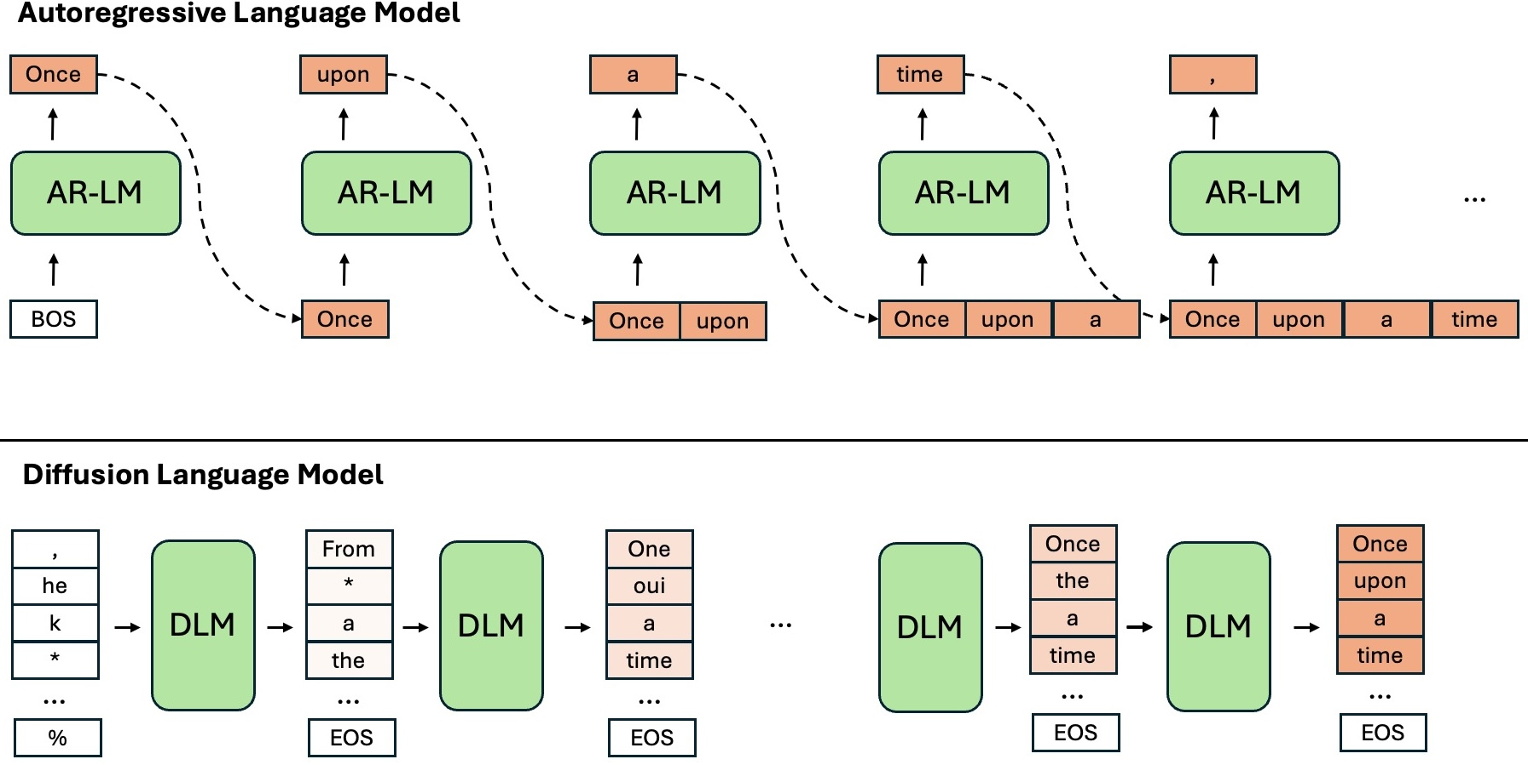
Self-supervised language models learn statistical understanding of language without labels
Figure credit:
Blog post from Xiaochen Zhu
Notes:
Hopefully, I’ve gotten you as excited about the biology as I am – let’s dig into how computational methods can help. This gap in our understanding of the genomic regulatory code coincides with the observation that self-supervised language models can learn a statistical understanding of language. These models are pretrained using tasks that can scale to massive unlabeled datasets. Many train using next-token prediction, making them autoregressive language models - given part of a sentence, a model may be trained to predict the next word. As for the intuition of why this learns an unsupervised understanding of language – suppose I asked you to solve this task, you would need to read the start of the sentence, understand it, and then use your knowledge of English vocabulary to predict what could plausibly go next. These are the skills required to achieve performance on this task – so the language model also needs to develop these skills.

Slide 15
Can we learn the “grammar” of the regulatory code by treating genomes like language?
Genomic
A
T
C
G
C
A
A
T
A
T
C
A
T
C
G
Notes:
This ability to learn an unsupervised understanding of language has profound implications for understanding the genomic regulatory code. If we were to treat genomic sequences as “language” – could we also, analogously, learn the grammar of this language, even if we don’t fully understand it ourselves? The core idea is to treat nucleotide sequence representations of genomes – the letters that make up DNA, A, T, C, and G – as if they were sequential text, and to pretrain models using the same sequence reconstruction techniques common for pretraining natural language models.

Slide 16
Prediction, interpretation, and generation can further understanding of regulatory grammar
Prediction
Gene Expression
in Cell State A
Notes:
Once we’ve trained these models, there are several ways they can advance our understanding of regulatory grammar. First, if they really have learned a more sophisticated understanding of regulatory grammar beyond our current understanding, then they should be able to better predict things like cell state-specific gene expression. In other words, prediction is a good way to verify understanding.

Slide 17
Prediction, interpretation, and generation can further understanding of regulatory grammar
Prediction
Interpretation
Gene Expression
in Cell State A
Notes:
But we’re often not just satisfied with black box understanding. Interpretation techniques can be used to convert these black box models into more human understandable principles. There are a lot of different techniques and I won’t review all of them – but for example, you may look at what parts of input sequence models pay disproportionate weight or attention to, which can guide us to functionally important parts of the sequence.

Slide 18
Prediction, interpretation, and generation can further understanding of regulatory grammar
Prediction
Interpretation
Generation
Gene Expression
in Cell State A
Notes:
Finally, because these models are typically also generative models can produce sequences, we can also use the generations to shed insights. For example, we could generate multiple sequences that the model believes will be active in a specific cell state, and analyze commonalities between these sequences.

Slide 19
Genome language modeling efforts have exploded
2021 0.
DNABert
2021
110M params
Nucleotide Transformer
2023
2.5B params
Evo
2024
7B params
Evo2
2026
40B params
Notes:
Because genome language models have the potential to significantly advance our understanding of genomes, since the first genome language models were proposed in 2021, dozens of different models have emerged. This slide shows, to scale, the size of modeling efforts over the years – DNABert barely registers as a speck, whereas I can’t even fit Evo2, which claims to be the largest open model to date and by our estimates cost a retail cost of $10 million to train. So people are really investing hard into these models now. For me, what makes these models so attractive is if they really do learn an understanding of principles of the regulatory code beyond our current knowledge, we can use this to further understanding.

Slide 20
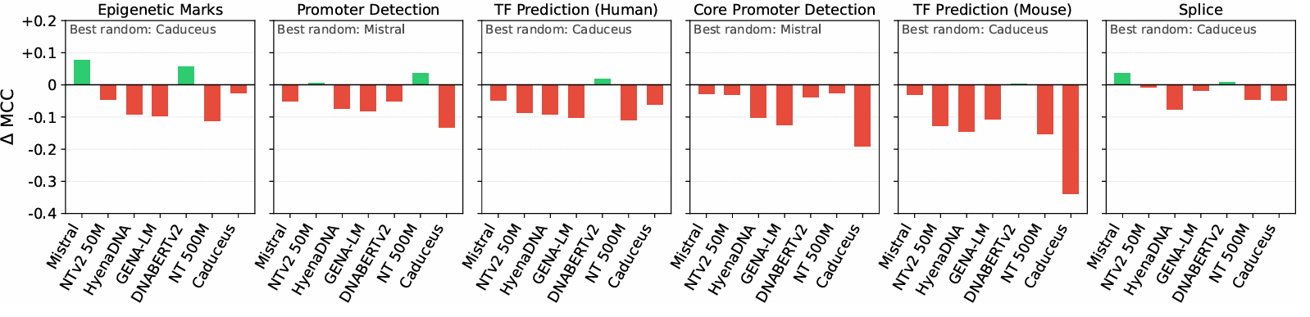
“Genomic foundationless models” learn no better an understanding than random weights
Vishniakov et al. 2025
Notes:
But that’s a big if. There is an emerging body of work showing that current genome language models may not be learning biological signal in genomic sequence well. The most striking one to me was the “Genomic Foundationless Models” preprint. The authors compared recent genomic language models on 52 genomic classification tasks, versus their randomly initialized counterparts. In other words, they’re comparing models to ones that have not been trained at all, versus models that have been exposed to hundreds or thousands of genomes. This is a reproduction of one of the figures from this paper. In this figure, each plot is a different genomic sequence prediction task, and the X-axis shows the 7 different models they evaluated. If the bar is below zero on the y-axis, randomly initialized models are performing better than the pretrained model. In other words, what this plot tells us is that across different tasks, the understanding of genomic sequence developed by pretraining does not improve performance – but in some cases even significantly harms performance. I don’t know about you – but for models that are costing millions of dollars to train – I have higher expectations.

Slide 21
Genomes do not behave like language!
Enhancer
Enhancer
Promoter
Gene
Notes:
Why is this happening? Why are genome language models not effective at picking up biological signal in sequences? If you can answer that question, please let me know – you’ll solve a chunk of my research program. But at minimum, we can speculate about this. Genomes do not behave like language!

Slide 22
Genomes do not behave like language!
Genomic sequences are low signal-to-noise
Highly repetitive, putatively low function regions
(e.g. ATATATATATAT…)
Enhancer
Enhancer
Promoter
Gene
Notes:
First, genomic sequences are characterized by a low signal-to-noise ratio. For example, most of the human genome is highly repetitive DNA, most of which may not be strongly functional. Imagine if you were training on text corpuses that were 50% gibberish that said “at the at the at the at the” five hundred times in a row – that’s what we’re working with here.

Slide 23
Genomes do not behave like language!
Different elements have different sequence-to-function logics
Codons code for amino acids
Transcription factor binding sites mediate function
Enhancer
Enhancer
Promoter
Gene
Notes:
Second, different elements in genomes have different sequence to function logics. For example, while coding regions operate under the logic of codons, enhancer function is mediated by transcription factor binding sites. In other words, this is like if were training on corpuses that arbitrarily toggled between English, Chinese, and other languages. This is not exhaustive, and I’ve skipped over stuff like the super distal non-linear interactions present in DNA – but the point is that as data, genomic sequences behave very differently than natural language. It’s possible these differences mean that pretraining strategies originally effective for natural language processing are not as effective when deployed on genomic sequences.

Slide 24
Bioinformatics methods often rely on evolutionary conservation for robust identification of signal
Enhancer
Enhancer
Promoter
Gene
Notes:
Bioinformaticians have been aware of these properties for decades. There are already effective methods for identifying functional signal in genomic sequences, that are robust to these issues. Many effective methods rely upon principles of evolutionary conservation as their workhorse. The idea is that if you have multiple genomes for species that diverged from the same common ancestor…

Slide 25
Bioinformatics methods often rely on evolutionary conservation for robust identification of signal
Enhancer
Enhancer
Promoter
Gene
Notes:
…you can align them and assess well-conserved parts of the sequence are. (Animation) – This allow us to focus our analyses on conserved parts of the sequence, which is useful, because conservation often implies function. In other words, evolutionary conservation addresses issues with the high noise ratio of genomes, by allowing us to ignore likely less functional regions. Moreover, it is a universal signal – principles of evolutionary conservation apply across all genomic elements, despite their different regulatory logics. Together, evolutionary conservation has been so essential to our current understanding of genomes, because it allows us to identify functional signal in genomes even when we don’t have prior knowledge about what’s important or how it functions.

Slide 26
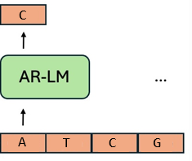







Combining evolution-based strategies with genome language modeling
Gamba
Does pretraining on conservation
better learn the regulatory code?
EnhancAR
Can we use evolution to steer generative models of enhancers?
Genomic Evolution
+
1.7
Conservation
Generate not just single
sequences but entire
homology family
Notes:
What’s surprising to me is that it remains currently largely uninvestigated how principles of evolutionary conservation can interact with genomic language models, with the biggest models in the field largely building upon methods from natural language processing. I’m going to show you two projects of ours that show how evolution can be integrated into genome language modeling. These works were done with a wonderful set of collaborators – the PhD students leading the projects, Mica Consens and Andrew Duncan, our collaborators from the University of Toronto, Alan Moses and Jennifer Mitchell, and collaborators from Microsoft Research – Kevin Yang, Lorin Crawford, and Ashley Conard. In our Gamba project, we asked if pretraining on evolutionary conservation can improve self-supervised learning of the regulatory code. And in our EnhancAR project, we looked at if we could use evolution to steer generative models of enhancers. I’ll go through each of these projects in turn…

Slide 27

Combining evolution-based strategies with genome language modeling
Gamba
Does pretraining on conservation
better learn the regulatory code?
Genomic Evolution
+
1.7
Conservation
Mica Consens
Notes:
Starting wit Gamba, led by Mica Consens, a PhD student at the University of Toronto.
Timing – at 13 minutes on this slide.

Slide 28
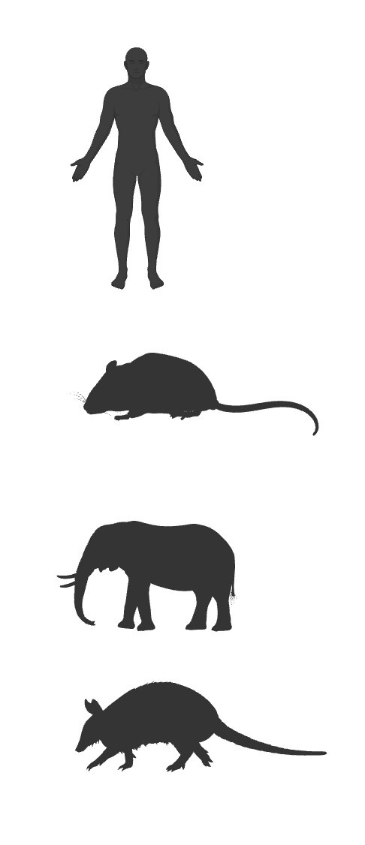
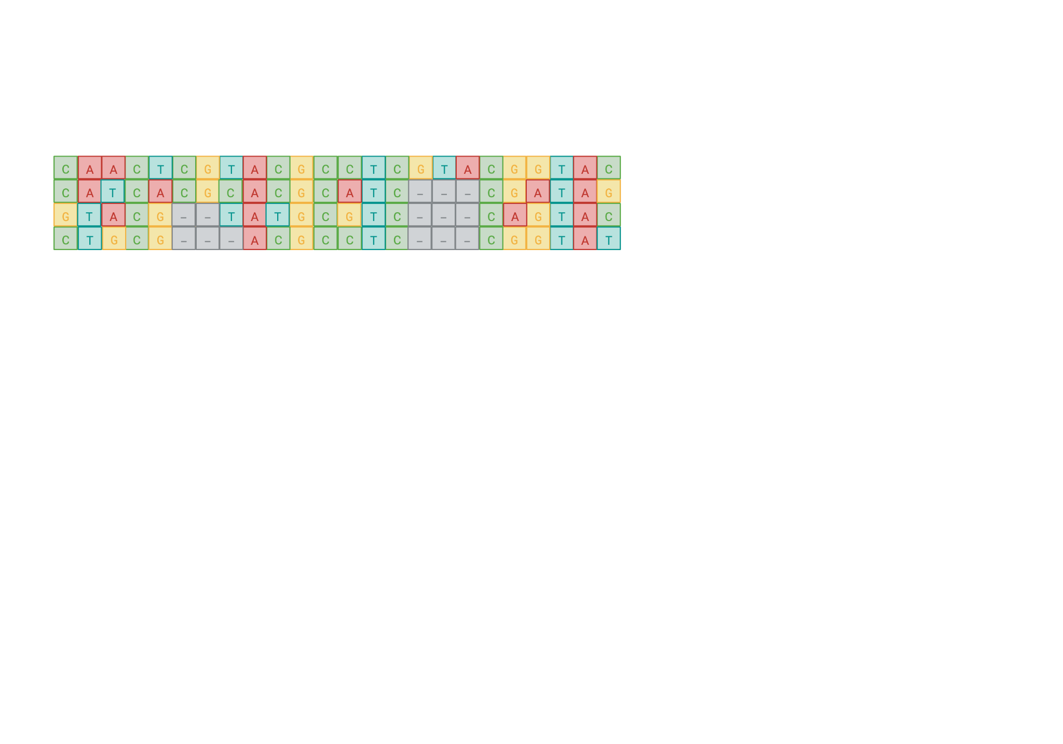
Bioinformatics methods can estimate evolutionary conservation at the nucleotide level…
Notes:
Let’s revisit sequence alignments. This is a less abstractized representation of a multiple sequence alignment of DNA than I previously showed you, where you can actually see the nucleotide letters.

Slide 29
Bioinformatics methods can estimate evolutionary conservation at the nucleotide level…
Notes:
What I hope this representation makes apparent is that you can estimate evolutionary conservation at a nucleotide level. You can see that some columns are strongly conserved across species, while others are not.

Slide 30
Bioinformatics methods can estimate evolutionary conservation at the nucleotide level…
0
-
-
+
-
+
+
-
+
0
+
+
-
+
+
⋅
⋅
⋅
+
0
0
+
+
-
Notes:
What this means is that we can calculate a score for each nucleotide, reflecting how conserved that position is, across species – at least for the positions where we have enough aligned sequences for. There are a lot of these kinds of scores possible – in this work, we use the PhyloP score, which accounts for the significance of the conservation compared to a neutral evolutionary model. (Huge shout-out to Katie Pollard, who is also speaking here, for developing these scores, making this data available – and also helping us out when we were stuck on some of this data!)

Slide 31
Can we use conservation scores to pre-train genome language models?
gLM
0
-
-
+
-
+
+
-
+
0
+
+
-
+
+
⋅
⋅
⋅
+
0
0
+
+
-
Conservation scores capture both regional and local functional signal
Notes:
Given these per-nucleotide conservation scores – can we somehow use this as the basis for pre-training genome language models opposed to sequence reconstruction? Given a single sequence, we would predict, how conserved nucleotides in the sequence are across evolution. Conservation scores capture both regional and local functional signal. Our hope is by training a genome language model to predict these scores, we bestow it with this sense of function, but without having to explicitly dictate function a priori.
#At the regional level, functional regions tend to be more conserved in genomes. But it can also capture fine-grained local details – a great example of this is that across species in coding regions, the third position in codons is systematically less conserved than the first two, because this is where there is the most degeneracy in the genetic code.

Slide 32
Designing pretraining tasks comparable with sequence-based reconstruction
Most biological sequence language models use one of two pretraining tasks
Autoregressive Language Modeling
Masked Language Modeling
C
A
A
C
T
C
G
T
A
C
C
A
⋅
C
T
⋅
G
⋅
A
C
AR-gLM
Bidirectional gLM
G
C
A
A
C
T
C
G
T
A
C
Notes:
Let’s get into how we implement this. Our goal was to design pretraining tasks comparable with sequence-based reconstruction. In general, biological sequence language models use one of two pretraining tasks. The first is autoregressive language modeling, which I previously explained – predict the next token, given previous ones. The second is masked language modeling. In this set-up, we randomly mask or corrupt a subset of tokens, and we pretrain models to reconstruct the missing tokens.

Slide 33
Designing pretraining tasks comparable with sequence-based reconstruction
Current conservation prediction shares input sequence and output
dimensionality with autoregressive language modeling
Autoregressive Language Modeling
Current Conservation Prediction
C
A
A
C
T
C
G
T
A
C
C
A
A
C
T
C
G
T
A
C
AR-gLM
AR-gLM
G
+
Notes:
The first pretraining task we designed is called current conservation prediction. Given a subsequence, we predict the conservation of the last token. This task is comparable with autoregressive language modeling – it shares the same input, and the same output dimensionality – a single token.

Slide 34
Designing pretraining tasks comparable with sequence-based reconstruction
Designing comparable pretraining tasks allows us to compare models
with the same pretraining data and architecture
Autoregressive Language Modeling
Current Conservation Prediction
C
A
A
C
T
C
G
T
A
C
C
A
A
C
T
C
G
T
A
C
AR-gLM
AR-gLM
G
+
Notes:
The reason why we want to do this is because it allows us to isolate differences between models to just the pretraining task alone. We can use the same data, both for training and evaluation, and present data to the models identically. We can also use the same architecture, because the output dimensions are the same. What this means is that differences we see between models can be attributed to the pretraining task and not model or data set-up.

Slide 35
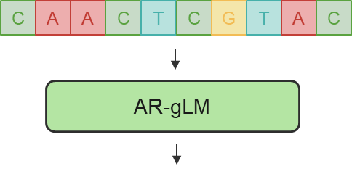


Designing pretraining tasks comparable with sequence-based reconstruction
Designing comparable pretraining tasks allows us to compare models
with the same pretraining data and architecture
Autoregressive Language Modeling
+
Current Conservation Prediction
Notes:
Because these models operate on the same inputs and output dimensionality, this also allows us to combine the two pretraining tasks. We can train a model that outputs both next token predictions and current conservation predictions – and assess if the two tasks can synergize.

Slide 36
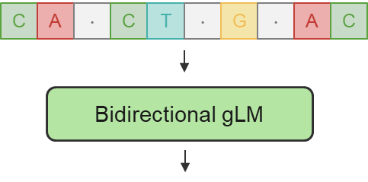


Designing pretraining tasks comparable with sequence-based reconstruction
Masked evolution modeling shares input sequence and output
dimensionality with masked language modeling
Masked Language Modeling
+
Masked Evolution Modeling
Notes:
For masked language modeling, we equivalently design a conservation-based training task called masked evolution modeling. Here, we predict the conservation scores over all positions. And just like before, we can combine the two objectives, to assess synergies.

Slide 37
We train six Gamba variants on the repeat-filtered human reference genome
Sequence only
Evolutionary rate only
Both combined
Notes:
In total, we train six Gamba variants on the repeat-filtered human reference genome. Two are trained using sequence-reconstruction tasks only, two using evolutionary-rate prediction tasks only, and two combining both sequence and evolutionary rate prediction.

Slide 38
We train six Gamba variants on the repeat-filtered human reference genome
Sequence only
Evolutionary rate only
Both combined
AR-Gamba models: 66M parameter Jamba architecture
Notes:
We use different architectures for our unidirectional versus bidirectional pretraining tasks. For the unidirectional pretraining tasks, we use a 66M parameter Jamba architecture, which is a hybrid Transformer-Mamba model with mixture of experts routing. We call these models AR-Gamba models.

Slide 39
We train six Gamba variants on the repeat-filtered human reference genome
Sequence only
Evolutionary rate only
Both combined
AR-Gamba models: 66M parameter Jamba architecture
Bi-Gamba models: 4M parameter Caduceus architecture
Notes:
For our bidirectional tasks, we use an 4M parameter model introduced by Caduceus – it includes inductive biases that make it reverse complement equivalent. So that’s our set-up, and hopefully I’ve reinforced that this set-up allows us to fairly compare pretraining on sequence reconstruction, evolutionary-rate prediction, and both.

Slide 40
We benchmark Gamba models on functional region classification
5’ UTR
Exon
3’ UTR
Enhancer
UCNE
Repeat
2KB Upstream TSS
Promoter
Intron
We make benchmarking more challenging by operating zero-shot and evaluating under confounders
Notes:
I’m going to show you some benchmarks of this set-up now. One of our main evaluations is functional region classification. This requires models to correctly classify different kinds of elements in the genomes – in our set-up, we use enhancers, UCNEs or ultra-conserved non-coding elements, repeats, sites 2KB upstream of the transcriptional start site, promoters, and different parts of genes including 5’ UTRs, exons, introns, and 3’ UTRs. This idea is not new and has been previously introduced by many benchmark datasets For virtually all of these datasets, the genomic foundationless model paper showed that randomly initialized models outperform. We thought about this, and we weren’t sure if this was because genome language models are really that bad, or because previous benchmarks were too easy. We decided to reimplement this idea to make it more challenging, by operating zero-shot, which is a technique for assessing pretrained models as-is without introducing a second training phase to align the models with the prediction task. We also evaluate under confounders not previously tested.

Slide 41
Existing benchmarks select confounder sequences at random from the genome
5’ UTR
Exon
3’ UTR
Enhancer
UCNE
Repeat
2KB Upstream TSS
Promoter
Intron
Randomly sampled regions
Notes:
To dig into the second point, in previous benchmarks, confounders are usually selected at random from the genome, matching the length of functional genomic elements.

Slide 42
Existing benchmarks select confounder sequences at random from the genome
5’ UTR
Exon
3’ UTR
Enhancer
UCNE
Repeat
2KB Upstream TSS
Promoter
Intron
Randomly sampled regions
Problems
This turns every task into mostly separating functional elements vs repeats!
Ignores local sequence biases like GC composition
Notes:
There are two problems with this. First, most the human genome is repeats. If you sample a random window from the human genome, chances are it’s going to be mostly or at least some repetitive regions. This effectively turns every single classification task into mostly separating functional elements versus repeats – in evaluations, models may not even have to detect signatures of function within these elements but simply notice that the DNA sequence is not low complexity. Second, it ignores local sequence biases. The human genome has huge local variation in GC composition ranging from 30% to 70% within windows in the genome. If you take random DNA from very far away, it may look very different from DNA proximate to the element.

Slide 43
We design benchmark four settings under increasing levels of confounders
5’ UTR
Exon
3’ UTR
1
Enhancer
UCNE
Repeat
2KB Upstream TSS
Promoter
Intron
Randomly sampled regions
Notes:
We introduce four different evaluation settings, that introduce increasing levels of confounders that control for these issues. Our first setting is just like everyone else – we match randomly sampled windows.

Slide 44
We design benchmark four settings under increasing levels of confounders
2
Separating functional regions from each other
Notes:
In our second setting, we try to address the imbalance of repeats and use other functional regions as confounders against each other.

Slide 45
We design benchmark four settings under increasing levels of confounders
2
Separating functional regions from each other
3
Separating length-standardized functional regions from each other
Notes:
However, different functional regions can have different lengths. Exons tend to be much longer than promoters, for example. This can leak information about the function of the element. In our third setting, we further control for this by sampling a 100 base pair window from the sequence, instead of using the full sequence, which standardizes sequence lengths.

Slide 46
We design benchmark four settings under increasing levels of confounders
4
Separating functional regions from 2KB upstream regions (of a different functional class)
Notes:
Finally, in our fourth setting, we attempt to control for locality biases – we sample 2KB upstream windows of the same length, ensuring that these nucleotides all belong to a different functional class.

Slide 47
We design benchmark four settings under increasing levels of confounders
1
Separating functional regions from random windows
2
Separating functional regions from each other
Controls for repeat bias in genomes
3
Separating length-standardized functional regions
from each other
4
Separating functional regions from 2KB upstream regions (of a different functional class)
Controls for locality biases in sequence
Notes:
To recap, we benchmark under four evaluation settings for functional region classification. Settings 2 and 3 control for repeat bias in genomes. And setting 4 controls for local biases in sequences. And we do all of this zero-shot. Having established our evaluations, I’m now going to show you the results of this benchmark.

Slide 48
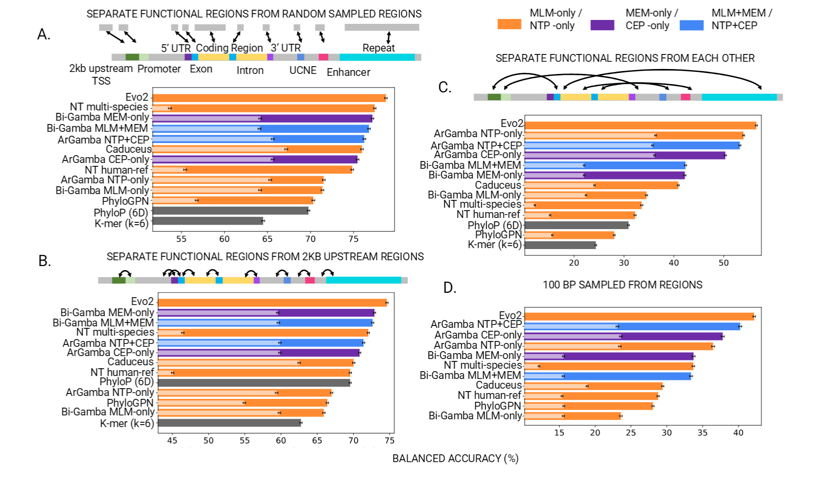
Conservation score pretraining usually outperforms sequence reconstruction
1
2
3
4
Notes:
These four plots show our four evaluation settings. The y-axis shows nearest neighbor retrieval accuracy, the higher it is, the better. Notice the different scaling between plots – settings 2 and 3 are harder than 1 and 4, suggesting that controlling for repeat bias is critical to difficulty. I have a bar plot associated with each model, and in light colors, I show the performance of a randomly initialized equivalent architecture. You’ll notice across all models I will show you, pretrained models outperform their randomly initialized counterparts – which is good, because it indicates our benchmark is challenging enough that it is not solved by random models. Next, you’ll notice I show models pretrained using evolutionary conservation only in purple, and models pretrained using sequence reconstruction only in orange. For almost all models – 3 out of 4 tasks, and 7 of 8 architecture and task combinations, conservation score pretraining outperforms sequence reconstruction. This result tells us that pretraining on conservation scores is an effective strategy.

Slide 49
Combining objectives leads to best-of-both-worlds performance
1
2
3
4
Notes:
Next, let’s look at how these pretraining tasks can combine. The blue bars show models trained using both conservation score and sequence reconstruction pretraining. Across all four settings, the combined models are on par with, if not better with, the better of the two pretraining strategies. Notably, for evaluation setting 3 – discriminating functional elements from each other with only 100 bp of sequence – the combined model outperforms either model alone, suggesting there is some degree of synergy. What this tells us is that while there is sometimes some instability in whether conservation or sequence pretraining is superior – using both objectives leads to best-of-both-worlds performance.

Slide 50

Our tiny Gamba models are comparable with or better than larger gLMs!
1
2
3
4
Notes:
Finally, we expanded our benchmarking to other genome language models, in orange, and to bioinformatics baselines, in grey. This was surprising to us – our tiny Gamba models are comparable with, or better than larger gLMs. Our models have 4 million and 66 million parameters, and you can compare that to models like nucleotide transformer, which has 500 million parameters. We weren’t trying to beat SOTA in this work, just conduct a principled evaluation. But even so, you can see our best Gamba models typically outperform every other genome language model we tried, except Evo2. But even comparing against Evo2, our performance is impressive – we have 0.06 to 0.97% of the parameters and we still achieve 95 to 98% of its performance. In other words – the name of our model ended up being a lucky coincidence. We originally called this Gamba as a riff off Jamba, but Mica informed me it also means “shrimp” in Spanish – and I think that creates a cute mental image of how a 4 million parameter model can still stand up to a 9 billion parameter model.

Slide 51
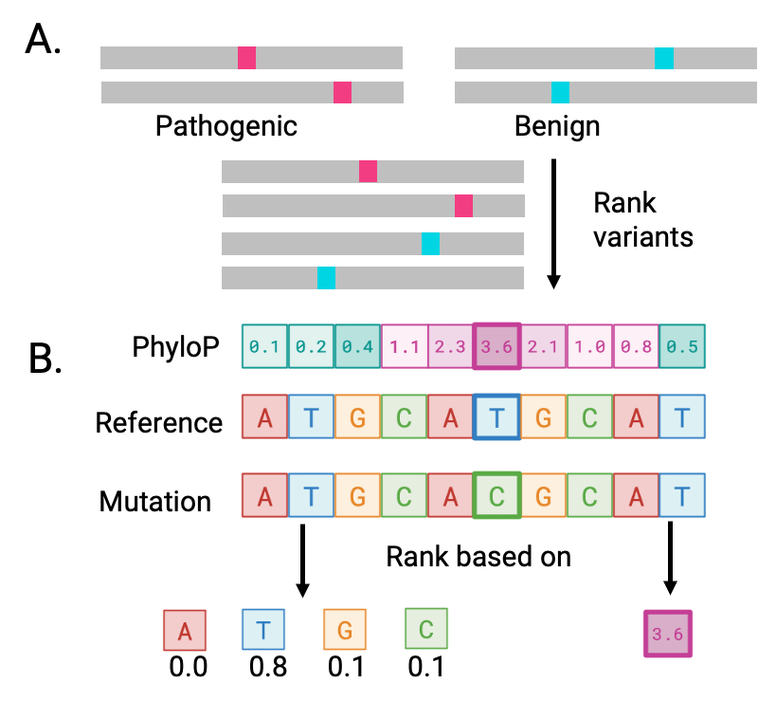
Variant effect prediction ranks mutated sequences based upon their pathogenicity
Notes:
Great. I’ve shown you a result that demonstrates that evolutionary conservation pretraining can be effective. I next want to talk about where we’re still limited – and not just for our models, but the field at large. For this, I’m going to show you benchmarks on a task called variant effect prediction. The goal is to rank mutated sequences based upon their pathogenicity. You have some sequences that have mutations that are known to cause disease, and some sequences that are benign, and the goal is to rank these sequences, such that the disease-causing variants are at the top.

Slide 52
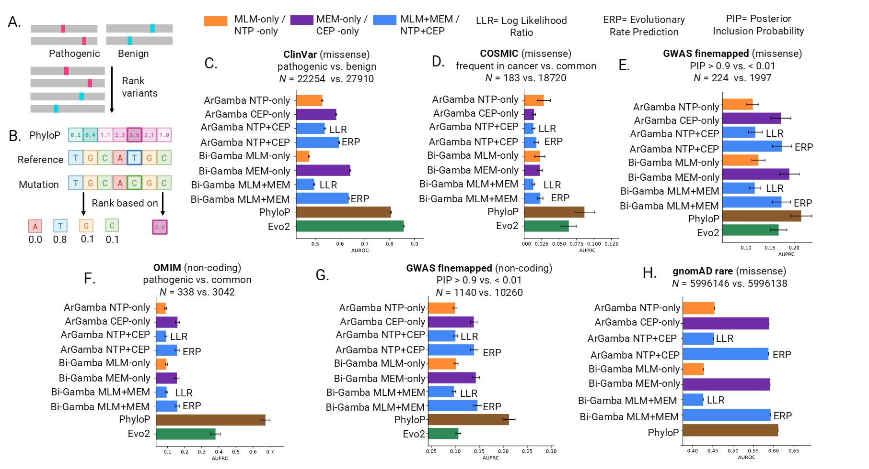
Both explicitly and implicitly learning evolution does not outperform direct use of conservation
Notes:
Here are our benchmarking results. I’m showing five datasets here – these are derived from different sources, and divided into coding, and non-coding variants. The higher the number along the x-axis, the better the model. I’m showing one representative Gamba model, and it does okay in this setting – for two of five tasks, it’s comparable with or better than Evo2. But I think the real story here is how well PhyloP does – on four of the five tasks, it blows either genome language model out of the water. For context on why this is surprising – I think of PhyloP as a weak baseline. The principle behind why PhyloP works for variant effect prediction is if a mutation is pathogenic, it often gets filtered out by evolution, so you observe that position tends to be more conserved. But this is only possible if you can construct a good alignment, which can be challenging if a part of a genome evolves rapidly. It’s exceptionally surprising to see that PhyloP does so well for non-coding variants, as non-coding regions tend to evolve much more rapidly than coding regions. But the other surprising part is that both genome language models should be learning evolution. Gamba is self-explanatory – we train it on PhyloP scores. Evo2 is trained with tens of thousands of genomes across species, and what we know from studies from similar strategies in protein language models, it should be implicitly learning conservation – patterns that repeat over evolution stand out as important and get amortized into the model. So even though in principle, both models should be learning evolutionary conservation – Gamba explicitly, and Evo2 implicitly – they’re clearly not doing well enough to beat a weak bioinformatics baseline that has direct access to this. Perhaps Gamba is excusable – we’re training tiny models, so maybe they don’t have the capacity to learn evolution at a fine-grained single nucleotide resolution, even if they seem to do so coarsely for regions. But Evo2 has been scaled to nearly the limits of what we have for genomes, at least across species – so again, this suggests that sequence reconstruction pretraining tasks may not be very effective, or at least efficient, at learning biological signal.

Slide 53

Gamba: Key Takeaways
Gamba
Does pretraining on conservation
better learn the regulatory code?
Pretraining on evolutionary conservation is more effective than sequence reconstruction for some kinds of genomic signal
Evolutionary conservation and sequence reconstruction pretraining can be combined
Current gLMs (including Gamba) do not yet learn evolution at single nucleotide resolution well
Genomic Evolution
+
1.7
Conservation
Read our preprint
Mica
Consens
Notes:
To recap key takeaways from the Gamba project…
(21 minutes for this section)

Slide 54
Generative enhancer design with EnhancAR
EnhancAR
Can we use evolution to steer generative models of enhancers?
Andrew Duncan
Generate not just single
sequences but entire
homology family
Notes:
Next, let’s move onto EnhancAR, which is led by Andrew Duncan, another PhD student at the University of Toronto.

Slide 55
Our goal is to generate enhancer sequences that drive gene expression in specific contexts
Increased
Transcription
Enhancer
Gene
Promoter
Notes:
The overarching goal of this project is to generate enhancer sequences that drive gene expression in specific contexts. As I previously explained, enhancers are cis-regulatory elements that are responsible for increasing the rate of gene transcription.

Slide 56
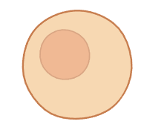
Our goal is to generate enhancer sequences that drive gene expression in specific contexts
Increased
Transcription
Enhancer
Gene
Promoter
Notes:
They are responsive to cellular context, so the same enhancer sequence may be active in certain contexts…

Slide 57
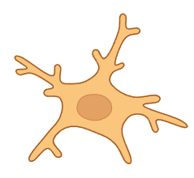
Our goal is to generate enhancer sequences that drive gene expression in specific contexts
Transcription rate not increased
Enhancer
Gene
Promoter
Notes:
…but inactive in others.

Slide 58
Our goal is to generate enhancer sequences that drive gene expression in specific contexts
Can we design enhancer sequences with context-specific activity?
Enhancer
Gene
Promoter
Notes:
For this part of the talk, we’re going to focus on a goal of context-specific enhancer design. Can we design enhancer sequences that are active in certain cellular contexts, but not in others?

Slide 59

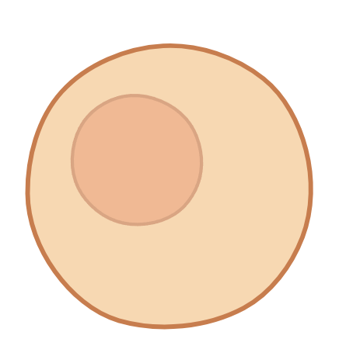
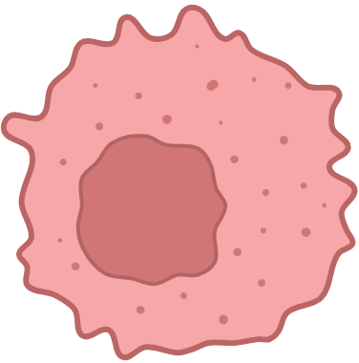
Context-specific enhancer design enables control and understanding of gene expression
Plasmid
Notes:
Why do we want to do this? Context-specific enhancer design enables control and understanding of gene expression. The ability to control gene expression has impacts on applications like gene therapy. Let’s say that you have a plasmid, that maybe expresses a pathogenic protein that will kill off a cell.

Slide 60
Context-specific enhancer design enables control and understanding of gene expression
Gene not expressed
Gene expressed
Plasmid
Notes:
You could broadly transfect cells with the plasmid but design an enhancer sequence that means the gene (animation) will only be expressed in cancer cells, but not in other cells. In other words, this gives us strategies where the targeting of cells doesn’t have to be specific, because our control of gene expression is. But taking a step back into more basic biological questions – I said earlier that we still don’t completely understand the principles in how enhancers drive this specificity. Being able to design enhancer sequences that drive this kind of cell state specific gene expression also means that we can reverse engineer principles – we can analyze sequences to try to determine features or properties of the sequence that drive this specificity.

Slide 61
Previous generative models of enhancers use massively parallel reporter assays (MPRAs) to label sequences
Reporter Gene (GFP)
Barcode
Plasmid
Library
Enhancer sequence
(different for each plasmid)
Notes:
Because context-specific enhancer design is so impactful, there have already been conditional generative models proposed for this. Most of these rely upon massive parallel reporter assays, or MPRAs, to label sequences for training. MPRAs usually start with libraries of plasmids. Each plasmid will contain a different enhancer sequence, a reporter gene – usually green fluorescent protein, and a barcode.

Slide 62
Previous generative models of enhancers use massively parallel reporter assays (MPRAs) to label sequences
Plasmid
Library
Notes:
We can transfect cells representing different cellular contexts with this plasmid library. The idea is that if the enhancer drives gene expression in a specific cell context…

Slide 63
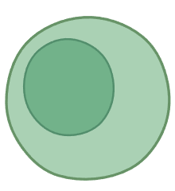
Previous generative models of enhancers use massively parallel reporter assays (MPRAs) to label sequences
Plasmid
Library
Notes:
Green fluorescent protein will be expressed, causing the cell to glow under certain wavelengths of light, whereas if the enhancer doesn’t drive gene expression, the cell won’t.

Slide 64
Previous generative models of enhancers use massively parallel reporter assays (MPRAs) to label sequences
Sort and
sequence
barcodes
…
Plasmid
Library
…
Notes:
We can use this fluorescent signal to sort cells, sequence just the fluorescent cells, and use the barcodes to identify what enhancer sequences drive expression in what cell contexts.

Slide 65
Previous generative models of enhancers use massively parallel reporter assays (MPRAs) to label sequences
…
Training
Generative Model
…
Plasmid
Library
Notes:
This data effectively gives us a list of sequences that drive activity for a specific cellular context and can be used to train conditional generative models. During training, the model is given an identifier representing the cell context we want to design sequences for and trained to output these sequences.

Slide 66
Previous generative models of enhancers use massively parallel reporter assays (MPRAs) to label sequences
…
Training
Generative Model
…
Plasmid
Library
Test
Generative Model
Notes:
Hopefully, if we have enough data to train a generalizable model, the model will generate novel sequences during test time that are active in the cell context. Overall, this is a beautiful cycle between wet lab experimentation and computational modeling, but it has its limitations.

Slide 67
Label-conditioned generative models create a chicken and egg problem with experimentation
This is probably a cell
line that cultures well!
…
Training
Generative Model
…
Test
Generative Model
Notes:
And in particular – I think it creates a chicken and egg problem with experimentation. Because if you go back to the MPRA – chances are if you can do a MPRA, these are going to be cells you can easily culture.

Slide 68
Label-conditioned generative models create a chicken and egg problem with experimentation
This is probably a cell
line that cultures well!
…
Rare cells, transient
cell states, etc. may be
difficult to collect data for.
Training
Generative Model
…
Test
Generative Model
Notes:
This leaves out rare cell types, or transient cell states, that may be difficult to collect data for.

Slide 69
Label-conditioned generative models create a chicken and egg problem with experimentation
This is probably a cell
line that cultures well!
…
Rare cells, transient
cell states, etc. may be
difficult to collect data for.
Training
Generative Model
…
Cell context space grows
combinatorically:
cell type, environment,
epigenetic state, etc.
Test
Generative Model
Notes:
Typically, MPRAs are conducted on different cell types in baseline conditions. But cell type is not the only thing that will influence enhancer activity – things like environmental perturbations, epigenetic modifications, and other factors, can also alter activity. However, considering these factors means cell context space grows combinatorically. That’s another limitation of this strategy – brute force collection of data for all the cell states we want to generate sequences for is just not tractable. In sum - we don’t just want to design for well-studied contexts that are the most amenable for wet lab experimentation. How do we reach cell contexts that don’t have high-throughput data associated with them?

Slide 70
Can we conditionally generate enhancers through examples, rather than through specification?
Generation through specifying cell context
Generative Model
…
Generative Model
Generation through example
…
Notes:
My proposal is that instead of building generative models that rely upon specification of cellular context to conditionally generate sequences, why don’t we conditionally generate enhancers through examples? We would show the model one or multiple sequences, and we would ask it to generate different sequences, that have a similar function. This means we could still generate sequences even if we knew only a single enhancer sequence active in that cell context. It also means we can conditionally generate sequences even if we don’t fully know the function of the sequence a priori – and that might help us figure out the function of the sequence, because we have more examples to identify patterns from. In other words, generating from example means we can still generate sequences even when we have limited data, or limited prior knowledge of function.

Slide 71
Can we conditionally generate enhancers through examples, rather than through specification?
To train this model, we need sets of different enhancer sequences that have similar (and diverse) functions
Generative Model
…
Notes:
To train a model that can conditionally generate from example – we need to have, as training data, sets of enhancer sequences that have similar and diverse functions.

Slide 72
Can we conditionally generate enhancers through examples, rather than through specification?
To train this model, we need sets of different enhancer sequences that have similar (and diverse) functions
Generative Model
…
Evolution provides us with these observations!
Notes:
Evolution provides us with these observations!

Slide 73
Multiple sequence alignments identify the same enhancer across species
Enhancer
Enhancer
Promoter
Gene
Evolution provides observations of diverged sequences with similar function
Notes:
Revisiting multiple sequence alignments, what these alignments can do is identify instances of the same enhancer over different species. (Animation) Because evolutionary time causes the accumulation of mutations, and non-coding regions tend to evolve fairly rapidly, these sequences are going to be naturally diverged. But because function tends to evolve slower than sequence, these sequences will have similar, but probably not exactly the same function. But the point is that evolution can give us a huge amount of reasonable quality data, to train our from-example generative model.

Slide 74
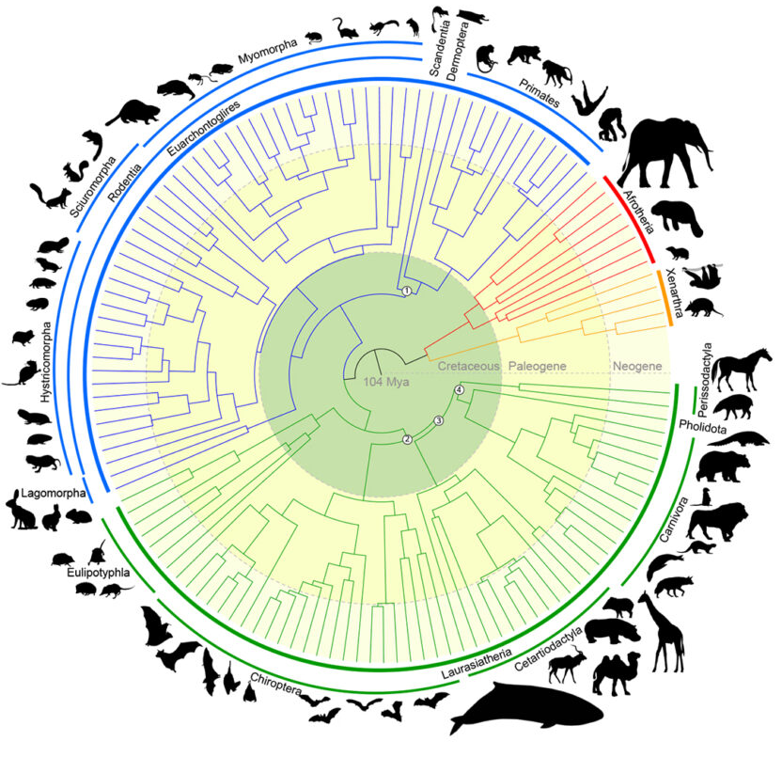
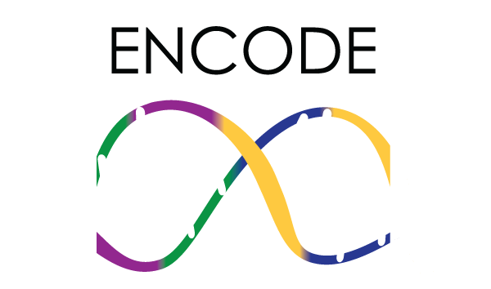
We curate the largest collection of enhancer homology families to date
233,158,475 homologs across
1.7 million enhancer homology families
X
=
ENCODE SCREEN:
1.7 million human enhancers
Zoonomia 241-way mammalian alignment
Notes:
To implement this idea, we created the largest collection of enhancer homology families to date. This is done by taking ENCODE SCREEN, which has identified 1.7 million candidate human enhancers, and cross-referencing it against the Zoonomia project’s 241-way mammalian alignment to identify homologs for these enhancers. When this is done, we curate more than 200 million homologs, across 1.7 million enhancer homology sets.

Slide 75
EnhancAR is trained autoregressively on unrolled homology families
ATCGATC
TGATC
ATGGAA
{ ATCGATC / TGATC / ATGGAA }
/
T
G
A
T
EnhancAR
EnhancAR
EnhancAR
EnhancAR
EnhancAR
{ ATCGATC
{ ATCGATC /
{ ATCGATC / T
{ ATCGATC / TG
{ ATCGATC / TGA
(170M Parameter Jamba Model)
Notes:
To train our model, we take these homology sets, randomly sample up to 64 sequences, and unroll them as a single long sequence that separates individual homologs with separator tokens. We train an autoregressive model called EnhancAR on these unrolled sequences, using a next token prediction task.

Slide 76
Autoregressive training enables flexible generation modes at inference time
Autoregressive training means EnhancAR sees homology families with variable number of sequences during training
{ ATCGATC /
EnhancAR
{ ATCGATC / TGATC/
EnhancAR
{ ATCGATC / TGATC / ATGGAA
EnhancAR
{
EnhancAR
Notes:
The reason why we decided to train this model autoregressively is because it enables flexible generation modes. Autoregressive training means that EnhancAR sees homology families with a variable number of sequences during training. Sometimes it’ll see one sequence and be asked to generate the next token. Sometimes it’ll see two, or more. And sometimes it may not see any sequences and have to generate completely from scratch. We reasoned this is a good property, because during inference, for a given sequence, we might have a lot of examples, or we may have very few examples. Autoregressive training means EnhancAR has been exposed to both kinds of inputs, so it should be able to handle both scenarios.
(8:30)

Slide 77
EnhancAR: Key Results
EnhancAR generates novel sequences that preserve functional features (i.e. motifs)
EnhancAR can design cell-type specific enhancers without cell-type information at training or inference time
Notes:
This was a long project that went over two years, and in fact, we’re still working on wet lab validation. It’s impossible for me to show you all of our results today, so I’m going to focus on three key results. I’ll show you that EnhancAR, for arbitrary enhancers in the genome, can generate novel sequences that preserve functional features – motifs. Second, EnhancAR can design enhancers predicted to be cell-type specific, without explicit cell-type information at training or inference time. Third, I’ll show you how the number of examples interacts with generation quality.

Slide 78
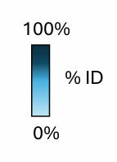
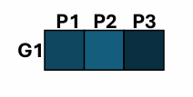
EnhancAR generates novel and diverse sequences
P1
Prompt sequences
(Real homologs)
P2
P3
EnhancAR
Generate Sequence
G1
Quantify Novelty
Notes:
The first thing we did was to evaluate if EnhancAR is capable of generating novel and diverse sequences. Our strategy is to generate sequences from example. There’s not much of a point in our model, if it just gives us sequences that are basically identical to the sequences we prompt it with. To make sure this isn’t happening, we generate sequences from prompt sequences that are real homologs – for our experiments, we use 63 prompt homologs – and we quantify novelty by measuring the percent identity of the generated sequence against any of the prompts.

Slide 79
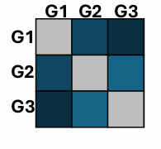
EnhancAR generates novel and diverse sequences
P1
Prompt sequences
(Real homologs)
P2
P3
EnhancAR
Quantify
Diversity
Generate Sequence
Generate Set
G1
G1
G2
G3
Quantify Novelty
Notes:
The second thing we wanted to check if EnhancAR diversifies generations. If you generate sequences over and over again, using different random seeds, from the same homology family, do you get the same generated sequence each time? Or do you get different generated sequences? We measure this by generating multiple sequences – 63 again in our experiments – and comparing the percent identity of sequences within the set of generated sequences against each other.

Slide 80
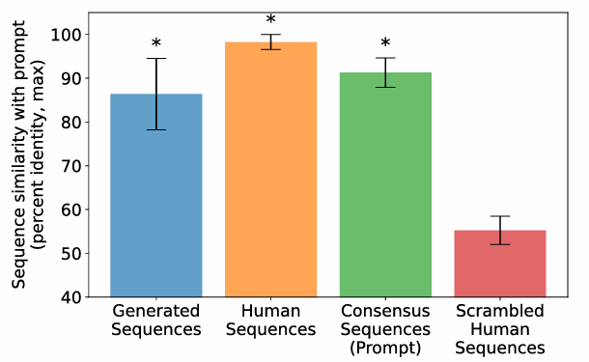
EnhancAR generates novel and diverse sequences
We generated sequences for 1000 randomly selected (unseen) enhancers in the genome
Novelty
Notes:
To test this, we generated sequences for 1000 randomly selected test enhancers in the genome. First, our novelty metric – the y-axis is showing percent identity, so the lower the bar, the more novel the sequence. We hold out the human sequence from all our prompts, so we can use it as a baseline of a real enhancer sequence. We also calculate the consensus sequence, as a naïve design strategy. As a lower bound, we scramble the human sequence – this will in almost all cases totally destroy the function of the enhancer, but tells you what the floor on this metric is if you didn’t care about preserving function. Our generated enhancers are obviously not at that floor, but we still generate sequences with a lower percent identity than the human sequence, and consensus design strategies.

Slide 81
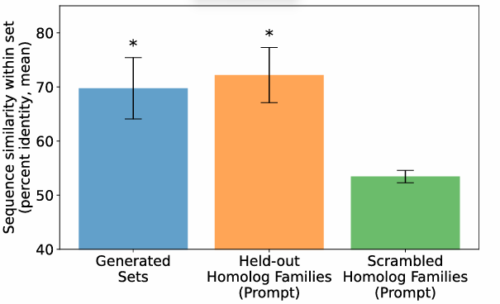
EnhancAR generates novel and diverse sequences
We generated sequences for 1000 randomly selected (unseen) enhancers in the genome
Novelty
Diversity
Notes:
Next testing the diversity of our sequence sets, we compared sets of sequences generated from the same homology family as prompt, against real held-out homology families. We also shuffle the members of homology families and calculate their similarity – and again, this is our floor, showing what similarity would be if we had sets of sequences that did not share function with each other. The diversity of sequences we generate with a set, is statistically significantly lower, just by a little bit, for the level of diversity that we see for real homologs. This is good, because it suggests that our model, at minimum, is generating sequences at a level of diversity similar to what evolution induces between mammals.

Slide 82
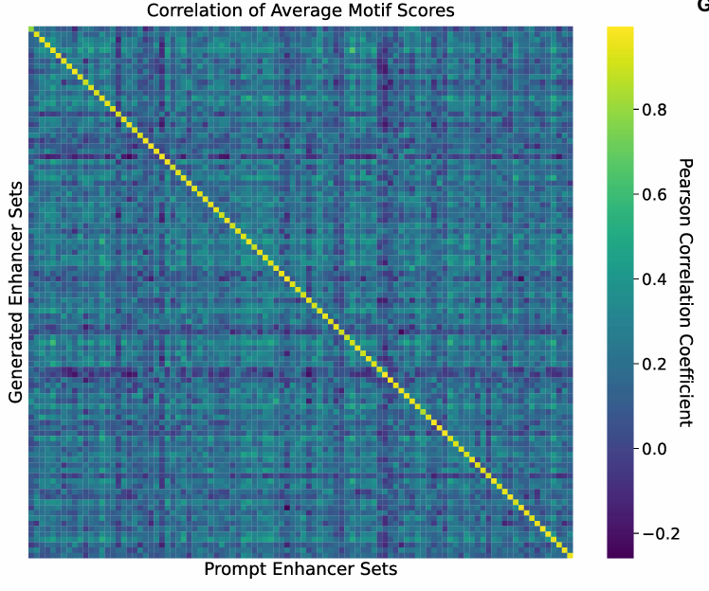
EnhancAR maintains functional sequence features in its generations
We generated sequences for 1000 randomly selected (unseen) enhancers in the genome
JASPAR catalogues known transcription factor binding motifs
(879 motifs for vertebrates)
Notes:
Of course, just making the sequence different isn’t worth much unless we’re retaining the function of the sequence. This is somewhat difficult to quantify, as we’re working with randomly selected enhancers in the genome – the function of most enhancers isn’t strongly characterized. But as a proxy for function, we can look to the JASPAR database, which catalogues known transcription factor binding motifs. These are patterns in sequences that are known to have strong affinities for transcription factors, so if that motif occurs in an enhancer, it is more likely to be a functional feature of the sequence than say, a randomly selected subwindow. We can scan sequences for these motifs and construct a vector that represents the presence or absence each of these motifs – there are about 900 of them. In the right figure, we calculated the Pearson correlation coefficient between these motif vectors for sets of generated enhancers, versus the real homology families used to prompt generation. There is a strong diagonal in this matrix, and not off the diagonal. This tells us that our generations preserve the unique “signature” of motifs seen for each given prompt homology family, suggesting that we preserve these functional sequence features in our generations.

Slide 83
EnhancAR can design cell-type specific enhancers
Notes:
Since motifs are just a weak proxy for function, we next wanted to more strongly verify we were designing functional sequences. To do this, we decided to see if EnhancAR can generate cell-type specific enhancers, because cell types are where the field has the strongest grasp of enhancer function. Remember that EnhancAR has never been trained on cell type labels. The way we generate cell type-specific enhancers then, is we identify human enhancers that are specific to a cell type, get homologs for these enhancers, and then generate sequences using these homologs as prompts. We then verify the generations using computational oracles, and if we are really generating cell-type specific enhancers, then we should see predicted activity for that cell type, but not others.

Slide 84
EnhancAR can design cell-type specific enhancers
Notes:
Here, we validate EnhancAR designs using the MPRALegNet models previously trained by Agarwal et al. 2025. These models predict enhancer activity based upon sequence, and there are three oracles, for HepG2, K652, and WTC11 cells. For each of these cell, we identify enhancers specific to the cell type, and we evaluate the activity of the human enhancers, of homologs of the human enhancer, and of our generations. We have the scrambled human sequence as a negative control here. Let’s focus on the human enhancer, which is our positive control. Across oracles, the human cell-type specific enhancer has high activity in the relevant cell type, but no activity in others. That’s good. Next if you look at the homologs, they also exhibit this specificity, although expression is predicted to be lower than using the human sequence. This makes sense biologically – homologs probably don’t perfectly preserve human activity. For example, transcription factor affinity for sequence may drift over evolution. We can’t fully rule out technical explanations – the oracles are trained on human sequences, so it’s possible they don’t generalize across sequences from different species. But I do think the biological explanation is compelling through principle still. What this means is that design through example homologs may not optimize function, even if it gets you something functional. And this is exactly what we see in our generations – generally, our generations are specific to cell types, but they match the activity of homologs, not the real human enhancers. That’s still exciting – it means that EnhancAR can generate cell-type specific enhancers.

Slide 85

EnhancAR: Key Takeaways
Using evolutionary homology to prompt generation enables design
EnhancAR can design cell-type specific enhancers cell-type information at training or inference time
Design through homology may not optimize activity
EnhancAR
Can we use evolution to steer generative models of enhancers?
Read our preprint
Andrew
Duncan
Notes:
Ok – that’s EnhancAR. Key takeaways. I argued in this part of the talk, that using evolutionary homology to prompt generation enables conditional design of enhancers without prior knowledge or experimental data of function. To demonstrate this, I showed you that EnhancAR can design cell-type specific enhancers cell-type information at training or inference time. Of course, cell-type specific enhancer design is only the tip of the iceberg, because we think this strategy is most useful for less understood cell contexts – but in future iterations of our work, we have some wet lab experiments lined up that will demonstrate this. Finally, I think it’s important that we acknowledge some limitations of our strategy here – design through homology may not optimize activity, even if it maintains it. This puts EnhancAR in contrast to some previous proposals that show that you can design activities that exceed that seen of nature – here we simply aim to match what is maintained by evolution.

Slide 86
Evolution improves generative genomic models
Predicting rate of evolution leads to improved latent understanding of genomic sequences
Using homologs to prompt generative models reaches new design spaces for enhancers
Notes:
To conclude the talk, let’s zoom out. I showed you today that evolution improves generative genomic models. I showed you that predicting the rate of evolution as a pretraining task leads to improved latent understanding of genomic sequences in the Gamba project. And I showed you that using homologs to prompt generative models can help us reach new design spaces for enhancers.

Slide 87
Evolution improves generative genomic models
Predicting rate of evolution leads to improved latent understanding of genomic sequences
Using homologs to prompt generative models reaches new design spaces for enhancers
These are not new insights!
Bioinformaticians have used evolution for decades!
Notes:
While these technical innovations are exciting, I want to emphasize – these are not new insights. In some ways, the fact that evolution both improves and expands capabilities of generative genomics models is an obvious insight. Bioinformatics have used evolution as decades – it is one of the most powerful and widely applied indicators of function. Part of me is like, I’m very happy we did this work, but it also felt like a pretty obvious thing to try.

Slide 88
Evolution improves generative genomic models
Predicting rate of evolution leads to improved latent understanding of genomic sequences
Using homologs to prompt generative models reaches new design spaces for enhancers
These are not new insights!
Bioinformaticians have used evolution for decades!
Domain knowledge and interdisciplinary collaboration can
improve generative modeling efforts in biology
Notes:
The big picture here then is the importance of domain knowledge and interdisciplinary collaboration. As we gear up efforts in AI for biology, we need to recognize that these are storied fields with long legacies of methods – and the reason why some methods have persisted so long, is because they incorporate strategies that are tailored to biological data. I think for us to build truly effective generative genomics models, we need to look to strategies, methods, and knowledge that has been accumulated in bioinformatics over decades. And I think this is going to be key to solving how models are currently not as effective, efficient, or general as we’d like, empowering the next wave of generative modeling efforts.
(13 minutes)

Slide 89
1
2
3
4

Slide 90
“Genomic sequences are really really complicated”
Notes:
“You guys – it turns out that genomic sequences are really, really complicated.” That might sound obvious – but I want us to appreciate just how much our appreciation of the complexity of genomes has advanced in a short time.

Slide 91
Variant effect prediction ranks mutated sequences based upon their pathogenicity
Notes:
There are a few ways you can execute this. First, if you have a genome language model trained on sequence reconstruction - these are generative models. You can look at the probability of generating the mutated nucleotide versus the reference genome nucleotide at the position, and score the sequence based upon how improbable the mutant is relative to the reference. The more improbable, the most pathogenic the sequence will be.

Slide 92
Variant effect prediction ranks mutated sequences based upon their pathogenicity
Notes:
Conversely, if you’re working with conservation scores like PhyloP, or models like ours that predict scores, then you can use the score itself to rank variants. The higher the score is, indicating that the position is more conserved, the higher you want to rank the variant – it indicates mutations in that position are not observed frequently in nature.

