Slide 1
AI to accelerate scientific discovery – even when we don’t know what we want to discover
Alex Lu
Microsoft Research
lualex@microsoft.com
Notes:
My name is Alex, and I’m a researcher at Microsoft Research New England – thank you to the department for hosting me, and in particular, to my collaborator, Annemarie Kocab, for the invitation and for organizing. A bit of background about me – I am a computational biologist, and I work at the intersection of AI and biology. I work across several biological disciplines, including microscopy, proteins, single-cell transcriptomics, and genomics. So this might be a bit different of a talk than what you’re are accustomed to, because I’ll be talking a lot about biology, since that’s where my background is concentrated – knowing this might not be the background of many folks in my audience, I’ve endeavored to make this as accessible as possible, but please interrupt with questions if I’m losing you. But the goal of this talk is to use these biological examples to highlight a theme that I feel will be applicable to many of you – how we can use AI to accelerate scientific research, particularly in fields where AI has yet to make an impact, because the data or conditions are not aligned with what classically makes AI effective. I’ll start off by our research in protein biology to illustrate this, but by the end of the talk, we’ll transition to talking about how these concepts can be used for sign language linguistics research.

Slide 2
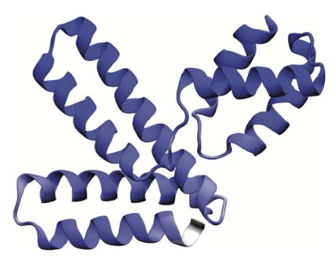
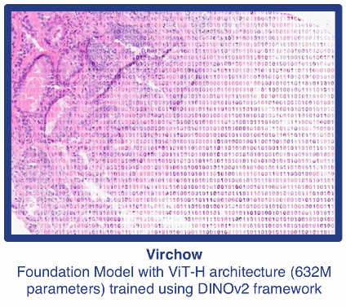
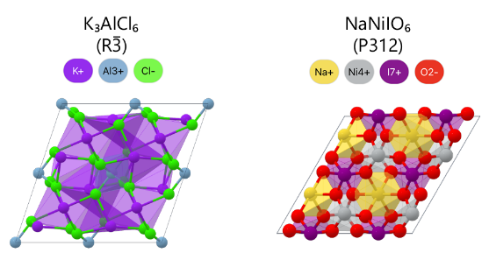
AI is revolutionizing science
Proteins
Pathology
Materials
EvoDiff
Virchow
Mattergen
Generative models trained on 50 million sequences can synthesize novel proteins
Digital pathology models trained on 1.5 million slides improve cancer detection
Model trained on 600,000 crystal structures generate novel inorganic materials
Alamdari et al. 2024
Vorontsov et al. 2024
Zeni et al. 2024
Notes:
AI is revolutionizing science. In just the past few years alone, we’ve seen tremendous advances across scientific disciplines. For example, in protein biology, generative models of proteins can synthesize novel proteins not seen in nature. In pathology, models are improving cancer detection. In materials science, we can now synthesize novel inorganic materials using models trained on crystal structures. Together, this paints a picture where AI is an increasing partner in scientific research – not just accelerating it but also unlocking capabilities not possible before. However, this increase in the development and deployment of AI methods also raises a question: are all scientific disciplines evenly benefitting from AI?

Slide 3
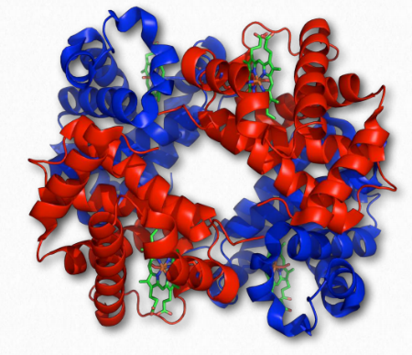
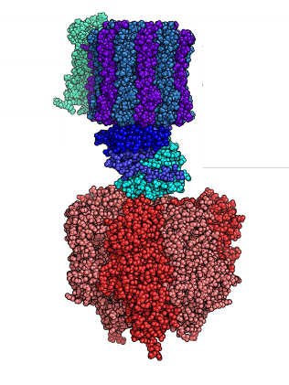
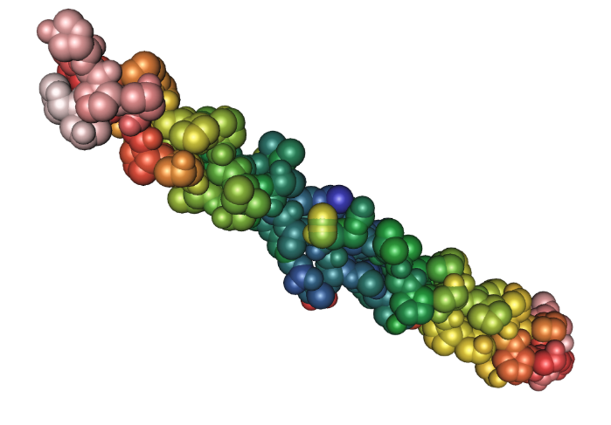
Proteins Actuate Most
Biological Functions
Collagen
Hemoglobin
ATP Synthase
Notes:
In my experience, this is not the case – advancements in AI for science are uneven, with some fields deeply benefiting, and others being left out. To try to convince you of this, I’m going to talk to you about what AI advances look like for protein biology. But first, a bit of background about proteins, so that everyone’s on the same page. Proteins are molecules that actuate most biological functions. Most functions in your body are carried out by proteins. For example, if you look at your hair or nails, the protein collagen is responsible for their structure. Hemoglobin carries oxygen in red blood cells. And ATP synthase is the protein that produces, ATP, the energy currency of cells. These are just three proteins – in humans, there are about twenty thousand different proteins. And across all organisms we’ve sequenced, we’ve identified billions of different proteins. So you can imagine the staggering and diverse array of functions that proteins, as a class, perform.

Slide 4
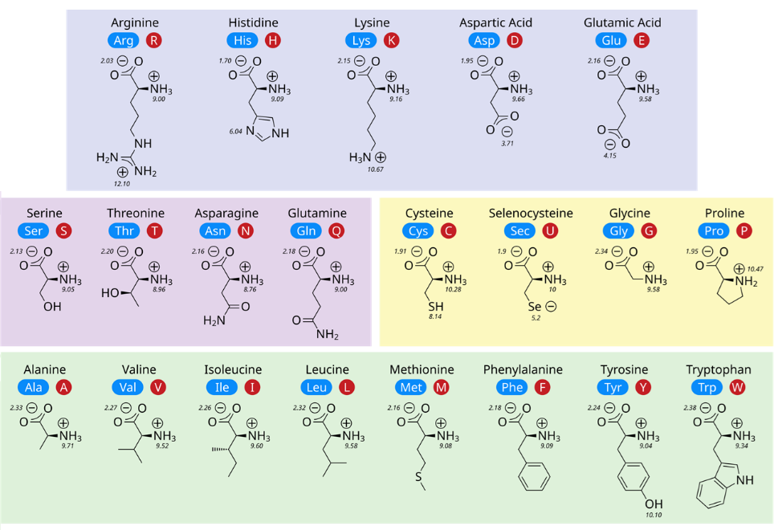
Proteins are made of amino acids
Notes:
Proteins are made of amino acids, and in total, there are twenty different amino acids, each with their own properties. Some are small, some are large. Some are negatively charged, some are positively charged. Some are hydrophobic, others are polar.

Slide 5
Proteins are made of amino acids
A
R
D
I
L
A
C
F
G
Protein Sequence
Notes:
These twenty amino acids are the building blocks for virtually all proteins and are arranged in a linear chain – each protein is a chain of typically a few hundred, to a few thousand amino acids. This means, as data, we can represent a protein as a string called a protein sequence – here, we denote each amino acid by a letter – for example, A corresponds to the amino acid Alanine, R is arginine and so forth.

Slide 6
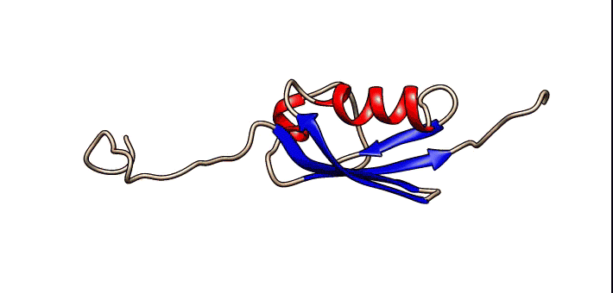
Sequences fold into Structures
A
R
D
I
L
A
C
F
G
Protein Sequence
Notes:
Because amino acids have physical properties, these sequences will self-assemble into structures, based upon what’s energetically favorable. For example, positively charged amino acids often like to be in contact with negatively charged ones. Hydrophobic amino acids like to be buried on the inside of the protein, away from water. Large or rigid amino acids may constrain the protein from moving in certain ways. Ultimately, the sequence of the protein determines the structure of the protein, which in term, determines what the protein function is.

Slide 7
Structured and Disordered Regions
Structured Regions
Comprise ~60% of
all human proteins
Notes:
This animation shows the structure of one protein, which we can categories into two kinds of regions. The first is structured regions, colored in red and blue in this image. These are parts of a protein that fold into a relatively rigid, fixed structure. There are many ways this can produce function, but to give you some examples, in some cases, the structure can produce a pocket that perfectly fits another molecule, allowing the protein to bind to that molecule. Or the structure could produce a channel through the protein, allowing it to transport molecules between membranes in a cell. Structured regions comprise about 60% of all human proteins.

Slide 8
Structured and Disordered Regions
Structured Regions
Comprise ~60% of
all human proteins
Disordered Regions
Comprise ~40% of
all human proteins
Notes:
The other part of proteins are disordered regions, which don’t fold into a rigid structure, and remain flexible. Just like how structure facilitates many functions, flexibility also facilitates many functions. For example, some disordered regions facilitate interaction with many different molecules, because they can adapt their shape to different interacting partners. In total, disordered regions make up about 40% of all human proteins. The reason why I introduce this taxonomy is because even though both regions are critical for function, and they comprise roughly equal proportions of proteins – the AI landscape for structure versus disorder could not look more different.

Slide 9
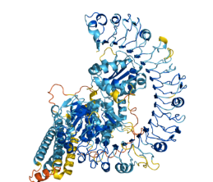
Computational methods for structure vs Disorder are Imbalanced
Sequence-to-structure prediction (Alphafold)
MAGELVSFAVN…
Jumper et al. 2021
Notes:
Let’s say you’re a scientist who works with structured regions – right off the bat, you have many AI tools that are applicable to you. For example, you have models that can predict the structure of a protein given a protein sequence – the most famous of which would be Alphafold, which won a Nobel prize last year.

Slide 10
Computational methods for structure vs Disorder are Imbalanced
Sequence-to-structure prediction (Alphafold)
MAGELVSFAVN…
Jumper et al. 2021
Structure-to-sequence prediction (ProteinMPNN)
MAGELVSFAVN…
Dauparas et al. 2022
Notes:
You have AI methods that can predict the sequence of a protein from a structure.

Slide 11
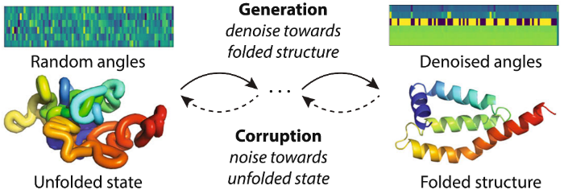
Computational methods for structure vs Disorder are Imbalanced
Sequence-to-structure prediction (Alphafold)
MAGELVSFAVN…
Jumper et al. 2021
Structure-to-sequence prediction (ProteinMPNN)
MAGELVSFAVN…
Dauparas et al. 2022
Generative structure models (FoldingDiff)
Wu et al. 2024
Notes:
And you have models that can generate de novo protein structures, never seen before in nature, from scratch – including FoldingDiff, which my colleagues and I produced.

Slide 12
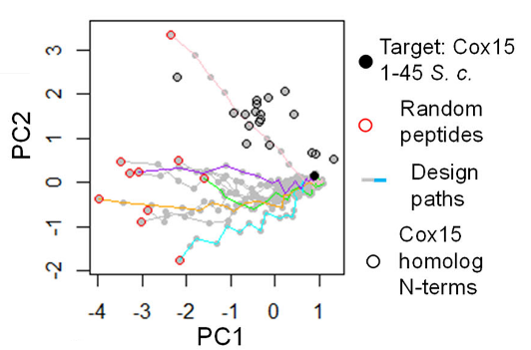
Computational methods for structure vs Disorder are Imbalanced
Sequence-to-structure prediction (Alphafold)
MAGELVSFAVN…
Recent computational design proposals for disordered regions use simple greedy optimization
Jumper et al. 2021
Structure-to-sequence prediction (ProteinMPNN)
MAGELVSFAVN…
Dauparas et al. 2022
Generative structure models (FoldingDiff)
Strome et al. 2023
Wu et al. 2024
Notes:
In contrast, if you’re a scientist who works with disordered regions, you have much fewer applicable AI methods. I don’t want to undermine existing AI methods for disordered regions, because some really are great – and I have some contributions in this area that I’ll show you later in the talk – but the performance and sophistication of methods do lag substantially behind. To give you a sense of how behind advances in disordered regions are – for generation, even as incredibly advanced generative models emerge for structure, recent methods for designing disordered regions remain basic. As recent as 2023, state-of-the-art proposals don’t even leverage AI, but simple greedy optimization – the idea is if you can manually identify desired features of a protein sequence, you can change one amino acid at a time, to optimize for that feature.

Slide 13
Disordered regions are difficult to generate knowledge for
Sequence
Function
MQRLLFPPLRALKGRQYLPLLAPRAAPRAQCDCIRRPLRPGQYSTISEVALQSGRGTVSLPSKAAERVVGRWLLVCSGTVAGAVILGGVTRLTESGLSMVDWH…
This protein catalyzes the second reaction in the biosynthesis of heme A
Notes:
Why is this happening? Why is there such an abundance of AI methods for structure, but not for disorder? One explanation is that the distinct biology of disordered regions also makes them difficult to generate knowledge for. With proteins, we are often interested in knowledge about how sequence relates to function. Characterizing this relationship is difficult, because the search space on both ends is huge. Proteins can carry out millions of functions – how do we know which function to test for? Similarly, proteins are hundreds to thousands of amino acids long – how do we know which amino acid, or combinations of amino acids to change to alter function?

Slide 14
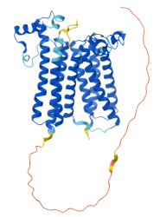
Disordered regions are difficult to generate knowledge for
Sequence
Function
MQRLLFPPLRALKGRQYLPLLAPRAAPRAQCDCIRRPLRPGQYSTISEVALQSGRGTVSLPSKAAERVVGRWLLVCSGTVAGAVILGGVTRLTESGLSMVDWH…
This protein catalyzes the second reaction in the biosynthesis of heme A
Structure
Notes:
The reason why structure predictors are so central is because they can narrow the search space for both. Often, even just looking at the structure hints at the function of the protein. And similarly, because you can see what amino acids are in contact with each other, and contribute towards structure, you get a sense of what parts of the sequence you can alter to change function.

Slide 15
Disordered regions are difficult to generate knowledge for
Sequence
Function
MQRLLFPPLRALKGRQYLPLLAPRAAPRAQCDCIRRPLRPGQYSTISEVALQSGRGTVSLPSKAAERVVGRWLLVCSGTVAGAVILGGVTRLTESGLSMVDWH…
This protein catalyzes the second reaction in the biosynthesis of heme A
?
?
Disorder
Notes:
The same logic does not apply to disordered regions. Structure predictions just spit out a long strand, that while tells you the region is disordered, doesn’t tell you about the function of the disorder, or which parts of the sequence, by nature of contributing to structure, might be important. This doesn’t just apply to structure predictors – many computational biology tools we have for generating insights into proteins weaken when applied on disordered regions, because the biology behaves so differently.

Slide 16
Disordered regions are difficult to generate knowledge for
Fewer sequences where function is known
Structure is well-defined, function is open-ended
Disorder
Notes:
This has two impacts. First, for disordered regions, we have fewer sequences where function is known. It’s harder to characterize the function of disordered regions. Second, in structured regions, researchers will often go from sequence, to structure, to function, using sequence as an intermediary step to narrow the search scope. But because that logic doesn’t apply to disordered regions, it’s more common to try to jump directly from sequence to function. But unlike structure, which has a defined answer, function is open-ended – there’s no single right answer to the question “what is the function of this sequence”. You might be interested in the function of a protein inside versus outside of a cell. Or different aspects of function, like which molecules it interacts with versus which cell compartment it locates in.

Slide 17
Challenges in disordered regions interact poorly with AI
Fewer sequences where function is known
Structure is well-defined, function is open-ended
AI is data hungry and benefits from large labeled datasets
AI benefits from well-defined, closed-form problems
Notes:
In turn, these conditions interact poorly with requirements for AI. AI is data hungry, and benefits from large labeled datasets – and we have less of that. AI also benefits from well-defined, closed-form problems – and function behaves less like that, unless you work hard to scope function.

Slide 18
Outline of Talk
How can AI make an impact when data or problem definition is limited?
Overview of current methods
  Self-supervised foundation models → Limited labeled data
  Model transfer → Limited data
  Exploration with embeddings → Limited problem definition
Limitations of current methods
  Foundation models may not learn embeddings relevant to our problems
  Controlling learning through principled design of pretraining tasks
Applications in sign language linguistics
Notes:
In summary, this means that the fields most poised to benefit from AI are data-rich fields that have accumulated extensive prior knowledge. I don’t think that’s great, because it creates a “rich gets richer” effect. How can we solve this? How can AI make an impact even when data or problem definition is limited? In today’s talk, I’m going to make moves towards answering this. First, I’m going to bring you to the forefront of our existing methods for this – I’ll show off advances in self-supervised foundation models, model transfer, and exploration with embeddings, which respectively address problems in limited labeled data, limited data, and limited problem formulation. Next, I’m going to show where we’re still limited – existing foundation models may not learn embeddings that are relevant to our problems – and I’ll show you one potential solution to this that I spend a lot of time thinking about, controlling what these models learned through principled design of pretraining tasks. Finally, while for the first part of the talk, I’m going to use examples from computational biology because we have a lot of mature research in that area, for the last part of the talk, I’ll talk about some of our emerging research, where we’re applying similar concepts to make an impact for sign language linguistics. So that’s our road map today.

Slide 19
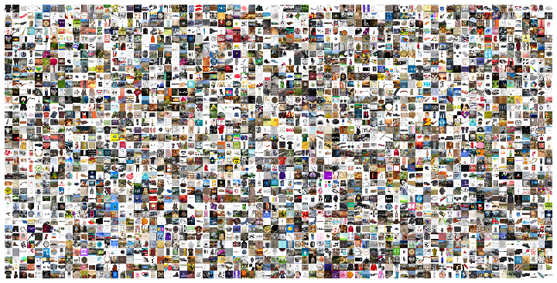
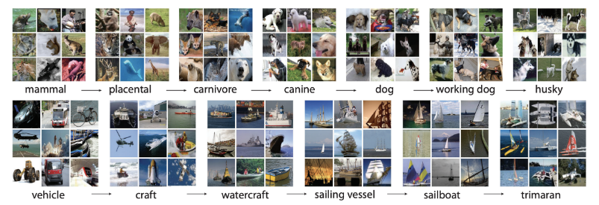
Unlabeled data is usually more abundant than labeled data
While labeled data is hard to collect, large unlabeled datasets may exist
ImageNet-1K
(Russakovsky et al. 2014)
1 million labeled natural images
Laion-5B
(Schuhmann et al. 2022)
5.85 billion unlabeled natural images
Notes:
Let’s begin by talking about data, because data is centric to AI, given that AI are data-driven methods that need large quantities of data to learn from. One observation that we can take advantage of is the idea that unlabeled data tends to be much more abundant than labeled data across many fields. What I mean by labeled data is data where each datapoint has an annotation attached to it, of something that would be useful to a model to output or predict. For example, with natural images, object recognition is useful, so you might take an image, and annotate it with “dog”, indicating there is a dog in the image. This is a central problem in computer vision, and the go-to dataset in that field is ImageNet-1K, which contains 1 million labeled images. But that number slouches off the number of images you could get by scraping the internet – something prepared in the Laion-5B dataset, which contains nearly 6 billion unlabeled images.

Slide 20
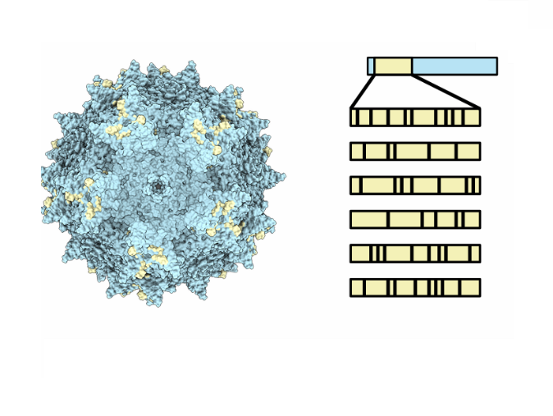
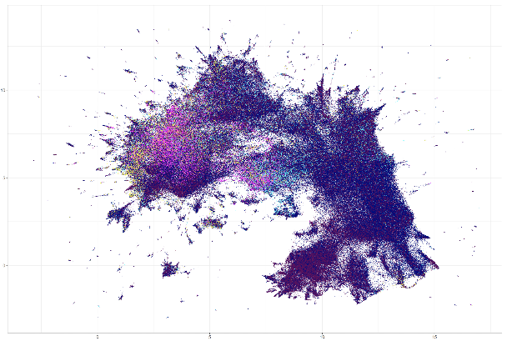
Unlabeled data is usually more abundant than labeled data
While labeled data is hard to collect, large unlabeled datasets may exist
Protein fitness datasets (labeled)
(Dallago et al. 2022)
100s – 10,000s of sequences
Proteins across public databases (unlabeled)
(Buchfink et al. 2023)
19 billion sequences
Notes:
This is not an uncommon trend. Labels can be difficult to acquire because they require human judgment. But they can also be difficult to acquire because the experimental process driving them is low-throughput, time-consuming, or expensive. This is often the case for protein fitness datasets – or datasets that try to measure a specific aspect of protein function across small variations in protein sequences. Sometimes the experiment required to measure that aspect of function is expensive, so many datasets contain measurements for only hundreds to thousands of sequences. But even as this labeled data is scarce, we have access to a large amount of unlabeled protein sequences – 19 billion across public databases.

Slide 21
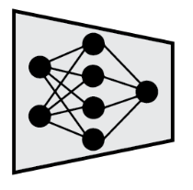

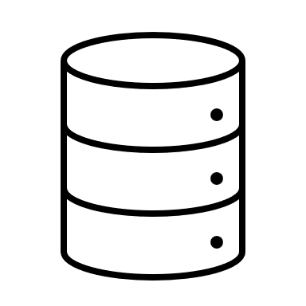
Directly fitting on limited labeled data can lead to poor performance
Predictions
Labeled Data
Notes:
Why is it important to distinguish between labeled and unlabeled datasets? Labeled data allows us to train models that can make predictions. This is because we can show the model the data, ask it to produce a prediction, and then since we know what the label is, we can tell the model how off the prediction was, and that becomes a signal for the model to learn how to improve its predictions. The problem is that if you only have a small labeled dataset, you might learn a model that performs poorly when getting it to output predictions on new unseen data. This is because a small dataset might not have sufficient examples to support learning – your new data may contain features not seen in the training dataset, or the model might learn to overly rely on features present in the training dataset, but not in new unseen data.

Slide 22
unlabeled data initializes Foundation models for transfer
Foundation Model
Unlabeled Data
Transfer Model
Predictions
Labeled Data
Notes:
To overcome this, the idea is that we can exploit the vast quantities of unlabeled data available to frontload some learning, by training a foundation model. By pre-training a model on a very large quantity of diverse data, the goal is to initialize the model with a good foundation of knowledge about a field, or a general-purpose understanding of the data that will benefit many downstream tasks. You can transfer foundation models as a starting point in training downstream predictors – so now, training a predictor can be viewed as a small amount of specialization on top of a foundation of general-purpose skills, which is more reasonable to accomplish with a small amount of labeled data, not trying to learn everything from scratch.

Slide 23

Training on unlabeled data requires defining a self-supervised task
Foundation Model
Self-Supervised Pretraining Task
Unlabeled Data
Transfer Model
Predictions
Labeled Data
Notes:
To train a foundation model on unlabeled data, we need to define some kind of task that the model can perform on the data – this is learning is not possible if we just give the model data alone, it needs to do something with the data, that we can tell the model if it’s doing correctly or not, which it can then use as feedback to learn how to understand the data. Since we’re working with unlabeled data, this means we’ll need to define some kind of task that can be performed using the data alone, and not any external annotation. We call this a self-supervised task because the model can assemble its own inputs and outputs for learning, instead of relying upon a human annotator to pose the output. Usually, the output of self-supervised tasks aren’t useful or actionable predictions. For this reason, they’re typically considered pre-training tasks – or tasks that are intended to promote model learning, but not necessarily get the model to output anything directly useful just yet.

Slide 24
Masked Language Modeling is an example of self-supervised pretraining
Masked Language Modeling
Introduced in natural language processing
(e.g. BERT – Devlin et al. 2018)
The
quick
brown
fox
leapt
quick
brown
leapt
Model
The
quick
brown
fox
leapt
Notes:
Let’s make this more concrete. A common pre-training task for natural language processing is masked language modeling. Given a sentence, we hold out some words, and we ask the model to predict what the masked words are. Hopefully, you can see how this pretraining task initializes the model with language understanding. To predict missing words, the model needs to develop an understanding of sentence context. It also needs to understand individual word semantics.

Slide 25
Protein Language models also use masked language modeling
CARP-640M
Pretrained using masked language modeling on 42 million unlabeled protein sequences
(Yang, Fusi, and Lu 2022)
M
G
V
A
G
G
V
G
Model
M
G
V
A
G
Notes:
By borrowing these ideas, we, and other groups, have been building foundation models for proteins. We trained a model called CARP-640M on 42 million unlabeled protein sequences, using masked language modeling. Here, we treat protein sequences like sentences, and individual amino acids like words, masking out the amino acids and having the model reconstruct them. Our hope here is by treating protein sequences like language, we can initialize the model with an underlying understanding of the “grammar” of proteins.

Slide 26
Pretraining improves performance in protein tasks
Notes:
When we transfer CARP to different kinds of protein function prediction tasks, on the x-axis, pre-training improves performance. The blue bar is transferring CARP, while the grey bar shows if we transferred the same model architecture, but without pretraining. The y-axis shows the spearman correlation between the model’s prediction, and the true label for a held-out test dataset, so the higher, the better. Across a series of tasks, self-supervised pre-training improves performance.

Slide 27
Foundation models can improve performance with unlabeled datasets…
Protein fitness datasets
(Dallago et al. 2022)
100s – 10,000s of sequences
Proteins across public databases
(Buchfink et al. 2023)
19 billion sequences
Notes:
Great. At this point, I’ve shown you how we can overcome one hurdle in applying AI to fields that lack labeled datasets – we can exploit unlabeled data to pretrain models.

Slide 28
But what happens if we don’t have unlabeled data to pretrain?
Protein fitness datasets
(Dallago et al. 2022)
100s – 10,000s of sequences
Proteins across public databases
(Buchfink et al. 2023)
19 billion sequences
Notes:
But this strategy is not always applicable – what if we don’t have large unlabeled datasets to pretrain? This would be true for example, for fields where data itself is costly to acquire, or has constraints around sharing.

Slide 29
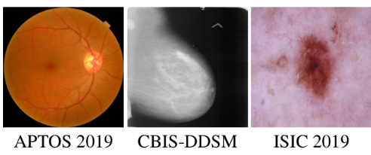
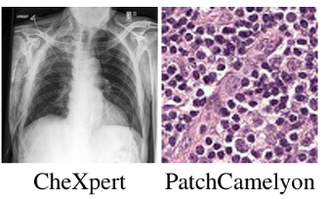
Transferring models trained on more distant datasets can be effective
ImageNet-1K
(Russakovsky et al. 2014)
1 million labeled natural images
Medical Image Datasets
Notes:
Medical imaging datasets are often a good example of this, because of the private nature of this data. Although there are some anonymized public image datasets, most medical image data is tied to patients, and cannot be easily shared. One idea here is instead of transferring a model from the same field – e.g. from proteins to proteins – can we transfer a model from a more distant, but more data-rich field? For example, if we went from natural images to medical images. A quick note to disambiguate terminology before we move on – previously I showed you examples where we transfer self-supervised models trained on unlabeled data. Here, we’re technically not doing that – when we transfer ImageNet pretrained models, these are supervised models trained on labeled data to perform object identification. But the spirit here is that we still overcome lack of labeled data in the field we want to work in, because we’re leveraging a label-rich field for pre-training.

Slide 30
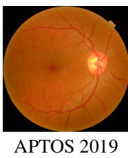
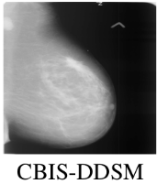
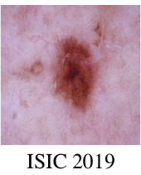
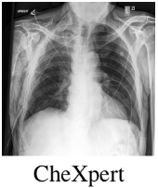
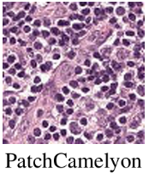
Pretraining on ImageNet benefits medical imaging tasks
Matsoukas et al. 2022
Notes:
For at least medical images, this has been a surprisingly performant idea. This is work by Matsoukas et al, and they showed that transferring models pre-trained using ImageNet improves performance over no pre-training. Over five different medical imaging domains, transferring ImageNet pre-trained models beats learning from scratch.

Slide 31
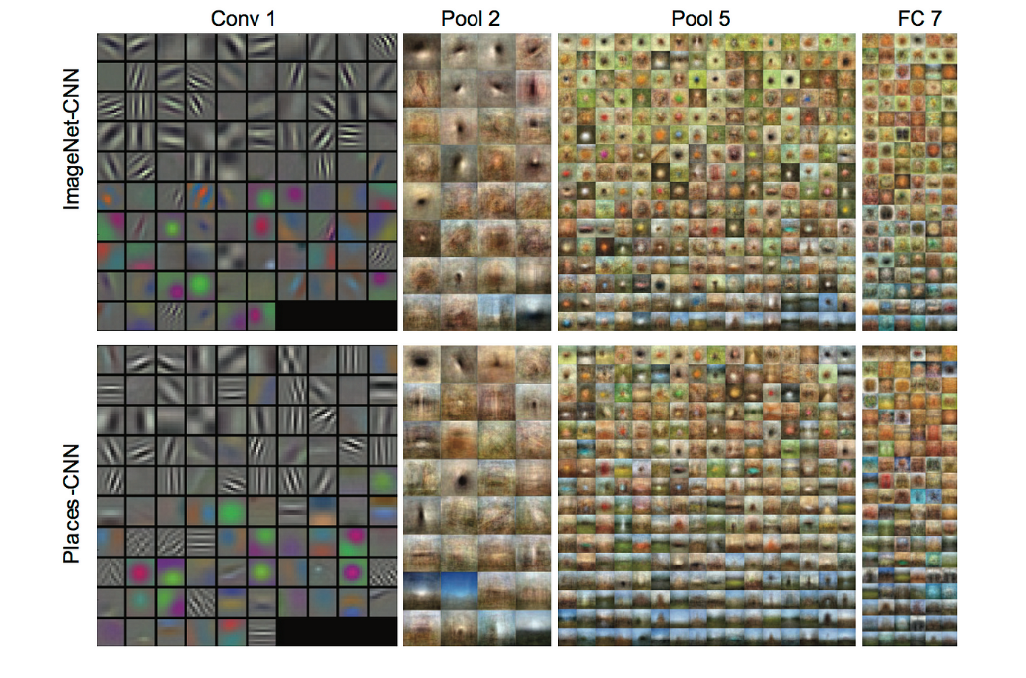
ImageNet pretraining learns general vision features
Karpathy and Fei-Fei 2014
Notes:
Why does this work? ImageNet has been trained on a large number of classes and datapoints – 1 thousand object classes and 1 million images. To distinguish that many kinds of objects, ImageNet needs to develop a rich visual vocabulary – it needs to recognize different kinds of primitive features like edges, textures, colors, and then assemble these features into higher order object invariances. Some of this visual vocabulary is going to be shared with medical images, explaining why transfer provides a boost.

Slide 32
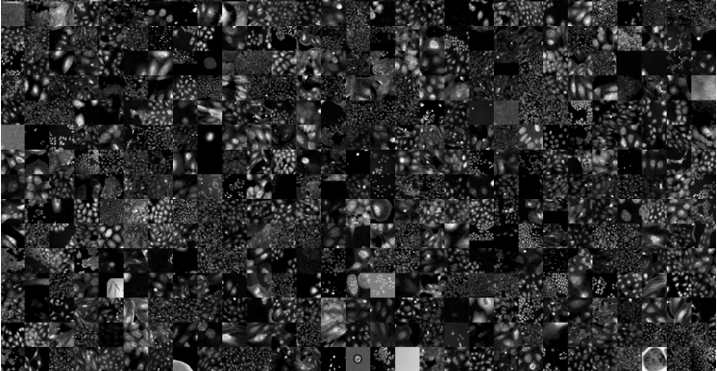

CytoImageNet is a large-scale dataset of microscopy images
CytoImageNet
(Hua, Lu and Moses 2022)
890,737 images from 40 datasets
894 weak metadata classes
Stan Hua
Notes:
Of course, there are limitations behind this – the further away the data you’re transferring from is, the less of an overlap you’d expect. This kind of transfer has largely been successful for images, which tend to operate on similar pixel-level primitives regardless of if you’re working with natural or biomedical images, but less so between natural language and protein sequences, for example, where characters mean very different things. But even with images, it could be that there are domain-exclusive features that occur in biomedical images, that are not or rarely seen in natural images. One way we know this is through the efforts of one of my students, Stan Hua, who curated CytoImageNet, a large-scale database of microscopy images, and pre-trained models with it.

Slide 33
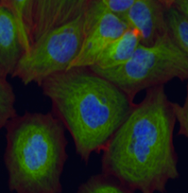
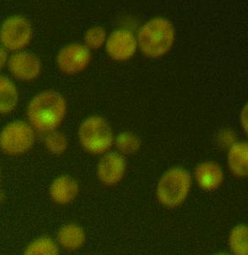
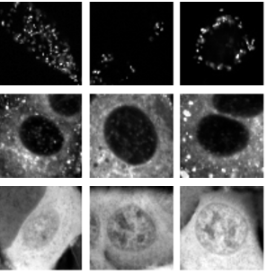
CytoImageNet compensates for features missing from ImageNet
Notes:
Stan investigated transferring CytoImageNet-trained models to three microscopy datasets. Importantly, he also compared transferring ImageNet-trained models. Interestingly, CytoImageNet-trained models, in yellow, alone do not outperform ImageNet-trained models, in blue, even though CytoImageNet is presumably trained on more relevant images. We think this is because unlike ImageNet, which is sourced from wide-ranging internet sources, microscopy images are more centralized, and we collected them from just 40 datasets. This means our dataset is less diverse, so the model might not learn as rich of a vocabulary. But if you were to combine both models, shown in green, that outperforms either model alone. This suggests that the value of CytoImageNet is that it contributes microscopy-specific features that are absent in ImageNet. And in general, this is a risk of transfer learning – the model might not fully – or at all – capture relevant features for your study. Keep that theme in the back of your mind, because we’ll return to it later.

Slide 34
Foundation models can improve classification or regression Performance…
Foundation Model
Self-Supervised Pretraining Task
Unlabeled Data
Transfer Model
Predictions
Labeled Data
Notes:
But for now, let’s return to our main story. I’ve shown you how transferring models, whether through self-supervised pretraining or distal domains, can improve performance on classification or regression problems when working with small labeled datasets.

Slide 35
But what if we don’t have a well-defined prediction problem?
Foundation Model
Self-Supervised Pretraining Task
Unlabeled Data
Transfer Model
Predictions
Labeled Data
Notes:
But what if we don’t even have that? Because being able to confidently declare “this is what we want the model to predict” implies we have a strong amount of structured knowledge in a field already. Classifying datapoints pre-supposes that we have a complete taxonomy for data. In many fields, we might not know how to categorize data. Or even if we know some classes, we might not think our knowledge of classes is complete.

Slide 36
AI models are comprised of hierarchical layers
Foundation Model
Self-Supervised Pretraining Task
Unlabeled Data
Notes:
To address this issue, let’s first dive into some technical details. Modern AI models are comprised of hierarchical layers. The first layer of the model receives, as input, the original raw data. But the second layer receives, as input, the output of the first layer. And the third, the output of the second, and so on until you reach the final model output.

Slide 37
AI models are comprised of hierarchical layers
Organizing information
into output
Extracting/organizing information from input
Notes:
What this means is there is a flow and reshaping of information as it moves through the model. The first layer might extract basic information from the data, the middle layers of the model re-organize this information into more invariant concepts, the final layers use the information extracted from input to form its predictive output.

Slide 38
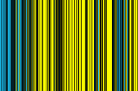
Extracting embeddings by intercepting intermediate layers
Embeddings are a vector representation of the information that AI extracts from data
Notes:
What we can do is intercept this flow of information, so instead of taking the final layer’s output prediction, we take an embedding of data from an intermediate layer. This embedding is a vector representation of the information that the AI is extracting and organizing from data to solve its training task – a series of numbers the AI model uses to represent the data, and I’m visualizing here as a heat map.

Slide 39

Embeddings enable many analyses
Clustering
Database Retrieval
Interpretation
Notes:
Because embeddings are a quantification of data, they’re versatile, and can be used for many analyses. For example, we can cluster embeddings across multiple datapoints, to reveal underlying structure in how the AI is grouping or separating data. We can use embeddings for retrieval – given an embedding, what are similar datapoints according to the AI? If we find that the embedding has certain features that seem to distinguish important or interesting datapoints, we can apply interpretation techniques to understand what these features pick up on in the datapoints. These are just ideas, not a comprehensive list, but hopefully, it highlights how versatile embeddings can be.

Slide 40
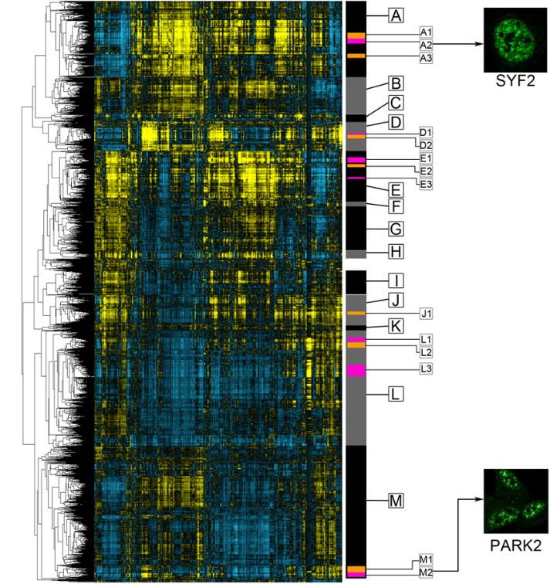
Clustering of Microscopy Images Discovers Novel and Rare Phenotypes
Clustering
Used embeddings from a foundation model to cluster 11,995 microscopy imaging experiments
(Lu et al. 2019)
Notes:
Let me show you a concrete example of how we can use embeddings to facilitate scientific discovery. Here’s an example of where we clustered embeddings of almost 12 thousand microscopy images. Each microscopy image shows a different experiment that induces a different phenotype, or cellular behavior. I’ve represented these embeddings as a heat map, so every single row in this map corresponds to the embeddings for one set of experiments. The lines on the left of the heat map is our clustering solution - this is a hierarchical clustering algorithm, so the lines on the left show how data is iteratively clustered together. In other words, this heat map shows how the AI, in its internal embedding space, groups together data at various level of resolution. We were able to annotate this clustering, shown by the labels on the right, to produce an atlas of different kinds of phenotypes in this dataset. For some kinds of phenotypes, although human experts thought they were the same, our AI strongly separated these datapoints – for example, the phenotypes for SYF2 and PARK2 are very separated. We were able to identify real biological differences between these distinct clusters, suggesting that the AI might be picking up upon real differences imperceptible to human experts.

Slide 41
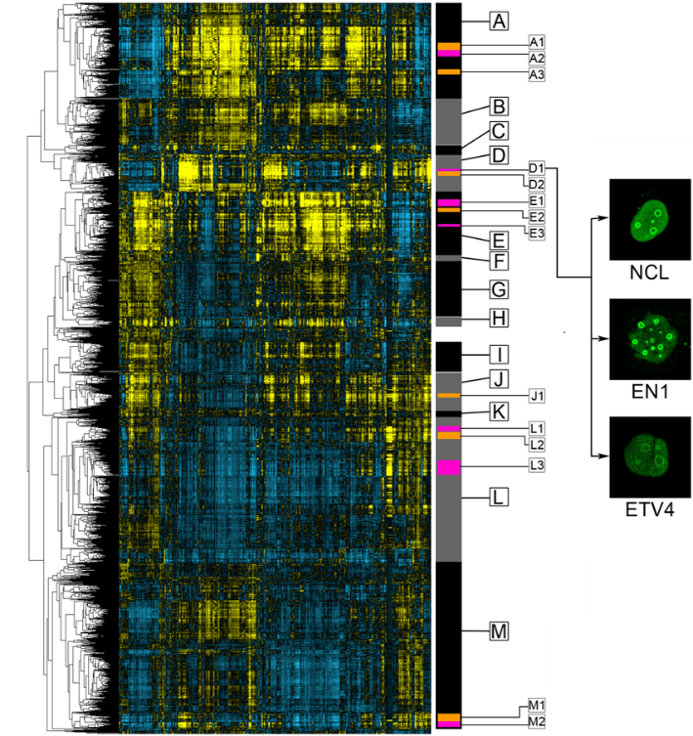
Clustering of Microscopy Images Discovers Novel and Rare Phenotypes
Clustering
Identified new examples of a rare phenotype that occurs in just 0.18% of the data, expanding total known examples from 20 to 32
Notes:
A second example of how this atlas guides discovery is in the expansion of rare phenotypes. There’s a particular phenotype, called the nucleolar rim phenotype, that only occurs in 0.18% of the data – it looks like this, it forms rings in the nucleus of cells. By searching for datapoints close to known examples, we were able to expand examples missed by human annotators – nearly doubling the number of examples from 20 to 32.

Slide 42
Outline of Talk
How can AI make an impact when data or problem definition is limited?
Overview of current methods
  Self-supervised foundation models → Limited labeled data
  Model transfer → Limited data
  Exploration with embeddings → Limited problem definition
Limitations of current methods
  Foundation models may not learn embeddings relevant to our problems
  Controlling learning through principled design of pretraining tasks
Applications in sign language linguistics
Notes:
Returning to our outline – I’ve walked you through our current methods for applying AI when data or problem definition is limited. We covered ways we can apply AI even when there is limited labeled data, limited data in general, and limited problem definition. Now that I’ve caught you up with our methods, I want to talk about where these strategies fall short – and new strategies we can bring in to correct for this.

Slide 43
Protein Language models use masked language modeling
CARP-640M
Pretrained using masked language modeling on 42 million unlabeled protein sequences
(Yang, Fusi, and Lu 2022)
M
G
V
A
G
G
V
G
Model
M
G
V
A
G
Notes:
Let’s return to the pre-training tasks used to train protein language models. Remember I introduced masked language modeling as a task adapted from natural language processing, which treats protein sequences like language. The premise is that this task will initialize models with a general-purpose understanding of proteins.

Slide 44


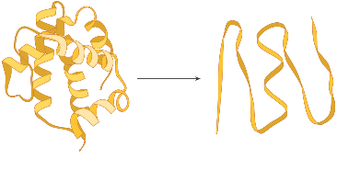
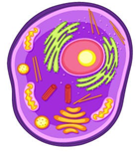
Do protein language models learn all aspects of function?
Structural
Elements
Denaturation
Temperature
Cell
Localization
Binding
M
G
V
A
G
G
V
G
Model
M
G
V
A
G
Notes:
But proteins are tremendously diverse in their functions, and even individual proteins can have multiple aspects that contribute to function. Some examples of downstream analyses we might want to do to decode function would be predicting if protein sequences will fold into structures containing certain structural elements, predicting what temperature a protein starts to degrade, where in the cell a protein will localize in, or if a protein can successfully bind a partner. There’s a leap in our thinking here. Do we really expect that this pretraining task, which was really designed for language and not proteins, to learn about all these different aspects of function?

Slide 45
Multiple mechanisms can lead to improvements in performance
Observation: Pretraining leads to improvements in performance
Interpretation
Pretraining initializes model with foundational understanding of proteins
Notes:
It may seem odd that I’m raising this question now, because if you remember, I previously showed you this chart that showed that protein language models improve transfer performance on downstream prediction tasks. Based upon this data, our interpretation was that pretraining initializes models with a foundational understanding of proteins.

Slide 46
Multiple mechanisms can lead to improvements in performance
Observation: Pretraining leads to improvements in performance
Hypothesis
Alternative Hypotheses
Pretraining initializes model with foundational understanding of proteins
Large # of params = some are useful by chance
Pretraining sets model weights to the right scales
Pretraining teaches superficial features
Notes:
But there are other alternative hypotheses, that can explain the observation that pretraining leads to improvements in performance. One is overparameterization – modern AI models can contain billions of parameters, and so by nature of being so big, some of these parameters might capture useful signal by random chance. A second is that pretraining may be more about setting model weights to the right scale, than learning anything about the data. When you’re training from scratch, you start from weights that are random, but sometimes these weights can be so low that it creates dead-ends in the model, so pretraining might just be allowing information to flow through the network. A third is that the model is learning – but it learns basic, superficial features, and doesn’t develop any deeper understanding of the data. If we cared about performance of transfer to well-established problems alone, we might not care about these alternative hypotheses, because they still lead to better-performing models. But we care about using these models for scientific exploration and discovery – and we want to be sure the model isn’t just relying upon technical effects, or learning boring, obvious features that don’t enhance our own understanding of the data.

Slide 47
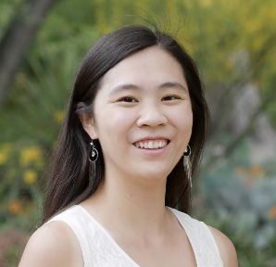
Multiple mechanisms can lead to improvements in performance
Observation: Pretraining leads to improvements in performance
Hypothesis
Alternative Hypotheses
Pretraining initializes model with foundational understanding of proteins
Large # of params = some are useful by chance
Pretraining sets model weights to the right scales
Pretraining teaches superficial features
Larger untrained models improve performance
Shuffling weights retains performance
Performance saturates early
in pretraining
Francesca Li
(Li et al. 2024)
Notes:
Our intern, Francesca Li, devised a series of tests you could perform to test if performance improvements could be explained by any of these alternative hypotheses and conducted the most extensive evaluation of transfer learning with protein language models to date, spanning different model architectures, sizes of models, datasets, degrees of training, and so forth. All together, she did nearly four hundred experiments. This is an extremely extensive study, and I won’t be able to get into most of it today.

Slide 48
Multiple mechanisms can lead to improvements in performance
Observation: Pretraining leads to improvements in performance
Hypothesis
Alternative Hypotheses
Pretraining initializes model with foundational understanding of proteins
Large # of params = some are useful by chance
Pretraining sets model weights to the right scales
Pretraining teaches superficial features
Larger untrained models improve performance
Shuffling weights retains performance
Performance saturates early
in pretraining
Francesca Li
(Li et al. 2024)
Notes:
But let’s zoom into one part of her study, testing if models learn superficial features. We can detect this by testing if performance on a prediction task saturates early in pretraining. Remember we’re training on 50 million unlabeled protein sequences. The idea is if the model maxes out on performance after seeing only a tiny fraction of that unlabeled data, the learning of the model is stuck at these superficial features, because no matter how much further you train, it never learns additional or deeper features relevant to the prediction task.

Slide 49
Structure scales with pretraining duration but other aspects of function are not correlated
Structural
Elements
Denaturation
Temperature
Cell
Localization
Binding
Immunogloblin Binding
Viral
Binding
Protein language models are biased and learn deep features
about some aspects of function but not others
Notes:
Francesca tested this over different prediction tasks representing different aspects of function. In the charts here, the Y axis is performance, and the X axis is duration of pretraining. The further along the X-axis, the more unlabeled data the model is exposed to, and the higher the Y-axis, the better the performance. For some tasks, like predicting structural elements, the longer you pretrain the model, the better it gets. But for other tasks, there is no correlation – and worse off, the trend is anticorrelated for some tasks, indicating the more you pretrain, the worse the model performs. Together, this means that protein language models are biased – they learn deep features about some aspects of function but not others. This is something that’s generally true for foundation models, that they’re biased – keep that in the back of your mind, because we’ll return to this when talking about sign language.

Slide 50
Biases hinder exploratory applications of foundation models
Disordered Regions
Comprise ~40% of
all human proteins
Can we train a foundation model that we know learns relevant features?
Notes:
Previously, I explained how embeddings from foundation models could be used for exploratory analyses in fields where we don’t have structured prior knowledge. But now, knowing these models can be biased – that hinders exploratory applications, because we simply don’t know if the foundation model captures information relevant to our field of study or not. Returning to disordered regions in proteins – I previously explained this as a field where we lack systematic knowledge about how disordered region sequence relates to their function. The application of a protein language model is risky here, because we simply do not know if what the model has learned is applicable or comprehensive for disordered regions. Instead, I’m going to show you how we can take an alternative approach – what if instead, we tried a foundation model where we know learns relevant features?

Slide 51



Using evolutionary biology to design a pretraining task
Notes:
We’re going to achieve this through design of a self-supervised pretraining task that forces the model to learn about our biology of interest. Specifically, we’re going to take inspiration from evolutionary biology. In evolution, different species can diverse from a shared common ancestor.

Slide 52
Using evolutionary biology to design a pretraining task
MLNAVSRAVARAAVRSSRRPRQSEARPAASAAVMSRPL
MLRAATRTVCRAAARCARRSGPPQVHTAVAMSL
MRPRVASRSTRRDRRASSARA
Proteins that descend from the same common ancestor are homologs
Notes:
At the protein level, individual protein sequences will accumulate mutations, gradually changing. We call proteins from different species, that descend from the same common ancestor, homologs. In general, homologs tend to carry out similar functions even if their sequences are different, at least over relatively short evolutionary timescales. This is because function tends to evolve slower than sequence. If you have a mutation that drastically changes the function of a protein, often that will adversely impact the organism’s ability to survive. In contrast, mutations that impact function less, are often more tolerated.

Slide 53
Using evolutionary biology to design a pretraining task
MLRAATRTVCRAAARCARRSGPPQVHTAVAMSL
MRPRVASRSTRRDRRASSARA
Proteins that descend from the same common ancestor are homologs
Notes:
So in other words, homologs effectively give us sets of protein sequences where the sequences are distinct, but their function, their underlying semantics, is similar. We can use these as the basis for our self-supervised pretraining task.

Slide 54
Using evolutionary biology to design a pretraining task
Notes:
Given a set of homologs, we’ll take some of these homologs.

Slide 55
Using evolutionary biology to design a pretraining task
Which of these disordered region sequences
is the held-out homolog?
Notes:
We’ll take another homolog from the same set, but we’ll mix it up with other sequences from different homology families. The task we’ll ask the AI to solve is this – which of these disordered region sequences is the held-out homolog, from this other set that I’m showing you?

Slide 56
Using evolutionary biology to design a pretraining task
To solve this task, model needs to recognize features preserved by evolution to maintain function
Which of these disordered region sequences
is the held-out homolog?
Notes:
To solve this task, the model needs to be able to recognize features, shared across different homologs in the family, that are preserved by evolution to maintain function. In other words, unlike masked language modeling, this pre-training task has a strong theoretical foundation for what the model is going to learn. Hopefully, you can now see what I mean when I say principled design of a pretraining task can control what a foundation model learns.

Slide 57
Using evolutionary biology to design a pretraining task
Trained using 5,306 disordered region homology families for yeast proteins (94,106 homologs)
Which of these disordered region sequences
is the held-out homolog?
Notes:
Finally, the nice thing about this task is that homology families can be automatically inferred from data – I won’t get into how, because that’d put us neck deep into bioinformatics that are out of the scope of this talk. But as a demonstration of this, we inferred over 5000 homology families containing a total of nearly 100 thousand disordered region sequences. And we trained a model using this data.

Slide 58
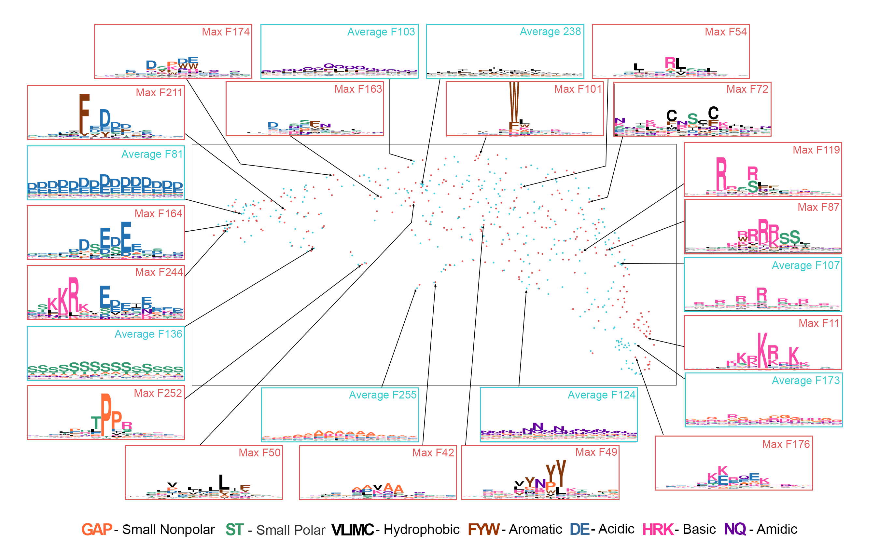
Interpreting model as an atlas of sequence features driving function in disordered regions
Lu et al. 2021
Notes:
Now we have this foundation model for disordered region sequences, we can interpret features learned by this model to create an atlas of features that drive function in disordered regions. I previously introduced you to the concept of an embedding, a vector that contains the information extracted by an AI to solve its training task. Every single feature in that embedding is generated by an individual neuron in the AI. Each neuron activates on some kinds of stimuli, but not others. For every neuron generating our embedding, we can take the top sequences the neuron activates on, find commonalities between the sequences, and visualize those commonalities as a sequence logo, shown in the boxes in this visualization. These sequence logos visualize, collectively, the kinds of subsequences that must be preserved in disordered regions to maintain function, across the entire universe of yeast disordered regions. Often, when I show this map to biologists, they get excited, because some of the features are immediately recognizable to them – some of the features resemble well-studied motifs important to disordered region interactions. That’s promising because we never told the model what these motifs are explicitly, suggesting the model uncovers this knowledge from data by itself. But other features are more novel, which suggests that the model may have learned biology beyond current human knowledge. And in subsequent bioinformatics experiments, we were able to show at least some of these features pointed towards functional biological distinctions between sequences – suggesting that this atlas can be used to discover disordered region biology.

Slide 59
Outline of Talk
How can AI make an impact when data or problem definition is limited?
Overview of current methods
  Self-supervised foundation models → Limited labeled data
  Model transfer → Limited data
  Exploration with embeddings → Limited problem definition
Limitations of current methods
  Foundation models may not learn embeddings relevant to our problems
  Controlling learning through principled design of pretraining tasks
Applications in sign language linguistics
Notes:
Ok. Now we’re finally ready to tackle sign language. I want to thank you all for bearing with me, because that was a lot of wind-up content to get to what will be the meat of the presentation for many of you. But now we’re past the set-up, we’re finally ready to answer the question about how we can apply some of the strategies effective for proteins, to sign language. This work is being done in collaboration with Annemarie Kocab, who is right here in the room – so while I’ll provide background, I won’t claim to be an expert in any of this stuff, and the real expert is actually right there.

Slide 60
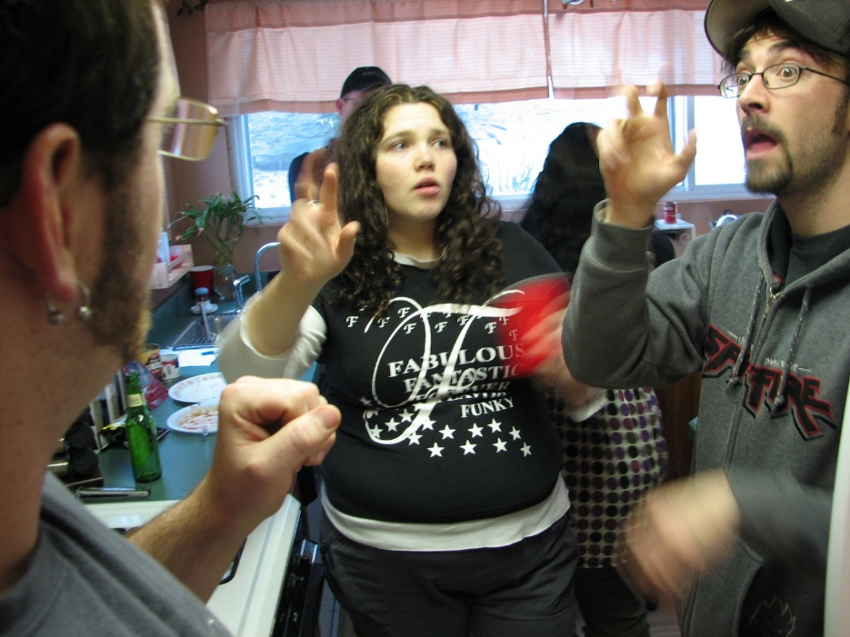
Sign languages are visual-manual languages
Sign languages are languages that use the visual-manual modality to convey meaning
Predominantly used by deaf people and their communities
The World Federation of the Deaf estimates >300 distinct sign languages globally
^{Image from Wikipedia}
Notes:
First, some intro on sign languages – sign languages are languages that use the visual-manual modality to convey meaning, as opposed to spoken languages, which use spoken words. Because of the accessible nature of sign languages, they’re predominantly, but not exclusively used by deaf people and the people they form communities with – friends, family, interpreters. The number of sign languages is up for debate, but the World Federation of the Deaf at least estimates at least 300 distinct languages globally.

Slide 61
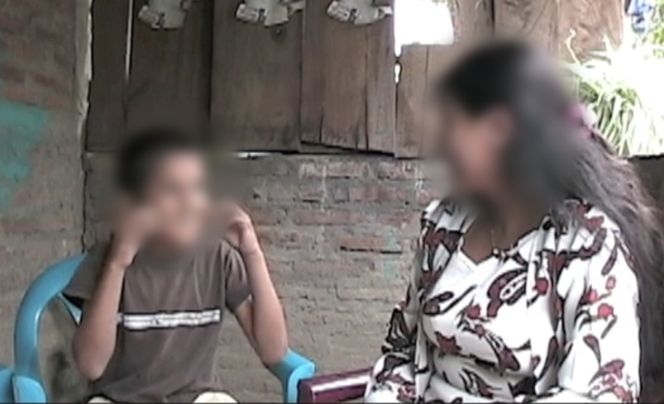
Home Signs are idiosyncratic communication systems
>90% of deaf children are born to hearing parents
In absence of supports, some may invent their own manual-visual communication systems
Home signing can shed insight into the development of language
Notes:
Today, we won’t be focusing on any of those languages, but a phenomena called home signing, which are idiosyncratic communication systems. The way they emerge is because over 90% of deaf children are born to hearing parents. Some of these children may come from a background where deaf educational systems are lacking, or where they have no deaf peers or mentors. As a consequence, to communicate with the people around them, their family and friends, they invent their own manual-visual communication systems. So home signs are not full languages. But they’re interesting to study because they can shed insight into the develop of language. For example, if you visit home signers year after year, you might see the signs they assign to concepts become more standardized or concise. You might also see the signs a child and a family member use become more similar over time, indicating they’ve developing agreement.

Slide 62
Challenges in applying AI to home signing
Home sign data is limited
Labeling schemes for home signers are not well-posed
Can we apply model transfer and extracting embeddings to
home signs?
Notes:
So home signers are scientifically interesting to study. But hopefully you can see the same problems in applying AI to disordered proteins, also apply to home signing. First, data is limited. Because home signers, by nature, are isolated, this means traveling to rural areas or countries with less developed access and support systems, to collect data from just a few individuals. Second, labeling schemes for home signers are not well-posed. While we can manually label videos of home signers with phonology, there’s no guarantee that the signs they invent follow a conventional phonological system. Our vision here becomes clear – can we apply the same concepts of model transfer and extracting embeddings to understand home signs with AI?

Slide 63
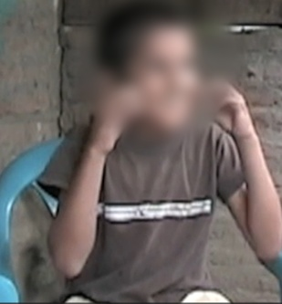
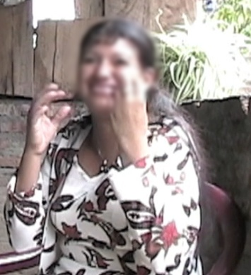
Can we identify a foundation model for embedding home signing videos?
Notes:
We’d like to identify some kind of pre-trained foundation model from which we can extract embeddings of home signers.

Slide 64
Can we identify a foundation model for embedding home signing videos?
Embedding of phonology
Notes:
The ideal model would give us an embedding that represents phonology. It would be robust to spurious variation, like a person’s appearance, or the conditions of filming, and instead focus exclusively on the person’s production of phonology.

Slide 65
Can we identify a foundation model for embedding home signing videos?
Embedding of phonology
Notes:
And if we can accomplish that, then we’d be able to use these models to execute the interesting scientific analyses I described before, which require comparing different people or the same person over time, and quantifying how their signing may change.

Slide 66
Can we identify a foundation model for embedding home signing videos?
What are candidate models we can transfer?
Embedding of phonology
Notes:
So that’s our vision. Now, the question becomes – what are candidate modes for transfer?

Slide 67
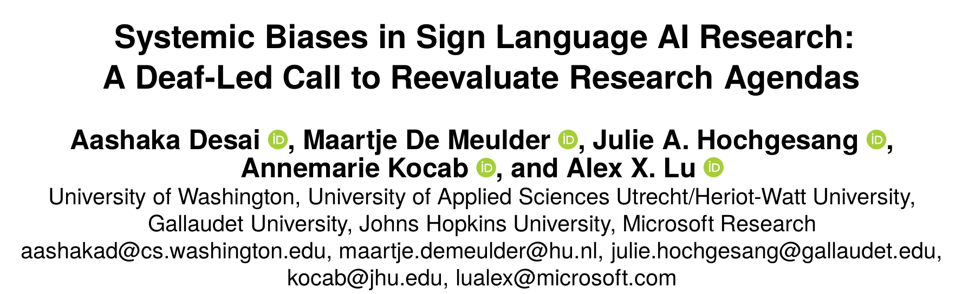
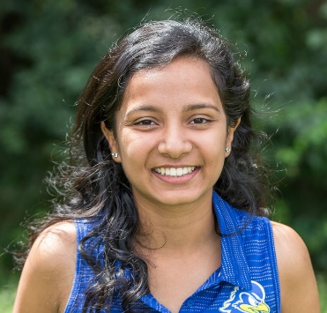
Cultural biases impact AI Landscape for sign language
A critical review of 101 recent sign language AI research articles
Aashaka Desai
(Desai et al. 2024)
Notes:
Previously, I talked about how the landscape of AI models can be impacted by technical factors, like available data or problem definition. But this isn’t just impacted by technical factors, it’s also impacted by cultural and social factors – researchers, both individually and collectively, choose what problems to prioritize. They choose what dataset collection is worth investing resources. When it comes to sign language AI, cultural biases seriously impact the landscape of AI models and research. Part of the reason why we know this is because of this critical review that we did of 101 recent sign language AI research articles, led by former MSR intern Aashaka Desai – I’m really proud of this work because it brought together an all-deaf and hard-of-hearing team of researchers across disciplines to deeply understand the state of the field.

Slide 68
Cultural biases impact AI Landscape for sign language
64% of papers focus on translation between sign language and spoken language
Aashaka Desai
(Desai et al. 2024)
Notes:
One of our findings was that 64% of sign language AI research focuses on translation between sign language and spoken language. This means that sign languages in AI research, are not being taken seriously in their own right as languages. Imagine if every single large language model for English needed to focus on translating English to Spanish or English to French, instead of it being accepted these models were still useful even if they could only operate in English alone – that’s effectively the situation for sign language AI right now. Why is this happening? When you look at the researchers leading these research studies, they tend to be hearing and non-signing. This is because there are serious barriers in the STEM training and advancement pipeline for deaf people, that lead to a near exclusion of deaf people in the field. So instead, you have hearing researchers leading these works. And they tend to be motivated by improving conditions for deaf communities, but because they lack experience with these communities, including lived experience of deafness, they make assumptions that flatten their research. They tend to assume that the central issue defining the deaf experience is a communication gap between deaf and hearing individuals. While access is important, it’s not the only issue – it’s the most visible issue to hearing people because they get to be privy to these interactions, whereas they may not see what happens internally within our own communities as we interact monolingually in sign language.

Slide 69
Large-scale AI models for sign language are translation models
The largest AI models and datasets for sign languages focus on translation
Notes:
Ultimately, this means the largest AI models and datasets we have for sign language focus on translation.

Slide 70
Large-scale AI models for sign language are translation models
The largest AI models and datasets for sign languages focus on translation
Does learning to translate necessarily result in complete phonological understanding?
Notes:
In our search for a foundation model that can give us a phonological embedding of home signs, this creates gaps in our source models versus target problem. Do we believe that learning to translate necessarily results in a complete phonological representation? Intuitively, while the two are related, the translation problems addressed by current sign language AI efforts are simplified. Many papers only focus on providing word-level translations for single signs in a small, fixed vocabulary. Where there are sentences, they tend to be simple or bounded in domain.

Slide 71
Large-scale AI models for sign language are translation models
The largest AI models and datasets for sign languages focus on translation
Does learning to translate necessarily result in complete phonological understanding?
Datasets focus on several high-resource languages
(e.g. American, Chinese, and British Sign Language)
Notes:
The second gap is that translation requires defining a source and target language. Current translation datasets focus on just a handful of high-resource languages – typically American, Chinese, or British sign language.

Slide 72
Large-scale AI models for sign language are translation models
The largest AI models and datasets for sign languages focus on translation
Does learning to translate necessarily result in complete phonological understanding?
Datasets focus on several high-resource languages
(e.g. American, Chinese, and British Sign Language)
Can these models recognize phonology in low-resource sign languages or home signs?
Notes:
And while these languages share foundations with home signs, their phonology is not completely overlapping. Can these models recognize phonology in low-resource sign languages or home signs? Or will they be biased towards missing phonological elements present in these systems, but absent in the language the models were pre-trained on?

Slide 73
Large-scale AI models for sign language are translation models
The largest AI models and datasets for sign languages focus on translation
Does learning to translate necessarily result in complete phonological understanding?
Datasets focus on several high-resource languages
(e.g. American, Chinese, and British Sign Language)
Can these models recognize phonology in low-resource sign languages or home signs?
Notes:
For now, this is still a developing project – so let me focus on the first aspect. We’re going to remove the gap between languages from the equation for now and just focus on the question – does translation result in complete phonological understanding, even when we’re focusing on just the exact same sign language we’re translating.

Slide 74
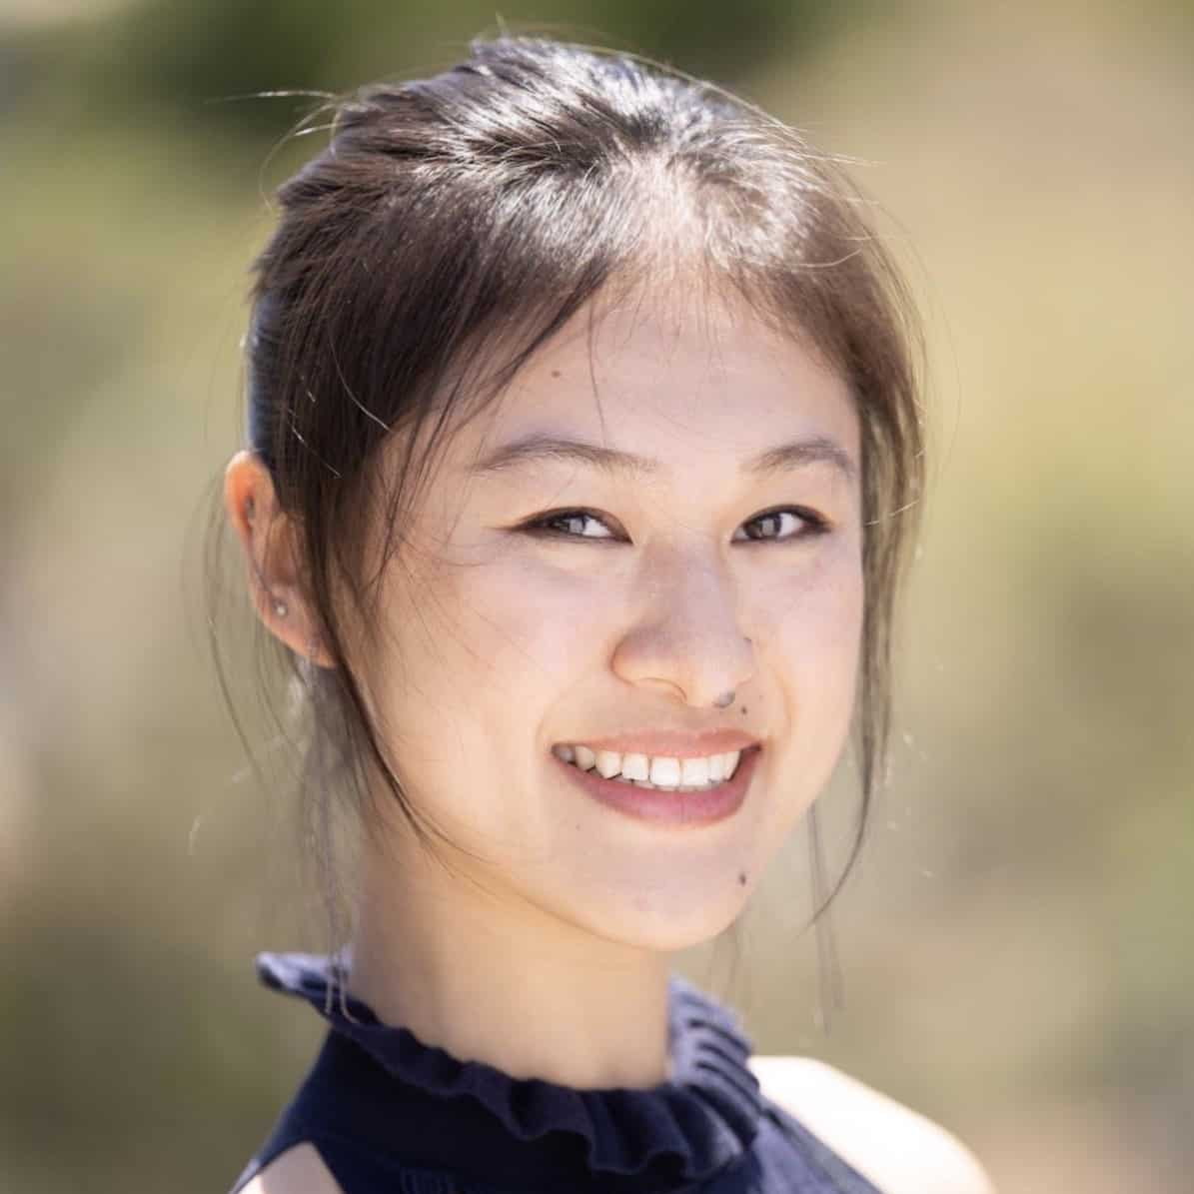
Large-scale AI models for sign language are translation models
The largest AI models and datasets for sign languages focus on translation
Does learning to translate necessarily result in complete phonological understanding?
Kayo Yin
Notes:
This work is being conducted by one of my former MSR interns, and Berkeley PhD student, Kayo Yin.

Slide 75

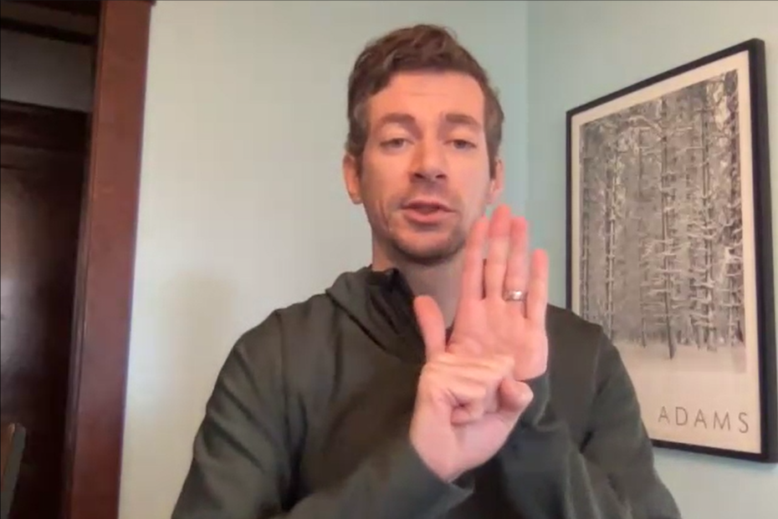
Minimal pairs to understand if embeddings are sensitive to phonology
Minimal pairs are signs distinguished in semantics,
but with only one change in phonology
“LAW”
“STATE”
^{Video Stills from ASL Citizen}
Notes:
So our question here is – are models trained on sign language translation sensitive to phonology. To answer this question, we’re going to probe them with minimal pairs, which are signs that are distinguished in semantics, but only have one change in phonology. An example of a minimal pair is LAW and STATE. LAW can be modified into STATE by changing a single phonological element, switching the L handshape, to an S handshape.

Slide 76
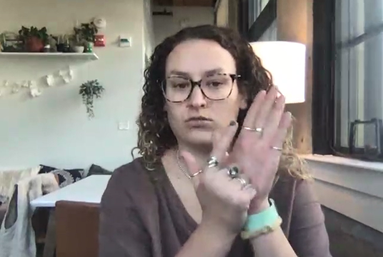

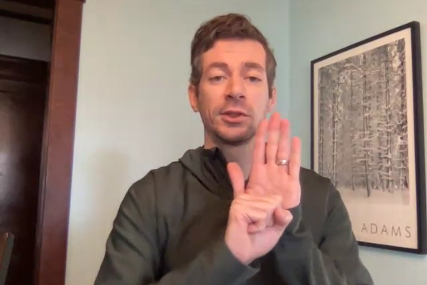
Minimal pairs to understand if embeddings are sensitive to phonology
Participant 1
Sign A
Participant 2
Sign A
Participant 2
Sign B
Notes:
We can use these kinds of minimal pairs to probe if candidate foundation models are sensitive to phonology. Here’s our set-up. Let’s say we have a video of someone, participant 1, performing one of the signs in our minimal pair, sign A. Then, we have two videos of someone else, participant 2, performing sign A, and performing sign B, the other minimal pair. In other words, The second video differs from the first only in the participant, not the phonology. The third video differs from the first in both the participant and the phonology.

Slide 77
Minimal pairs to understand if embeddings are sensitive to phonology
Participant 1
Sign A
Participant 2
Sign A
Participant 2
Sign B
Notes:
We can put each of these videos through our candidate foundation model and extract embeddings…

Slide 78
Minimal pairs to understand if embeddings are sensitive to phonology
Participant 1
Sign A
Participant 2
Sign A
Participant 2
Sign B
More similar
More different
If model is sensitive to the phonological change, changing the sign
should induce a bigger change in the embedding than changing participant alone
Notes:
So now, the prediction is that if the model is sensitive to the phonological change, changing the sign should induce a bigger change in the embedding, than changing the participant alone. We can quantify this by measuring the cosine difference between the embeddings – the distance between the first two videos should be smaller than the distance between the first and third videos.

Slide 79
Minimal pairs to understand if embeddings are sensitive to phonology
Participant 1
Sign A
Participant 2
Sign A
Participant 2
Sign B
More similar
More different
Curated 254 minimal pairs, each performed by 5 pairs of participants
Notes:
To create a dataset which we could use to test candidate foundation models, we curated 254 minimal pairs, each of which were performed by 5 pairs of participants.

Slide 80
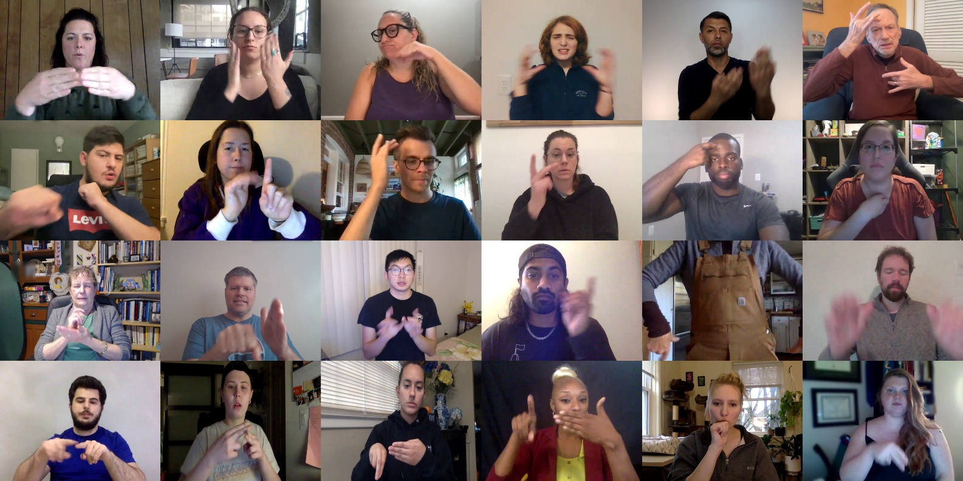
Probing Models trained on
ASL Citizen with minimal pairs
Crowdsourced dataset for single-sign recognition
83,399 videos for 2,731 signs categorized by English gloss
(Desai et al. 2023)
Notes:
As our first candidate for a sign language foundation model, we applied our minimal pairs test to models trained on ASL citizen, one of the largest single sign translation datasets to date. ASL citizen contains over 80 thousand videos for over two thousand seven hundred signs, categorized by their English gloss. Aashaka Desai, who you may remember conducted our critical review, trained AI models on this dataset as part of a MSR internship. She’s a rockstar, graduating from her PhD soon and looking for job opportunities – so if you have any ideas for her, please let me know and I’ll pass them on.

Slide 81
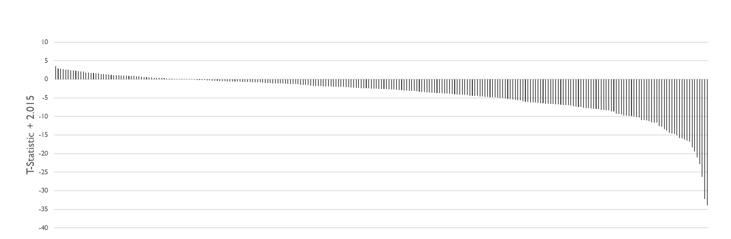
ASL Citizen Embeddings can distinguish most minimal pairs
200 of 254 minimal pairs (78.7%) induce significantly higher distances in embeddings across 5 pairs of signers (p < 0.05)
Notes:
Here’s what our minimal pairs look like using embeddings from the ASL Citizen model. This bar plot shows the t-statistic for each minimal pair, using a paired t-test across the five pairs of participants for each minimal pair. I’ve centered the t-statistic here around a p-value of 0.05, so anything above the axis means the minimal pair does not have a significantly higher distance between embeddings when changing the sign versus changing the participant alone, while anything below the axis does. On surface look, this data suggests that the ASL Citizen model is sensitive to most phonological changes represented by our minimal pair dataset – 200 of 254 minimal pairs induce a statistically significant increase in the distance between embeddings, or roughly 80% of our pairs. For context as to why we think this number is high, many of the minimal pairs we curated are very challenging, to the point that even human language experts would struggle to tell them apart without sentence context.

Slide 82
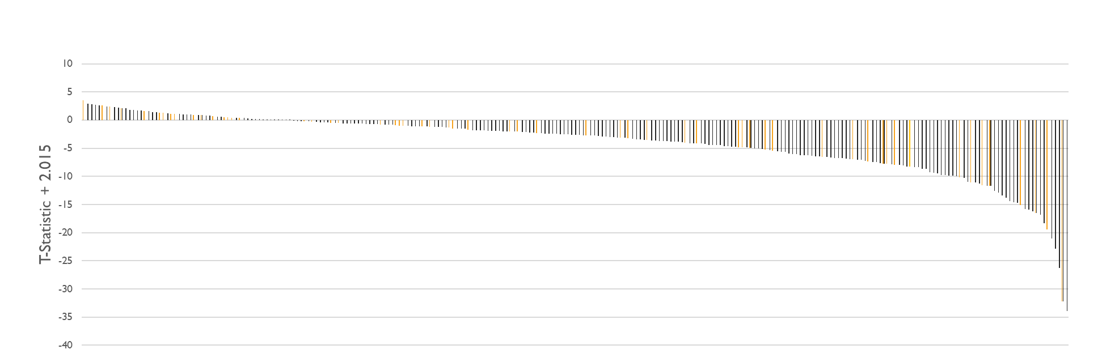
Signs not distinguishable do not correlate with expert language user perception
14 of 54 (26%)
37 of 200 (18.5%)
Minimal pairs scored as “very similar” by human annotator
No significant difference (Fisher exact test p = 0.2518)
Notes:
Naturally, a next question is – is there any pattern in the kinds of signs that the ASL Citizen model cannot distinguish? For example, are these also the signs that human language experts struggle to distinguish? To test this, we had a research assistant annotate each of our minimal pairs as “very similar”, “somewhat similar”, or “not similar”. And this is where pathologies in the model start becoming apparent. For example, if you look at minimal pairs scored as “very similar” by a language expert – although there is a slight enrichment of these in the set of signs the model cannot distinguish, this different is not statistically significant.

Slide 83
Signs not distinguishable do not correlate with expert language user perception
“BLOND”/”GOLD”
14 of 54 (26%)
37 of 200 (18.5%)
Minimal pairs scored as “very similar” by human annotator
No significant difference (Fisher exact test p = 0.2518)
Notes:
We can pick out individual examples of very similar pairs – like “BLOND” and “GOLD”. I’m exaggerating the differences a little – in a textbook production of these signs, blond tends to start near the forehead, whereas gold is lower in the head. But in practice, you see variable and overlapping production – some people will sign blond lower, and gold higher. And in fact, if we look at the videos for the actual minimal pair dataset we’re using to probe this model, we do see that variability in production. In other words – we’re stumped at how BLOND and GOLD rank among the top pairs the model can distinguish – it’s unclear to us what features the model is picking up on, that allow it to so reliably distinguish between the two signs.

Slide 84
Signs not distinguishable do not correlate with expert language user perception
22 of 54 (41%)
81 of 200 (41%)
Minimal pairs scored as “not similar” by human annotator
No significant difference (Fisher exact test p = 1.0)
Notes:
When we look at pairs scored as “not similar”, we see an even worse trend – the proportion of pairs that the model cannot distinguish versus can distinguish, is the same.

Slide 85
Signs not distinguishable do not correlate with expert language user perception
“OFFICE”/
“ROOM”
22 of 54 (41%)
81 of 200 (41%)
Minimal pairs scored as “not similar” by human annotator
No significant difference (Fisher exact test p = 1.0)
Notes:
Some of the pairs ranked among the most indistinguishable have some major changes – for example, OFFICE and ROOM. OFFICE uses an O handshape, ROOM uses a B-handshape – and you can see that even just perceptually, that’s a pretty big difference. So again, we’re stumped – why can’t the model tell these signs apart?

Slide 86
Signs not distinguishable do not correlate with expert language user perception
22 of 54 (41%)
81 of 200 (41%)
Single-sign translation models have unpredictable failures at identifying phonological changes
Notes:
To synthesize these results – this means that even as the ASL Citizen model can distinguish most minimal pairs, it has unpredictable failures at identifying phonological changes. This makes them risky to apply to home signing analyses – there may be cases where the participants are signing something very different, but the model doesn’t detect the difference. Or conversely, the participants are signing something very similar – but the model is overly sensitive to these differences and score them as much more different than something that is far more perceptually different according to human language users.

Slide 87

Does pretraining task and dataset influence if models learn more human-like perception?
Identifying a sign language foundation model aligned with human perception of signs is critical for well-behaved downstream analyses of home signing
Sign Language Translation Models
Notes:
In other words, for us to deploy foundation models to home signers, a useful thing would be to identify a sign language foundation model that is aligned with human perception of signs – even if it is not sensitive to all phonological changes, if it is more sensitive to differences between very different signs, and primarily fails to detect differences between very similar signs, we’d be more confident about analyses stemming from these models, than models that make mistakes at random. Today, I showed you how single-sign translation models don’t satisfy that criteria – and while they’re the bulk of sign language AI models out there, there’s still a gamut of other models we could test.

Slide 88

Does pretraining task and dataset influence if models learn more human-like perception?
Identifying a sign language foundation model aligned with human perception of signs is critical for well-behaved downstream analyses of home signing
Sign Language Specific
Sign Language Translation Models
Sign Language Representation Learning Models
Notes:
For example, we could look at models trained on more fluid, natural signing. Recently, self-supervised sign language models have emerged, which try to train on sign language videos similarly in concept to how large language models for spoken languages are pretrained. Unlike sign language translation models, which more resemble rote learning in their training - which might explain why they have so unpredictable failures, because they’re trained to learn each sign and sentence as an independent, rote element – these self-supervised models are exposed to a larger amount of data in a less structured way, which may result a more complete phonological understanding.

Slide 89


Does pretraining task and dataset influence if models learn more human-like perception?
Identifying a sign language foundation model aligned with human perception of signs is critical for well-behaved downstream analyses of home signing
General Perception
Sign Language Specific
General
Video Models
Sign Language Translation Models
Sign Language Representation Learning Models
Action/Pose Recognition Models
Notes:
But we can also go the other way and investigate models with more general perceptual skills – for example, models trained to recognize action and poses in humans in general, or models trained on videos of the natural world. The idea here is that sign language doesn’t occur in a vacuum but builds upon our visual processing abilities. Changes that we can’t reliably recognize visually, just aren’t useful to tether to linguistic meaning. In other words, the same skills that are required to recognize differences in our natural environment may be shared with the skills needed to recognize differences in signs. So you can see that there’s a gamut of different models we can be testing here to overcome the limitations of sign language translation models – but that’s all future work.

Slide 90
In Summary…
AI is revolutionizing science, but gains are not evenly realized across fields
Transfer and embedding methods enable exploratory science, but risk irrelevant features
AI can make an impact in sign language linguistics, but current translation models are insufficient
Notes:
Great, that’s my talk. To summarize key take-aways – I argued that AI is revolutionizing science, but gains were not evenly realized across fields, with fields with less data and problem formalization being left behind. I then showed you some methods using model transfer and embedding, that enable exploratory science – but their risks, in that they may not be picking up on relevant features. And finally, I showed you show these principles could be used to make an impact in sign language linguistics, particularly around home signers – but I also showed you shortcomings in our ability to transfer existing translation models to do this.

Slide 91
Acknowledgements
Microsoft
Nicolo Fusi
Ava Amini
Kristen Severson
Kevin Yang
Lorin Crawford
Sarah Alamdari
Maddie Huges
David Alvarez Melis
Neil Tenenholtz
Jimmy Hall
Lester Mackey
Eric Zimmermann
Emre Hayir
Akshaya Thoutam
Danielle Bragg
Chinmay Singh
Hal Daume III
Philip Rosenfield
Rianne van den Berg
JHU
Annemarie Kocab
Leyla Isik
Riad Dajani
Cassandra Kim
Collaborators
Lauren Erdman
Irene Chen
Richard Ladner
Yisong Yue
Maartje De Meulder
Julie Hochgesang
University of Toronto
Alan Moses
Amy Lu
Taraneh Zarin
Iva Pritisanac
Julie Forman-Kay
Interns/Students
Kevin Wu
Francesca Li
Kasia Kedzierska
Stanley Hua
Aashaka Desai
Kayo Yin

