Slide 1

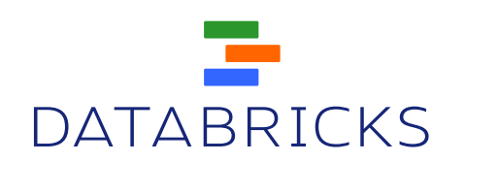
Building a Unified Data Pipeline in Apache Spark
Aaron Davidson

Slide 2
This Talk
Spark introduction & use cases
The power of unification
Demo

Slide 3
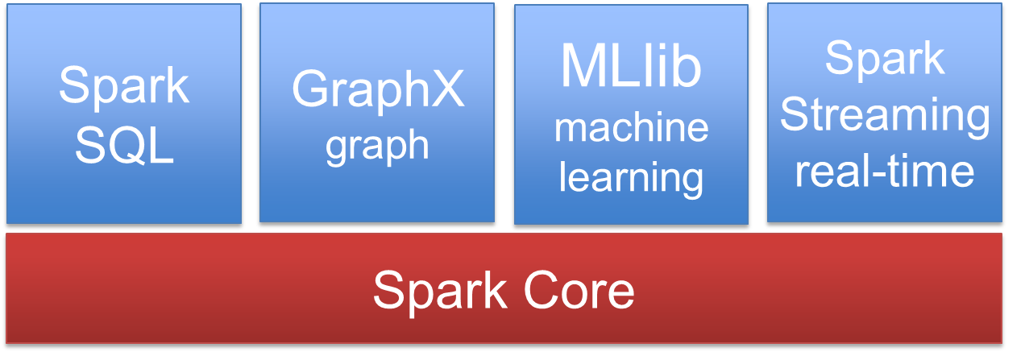
What is Spark?
Distributed data analytics engine, generalizing Map Reduce
Core engine, with streaming, SQL, machine learning, and graph processing modules

Slide 4
Most Active Big Data Project
Activity in last 30 days*
*as of June 1, 2014

Slide 5

Big Data Systems Today
Pregel
Giraph
Dremel
Drill
MapReduce
Impala
GraphLab
Storm
S4
…
General batch processing
Specialized systems
(iterative, interactive and streaming apps)
Unified platform

Slide 6
Spark Core: RDDs
Distributed collection of objects
What’s cool about them?
In-memory
Built via parallel transformations (map, filter, …)
Automatically rebuilt on failure

Slide 7
Data Sharing in MapReduce
HDFS read
HDFS write
HDFS read
HDFS write
iter. 1
iter. 2
. . .
Input
HDFS read
query 1
result 1
query 2
result 2
query 3
result 3
Input
. . .
Slow due to replication, serialization, and disk IO
Notes:
Each iteration is, for example, a MapReduce job

Slide 8
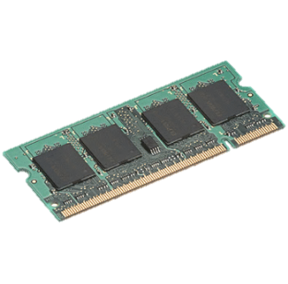
What We’d Like
iter. 1
iter. 2
. . .
Input
query 1
one-time processing
query 2
query 3
Input
Distributed memory
. . .
10-100× faster than network and disk

Slide 9

Example: Log Mining
Load error messages from a log into memory, then interactively search for various patterns
Transformed RDD
Base RDD
lines = spark.textFile(“hdfs://...”)
errors = lines.filter(lambda x: x.startswith(“ERROR”))
messages = errors.map(lambda x: x.split(‘\t’)[2])
messages.cache()
Cache 1
results
Worker
tasks
Block 1
Driver
Action
messages.filter(lambda x: “foo” in x).count()
messages.filter(lambda x: “bar” in x).count()
Cache 2
. . .
Worker
Cache 3
Result: full-text search of Wikipedia in <1 sec (vs 20 sec for on-disk data)
Result: scaled to 1 TB data in 5-7 sec (vs 170 sec for on-disk data)
Worker
Block 2
Block 3
Notes:
Add “variables” to the “functions” in functional programming
Natural

Slide 10
A Unified Platform
Spark
SQL
GraphX
graph
MLlib
machine learning
Spark Streaming real-time
Spark Core

Slide 11
Spark SQL
Unify tables with RDDs
Tables = Schema + Data
Notes:
Unifies tables and RDDS

Slide 12
Spark SQL
Unify tables with RDDs
Tables = Schema + Data = SchemaRDD
coolPants = sql("""
SELECT pid, color
FROM pants JOIN opinions
WHERE opinions.coolness > 90""")
chosenPair =
coolPants.filter(lambda row: row(1) == "green").take(1)
Notes:
Unifies tables and RDDS

Slide 13
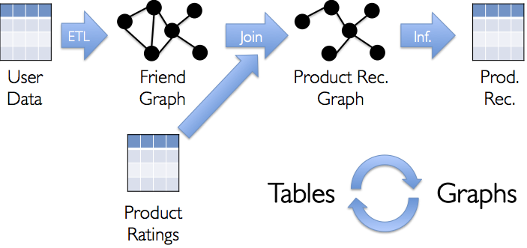
GraphX
Unifies graphs with RDDs of edges and vertices

Slide 14
GraphX
Unifies graphs with RDDs of edges and vertices

Slide 15
GraphX
Unifies graphs with RDDs of edges and vertices

Slide 16
GraphX
Unifies graphs with RDDs of edges and vertices

Slide 17
MLlib
Vectors, Matrices

Slide 18

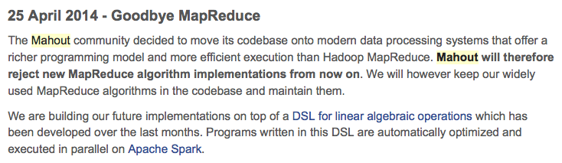
MLlib
Vectors, Matrices = RDD[Vector]
Iterative computation

Slide 19
Spark Streaming
Time
Input

Slide 20
Spark Streaming
Time
RDD
RDD
RDD
RDD
RDD
RDD
Express streams as a series of RDDs over time
val pantsers = spark.sequenceFile(“hdfs:/pantsWearingUsers”)
spark.twitterStream(...)
.filter(t => t.text.contains(“Hadoop”))
.transform(tweets => tweets.map(t => (t.user, t)).join(pantsers) .print()
Notes:
Twitter stream example

Slide 21



What it Means for Users
Separate frameworks:
HDFS read
ETL
HDFS write
HDFS read
train
HDFS write
HDFS read
query
HDFS write
…
Spark:
Interactive analysis
HDFS read
ETL
train
query
HDFS

Slide 22
Combining Processing Types
From Scala:
val points = sqlContext.sql( “SELECT latitude, longitude FROM historic_tweets”) val model = KMeans.train(points, 10) sc.twitterStream(...) .map(t => (model.closestCenter(t.location), 1)) .reduceByWindow(“5s”, _ + _)

Slide 23

Benefits of Unification
No copying or ETLing data between systems
Combine processing types in one program
Code reuse
One system to learn
One system to maintain

Slide 24
Benefits of Unification: Code Size
non-test, non-example source lines

Slide 25
Benefits of Unification: Code Size
Streaming
non-test, non-example source lines

Slide 26
Benefits of Unification: Code Size
SparkSQL
Streaming
non-test, non-example source lines

Slide 27
Benefits of Unification: Code Size
GraphX
SparkSQL
Streaming
non-test, non-example source lines

Slide 28
This Talk
Spark introduction & use cases
The power of unification
Demo

Slide 29
The Plan
Raw JSON Tweets
Streaming
SQL
Machine Learning

Slide 30
Demo!

Slide 31
Summary: What We Did
Raw JSON
Streaming
SQL
Machine Learning

Slide 32
import org.apache.spark.sql._
val ctx = new org.apache.spark.sql.SQLContext(sc)
val tweets = sc.textFile("hdfs:/twitter")
val tweetTable = JsonTable.fromRDD(sqlContext, tweets, Some(0.1))
tweetTable.registerAsTable("tweetTable")
ctx.sql("SELECT text FROM tweetTable LIMIT 5").collect.foreach(println)
ctx.sql("SELECT lang, COUNT(*) AS cnt FROM tweetTable \
GROUP BY lang ORDER BY cnt DESC LIMIT 10").collect.foreach(println)
val texts = sql("SELECT text FROM tweetTable").map(_.head.toString)
def featurize(str: String): Vector = { ... }
val vectors = texts.map(featurize).cache()
val model = KMeans.train(vectors, 10, 10)
sc.makeRDD(model.clusterCenters, 10).saveAsObjectFile("hdfs:/model")
val ssc = new StreamingContext(new SparkConf(), Seconds(1))
val model = new KMeansModel(
ssc.sparkContext.objectFile(modelFile).collect())
// Streaming
val tweets = TwitterUtils.createStream(ssc, /* auth */)
val statuses = tweets.map(_.getText)
val filteredTweets = statuses.filter {
t => model.predict(featurize(t)) == clusterNumber
}
filteredTweets.print()
ssc.start()

Slide 33

What’s Next?
Learn more at Spark Summit (6/30)
Includes a day for training
http://spark-summit.org
Join the community at spark.apache.org
Notes:
DB logo, link for summit, for training, logo for summit

Slide 34

Building a Unified Big Data Pipeline in Apache Spark
What is Spark?
What is a “unified big data pipeline”?

Slide 35
What is Spark?
Community-driven Apache open source project
Distributed data analytics engine, filling a similar role to Map Reduce or Tez
Core engine, with streaming, SQL, machine learning, and graph processing modules
Just released Spark 1.0!

Slide 36
Core Programming Model: RDDs
“Resilient Distributed Dataset”
Example:
Log data, organized by user
Format: (userid, json blob)
JavaPairRDD<Long, String> logs =
sc.textFile("hdfs:/logdata/")
Partitioned across cluster

Slide 37
Core Programming Model: API
map(), reduceByKey(),…
filter(), join(), sort(), union(), …
cache()
import json
parsed_logs = logs.map(lambda (userid, log_json): json.loads(log_json))
today_logs = parsed_logs.filter(lambda log: log.date > time() - 24*3600)
error_logs = today_logs.filter(lambda log: log.level == 'ERROR')
error_logs.cache()
print error_logs.count()
ooms = error_logs.filter(lambda log: log.text.contains('OutOfMemory'))
If ooms.count() > 0:
panic()

Slide 38


A Happy Place
Storm
Operating System
Two changes:
general task DAG
data sharing
H2O
MLLib
SparkSQL
Graph Lab
Impala
Specialized system
Generalized system
Hive
GraphX
Spark Streaming
Map Reduce
Pig
Notes:
Spark is in a happy place between a more generalized system and a more specialized system.
Highly specialized systems like Map Reduce are great when we can frame our problem in their terms.
However, if we’re unable to do so, we need to resort to building our applications on top of a more general system, such as an operating system.
This requires a lot more code, and a much higher intellectual burden.
Many applications were successful…

