Slide 1

Statistical Inference
Not your parent’s cross-validated ML model
DS6040 Fall 2024
Teague R. Henry

Slide 2

Outline
Inference vs. Prediction
History of Statistical Inference
Thomas Bayes with the steel chair!
Bayesian Inference
What can you do with Bayes?

Slide 3
Inference vs. Prediction
You are working as a data scientist and the higher-ups ask you for:
A model that can predict if a visitor to the website actually buys the product.
What factors are important for if a visitor buys the product.
Are these the same problem?
If I’m asking the question, probably not.
Why are both things important to do?

Slide 4
Prediction
Data Science has really focused on highly accurate predictive models:
Use a huge amount of data to predict outcomes.
Models like neural networks aren’t (directly) interpretable.
Cross-validation methods look at how well the models predict in the population.
Consider the following situation:
You’ve fit a neural network to predict sales.
Can you tell me what factors are most important for sales from that model?

Slide 5
Inference
Statistical Inference – Determining what components are “important” in a model.
Technically: Determining the magnitude and uncertainty of parameter estimates.
A highly accurate predictive model (such as a neural network) might not be appropriate for inference, as the model parameters themselves are not interpretable.
An inferential model (e.g. a linear regression) might be relatively bad at prediction, but inference can be done on the parameter estimates.

Slide 6
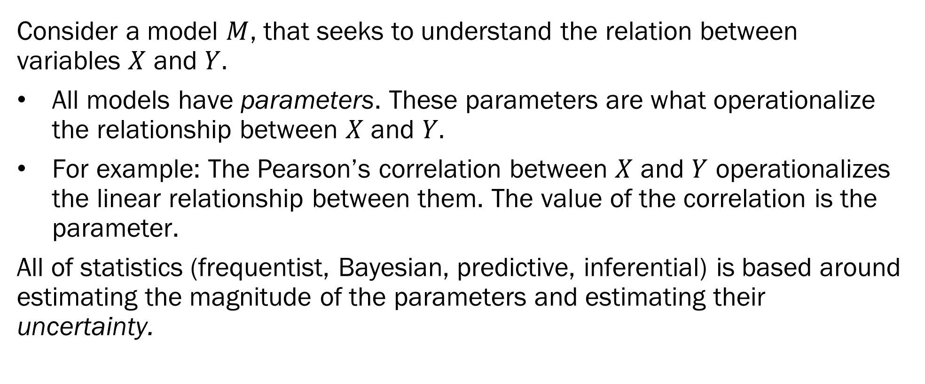
What is Inference?
Consider a model $M$, that seeks to understand the relation between variables $X$ and $Y.$
All models have parameters. These parameters are what operationalize the relationship between $X$ and $Y.$
For example: The Pearson’s correlation between $X$ and $Y$ operationalizes the linear relationship between them. The value of the correlation is the parameter.
All of statistics (frequentist, Bayesian, predictive, inferential) is based around estimating the magnitude of the parameters and estimating their uncertainty.

Slide 7
What is Inference?
We estimate parameters. But under what criteria do we estimate them?
Speaking very broadly, we estimate parameters so that the models result in the best fit to the data.
There are multiple ways of defining what we mean by best fit.
We need to estimate two major components for any parameter:
The location of the parameter – What is the magnitude of the correlation?
The uncertainty of the parameter – How sure are we that the magnitude is correct?

Slide 8
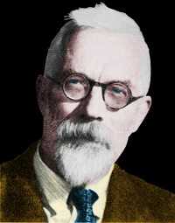
A Brief History Lesson
Statistics is a young field. It originated in the very early 1900’s.
R.A. Fisher (1890 - 1962)
Founder of modern statistics
Legitimate mathematical genius
Huge racist and proponent of eugenics
Didn’t believe that smoking led to lung cancer
“Correlation doesn’t imply causation”
The outstanding scientist, R.A. Fisher: his views on eugenics and race | Heredity (nature.com)

Slide 9
A Brief History Aside
Unfortunately, quite a lot of work in early statistics was focused on eugenics.
Galton, Pearson, Fisher – Good Lord, some of the things that they wrote.
Just because the mathematical theories behind statistical methods are correct, does not mean that they are always used correctly.
In part, you are here to learn how to correctly use these methods. This goes beyond just knowing the math.
Bad data + “correct” math = incorrect conclusions.
Bad theories + good data = incorrect conclusions.
Full article: Teaching the Difficult Past of Statistics to Improve the Future (tandfonline.com)

Slide 10
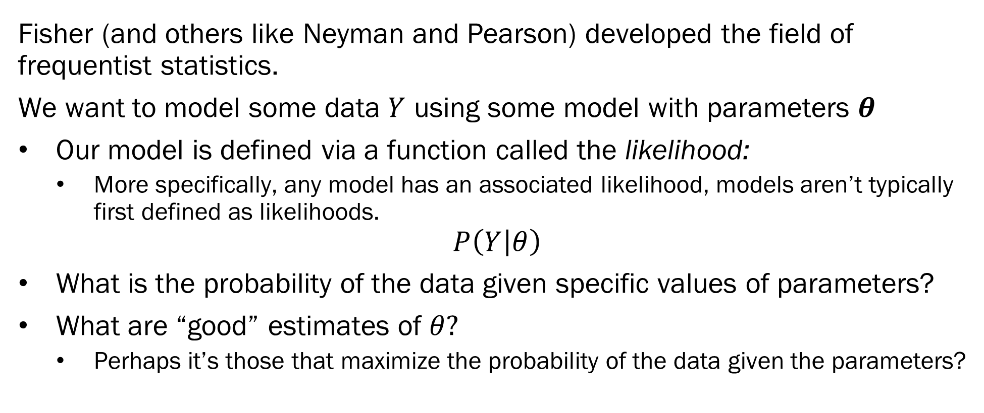
Frequentist Inference
Fisher (and others like Neyman and Pearson) developed the field of frequentist statistics.
We want to model some data $Y$ using some model with parameters $θ$
Our model is defined via a function called the likelihood:
More specifically, any model has an associated likelihood, models aren’t typically first defined as likelihoods.
$$P\left(Y | θ\right)$$
What is the probability of the data given specific values of parameters?
What are “good” estimates of $θ?$
Perhaps it’s those that maximize the probability of the data given the parameters?

Slide 11
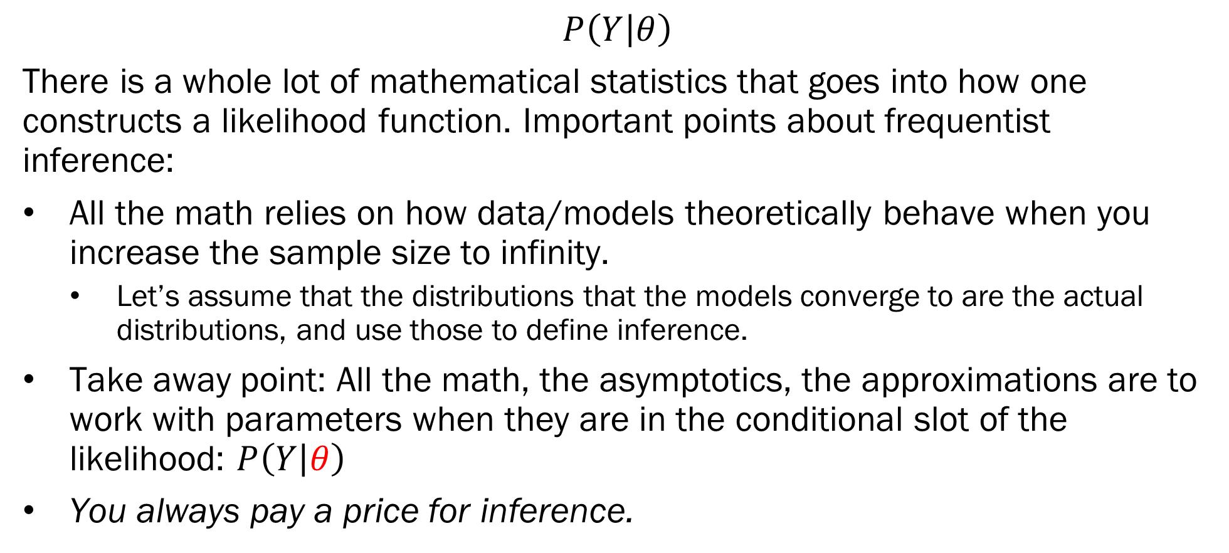
Frequentist Inference
$$P\left(Y | θ\right)$$
There is a whole lot of mathematical statistics that goes into how one constructs a likelihood function. Important points about frequentist inference:
All the math relies on how data/models theoretically behave when you increase the sample size to infinity.
Let’s assume that the distributions that the models converge to are the actual distributions, and use those to define inference.
Take away point: All the math, the asymptotics, the approximations are to work with parameters when they are in the conditional slot of the likelihood: $P\left(Y | θ\right)$
You always pay a price for inference.

Slide 12
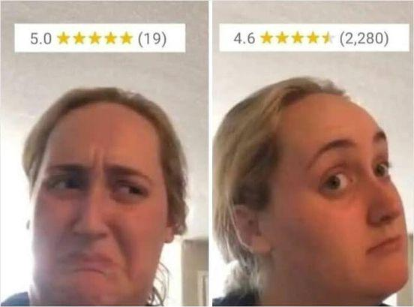
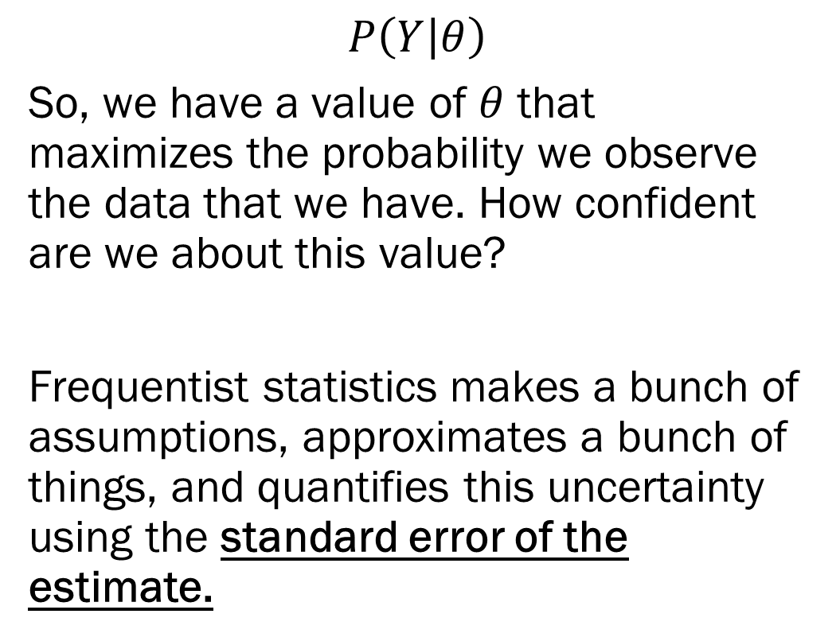
Frequentist Inference
$$P\left(Y | θ\right)$$
So, we have a value of $θ$ that maximizes the probability we observe the data that we have. How confident are we about this value?
Frequentist statistics makes a bunch of assumptions, approximates a bunch of things, and quantifies this uncertainty using the standard error of the estimate.

Slide 13
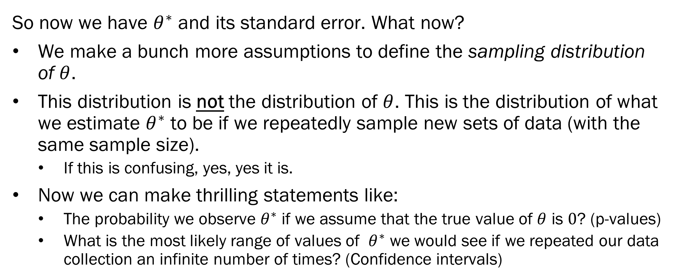
Frequentist Inference
So now we have $θ^{∗}$ and its standard error. What now?
We make a bunch more assumptions to define the sampling distribution of $θ$.
This distribution is not the distribution of $θ$. This is the distribution of what we estimate $θ^{∗}$ to be if we repeatedly sample new sets of data (with the same sample size).
If this is confusing, yes, yes it is.
Now we can make thrilling statements like:
The probability we observe $θ^{∗}$ if we assume that the true value of $θ$ is $0$? (p-values)
What is the most likely range of values of $θ^{∗}$ we would see if we repeated our data collection an infinite number of times? (Confidence intervals)

Slide 14
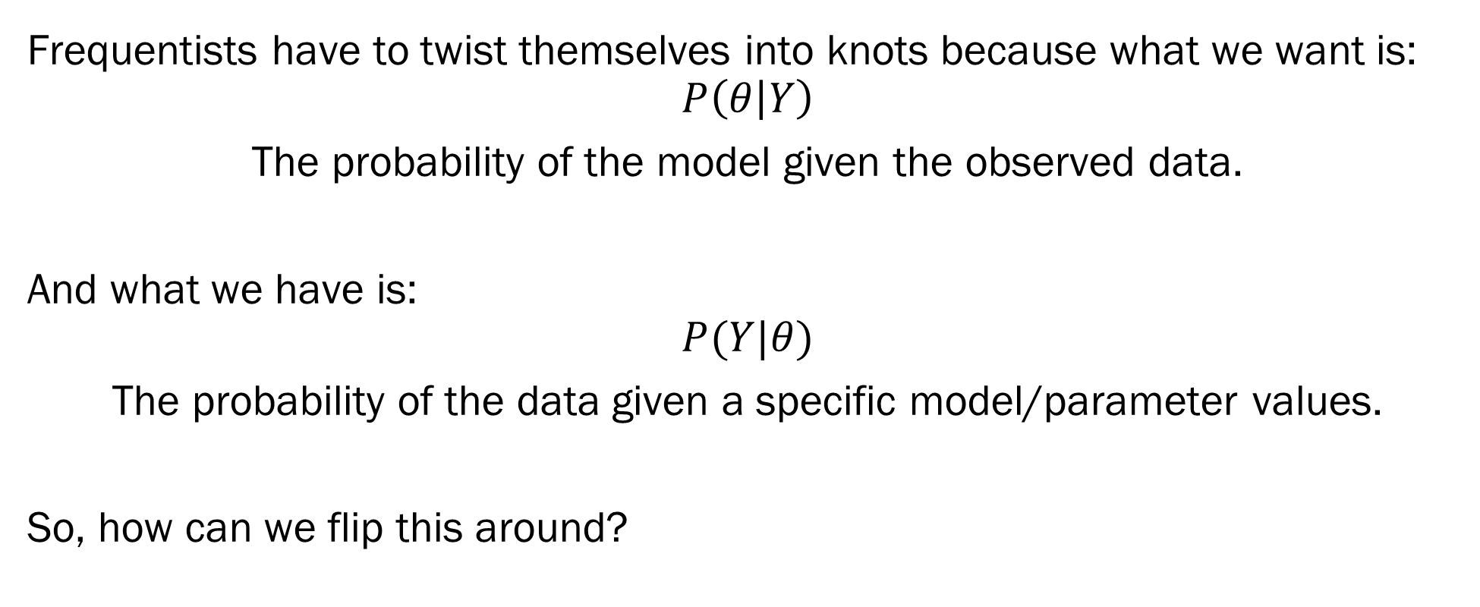
Inference
Frequentists have to twist themselves into knots because what we want is:
$$P\left(θ | Y\right)$$
The probability of the model given the observed data.
And what we have is:
$$P(Y|θ)$$
The probability of the data given a specific model/parameter values.
So, how can we flip this around?

Slide 15
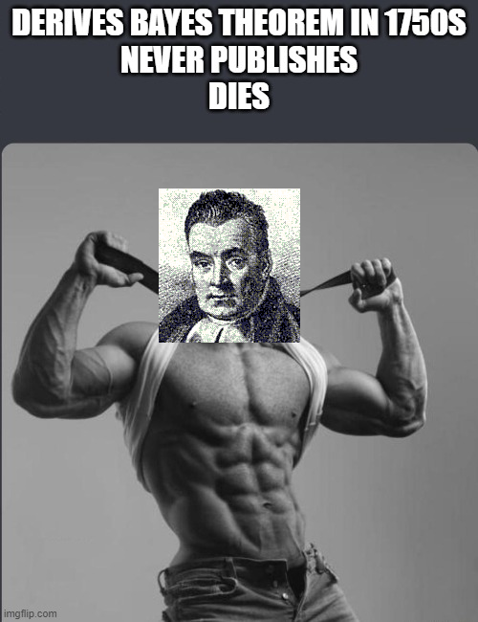
It’s Thomas Bayes with the Steel Chair!
Thomas Bayes - 1701-1759
English Presbyterian Minister
Math was a hobby
Bayes Theorem was presented to the Royal Society in 1763 after his death.
Only published 2 things:
Divine Benevolence, or an Attempt to Prove That the Principal End of the Divine Providence and Government is the Happiness of His Creatures (1731)
An Introduction to the Doctrine of Fluxions, and a Defence of the Mathematicians Against the Objections of the Author of The Analyst (1936)

Slide 16
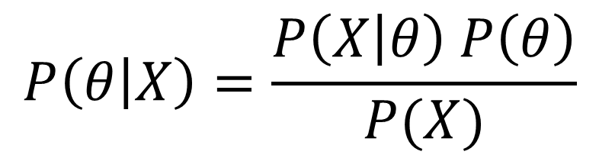

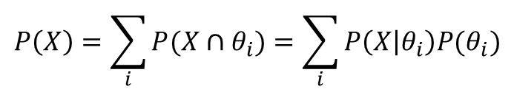
Bayes’ Theorem
Likelihood
(Probability of Data Given Model)
Posterior Distribution
(Probability of Model Given Data)
$$P\left(θ | X\right)=\frac{P\left(X | θ\right) P\left(θ\right)}{P(X)}$$
Prior Distribution
(Probability of Model)
$$P\left(X\right)=\sum_{i}{P(X∩θ_{i})}=\sum_{i}{P\left(X | θ_{i}\right)P(θ_{i})}$$
Marginal Distribution
(Probability of Data)
Probability of your data occurring for any choice of $θ$
Note: Possible $θ_{i}$ are constrained by the model type.

Slide 17
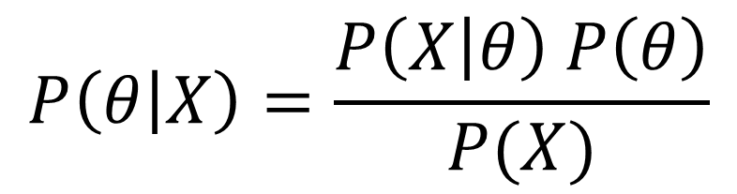
Bayes’ Theorem
$$P\left(θ | X\right)=\frac{P\left(X | θ\right) P\left(θ\right)}{P(X)}$$
Bayes’ Theorem lets us “flip” the conditional probability around:
From “The probability of the data given specific parameters”
To “The probability of the parameters given the observed data”
This is fundamentally what we want to know in inference –
These “posterior” distributions allow us to quantify both magnitude and uncertainty easily, with no use of asymptotics.

Slide 18
Bayes’ Theorem
If Bayes’ Theorem gets what statisticians have always wanted, why aren’t we all Bayesians?
Reason 1: Fisher didn’t like it.
“The theory of inverse probability is founded upon an error, and must be wholly rejected” (Fisher 1925)
Because he tried to derive it as though Bayes was a frequentist.
Reason 2: You need to provide priors for your parameters.
What do you expect your parameters to be like before you’ve observed data?
This makes Bayesian statistics “subjective” (not really, and we will explore this.)
Reason 3: Actually doing Bayesian inference is computationally difficult
We needed computers to do anything other than very basic tests
R. A. Fisher on Bayes and Bayes' theorem (projecteuclid.org)

Slide 19
Bayesian Inference
The posterior distribution of a parameter describes both the estimated magnitude and the uncertainty of the parameter
Under Bayesian Inference, parameters are random variables
This very much differs from frequentist inference, where parameters are single values.
From the posterior distribution, we can calculate a number of useful statistics
The Expected A Posteriori value (EAP) – What is the most probable value of the parameter
Credibility Intervals – What confidence intervals want to be: What is the most likely range of parameter values.

Slide 20
What you can do with Bayes
Bayesian Inference allows you to perform inference in the way you’d intuitively want, by paying the price of specifying your priors.
Now, in theory, this is an advantage. As it turns out, Bayesian models with uninformative priors give results very similar to frequentist models.
Two powerful uses of Bayesian Inference:
You can do very interesting things with priors. Priors that act like regularization, priors for model selection. Because they are part of Bayesian inference, you don’t need more math for this.
Bespoke Models: Bayesian machinery is very flexible, allowing one to create complex models that best represent your data.

Slide 21
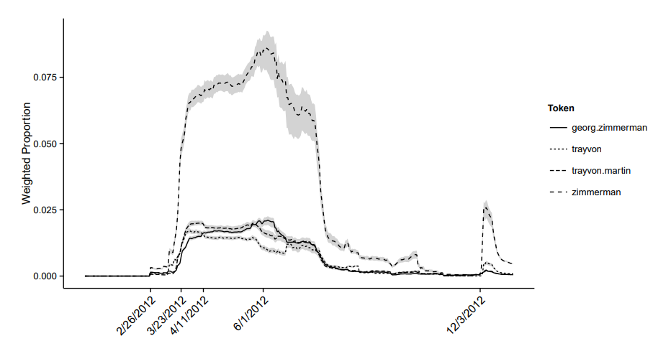
Examples
Modeling Community Structure and Topics in Dynamic Text Networks
Bespoke model for political blog data from 2012.
Dynamical topics that were impacted by/impacted the relations between blogs.
Models were written in C++ and took 21 days to run on a supercomputer
Because I didn’t know how to optimize…

Slide 22
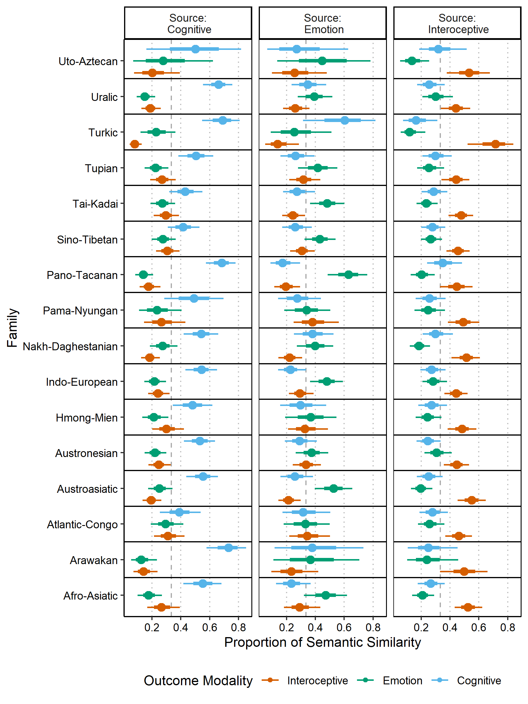
Examples
How do words that relate to cognition, bodily states, and emotion colexify with one another across language families?
Outcome variable is 3 proportions that sum up to 1.
Use Bayesian Dirichlet Regression to perform this analysis.
Difficult to do in a frequentist framework, easy in Bayesian.

Slide 23
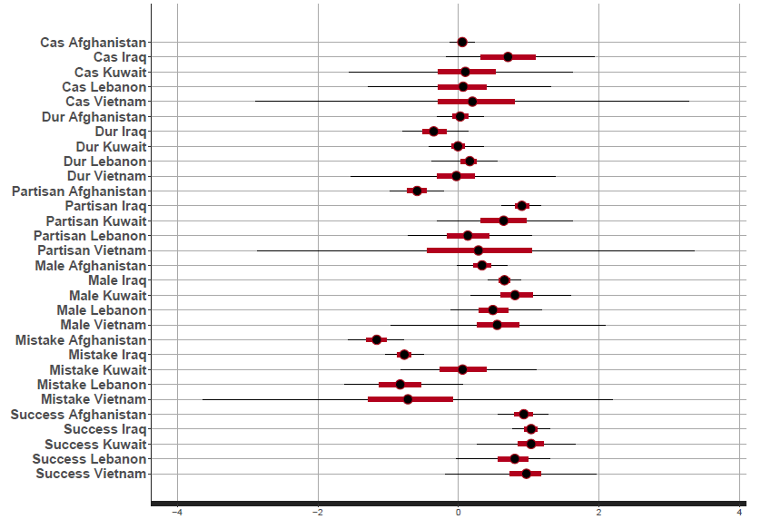
Examples
What predicts citizen support of US conflicts?
Hypothesized “sunk cost” fallacy regarding causalities
Used a Bayesian hierarchical logistic regression.
Models can be fit in frequentist framework, but priors make the models much more stable.

Slide 24
In Class Exercise
Groups of 5
I’d like you to discuss examples of bad statistics/bad models.
For example: Bias in AI, issues with sampling, issues with model misspecification.
This can be specific examples you know of, or you can consider more hypothetical situation.
The point of this exercise is to start thinking about how models/statistics can lie to you.
Regroup in 10 minutes and share with the class!
I’ll select groups to share at random!

Slide 25
Next Week on Bayesian ML
Tuesday: Taking a step back to review probability
What is a probability?
Properties of probabilities
Thursday: Random Variables and Distributions
Properties and construction
Different types of probability distributions.

