Slide 1

Bayesian Machine Learning
Uncertainty and You
DS6040 Fall 2024
Teague R. Henry

Slide 2

Outline
Introductions
Syllabus
Uncertainty in Machine Learning
Statistical Inference

Slide 3
Introductions
Professor: Teague R. Henry, PhD.
PhD in Quantitative Psychology from UNC Chapel Hill
Masters in Statistics from UNC-CH
Postdocs in Clinical Neuroimaging at UNC-CH and Upitt
Research Focus –
Methods to understand psychopathology as dynamical systems
Neuroimaging processing
Data Standards
Office: Gilmer Hall 216F
Email: trhenry@virginia.edu

Slide 4
Course Structure
Lecture: Tuesdays and Thursdays, 11:00am - 12:15am
Attendance is expected, but not enforced
Lecture slides are uploaded, but no asynchronous option
Please get in contact if you have accommodations!
Office Hours:
Data Science Building (Location TBD) – Tuesday 12:30-1:30
With me (Teague)

Slide 5
Assignments and Grades
Four HW Assignments (80% of Grade)
Substantial take home assignments
With the exception of the first, all require a submission of an HTML compiled Rmd document
Please do not start these the night before, they will take a bit of time to complete
All assignments are already uploaded to the Canvas site

Slide 6
Assignments and Grades
In-Class Pen & Paper Midterm (10% of grade)
Single normal sized piece of paper for notes, back and front.
You can bring a calculator, but you can also use phone calculator
Honor system for not using phone to cheat
Focused on comprehension rather than calculation
There will be a review lecture before the midterm, and I will tell you what you need to know.

Slide 7
Assignments and Grades
Take Home Final (10% of grade)
Consider this to be a HW type assignment where you can’t collaborate with others or get help from TAs.
It will be a data analysis “project.”
Open book, obviously.

Slide 8
Grading Policy
Assignments are graded on a completion basis, not a correctness basis
If you give all components of an assignment the good ole’ college try, you’ll get 100%.
What does completion mean? It means enough that we can give you feedback on what you did wrong.
Extra credit on each assignment are graded on correctness
Equivalent of an entire HW assignment
Midterm and Final are graded on correctness

Slide 9
Grading Policy
Why do I grade this way?
If you complete all the HW assignments and don’t do the midterm/final, you will still pass the class with 80%.
You can get 100% in the course if you do all the extra credit, even if you don’t do the midterm/final.
The midterm and final are designed to a) let me understand how the class is doing, b) reward those who are really getting the materials.
This material is hard, and I’m hoping that this grading scheme takes some of the pressure off of you so you can focus on learning the material.

Slide 10
Canvas Site
The Canvas site is where you will find the HW, and where you will submit them (and the final).
You’ll also find the uploaded lectures and syllabus.
If I add readings to the lectures, which would aways be optional, then you’ll find the readings in the Resources section of the Canvas site.
There is no “required” textbook, I’ll provide the specific readings.

Slide 11
Programming Requirements
This course will ask you to use R rather than Python?
Why?
The ease of fitting Bayesian Models using R packages is significant
Fewer difficulties with setting up the environments
Probabilistic Programming Language (Stan) is independent of the scripting language.
There really isn’t anything I’ll be asking you to do that needs the power of Python.
Overall, I chose R for this course to make all of our lives easier!

Slide 12
Questions?
?

Slide 13
Learning Goals
Understand the logic of Bayesian Inference
Why is it useful?
Why is it different than more traditional methods?
Understand the process of Prior Selection
Why are different priors appropriate in different situations?
What is the impact of prior choice on model performance?
Understand the process of Bayesian Inference
What are conjugate priors?
How do samplers work? Why do we need them?

Slide 14
Learning Goals
Bayesian Hierarchical Regression
How to use it, when to use it, and how to interpret it.
Overview of Bayesian Machine Learning Techniques
Why are we using them? When?
Overview of more advanced Bayesian Methods (time permitting)
Bespoke modeling
Gaussian Process Models

Slide 15
Course Outline
Probability and Inference
Probability Review
Statistical Inference Basics
Bayesian Statistics
Bayes Theorem
Priors
Conjugate Tests
Bayesian Inference
Samplers
More samplers
Variational Inference

Slide 16
Course Outline
Probabilistic Programming Languages
Stan
Bayesian Linear Regression in brms
Hierarchical Modeling
Bayesian Machine Learning Overview
Bayesian Non-Parametrics Overview (Time Permitting)

Slide 17
Shall We Begin?
A test for COVID has been shown to be
95% sensitive – If you have COVID, the test will indicate that 95% of the time.
90% specific – If you don’t have COVID, the test will show a negative 90% of the time.
You receive a positive COVID test. What is the probability that you actually are COVID positive?
We are missing important information here: The base rate of COVID.
What if COVID is very low prevalence? Does that change the probability you actually have COVID? How about high prevalence?

Slide 18
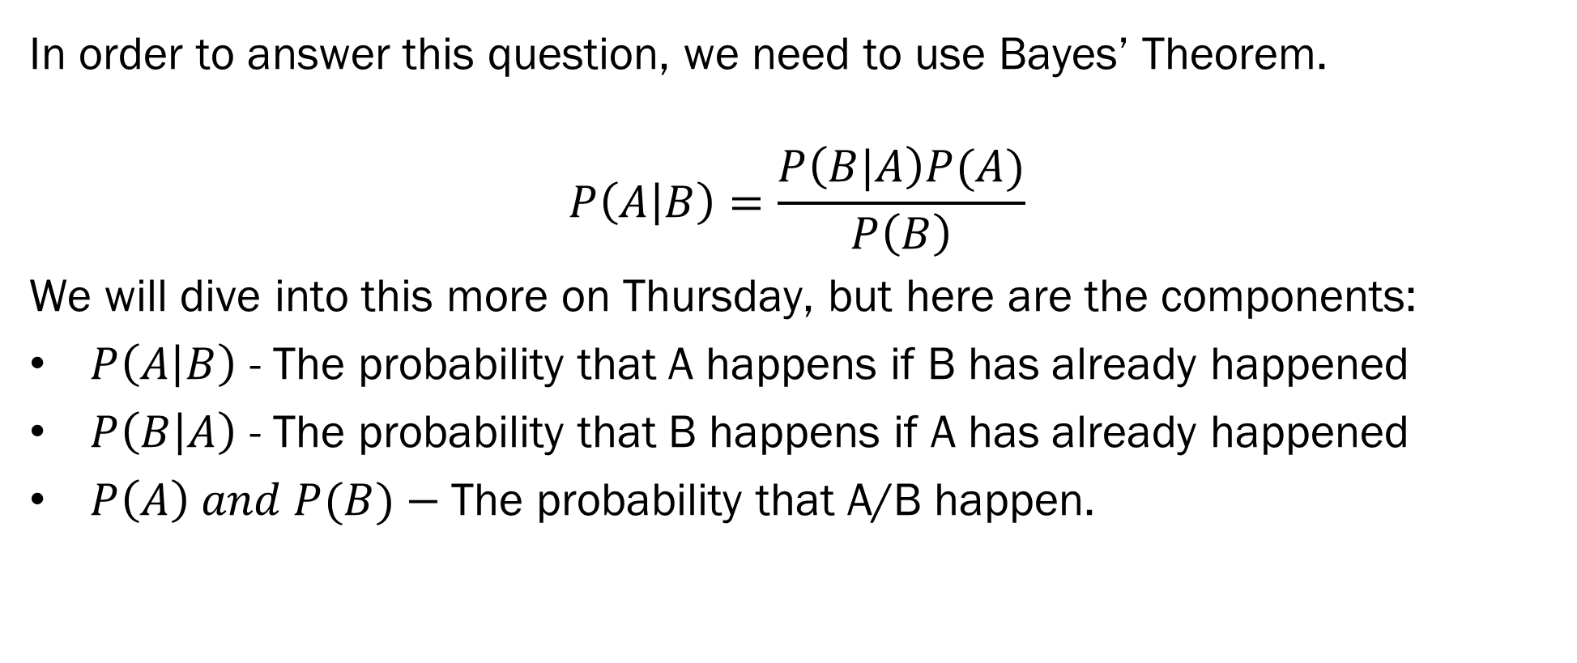
Testing For COVID
In order to answer this question, we need to use Bayes’ Theorem.
$$P\left(A | B\right)=\frac{P\left(B|A\right)P(A)}{P\left(B\right)}$$
We will dive into this more on Thursday, but here are the components:
$P\left(A | B\right)$ - The probability that A happens if B has already happened
$P\left(B | A\right)$ - The probability that B happens if A has already happened
$P\left(A\right) and P(B)−$The probability that A/B happen.

Slide 19
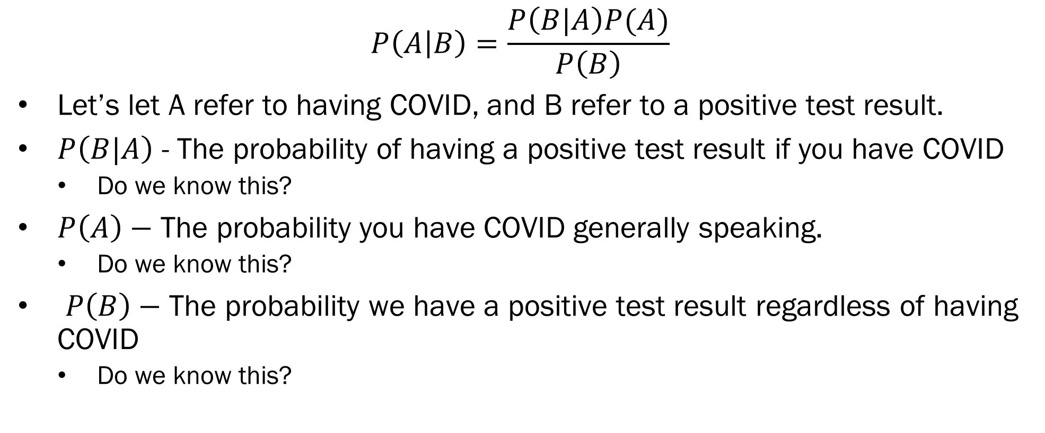
Testing For COVID
$$P\left(A | B\right)=\frac{P\left(B|A\right)P(A)}{P\left(B\right)}$$
Let’s let A refer to having COVID, and B refer to a positive test result.
$P\left(B|A\right)$ - The probability of having a positive test result if you have COVID
Do we know this?
$P\left(A\right)−$ The probability you have COVID generally speaking.
Do we know this?
$P\left(B\right)−$ The probability we have a positive test result regardless of having COVID
Do we know this?

Slide 20
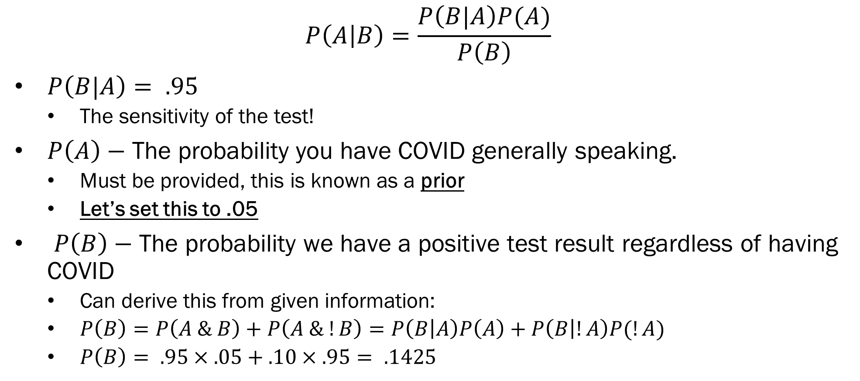
Testing For COVID
$$P\left(A | B\right)=\frac{P\left(B|A\right)P(A)}{P\left(B\right)}$$
$P\left(B|A\right)= .95$
The sensitivity of the test!
$P\left(A\right)−$ The probability you have COVID generally speaking.
Must be provided, this is known as a prior
Let’s set this to .05
$P\left(B\right)−$ The probability we have a positive test result regardless of having COVID
Can derive this from given information:
$P\left(B\right)=P\left(A \& B\right)+P\left(A \& !B\right)=P\left(B | A\right)P\left(A\right)+P\left(B | !A\right)P(!A)$
$P\left(B\right)= .95×.05+.10×.95= .1425$

Slide 21
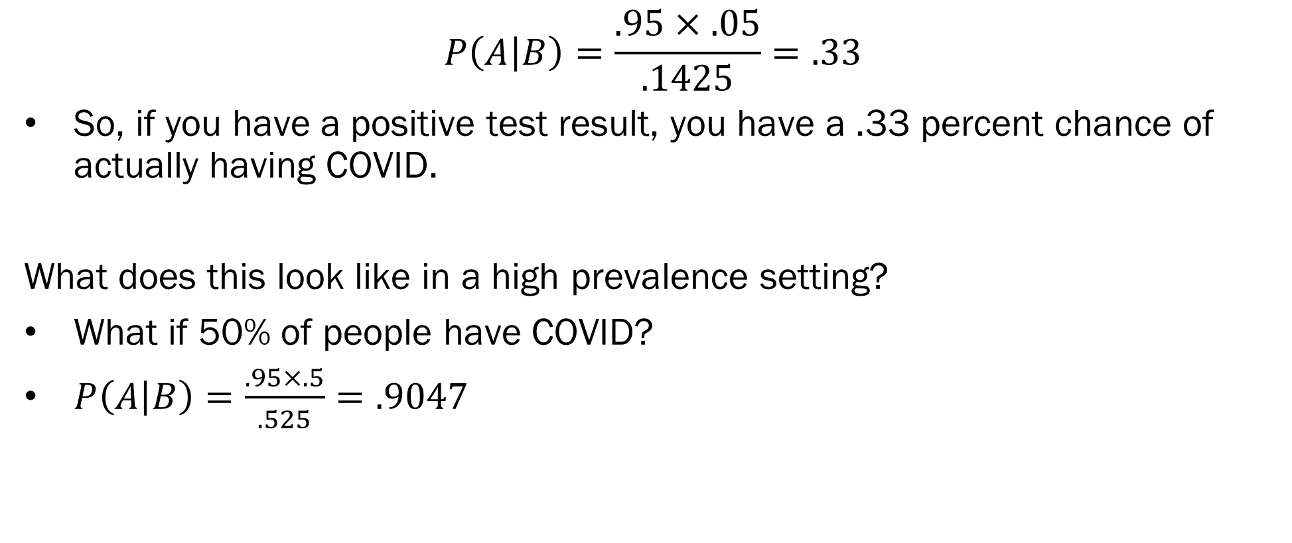
Testing For COVID
$$P\left(A | B\right)=\frac{.95×.05}{.1425}=.33$$
So, if you have a positive test result, you have a .33 percent chance of actually having COVID.
What does this look like in a high prevalence setting?
What if 50% of people have COVID?
$P\left(A | B\right)=\frac{.95×.5}{.525}=.9047$

Slide 22
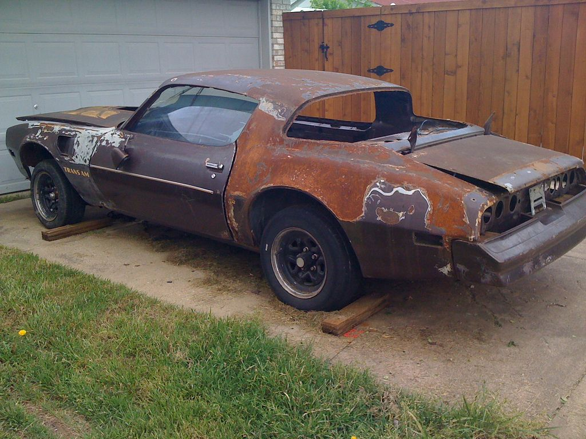
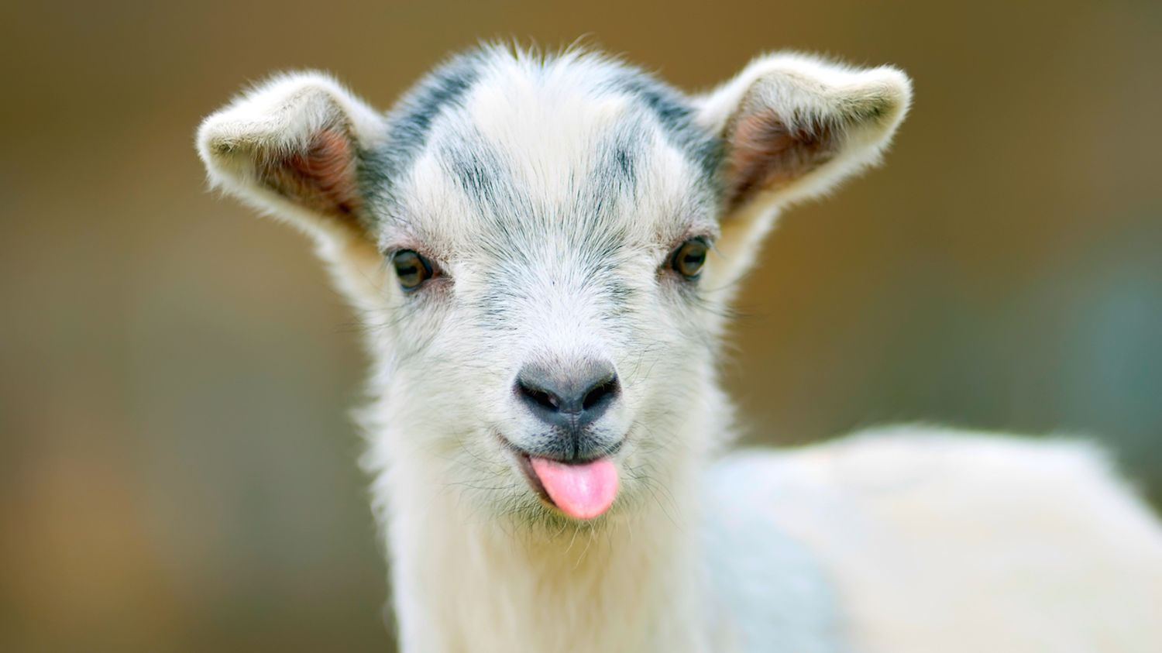
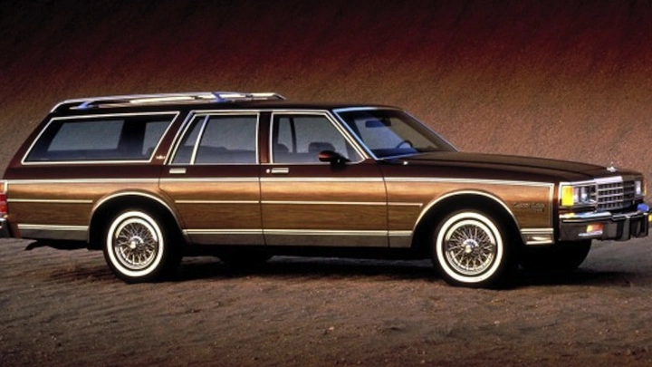
The Monty Hall Problem – Goat Edition
You are a goat farmer. You are presented with 3 doors. Two of those doors hold cars, one holds a goat. After you select a door, the host opens one of the unselected doors to reveal a car. Should you switch your choice of door to the other (unselected, unopened) door, if you are aiming to win the goat?

Slide 23

The Monty Hall Problem – Goat Edition
Stage 1 – Before the Reveal
$P\left(Choosing the Goat | Goat is behind 1 of 3 doors\right)=\frac{1}{3}$
Stage 2 – After the Reveal
Imagine you have to make the choice of doors again from any door… What additional information do you have?
$P\left(Goat behind opened door\right)=0$ (obviously)
$P\left(Goat behind door you chose originally\right)=\frac{1}{3}$
Why? Because your choice locks the door down. The host won’t open it regardless of goat, so you get no additional information as to what is behind your door.
$P\left(Goat behind other, unopened door\right)=\frac{2}{3}$

Slide 24




The Monty Hall Problem – Goat Edition
Intuition – We need to use information as to the structure of the problem to solve it. Here, the key piece of information is that the host will not open the door you originally chose, even if it has a car…
Solution using Bayes’ Theorem –
$P(G = 1 | H = 2, Y = 3)$– Probability that the goat is behind door 1, if you chose door 3 and the host opened door 2.
$$\frac{P\left(H=2 \right| G=1, Y=3)∗P(Y=3 ∩G=1)}{P\left(H=2 \right|Y=3)∗P(Y=3)}$$
$$=\frac{1}{3}∗ P(Y=3)$$
= 1
$$=\frac{\frac{1}{3}}{\frac{1}{2}}=\frac{2}{3}$$
$$=\frac{1}{2}$$

Slide 25
Thursday on Bayesian ML…
High level overview of statistical inference
Why do statisticians have jobs?
Inference = Estimate + Uncertainty
Frequentist vs. Bayesian Inference
Components of Bayes Theorem
Next week on Tuesday –
Probability review!
First HW due 9/20 by 11:59pm

