Slide 1

Random Variables and Statistics
DS6040 Fall 2024
Teague R. Henry

Slide 2

Announcement
Office Hours!
Thursdays, 3:30-4:30pm on Zoom
Room 340 has been reserved to call from if necessary
Zoom info is on the Canvas homepage!

Slide 3
Outline
What is a probability distribution?
Continuous/discrete/categorical distributions
Quantifying distributions using statistics

Slide 4
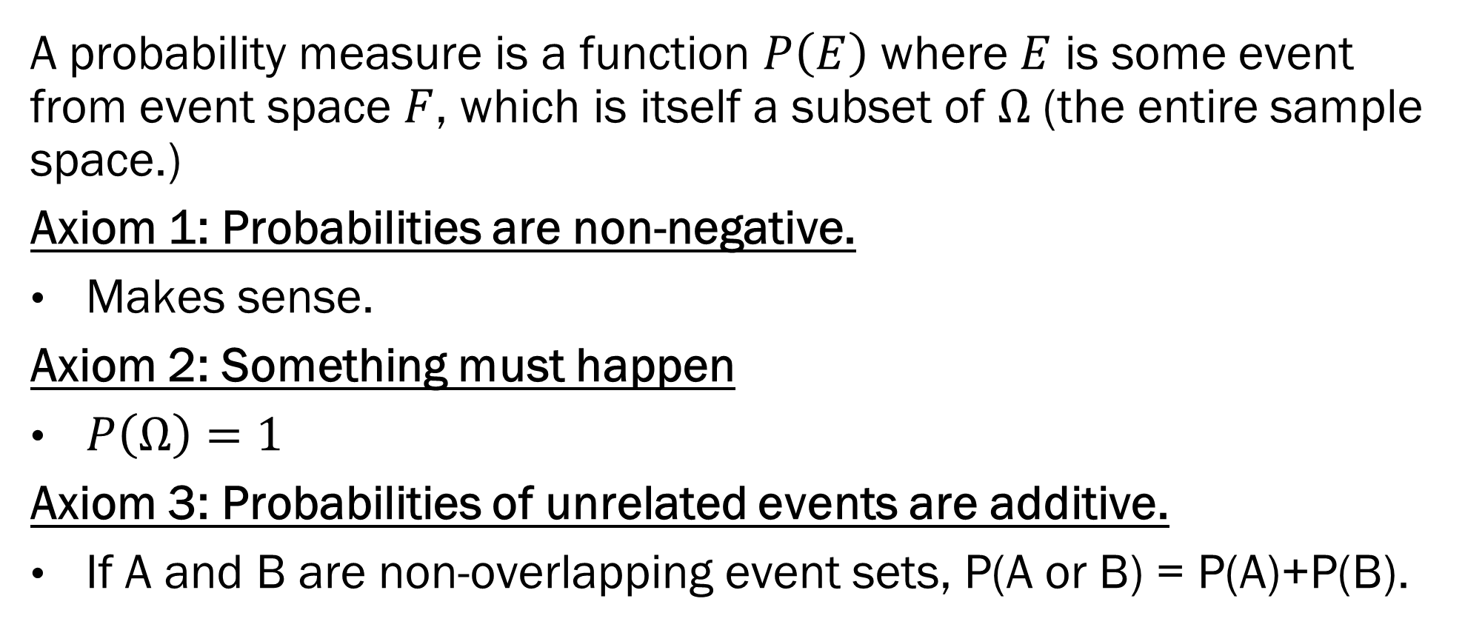
Recall our Probability Axioms
A probability measure is a function $P\left(E\right)$ where $E$ is some event from event space $F$, which is itself a subset of $Ω$ (the entire sample space.)
Axiom 1: Probabilities are non-negative.
Makes sense.
Axiom 2: Something must happen
$P\left(Ω\right)=1$
Axiom 3: Probabilities of unrelated events are additive.
If A and B are non-overlapping event sets, P(A or B) = P(A)+P(B).

Slide 5
Random Variables and Distributions
A random variable can be described as the numerical representation of a random process.
The technical definition involves functions that map from sample spaces to real numbers, but this isn’t important to understand what a random variable is.
In practice, a random variable is just a number that you don’t know the exact value of.
For the most part, you can treat random variables algebraically the same way you can treat a regular variable or number

Slide 6
Random Variables and Distributions
Random variables have a probability distribution
A probability distribution is a function (a probability measure) that maps the values a random variable can take to probabilities.
Technical aside: This is not quite true, but it is sufficient for understanding what a distribution is.
Any function that fulfills the axioms of probability is a probability distribution.
The named probability distributions are just ones that are well behaved, or have interesting properties.

Slide 7
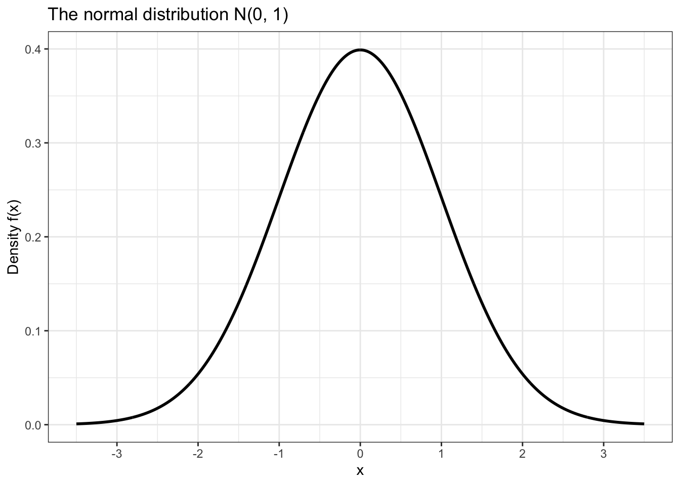
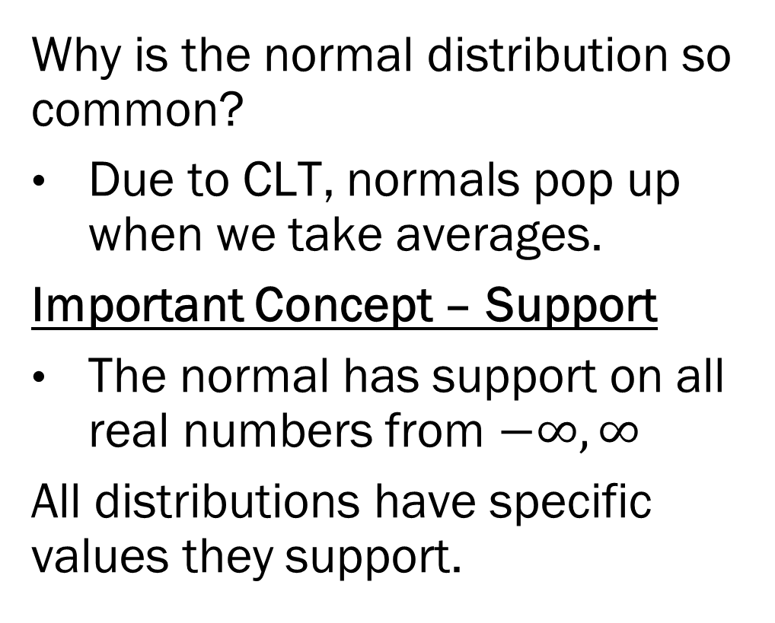
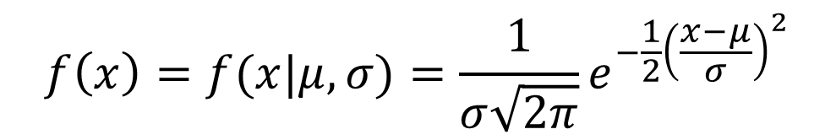
The Normal Distribution
Why is the normal distribution so common?
Due to CLT, normals pop up when we take averages.
Important Concept – Support
The normal has support on all real numbers from $−∞,∞$
All distributions have specific values they support.
$$f\left(x\right)=f(x|μ,σ)=\frac{1}{σ\sqrt{2π}}e^{−\frac{1}{2}{\left(\frac{x−μ}{σ}\right)}^{2}}$$

Slide 8
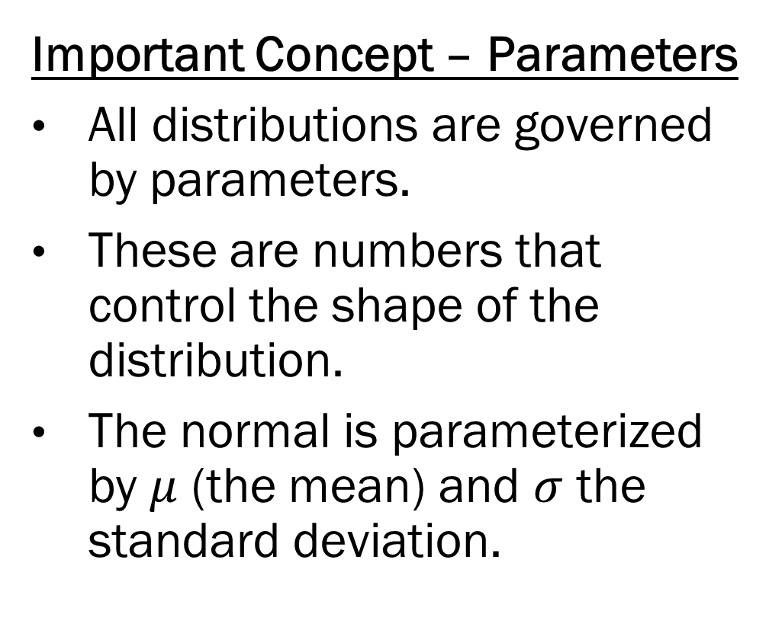
The Normal Distribution
Important Concept – Parameters
All distributions are governed by parameters.
These are numbers that control the shape of the distribution.
The normal is parameterized by $μ$ (the mean) and $σ$ the standard deviation.
$$f\left(x\right)=f(x|μ,σ)=\frac{1}{σ\sqrt{2π}}e^{−\frac{1}{2}{\left(\frac{x−μ}{σ}\right)}^{2}}$$

Slide 9
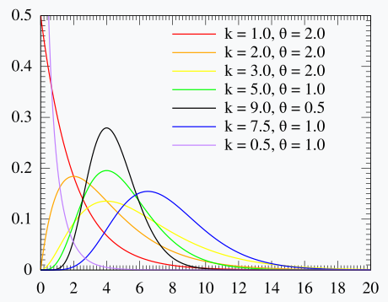
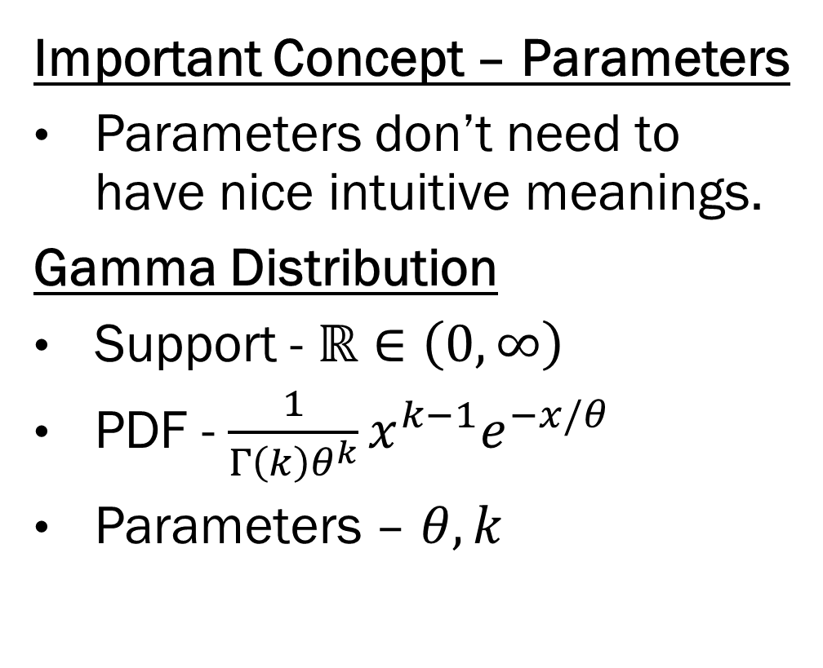
Parameters
Important Concept – Parameters
Parameters don’t need to have nice intuitive meanings.
Gamma Distribution
Support - $ℝ∈\left(0, ∞\right)$
PDF - $\frac{1}{Γ\left(k\right)θ^{k}}x^{k−1}e^{−x/θ}$
Parameters – $θ, k$

Slide 10
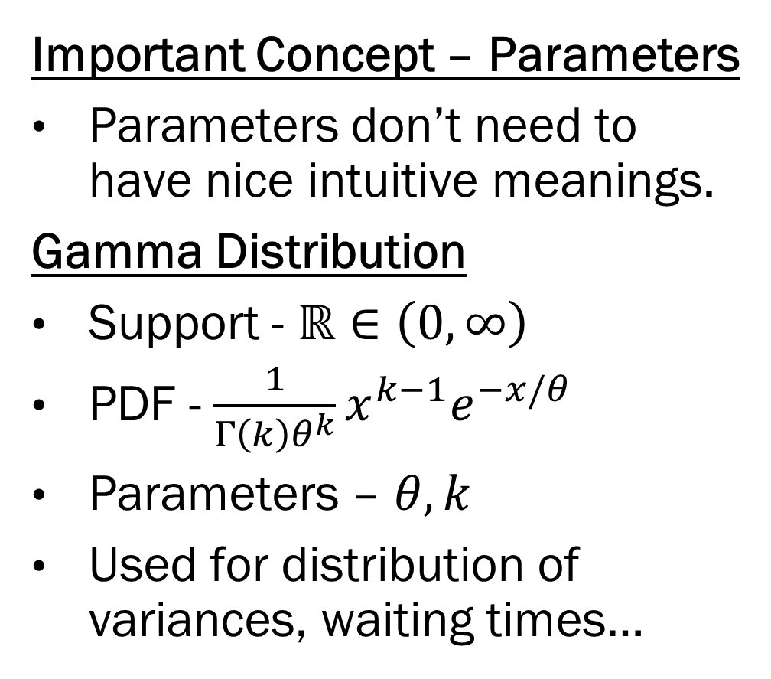
Parameters
Important Concept – Parameters
Parameters don’t need to have nice intuitive meanings.
Gamma Distribution
Support - $ℝ∈\left(0, ∞\right)$
PDF - $\frac{1}{Γ\left(k\right)θ^{k}}x^{k−1}e^{−x/θ}$
Parameters – $θ, k$
Used for distribution of variances, waiting times…

Slide 11
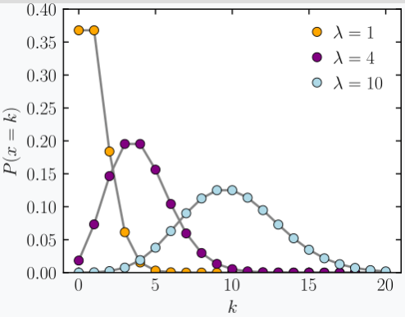
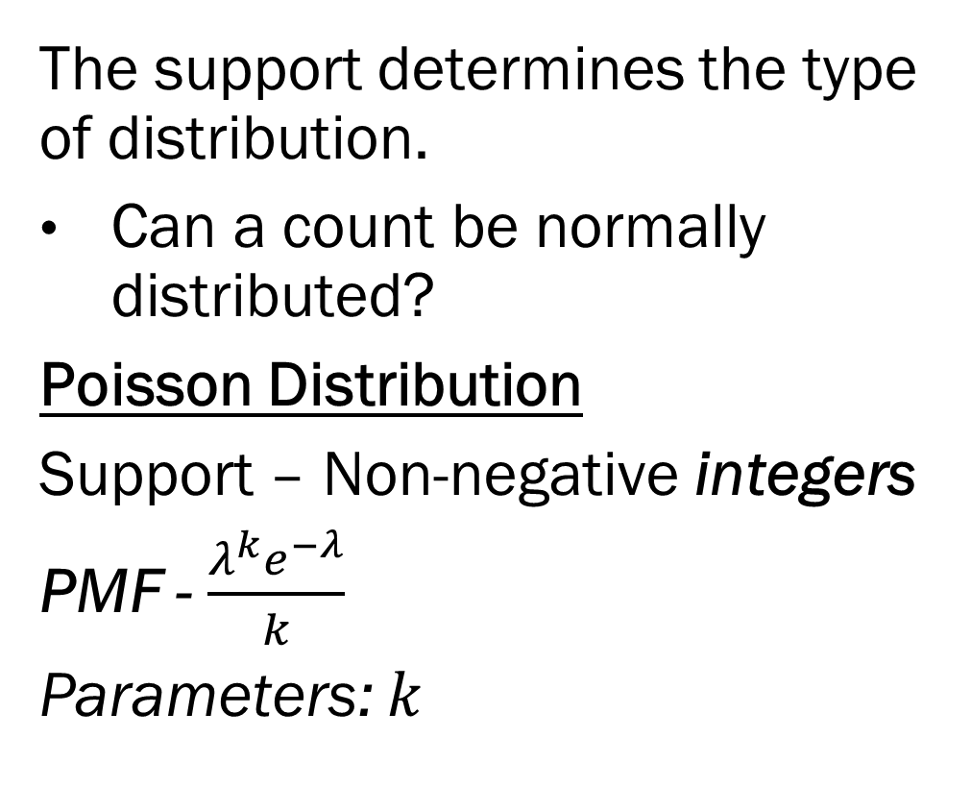
Continuous vs. Discrete
The support determines the type of distribution.
Can a count be normally distributed?
Poisson Distribution
Support – Non-negative integers
PMF - $\frac{λ^{k}e^{−λ}}{k}$
Parameters: $k$

Slide 12
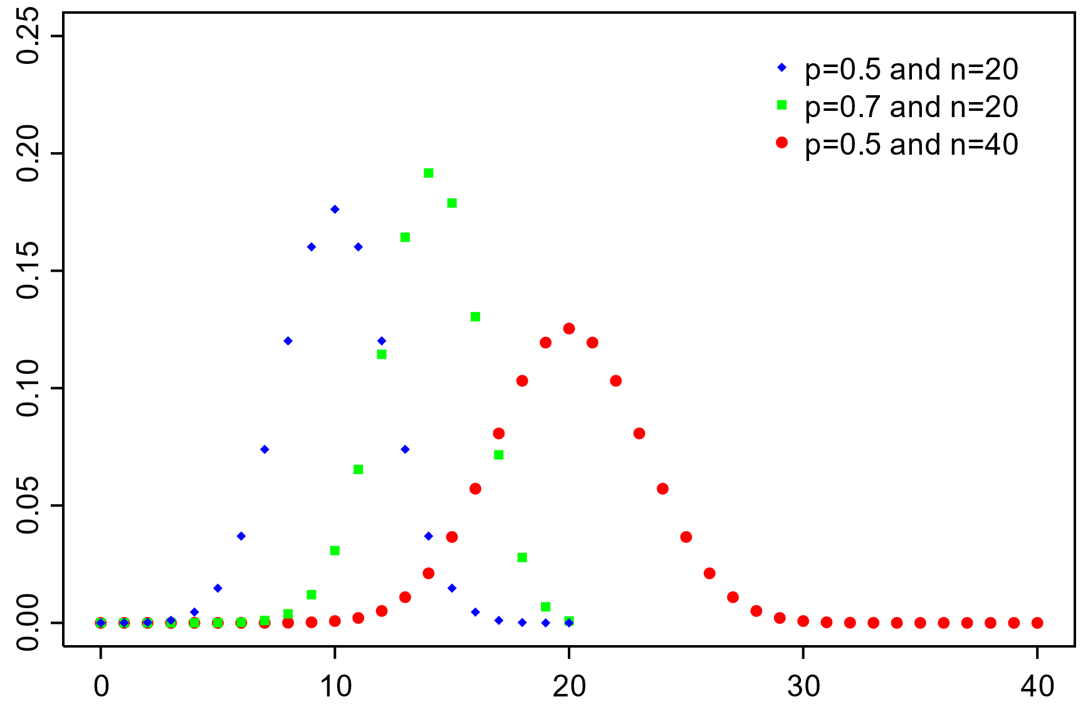
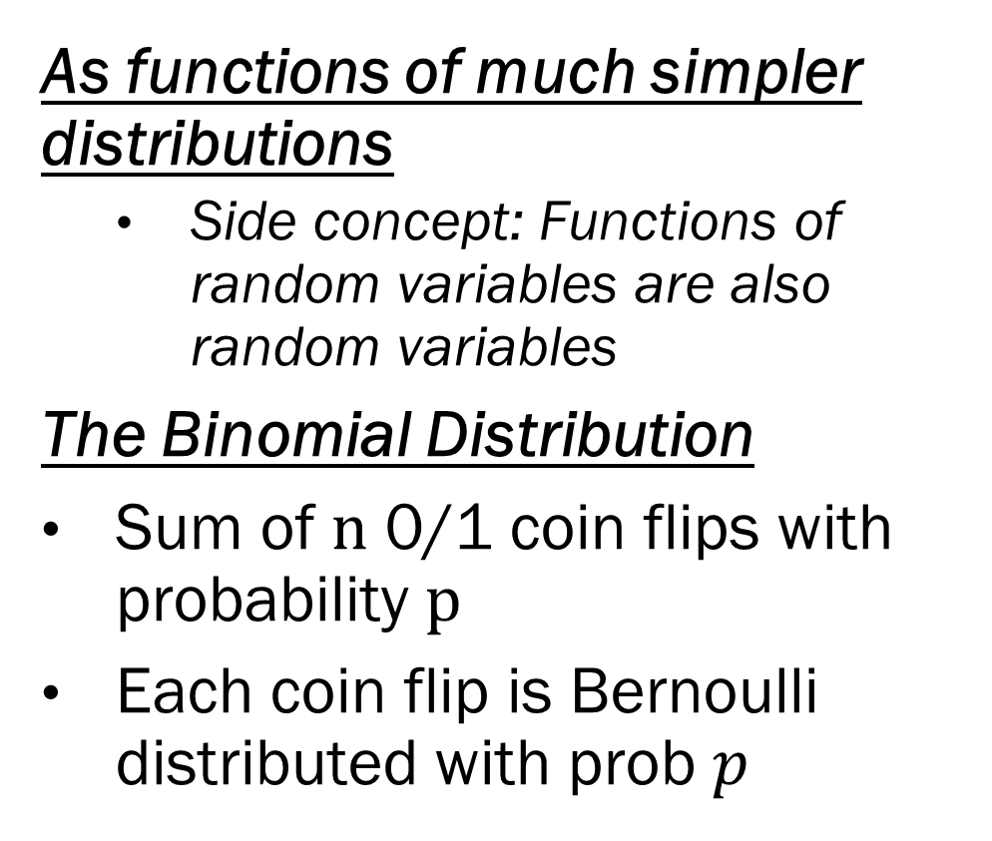
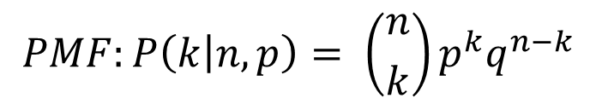
Where do distributions come from?
As functions of much simpler distributions
Side concept: Functions of random variables are also random variables
The Binomial Distribution
Sum of $n$ 0/1 coin flips with probability $p$
Each coin flip is Bernoulli distributed with prob $p$
$$PMF:P\left(k | n, p\right)= \left({n \atop k}\right)p^{k}q^{n−k}$$
What are the parameters here?

Slide 13
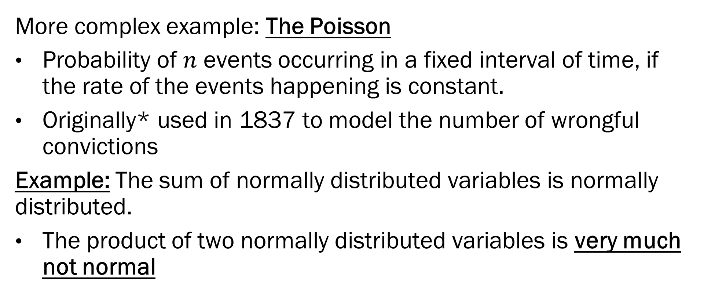
Where do distributions come from?
More complex example: The Poisson
Probability of $n$ events occurring in a fixed interval of time, if the rate of the events happening is constant.
Originally* used in 1837 to model the number of wrongful convictions
Example: The sum of normally distributed variables is normally distributed.
The product of two normally distributed variables is very much not normal
*Actually developed in 1711 by Moivre. Very few things in math
are named correctly

Slide 14
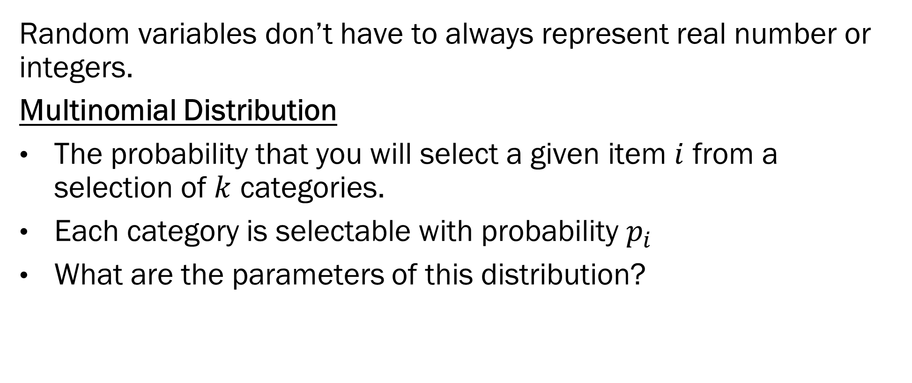
Categorical Distributions
Random variables don’t have to always represent real number or integers.
Multinomial Distribution
The probability that you will select a given item $i$ from a selection of $k$ categories.
Each category is selectable with probability $p_{i}$
What are the parameters of this distribution?

Slide 15
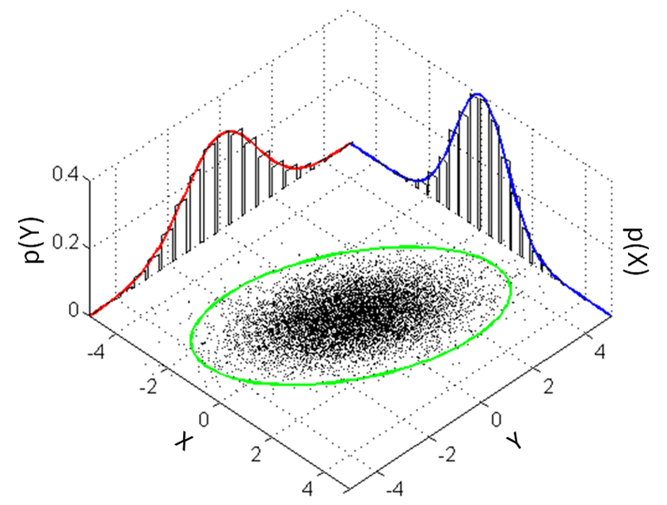
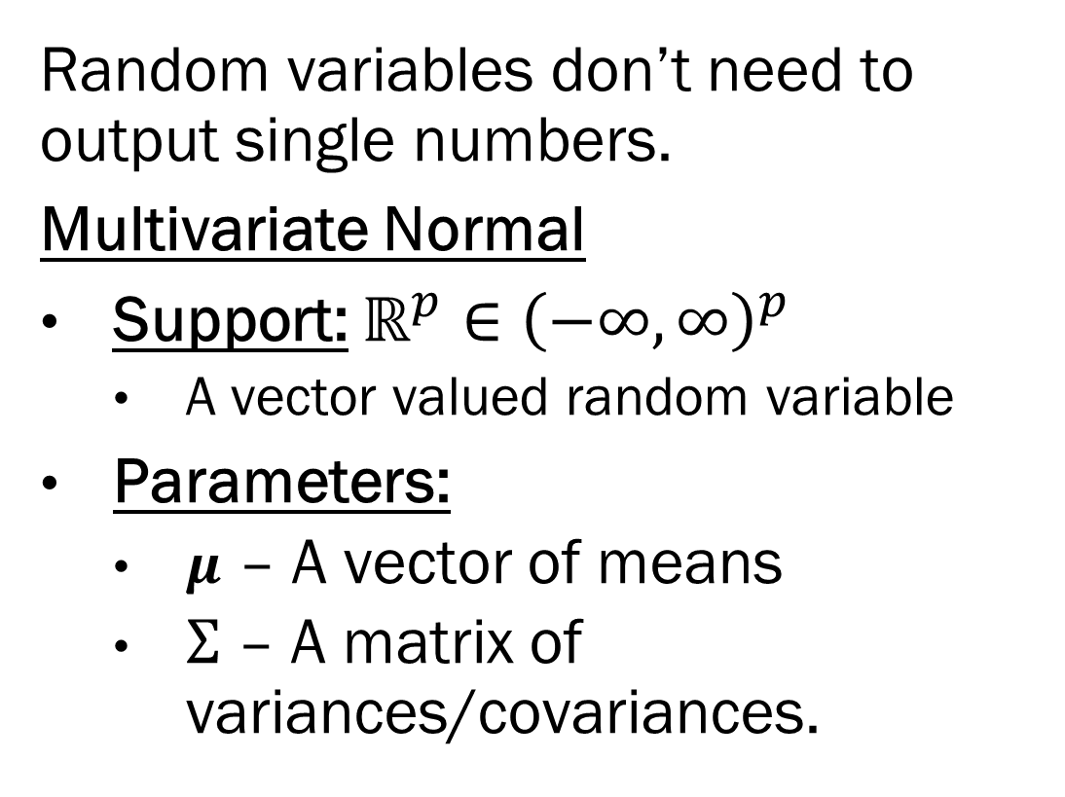
Univariate vs. Multivariate Distributions
Random variables don’t need to output single numbers.
Multivariate Normal
Support: $ℝ^{p}∈{\left(−∞,∞\right)}^{p}$
A vector valued random variable
Parameters:
$μ$ – A vector of means
$Σ$ – A matrix of variances/covariances.

Slide 16

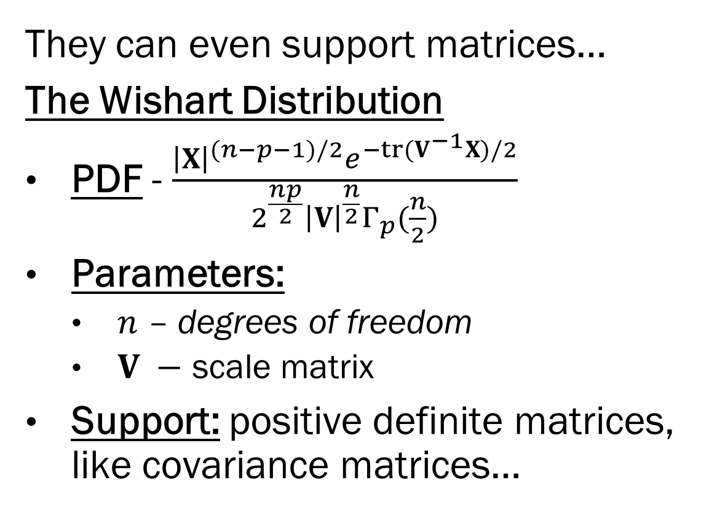
Univariate vs. Multivariate Distributions
They can even support matrices…
The Wishart Distribution
PDF - $\frac{{\left|X\right|}^{(n−p−1)/2}e^{−tr(V^{−1}X)/2}}{2^{\frac{np}{2}}{\left|V\right|}^{\frac{n}{2}}Γ_{p}(\frac{n}{2})}$
Parameters:
$n$ – degrees of freedom
$V −$ scale matrix
Support: positive definite matrices, like covariance matrices…

Slide 17
Probability Distributions
Distributions are just functions that map the outcomes of a random variable to probabilities.
Named distributions are functions that have nice closed form solutions.
So why are we learning about them?
Statistical models represent complicated conditional probability distributions.
In Bayesian statistics, everything is a random variable
Data and parameters.

Slide 18
Quantifying Distributions
It’s one thing to have the equation for a distribution. But how can we characterize a distribution?
Question: We have a continuous variable of observed data, say, income. What is a good characterization of that data?

Slide 19
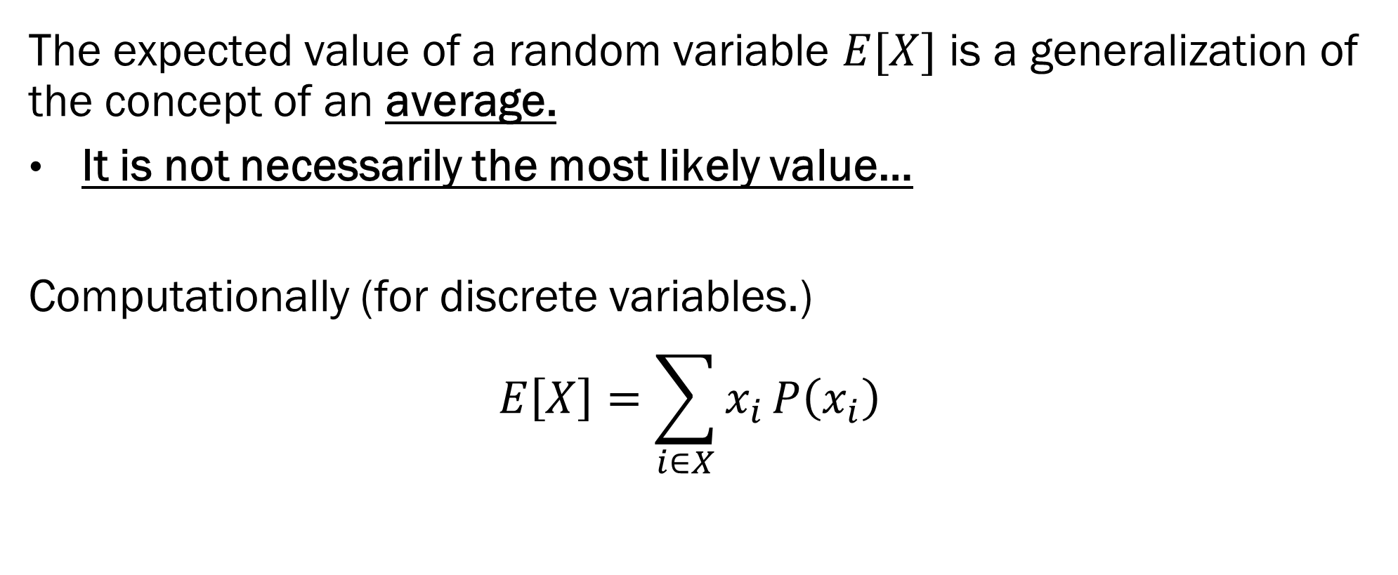
Expected Values
The expected value of a random variable $E[X]$ is a generalization of the concept of an average.
It is not necessarily the most likely value…
Computationally (for discrete variables.)
$$E\left[X\right]=\sum_{i∈X}{x_{i}}P\left(x_{i}\right)$$

Slide 20
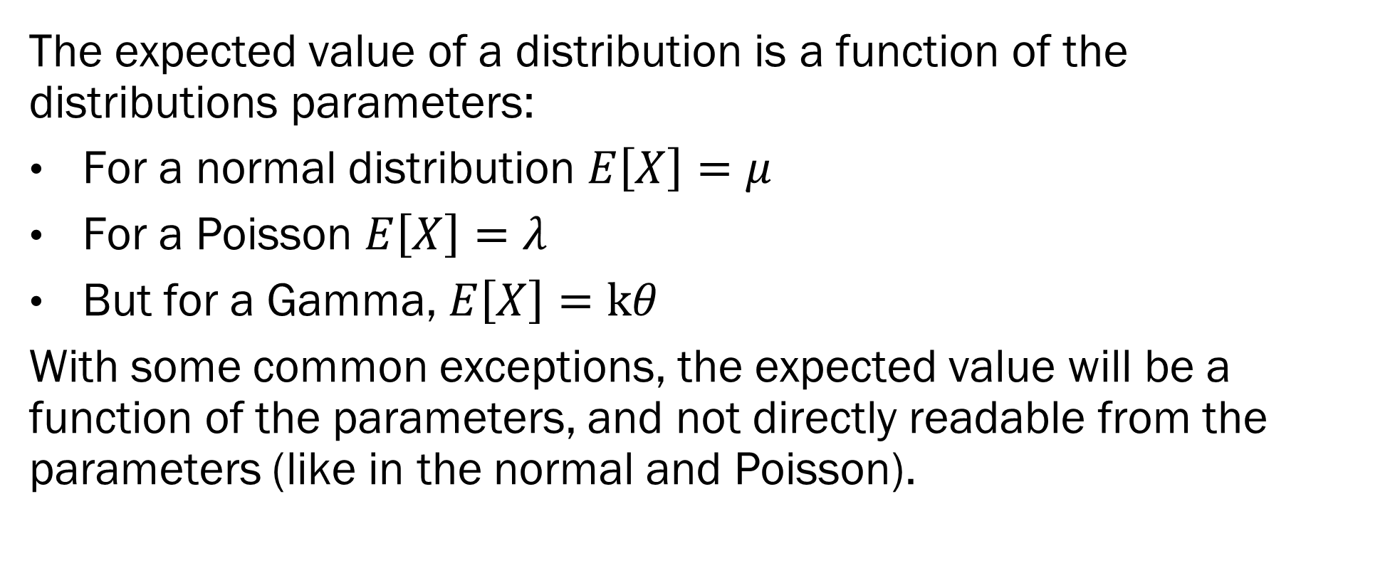
Expected Values
The expected value of a distribution is a function of the distributions parameters:
For a normal distribution $E\left[X\right]=μ$
For a Poisson $E\left[X\right]=λ$
But for a Gamma, $E\left[X\right]=kθ$
With some common exceptions, the expected value will be a function of the parameters, and not directly readable from the parameters (like in the normal and Poisson).

Slide 21
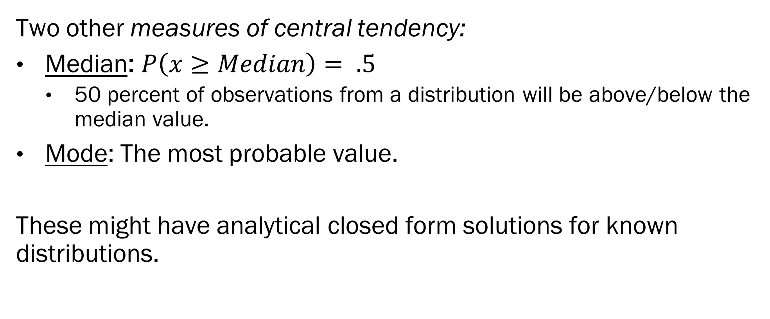
Median and Mode
Two other measures of central tendency:
Median: $P\left(x≥Median\right)= .5$
50 percent of observations from a distribution will be above/below the median value.
Mode: The most probable value.
These might have analytical closed form solutions for known distributions.

Slide 22
Variance
Mean/Median/Mode all tell you about the location of a distribution
Corresponds to the “estimate” component of inference,
Variance characterizes how certain you can be about the expected value (and more broadly, how certain can you be about the random variable.)
Like with the Expected Value, this is available in closed form for most known distributions.

Slide 23
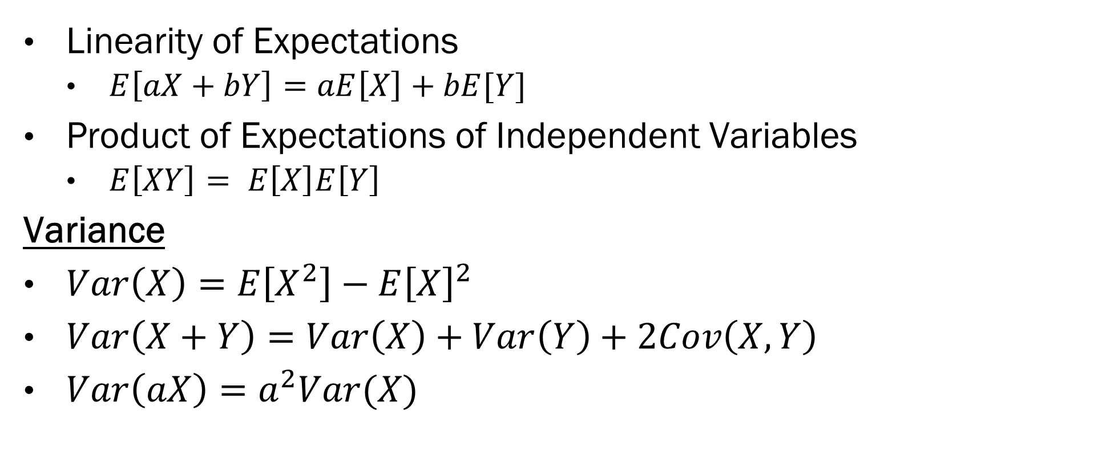

Properties of $E\left[X\right]$ and $Var[X]$
Linearity of Expectations
$E\left[aX+bY\right]=aE\left[X\right]+bE[Y]$
Product of Expectations of Independent Variables
$E\left[XY\right]= E\left[X\right]E\left[Y\right]$
Variance
$Var\left(X\right)=E\left[X^{2}\right]−E{\left[X\right]}^{2}$
$Var\left(X+Y\right)=Var\left(X\right)+Var\left(Y\right)+2Cov\left(X, Y\right)$
$Var\left(aX\right)=a^{2}Var(X)$

Slide 24
In-class Exercise!
Groups of 5
What is the expected value of a 5 card hand drawn from a standard deck?
Face cards = 10, Aces = 11
Can we bound this estimate by a different, simpler estimate?
What is the probability you will have a hand worth more than 30?
Can we approximate this probability by making distributional assumptions

Slide 25
In-class Exercise!
Hint:
Break out R and write a quick simulation study…
Or try to approximate the quantities. What about sampling from the deck with replacement?

Slide 26
Next Week on Bayes ML
Back to Bayesian Statistics!
Priors and posteriors!
Conjugate priors!

