Slide 1

Probability Theory
DS6040 Fall 2024
Teague R. Henry

Slide 2

Outline
What is a probability?
Fundamental concepts in probability theory
Feel free to doze during this
Properties of probability theory
Connections to Boolean logic
Statistics and Distributions

Slide 3
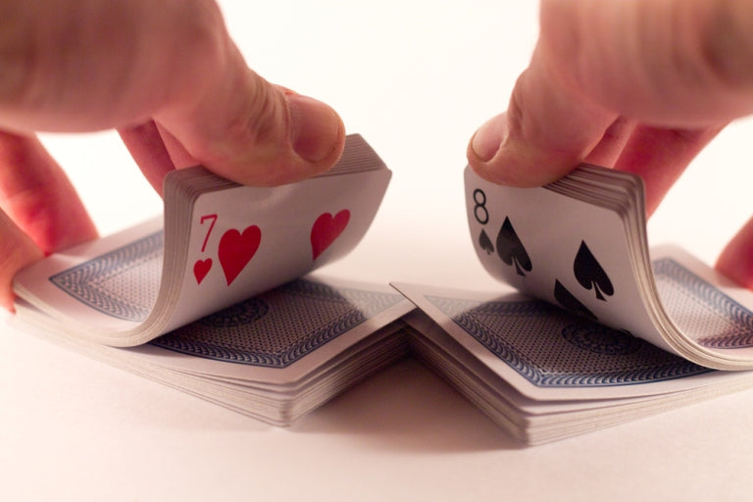
What is a probability?
What does “the probability of drawing an ace = 4/52” mean?
4/52 cards are aces?
If you repeatedly shuffle and draw, approximately 4/52 of the times you draw you will draw an ace?
You believe an ace will be drawn with 4/52 confidence?

Slide 4
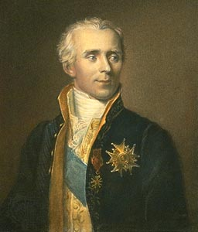
Classical Probability
Intuitive definition of probability
Set of events that can happen – Sample space
Probability is then simply the size of desired subset relative to the size of the sample space.
Pierre-Simon Laplace

Slide 5
Classical Probability
Issues:
Considers discrete events
The principle of indifference –
In absence of information, events have equal probability.
Bertand’s Paradox
Pierre-Simon Laplace
Notes:
Bertrands Paradox-
Consider the following problem. Given a circle, with an equilateral triangle inscribed within, and choosing a chord at random, what is the probability that the chord is longer than one of the triangles sides.
If you chose random end points, you get 1/3
If you chose random points on a radian, you get ½
If you chose random mid points, you get ¼
All are completely random (principle of indifference) selections of chords, but they lead to different outcome probabilities.

Slide 6
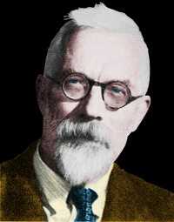
Frequentist Probability
The probability of a thing happening is simply…
How often it would happen if you repeated the experiment an infinite number of times under the exact same conditions.
This guy again
Notes:
Bertrands Paradox-
Consider the following problem. Given a circle, with an equilateral triangle inscribed within, and choosing a chord at random, what is the probability that the chord is longer than one of the triangles sides.
If you chose random end points, you get 1/3
If you chose random points on a radian, you get ½
If you chose random mid points, you get ¼
All are completely random (principle of indifference) selections of chords, but they lead to different outcome probabilities.

Slide 7
Frequentist Probability
Frequentist probability is fundamentally experimental:
It doesn’t require you to assign probabilities to events.
It doesn’t require you to know anything about the phenomena
In fact, this is explicitly not allowed!
Issues:
What is the probability of a unique event?
Dependence on infinite trials…
Notes:
Bertrands Paradox-
Consider the following problem. Given a circle, with an equilateral triangle inscribed within, and choosing a chord at random, what is the probability that the chord is longer than one of the triangles sides.
If you chose random end points, you get 1/3
If you chose random points on a radian, you get ½
If you chose random mid points, you get ¼
All are completely random (principle of indifference) selections of chords, but they lead to different outcome probabilities.

Slide 8
Subjective/Bayesian Probability
"Whatever happens to you has been waiting to happen since the beginning of time. The twining strands of fate wove both of them together: your own existence and the things that happen to you.“ – Marcus Aurelius
The probability of an event is your certainty of the event happening.
It’s fundamentally based on the information available to you, and your beliefs about the phenomena.
For example: It will either rain tomorrow or it won’t.
The probability you assign to if it will rain depends on if you’ve looked at the forecast.
Notes:
Bertrands Paradox-
Consider the following problem. Given a circle, with an equilateral triangle inscribed within, and choosing a chord at random, what is the probability that the chord is longer than one of the triangles sides.
If you chose random end points, you get 1/3
If you chose random points on a radian, you get ½
If you chose random mid points, you get ¼
All are completely random (principle of indifference) selections of chords, but they lead to different outcome probabilities.

Slide 9

Bayesian Probability
Bayesian Probability is just Subjective Probability with the ability to update based on prior beliefs.
Issues:
iT’s SuBjEcTiVe
A critic of subjective probability (colorized)
Notes:
Bertrands Paradox-
Consider the following problem. Given a circle, with an equilateral triangle inscribed within, and choosing a chord at random, what is the probability that the chord is longer than one of the triangles sides.
If you chose random end points, you get 1/3
If you chose random points on a radian, you get ½
If you chose random mid points, you get ¼
All are completely random (principle of indifference) selections of chords, but they lead to different outcome probabilities.

Slide 10
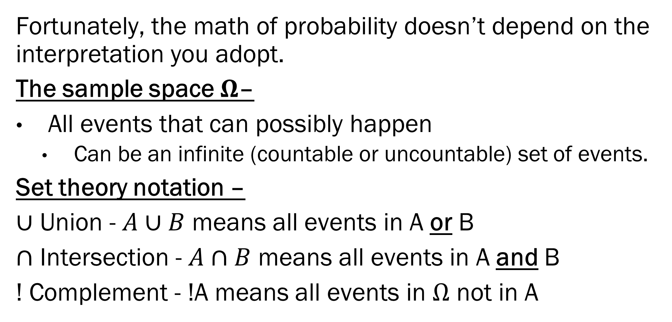
Probability Theory vs. Interpretation
Fortunately, the math of probability doesn’t depend on the interpretation you adopt.
The sample space $Ω$–
All events that can possibly happen
Can be an infinite (countable or uncountable) set of events.
Set theory notation –
$∪$ Union - $A∪B$ means all events in A or B
$∩$ Intersection - $A∩B$ means all events in A and B
! Complement - !A means all events in $Ω$ not in A
Notes:
Bertrands Paradox-
Consider the following problem. Given a circle, with an equilateral triangle inscribed within, and choosing a chord at random, what is the probability that the chord is longer than one of the triangles sides.
If you chose random end points, you get 1/3
If you chose random points on a radian, you get ½
If you chose random mid points, you get ¼
All are completely random (principle of indifference) selections of chords, but they lead to different outcome probabilities.

Slide 11
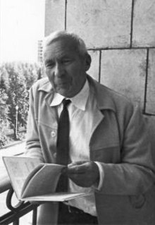
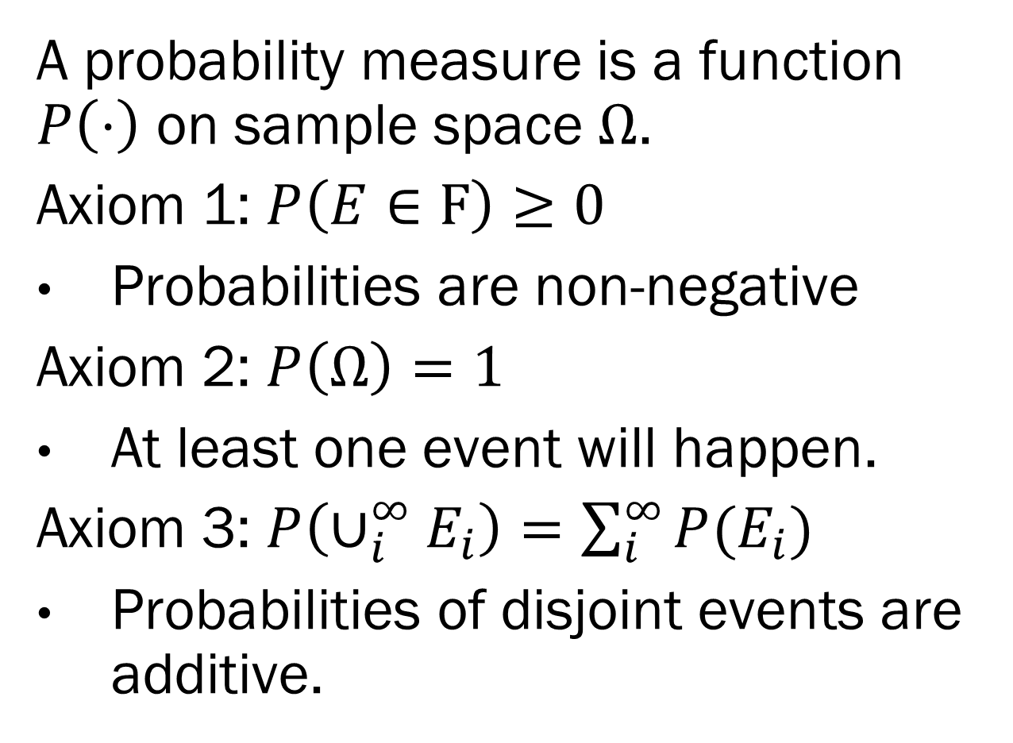
Axioms of Probability
A probability measure is a function $P\left(⋅\right)$ on sample space $Ω$.
Axiom 1: $P\left(E∈F\right)≥0$
Probabilities are non-negative
Axiom 2: $P\left(Ω\right)=1$
At least one event will happen.
Axiom 3: $P\left(∪_{i}^{∞}E_{i}\right)=\sum_{i}^{∞}{P(E_{i})}$
Probabilities of disjoint events are additive.
Andrey Kolmogorov
Notes:
Soviet Mathematician- One of the most prolific mathematicians
- Editor of the math section of “The swallow of spring” at age 5
- Every mathematician believes that he is ahead of the others. The reason none state this belief in public is because they are intelligent people.

Slide 12
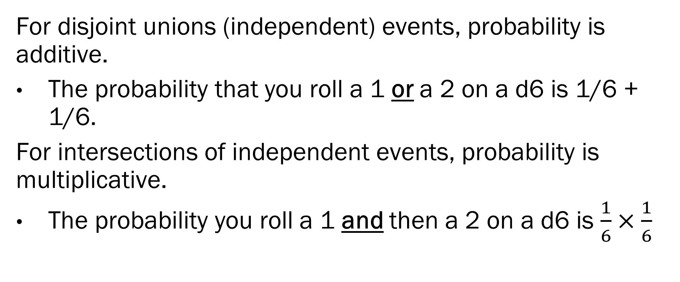
Properties of Probability
For disjoint unions (independent) events, probability is additive.
The probability that you roll a 1 or a 2 on a d6 is 1/6 + 1/6.
For intersections of independent events, probability is multiplicative.
The probability you roll a 1 and then a 2 on a d6 is $\frac{1}{6}×\frac{1}{6}$
Notes:
Soviet Mathematician- One of the most prolific mathematicians
- Editor of the math section of “The swallow of spring” at age 5
- Every mathematician believes that he is ahead of the others. The reason none state this belief in public is because they are intelligent people.

Slide 13
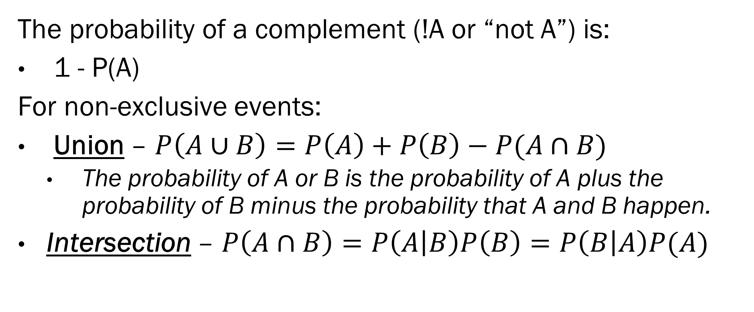
Properties of Probability
The probability of a complement (!A or “not A”) is:
1 - P(A)
For non-exclusive events:
Union – $P\left(A∪B\right)=P\left(A\right)+P\left(B\right)−P(A∩B)$
The probability of A or B is the probability of A plus the probability of B minus the probability that A and B happen.
Intersection – $P\left(A∩B\right)=P\left(A | B\right)P\left(B\right)=P\left(B | A\right)P(A)$
Notes:
Soviet Mathematician- One of the most prolific mathematicians
- Editor of the math section of “The swallow of spring” at age 5
- Every mathematician believes that he is ahead of the others. The reason none state this belief in public is because they are intelligent people.

Slide 14

Properties of Probability
Conditional probabilities:
$P\left(A | B\right)$- The probability of A if B has happened
$P\left(A | B\right)=P\left(A\right)$ if A and B are independent
Important thing to know about conditional probabilities:
The conditioner (B in the example) is fixed.
You cannot easily flip the conditional, we have to use Bayes Theorem.
Notes:
Soviet Mathematician- One of the most prolific mathematicians
- Editor of the math section of “The swallow of spring” at age 5
- Every mathematician believes that he is ahead of the others. The reason none state this belief in public is because they are intelligent people.

Slide 15
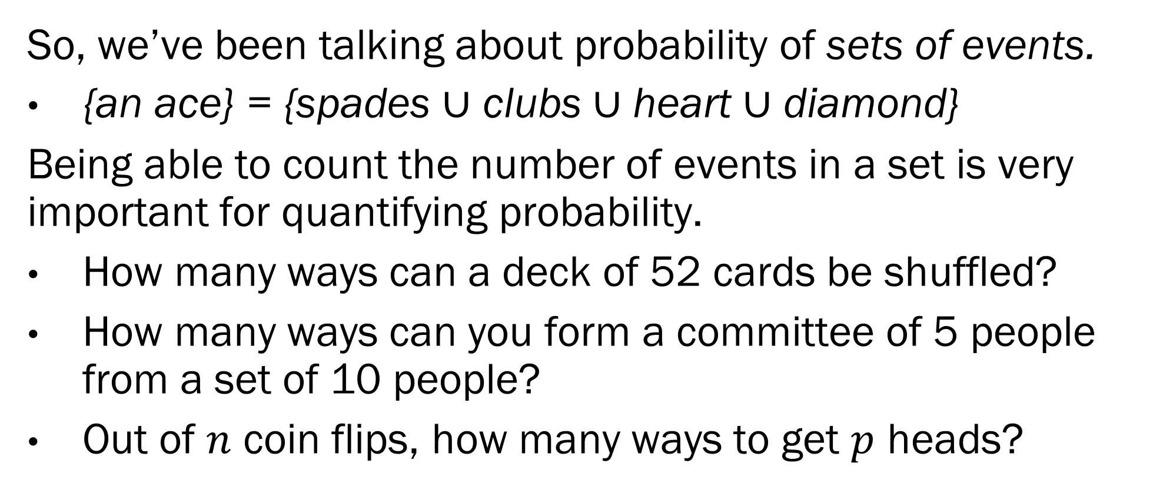
Combinatorics
So, we’ve been talking about probability of sets of events.
{an ace} = {spades $∪$ clubs $∪$ heart $∪$ diamond}
Being able to count the number of events in a set is very important for quantifying probability.
How many ways can a deck of 52 cards be shuffled?
How many ways can you form a committee of 5 people from a set of 10 people?
Out of $n$ coin flips, how many ways to get $p$ heads?
Notes:
Soviet Mathematician- One of the most prolific mathematicians
- Editor of the math section of “The swallow of spring” at age 5
- Every mathematician believes that he is ahead of the others. The reason none state this belief in public is because they are intelligent people.

Slide 16
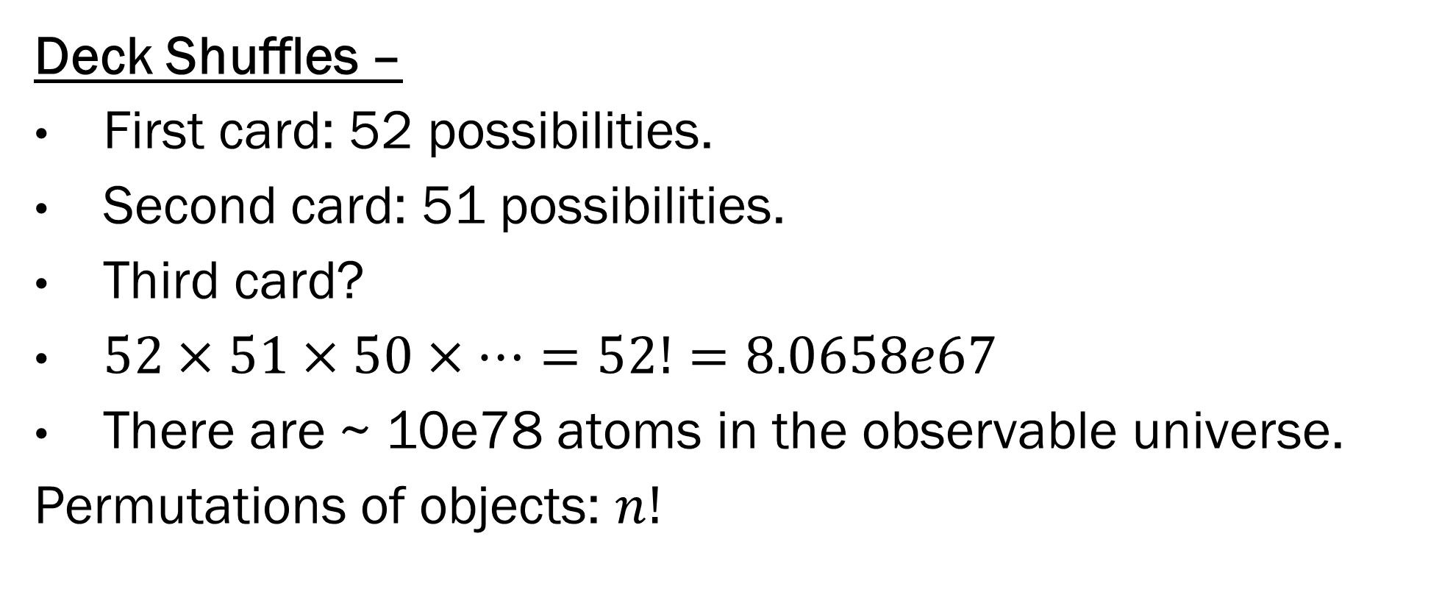
Combinatorics
Deck Shuffles –
First card: 52 possibilities.
Second card: 51 possibilities.
Third card?
$52×51×50×⋯=52!=8.0658e67$
There are ~ 10e78 atoms in the observable universe.
Permutations of objects: $n!$
Notes:
Soviet Mathematician- One of the most prolific mathematicians
- Editor of the math section of “The swallow of spring” at age 5
- Every mathematician believes that he is ahead of the others. The reason none state this belief in public is because they are intelligent people.

Slide 17
An Aside
Set a timer for 52! seconds
Take 1 step around the earth’s equation every billion years.
Each time you go around the earth, take a drop of water out of the Pacific
Each time you empty the Pacific, put a sheet of paper on a stack.
You will have gotten through ~10% of the time when the stack of paper hits the sun
Notes:
Soviet Mathematician- One of the most prolific mathematicians
- Editor of the math section of “The swallow of spring” at age 5
- Every mathematician believes that he is ahead of the others. The reason none state this belief in public is because they are intelligent people.

Slide 18
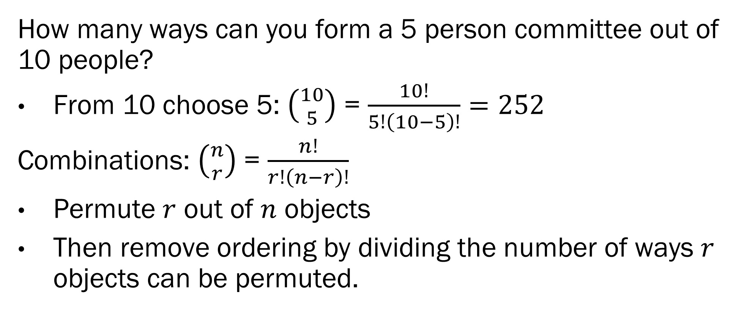
Combinatorics
How many ways can you form a 5 person committee out of 10 people?
From 10 choose 5: $\left({10 \atop 5}\right)$ = $\frac{10!}{5!\left(10−5\right)!}=252$
Combinations: $\left({n \atop r}\right)$ = $\frac{n!}{r!\left(n−r\right)!}$
Permute $r$ out of $n$ objects
Then remove ordering by dividing the number of ways $r$ objects can be permuted.
Notes:
Soviet Mathematician- One of the most prolific mathematicians
- Editor of the math section of “The swallow of spring” at age 5
- Every mathematician believes that he is ahead of the others. The reason none state this belief in public is because they are intelligent people.

Slide 19
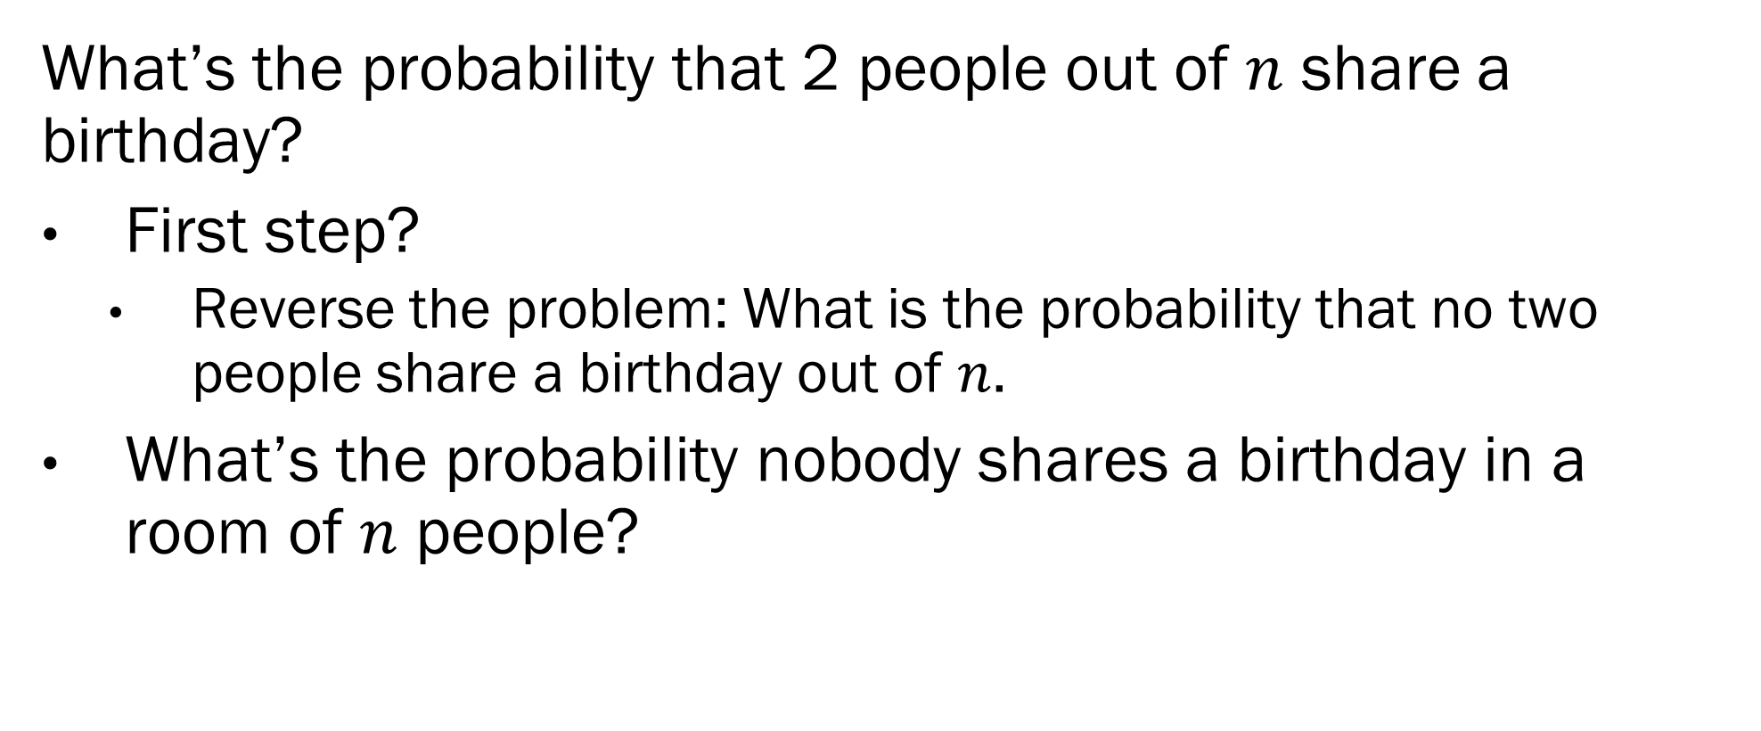
Probability and Combinatorics
What’s the probability that 2 people out of $n$ share a birthday?
First step?
Reverse the problem: What is the probability that no two people share a birthday out of $n$.
What’s the probability nobody shares a birthday in a room of $n$ people?
Notes:
Soviet Mathematician- One of the most prolific mathematicians
- Editor of the math section of “The swallow of spring” at age 5
- Every mathematician believes that he is ahead of the others. The reason none state this belief in public is because they are intelligent people.

Slide 20
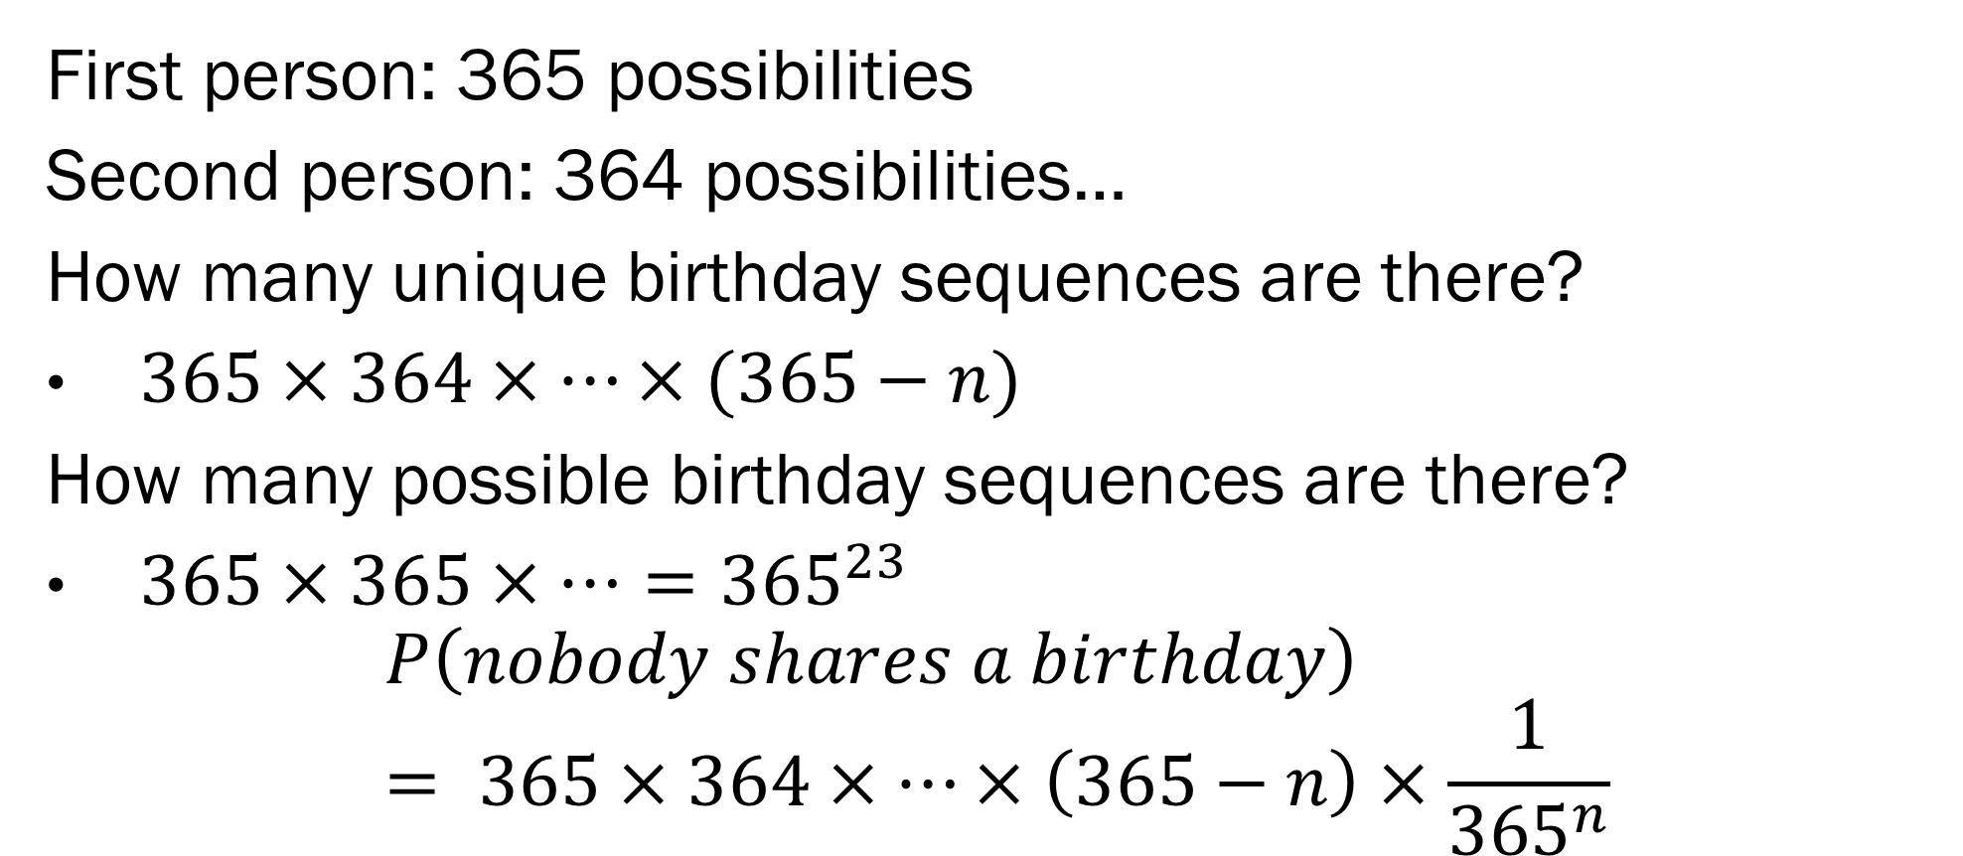
Probability and Combinatorics
First person: 365 possibilities
Second person: 364 possibilities…
How many unique birthday sequences are there?
$365×364×…×(365−n)$
How many possible birthday sequences are there?
$365×365×…={365}^{23}$
$$P\left(nobody shares a birthday\right)= 365×364×…×\left(365−n\right)×\frac{1}{{365}^{n}}$$
Notes:
Soviet Mathematician- One of the most prolific mathematicians
- Editor of the math section of “The swallow of spring” at age 5
- Every mathematician believes that he is ahead of the others. The reason none state this belief in public is because they are intelligent people.

Slide 21
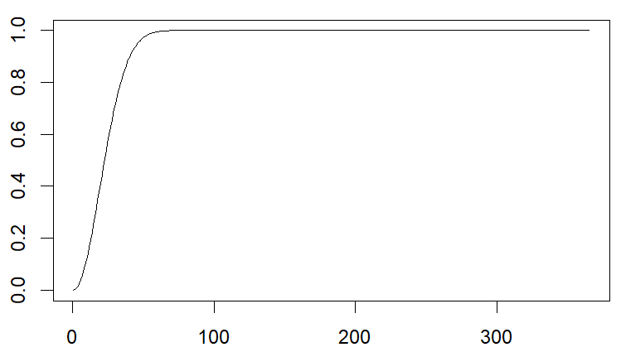
Probability and Combinatorics
Notes:
Soviet Mathematician- One of the most prolific mathematicians
- Editor of the math section of “The swallow of spring” at age 5
- Every mathematician believes that he is ahead of the others. The reason none state this belief in public is because they are intelligent people.

Slide 22
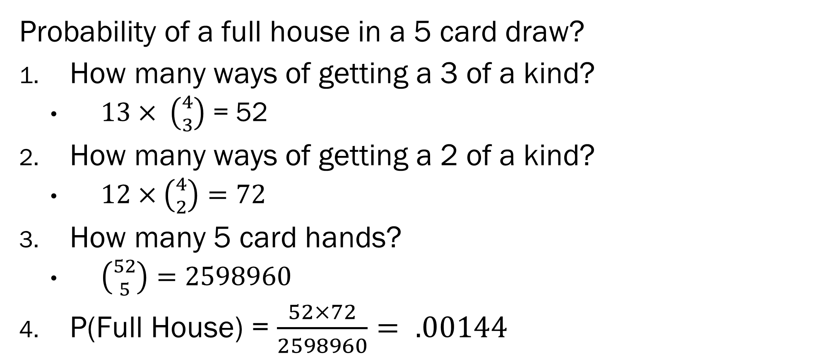
Probability and Combinatorics
Probability of a full house in a 5 card draw?
How many ways of getting a 3 of a kind?
$13× \left({4 \atop 3}\right)$ = 52
How many ways of getting a 2 of a kind?
$12×\left({4 \atop 2}\right)=72$
How many 5 card hands?
$\left({52 \atop 5}\right)=2598960$
P(Full House) = $\frac{52×72}{2598960}= .00144$
Notes:
Soviet Mathematician- One of the most prolific mathematicians
- Editor of the math section of “The swallow of spring” at age 5
- Every mathematician believes that he is ahead of the others. The reason none state this belief in public is because they are intelligent people.

Slide 23
In Class Exercise
Split into groups of 5 to solve the following problem:
In a game of Virginia Holdem’ the dealer deals 3 cards to the river, and then deals 2 cards to 2 players. What is the probability that the river has a 3 of a kind and each player has a pair?
How does this differ from “What is the probability that each player has a full house?”
Notes:
Soviet Mathematician- One of the most prolific mathematicians
- Editor of the math section of “The swallow of spring” at age 5
- Every mathematician believes that he is ahead of the others. The reason none state this belief in public is because they are intelligent people.

Slide 24
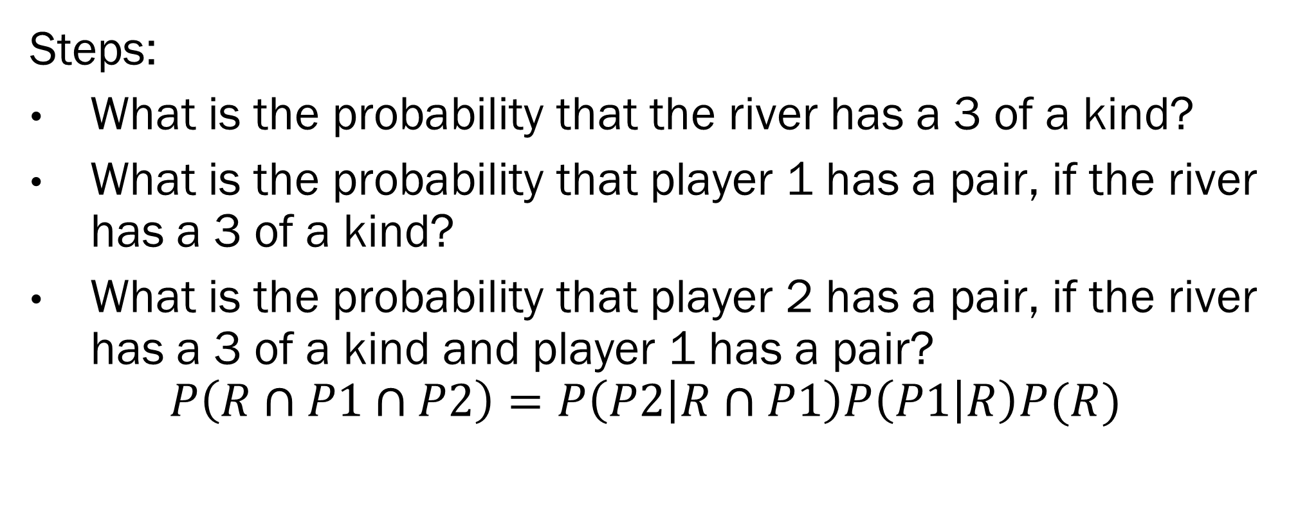
In Class Exercise
Steps:
What is the probability that the river has a 3 of a kind?
What is the probability that player 1 has a pair, if the river has a 3 of a kind?
What is the probability that player 2 has a pair, if the river has a 3 of a kind and player 1 has a pair?
$$P\left(R∩P1∩P2\right)=P\left(P2 | R∩P1\right)P\left(P1 | R\right)P(R)$$
Notes:
Soviet Mathematician- One of the most prolific mathematicians
- Editor of the math section of “The swallow of spring” at age 5
- Every mathematician believes that he is ahead of the others. The reason none state this belief in public is because they are intelligent people.

Slide 25
Thursday on Bayes ML!
Probability distributions and statistics!
The thrilling Gaussian
The delicate Poisson
The nightmarish Cauchy
And how to characterize these distributions:
Expected values, variances, moments, etc!
Notes:
Soviet Mathematician- One of the most prolific mathematicians
- Editor of the math section of “The swallow of spring” at age 5
- Every mathematician believes that he is ahead of the others. The reason none state this belief in public is because they are intelligent people.

