Slide 1
Analysis Plan
Schema Integration & Justification – Recommendation Group
Pavan Jahagirdhar – Susram Kanamarlapudi – Paul de Fusco – Jennifer De La Cruz
Oct 13, 2017

Slide 2
Summary
Datasets Overview
Brief presentation of all data
Data Integration Considerations
Explanation of Data integration goals from our perspective
Questions for Other Teams
Logical Model Considerations
Explanation of potential integrated schema
Notes:
Pavan:

Slide 3
Datasets Overview
Postgres Schema
Reviews File: reviews.json
Categories File: US_btg.xlsx
Notes:
Pavan

Slide 4
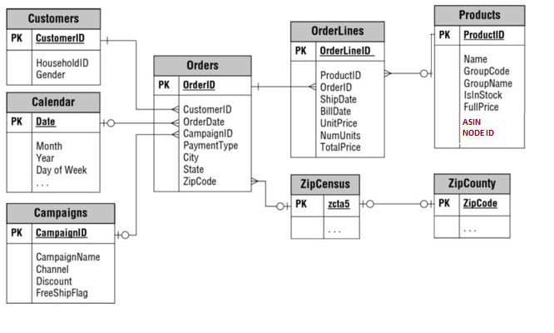
Current Postgres Schema
Notes:
Pavan

Slide 5
Reviews.json: Analysis:
Json file with the following fields:
"reviewerID”:
"asin":
"reviewerName":
"helpful":
"unixReviewTime":
"reviewText":
"overall":
"reviewTime":
"summary":
Notes:
Pavan

Slide 6
Categories File Analysis
Xlsx file with the following fields:
Classification – Bottom level node from ‘Node Path’ field
Node ID – Unique ID for Node Path
Node Path – Entire Node Path describing the category to which product belongs
Notes:
Pavan

Slide 7
Data Integration Considerations
Goal: production system integrating current schema with two files provided
Traditional Approach: analyze/parse the two files, create relational structures with output data, load into Postgres in augmented schema
Advantages: relational structure enabling fast querying, referential integrity, strong data lineage
NoSQL Alternative: host data in NoSQL technologies (like AsterixDB, Solr)
Advantages: original file data structure preserved, complete machine learning playground, semi-structured data, scalable, second level indexing, text analysis, in-database analytics
Team recommendation:
Discuss querying needs with Querying team
Is the scope of the project to perform a one time analysis or do we want to integrate data on frequent basis
What will be daily reports vs. ad hoc query needs
Discuss with machine learning team which insights can be created from files (‘feature engineering’) – goal is to see which of these features can be integrated in our db technology.
Discuss with Data Exploration team on expected frequency of new incoming files, details for updates/ inserts
Final decision rests on the project needs
Notes:
Pavan
What will be daily reports vs. ad hoc query needs
Prof: mentioned use both

Slide 8
Preliminary Logical Modeling Considerations
Reviews Json
Categories xlxs
ASIN Column in Products Table could be mapped to ASIN in Reviews File
Helpful field will be split into two columns in DB, (nhelpful, ratio)
Questions:
Can Additional Columns be Created?
Is the ASIN Column unique?
Node ID Column could be mapped to Node ID Column in Products Table
We will have to split the Node Path field into different sub-levels
Questions:
Which insights from the Node Path field should be retained? (e.g. top level node vs. intermediate)
Notes:
pavan

Slide 9
Reviews.json: Preliminary schema
create type reviewerType as closed {
REVIEWERID: string,
ASIN: string
}
create type reviewType as open {
reviewer: [reviewerType]
REVIEWERNAME: string?,
HELPFUL: string?,
UNIXREVIEWTIME: string?,
REVIEWTEXT: string?,
OVERALL: string?,
REVIEWTIME: string?,
SUMMARY: string?
}
Notes:
susram

Slide 10
Categories File: preliminary schema
create type classificationType as close {
classification: string,
nodeID: int,
}
create type classificationInfoType as open {
classifier:[classificationType]
category: {
level_0: string,
nested: {
level_1: string,
nested: {
level_2: string,
nested: {
level_3: string,
nested: {
level_4: string,
nested: {
level_5: string,
nested: {}
}
}
}
}
}
}
}

Slide 11
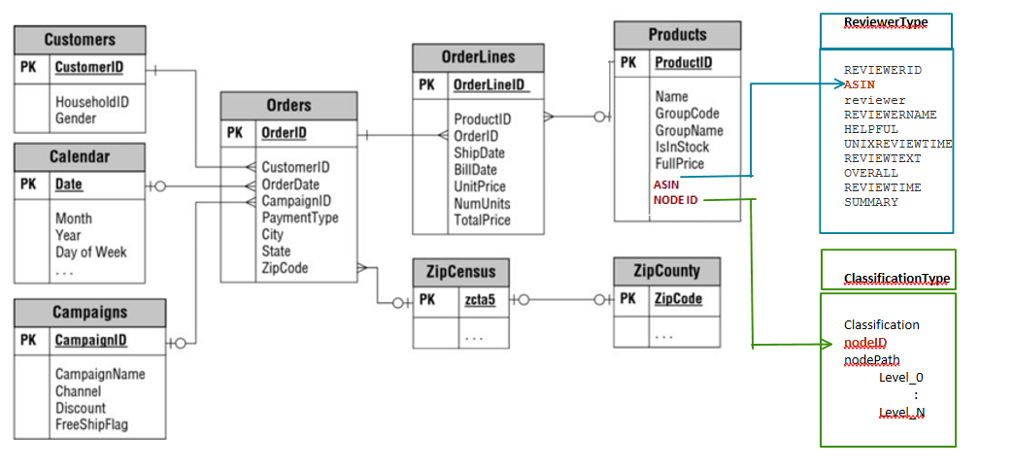
Integrated schema

Slide 12
Technologies for Data inegration
We plan to use:
Java
Python
Pentaho (open data integration tool, if allowed)
Notes:
Pentaho: prof. mentioned not to use pentaho

Slide 13
Thank You! pjahagir@eng.ucsd.edu srkanama@eng.ucsd.edu pdefusco@eng.ucsd.edu jld029@eng.ucsd.edu

