Slide 1
Query Capability Update
ML models and high-level queries
Integrated Schema
Query processing flow
Logistics
API in python
Pandas.dataframe
project github
Recommendation

Slide 2
Query Processing
Collaborative Filtering
Content based filtering
Mediator: High-level query API
Integrated schema
Integrated schema
Query Criteria
Wrapper Class
CustomerFeature
ProductFeature
FlexCategory
ReviewFeature
Postgres
customers
orders
orderlines
products
AsterxDB
Solr
ClassificationInfo
reviewText
campaigns
reviews
Zipcensus, ..
Recommendation

Slide 3
Collaborative filtering
High level queries for Collaborative Filtering
Co-occurrence matrix
per group
Demographic criteria
Product/category criteria
Query Criteria
Wrapper Class
Co-occurrence Matrix
CustomerFeature
ProductFeature
FlexCategory
Postgres
AsterxDB
customers
orders
orderlines
products
ClassificationInfo
Recommendation
Recommendation

Slide 4
Content based filtering
High-level queries for Content Based Filtering
content-based features
per group
Demographic Filtering
Product/category filtering
Query Criteria
Wrapper Class
ProductFeature
ReviewFeature
Price
Total_order_count
Total_copy_count
1. Review Length
2. Review Product Rating
3. Total Votes for review
4. Reviewers review count
5. Review Age
6. Number of reviews for product
7. Avg word length
8. Number of words in Capital
9. Ratio of exclamations and question marks in review to total characters
10.Avg Sentence length
11.Review Sentiment (if possible, not necessary)
12 ARI index for review (Automated Readability Index)
13.TF-IDF for top 100 features
Recommendation

Slide 5
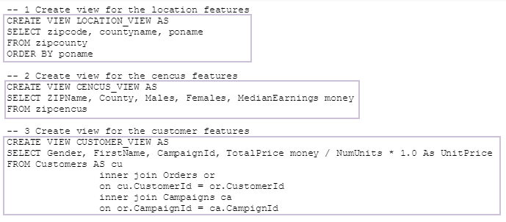
CustomerFeature
Customer View
Customer Attributes
Zipcode, county name, poname, etc.
Location features
ZIPName, county, Males, Females, MedianEarnings, etc.
Census features
Gender, FirstName, CampaignID, UnitPrice, etc.
Customer features
Recommendation

Slide 6
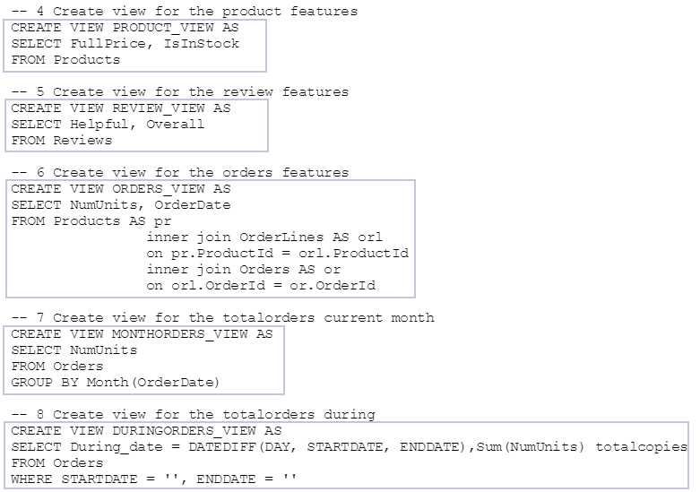
ProductFeature
Product View
Product Attributes
Product features
FullPrice,IsInStock, etc.
Review features
Helpful,Overall, etc.
Order features
NumUnits,OrderDate, etc.
Monthly Order (Current Month)
Monthly Order (In Between Month)
Recommendation

Slide 7
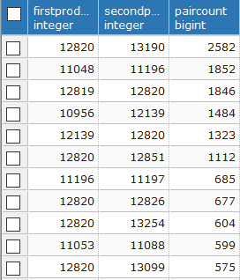
Co-occurrence Matrix
--1 Create view for the customers and their associated products
WITH cust_prod as
(SELECT c.customerid, pr.productid
FROM customers c, orders o, orderlines ol, products pr
WHERE o.customerid = c.customerid and ol.orderid = o.orderid and pr.productid = ol.productid)
--2 Create view for the co-occurrence matrix
SELECT cp1.productid as firstproduct, cp2.productid as secondproduct, count(cp1.customerid) as paircount
FROM cust_prod cp1, cust_prod cp2
WHERE cp1.customerid = cp2.customerid
GROUP BY cp1.productid, cp2.productid
ORDER BY COUNT(cp1.customerid) DESC
--3 Get non-duplicate pairs not on the diagonal
SELECT ppc.firstproduct, ppc.secondproduct, ppc.paircount
FROM product_pair_count ppc
WHERE ppc.firstproduct < ppc.secondproduct
ORDER BY ppc.paircount DESC
Customer & associated products
Group by co-occurring pairs and find the count
Find unique pairs
Example of Output:
Recommendation

Slide 8
FlexCategory & High-level API
get nodeIDs for category
at any level
multiple levels
orderless
Possibilities
enforce level order
fuzzy matching on category string
High-level API
implemented with wrapper class
Integrated schema can be enforced by parameter validation.
state programming
#example
result = get_product_feature_in_category(['Education'])
def get_product_feature_in_category(category, **kwargs):
classinfo = ClassificationInfo()
pv = ProductView()
nodes = classinfo.get_nodes_by_category(category, id=True)
strnodes = ', '.join(["'{}'".format(n) for n in nodes])
condition = "category in ({})".format(strnodes)
return pv.get_product_view(limit=10, where=condition, **kwargs)
# get nodeID list given level
get_nodes_by_level({'level_1':’history’})
# get nodeID list for category
get_nodes_by_category(['History', 'Architecture'])
get_nodes_by_category([‘Architecture’, ‘History])
use TinySocial; With node_map AS ( select value {'nodeid': c.nodeID, 'level' : [ c.category.nested.level_1, c.category.nested.nested.level_2, c.category.nested.nested.nested.level_3, c.category.nested.nested.nested.nested.level_4, c.category.nested.nested.nested.nested.nested.level_5] } from ClassificationInfo c ) select m.nodeid, m.level from node_map m where "History" in m.level and "Architecture" in m.level;
Recommendation

