Slide 1
Query Capability Milestone3
Contents
As the interface is formalized between query team and integration team, query team now focus on designing the wrapper which takes in the reformulated datalog queries against each source database and translate them into native query language on source database or various views.
We also update on query processing architecture to reflect the interface, newly added views as well as new capabilities like writeback path.
Last part focus on analysis of the 5 questions and potential impact on query processing and how we support them with updated query architecture.
Recommendation

Slide 2
Query Architecture
Query architecture update
A translator layer is added in the wrapper which translate Datalog query to query on each source database
Writeback path is added for the requirement from ML to store precomputed co-occurrence matrix and recommendation table.
Lookup queries can also be made on these precomputed tables.
More views are added to source database to make it easier for integrated schema mapping and complex query need.
Recommendation

Slide 3
Query Architecture
Collaborative Filtering
Content based filtering
datalog
datalog
Mediator
Integrated Schema
Integrated Schema
Reformulate query to source schema
datalog
datalog
Wrapper
Query Criteria
Translator to SQL
Translator to SQL++
Translator to Solr API
SQL
SQL++
CustomerView
ProductView
…
CustomerProduct
FlexCategory
ReviewFeature
Postgres
customers
orders
orderlines
products
AsterxDB
Solr
ClassificationInfo
reviewText
campaigns
reviews
Zipcensus, ..
Recommendation

Slide 4
Writeback path
Purpose
ML model suggests a writeback path to store the precomputed result to source database and serves a real-time recommendation query for customer with a simple lookup from these stored table.
Design
Postgresql will be used for these precomputed table.
It is one-to-one direct schema mapping from ML-defined table to source database table.
It’s a pass through from intergrated schema to source for Datalog operation on these tables with a simple translation by wrapper.
Schema
CoOccurrenceCache(asin_purchased, asin_together, metric, catlvl1, catlvl2, catlvl3, catlvl4, catlvl5, season1, season2, season3, season4, price_asin_together, demographic_region, demographic_gender)
RecommendationColaborative(productid, category, rank)
RecommendationContent(productid, category, rank)
Recommendation

Slide 5
Writeback Processing
Collaborative Filtering
Content based filtering
datalog
datalog
Mediator
Integrated Schema
Integrated Schema
Reformulate query to source schema
datalog
datalog
Wrapper
Query Criteria
Translator to SQL
SQL
Postgres
co-occurrence_matrx
Recommendation_collaborative
Recommendation_content
Recommendation

Slide 6
Intermediate Views
All existing postgres tables can also be directly exposed to integrated schema.
Below intermediate views can make integrated schema mapping easier.
Views on Postgres
CustomerView(customerid, gender, firstname, zipcode, total_order)
ProductView(productid, name, nodeid, asin, total_review, avg_review_rating, total_order)
CoOccurrenceMatrix(productA, productB, pair_count)
CustomerProduct(customerid, productid, likes, gender, orderdate, orderstate, zipcode)
ReviewView (reviewid, asin, length, rating, total_votes, helpful, reviewtime)
Views on AsterixDB
CategoryLevel(nodeid, classification, level_0, level_1, level_2, level_3, level_4, level_5)
CategoryMixed(nodeid, categories)
ReviewViewAsterix(reviewid, asin, length, rating, total_votes, helpful, reviewtime)
Views on Solr
ReviewText(reviewid, avg_word_length, number_word_capital, ratio_exlamation_question, avg_sentence_length, ari, tfidf_100)
Recommendation

Slide 7
Customer-Product View
CustomerProduct(customer, product, likes, order_number, copy_number, …)
Each record as customer x product pair with various metrics on how much the customer “likes” the product
The view serves as input for neighborhood or latent factor method in collaborative filtering.
Implementation
The matrix could be huge in size if all customer, products are included
But it can be constructed on fly if customer and product are pre-filtered by criteria
Materializing part of matrix for old customers and products is an option for performance boost once dataset is sufficient large to disclose latent factor, but is beyond scope of this prototype project.
Recommendation

Slide 8
Problem I
Problem: Recommend a summertime book for Children on History of Science
Strategy
Create view of review subset (asin, reviewtext). Analysis review text, extract data subset and whose reviews include the following words: “kids”, “Kids”, “child”, “Child”, “Children”, “daughter”, “Daughter”, “son”, “Son”. Meanwhile order the subset table according to the count of asin number, finally groupby the subset table according to asin. Reviews table: (reviewid, asin, reviewername, helpful, unixreviewtime, reviewtext overall, reviewtime, summary)
Create product_review view (asin, reviewtext, productid, name, category) through joining review subset with products table based on asin variable. Products table: (productid, name, groupcode, groupname, isinstock, fullprice, asin, category)
Create summer_order view (orderid, productid, orderdate) through joining orderlines table with orders table based on orderid, and extract summer time subset according to orderdate. orderlines: (orderlineid, orderid, productid, shipdate, billdate, unitprice, numunits, totalprice); orders(orderid, customerid, campaignid, orderdate, city, state, zipcode, paymenttype, totalprice, numorderlines, numunits)
Create summer_rec view (productid, name, category, asin) through joining product_review with summer_order based on productid.

Slide 9
Problem 1 - Cont.
Review
Review
Kids book
Product
Review text
ASIN
Product
Review
Summer
Book
History
Category
Productid
Summer
Order
Since we have new tables are created, we may need to change our schema
Order date
Orderlines
Orders
orderid

Slide 10
Problem 1 - Cont.
Create review subset
CREATE VIEW review_subset AS
SELECT reviewtext, asin, count(asin) asin_count
FROM reviews
WHERE reviewtext LIKE '%kid%'
OR reviewtext LIKE '%Kid%'
OR reviewtext LIKE ’%child%’
OR reviewtext LIKE '%Child%'
OR reviewtext LIKE ’%daughter%’
OR reviewtext LIKE ’%Daughter%'
OR reviewtext LIKE ’%son%’
OR reviewtext LIKE '%Son%’
ORDERBY asin_count
Create product and review
CREATE VIEW product_review AS
SELECT productid, name, asin, reviewtext, category
FROM products as pr
inner join review_subset as resu
on pr.asin = resu.asin
Create summer order view
CREATE VIEW summer_order AS
SELECT orderid, productid, orderdate
FROM orders as ords
inner join orderlines as ordlines
on ords.orderid = ordlines.orderid
Create summer order view
CREATE VIEW summer_order AS
SELECT productid, name, category, asin
FROM product_review as prres
inner join summer_order as suors
on prres.productid = suors.productid

Slide 11
Problem 2
Problem: [Cold-start problem] A new customer comes in as a first time user. Which books would you recommend to him/her?
Strategy:
Strategy 1- Assuming that we know something about the new customer, with hidden assumption that we received additional information about the customer, such as a new dataset that include the customer’s favorite type of book (novel, science, art, etc.), favorite way of receiving discounts/coupons, etc., do they care about free-shipping, etc.
Approach –
Step 1 Extracting the best selling books from each category
Step 2 Extracting new customers’ features: favorite type of book, free-shipping, preference over email/mail/inserts to receive discounts/coupons
Step 3 Extracting information from Campaigns to collect free-shipping and channel information
Step 4 Join Step 1 with Campaigns to see if the best selling book in each category has the correlated campaign factors that the customer cares about
Step 5 Match the result of step4 with the result of step2
Strategy 2- Assuming that we don’t know anything about the new customer
Approach – simply recommend the best selling book of the season
Recommendation
Recommendation

Slide 12
Problem 2 - Cont.
Scenario 1
Scenario 2
If knowing something about customer
If knowing nothing about customer
Hidden Assumption:
We are given additional fields that Customer filled out survey, etc.
Strategy: Simply Query on product and orders
Strategy: Parsing additional Customer features
Postgres
Postgres
Asterx
CustomerFeature
Campaigns
Orders (highest volume)
Orders
Orderlines
Products
Categories
1. If the customer prefer certain types of campaign features
2. If the highest volume (best selling) orders has those features
3. Return the matches between 1&2
Select NumUnits, OrderDate
FROM Products AS pr
Inner Join OrderLines AS orl
On pr.ProductID=orl.ProductID
Inner Join Orders AS or
On orl.OrderID=or.OrderID
Group by sum(NumUnits),
Order by sum(NumUnits
Channel/discount/freeshippingflag
Produce the Highest selling volume of books
If Customer Has Specific interest in XX category
Asterx
Postgres
CustomerFeature
Categories
Recommendation
Recommendation

Slide 13
Problem 3
Problem: A customer has read only one book x1. What book would you recommend to this person?
Strategy: Collaborative filtering method is used to handle this
We first find what the associated product id of the product that is the book x1
SELECT p.productid
FROM products p
WHERE p.groupid = ‘BK’ AND p.name = ‘x1’
From there, we use the id that we found to look for products it has been paired with below query
SELECT *
FROM CoOccurrenceMatrix cm
WHERE cm.productA = a OR cm.product = a
ORDER BY cm.total_count DESC
Schema change
We require no schema change because the data is already there for all of the querying steps
Recommendation
Recommendation

Slide 14
Problem 4
Problem: The customer has read books with ASINs x1, x2, x3 and x4. Which are the next n books that he/she should buy?
Strategy: collaborative filtering can be used for recommendation based on purchase history.
One strategy with Co-Occurrence Matrix is just filtering product pairs with one product to be any of (x1, x2, x3, x4), and aggregate the co-occurrence count for other books and rank by the count.
Another approach is through neighborhood method or latent factor method which is illustrated below.
Adjustment to schema
A new view ‘CustomerProduct’ is introduced
View ‘weightedMykindLikes’ can be exposed to integrated schema
Neighborhood method
Build customer ‘Likes’ product matrix directly from CustomerProduct
Create View likes (customerid, productid, likeness) AS
select cp.customerid, cp.productid, cp.likeness
from CustomerProduct
Recommendation
Recommendation
Notes:
The problem asks for recommendation strategy for a customer based on based on its purchase history.
Collaborative filtering is perfect for this usage with 2 methods: neighborhood method and latent factor method

Slide 15
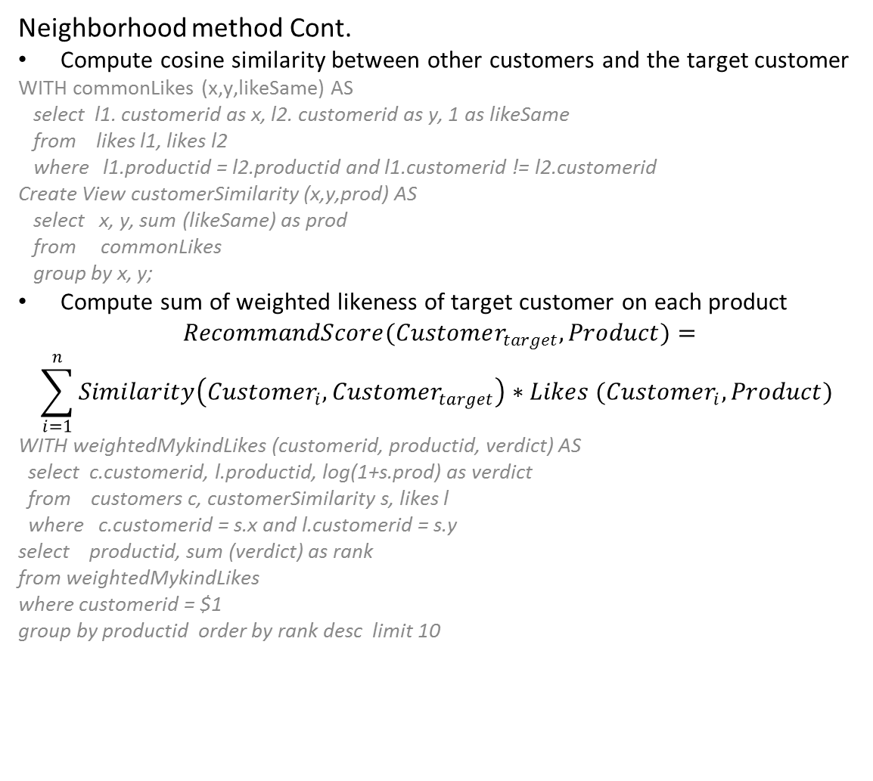
Problem 4 – Cont.
Neighborhood method Cont.
Compute cosine similarity between other customers and the target customer
WITH commonLikes (x,y,likeSame) AS
select l1. customerid as x, l2. customerid as y, 1 as likeSame
from likes l1, likes l2
where l1.productid = l2.productid and l1.customerid != l2.customerid
Create View customerSimilarity (x,y,prod) AS
select x, y, sum (likeSame) as prod
from commonLikes
group by x, y;
Compute sum of weighted likeness of target customer on each product
$$RecommandScore(Customer_{target}, Product)=$$
$$\sum_{i=1}^{n}{Similarity\left(Customer_{i}, Customer_{target}\right)∗Likes (Customer_{i}, Product)}$$
WITH weightedMykindLikes (customerid, productid, verdict) AS
select c.customerid, l.productid, log(1+s.prod) as verdict
from customers c, customerSimilarity s, likes l
where c.customerid = s.x and l.customerid = s.y
select productid, sum (verdict) as rank
from weightedMykindLikes
where customerid = $1
group by productid order by rank desc limit 10
Recommendation
Recommendation
Notes:
The query cmd above doesn’t handle corner case like total_copy_number is 0 etc

Slide 16
Problem 4 – Cont.
Latent Vector Method:
Just return CustomerProduct matrix
ML takes the matrix combined with input customer of history (x1, x2,.. ) and run SVD
The result vector for input customer is the prediction of how much he likes the product.
Sort the vector and pick the top ranked products.
Comparison
neighborhood method is done completely from query processing
Latent Vector method is simpler for query, but need SVD computation from ML
Recommendation
Recommendation
Notes:
The problem asks for recommendation strategy for a customer based on based on its purchase history.
Collaborative filtering is perfect for this usage with 2 methods: neighborhood method and latent factor method

Slide 17
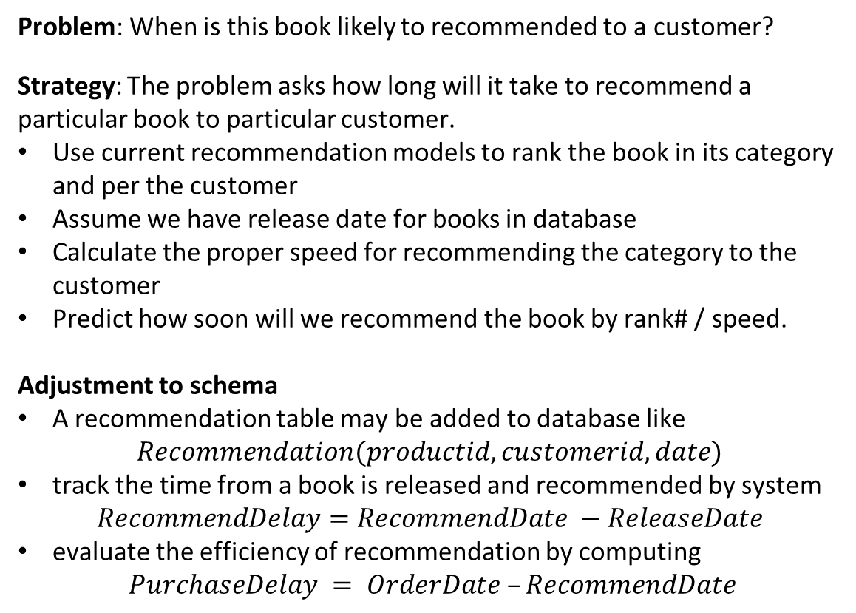
Problem 5
Problem: When is this book likely to recommended to a customer?
Strategy: The problem asks how long will it take to recommend a particular book to particular customer.
Use current recommendation models to rank the book in its category and per the customer
Assume we have release date for books in database
Calculate the proper speed for recommending the category to the customer
Predict how soon will we recommend the book by rank# / speed.
Adjustment to schema
A recommendation table may be added to database like
$$Recommendation(productid, customerid, date)$$
track the time from a book is released and recommended by system
$$RecommendDelay=RecommendDate −ReleaseDate$$
evaluate the efficiency of recommendation by computing
$PurchaseDelay = OrderDate –RecommendDate$
Recommendation
Recommendation

Slide 18
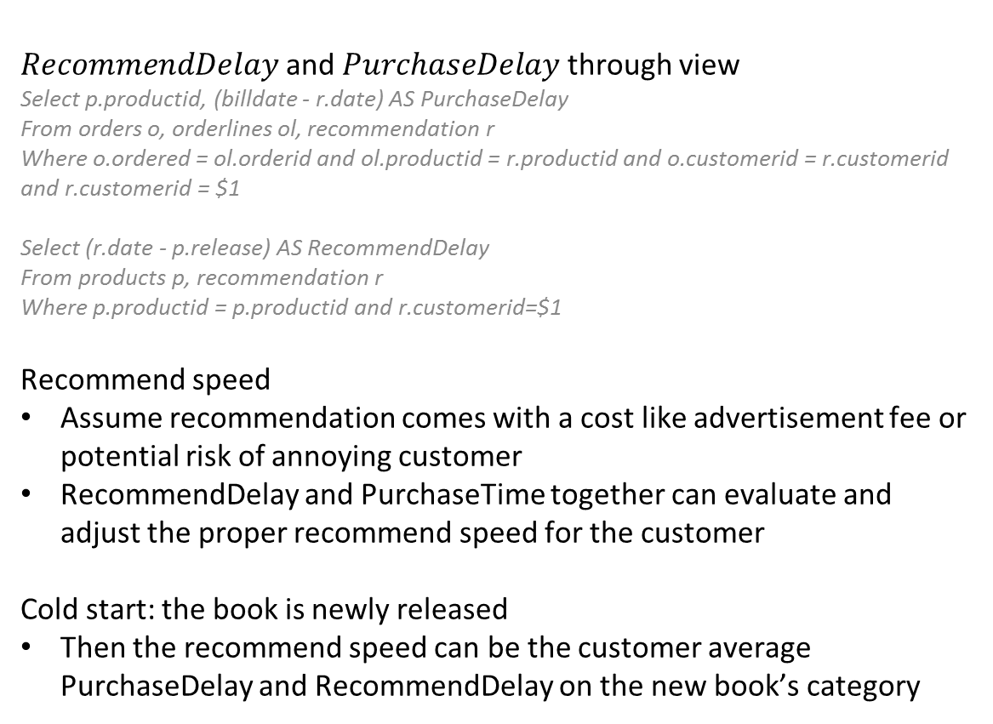
Problem 5 – Cont.
$RecommendDelay$and $PurchaseDelay$ through view
Select p.productid, (billdate - r.date) AS PurchaseDelay
From orders o, orderlines ol, recommendation r
Where o.ordered = ol.orderid and ol.productid = r.productid and o.customerid = r.customerid and r.customerid = $1
Select (r.date - p.release) AS RecommendDelay
From products p, recommendation r
Where p.productid = p.productid and r.customerid=$1
Recommend speed
Assume recommendation comes with a cost like advertisement fee or potential risk of annoying customer
RecommendDelay and PurchaseTime together can evaluate and adjust the proper recommend speed for the customer
Cold start: the book is newly released
Then the recommend speed can be the customer average PurchaseDelay and RecommendDelay on the new book’s category
Recommendation
Recommendation

