Slide 1
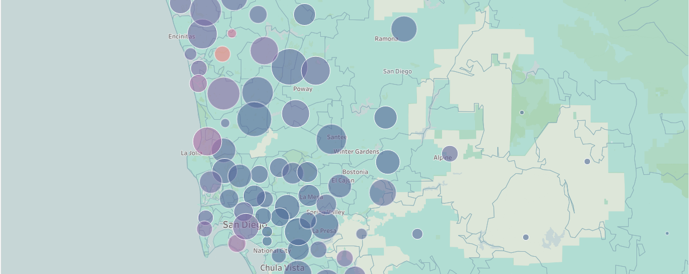
SAN DIEGO HOUSING PROJECT
TEAM: Wen Yan, Mengting Wang, Salah Ahmad, Xia Song
Advisor: Volkan Vural, Ilkay Altintas

Slide 2
Agenda
Overview
Overall progress
Major features
Updates on data exploration, major features & ongoing feature engineering
Modeling
Introducing baseline model

Slide 3
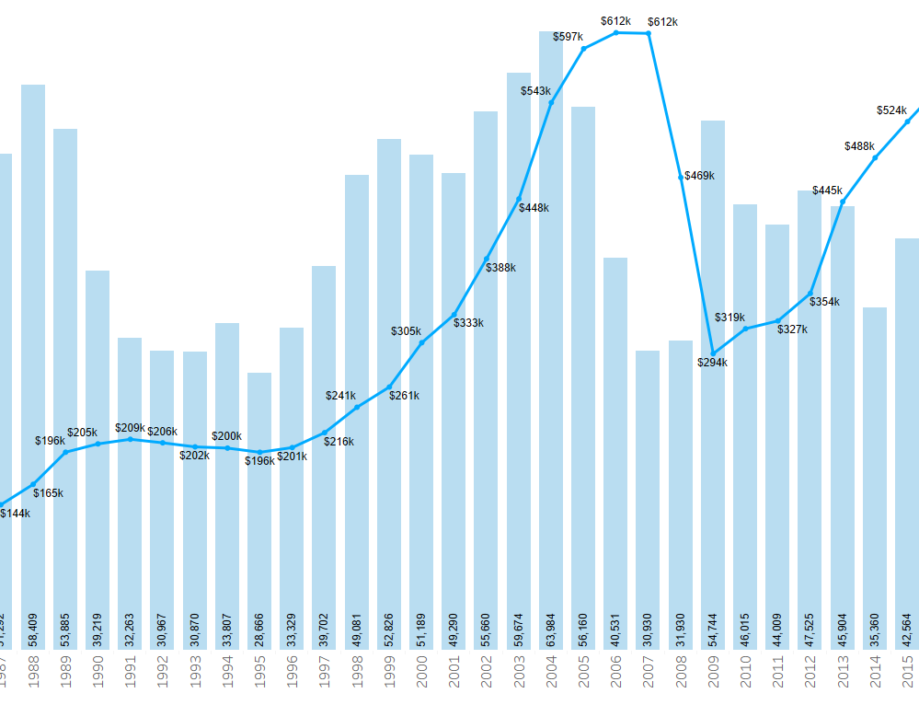
Overview
We are running multiple tasks in parallel in current stage:
Continued data exploration
Solving open issues on current data;
Feature engineering
Design baseline model

Slide 4
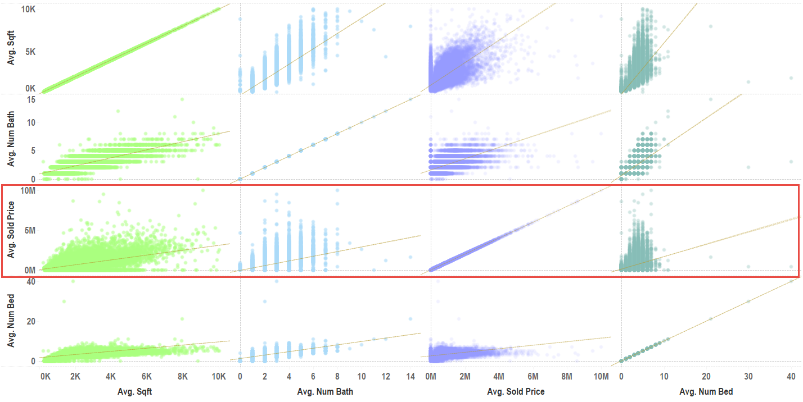
Further Data Exploration
Scatter Matrix on selected features– we observed linear relationships between certain features
Outliers in certain features (i.e. bedroom) skewing the data

Slide 5

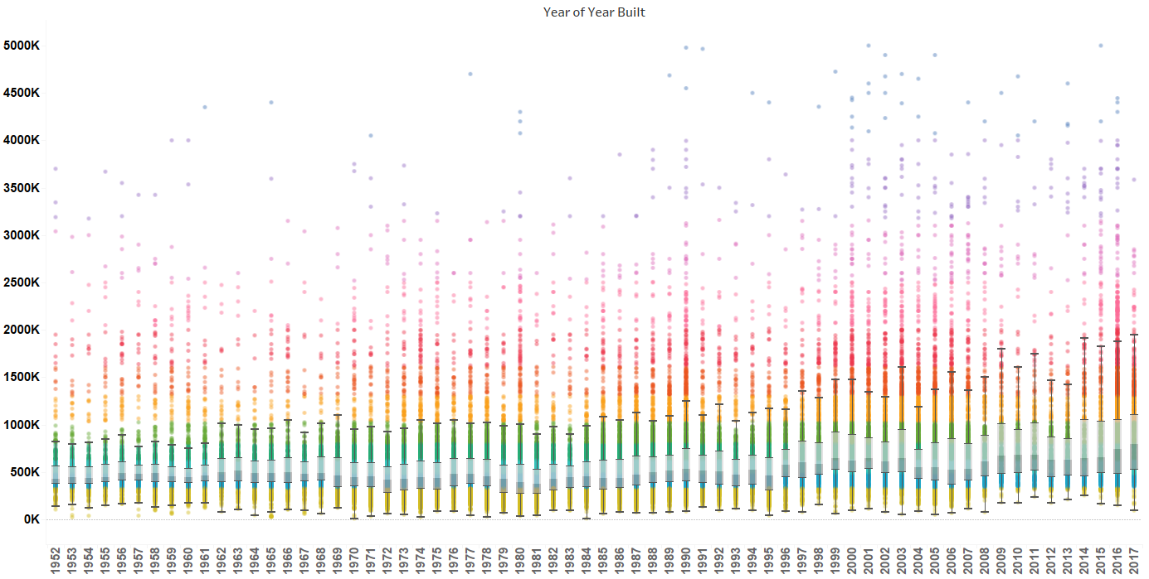
Further Data Exploration:
Sold price range is expanding as built year getting recent, and moving towards the higher end
Notes:
this is a showing sold price distribution over Year Built. The price range is expanding as build year gets more recent.

Slide 6
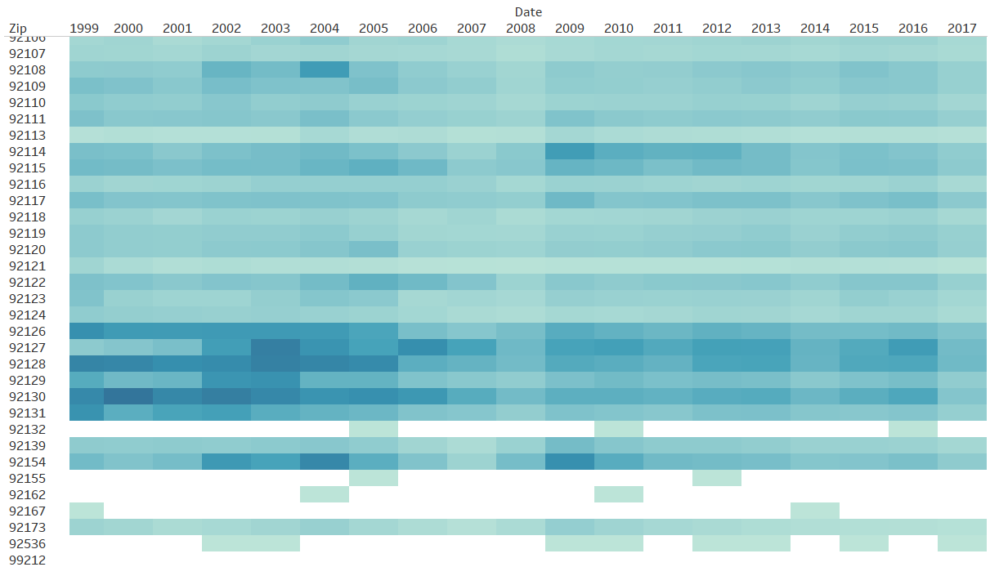
Further Data Exploration
Heatmap on Number of Records by Sold Year and by Zip
Indicates the areas where the transactions occur most heavily within each year
Also a good indicator for observing potential abnormal data

Slide 7
Baseline Models
Independent Variables included in baseline:
Sqft: square feet, continuous data type.
Num_bed: number of bedroom, continuous data type.
Num_bath: number of bathroom, continuous data type.
View: house with view or not, ordinal Categories (1 represent with view, 0 represent none).
Pool: house with pool or not, ordinal Categories (1 represent with view, 0 represent none).
Sqft_zip_avg: average square feet in zip code level, continuous data type.
Sqft_price_zip_avg: average square feet price in zip level, continuous data type.
Sold_price_zip_avg: average sold price in zip level, continuous data type.
Dependent Variable Used:
Sold_price

Slide 8
Baseline Models- Preliminary Results
Models | Pros | Cons | Parameters | Cross Validated MSE
Random Forest | Lower variance, Correlated data, scale invariant | High bias, difficult to interpret | N_estimator = 1000 N_depth = 7 N_features = 8 | 0.072
Gradient Boost | Feature scaling not needed high accuracy | Expensive computation, overfitting | N_estimator = 350 N_depth = 6 N_features = 2 Leaf = 10 Learning rate = 0.05 | 0.25
Linear Regression | Easily interpretable, inexpensively computation, less prone to overfitting | Required scaled variable, require numerical data set | Alpha = 0.5 | 0.30

Slide 9
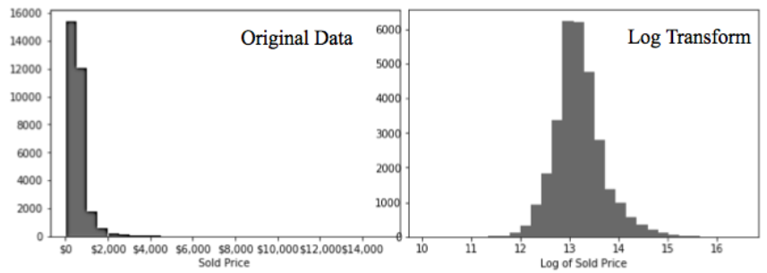
Baseline Models
Dependent Variable Used:
Log of Sold Price

Slide 10
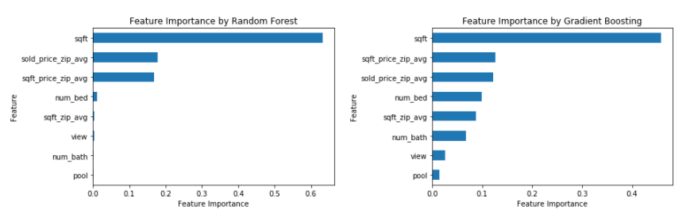
Importance of Features
Both Random Forest and Gradient Boost models rank square feet as the most important feature, and sold price and square feet price in zip code level are two second important features. In addition number of bedrooms, square feet in zip code level and number of bathrooms are also obviously contributed to Gradient Boosting model simulation however, these features are not significantly contribute to Random Forest model simulation

Slide 11
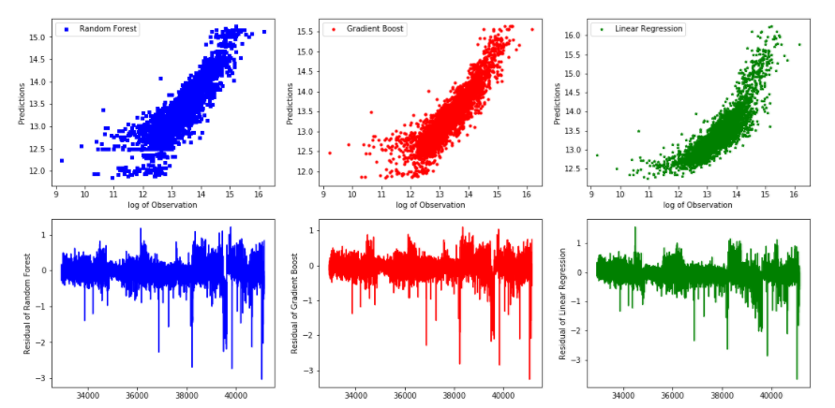
Model Comparison
Chart demonstrates the comparison between observed values and predicted values and residuals of each model. From the comparison and residual pattern, we also can conclude that tree based models (Random Forest and Gradient Boosting) are also performed better than linear model in predicting house price.

Slide 12
Outstanding/Open Items on Key features
Year Built: Not all data has year_built field filled in.
School: Still mapping the properties to public schools through GIS
Mello Roos: Which properties pay Mello Roos tax.
HOA: Wherever applicable, how much HOA is paid.
Permits/Construction: Type, cost,date of permits and constructions took place.

Slide 13
Key Feature Engineering
Geo-location
Geo griding: heterogeneous division of the map into grids that same number of properties can be contained. More dense properties in an area, more fine grids it will be divided into.
avg_grid_price: average price of the transactions in certain time range per each grid
School related
school attended: with lon/lat and geo boundary of schools, get the schools for each property by point-in-polygon detection.
school_score: the rank of the school attended for each property
school_dist: line distance to the schools attended
Community
crime rate
average age
inflation/CPI index
average household income
Other related social/econ factors

Slide 14
Next Steps: More features & data
Variable Name | Description
Lot_size | Lot size in sqft
First_floor_area | First floor area in sqft
Sold_age | the year count from year built to year sold
distance_to_primary/middle/high_school | depending on school boundary GIS data
score_of_primary/middle/high_school | depending on school boundary GIS
sqft_bracket | categorical feature that which sqft bracket the property belongs to
geo_grid_bracket | instead of zip/city, we’ll try to create our own geo grids and then cluster them to get categorical feature for each property

Slide 15
Next Steps: Segmentation on Key Features
Instead of training one general model, we’ll try clustering on single key feature or various combination of features, and train separate model for each cluster. Key features include property_type, sqft, geo_grid, year_built.

Slide 16
Next Steps: Beyond modeling
When the modeling of price evaluation is successful:
Train models for each year.
Evaluate the price for all properties for all years.
Utilizing time-series data, research short/long-term trending for property value.
Cluster properties based on trending.
Study the correlation of the trending with various property features.

Slide 17
THANK YOU!

