Slide 1
SAN DIEGO HOUSING MARKET
ADVISOR: VOLKAN VURAL
TEAM: WEN YAN, MENGTING WANG, SALAH AHMAD, XIA SONG

Slide 2
AGENDA
Validation Methodology (Wen)
Baseline Model Result (Xia)
Visualization – Residual analysis (Mengting)
Next Steps for Improvement (Salah)

Slide 3
House Price Estimation
Transactional data (1983 ~ 2017)
Target: sale price under current market rather than price forecast for future.
Not strictly time-series dataset
Still need overcome ‘concept drift’
Impractical to use later data in training to predict earlier data
Long-term trending
Kaggle Zillow competition
Training: 2016.1 ~ 2016.10, 2017.1~2017.10
Testing: 2016.10 ~ 2016.12, 2017.10~2017.12
Notes:
A time series is a sequence of observations taken sequentially in time.
Time series adds an explicit order dependence between observations: a time dimension.
This additional dimension is both a constraint and a structure that provides a source of additional information.
Time-series analysis tries to find seasonal pattern, trend, relation to external factor. Time-series forecast is to forecast future value of that series.
concept drift - the statistical properties of the target variable, which the model is trying to predict, change over time in unforeseen ways.

Slide 4
Walk-forward Validation
2013
All samples
2017
2015
Tracking window T (eg, 24 months)
Prediction with Optimized hyperparams
Extreme case: validate once and used forever
Sliding window m (eg 12 month)
Sliding window2
Sliding window3
Test window h (eg 2months)
. . .
Sliding window (T-m)/h
Sliding window (T-m)/h+1
Validation
GridSearch optimized model hyperparams
Eg. RR n_estimator, max_depth
(T-m)/h+1 Fold * Param Grid Dim
Select best model hyperparams
Only done once

Slide 5
Extreme Case
2013
All samples
2017
2015
validation(eg, 24 months)
Prediction (eg, 2 months)
Validation
Train-valid split
Multiple train-valid split
Walk forward
Need lots of compute
((T-m)/h+1)*All/h * GridDim
= ((24-12)/2+1)*35*12/2 * 64
= 94080
. . .

Slide 6
Tracking Window
2013
All samples
2017
2015
Tracking window T (eg, 24 months)
1
Sliding window m (eg 12 month)
Sliding window2
Sliding window3
Sliding window (T-m)/h
Sliding window (T-m)/h+1
prediction
Use optimized hyperparams to train a model for each sliding window and predict samples for 2months
Rolling forward for a period of T
The optimized hyperparams expired and need redo validation for another tracking window
Total Iteration for whole dataset: All/h ~ 210
Validation
GridSearch optimized model hyperparams
Eg. RR n_estimator, max_depth
(T-m)/h+1 Fold * GridDim
Total folds for whole dataset (1983~2017)
((T-m)/h+1)*All/T * GridDim
= ((24-12)/2+1)*35*12/24 * 64
= 7840
New Tracking window for validation

Slide 7
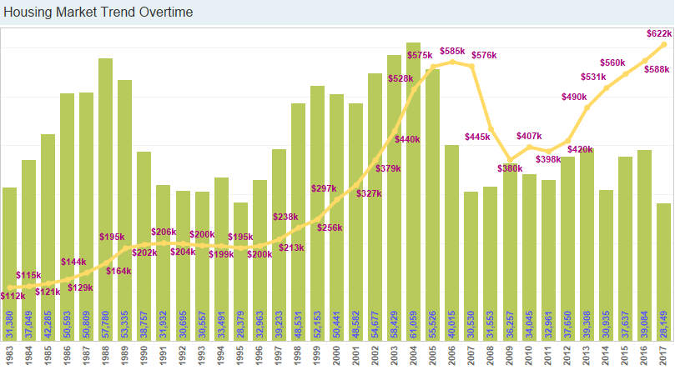
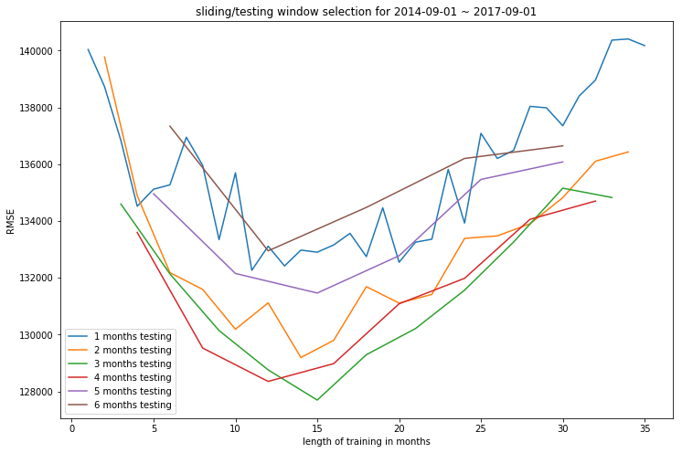
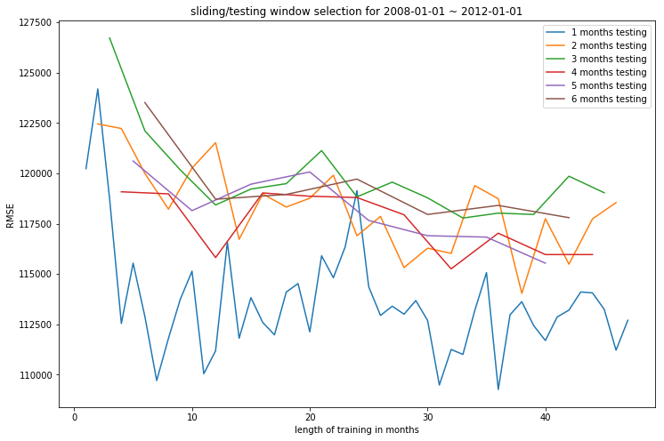
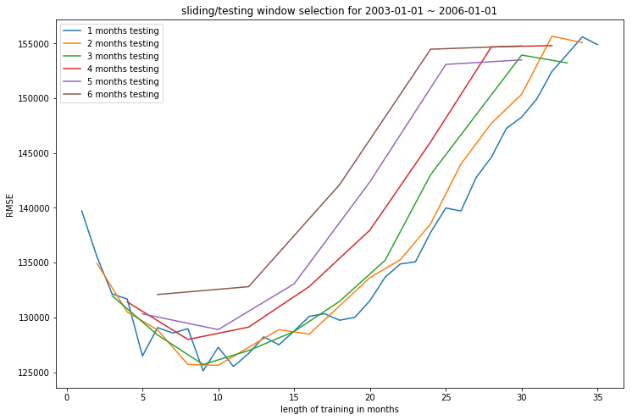
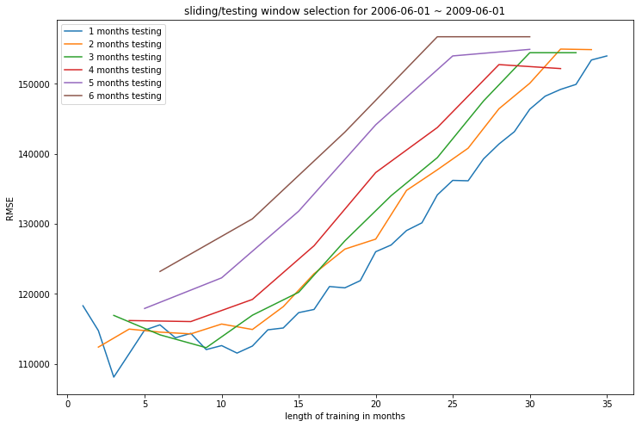
Sliding/Test window selection

Slide 8
Tracking/Sliding/Test window
Test window – depends on dataset and EDA profiling result
Sliding window - dynamic, can be validated as a hyperparameter
Tracking window – depends on data density over time
Validation frequency – depends on compute resource

Slide 9
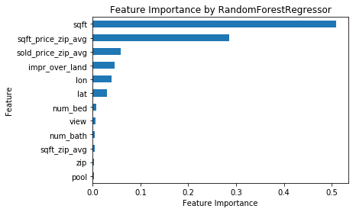
Baseline model result
Used as baseline for feature engineering and modeling improvement
Dataset: 2015-10-01 ~ 2017-10-01
Testing/Sliding/Tracking window – 4/12/24 months
Feature set
Model: RandomForestRegressor(n_estimator=100, max_depth=14
Error( RMSE): testing - 127516, training - 93770

Slide 10
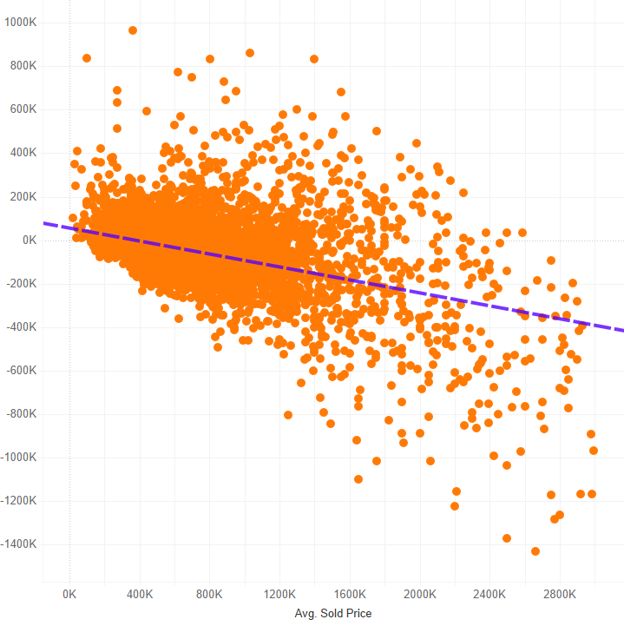
Residual Analysis on Baseline Model
Scatter plot on residuals over average sold price presents a linear negative relationship
The more expensive the property is, the more underestimated the price is

Slide 11
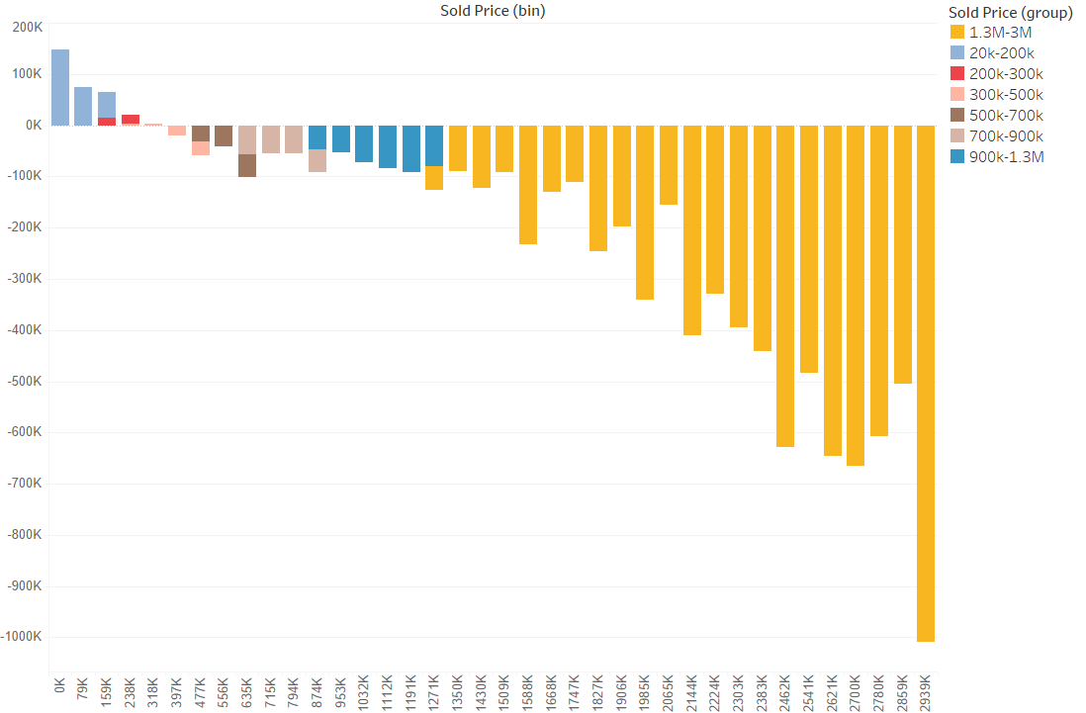
Residual Analysis on Baseline Model
Most of low price properties tend to get over-estimated while the higher the price, the more fluctuations on the underestimation pattern

Slide 12
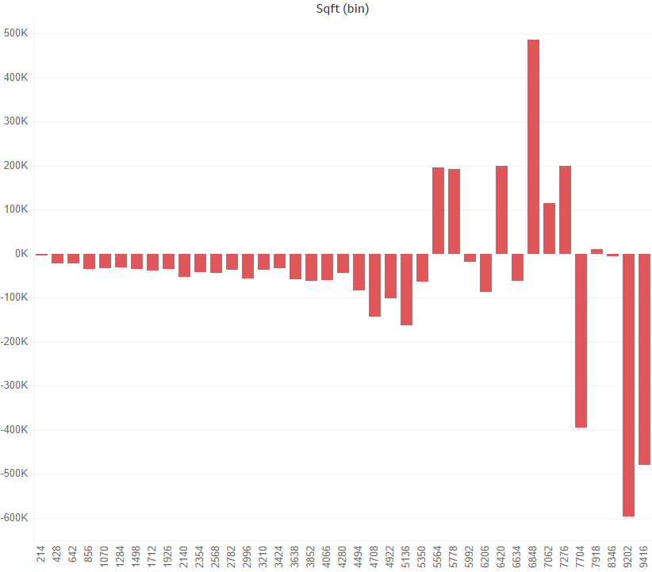
Residual Analysis on Baseline Model
Residuals over Sqft also presents similar pattern- the higher the sqft is, the more fluctuations are presenting on residuals in both directions

Slide 13
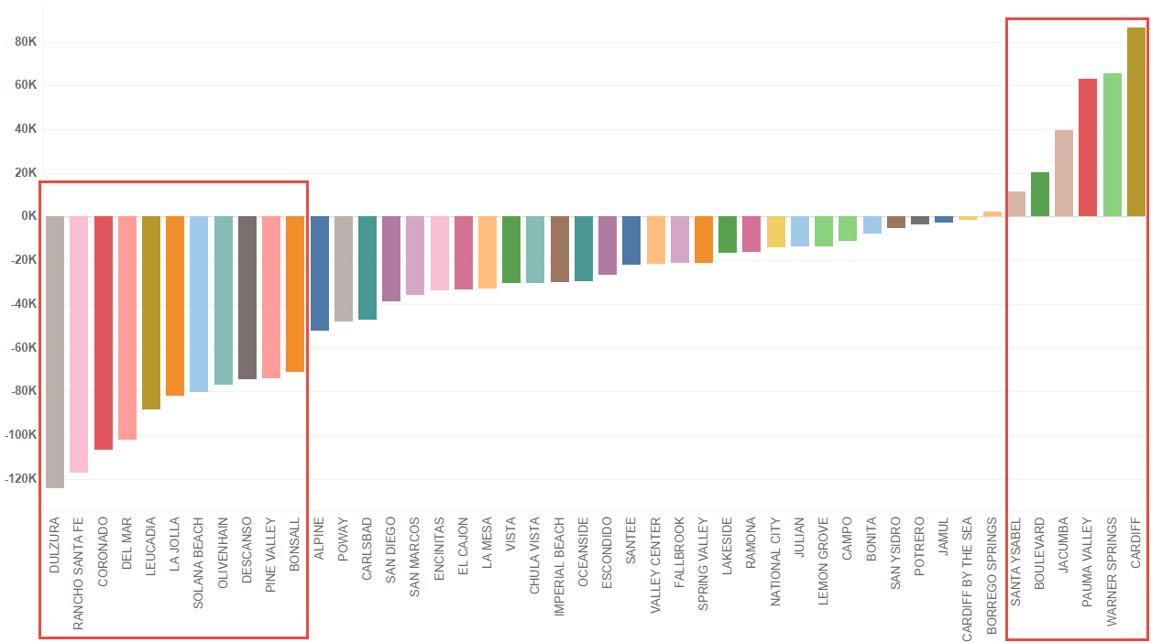
Residual Analysis on Baseline Model
Identified locations/areas where the most underestimated/overestimated properties are located

Slide 14
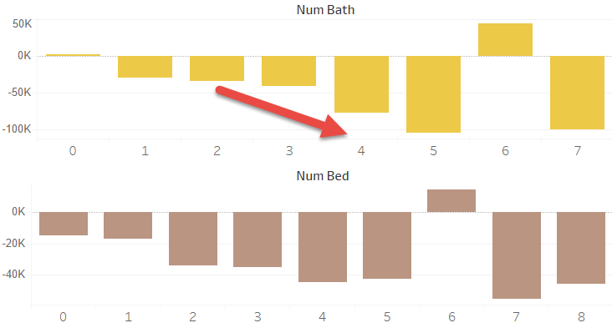
Residual Analysis on Baseline Model
Number of Bathroom is showing more fluctuations over residuals than number of bedroom

Slide 15
NEXT STEPS FOR IMPROVEMENT
Version 2: Segment the data (cluster on price only). Voting method for evaluation.
Version 3: Same as Version 2, but cluster based on neighborhood.
Version 4: Engineer and add the year_built feature to the model.
Version 5: Bring additional data sources to the model such as,
school distance, prime rate/libor, inflation/GDP.

