Slide 1
SAN DIEGO HOUSING MARKET
ADVISOR: VOLKAN VURAL
TEAM: WEN YAN, MENGTING WANG, SALAH AHMAD, XIA SONG

Slide 2
AGENDA
Scalability and Robustness Requirements
Data Model for scalability
Data Pipeline update
Programming Model
Evaluation Strategy and Plan

Slide 3
Scalability Requirements
Computation Power is Required to be able to Handle the Following...
More Data Sources
Scaling on current relational database solution
Horizontal: expanding to the rest of CA, even to the entire USA
Vertical: historic estimates give insight how a home (or an area) has changed in value over the years
Update frequency
Algorithm/model change or tuning (hyper-parameter) for performance improvement purposes; models need to be re-trained and re-predicted on the entire datasets, such as when new data is added
i.e. ZEstimate: 3 major update (2006, 2008 and 2011)
More models that fit into other types of housing prediction topics
Hybrid database solution is required
Multi-types: i.e. pictures of properties, reviews & comments, etc.

Slide 4
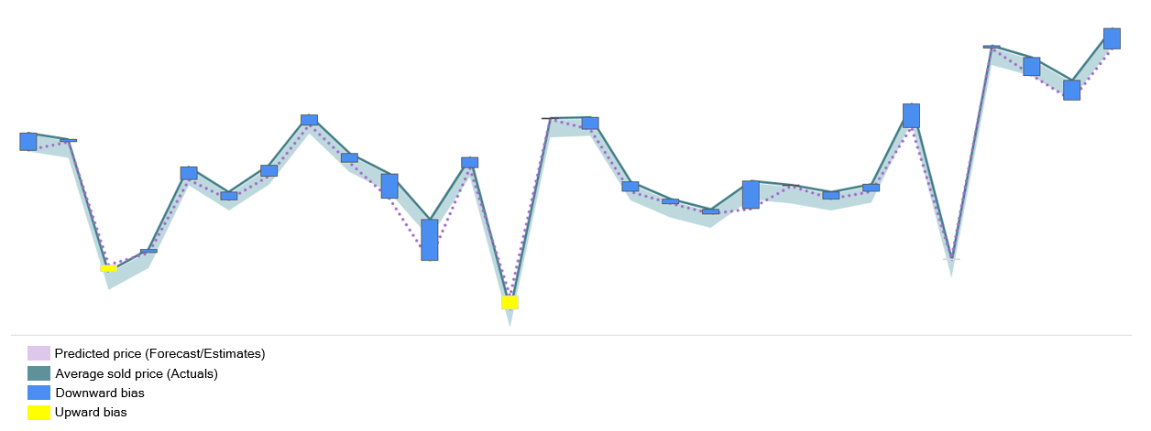
Robustness
Model Accuracy
Residual(RSME) monitoring, mean/std
Evaluation value range with certain confidence interval: calculate Margin of Error based on 95% confidence interval to come up with forecast accuracy range

Slide 5
Robustness
Noises that Impact Forecast Accuracy
Fallback plan for invalid/outlier
Invalid transactions that have NAN in features (i.e. school)
Transactions that don’t have enough data (i.e. within certain zips)
Reasonable outliers: eg. foreclosures > strategy
Strategies
For true noises such as transactions that missing features:
> Fill in with aggregated values, i.e. average with the zip
> If certain zips don’t have enough data to work with, using zip clusters (engineered)
For reasonable outliers such as foreclosure
> Fit them with different model

Slide 6
Data pipeline - Current
County (txt)
Sandag (shapefile)
GreatSchool (csv)
Data Sources
Sales
(507 MB)
Characteristics
(606 MB)
Evaluation
(59 MB)
Address
(119 MB)
School geolocation
Zip boundary
School rating
ETL
Raw Database (14 GB)
App
De Dup
Matching
Format
filtering
geocoding
Feature Engineering
SQL
statistics
Staging Database
joining
Aggregation
views
materialize
Feature Engineering
SQL
Data Warehouse
Analytics
Aggregation
cleaning
clustering
Feature Engineering
python
modeling

Slide 7
Solution architecture
AWS S3
County (txt)
Sandag (shapefile)
GreatSchool (csv)
Data Dumps
Sales
Characteristics
Evaluation
Address
School geolocation
Zip boundary
School rating
Tableau
AWS RDS
Staging Database
Cleaning, preprocessing
De Dup
Matching
Format
filtering
Geocoding
Web App
Data Warehouse
Statistics, Feature Engineering
joining
Virtual/materialized views
indexing
Aggregation
Geo computation
AWS Compute
DataSource
Preprocessing
MultiSegmentRegressor
ModelManager
ModelRegression
Notebook
cleaning
Aggregation
clustering
WF validation
Data segment
PlotUtils
transform
Feature eng
Regression Modeling
Data segment

Slide 8
Solution architecture
AWS S3
County (txt)
Sandag (shapefile)
GreatSchool (csv)
Data Dumps
Sales
Characteristics
Evaluation
Address
School geolocation
Zip boundary
School rating
Tableau
AWS RDS
Cleaning, preprocessing
Staging Database
De Dup
Matching
Format
filtering
Geocoding
Web App
Data Warehouse
Statistics, Feature Engineering
joining
Virtual/materialized views
indexing
Aggregation
Geo computation
sampling/histogram
AWS Compute
DataSource
Preprocessing
MultiSegmentRegressor
ModelManager
ModelRegression
Notebook
cleaning
Aggregation
clustering
WF validation
Data segment
PlotUtils
transform
Feature eng
Regression Modeling
Data segment

Slide 9





Scalability
RDMS
 | SD | SC | King | …
2018
2016
2014
…
Storage: 16TB, aurora 64TB
IO: 1,000 to 30,000 IOPS, 256 KB/IO
CPU/MEM: 64 vCPU, 488 GB
Task Distribution System
Compute
Farm
Node
Node
Node

Slide 10
Database for big data
RDMS (AWS RDS)
Storage: 16TB, aurora 64TB
IO: 1,000 to 30,000 IOPS with cap 256 KB/IO
CPU/MEM: 64 vCPU, 488 GB
Services: Replica, backup, permission, performance monitor, version update …
Scalability: vertically
HDFS
Storage: in PB
Scalability: horizontally
Commodity hardware
High throughput and low latency

Slide 11
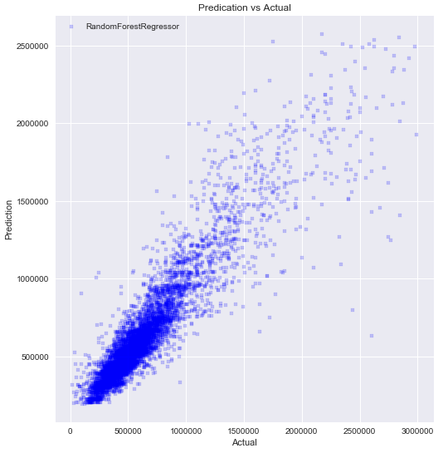
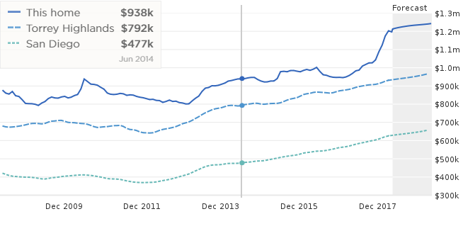
Pipeline Scalability
Any manual work will be problem for scalability
Database: SQL script, function, trigger
Modeling: Leverage between model accuracy and scalability. eg. Segmentation vs categorical feature
RDMS
OLTP
EDA
Program/notebook
PlotUtils
OLAP warehouse
Preprocessing
Cleaning
Transform
Feature Engineer
ModelManager
Clustering
segmentation
ModelResult
ModelRegression
ModelManager Instance per tracking_window
Automation Infrastructure
Slice the data on geo area and time period
Instance ModelRegression as a task
Dashboard
Application(debug)
Statistics
EDA result
Modeling Result and Evaluation
Infrastructure Monitor

Slide 12
Relational data model
Our case
Tabular relational data and some geo data that scales to TB
Query for both application and analytics
A lot of virtual/materialized views and joining/aggregations for feature engineering
SQL on Hadoop?
Geocoding and geo related function are preferred by database server
Modeling with data segment, more data means building more models. Scalability requirement is distributed tasking rather than distributed computing.

Slide 13
big data modeling
Relational Database + Multi-tasking distribution
HDFS + Spark/SparkSQL
RDMS
OLTP
 | SD | SC | King | …
2018
2016
2014
…
 | SD | SC | King | …
2018
2016
2014
…
Task Distribution System: LSF, Jenkins
Wrapper: script
Compute
Farm
Compute
Farm
disk
disk
disk
disk
Node
Node
Node
Node
Node
Node
Node
Node
Python + scipy/sklearn
Spark/SparkSQL

Slide 14
big data modeling
Relational Database + Power Machine
OLTP
 | SD | SC | King | …
2018
2016
2014
…
Powerful
Machine
disk
GPU
Tensorflow

Slide 15
Q&A Thanks

