Slide 1
Walk-forward validation

Slide 2
House price prediction
Transaction data (1983 ~ 2017), house attributes (2017)
Target: sale price under market rather than price forecast in future.
Not strictly time-series dataset
Still need overcome ‘concept drift’
Impractical to use later data in training to predict earlier data
Long-term trending
Kaggle Zillow competition
Training: 2016.1 ~ 2016.10, 2017.1~2017.10
Testing: 2016.10 ~ 2016.12, 2017.10~2017.12
Notes:
A time series is a sequence of observations taken sequentially in time.
Time series adds an explicit order dependence between observations: a time dimension.
This additional dimension is both a constraint and a structure that provides a source of additional information.
Time-series analysis tries to find seasonal pattern, trend, relation to external factor. Time-series forecast is to forecast future value of that series.
concept drift - the statistical properties of the target variable, which the model is trying to predict, change over time in unforeseen ways.

Slide 3
Walk-forward Validation
2013
All samples
2017
2015
Tracking window T (eg, 24 months)
Prediction with Optimized hyperparams
Extreme case: validate once and used forever
Sliding window m (eg 12 month)
Sliding window2
Sliding window3
Test window h (eg 2months)
. . .
Sliding window (T-m)/h
Sliding window (T-m)/h+1
Validation
GridSearch optimized model hyperparams
Eg. RR n_estimator, max_depth
(T-m)/h+1 Fold * Param Grid Dim
Select best model hyperparams
Only done once

Slide 4
Extreme case
2013
All samples
2017
2015
validation(eg, 24 months)
Prediction (eg, 2 months)
Validation
Train-valid split
Multiple train-valid split
Walk forward
Need lots of compute
((T-m)/h+1)*All/h * GridDim
= ((24-12)/2+1)*35*12/2 * 64
= 94080
. . .

Slide 5
Tracking window
2013
All samples
2017
2015
Tracking window T (eg, 24 months)
1
Sliding window m (eg 12 month)
Sliding window2
Sliding window3
Sliding window (T-m)/h
Sliding window (T-m)/h+1
Validation
GridSearch optimized model hyperparams
Eg. RR n_estimator, max_depth
(T-m)/h+1 Fold * GridDim
Total folds for whole dataset (1983~2017)
((T-m)/h+1)*All/T * GridDim
= ((24-12)/2+1)*35*12/24 * 64
= 7840
prediction
Use optimized hyperparams to train a model for each sliding window and predict samples for 2months
Rolling forward for a period of T
The optimized hyperparams expired and need redo validation for another tracking window
Total Iteration for whole dataset: All/h ~ 210
New Tracking window for validation

Slide 6
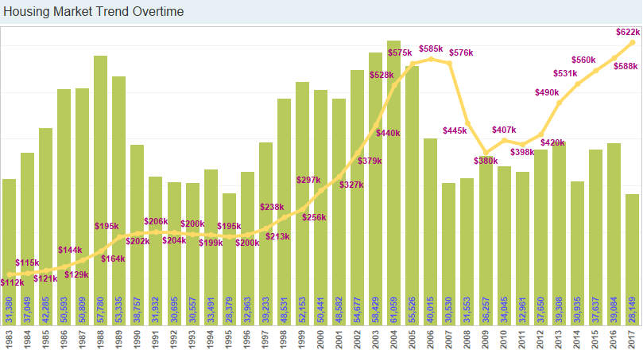
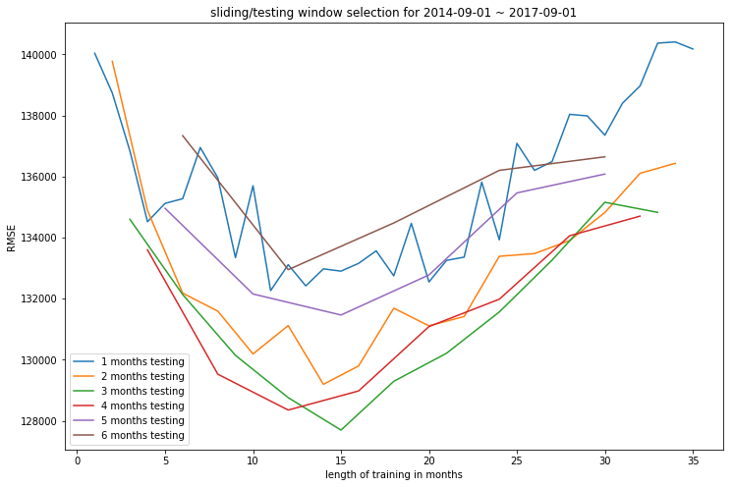
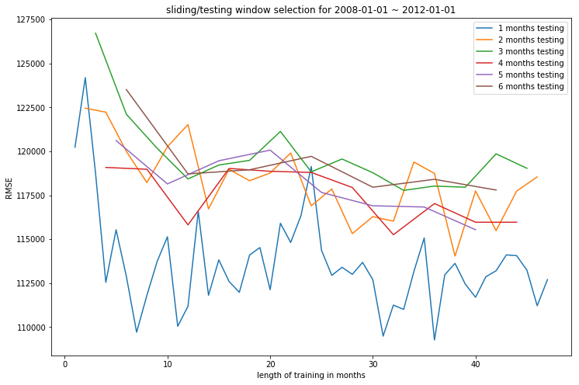
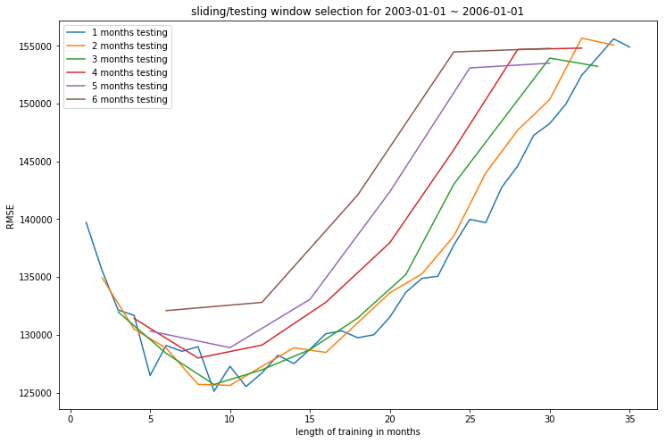
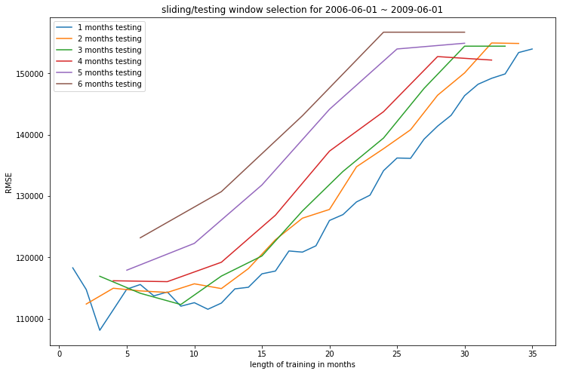
Sliding/test window selection

Slide 7
Tracking/Sliding/test window selection
Test window – depends on dataset and EDA profileing result
Sliding window - dynamic, can be validated as a hyperparameter
Tracking window – depends on data density over time
Validation frequency – depends on compute resource

