Slide 1
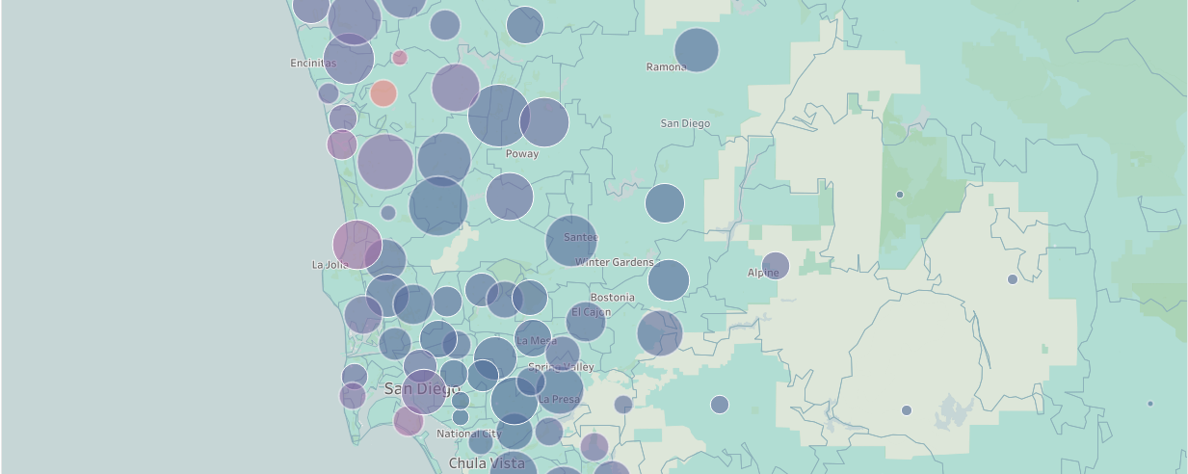
SAN DIEGO HOUSING MARKET
TEAM: Wen Yan, Mengting Wang, Salah Ahmad

Slide 2
Agenda
Dataset
Brief description of the dataset
Motivation
Main purpose, stackholders
Related work
Related research papers
Design Overview
Demo
Tasks and visual idioms
Solution of the visual design

Slide 3
Dataset
attribute | description
date | transaction date of the record
sold price | Sold price of the house in transaction
zip | Address with several fields, only zip used
year_built | Year the house was built
house_type | House type: single family, condo, multi family
sqft | Size of building structure in sqft.
num_bed | Num of bedrooms
num_bath | Num of bathrooms
view | House has view or not
pool | House has pool or not

Slide 4
Motivation
Main purpose:
Understanding the housing market is crucial to the home buyers and realtor investors.
The visualization helps to understand the current house pricing as well as historical trend for different areas and correlation to limited house attributes.
Help users to narrow down their choices based on budget and preference of various house characteristics and understand the potential risk for different market environment.
Stack holders: home buyers and realtor investors
Target solution:
Focus on the housing price and transaction volume.
Geospatial and temporal visualization

Slide 5
Related research
Market, Geospatial, Temporal Visualization

Slide 6
Tasks & Design
Breakdown into 4 tasks and 4 dashboards
visualize pricing and other basics of the current market for various geographic area (zip)
visualize historical trend of market for various geographic area (zip)
visualize the correlation of various house characteristics to the price trend
Visualize more details (eg. Distribution) of various attributes at each time and the change over time.
Classical design choices
Geolocation - choropleth map.
Temporal data (trend) - Line, stream, animation
Linked view and interaction
Notes:
* Geolocation is a key factor that determine the individual house value.

Slide 7
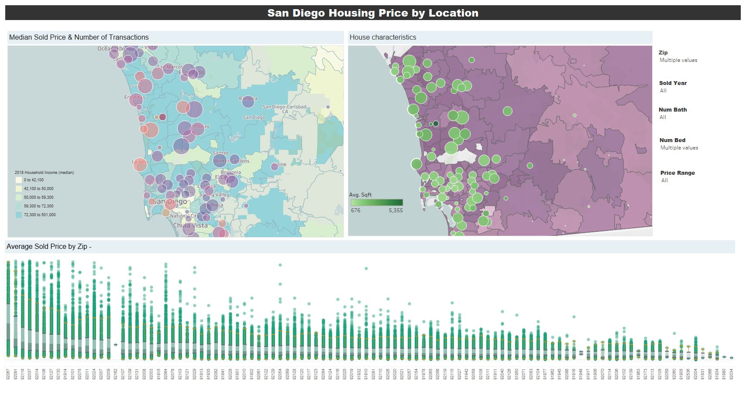
Task1: Current Market
Why: understand price level and other basics of the current market for various geographic area (zip)
What (data):
sold price and attributes of transaction in last year
(Derived) Aggregated count and median value of transactions
(Derived) geographic data from zip
How (Visual idioms):
choropleth map
Scatter plot and boxplot
Interaction & linked view

Slide 8
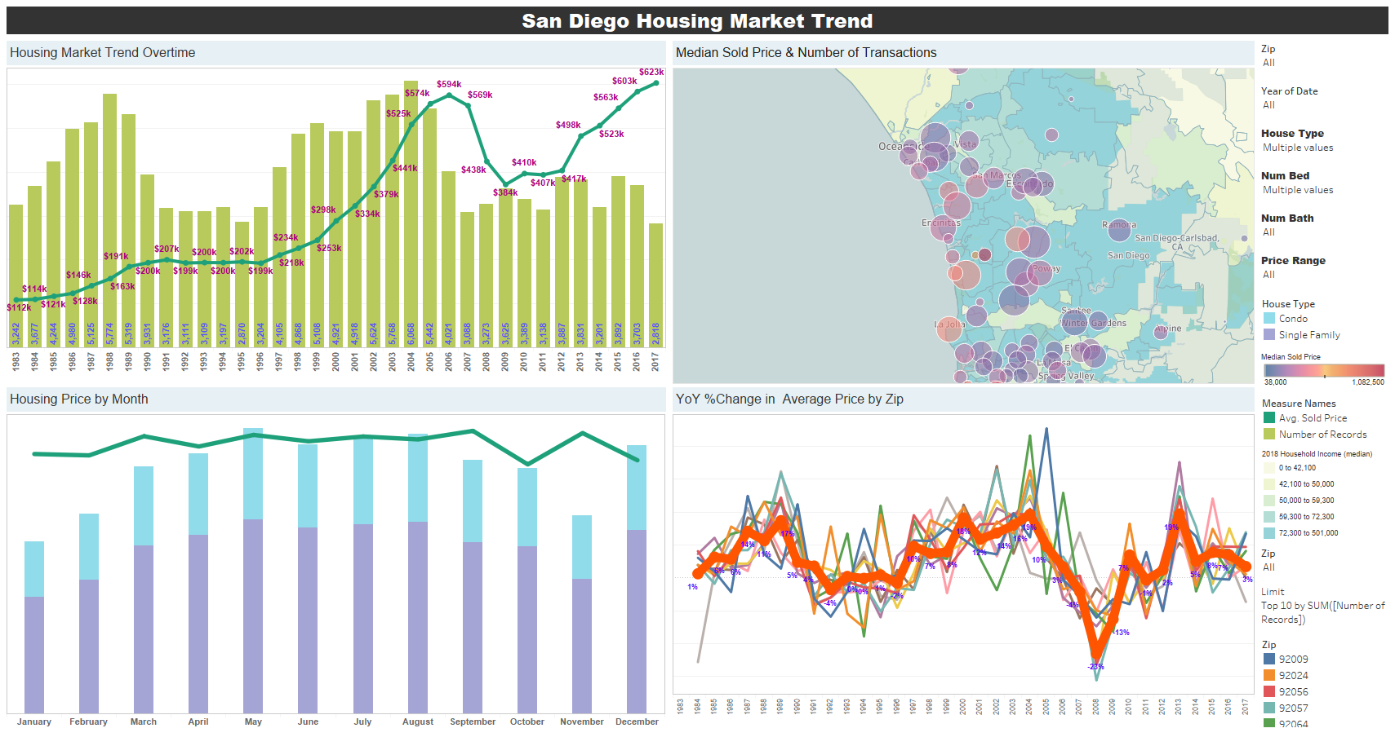
Task2: Market historical trend
Why: understand historical trend of market for various geographic area (zip)
What (data derived): yearly/monthly aggregated count and median value transactions. YoY change of average sqft price, geographic data
How (Visual idioms):
Line and bar chart of median price trend
Choropleth map
Interaction with filters and linked view

Slide 9
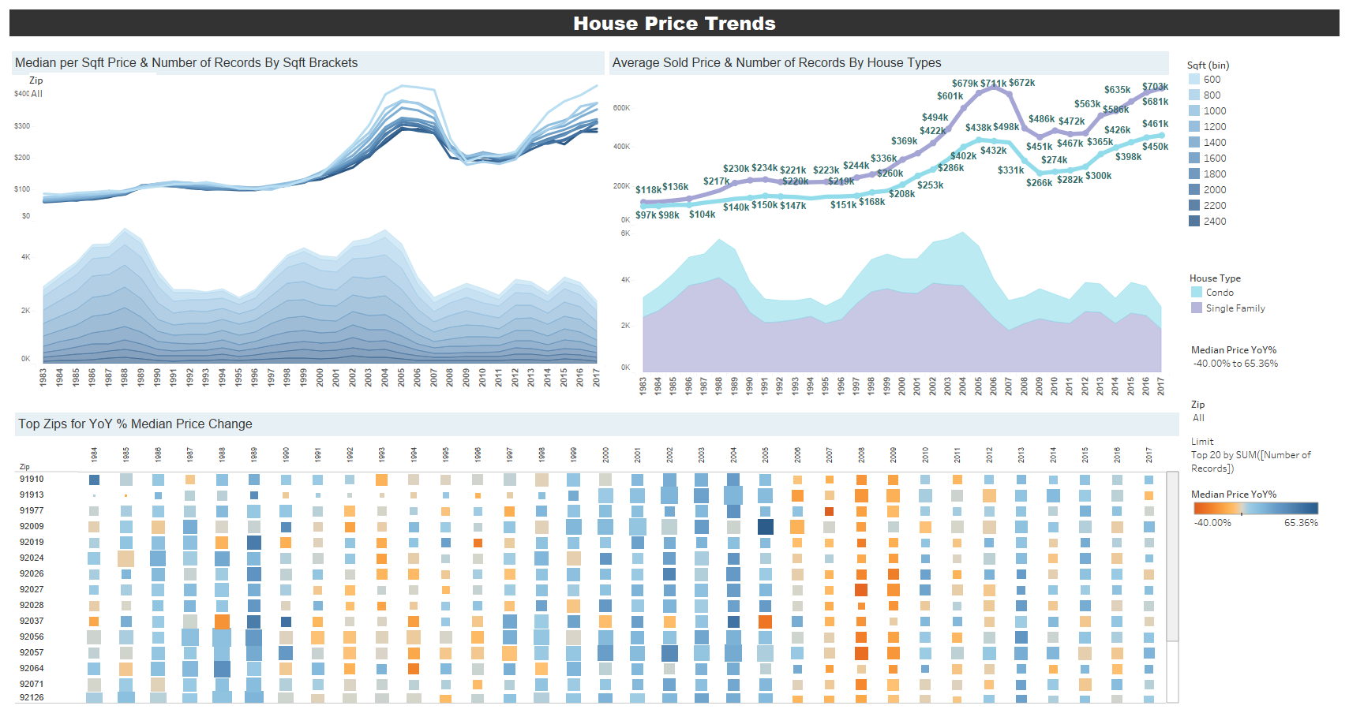
Task3: House characteristics correlation
Why: understand correlation of various house characteristics to its value, how the price trend can differentiate on characteristics’ value or value range.
What (data derived):
yearly aggregated count and median value of transactions per category
Binning of continuous numeric values into brackets
YoY change of sold price per zip
How (Visual idioms):
Line chart of median price trend
stream chart of volume per each category/bracket
Heatmap for categorical attribute zip which has more than 10 values
Interaction with filters and linked view

Slide 10
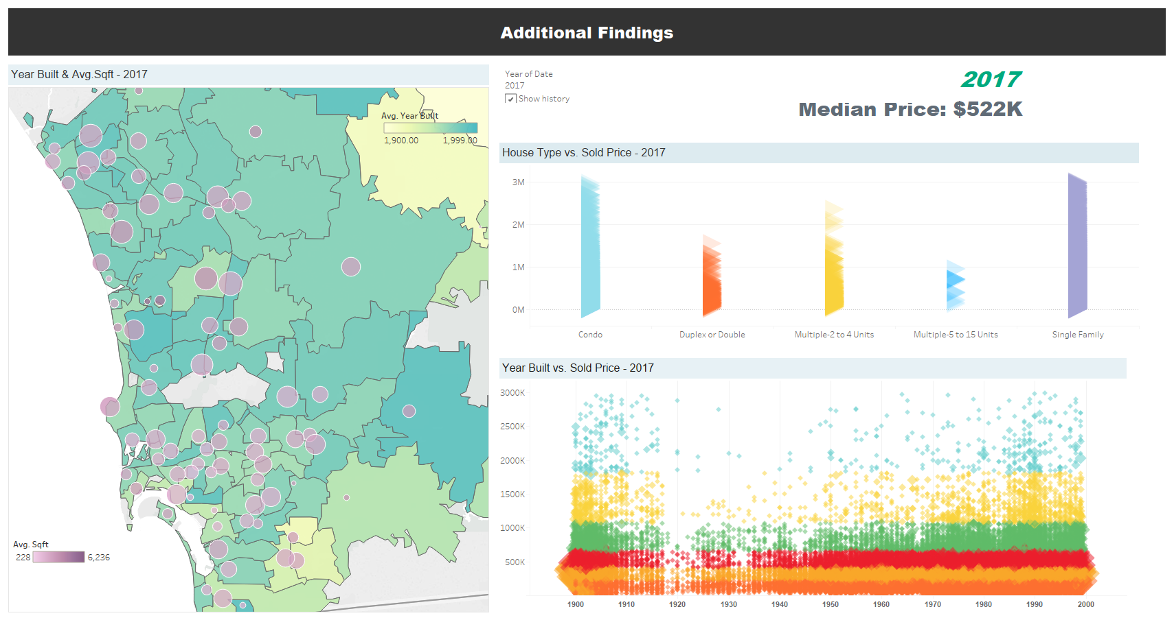
Task4: Animation of the trend
Why: understand more details for various attributes and the change as the time proceeded.
What (data derived):
Raw data
Aggregated median price and count of transactions per zip and zip geographic data
How (Visual idioms):
Choropleth of aggregated median price/count per zip
Scatter plot for correlation between house character attributes and house value
Animation by sliding over years.

Slide 11
Demo
Tool: tableau

Slide 12
THANK YOU!

