Slide 1

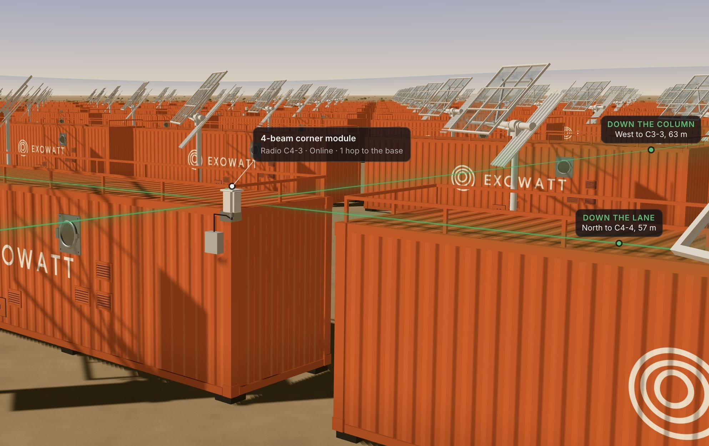
Construction
$74.6k
Radio network for the whole 23,000-unit site
≈ $3.24 per P3 · a module on every P3 would cost ≈ $18.3M
Item | Qty × price | Cost
Corner modules (Wi-Fi HaLow) | 45 × $794 | $35.7k
Battery packs (reused) | 17 × $1,229 | $20.9k
Base radio | 1 × $8,000 | $8.0k
Spares 5% + contingency 10% |  | $10.0k
Total |  | $74.6k
One 4-beam corner module on selected P3s, beaming down the lane and across the rows
Why Wi-Fi HaLow
45
~425 m
~112 W
LoRa: $11k, but ~5 kbps is too slow for machine traffic
5 GHz mesh: $634k (144 modules, 300 m range)
Bluetooth: $615k–$1.04M (1,950 modules, 80 m range)
radio modules
between modules
whole network
Team cost model (unverified estimates, not supplier quotes). Module = 2 HaLow radios + host board, 4 antennas, enclosure, bracket, sun shield, 0.75 h install; 500 m range, 2.5 W. Packs hold 30 days of power until the module's P3 is commissioned.

