Slide 1
Self-Stabilization
& Fault Tolerance
Team Faultless
Alexander Dung ○ Thulasiram Duraisamy
Samyugdha Radhakrishnan ○ Sai Raj Reddy

Slide 2
Introduction
This presentation will cover:
What is self-stabilization?
Benefits and limitations
Relation to fault tolerance
Examples of self-stabilizing algorithms
Dijkstra’s Token Ring algorithm
Contemporary Token Ring algorithm
Leader Election algorithm

Slide 3
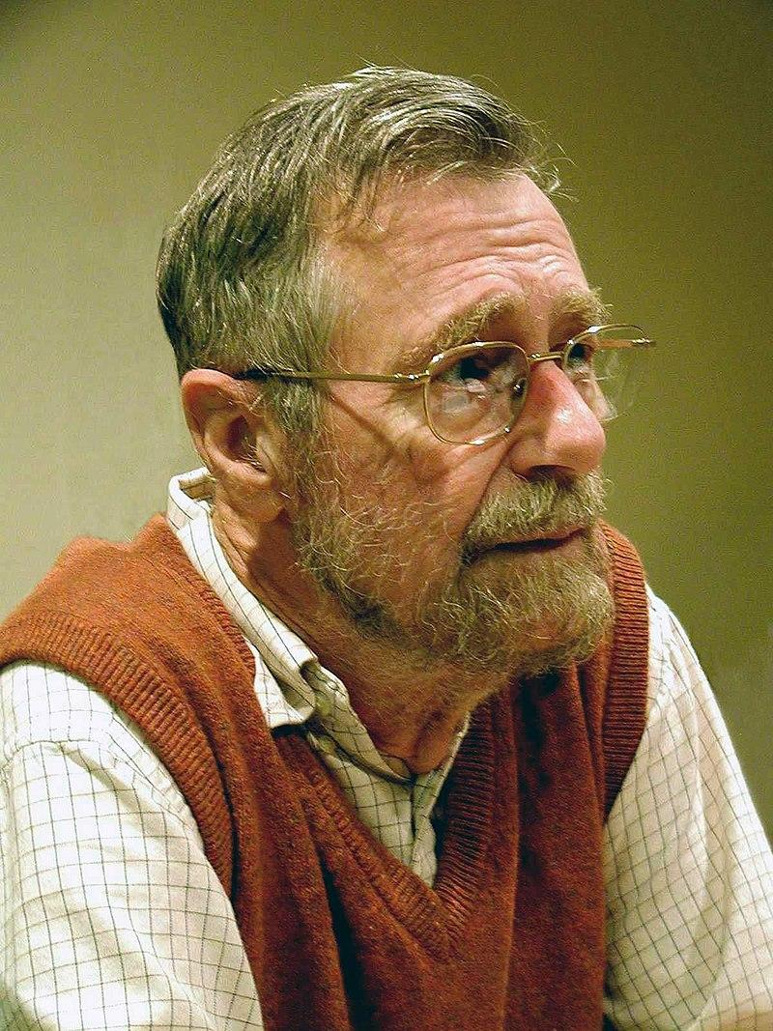
History of Self-Stabilization
Concept and first example presented by Dijkstra in 1973.
Self-stabilizing systems in spite of distributed control
In Communications of the ACM Vol. 17, 1974
It went ignored until years later.
Leslie Lamport [1985] regards the paper “as Dijkstra’s most brilliant work… It’s almost completely unknown.”
It is now an active topic of research in distributed computing.
Edsger W. Dijkstra, 2002

Slide 4
What is Self-Stabilization?
A pair of properties of algorithms for distributed systems:
the system can transition from any arbitrary state to a valid configuration in a finite number of steps
once the system reaches a valid configuration, any further steps taken cannot make it invalid
No matter the initial state, the system will eventually converge to a solution.

Slide 5
Effects & Limitations
No need for initialization procedures
Guarantees eventual system stabilization
Convergence continues after state is changed at any time in execution
However…
No guarantee of convergence if system topology is affected
No guarantee of convergence if state is constantly being affected
No limit on the number of steps needed for convergence

Slide 6
Relation to Fault Tolerance
Self-stabilization is a form of fault tolerance.
“...I regard it to be a milestone in work on fault tolerance.” [Lamport 1985]
If a system node experiences an error and transitions to another state in the program, that results in a global configuration that can eventually converge.

Slide 7
Relation to Fault Tolerance
Self-stabilizing algorithms can handle transient failures.
Transient failures affect the state of the program, but not the behavior.
e.g. transmission failures/corruption, memory corruption.
Because transient failures only affect the state of the program, convergence guarantees that the system can recover to a valid state.

Slide 8
Self-Stabilization vs Other Fault Tolerance
Self-stabilization is different from other forms of fault tolerance.
Traditional fault tolerance:
prevents errors before they occur
has specific procedures for specific errors
Self-stabilization:
guarantees recovery after an error occurs
handles all transient faults similarly

Slide 9
Dijkstra's Self-stabilizing Token Ring
One of the first self-stabilizing algorithms was Dijkstra’s token ring network. A token ring is an early form of a local area network where nodes are arranged in a ring, communicating by a token. The system is correct if there is exactly one token in the ring.
Given an oriented ring, we simply call the clockwise neighbor parent (p), and the counterclockwise neighbor child (c). Also, there is a leader node v₀. Every node v is in a state S(v) ∈ {0, 1, . . . , n}, perpetually informing its child about its state. The token is implicitly passed on by nodes switching state.

Slide 10
Upon noticing a change of the parent state S(p), node v executes the following code:
1: if v = v₀ then
2: if S(v) = S(p) then
3: S(v) := S(v) + 1 (mod n)
4: end if
5: else
6: S(v) := S(p)
7: end if
Every node apart from leader v₀ will always attain the state of its parent.

Slide 11
Leader State Propagation: Over time, nodes learn the current state of the leader node v₀ as the token circulates around the ring. This happens sequentially, with one node after the other learning the leader's state.
Leader State Increase: The leader node v₀ may increase its state multiple times without reaching stability. However, at some point, the leader will reach a state ‘s’ that no other node had at time t₀. This is guaranteed to happen eventually since there are n nodes and n states.

Slide 12
Stabilization: Once the leader reaches state s, it cannot push for s + 1 (mod n) until every node (including its parent) has state s. Therefore, the system must stabilize at this point, ensuring that all nodes have synchronized their states.
Post-Stabilization: After stabilization, there will always be only one node changing its state at any given time. This ensures that the system remains in a legitimate and stable state, with no conflicting state changes occurring simultaneously.

Slide 13
Self-stabilizing token circulation protocol
Introduces a deterministic protocol for fair token circulation in prime-sized uniform networks.
Employs a novel three-color scheme to guide the token's path, guaranteeing that each node receives the token in a fair and predictable manner.
Maintains a dynamic spanning tree structure that adapts post-transient faults, showcasing the protocol's resilience and fault tolerance.
Applies to fault-tolerant computing and consistent state maintenance in distributed systems.

Slide 14
Key Contributions
Three-color Scheme:
Novel method for fair token circulation among nodes of a spanning tree.
Ensures every node is visited infinitely often by the token.
Self-stabilizing Tree Merging Technique:
Addresses transient faults in pointer variables, merging multiple tree components into a single spanning tree.
Critical for reconstructing network topology after disturbances.

Slide 15
Protocol Mechanics:
Each node maintains a father pointer and a color variable.
Detailed rules for token passing and tree merging to address cycles and component merging.
Fault Tolerance:
The protocol can handle arbitrary initial states, including those with cycles or disjoint components.
Fairness and Determinism:
Fair token circulation ensured through the three-color scheme, with a deterministic approach for tree merging.

Slide 16
Fault Tolerance and Recovery
Handling Transient Faults:
Explanation of the protocol's ability to self-correct after faults disturb the network's state.
Spanning Tree Reconstruction:
Insights into the algorithm's process for re-establishing the spanning tree to resume normal operations.
Cycle Detection and Resolution:
Outline the protocol's capability to identify and eliminate cycles within the network, facilitating the swift and efficient reconstruction of the spanning tree, thus preventing deadlock scenarios and ensuring continuous token circulation.

Slide 17
Relevance to Distributed Systems:
The deterministic nature of the protocol, devoid of randomness, ensures predictable behavior, crucial for system reliability.
Demonstrates practical application in constructing fault-tolerant distributed systems, potentially serving as a foundational building block for more complex protocols.
Academic and Practical Implications:
Sets a new standard for research in self-stabilizing systems within distributed computing.
Offers a protocol that could be directly applied to improve the robustness of critical infrastructure systems, such as distributed databases, networked control systems, and blockchain networks.

Slide 18
Uniform Dynamic Self-Stabilizing Leader Election
Uniform Systems: Systems where all processors with the same number of neighbors are identical, crucial for environments with uniform processor fabrication without unique identifiers.
Dynamic Systems: Capable of handling the addition or deletion of processors and links without requiring reinitialization.
Role of Randomization: Essential for breaking symmetry among processors to elect a leader.

Slide 19
Protocol Overview
Objective: Election of a single leader in a distributed system under read-write atomicity conditions.
Stabilization Time: The protocol stabilizes inO(AD log n) time for unknown processor count, and O(AD)for known count,where
A is the maximal node degree,
D is the network diameter, and
n is the number of processors.

Slide 20
The Leader Election Protocol
Phase 1: Cycle Elimination - Ensuring that all cycles in the Father-Son Graph (FSG) are removed to prevent loops.
Phase 2: Tree Fusion - Merging of multiple trees into a single tree, using randomization to resolve conflicts between trees with identical identifiers.
Building Blocks and Complexity
Self-Stabilizing Synchronization Protocols: Utilized for both cycle elimination and tree fusion phases, fundamental for achieving the desired stabilization time.
Space Complexity: O(logn) for processor memory usage, emphasizing the efficiency of the protocol in terms of resource consumption.

Slide 21
Randomization in Uniform Systems
Randomization introduces unpredictability in convergence times but allows for statistical predictability of system behavior, aiding in planning and optimization.
Mechanics of Randomization: Dive deeper into how randomization is implemented and why it is effective in breaking symmetry among uniform nodes, including examples of random number generation and distribution techniques.
Benefits and Limitations: Discuss the benefits of using randomization, such as simplicity and fairness, and address its limitations, including unpredictability in convergence time.

Slide 22
Comparative Analysis with Other Protocols
Benchmark Comparisons: Offer a comparative analysis between this uniform dynamic self-stabilizing leader election protocol and other existing protocols, focusing on metrics like convergence time, message complexity, and fault tolerance.
Unique Advantages: Highlight the unique advantages of this protocol over others, particularly in uniform and dynamic environments.
Adaptability to Network Conditions: This protocol excels in adapting to changing network conditions, showcasing superior robustness in dynamic environments compared to others.

Slide 23
Thank you for listening.
Any questions?

Slide 24
References
Leslie Lamport. 1985. Solved problems, unsolved problems and non-problems in concurrency. SIGOPS Oper. Syst. Rev. 19, 4 (October 1985), 34–44. https://doi.org/10.1145/858336.858339
Afek Y, Kutten S, Yung M: Memory-efficient self-stabilizing protocols for general networks. Proc 4th Workshop on Distrib- uted Algorithms (LNCS 486). Springer, Berlin Heidelberg New York, pp 15—28, 1990
K. Abrahamson, A. Adler, L. Higham, and D. Kirkpatrick, "Probabilistic Solitude Verification on a Ring," Proc. Fifth Ann. ACM Symp. Principles of Distributed Computing, Quebec City, pp. 161-173, Aug. 1986.

