Slide 1

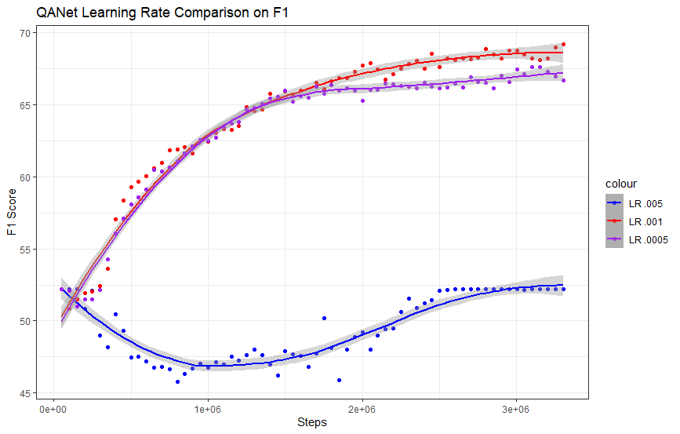
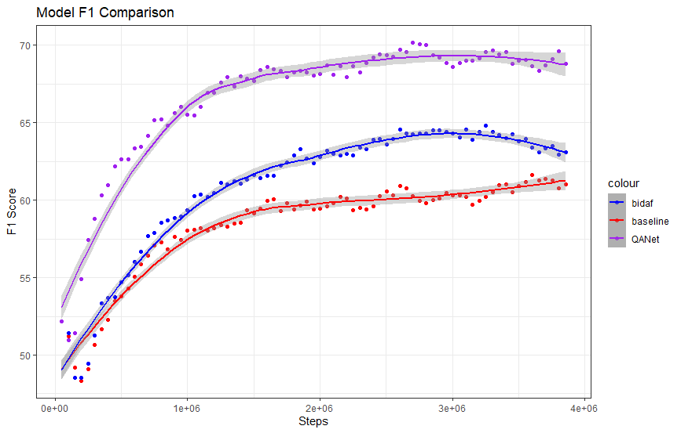
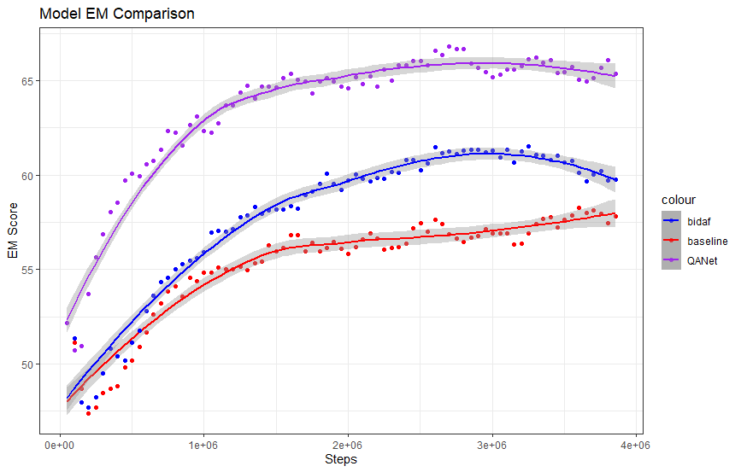
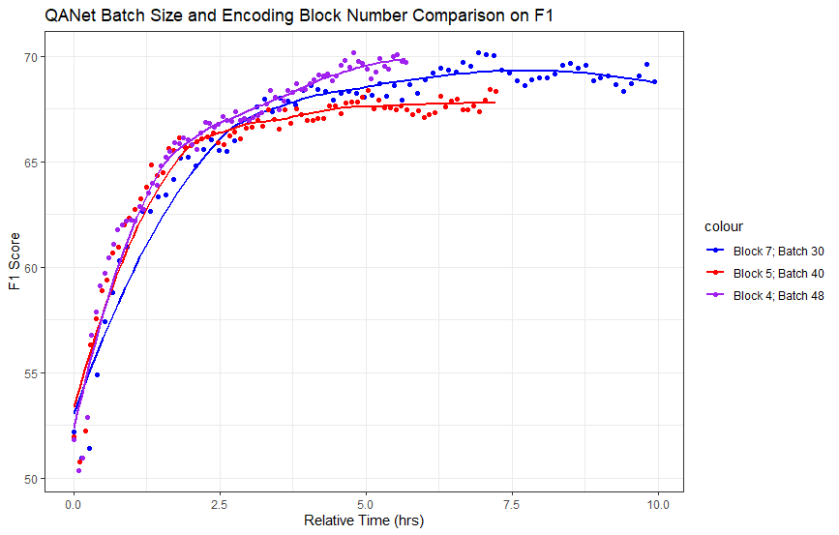
QANet on SQuAD v2.0 Alex Fan¹ and Yixuan (Sherry) Wu¹ ¹Department of Statistics, Research Mentor: Sarthak Kanodia
CS224n: NLP with Deep Learning
Poster Presentation, Winter 2022
Introduction
Hyperparameter Tuning
Results
Problem:
Given a context paragraph, can the machine extract the right span of words to answer a given question? And when a question is unanswerable, can it produce an empty span?
Dataset:
We will use SQuAD 2.0, which contains 141,934 crowd-sourced questions of Wikipedia articles. 129,941 of those are used as train set, about 6000 as dev set and another 6000 as test set.
Goal:
The goal is to improve the architecture of the Bi-Directional Attention Flow network model detailed in Seo et al. (2017) by:
Implementing the character-level embeddings
Adapting the QANet model introduced by Yu et al. (2018) from scratch
Tuning the QANet model’s hyperparameters
F1 Score
70
Tuned Parameter | Value | F1 | EM
Learning Rate | 0.0005 | 67.29 | 64.02
 | 0.001* | 69.17 | 66.82
 | 0.005 | 52.19 | 52.19
Dropout Prob | 0.05 | 69.62 | 65.89
 | 0.1* | 70.17 | 66.81
 | 0.2 | 69.17 | 65.82
Batch size ~ # of Stacked Encoder Blocks (see fig. 1) | #Rep = 7, B = 30* | 70.17 | 66.81
 | #Rep = 5, B = 40 | 68.39 | 64.86
 | #Rep = 4, B = 48 | 70.17 | 66.83
70
65
60
55
50
F1 Score
EM Score
65
65
60
LR 0.005
LR 0.001
LR 0.0005
60
55
55
Fig 2. F1 scores with different Learning Rates
50
Bidaf w/ Char
Baseline
QANet
45
50
0 1e+6 2e+6 3e+6
Steps
0 1e+6 2e+6 3e+6 4e+6
0 1e+6 2e+6 3e+6 4e+6
F1 Score
70
Fig 5. F1 and EM of three different models vs. Steps
65
The best performing model is the QANet model:
Achieves an F1 score of 70.17 and EM score of 66.81 on SQuAD v2.0.
+9/+8 on F1/EM over the baseline
+6/+3 on F1/EM over the BiDAF w/ Char
Some clear best performing hyperparameters:
LR = 0.001 does not overshoot minima
pDrop = 0.1 much more consistent results
Some tradeoff in architecture:
Reducing the number of stacked encoder blocks from 7->4 and increasing the batch size cut the training time from ~10 hours to ~6 hours.
Only minor decrease in performance, suggesting that decreasing the number of blocks could be useful if faced with limited compute resources.
Fig 3. F1 scores vs. Training Time
with different # Blocks and Batch sizes
60
Table 1. Parameter Tuning (*Default training param)
Model Architecture
55
Rep 7, B 30
Rep 5, B 40
Rep 4, B 48
Learning Rate
Dropout Prob
Batch Size ~ Rep
50
Best LR Param
Best LR+Drop Params
Our best performing model:
Transformer-based model adapted from QANet by Yu et al.
Design Specifics:
Hidden size: 128
# of Conv in the Contextual Embed Encoder Block: 4
# of Conv in a Stacked Encoder Block: 2
# of heads in Self-attention: 8
Used a 1d Convolution to decrease input size when necessary
0.0 2.5 5.0 7.5 10.0
Relative Training Time (hrs)
Fig 4. Tuning Sequence (due to time constraint)
Analyses
AvNA
Confusion matrix of model predictions
X: Model predictions; Y: Ground Truths
Correct: 76.5%;
 | Has Answer | No Answer
Answered | 2361 (39.67%) | 912 (15.33%)
Not Answered | 487 (8.18%) | 2191 (36.82%)
P1
P2
One Encoder Block
Table 2. AvNA
Future Work
Feedforward Layer
Performance by Question Type
Table shows predictions on questions that include or start with the following words
(e.g. “Who” category contains questions with “whom”, “whose”, etc.)
(e.g. Questions that include for example “whatever” are not included in the “What” category)
Concat +
Dense +
Softmax Output
Concat +
Dense +
Softmax Output
Layer Norm
Due to time and compute limitations, there is still room for improvement. These include:
Using a more fine-grained grid search for hyper-parameter tuning
Testing model architecture improvements such as including attention-fusion networks (Wang et al. 2018) within the transformer encoder blocks.
Using data augmentation strategies such as back-translation to boost model performance
Ensembling the QANet models together by averaging the output probabilities
Self-attention
 | What | When | Where | Which | Who | Why | How | Others
F1 | 69.30 | 76.03 | 66.31 | 74.80 | 72.09 | 65.60 | 69.24 | 70.57
EM | 65.85 | 75.22 | 62.10 | 70.83 | 69.22 | 55.81 | 65.00 | 67.81
Count | 3,432 | 456 | 248 | 216 | 601 | 86 | 560 | 351
Stacked Encoder Blocks
Layer Norm
Stacked Encoder Blocks
Table 3. Performance by Q Type
Repeat
Error Type Examples
Difficult reading comprehension questions (esp. in “Why” category)
Q: Why was there a depreciation of the industrialized nations dollars?
C: … Anticipating that currency values would fluctuate unpredictably for a time, the industrialized nations increased their reserves (by expanding their money supplies) in amounts far greater than before. The result was a depreciation of the dollar and other industrialized nations' currencies…
A: industrialized nations increased their reserves
P: N/A
Confounding & Proximity of Q&A
Q: What treaty took the place of constitutional treaty?
C: Following the Nice Treaty, there was an attempt to reform the constitutional law of the European Union and make it more transparent; … (40 words)… Instead, the Lisbon Treaty was enacted…
A: the Lisbon Treaty
P: Nice Treaty
Stacked Encoder Blocks
Conv
Layer Norm
References
Context-Query Attention Layer
Positional Encoding
Contextual Embedding Encoder Block
Contextual Embedding Encoder Block
[1] Minjoon Seo, Aniruddha Kembhavi, Ali Farhadi, and Hannaneh Hajishirzi. Bidirectional attention flow for machine comprehension. In Association for Computational Linguistics (ACL), 2017. [2] Adams Wei Yu, David Dohan, Minh-Thang Luong, Rui Zhao, Kai Chen, Mohammad Norouzi, and Quoc V Le. Qanet: Combining local convolution with global self-attention for reading comprehension. In ACL, 2018. [3] Wei Wang, Ming Yan, and Chen Wu. Multi-granularity hierarchical attention fusion networks for reading comprehension and question answering. In Association for Computational Linguistics (ACL), 2018.
Embedding Layer
Embedding Layer
Context Words
Context Characters
Context Words
Context Characters
Fig 1. QANet Diagram

