Slide 1
StudyBot
AI-Powered Study Assistant
Aleksandr Martiushev
a.martiushev@innopolis.university | CSE-03

Slide 2
Context
End-user
University students who want to efficiently understand study material and retain it long-term.
Problem
Students spend hours on lecture notes and textbooks without a tool to explain concepts, generate flashcards, or create self-assessment quizzes.
Product idea
StudyBot is an AI assistant that takes study material (text, PDF, DOCX), explains it in simple terms, creates flashcards with spaced repetition, and generates multiple-choice quizzes for self-testing.

Slide 3
Implementation
Tech Stack
Version 2 — New Features
▸ Quiz generation (10 MCQs, single & multi-select)
▸ Interactive quiz UI with score & explanations
▸ Spaced repetition (SM-2 algorithm)
▸ Review page for due flashcards (quality 0–5)
▸ Statistics page (progress tracking)
▸ File upload (.pdf, .docx with text extraction)
▸ Public deployment on VM with Nginx
Backend: Python 3.12 + FastAPI
Database: PostgreSQL + SQLAlchemy (async) + Alembic
AI: DeepSeek API (OpenAI-compatible)
Web Client: React + Vite + TypeScript
Deployment: Docker Compose + Nginx + VM
Version 1
Upload study text → AI explanation → Generate flashcards. Web interface.

Slide 4
Demo
1
Open the web app → home page showing uploaded materials
2
Upload a PDF file → material is created automatically
3
Click "Explain" → AI generates a clear explanation as Markdown
4
Click "Flashcards" → interactive flip cards appear
5
Open "Review" → start a spaced repetition session (SM-2)
6
Click "Generate Quiz" → take a quiz, see your score, review mistakes

Slide 5
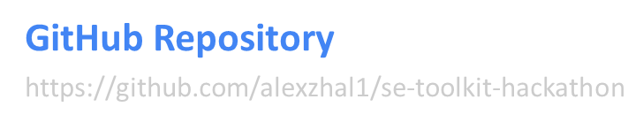
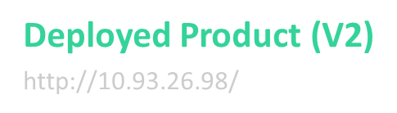
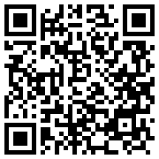
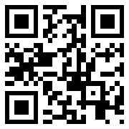
Links

