Slide 1
Rendering Pipeline
Rasterizer
Application
Geometry
CPU
Each stage can be also pipelined
The slowest of the pipeline stage determines the rendering speed.
Frames per second (fps)

Slide 2
Application Stage
Executes on the CPU
Collision detection – may provide the feedback
Global acceleration algorithms, etc
Generate rendering primitives, points, lines, triangles ..
Input from other sources (keyboard, mouse..)
..

Slide 3
Geometry stage
The majority of the per-polygon and per-vertex operations (Floating point operations)
Intel’s MMX/SSE
Old time: Software implementation.
Move objects (matrix multiplication)
Move the camera (matrix multiplication)
Compute lighting at vertices of triangle
Project onto screen (3D to 2D)
Clipping (avoid triangles outside screen)
Map to window

Slide 4
Geometry stage
Move objects (matrix multiplication)
Move the camera (matrix multiplication)
Compute lighting at vertices of triangle
Project onto screen (3D to 2D)
Clipping (avoid triangles outside screen)
Map to window
Model & View
Transform
Vertex
Shading
Projection
Clipping
Screen
Mapping

Slide 5
What’s a Vertex?
The defining “corners” of a primitive
Often means a triangle
A
Triangle
Vertices
© David Kirk/NVIDIA and Wen-mei W. Hwu, 2007 ECE 498AL, UIUC

Slide 6
The RASTERIZER stage
From GEOMETRY to visible pixels on screen
Add textures and various other per-pixel operations
And visibility is resolved here: sorts the primitives in the z-direction
Per pixel operation
Mostly integer operations

Slide 7
Rasterizer
Application
Geometry
Frame Buffer

Slide 8
Color Framebuffer
2D array of R,G,B color pixel values
8 bits (256 levels) per color component
Three 8-bit components can represent 16 million different colors, including 256 shades of gray
4th component: alpha; used for blending
© David Kirk/NVIDIA and Wen-mei W. Hwu, 2007 ECE 498AL, UIUC

Slide 9


Interfaces between CPU and GPU
AGP: Advanced Graphics Port – an interface between the computer core logic and the graphics processor
AGP 1x: 266 MB/sec – twice as fast as PCI
AGP 2x: 533 MB/sec
AGP 4x: 1 GB/sec → AGP 8x: 2 GB/sec
256 MB/sec readback from graphics to system
PCI-E: PCI Express – a faster interface between the computer core logic and the graphics processor
PCI-E 1.0: 4 GB/sec each way → 8 GB/sec total
PCI-E 2.0: 8 GB/sec each way → 16 GB/sec total
AGP
http://www.cis.upenn.edu/~suvenkat/700/

Slide 10
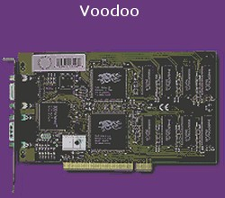
Generation I: 3dfx Voodoo (1996)
One of the first true 3D game cards
Worked by supplementing standard 2D video card.
Did not do vertex transformations: these were done in the CPU
Did do texture mapping, z-buffering.
http://accelenation.com/?ac.id.123.2
Vertex
Transforms
Primitive
Assembly
Rasterization
and
Interpolation
Frame
Buffer
Raster
Operations
CPU
PCI
GPU

Slide 11
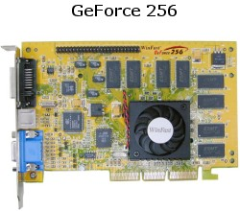
Generation II: GeForce/Radeon 7500 (1998)
Main innovation: shifting the transformation and lighting calculations to the GPU
Allowed multi-texturing: giving bump maps, light maps, and others..
Faster AGP bus instead of PCI
http://accelenation.com/?ac.id.123.5
Vertex
Transforms
Primitive
Assembly
Rasterization
and
Interpolation
Frame
Buffer
Raster
Operations
AGP
GPU

Slide 12
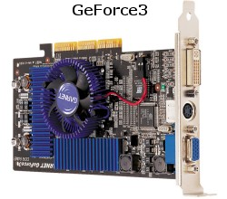
Generation III: GeForce3/Radeon 8500(2001)
For the first time, allowed limited amount of programmability in the vertex pipeline
Also allowed volume texturing and multi-sampling (for antialiasing)
http://accelenation.com/?ac.id.123.7
Vertex
Transforms
Primitive
Assembly
Rasterization
and
Interpolation
Frame
Buffer
Raster
Operations
GPU
AGP
Small vertex
shaders

Slide 13
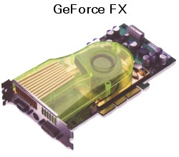
Generation IV: Radeon 9700/GeForce FX (2002)
This generation is the first generation of fully-programmable graphics cards
Different versions have different resource limits on fragment/vertex programs
http://accelenation.com/?ac.id.123.8
Vertex
Transforms
Primitive
Assembly
Rasterization
and
Interpolation
Frame
Buffer
Raster
Operations
AGP
Programmable
Vertex shader
Programmable
Fragment
Processor

Slide 14
Generation IV.V: GeForce6/X800 (2004)
Not exactly a quantum leap, but…
Simultaneous rendering to multiple buffers
True conditionals and loops
Higher precision throughput in the pipeline (64 bits end-to-end, compared to 32 bits earlier.)
PCIe bus
More memory/program length/texture accesses

Slide 15
Fixed-function pipeline
3D API
Commands
3D API:
OpenGL or
Direct3D
3D
Application
Or Game
CPU-GPU Boundary (AGP/PCIe)
GPU
Command &
Data Stream
Vertex
Index
Stream
Pixel
Location
Stream
Assembled
Primitives
Pixel
Updates
GPU
Front End
Primitive
Assembly
Rasterization
and
Interpolation
Frame
Buffer
Raster
Operations
Pre-transformed
Vertices
Transformed
Vertices
Transformed
Fragments
Pre-transformed
Fragments
Programmable
Vertex
Processor
Programmable
Fragment
Processor

Slide 16
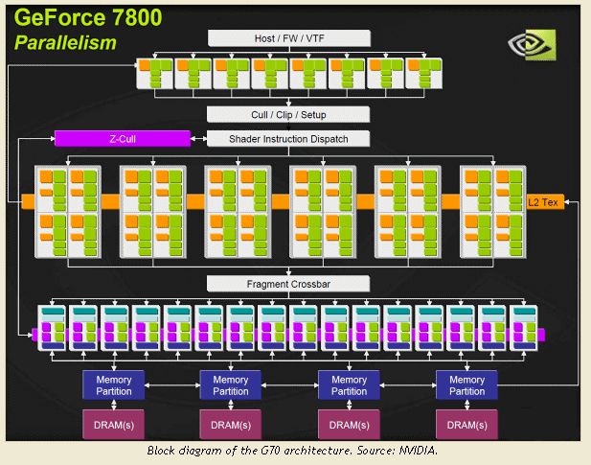
NVIDIA GeForce 7800 Pipeline

Slide 17
GeForce 8800
16 highly threaded SM’s, >128 FPU’s, 367 GFLOPS, 768 MB DRAM, 86.4 GB/S Mem BW, 4GB/S BW to CPU
Host
Input Assembler
Thread Execution Manager
Parallel Data Cache
Parallel Data Cache
Parallel Data Cache
Parallel Data Cache
Parallel Data Cache
Parallel Data Cache
Parallel Data Cache
Parallel Data Cache
Texture
Texture
Texture
Texture
Texture
Texture
Texture
Texture
Texture
Load/store
Load/store
Load/store
Load/store
Load/store
Load/store
Global Memory
© David Kirk/NVIDIA and Wen-mei W. Hwu, 2007 ECE 498AL, UIUC

Slide 18
Xbox 360 : Unified shader (ATI/AMD)
Playstation 3: a modified version of GeForce 7800 (NVIDIA)
Cuda: unified shader (NVIDIA)

Slide 19
The GEOMETRY stage in more detail
The model transform
Originally, an object is in ”model space”
Move, orient, and transform geometrical objects into ”world space”
Example, a sphere is defined with origin at (0,0,0) with radius 1
Translate, rotate, scale to make it appear elsewhere
Done per vertex with a 4x4 matrix multiplication!
The user can apply different matrices over time to animate objects

Slide 20
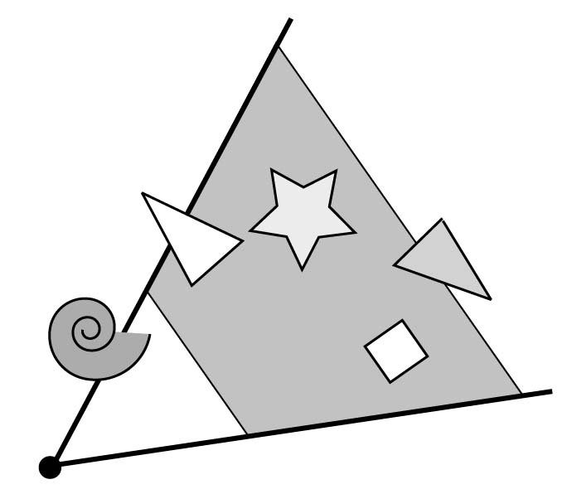
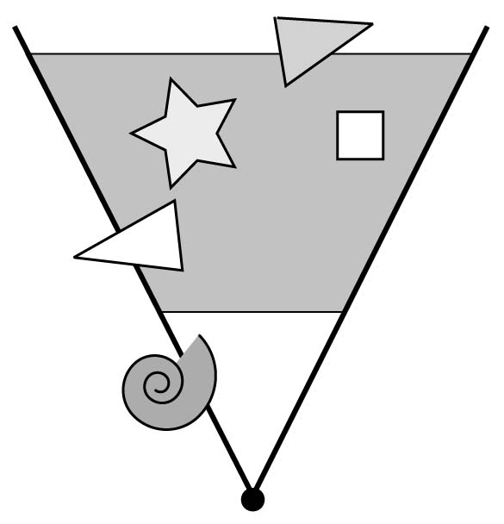
The view transform
You can move the camera in the same manner
But apply inverse transform to objects, so that camera looks down negative z-axis
z
x

Slide 21
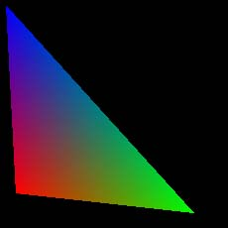
GEOMETRY Lighting
Compute ”lighting” at vertices
Rastrizer
(interpolation)
light
blue
Geometry
red
green
Try to mimic how light in nature behaves
Empirical models and some real theory

Slide 22
GEOMETRY Projection
Application
Geometry
Rasterizer
Two major ways to do it
Orthogonal (useful in few applications)
Perspective (most often used)
Mimics how humans perceive the world, i.e., objects’ apparent size decreases with distance

Slide 23
GEOMETRY Clipping and Screen Mapping
Square (cube) after projection
Clip primitives to square
Screen mapping, scales and translates square so that it ends up in a rendering window
These ”screen space coordinates” together with Z (depth) are sent to the rasterizer stage

Slide 24
GEOMETRY Summary
model space
world space
world space
camera space
clip
map to screen
projection
image space
compute lighting

Slide 25
The RASTERIZER in more detail
Scan-conversion
Find out which pixels are inside the primitive
Texturing
Put images on triangles
Interpolation over triangle
Z-buffering
Make sure that what is visible from the camera really is displayed
Double buffering
And more…

Slide 26
The RASTERIZER Scan conversion (Traingle traversal)
Triangle vertices from GEOMETRY is input
Find pixels inside the triangle
Or on a line, or on a point
Do per-pixel operations on these pixels:
Interpolation
Texturing
Z-buffering
And more…

Slide 27
The RASTERIZER Interpolation
Interpolate colors over the triangle
Called Gouraud interpolation
blue
red
green

Slide 28

The RASTERIZER Texturing
One application of texturing is to ”glue” images onto geometrical object
Associate points in an image to points in a geometric object
+
=

Slide 29
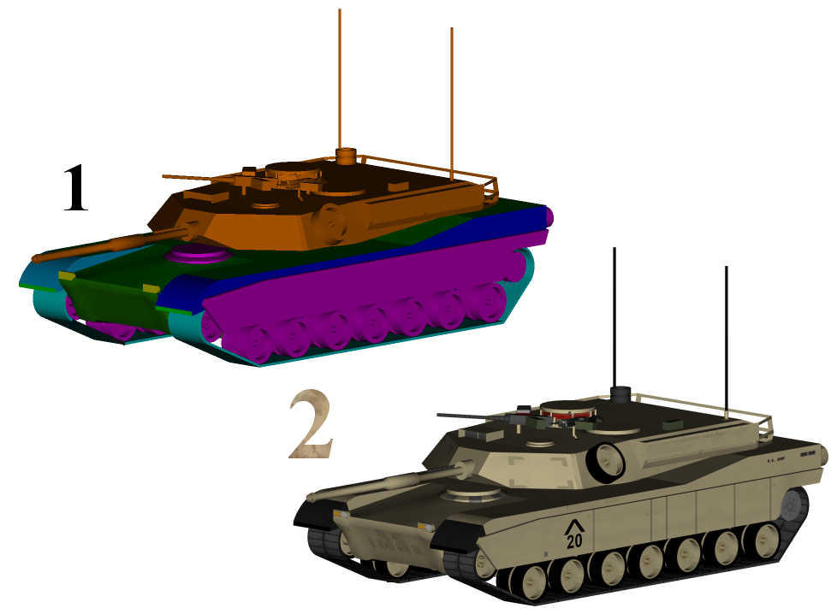
Examples
Without texture mapping
With texture mapping
From wikipedia

Slide 30



Another Example: Bump mapping
=
+
From wikipedia

Slide 31
The RASTERIZER Z-buffering
The fixed graphics hardware ”just” draws triangles
However, a triangle that is covered by a more closely located triangle should not be visible
Assume two equally large tris at different depths
incorrect
correct
Triangle 1
Triangle 2
Draw 1 then 2
Draw 2 then 1

Slide 32
The RASTERIZER Z-buffering
Would be nice to avoid sorting…
The Z-buffer (aka depth buffer) solves this
Idea:
Store z (depth) at each pixel
When scan-converting a triangle, compute z at each pixel on triangle
Compare triangle’s z to Z-buffer z-value
If triangle’s z is smaller, then replace Z-buffer and color buffer
Else do nothing
Can render in any order

Slide 33
The RASTERIZER Double buffering
The monitor displays one image at a time
So if we render the next image to screen, then rendered primitives pop up
And even worse, we often clear the screen before generating a new image
A better solution is ”double buffering”

Slide 34
The RASTERIZER Double buffering
Use two buffers: one front and one back
The front buffer is displayed
The back buffer is rendered to
When new image has been created in back buffer, swap front and back

Slide 35
3D pipeline
Rasterizer
Application
Geometry
Frame Buffer

Slide 36
Graphics Processor Trend
Fixed pipeline processor
More and more CISC style processors
OpenGL API~= One instruction
Programmable parallel processors
Scatter/Gather operations
Scatter: Aout[B[i]]=Ain[i]
Gather: Aout[i]=Ain[B[in]]
Enable GPGPU

Slide 37
Fixed Function vs. Programmable Function
Fixed function stage:
Fixed vertex stage: Cilp-space vertex computations, per-vertex normal, many other per-vertex operations (color material, texture coordinate, normal transformation)
Fixed fragment stage: many basic lighting models and effects etc.
Programmable function pipeline
Custom computations

Slide 38
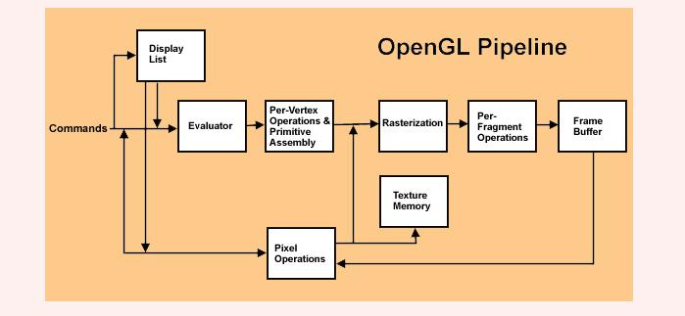
OpenGL pipeline(1997)

Slide 39
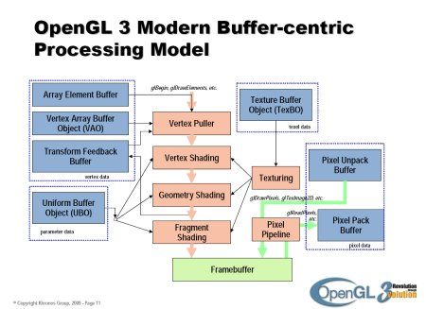
OpenGL 3

Slide 40
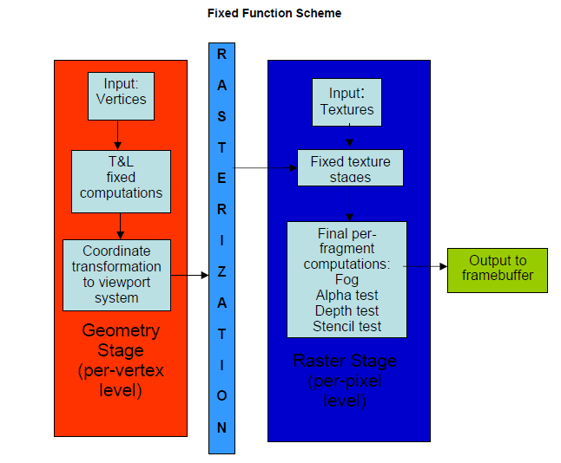
Fixed Function Scheme

Slide 41
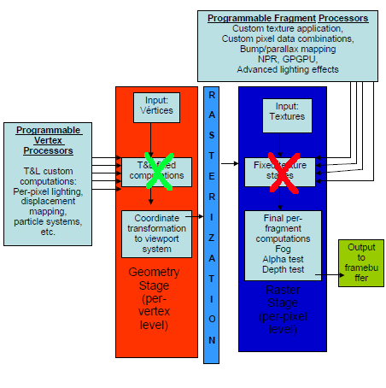
Programmable Function Scheme

Slide 42
Hardware Design Issues in Fixed Pipeline
Start from straightforward mapping
Efficient Instruction mapping
Better compiler is good
Primitive Assembly
Efficient Rasterization
Register Bank issues
Texture cache access
Prefetching
Memory bandwidth
Better optimizations to reduce the amount of computations,

Slide 43
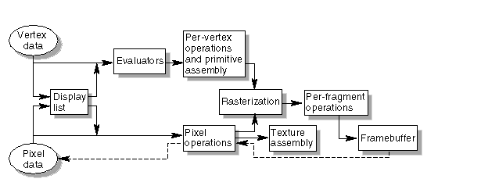
OpenGL Rendering Pipeline
http://glprogramming.com/red/

Slide 44
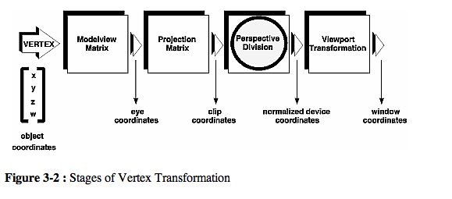
View Transformation

Slide 45
GEOMETRY Summary (Review)
model space
world space
world space
camera space
clip
map to screen
projection
image space
compute lighting

Slide 46
Vertex & Primitives
V3
V1 = (x1, y1, z1)
V2 = (x2, y2, z2)
V3 = (x3, y3, z3)
+y
V2
+z
V1
+x
Normal vectors:
Surface Normals: Physical meaning
Vertex Normals: Useful for fast and effective lighting algorithms

Slide 47
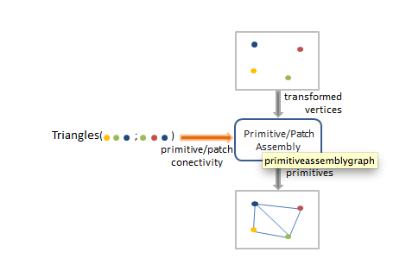
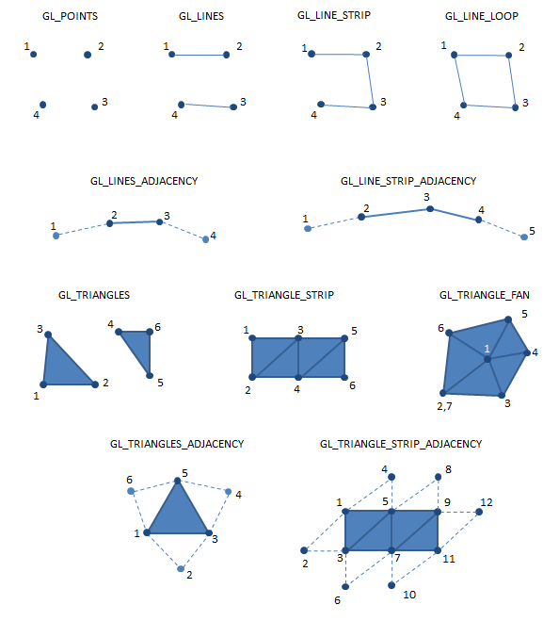
Primitive Assembly

Slide 48
Model Space: Each model has own coordinate
Word Space: All models have the same coordinate
Camera Space (Eye Space): Relative to the camera (eye) position. (Camera position, z = 0)
Screen space: Actual hardware coordinates

Slide 49
Transformation Pipeline
World Transformation
Model coordinates → World coordinates
View Transformation
World coordinates → Camera Space
Projection Transformation
Camera Space → View Plane
Matrix Multiplications for transformations
From Hsien-Hsin Lee’s MPG class

Slide 50
Homogeneous Coordinates
Adding one more imaginary coordinate
Enable all transformations to be done by “multiplication”
“projective transformations” can be easily represented
Add one coordinate (w) to 3D vector
W=1 is a cartesian coordinate
W >1 useful for projective projection

Slide 51
Transformations
+y
+y
(tx, ty, tz)
(x1’, y1’, z1’)
(x1, y1, z1)
+z
+z
+x
+x
x1’
y1’ =
z1’
x1 tx
Y1 + ty
z1 tz
]
[
]
[
x1’ 1 0 0 tx
y1’ = 0 1 0 ty
z1’ 0 0 1 tx
1 0 0 0 1
]
x1
y1
z1
1
]
[
[

Slide 52
Others
Scaling
Rotation (with Z-axis)
x1’ Sx 0 0 0
y1’ = 0 Sy 0 0
z1’ 0 0 Sz 0
1 0 0 0 1
x1
y1
z1
1
]
[
]
[
x1’ cosΘ sinθ 0 0
y1’ = -sinθ cosθ 0 0
z1’ 0 0 1 0
1 0 0 0 1
[
x1
y1
z1
1
]
[
]

Slide 53
Non-commutative Property
Scale by 2
X,Y translate +5, +5
[X’] = [A][B][X] ≠ [B][A][X]
+z
(1,1,-1)
X,Y translate +5, +5
Scale by 2
+z
+z

Slide 54
Affine Transformation
Line → Line
keep straight lines, ratios of distances between points
Angle can be changed

Slide 55
Projects
Orthographic projection
Projective projection

Slide 56
Canonical View Volume
+y
+z
+x
Orthographic Project
OpenGL GL_Projection matrix
+y
+z
+x

Slide 57

Field of View
Frustrum: the region of space in the modeled world that may appear on the screen
y
y_{s}
d
z
far
near

Slide 58
Prospective Projection
far
+y
+z
near
+x

Slide 59
Data Structures in Pipeline
Application
struct { float x,y,z,w; float r,g,b,a; } vertex;
Vertex assembly
Vertex operations
struct { vertex v0,v1,v2 } triangle;
Primitive assembly
Primitive operations
Not in this project
struct { short int x,y; float depth; float r,g,b,a; } fragment;
Screen coordinates
Rasterization
Fragment operations
Not in this project
struct { int depth; byte r,g,b,a; } pixel;
Frame buffer
Display
Akeley Fall 2007 Slides

Slide 60
Graphics Pipeline
Design option #1
Expand Execution stage to include graphics functional units
Design option #2
Add additional pipeline stages after the WB stage
Need triangle setup unit
Need a separate stage for Rasterizer

Slide 61
Graphics Instructions

Slide 62
Registers
Vector Registers (64bits = 16bits * 4)
There are 64 vector registers.
Each vector register holds 4 elements (Scalar Registers).
All vectors store only floating-point numbers.
Use idx field to indicate an element.
Vector Register
elmt 3 | elmt 2 | elmt 1 | elmt 0

Slide 63
VADD instruction
Assembly Formats
vadd dest src1 src2
Encoded to
Operation
dest[0] <- src1[0] + src2[0]
dest[1] <- src1[1] + src2[1]
dest[2] <- src1[2] + src2[2]
dest[3] <- src1[3] + src2[3]
Examples
vadd v0 v1 v2
31 | 30 | 29 | 28 | 27 | 26 | 25 | 24 | 23 | 22 | 21 | 20 | 19 | 18 | 17 | 16
0 | 0 | 0 | 0 | 0 | 0 | 1 | 0 |  |  | dest
15 | 14 | 13 | 12 | 11 | 10 | 9 | 8 | 7 | 6 | 5 | 4 | 3 | 2 | 1 | 0
 |  | src1 |  |  |  |  |  |  |  | src2

Slide 64
VMOV instruction
Assembly Formats
vmov dest src
Encoded to
Operation
dest <- src
Description
Move Instruction for Vector Registers
Examples
vmov v1 v2
31 | 30 | 29 | 28 | 27 | 26 | 25 | 24 | 23 | 22 | 21 | 20 | 19 | 18 | 17 | 16
0 | 0 | 0 | 1 | 0 | 0 | 1 | 0 |  |  | dest
15 | 14 | 13 | 12 | 11 | 10 | 9 | 8 | 7 | 6 | 5 | 4 | 3 | 2 | 1 | 0
 |  | src

Slide 65
VMOVI instruction
Assembly Formats
vmovi dest imm16
Encoded to
Operation
dest[0], dest[1], dest[2], dest[3] <- imm16
Description
Move Instruction for Vector Registers (Floating-point).
imm16 will be copied to all four elements of the dest vector register
Examples
vmovi v1 1000.f
31 | 30 | 29 | 28 | 27 | 26 | 25 | 24 | 23 | 22 | 21 | 20 | 19 | 18 | 17 | 16
0 | 0 | 0 | 1 | 0 | 1 | 1 | 1 |  |  | dest
15 | 14 | 13 | 12 | 11 | 10 | 9 | 8 | 7 | 6 | 5 | 4 | 3 | 2 | 1 | 0
imm16

Slide 66
VCOMPMOV instruction
Assembly Formats
vcompmov dest idx src
Encoded to
Operation
dest[idx] <- src
Note: dest - vector register, src - scalar register
Description
Move Instruction for Vector Register’s element.
Examples
vcompmov v1 0 r1
31 | 30 | 29 | 28 | 27 | 26 | 25 | 24 | 23 | 22 | 21 | 20 | 19 | 18 | 17 | 16
0 | 0 | 1 | 0 | 0 | 0 | 1 | 0 | idx |  | dest
15 | 14 | 13 | 12 | 11 | 10 | 9 | 8 | 7 | 6 | 5 | 4 | 3 | 2 | 1 | 0
 |  |  |  | src

Slide 67
VCOMPMOVI instruction
Assembly Formats
vcompmovi dest idx imm16
Encoded to
Operation
dest[idx] <- imm16
Description
Move Instruction for Vector Register’s element (Floating-point).
Examples
vcompmovi v1 0 1.5f
31 | 30 | 29 | 28 | 27 | 26 | 25 | 24 | 23 | 22 | 21 | 20 | 19 | 18 | 17 | 16
0 | 0 | 1 | 0 | 0 | 1 | 1 | 1 | idx |  | dest
15 | 14 | 13 | 12 | 11 | 10 | 9 | 8 | 7 | 6 | 5 | 4 | 3 | 2 | 1 | 0
imm16

Slide 68
SETVERTEX instruction
Assembly Formats
setvertex vr
Encoded to
Operation
The value of vr[1]: X coordinate
The value of vr[2]: Y coordinate
The value of vr[3]: Z coordinate
Ignore the value of vr[0]
Description
Set the current vertex using vr register
Examples
setvertex v1
31 | 30 | 29 | 28 | 27 | 26 | 25 | 24 | 23 | 22 | 21 | 20 | 19 | 18 | 17 | 16
0 | 1 | 0 | 0 | 0 | 0 | 1 | 0 |  |  | vr
15 | 14 | 13 | 12 | 11 | 10 | 9 | 8 | 7 | 6 | 5 | 4 | 3 | 2 | 1 | 0

Slide 69
SETCOLOR instruction
Assembly Formats
setcolor vr
Encoded to
Operation
The value of vr[0]: R component
The value of vr[1]: G component
The value of vr[2]: B component
Ignore the value of vr[3]
Description
Set the color of the current vertex using vr register
Examples
setcolor v1
31 | 30 | 29 | 28 | 27 | 26 | 25 | 24 | 23 | 22 | 21 | 20 | 19 | 18 | 17 | 16
0 | 1 | 0 | 0 | 1 | 0 | 1 | 0 |  |  | vr
15 | 14 | 13 | 12 | 11 | 10 | 9 | 8 | 7 | 6 | 5 | 4 | 3 | 2 | 1 | 0

Slide 70
ROTATE instruction
Assembly Formats
rotate vr
Encoded to
Operation
The value of vr[0]: Angle
The value of vr[3]: Z-coordinate
Ignore the value of vr[1] & vr[2]
Description
Rotate the current matrix using vr register
Examples
rotate v1
31 | 30 | 29 | 28 | 27 | 26 | 25 | 24 | 23 | 22 | 21 | 20 | 19 | 18 | 17 | 16
0 | 1 | 0 | 1 | 0 | 0 | 1 | 0 |  |  | vr
15 | 14 | 13 | 12 | 11 | 10 | 9 | 8 | 7 | 6 | 5 | 4 | 3 | 2 | 1 | 0

Slide 71
TRANSLATE instruction
Assembly Formats
translate vr
Encoded to
Operation
The value of vr[1]: distance to move on x-axis
The value of vr[2]: distance to move on y-axis
Ignore the values of vr[0] & vr[3]
Description
Translate the current matrix using vr register
Examples
translate vr1
31 | 30 | 29 | 28 | 27 | 26 | 25 | 24 | 23 | 22 | 21 | 20 | 19 | 18 | 17 | 16
0 | 1 | 0 | 1 | 1 | 0 | 1 | 0 |  |  | vr
15 | 14 | 13 | 12 | 11 | 10 | 9 | 8 | 7 | 6 | 5 | 4 | 3 | 2 | 1 | 0

Slide 72
SCALE instruction
Assembly Formats
scale vr
Encoded to
Operation
The value of vr[1]: scale value on x-axis
The value of vr[2]: scale value on y-axis
Ignore the values of vr[0] & vr[3]
Description
Scale the current matrix using vr register
Examples
scale v1
31 | 30 | 29 | 28 | 27 | 26 | 25 | 24 | 23 | 22 | 21 | 20 | 19 | 18 | 17 | 16
0 | 1 | 1 | 0 | 0 | 0 | 1 | 0 |  |  | vr
15 | 14 | 13 | 12 | 11 | 10 | 9 | 8 | 7 | 6 | 5 | 4 | 3 | 2 | 1 | 0

Slide 73
PUSHMATRIX instruction
Assembly Formats
pushmatrix
Encoded to
Operation
Description
Push the current matrix into the stack.
Examples
pushmatrix
31 | 30 | 29 | 28 | 27 | 26 | 25 | 24 | 23 | 22 | 21 | 20 | 19 | 18 | 17 | 16
1 | 0 | 0 | 0 | 0 | 0 | 0 | 0
15 | 14 | 13 | 12 | 11 | 10 | 9 | 8 | 7 | 6 | 5 | 4 | 3 | 2 | 1 | 0

Slide 74
POPMATRIX instruction
Assembly Formats
popmatrix
Encoded to
Operation
Description
Pop a matrix from the stack to the current matrix.
Examples
popmatrix
31 | 30 | 29 | 28 | 27 | 26 | 25 | 24 | 23 | 22 | 21 | 20 | 19 | 18 | 17 | 16
1 | 0 | 0 | 0 | 1 | 0 | 0 | 0
15 | 14 | 13 | 12 | 11 | 10 | 9 | 8 | 7 | 6 | 5 | 4 | 3 | 2 | 1 | 0

Slide 75
BEGINPRIMITIVE instruction
Assembly Formats
beginprimitive type
Encoded to
Pre-defined Types
Points: 0, Lines: 1, Line strip: 2, Line loop: 3, Triangles: 4, Triangle strip: 5, Triangle fan: 6, Quads: 7, Quad strip: 8, Polygon: 9
Refer to http://www.jmp.com/support/help/Graphics_Primitives.shtml
Description
Delimit the vertices that define a primitive or a group of primitives.
Examples
beginprimitive 4 -> Begin describing “triangle” primitive
31 | 30 | 29 | 28 | 27 | 26 | 25 | 24 | 23 | 22 | 21 | 20 | 19 | 18 | 17 | 16
1 | 0 | 0 | 1 | 0 | 0 | 0 | 1 |  |  |  |  | type
15 | 14 | 13 | 12 | 11 | 10 | 9 | 8 | 7 | 6 | 5 | 4 | 3 | 2 | 1 | 0

Slide 76
ENDPRIMITIVE instruction
Assembly Formats
endprimitive
Encoded to
Operation
Description
Delimit the vertices that define a primitive or a group of primitives.
Examples
endprimitive
31 | 30 | 29 | 28 | 27 | 26 | 25 | 24 | 23 | 22 | 21 | 20 | 19 | 18 | 17 | 16
1 | 0 | 0 | 1 | 1 | 0 | 0 | 0
15 | 14 | 13 | 12 | 11 | 10 | 9 | 8 | 7 | 6 | 5 | 4 | 3 | 2 | 1 | 0

Slide 77
LOADIDENTITY instruction
Assembly Formats
loadidentity
Encoded to
Operation
Description
Replace the current matrix with the identity matrix.
Examples
loadidentity
31 | 30 | 29 | 28 | 27 | 26 | 25 | 24 | 23 | 22 | 21 | 20 | 19 | 18 | 17 | 16
1 | 0 | 1 | 0 | 0 | 0 | 0 | 0
15 | 14 | 13 | 12 | 11 | 10 | 9 | 8 | 7 | 6 | 5 | 4 | 3 | 2 | 1 | 0

Slide 78
FLUSH instruction
Assembly Formats
flush
Encoded to
Operation
Description
Flush (Empty) the contents of the frame buffer.
Examples
flush
31 | 30 | 29 | 28 | 27 | 26 | 25 | 24 | 23 | 22 | 21 | 20 | 19 | 18 | 17 | 16
1 | 0 | 1 | 1 | 0 | 0 | 0 | 0
15 | 14 | 13 | 12 | 11 | 10 | 9 | 8 | 7 | 6 | 5 | 4 | 3 | 2 | 1 | 0

Slide 79
DRAW instruction
Assembly Formats
draw
Encoded to
Operation
Description
Draw the contents of the frame buffer on a screen (if available).
Also, this instruction indicates the end of frame.
Examples
draw
31 | 30 | 29 | 28 | 27 | 26 | 25 | 24 | 23 | 22 | 21 | 20 | 19 | 18 | 17 | 16
1 | 0 | 1 | 1 | 1 | 0 | 0 | 0
15 | 14 | 13 | 12 | 11 | 10 | 9 | 8 | 7 | 6 | 5 | 4 | 3 | 2 | 1 | 0

Slide 80
Translation, Rotation, Scale Operations
Design options: (1) Set up matrix elements, (2) set up angle
Scaling, Rotation
Transcendental functions
Use a look-up table ( case statements)
x1’ Sx 0 0 0
y1’ = 0 Sy 0 0
z1’ 0 0 Sz 0
1 0 0 0 1
x1
y1
z1
1
]
x1
y1
z1
1
[
]
[
[
x1’ cosΘ sinθ 0 0
y1’ = -sinθ cosθ 0 0
z1’ 0 0 1 0
1 0 0 0 1
]
[
]

Slide 81
Matrix Multiplication
OK, we want to do [4x4] [4x1] matrix multiplication. How many multiplier?
(4*4)*4 = 64 multiplier
32-bit 64 multiplier
How many Logic Elements?
Parallel computations? Serial computations? Special functional units for each operation?
x1’ Sx 0 0 0
y1’ = 0 Sy 0 0
z1’ 0 0 Sz 0
1 0 0 0 1
x1
y1
z1
1
]
[
]
[
→ x1’=Sx X1, y1’ = Sy Y1, z1’ = Sz Z1

Slide 82
View Transformation

Slide 83
GEOMETRY Summary (Review)
model space
world space
world space
camera space
clip
map to screen
projection
image space
compute lighting

Slide 84
Vertex & Primitives
V3
V1 = (x1, y1, z1)
V2 = (x2, y2, z2)
V3 = (x3, y3, z3)
+y
V2
+z
V1
+x
Normal vectors:
Surface Normals: Physical meaning
Vertex Normals: Useful for fast and effective lighting algorithms

Slide 85
Primitive Assembly

Slide 86
Model Space: Each model has own coordinate
Word Space: All models have the same coordinate
Camera Space (Eye Space): Relative to the camera (eye) position. (Camera position, z = 0)
Screen space: Actual hardware coordinates

Slide 87
Transformation Pipeline
World Transformation
Model coordinates → World coordinates
View Transformation
World coordinates → Camera Space
Projection Transformation
Camera Space → View Plane
Matrix Multiplications for transformations
From Hsien-Hsin Lee’s MPG class

Slide 88
Homogeneous Coordinates
Adding one more imaginary coordinate
Enable all transformations to be done by “multiplication”
“projective transformations” can be easily represented
Add one coordinate (w) to 3D vector
W=1 is a cartesian coordinate
W >1 useful for projective projection

Slide 89
Transformations
+y
+y
(tx, ty, tz)
(x1’, y1’, z1’)
(x1, y1, z1)
+z
+z
+x
+x
x1’
y1’ =
z1’
x1 tx
Y1 + ty
z1 tz
]
[
]
[
x1’ 1 0 0 tx
y1’ = 0 1 0 ty
z1’ 0 0 1 tx
1 0 0 0 1
]
x1
y1
z1
1
]
[
[

Slide 90
Others
Scaling
Rotation (with Z-axis)
x1’ Sx 0 0 0
y1’ = 0 Sy 0 0
z1’ 0 0 Sz 0
1 0 0 0 1
x1
y1
z1
1
]
[
]
[
x1’ cosΘ sinθ 0 0
y1’ = -sinθ cosθ 0 0
z1’ 0 0 1 0
1 0 0 0 1
[
x1
y1
z1
1
]
[
]

Slide 91

Exercise
Write an affine transformation matrix and write down the new coordinates of A, B. The yellowjacket becomes 2 times bigger, 90 rotation (counter clock wise) and move + 1 x-axis
A’
A
(1,1,0)
(0,0,0)
(0,1,0)
(-1,-1,0)
(0,0)
B
(0, -2, 0,0)
(2, 0, 0,0)
(0, 0, 1,0)
(0, 0, 0,1)
A’ = (-1,2,0)
B’ = (3,-2,0)
B’
x1’ Sx 0 0 0
y1’ = 0 Sy 0 0
z1’ 0 0 Sz 0
1 0 0 0 1
x1
y1
z1
1
x1’ cosΘ sinθ 0 0
y1’ = -sinθ cosθ 0 0
z1’ 0 0 1 0
1 0 0 0 1
[
x1
y1
z1
1
]
[
]
]
[
]
[

Slide 92
Non-commutative Property
Scale by 2
X,Y translate +5, +5
[X’] = [A][B][X] ≠ [B][A][X]
+z
(1,1,-1)
X,Y translate +5, +5
Scale by 2
+z
+z

Slide 93
Affine Transformation
Line → Line
keep straight lines, ratios of distances between points
Angle can be changed

Slide 94
Projects
Orthographic projection
Projective projection

Slide 95
Canonical View Volume
+y
+z
+x
Orthographic Project
OpenGL GL_Projection matrix
+y
+z
+x

Slide 96
Field of View
Frustrum: the region of space in the modeled world that may appear on the screen
y
y_{s}
d
z
far
near

Slide 97
Prospective Projection
far
+y
+z
near
+x

Slide 98
Data Structures in Pipeline
Application
struct { float x,y,z,w; float r,g,b,a; } vertex;
Vertex assembly
Vertex operations
struct { vertex v0,v1,v2 } triangle;
Primitive assembly
Primitive operations
Not in this project
struct { short int x,y; float depth; float r,g,b,a; } fragment;
Screen coordinates
Rasterization
Fragment operations
Not in this project
struct { int depth; byte r,g,b,a; } pixel;
Frame buffer
Display
Akeley Fall 2007 Slides

Slide 99
The RASTERIZER stage
From GEOMETRY to visible pixels on screen
Add textures and various other per-pixel operations
And visibility is resolved here: sorts the primitives in the z-direction
Per pixel operation
Mostly integer operations

Slide 100
How to draw a Line?:Bresenham Algorithm
y = mx + b
Brute-force approach
f(x,y) = (y₀-y₁)x+(x₁-x₀)y+x₀y₁-x₁y₀=0 (x₀<= x₁)
When (0<m<=1) , draw (x,y) → draw (x+1,y) or (x+1, y+1)
y = y₀
for x=x₀ to x₁ do
draw (x,y)
if (some condition) then
y = y+1
Condition → f (x+1, y+0.5) < 0 then y = y+1
Shirley’s text book Chapter 3

Slide 101
Optimization-I
Since f(x,y) = (y₀-y₁)x+(x₁-x₀)y+x₀y₁-x₁y₀=0
f(x+1, y ) = f(x+y) + (y₀-y₁)
f(x+1, y+1) = f(x,y) + (y₀-y₁)+(x₁-x₀)
We already calculated f(x-1,y+0.5) or f(x-1, y-0.5) after the first iteration
for x=x₀ to x₁ do
draw (x,y)
if (d <0) then
y = y+1
d = d+(x1-x0)+(y0-y1)
else
d = d+(y0-y1)

Slide 102
Optimization-II
Remove floating point operations
Use 2f(x,y) instead of f(x,y)
2f(x₀+1,y₀+0.5) = 2(y₀-y₁)(x₀+1)+(x₁-x₀)(2y₀+1)+2x₀y₁-2x₁y₀=0
Resulting code is
y = y₀,
d= 2(y₀-y₁)(x₀+1)+(x₁-x₀)(2y₀+1)+2x₀y₁-2x₁y₀
for x=x₀ to x₁ do
draw (x,y)
if (d <0) then
y = y+1
d = d+2(x1-x0)+2(y0-y1)
else
d = d+2(y0-y1)

Slide 103
Barycentric Coordinates
v0
P = aV0+bV1+cV2
a+b+c = 1
P is inside triangle if
0<a<1
0<b<1
0<c<1
P
v2
v1
a = f12(x,y)/f12(x0,y0)
b = f20(x,y)/f20(x1,y1)
c = f01(x,y)/ f01(x2,y2)
fi,j is the previous function with appropriate vertices

Slide 104
Gouraud interpolation
Gouraud shaded
v0, v1, v2 have colors c0, c1, c2
Color at (x,y) : c = a c0 +b c1 + d c2
If p is inside the triangle
Draw c

Slide 105
Triangle rasterization examples
Gouraud shaded (GTX)
Edge walk, planar parameterization (VGX)
Barycentric direct evaluation (InfiniteReality)
Small tiles (Bali – proposed)
Per-pixel evaluation (Pixel Planes 4)
Akeley’s slides

