Slide 1
CORELS: Learning certifiably optimal rule lists for categorical data
Elaine Angelino*, Nicholas Larus-Stone, Daniel Alabi, Margo Seltzer, Cynthia Rudin
*Thanks to Elaine for many of these slides

Slide 2
overview
motivation
rule lists
branch-and-bound
data structures
experiments

Slide 3
motivation
some problems require human interpretation
criminal recidivism prediction
current model is proprietary black box algorithm called COMPAS
ProPublica released an article on racial bias in COMPAS
“…it is difficult to construct a score that doesn’t include items that can be correlated with race — such as poverty, joblessness and social marginalization. 'If those are omitted from your risk assessment, accuracy goes down,’"
https://www.propublica.org/article/machine-bias-risk-assessments-in-criminal-sentencing

Slide 4
ProPublica COMPAS recidivism dataset
Northpointe’s Correctional Offender Management Profiling for Alternative Sanctions (COMPAS) is a controversial, proprietary black box algorithm
"In 2009, Brennan [et al] published a validation study that found that Northpointe’s risk of recidivism score had an accuracy rate of [68%] in a sample of 2,328 people. Their study also found that the score was slightly less predictive for black men than white men — [67% vs. 69%].”
open problem: can human-interpretable machine learning transparently achieve competitive results?
https://www.propublica.org/article/machine-bias-risk-assessments-in-criminal-sentencing

Slide 5
ProPublica COMPAS recidivism dataset
7214 individuals (52% recidivate within 2 years)
sex (male, female)
age (18-20, 21-25, 26-30, 31-40, 41-50, >50)
race (African American, Caucasian, Asian, Hispanic, Native American, Other)
# juvenile felonies (0, >0)
# juvenile misdemeanors (0, >=1)
# juvenile crimes (0, >=1)
# priors (0, 1, 2-3, >3)
current charge (misdemeanor, felony)
rule mining yields ~157 rules
1-2 clauses with min (max) support = 0.01 (0.99)
https://github.com/propublica/compas-analysis

Slide 6
rule lists
will the person commit another crime?
if (age = 23 - 25) ^ (priors = 2 - 3) then predict (yes) else if (age = 18 - 20) then predict (yes)
else if (sex = male) ^ (age = 21 - 22) then predict (yes)
else if (priors > 3) then predict (yes)
else predict (no)

Slide 7
rule lists
can be constructed from leaves of decision trees
predictive accuracy competitive with decision trees
boolean functions for binary classification
conjuctions allow for expressive, rich features
easily interpreted by humans due to IF … THEN … structure

Slide 8
example rule lists (with certificates of optimality)
predict whether individual recidivates within 2 years
if (male and juvenile crimes > 0) then (yes)
else if (juvenile felonies = 0 and priors > 3) then (yes)
else (no)
if (age = 18-20) then (yes)
else if (male and age = 21-25) then (yes)
else if (age = 26-30 and priors = 2-3) then (yes)
else if (priors > 3) then (yes)
else (no)
regularization (c) = 0.005
test accuracy = 0.675 +/- 0.020 (10-fold cross-validation)

Slide 9
learning rule lists
typical algorithms don’t do global optimization
greedy (fast)
Monte Carlo (slow)
goal: global optimization via branch-and-bound
selected related work:
learning decision lists (Rivest, 1987)
Bayesian rule lists (Letham, Rudin, McCormick, Madigan, 2015) … stroke prediction model
scalable Bayesian rule lists (Yang, Rudin, Seltzer, 2016) … cache, efficient bit vector operations

Slide 10
minimize over all possible rule lists RL :
objective(RL) = error(RL) + c length(RL)
~ 0.01
will the person commit another crime?
if (age = 23 - 25) ^ (priors = 2 - 3) then predict (yes) else if (age = 18 - 20) then predict (yes)
else if (sex = male) ^ (age = 21 - 22) then predict (yes)
else if (priors > 3) then predict (yes)
else predict (no)

Slide 11
bounds on the objective drive branch-and-bound
objective(RL) = error(RL) + c length(RL)
= error(prefix) + error(default) + c length(prefix)
will the person commit another crime?
if (age = 23 - 25) ^ (priors = 2 - 3) then predict (yes) else if (age = 18 - 20) then predict (yes)
else if (sex = male) ^ (age = 21 - 22) then predict (yes)
else if (priors > 3) then predict (yes)
else predict (no)

Slide 12
bounds on the objective drive branch-and-bound
objective(RL) = error(RL) + c length(RL)
= error(prefix) + error(default) + c length(prefix)
>= error(prefix) + c length(prefix)
= lower bound(prefix)
a rule list that starts with prefix can only improve by correcting errors made by the default rule

Slide 13
lower bounds monotonically increase as prefixes grow
if (age = 23 - 25) ^ (priors = 2 - 3) then predict (yes) else predict (no)
lower bound( ) = error( ) + c

Slide 14
lower bounds monotonically increase as prefixes grow
if (age = 23 - 25) ^ (priors = 2 - 3) then predict (yes) else predict (no)
lower bound( ) = error( ) + c
if (age = 23 - 25) ^ (priors = 2 - 3) then predict (yes) else if (priors = 2) then predict (yes)
else predict (no)
lower bound( , ) = error( ) + error( | ) + 2c
>= error( ) + c
= lower bound( )

Slide 15
branch-and-bound
don’t pursue rule lists with a lower bound > minimum objective
allows us to prune the search space of a combinatorially difficult problem

Slide 16
search space = all permutations up to length 4
(paths starting from the root encode prefixes)
≈
canonical branch-and-bound = breadth-first

Slide 17
evaluate all prefixes of length 1
≈
best objective = .20

Slide 18
keep only prefixes with lower bound < best objective
≈
lower bound = .05
best objective = .20
lb = .01
lb = .04
lb = .15

Slide 19
incrementally* grow to all prefixes of length 2
≈
best = .10
*requires efficient cache data structure (e.g., prefix tree)

Slide 20
keep all prefixes with lower bound < best objective
≈
lb = .05
lb = .01
lb = .04
lb = .15
best = .10
lb = .05
.06
.05
.03
.05
.10
.06
.11
.07

Slide 21
delete prefixes with lower bound >= best objective
≈
lb = .05
lb = .01
lb = .04
lb = .15
best = .10
lb = .05
.06
.05
.03
.05
.10
.06
.11
.07

Slide 22
lower bounds let us prune our search space
≈
lb = .15
best = .10
.10
.11

Slide 23
incrementally grow to all prefixes of length 3
≈
best = .10

Slide 24
use lower bounds to prune
≈
best = .10

Slide 25
incrementally grow to prefixes of length 4
≈

Slide 26
global optimization complete
≈

Slide 27
summary of computations
≈
computational gains depend on how quickly lower bounds become tight or exceed best known objective

Slide 28
we can derive other bounds
combine for more aggressive pruning

Slide 29
we can derive other bounds
combine for more aggressive pruning
e.g., exploit structure based on permutations
=> only extend best prefix within permutation group
e.g., ensure rules we add capture sufficient data
=> if a rule doesn’t capture enough data, don’t add to prefix

Slide 30
evaluate all prefixes of length 1
≈

Slide 31
incrementally grow to all prefixes of length 2
≈

Slide 32
p1, p2 equivalent up to permutation
≈
p1
p2

Slide 33
p1, p2 equivalent up to permutation
=> possible extensions have the same effect
≈
p1
p2

Slide 34
=> delete inferior permutation*
≈
*requires permutation-aware cache queries

Slide 35
delete all inferior permutations of length 2
=> prunes remaining search space by 1/2
≈

Slide 36
(optional: prune childless nodes)
≈

Slide 37
(optional: prune childless nodes)
≈

Slide 38
incrementally grow to prefixes of length 3
≈

Slide 39
delete inferior permutations
=> prunes remaining search space by 2/3
≈

Slide 40
(optional: prune childless nodes)
≈

Slide 41
(optional: prune childless nodes)
≈

Slide 42
incrementally grow to prefixes of length 4
≈

Slide 43
global optimization complete
≈

Slide 44
summary of computations
≈
# states = 4 + (4x3) + (4x3x2) + (4x3x2x1) = 64
# evaluated states = 4 + (4x3) + (4x3) + 4 = 32

Slide 45
data structures
cache
queue
map

Slide 46
cache
a trie efficiently represents evaluated prefixes
supports incremental computation
nodes store computed lower bounds
≈

Slide 47
queue
can support different scheduling policies
indexes the trie’s leaves (next computations)
FIFO/LIFO for BFS/DFS
priority queue (order by lower bound or objective)

Slide 48
garbage collection
triggered when best known objective decreases
traverse trie, call delete_subtree(node) when lower bound(node) < best known objective
delete_subtree(node)
delete non-leaf (done) nodes
mark leaf nodes because they’re in the queue
lazily gc marked nodes when popped from queue

Slide 49
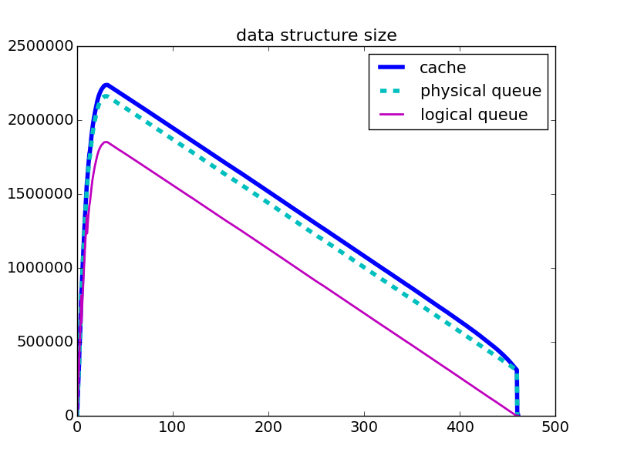

Slide 50
permutation map
supports permutation-aware gc
keys represent sets of prefixes equivalent up to a permutation
values stores index of best known (only) such prefix that has been evaluated, plus its lower bound
{ (1, 2, 3) : ( (3, 1, 2), 0.05 ) }
supports our permutation lower bound
note that (3, 1, 2) could be deleted from the cache

Slide 51
implementation details
Python useful for prototyping but ultimately slow, not memory-efficient, limited options for parallelism and custom data structures
initial rewrite in C++ with custom trie about 10x faster, 100x more cache elements
templates enable efficient modular exploration of many variants depending on different data structures
leverages library for fast bit vector operations based on GMP

Slide 52
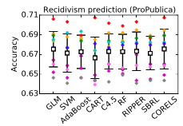
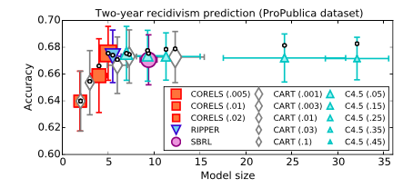
experiments
CORELS’ accuracy is just as good as other methods, both interpretable and non-interpretable
CORELS’ regularization prevents overfitting, allowing it to strike a good balance between accuracy and sparsity

Slide 53
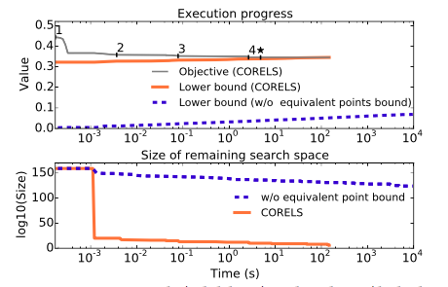
experiments
solid lines represent CORELS with the equivalent points bound, dashed lines represent CORELS without that bound.
top graph plots the objective value and the lower bound
bottom graph shows an upper bound on the size of the remaining search space

Slide 54
experiments
Removed Component | t_{total} (min) | t_{opt} _{(s)} | i_{total} (x10⁶) | Q_{max} (x10⁶) | K_{max}
CORELS | 5.5 (1.6) | 8 (2) | 1.7 (0.4) | 1.3 (0.4) | 5-6
priority queue | 6.7 (2.2) | 4 (1) | 1.9 (0.6) | 1.5 (0.5) | 5-6
support bounds | 10.2 (3.4) | 13 (4) | 2.7 (0.8) | 2.2 (0.7) | 5-6
table columns are: total execution time, time to optimum, number of queue insertions, maximum queue size, maximum evaluated prefix length
graphs show the number of prefixes in the queue at a given time, separated and colored by length

Slide 55
experiments
Removed Component | t_{total} (min) | t_{opt} _{(s)} | i_{total} (x10⁶) | Q_{max} (x10⁶) | K_{max}
CORELS | 5.5 (1.6) | 8 (2) | 1.7 (0.4) | 1.3 (0.4) | 5-6
priority queue | 6.7 (2.2) | 4 (1) | 1.9 (0.6) | 1.5 (0.5) | 5-6
support bounds | 10.2 (3.4) | 13 (4) | 2.7 (0.8) | 2.2 (0.7) | 5-6
symmetry-aware map | 58.6 (23.3) | 23 (6) | 16.0 (5.9) | 14.5 (5.7) | 5-6
table columns are: total execution time, time to optimum, number of queue insertions, maximum queue size, maximum evaluated prefix length
graphs show the number of prefixes in the queue at a given time, separated and colored by length

Slide 56
experiments
Removed Component | t_{total} (min) | t_{opt} _{(s)} | i_{total} (x10⁶) | Q_{max} (x10⁶) | K_{max}
CORELS | 5.5 (1.6) | 8 (2) | 1.7 (0.4) | 1.3 (0.4) | 5-6
priority queue | 6.7 (2.2) | 4 (1) | 1.9 (0.6) | 1.5 (0.5) | 5-6
support bounds | 10.2 (3.4) | 13 (4) | 2.7 (0.8) | 2.2 (0.7) | 5-6
symmetry-aware map | 58.6 (23.3) | 23 (6) | 16.0 (5.9) | 14.5 (5.7) | 5-6
lookahead bound | 71.9 (23.0) | 9 (2) | 18.5 (5.9) | 16.3 (5.3) | 6-7
table columns are: total execution time, time to optimum, number of queue insertions, maximum queue size, maximum evaluated prefix length
graphs show the number of prefixes in the queue at a given time, separated and colored by length

Slide 57
experiments
Removed Component | t_{total} (min) | t_{opt} _{(s)} | i_{total} (x10⁶) | Q_{max} (x10⁶) | K_{max}
CORELS | 5.5 (1.6) | 8 (2) | 1.7 (0.4) | 1.3 (0.4) | 5-6
priority queue | 6.7 (2.2) | 4 (1) | 1.9 (0.6) | 1.5 (0.5) | 5-6
support bounds | 10.2 (3.4) | 13 (4) | 2.7 (0.8) | 2.2 (0.7) | 5-6
symmetry-aware map | 58.6 (23.3) | 23 (6) | 16.0 (5.9) | 14.5 (5.7) | 5-6
lookahead bound | 71.9 (23.0) | 9 (2) | 18.5 (5.9) | 16.3 (5.3) | 6-7
equivalent pts bound | >134 | >7168 | >800 | >789 | >10
table columns are: total execution time, time to optimum, number of queue insertions, maximum queue size, maximum evaluated prefix length
graphs show the number of prefixes in the queue at a given time, separated and colored by length

Slide 58
current and future directions
tighter data-driven lower bounds
exploring space/time tradeoffs
parallel implementation
better scheduling policies?
other rule mining strategies?
approximate variants of the algorithm?

Slide 59
Questions?

Slide 61
Adult with a single clause performs well
Predict whether income > 50K
if (capital gains >= 7298) then (yes)
else if (never married) then (no)
else if (no longer with spouse) then (no)
else if (education = graduate school) then (yes)
else if (education = Bachelors) then (yes)
else (no)
All 10 cross-validation folds find this rule list
Regularization (c) = 0.01
Test accuracy = 0.8376 +/- 0.0045

Slide 62
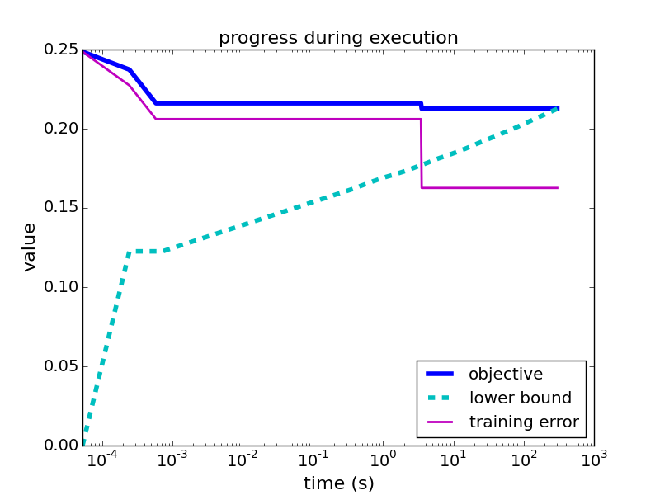

Slide 63
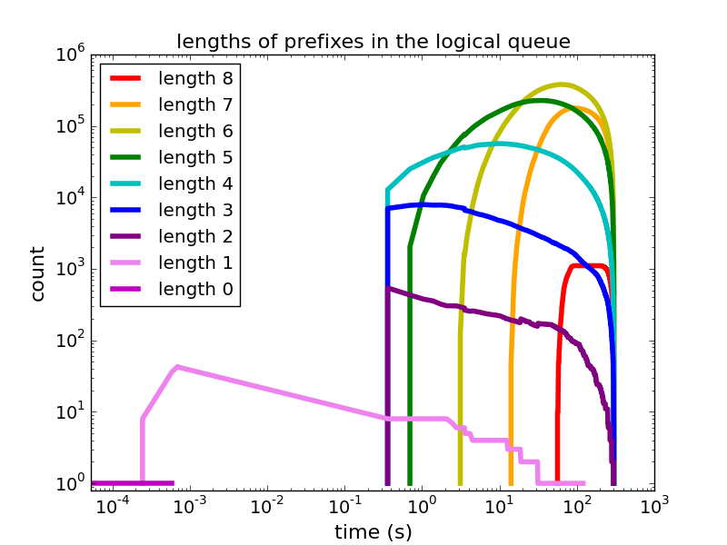

Slide 67
≈

Slide 68
≈

Slide 69
≈

Slide 70
≈

Slide 71
≈

Slide 72
≈

Slide 73
≈

Slide 74
≈

Slide 75
≈

Slide 76
summary of computations
≈
# states = 4 + (4x3) + (4x3x2) + (4x3x2x1) = 64
# evaluated states = 4 + (4x3) + (4x3) + 4 = 32

Slide 77
Will the person stay inside or go outside?
if (using computer) then predict (stay inside) else if (time is between 11PM-7AM) then predict (stay inside)
else if (sunny and not raining/snowing) then predict (go outside)
else if (temperature > 55 F) then predict (go outside) else predict (stay inside)
fast branch-and-bound for rule lists
incremental
parallel (?)
asynchronous (?)
global combinatorial optimization algorithm
(vs. greedy heuristics or random search)
human-interpretable machine learning
with a symmetry-aware cache
exploit problem structure
(permutations)
data structures to store & reuse computation

