Slide 1


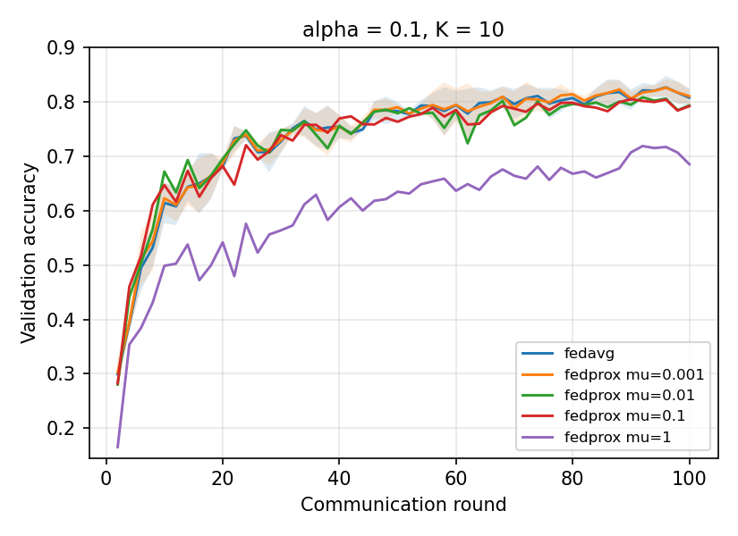
Privacy-Preserving Federated Learning for Distributed Skin Disease Classification
Key finding
Federated training matched the centralised model on IID data and lost about 6 points under severe label skew. FedProx did not reduce that loss beyond seed noise.
Alex Gu, supervised by Dr Ruihong Qiu and Prof Zi (Helen) Huang
School of Electrical Engineering and Computer Science, The University of Queensland | REIT4881 | alex.gu@student.uq.edu.au
Motivation
Method
Results
Why FedProx did not help
Skin disease classifiers need diverse photos, but those photos sit in separate hospitals. HIPAA and GDPR restrict pooling them.
Federated learning trains one model across sites. Each site trains on its own images and sends only model weights to a server, which averages them (FedAvg) [1].
Sites see different mixes of conditions, so local models drift apart. FedProx adds a penalty that pulls each local model back toward the global one [2].
Server averages client weights
IID data: federation matches centralised training
The penalty only acts when local models drift from the global model. Starting every client from ImageNet weights kept drift small, so μ = 0.001 behaved like FedAvg.
Larger μ held clients back with no drift to correct, so it only slowed training.
NIID-Bench [6] found the same across many non-IID splits.
Method | Test accuracy | Macro F1 | Rounds to 0.85
Centralised | 0.877 | 0.875 | n/a
FedAvg | 0.875 ± 0.001 | 0.873 ± 0.001 | 19.3 ± 1.2
FedProx (μ = 0.001) | 0.873 ± 0.002 | 0.872 ± 0.002 | 20.0 ± 2.0
global model
local weights
10 simulated clients. 5 chosen at random each round (orange).
Mean ± std over 3 seeds. Every 100-round run moved 44.8 GB of model weights between server and clients.
30 classes of clinical photos from a public Kaggle dataset [3]. Test set of 3,000 images, 100 per class, shared by every method.
ImageNet-pretrained ResNet-18 [4] for every method.
5 local epochs, batch 32, 100 rounds.
Label skew from a Dirichlet split [5] with α of 1.0, 0.5 and 0.1. Lower α means more skew.
FedProx μ from 0.001 to 1. Three seeds per setting.
Label skew: about 6 points lost at α = 0.1, FedProx tracks FedAvg
Site A
Site B
Site C
Conclusion
When fine-tuning a pretrained CNN on skin photos, plain FedAvg is enough. Under severe label skew, FedProx did not measurably close the gap.
Each bar is one condition. Every site sees a different mix, which is what non-IID means here.
Aims
Skew at α = 0.1
Limits and next steps
Measure how close FedAvg and FedProx get to centralised training on 30 skin conditions.
Measure how accuracy falls as label skew grows.
Test whether FedProx recovers what FedAvg loses and what it costs in communication.
8–27
45%
13×
Limited by one dataset and label skew only. Real hospitals also differ in cameras and lighting.
No privacy attack or defence was tested. Secure aggregation [7] and differential privacy should be tested.
Force drift with stragglers, random init or 20 local epochs to find where FedProx starts to help.
Mean over 3 seeds. At α = 0.1 the seed std is about 1.2 points, so FedProx's 0.5-point lead is noise.
Larger μ slows convergence. At μ = 1 (one seed) the model is still climbing at round 100, 10 points below FedAvg.
classes per client, out of 30
of client-class pairs are empty
size gap, largest to smallest client
References
[1] McMahan et al., AISTATS 2017. [2] Li et al., MLSys 2020. [3] M. A. Sami, Massive Skin Disease Balanced Dataset, Kaggle. [4] He et al., CVPR 2016. [5] Hsu et al., arXiv:1909.06335, 2019. [6] Q. Li, Diao, Chen and He, ICDE 2022. [7] Bonawitz et al., ACM CCS 2017.
Thanks to Laith Alzubaidi.
10 clients, seed 42. At α = 0.5 and 1.0 every client still holds at least 26 classes.
Notes:
ELEVATOR PITCH (about 30 s): Hospitals each hold a small, different set of skin disease photos, and privacy law stops them pooling it. Federated learning trains one model without moving the photos. I tested whether FedProx, a method built for uneven data, beats plain averaging on 30 skin conditions. It didn't. Severe skew cost about six points either way, because a pretrained model barely drifts.
WALKTHROUGH (about 2 min): Motivation and the three sites. Aims. Method diagram: 10 clients, 5 per round, server averages. Skew stats show what alpha 0.1 does to the data. Results table: IID federation is within 0.2 points of centralised. Chart: no loss until alpha 0.1, then about 6 points, same for both methods. Mu curves: bigger mu only slows things. Why: pretrained start means little drift, matches NIID-Bench. Conclusion and limits.
LIKELY QUESTIONS: Where is the privacy in the title? Is 6 points significant given seed std? Why did more clients help at alpha 0.1? Why not SCAFFOLD or FedNova?

