Slide 1
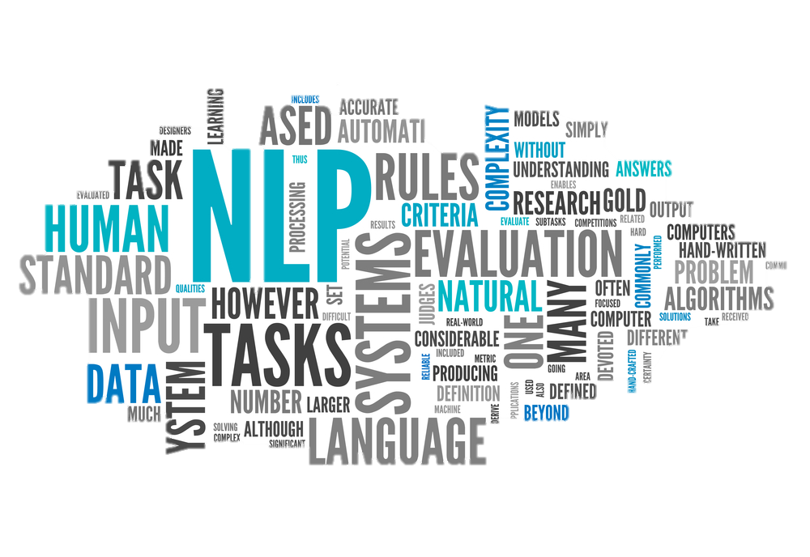
Applied Natural Language Processing
Final project
Dr. Rachel Shapira

Slide 2
Project Grade Breakdown
5% – Project Proposal: Submit a 0.5-1 page document defining the project goal, reviewing relevant work, preparing a plan, and describing the intended final outcome. Deadline: 7.1.25.
5% – Mid-Project Progress Report: Provide a brief update on the progress made, challenges encountered, and next steps planned. Deadline: 23.1.25.
40% – Project Code and Results:
Quality of the code, including comments, structure, and ease of execution.
Clear and concise instructions for running the code.
Results derived from the code's execution.
40% – Project Handout: Submit a 3-4 page handout that includes:
A description of the project and the data used, including basic analysis.
A detailed explanation of the model, chosen metric, and results.
Suggestions for future work and improvements.
Final submission deadline: 6.2.25.
10% – Live Presentation: Deliver a live presentation of your project, including key highlights such as the problem addressed, methodology, results, and conclusions. Presentation Date: 4-6.2.25.

Slide 3
Project Proposal- Content Expectations
Project Goal: Clearly state what the project aims to achieve. Ensure the goal is specific, measurable, and aligned with the overall objectives of the course.
(Optional) Relevant Work: Provide a brief review of similar projects, research papers, or methodologies related to your topic. Highlight what makes your project unique or how it builds upon this work.
Project Modules and Team Responsibilities:
Define the modules or components of the project, ensuring that the number of modules matches or exceeds the number of team members.
Each module should represent a distinct part of the project and focus on different techniques, models, or approaches. Examples of modules could include: Implementing a RNN or LSTM, Using a Transformer model (e.g., BERT or GPT), Applying unsupervised learning techniques, such as clustering or dimensionality reduction, Developing a web crawler to collect data for training and analysis, Leveraging Large Language Models (LLMs) for zero-shot or few-shot tasks and more.
Describe how these modules will integrate to form the final project..
Final Outcome: Describe the expected deliverables (e.g., a trained model, analysis report, or interactive tool) and how you plan to evaluate the project's success.

Slide 4
You can start by selecting the data
find an interesting dataset to use on the different approaches we learnt in class.
How to get the data:
Collect it your self (preferred): scrape some relevant websites, collect manually, collaborate with someone who owns the data.
Get data from the web:
Kaggle
Papers with code
Hugging Face
Other places like:
• https://machinelearningmastery.com/datasets-natural-language-processing/
• https://github.com/niderhoff/nlp-datasets

Slide 5
interesting datasets
Squad1.1 (Question Answering)
https://rajpurkar.github.io/SQuAD-explorer/explore/1.1/dev/
https://paperswithcode.com/dataset/squad (data loaders)
WMT (Workshop on Machine Translation)
Example (2019): https://huggingface.co/datasets/wmt19

Slide 6
Get inspiration from articles
Where to look?
Google scholar (search for specific tasks and papers that have a lot of citations)
NLP benchmarks (see/: https://nlpprogress.com)
Papers with code (see: https://paperswithcode.com/)
Example project:
Generating Gender Augmented Data for NLP

Slide 7

Paperswithcode Datasets
https://www.paperswithcode.com
/datasets?mod=texts&page=1

Slide 8
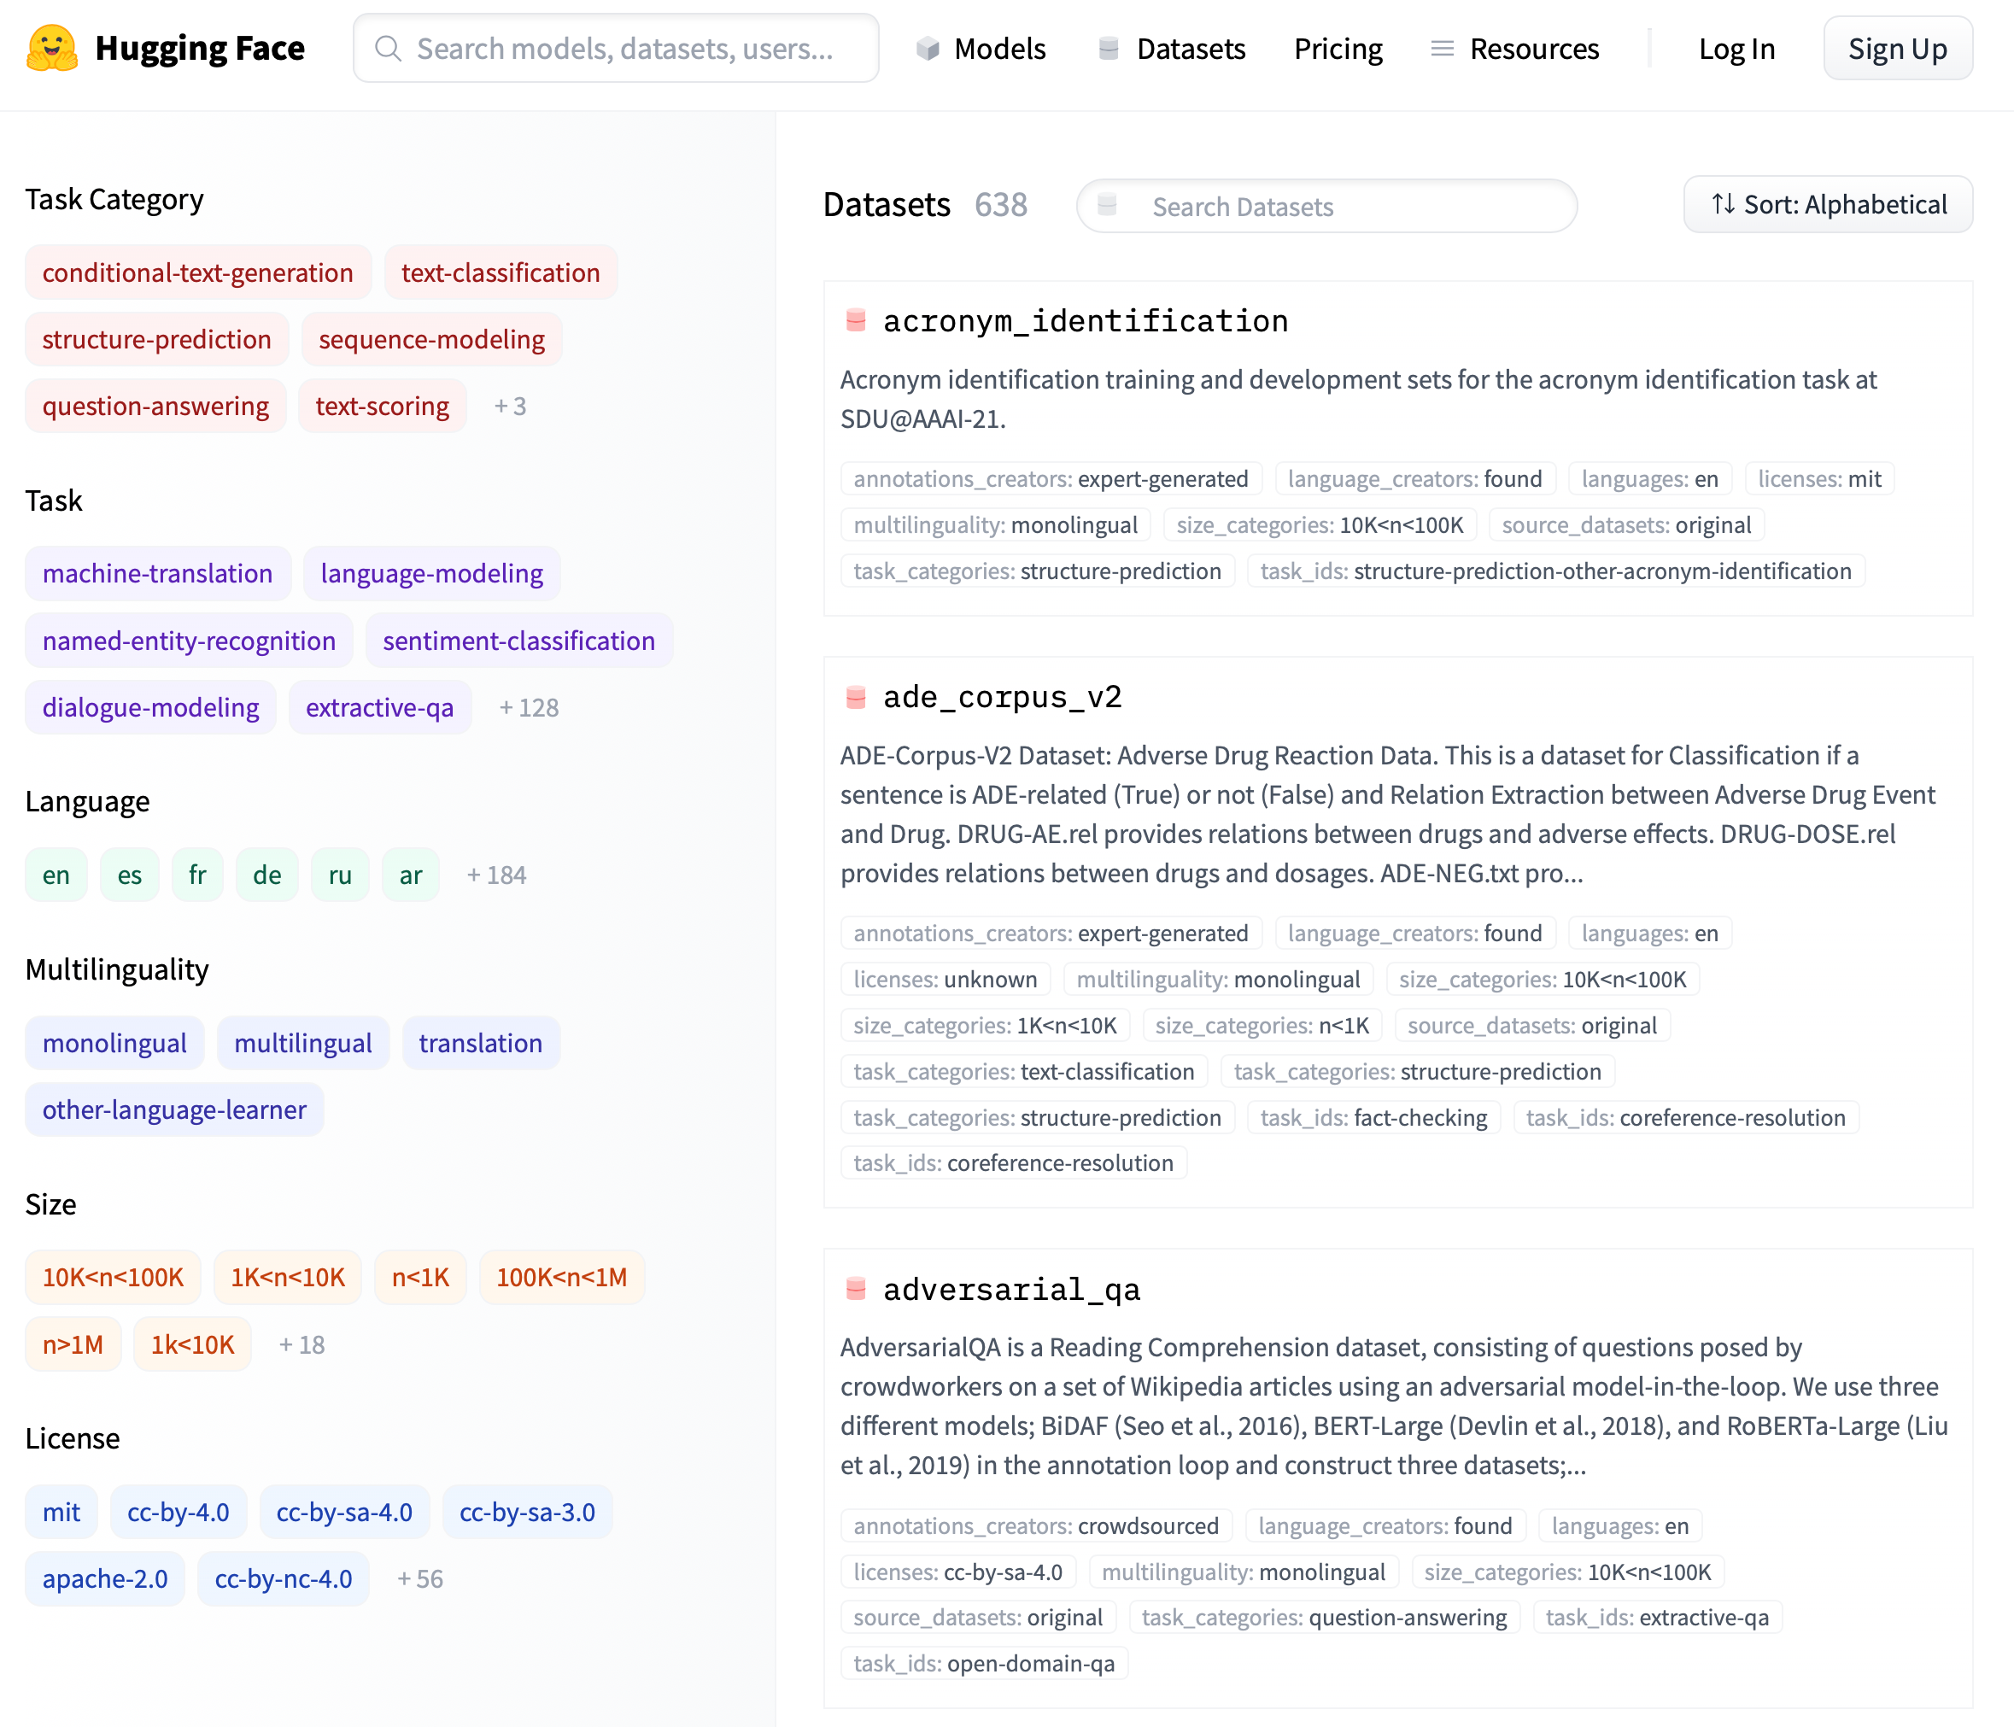
Huggingface Datasets
https://huggingface.co/datasets

Slide 9
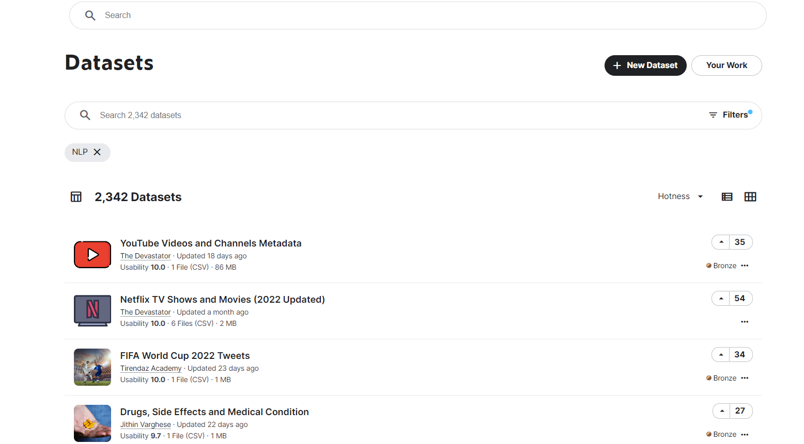
Kaggle Datasets
https://www.kaggle.com/datasets?tags=13204-NLP

Slide 10
More inspiration
One shot learning
AI with Noor
Machine Learning Projects
InsightsByRish

Slide 11
Resources
https://spacy.io/
Excellent open-source library
Tokenization, NER, Sentiment Analysis, Word Vectors, Transformers and much more
https://stanfordnlp.github.io/stanza/
Contains all sorts of NLP pipelines (NER, Dependency parsing, Sentiment Analysis and more)
https://huggingface.co/
Excellent resources for SOTA models (with easily accessed API)
Can sort models by tasks, library and language
Sorted by popularity, usage, etc.

Slide 12
#1 Project Example: Domain-Specific Chatbot for Personal Questions About Course Material
Potential Modules:
Intent Recognition: Identify the intent behind personalized questions (e.g., "What topics should I review?", "How do I improve on X?", "Explain concept Y").
Implement and compare RNN-based models (e.g., LSTMs or GRUs) trained on embeddings like Word2Vec or GloVe.
Response Generation: Design the response system to handle diverse personal queries:
Generative Responses: Use LSTM-based sequence-to-sequence models to dynamically generate personalized responses based on the user’s query and course data.
Unsupervised analysis focuses on extracting meaningful patterns, clusters, or topics from user input without the need for labeled data. Techniques like clustering, topic modeling (e.g., LDA), or keyphrase extraction (e.g., TF-IDF) enable the chatbot to dynamically identify relevant concepts, such as assignments or exam dates, and improve its responses.
Transformers for Personalization: Experiment with basic transformer models (e.g., BERT or DistilBERT):
Use transformers for intent recognition to compare accuracy with RNN-based methods.
Fine-tune transformers or use few shots learning for personalized response generation
Personalized Context Module: Build a context-tracking module using RNNs or transformers to maintain conversational flow and provide responses based on the student’s history or progress (e.g., "Last week you struggled with X, here’s a quick review.").

Slide 13
#2 Project Example: Analyzing the National Mood in Israel Through Text
1. Data Collection: choose your source (working with Hebrew, is a challenge! (also Arabic…)
Social Media Platforms: Twitter, Facebook, Telegram (public posts or hashtags related to current events like #Israel, #War, #Solidarity).
News Headlines: Scrape headlines from Israeli news outlets (e.g., Ynet, Haaretz).
Public Comments: Analyze responses to public figures or government announcements.
Languages: 2. Preprocessing:
Text Cleaning: Normalize text by handling abbreviations, slang, and mixed Hebrew-English content.
Tokenization: Use word or subword tokenization (e.g., with multilingual models like mBERT or AlephBERT for Hebrew).
Translation (Optional).
3. Feature Representation: Use modern embedding techniques to represent text
BERT Models: Fine-tune AlephBERT or mBERT for Hebrew and multilingual text embeddings.
Sentence Embeddings: Use models like Sentence-BERT to represent entire sentences or documents.
4. Classification
Emotional Labels: Define mood categories such as: "Fear," "Anger," "Hope," "Solidarity," "Sadness," "Frustration."
Model Choices:
Start with basic classifiers like Logistic Regression or Random Forest.
Progress to deep learning models like LSTM, BiLSTM, or transformers for more nuanced classification.
Multilingual Classification: Fine-tune multilingual models like mBERT to handle Hebrew, Arabic, and English text seamlessly.
5. Time-Series Analysis: Aggregate results over time to track mood trends:
Example: Analyze daily or weekly shifts in sentiment based on public events (e.g., escalation of conflict, ceasefire announcements).
Visualize mood fluctuations using graphs or heatmaps.

Slide 14
#3 Project Example: Text Analysis and Generation on Song Lyrics
Data Collection:
Scraping: Develop a web scraper to collect lyrics from publicly available sources, targeting 1.2 million songs categorized by genre (e.g., pop, rock, hip-hop).
Cleaning: Process and clean the scraped data to remove duplicates, unwanted symbols, and incomplete entries.
Linguistic Analysis: Perform various analyses to extract insights from the lyrics: Word Frequency, Lexical Complexity, Sentiment Analysis, Stylistic Patterns: Explore rhyme patterns, word length, and line structures.
Deep Learning Language Model:
Train an LSTM or GRU-based language model using the lyrics, with genres as conditional input.
The model can be trained using character-based or word-based tokenization to explore different granularities of text representation.
Fine-tune the model to generate genre-specific lyrics (e.g., upbeat lyrics for pop, introspective lines for blues).
Experimentation:
Compare performance with simpler models like MLPs or more advanced architectures like transformers (optional).
Generate lyrics for genres outside the training data to test the model's creativity.

Slide 15
#4 Project Example: Multimodal Recipe Generator
1. Textual Prompt Understanding: Process user-provided prompts to understand preferences, cuisine type, or dietary restrictions.
2. Recipe Generation: Generate a step-by-step recipe using the structured input.
Implementation:
Use Deep Learning techniques (e.g., LSTMs, GRUs) to extract and analyze key information from prompts.
Experiment with Transformer-based models (e.g., BERT) for more advanced language understanding.
Explore unsupervised methods such as clustering or topic modeling (e.g., Latent Dirichlet Allocation, Word2Vec embeddings) to group and extract preferences without labeled data.
Example: Input: "Italian cuisine, tomatoes, garlic, basil, pasta" → Output: A structured recipe for Spaghetti Pomodoro.
3. Nutritional Analysis: Calculate nutritional information based on the ingredient list.
Implementation:
Use publicly available food nutrition databases (e.g., USDA FoodData Central).
Build a module to estimate calories, macronutrients (protein, carbs, fats), and micronutrients (vitamins, minerals).
Display this information alongside the recipe as an additional feature.
Example: Calculate that the Spaghetti Pomodoro recipe contains 400 calories, 15g protein, 60g carbs, and 10g fat per serving.
.

Slide 16
My dataset is not labeled! What should I do?
1. Generate Pseudo-Labels
Create labels for your dataset programmatically or semi-manually using the following techniques:
Heuristics: Define rules to assign pseudo-labels.
Example: If the text contains "pasta," assign it the pseudo-label "Italian cuisine."
Clustering with Manual Annotation: Cluster your data into groups and manually assign a label to each cluster.
Example: Group recipes into clusters like "desserts" or "main courses" based on ingredient patterns.
Self-Supervised Learning: Train models to predict aspects of your data based on context.
The idea is to create a pretext task that trains the model to learn meaningful representations of the data based on its inherent structure. This is different from rule-based systems, as the model discovers patterns and relationships in the data rather than relying on predefined heuristics.
Example: Mask certain words (e.g., "garlic") and train the model to predict them based on surrounding words.
2. Use Pre-trained Models
3. Unsupervised Learning Approaches
4 Semi-supervised.

Slide 17
Training Neural Networks- tips
1. Right at the beginning, separate off dev-test and test data splits
2. Define your metric(s):
• Search online for well established metrics on this task
• Human evaluation is still much better for summarization
• You may be able to do at least a very small-scale human eval – ask some friends
3. Establish a baseline
• Implement the simplest model first (e.g., logistic regression on unigrams and bigrams or averaging word vectors)
• Compute metrics on train AND dev NOT test
• Analyze errors
• If metrics are amazing and no errors:
• Done! Problem was too easy. Need to restart. J/L

Slide 18
Training Neural Networks-tips
4. Implement existing neural net model
• Compute metric on train and dev
• Analyze output and errors
5. Always be close to your data! (Except for the final test set!)
• Visualize the dataset
• Collect summary statistics
• Look at errors
• Analyze how different hyperparameters affect performance
6. Try different models:
Fixed Window FC networks
RNNs/LSTMs with or without attention
Simple Transformers

Slide 19
Overfitting
• When training, models overfit to what you are training on
• The model correctly describes what happened to occur in particular data you trained on, but the patterns are not general enough patterns to be likely to apply to new data
• The way to monitor and avoid problematic overfitting is using independent validation and test sets …
• Ensure your training, validation, and test sets are balanced (e.g., equal class distribution) to avoid bias in performance metrics.

Slide 20
Overfitting and fine-tuning: Big Data
Split your data into training, tuning, dev, and test sets:
60% training, 20% tuning/dev, 20% test (example proportions).
Train your model on the training set.
Use the tuning set to adjust hyperparameters (e.g., Activation Functions, learning rate, number of layers, Batch Size, Dropout Rate).
Use the dev set to monitor progress and decide when to stop training.
At the very end, evaluate the final model on the test set.
• Use the final test set extremely few times … ideally only once

Slide 21
Overfitting and fine-tuning
• The train, tune, dev, and test sets need to be completely distinct
• It is invalid to test on material you have trained on
• You will get a falsely good performance.
• We almost always overfit on train: A model might memorize specific examples in the training set instead of learning generalizable patterns.
• You need an independent tuning set
• The hyperparameters won’t be set right if tune is same as train
• If you keep running on the same evaluation set, you begin to overfit to that evaluation set.
• Effectively you are “training” on the evaluation set … you are learning things that do and don’t work on that particular eval set and using the info
• If you've used the dev set extensively, you might want a second, untouched validation set (Dev2) to ensure your choices haven't overfit to the original dev set.
• To get a valid measure of system performance you need another untrained on, independent test set … hence dev2 and final test.

Slide 22
Experimental strategy
• Work incrementally!
• Start with a very simple model and get it to work!
• It’s hard to fix a complex but broken model
• Add bells and whistles (e.g., layers, regularization, or advanced architectures) one-by-one and get the model working with each of them (or abandon them)
• Initially run on a tiny amount of data
• You will see bugs much more easily on a tiny dataset. You can manually inspect predictions and understand what’s happening.
• Something like 4–8 examples is good
• Often synthetic data is useful for this (artificially created data that you control).
• Make sure you can get 100% on this data
• Otherwise, your model is definitely either not powerful enough or it is broken

Slide 23
Experimental strategy
• Train and run your model on a large dataset
• It should still score close to 100% on the training data after optimization
• Otherwise, you probably want to consider a more powerful model!
• Overfitting to training data is not something to be scared of when doing deep learning
• These models are usually good at generalizing because of the way distributed representations share statistical strength regardless of overfitting to training data
• But, still, you now want good generalization performance:
• Regularize your model until it doesn’t overfit on dev data
• Strategies like L2 regularization can be useful
• But normally generous dropout is the secret to success

Slide 24
Workflow for Model Development
Start Simple: Build a basic model (e.g., a single-layer neural network or logistic regression).
Train it on a tiny dataset (4–8 synthetic examples) and ensure it achieves 100% accuracy to debug the implementation.
Scale Up: Train the model on the full training dataset.
Ensure the model fits the training data well (close to 100% accuracy).
If it fails, increase model capacity (e.g., add layers or neurons).
Tune Hyperparameters:
Use a tuning set (independent of the training set) to optimize hyperparameters like learning rate, batch size, and number of layers.
Adjust hyperparameters until performance on the tuning set improves, without touching the dev set.
Monitor Generalization:
After tuning, evaluate the model on the dev set to track performance on unseen data.
The dev set is used to assess how well the model generalizes, but no parameter or hyperparameter adjustments should be made based on this set.
Iterate: Gradually increase model complexity (e.g., layers, embeddings, or features).
Re-train and validate after each modification, using the tuning set for hyperparameter adjustments and the dev set for generalization monitoring.
Final Evaluation: Once the model performs well on the dev set, evaluate it on an untouched test set.
Use the test set sparingly (ideally only once) to get an unbiased measure of real-world performance.

