Slide 1

K-Nearest Neighbours (KNN)

Slide 2
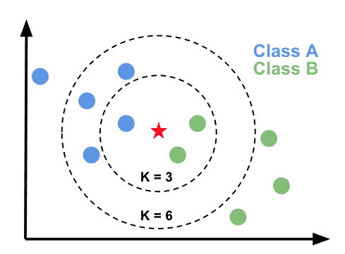
Conceptually, KNN is amongst one of the more basic (albeit situationally powerful) machine learning models.
It relies on the idea that similar data points tend to have similar labels or values.
It can be used for both classification (binary and multi-class) and regression – just like decision trees.

Slide 3
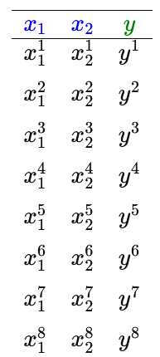
Assume that we have a dataset with two features and one target.
...
The target can be anything, but assume that it is binary in this case and that we thus want to train a classifier model to predict class, given the features.

Slide 4
Class 0
Class 1
Since we only have two features, we can plot the whole training dataset

Slide 5
Ok, cool. We’ve now plotted our whole training dataset.
Assume now that we have a new, unseen sample that we want to classify
Class 0
Class 1
?
How should we classify it?

Slide 6
It’s actually very simple. KNN classfies new samples according to the majority class of it’s k-nearest neighbours (just as the name suggest)
Class 0
Class 1
Class 1
So, for example. If we choose k = 1 we simply classify our sample according to the absolute nearest neighbour.
In this case, we get Class 1

Slide 7
It’s actually very simple. KNN classfies new samples according to the majority class of it’s k-nearest neighbours (just as the name suggest)
Class 0
Class 1
Class 1
So, for example. If we choose k = 4 we chose the majority class of the 4 nearest neighbours.
In this case, we also get Class 1
The number k is a hyperparameter that you need to tune and find the optimal number for!

Slide 8
Having a too low number for k can lead to severe overfitting.
Assume that we have k = 1 again.
Class 0
Class 1
Class 0

Slide 9
Having a too high number for k can instead lead massive underfitting, and a really useless model.
Class 0
Class 1

Slide 10
KNN works equally well for multi-class classification!
Class 0
Class 1
Class 2
Class 2

Slide 11
As promised, it works equally well for regression aswell!
In that case, the prediction will simply be the average of the k nereast neighbours.

Slide 12
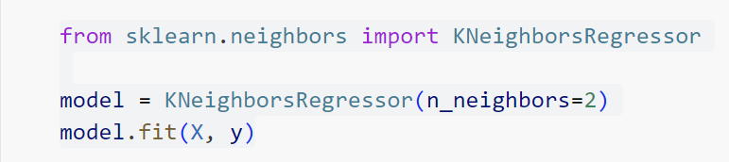
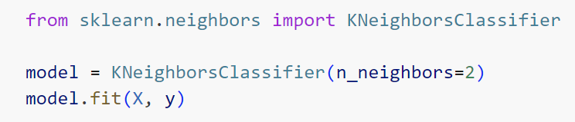
Practically using KNN is as simply as any other model in scikit-learn.
As with other models, this is where you also set your hyperparameters.
Regression
Classification
Read more about these at the respective scikit-learn documentation page!

Slide 13
Some important points…

Slide 14
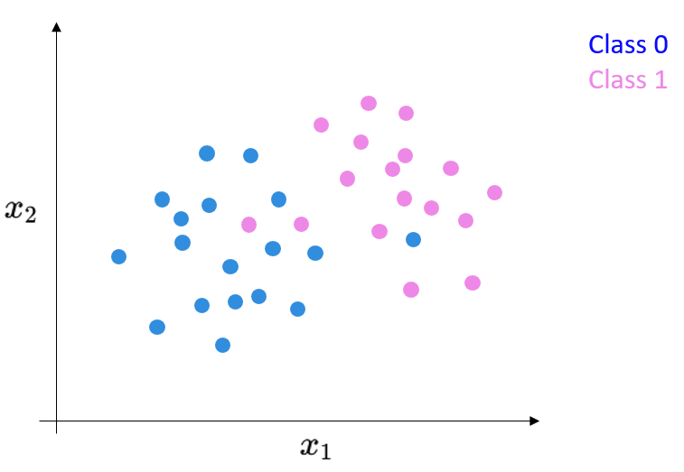
How does KNN training work? Well, the KNN-algorithm actually memorizes the whole training set. It has to do it, since this is the only way for it to be able to calculate the nearest neighbours for a new unseen sample.
KNN is a so-called lazy learner since it doesn’t learn any weights (as with linear and logistic regression) or good questions to ask (as with trees). It simply memorizes the training set.

Slide 15
Three more points
You can of course use additional features, not only two. In fact, you can use as many as you want. We just used two for demonstrative purposes here.
When using KNN-models, you must conduct feature scaling! This is the first family of models we’ve encountered that truly requires it. The reason is that KNN is purely distance based, and large differences in feature scale can really mess things up
KNN can only handle numeric features

Slide 16
Överkurs
If you want even more!

Slide 17
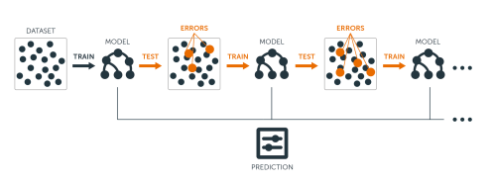
Last week, we learned about tree-based models. This week, you’ll have the opportunity to dig deeper into them.
Try finding resources and learn about how AdaBoost works
Model interpretability is an important aspect, and we’ll talk more about this later. Until then, try looking for resources on interpretability in machinel learning to understand it better.
On the same theme as above, you can also learn more about the model Explainable Boosting Machines. This is a really popular, and powerful, tree based model which is also super interpretable.

