Slide 1

Simple Operations
Notes:
You have seen basic python data types and type conversions so far. I would like to show you how we use these types in some python operations such as :

Slide 2
Table of Contents
Arithmetic Operations
Escape Sequences

Slide 3
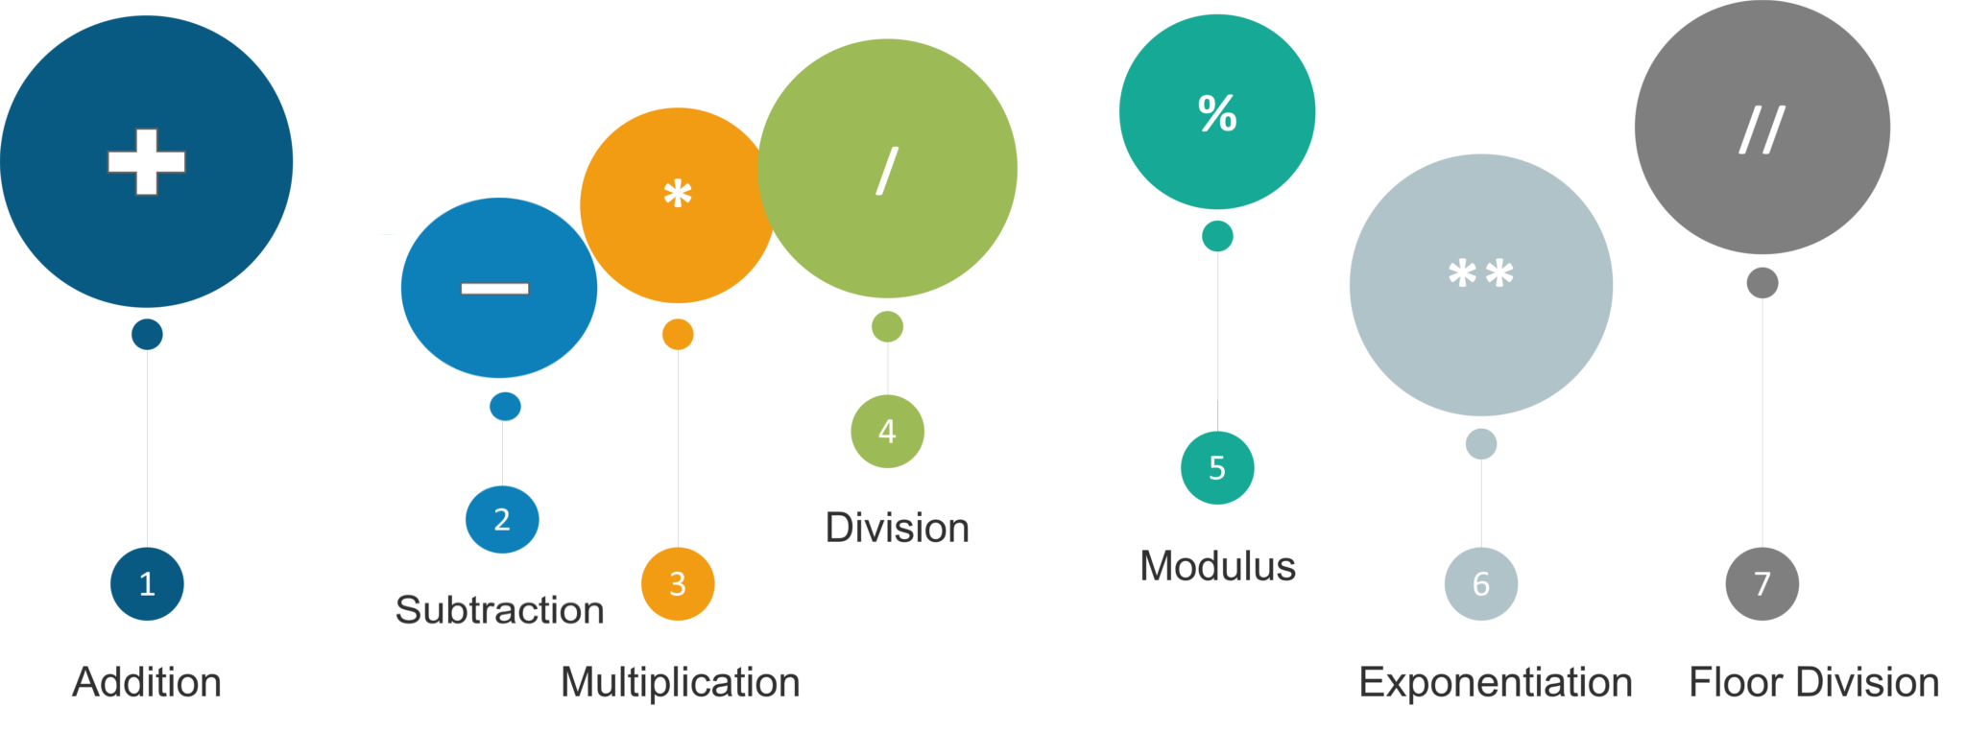
Arithmetic Operations
Notes:
In Python, there are almost all of the arithmetic operations we use in mathematics. They are so simple to use and we can also use these operations on almost all data types, including string. You are gonna see How we do that. it is obvious, right? then I want you to complete this interactive matching question then.

Slide 4
Arithmetic Operations
Operator | Description | Example
+ | Addition operator | 100 + 45 = 145
- | Subtraction operator | 500 - 65 = 435
* | Multiplication operator | 25 * 4 = 100
/ | Float Division Operator | 10 / 2 = 5.0
// | Integer Division Operator | 11 // 2 = 5
** | Exponentiation Operator | 5 ** 3 = 125
% | Remainder Operator | 10 % 3 = 1
Notes:
Here are some mathematical operations with numbers
a hundred plus forty five
five hundred minus sixty five… and it is used very often for selecting even and odd numbers..
twenty five times four is equals to one hundred
ten divided by two is equals float five. by the way, division operations always return float type.
the integer part of eleven divided by two is five.
5 to the power of 3 equals a hundred twenty five
ten modulus 3 which means the remainder of ten divided by 3 is 1

Slide 5
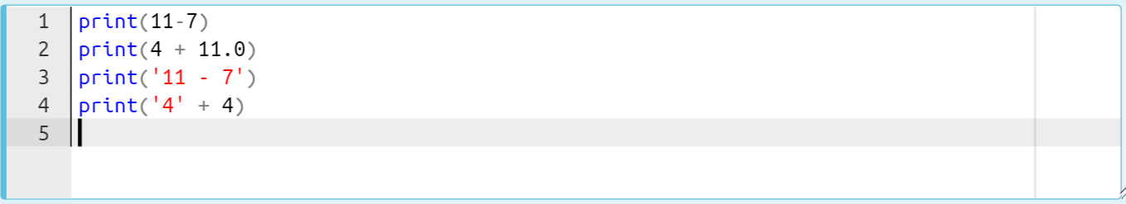
Arithmetic Operations
Interactive question :
Notes:
Let’s grasp these operations through several examples:
print(11-7)
print(4 + 11.0)
print("11 - 7")
print("4" + 4)

Slide 6
Arithmetic Operations
The output :
4
15.0
11 - 7
Traceback (most recent call last):
File "code.py", line 5, in <module>
print('4'+ 4)
TypeError: can only concatenate str (not "int") to str
Notes:
When we run the output is .. there 3 lines of output and the last line raised an error due to the wrong addition of integer and string type. addition operation works with same type of value. you must have know that when we use addition sign with strings we concatenate them. which means we stick them together.
print(11-7)
print(4 + 11.0)
print("11 - 7")
print("4" + 4)

Slide 7
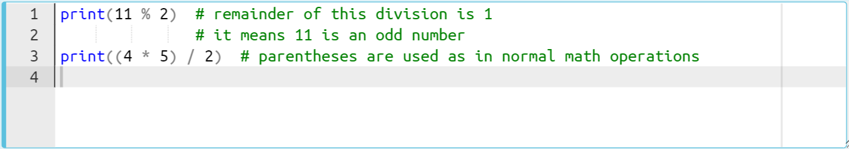
Arithmetic Operations
Interactive question :
Notes:
In this exercise, I would like to emphasize the importance of the modulus. We use it very often in our real life projects. In general we use modulus with the number two in order to detect odd and even numbers. how we do that? Can anyone tell how we do this with the modulus in Python? Yess if a number divided by two using modulus and if the result is 1 then the number is odd and if the result is zero then the number is even. Because even numbers do not leave a remainder when divided by two.
print(11 % 2)
print((4 * 5) / 2)

Slide 8
Arithmetic Operations
The output :
1
10.0
Notes:
print(11 % 2)
print((4 * 5) / 2)

Slide 9
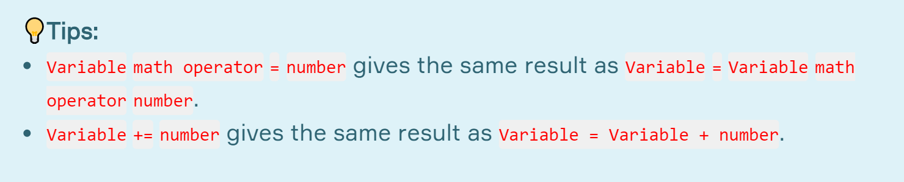
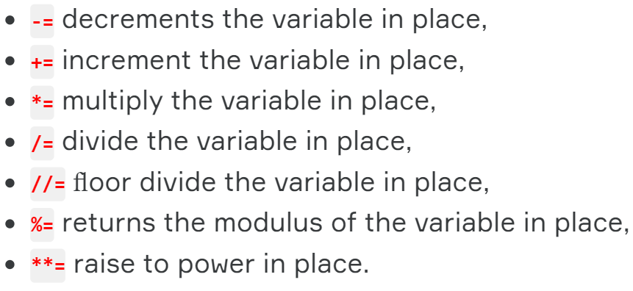
Arithmetic Operations
x += 3 ⇐⇒ x = x + 3
x *= 3 ⇐⇒ x = x * 3
x **= 3 ⇐⇒ x = x ** 3
Notes:
All arithmetic operators can be used in the same way.

Slide 10
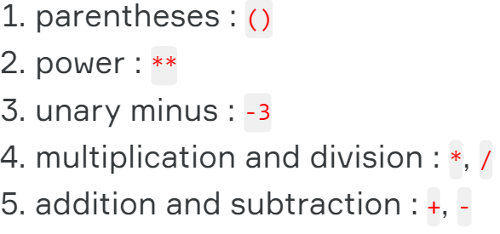
Arithmetic Operations
⚠
Notes:
Keep in mind this list of priorities for all considered operations
Unary Minus
“-” is used for two purposes. In some contexts, - is the unary minus operator. In other contexts, - is the subtraction operator.
The unary minus is used to show a negative number. For example:
-97.34
means "negative ninety seven point thirty four." The subtraction operator is used to show a subtraction of one number from another. For example:
95 - 12
asks for 12 to be subtracted from 95.
The unary minus operator has high precedence. Addition and subtraction have low precedence. For example
-12 + 3
means add 3 to negative 12 (resulting in -9). The unary minus is done first, so it applies only to the twelve.
unary plus + can be applied to a number to show that it is positive. It also has high precedence. It is rarely used.

Slide 11
Arithmetic Operations
Interactive question :
a = (1 + 3 ) ** (2 ** (1 * 2 / 2) / 2)
print(a)
Notes:
So by keeping in mind this priorities, let’s solve this example Without using any Interpreter or IDLE, just calculate the result please in your mind.
I wanna see your responses via pear deck as well.
a = (1 + 3 ) ** (2 ** (1 * 2 / 2) / 2)
print(a)

Slide 12
Arithmetic Operations
The output :
a = (1 + 3 ) ** (2 ** (1 * 2 / 2) / 2)
print(a)
4.0
Notes:
Let’s remember the priorities of arithmetic operations. First parenthesis.
so we have two to power of one division by two. Here, the priority belongs to power operator. So we calculate two to power of 1 and then we divide the result by two, so we calculated the big parenthesis and it becomes the power of the other small parenthesis which is four. so the result is four to power of float one
a = (1 + 3 ) ** (2 ** (1 * 2 / 2) / 2)
print(a)

Slide 13
Escape Sequences
\n
\t
\b

Slide 14
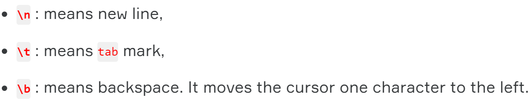
Escape Sequences (review)
Python ignores any character which comes immediately after \ .
Notes:
👉🏻 \ is a special sign used in expressions called escape sequences, which behaves according to the character immediately after 👉🏻 \. if a special character comes after backslash then python ignores the specification of this special character. Here are basic escape sequences in Python:

Slide 15
Escape Sequences, Quiz
Let’s take a closer look at the escape sequences through the examples.
print('we are', '\boosting', 'our', '\brotherhood')
print('it\'s essential to learn Python\'s libraries in IT World')
print('C:\\north pole\noise_penguins.txt')
print('first', 'second', 'third', sep='\t')
Notes:
brainstorming....
how this output displayed. examine them carefully
print('we are', '\boosting', 'our', '\brotherhood')
print('it\'s essential to learn Python\'s libraries in IT World')
print('C:\\north pole\noise_penguins.txt')
print('first', 'second', 'third', sep='\t')

Slide 16
Escape Sequences, Quiz
Let’s take a closer look at the escape sequences through the examples.
print('we are', '\boosting', 'our', '\brotherhood')
print('it\'s essential to learn Python\'s libraries in IT World')
print('C:\\north pole\noise_penguins.txt')
print('first', 'second', 'third', sep='\t')
we areoosting ourrotherhood
it's essential to learn Python's libraries in IT World
C:\north pole
oise_penguins.txtfirst second third
Notes:
brainstorming....
how this output displayed. examine them carefully
Normally when we use 👉🏻' inside the 👉🏻' ', Python will give error. Because single-quote in single quotes gives an error. But here, in the example below, 👉🏻\ allows single-quote 👉🏻' to be ignored. So it gives no error.
print('we are', '\boosting', 'our', '\brotherhood')
print('it\'s essential to learn Python\'s libraries in IT World')
print('C:\\north pole\noise_penguins.txt')
print('first', 'second', 'third', sep='\t')

Slide 17
Boolean Operations
Notes:
Hello. How are you guys. I see and follow your correspondence and messages from channels. I think you have achieved a very good Synergy. I follow your good work about your python assignments and your codes. Continue like this. interactive way of working together will be very useful to you. Believe it. ok anyway.
Yess. We keep learning data types. This time we are gonna go to deeper of Boolean types that you’ve learned. As I stated before, my friends, you have to learn this topic well. It is Really important python or even programming concept that you will deal with in your career.

Slide 18
Table of Contents
Boolean Logic Expressions
Order of Priority
Truth Values of Logic Statements
Notes:
So what we have here...

Slide 19
Boolean Logic Expressions
not
or
and
Notes:
Let’s take a quick review, if you want. As we learned in the previous lesson boolean or bool can only have two values. What were they? True and False.
To put it easily, we can say that bool represent 1 and 0. let me put it in a different word, yes & no or exist & nonexistent can be expressed by bool type.
For example, let's define a variable as to whether students have passed a course. Let the variable be called is_pass. Then;
If you pass the course : is_pass = True,
If you did not pass the course : is_pass = False

Slide 20
Boolean Logic Expressions
There are three built-in operators in Python :
It evaluates all expressions and returns the last expression if all expressions are evaluated True. Otherwise, it returns the first value that evaluated False.
and
It evaluates the expressions left to right and returns the ﬁrst value that evaluated True or the last value (if none is True).
or
It evaluates the expression that follows it as the opposite of the truth. eg. not True means False
not
Notes:
Ok then. Let’s move on! What we have here is that Boolean Logic Expressions. My friends, these definitions are key knowledge for setting boolean algorithms in python. Let’s read them together one by one. and operator : if there is no false then the last expression is your result. if there are any false, which means at least one false then the first false is your result. how it works we are gonna see in jupyter soon. let’s jump to or operator : it has opposite logic of and operator. that is : if all values is False then the result is the last one from left to right. if there there is any true value, the first True is your result.

Slide 21
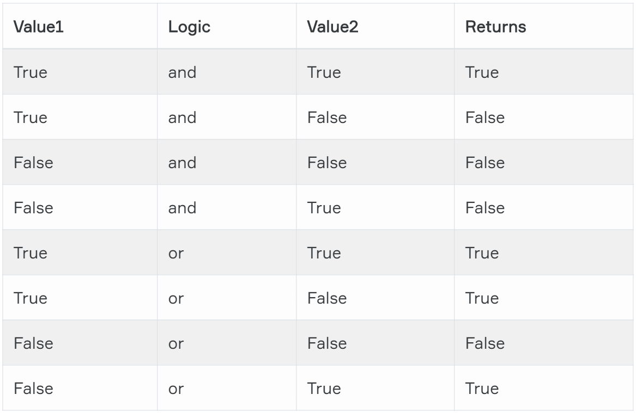
Boolean Logic Expressions
Table of Logic Expressions in Python :
It’s better to keep this table in mind.
Notes:
logic = 'True' and 3 or not [] or 0
print(logic)

Slide 22
Order of Priority
Notes:
Yes my friend. Think of that we have all three boolean logic operator at a same time in a code line. How the python behave these operator is related to their priority. What I am trying to say is that they have order of priority.

Slide 23
Order of Priority
Here are the operators in order of their priorities :
1. not
2. and
3. or
Notes:
It is important to remember that, logical operators have a different priority and it has an effect on the order of evaluation.

Slide 24
Order of Priority
It is important to remember that, logical operators have a different priority and it has an effect on the order of evaluation.
Here are the operators in order of their priorities :
1. not
2. and
3. or
bool_var = False and not True
print(bool_var)
Notes:
bool_var = False and not True
print(bool_var)

Slide 25
Order of Priority
It is important to remember that, logical operators have a different priority and it has an effect on the order of evaluation.
Here are the operators in order of their priorities :
Firstly evaluated. The result = False
1. not
2. and
3. or
bool_var = False and not True
print(bool_var)
Notes:
bool_var = False and not True
print(bool_var)

Slide 26
Order of Priority
It is important to remember that, logical operators have a different priority and it has an effect on the order of evaluation.
Here are the operators in order of their priorities :
Secondly evaluated. False and False = False
Firstly evaluated. The result = False
1. not
2. and
3. or
bool_var = False and not True
print(bool_var)
Notes:
bool_var = False and not True
print(bool_var)

Slide 27
Order of Priority
It is important to remember that, logical operators have a different priority and it has an effect on the order of evaluation.
Here are the operators in order of their priorities :
Secondly evaluated. False and False = False
Firstly evaluated. The result = False
1. not
2. and
3. or
bool_var = False and not True
print(bool_var)
False
Notes:
bool_var = False and not True
print(bool_var)

Slide 28
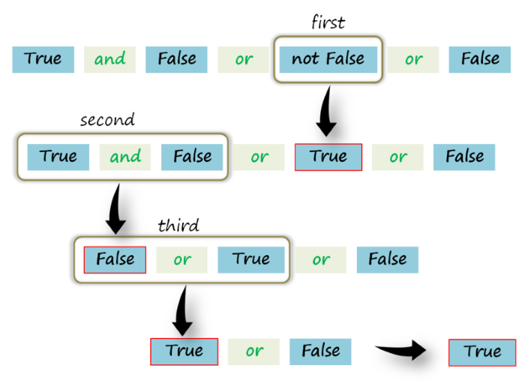
Order of Priority (review)
True and False or not False or False = ?
Notes:
We have a single line boolean logic operator syntax here that you should have been familiar with it in pre-class content on lms. Let's follow the steps to see How we do that.

Slide 29
Truth Values of Logic Statements
Notes:
Now we came to another key point of boolean phenomenon in python. Truth values… So what is that? Did you get it from your pre-class contents?

Slide 30
Truth Values of Logic Statements
Falsy values in Python:
None
Zero : 0, 0.0, 0j
Empty Seq. and collections : '', [], {}
Any remaining value : True
Notes:
Although Python has its own boolean data type, you know them which are True and False, we often use non-boolean values in logical operations.
Now, my friends listen to me very carefully : The values of non-boolean types (integers, strings, etc.) are considered truthy or falsy when used with logical operations, depending on whether they are seen as True or False by the python interpreter.
The values on the screen are considered falsy, in that they evaluate to False when applied to a boolean operator (and, or, not) Any remaining value other than these is considered as True in python.

Slide 31
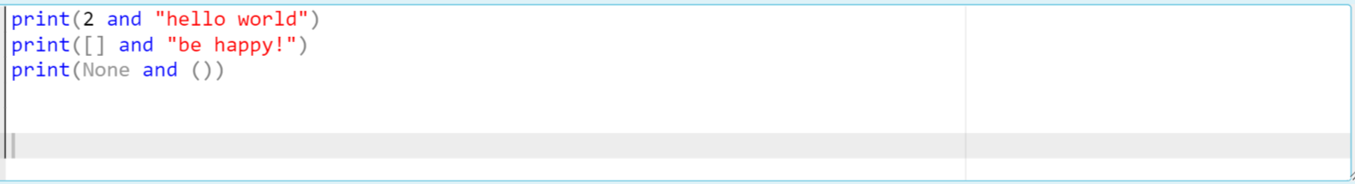
Truth Values of Logic Statements
Notes:
print(2 and "hello world")
print([] and "be happy!")
print(None and ())

Slide 32
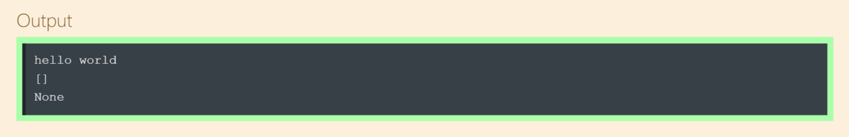
Truth Values of Logic Statements
Notes:
print(2 and "hello world")
print([] and "be happy!")
print(None and ())

Slide 33
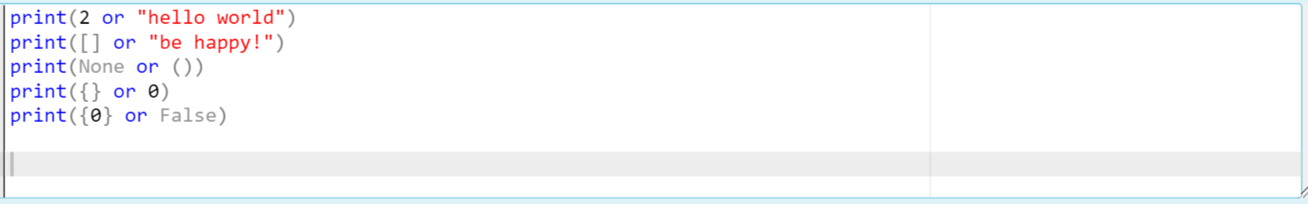
Truth Values of Logic Statements
Notes:
print(2 or "hello world")
print([] or "be happy!")
print(None or ())
print({} or 0)
print({0} or False)

Slide 34
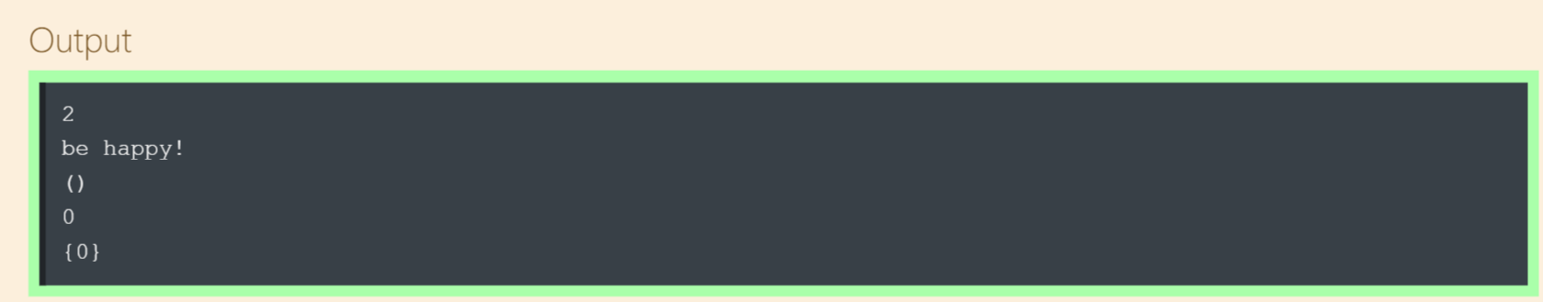
Truth Values of Logic Statements
Notes:
print(2 or "hello world")
print([] or "be happy!")
print(None or ())
print({} or 0)
print({0} or False)

Slide 35
Indexing & Slicing Strings
best ='Clarusway'
best[2]
best[2:]
Notes:
as you already know, While explaining the subjects we will cover as a lesson, it is our primary method to explain directly through examples. So now, let's discuss this issue with examples.

Slide 36
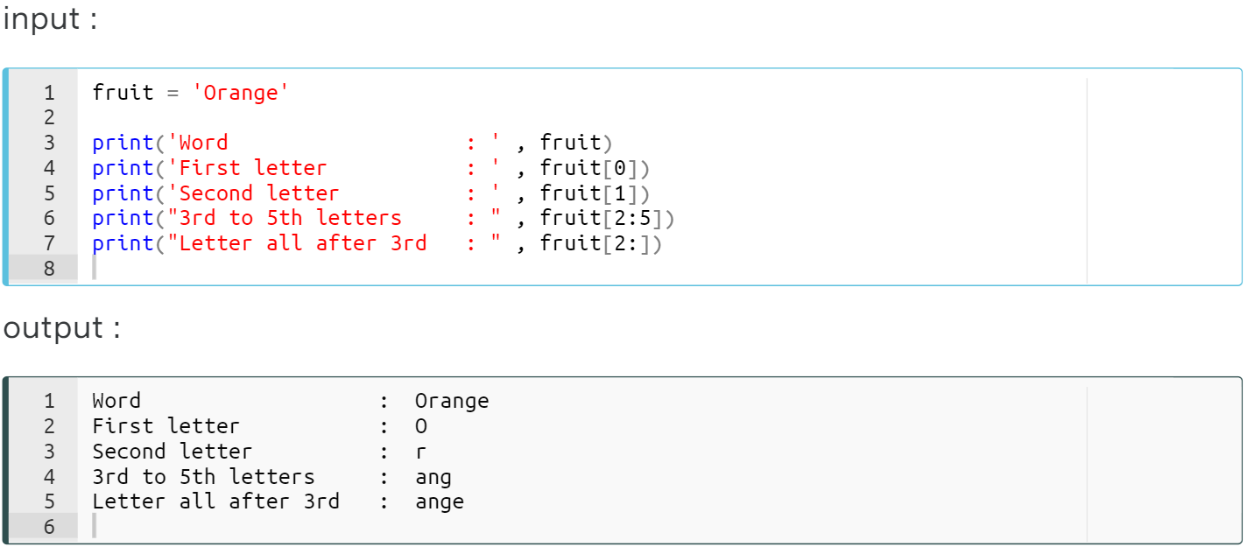
Indexing&Slicing Strings
Let’s elaborate on this example :
Notes:
You can access all elements of a string type data very easily. Accordance with the sequence of string letters, you can specify them from left to right in brackets. You can put the indices that you want to access to
So what are the outputs. Let’s solve it together.
fruit = 'Orange'
print('Word : ', fruit)
print('First letter : ', fruit[0])
print('Second letter : ', fruit[1])
print('3rd to 5th letters : ', fruit[2:5])
print('Letters all after 3rd : ', fruit[2:])

Slide 37
Indexing&Slicing Strings
Let’s elaborate on this example :
Notes:
ok, when we run it, this is the output. Let’s examine the output line by line. == next slide ==
fruit = 'Orange'
print('Word : ', fruit)
print('First letter : ', fruit[0])
print('Second letter : ', fruit[1])
print('3rd to 5th letters : ', fruit[2:5])
print('Letters all after 3rd : ', fruit[2:])

Slide 38
Indexing&Slicing Strings
Let’s elaborate on this example :
[start:stop:step]
'O r a n g e'
| | | | | |
0 1 2 3 4 5
Notes:
ok, when we run it, this is the output. Let’s examine the output line by line. all the iterable values, which means separable into their elements, have indices. that is we can separate them into their elements. and the strings are iterable. so we can separate them as well. ok the first index is always starts from zero. do not confuse with the length of the iterables. did you know len function. did you studied it in pre-class? ok. len function returns the length of the iterables. in this case the length of this string is six, right? all indexing and slicing syntax are similar. we have start parameter, stop parameter and step parameter as well. it starts from start index, goes to stop minus one by step index
If we wanna print out the whole string, we simply call the variable name.
and if we wanna access and print out the first character of the string we put the first index which is zero, in a square bracket. in python we always use square bracket for accessing, indexing and slicing operations.
When slicing a variable and doesn’t matter its type, I mean all the iterables, the stop index represents the end minus one. did i make myself clear?

Slide 39
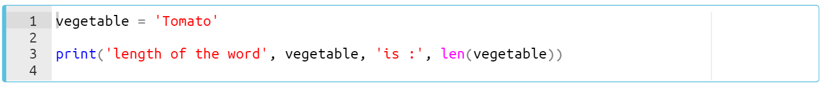
Indexing&Slicing Strings
len() function measure the length of any iterable :
Notes:
You can use the len() function to find out the length (number of characters) of a text or a variable of any iterable type. It returns an int type. it counts the elements of an iterable.
önce hatayı bulalım. çoğul...
# find the error first!
vegetable = "Tomato"
print('length of the word', vegetable, "is : ", len(vegetables))

Slide 40
Indexing&Slicing Strings
The output :
'T o m a t o'
| | | | | |
✔+✔+✔+✔+✔+✔
Totally 6 chars
=
Notes:
So let’s count the elements of this string we have “tomato” by the way...Think about it, meals, in the Ottoman Empire, were without tomato paste. I can't imagine.… .. we have six elements which means we have six characters.

Slide 41
String Formatting
String Formatting with Arithmetic Syntax
Notes:
You have learned very important phenomenon of strings, which is indexing and slicing, so far. and now we can start to learn formatting methods with arithmetic syntaxes. buuut what we gonna do first is ..

Slide 42
String Formatting with Arithmetic Syntax
Here are basic operators :
+
=
*
Notes:
We can use arithmetic operator syntaxes in string formatting operations. and here are basic operators we use in string formatting. plus, equal and asterisk signs

Slide 43

String Formatting with Arithmetic Syntax
We can use arithmetic operator syntaxes in string formatting operations
Here are basic operators :
str_one = 'upper'
str_two = 'case'
str_comb = str_one + str_two
print('upper' + 'case')
print(str_one + str_two)
print(str_comb)
+
=
*
Notes:
So you should have learned how we teach in in-class? We directly, dive into the topic with examples right? That is how we teach. And the key point of that learning methodology here is studying the pre-classes. so when we come to the interactive question here you can realize that we use plus sign in this question. We can use + operator for combining the two string together without any spaces. remember that if you use plus sign with strings actually we do concatenate them. we stick them together.
str_one = 'upper'
str_two = 'case'
str_comb = str_one + str_two
print('upper' + 'case')
print(str_one + str_two)
print(str_comb)

Slide 44
String Formatting with Arithmetic Syntax
We can use arithmetic operator syntaxes in string formatting operations
Here are basic operators :
str_one = 'upper'
str_two = 'case'
str_comb = str_one + str_two
print('upper' + 'case')
print(str_one + str_two)
print(str_comb)
+
=
*
uppercase
uppercase
uppercase
Notes:
so as you can see that all the outputs are the same. check your answers. anything unclear? and do you want me to review the output for you?
str_one = 'upper'
str_two = 'case'
str_comb = str_one + str_two
print('upper' + 'case')
print(str_one + str_two)
print(str_comb)

Slide 45
String Formatting with Arithmetic Syntax
Another example :
+
=
*
str_one = 'upper'
str_two = 3 * 'upper'
str_comb = str_one * 3
print(str_two)
print(str_comb)
print(* str_one)
Notes:
In this example we use asterisk operator. We use * operator for repeating the string without any spaces. yess remember your pre-class knowledge.
str_one = 'upper'
str_two = 3 * 'upper'
str_comb = str_one * 3
print(str_two)
print(str_comb)
print(* str_one)

Slide 46
String Formatting with Arithmetic Syntax
Another example :
+
=
*
str_one = 'upper'
str_two = 3 * 'upper'
str_comb = str_one * 3
print(str_two)
print(str_comb)
print(* str_one)
upperupperupper
upperupperupper
u p p e r
Notes:
ok when we follow the statements here we can see that the word upper repeats 3 times with no space. but we have another usage of asterisk in strings. you may not get familiar with this usage from your pre-class material i think. …
str_one = 'upper'
str_two = 3 * 'upper'
str_comb = str_one * 3
print(str_two)
print(str_comb)
print(* str_one)

Slide 47
String Formatting with Arithmetic Syntax
Another example :
+
=
*
str_one = 'upper'
str_two = 3 * 'upper'
str_comb = str_one * 3
print(str_two)
print(str_comb)
print(* str_one)
Separates the string into its elements
upperupperupper
upperupperupper
u p p e r
Notes:
What's happening here is a different method of separation. we put the asterisk in front of the iterable like this and it separates the iterable, - in this case we have string type here, - into its elements.
* "Clarusway"

Slide 48
String Formatting with Arithmetic Syntax
Another example :
+
=
*
str_one = 'upper'
str_one += 'case'
print(str_one)
str_one += 'letter'
print(str_one)
str_one += 'end'
print(str_one)
Notes:
And the last arithmetic operator we use : equal sign
str_one = 'upper'
str_one += 'case'
print(str_one)
str_one += 'letter'
print(str_one)
str_one += 'end'
print(str_one)

Slide 49
String Formatting with Arithmetic Syntax
Another example :
str1 = str1 + str
str1 += str
+
=
*
str_one = 'upper'
str_one += 'case'
print(str_one)
str_one += 'letter'
print(str_one)
str_one += 'end'
print(str_one)
str1 = str1 * 2
str1 *= 2
uppercase
uppercaseletter
uppercaseletterend
Notes:
we can concatenate or repeat the string with using plus or asterisk sign with equal sign together. (explain it on the tablet) it consecutively cumulatively concatenate the values
str_one = 'upper'
str_one += 'case'
print(str_one)
str_one += 'letter'
print(str_one)
str_one += 'end'
print(str_one)

Slide 50
String Formatting
String Formatting with string.format() Method
Notes:
Now, we come to my favorite formatting methods. I don’t know, like to use it.

Slide 51
String Formatting with string.format() Method
The formula syntax 👇
'string {} string {} string'.format(data1, data2)
Notes:
string.format() method is the improved form of % Operator formatting that we skipped. as i stated before.:
The value of expression comes from .format() method in order. Curly braces 👉🏻 {} receives values from .format().
If any question, extra explanation :
We have stated to you what the function is? in the previous lessons. At this point, let us give the definition of the term method. A method is like a function, except it is attached to an object. We call a method on an object, and it possibly makes changes to that object (like string.format()).
'string {} string {} string'.format(data1, data2)

Slide 52
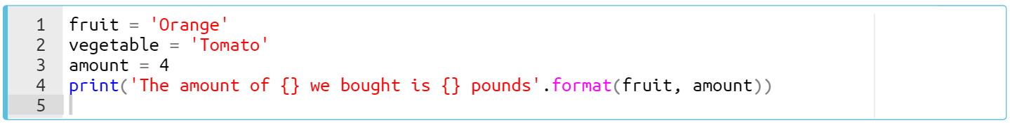
String Formatting with string.format() Method
Take a look at the example 👇
Notes:
Let’s take a closer look at this formatting method with this example on the screen. ok what we have here.. again tomato..
fruit = "Orange"
vegetable = 'Tomato'
amount = 4
print("The amount of {} we bought is {} pounds".format(fruit, amount))

Slide 53
String Formatting
String Formatting with f-string
Notes:
and we come to the last formatting method in use. this is the newest and simplest method we have in python. let’s take a closer look

Slide 54
String Formatting with f-string
The formula syntax 👇
f'string {variable1} string {variable2} string'
Notes:
i said that, It is the easiest and useful formatting method of the strings.
f-string is the string syntax that is enclosed in quotes with a letter f at the beginning. Curly braces 👉🏻 {} that contain variable names or expressions (I am gonna show you just now) are used to replace with their values. how we do that, let’s learn it with examples as usual

Slide 55
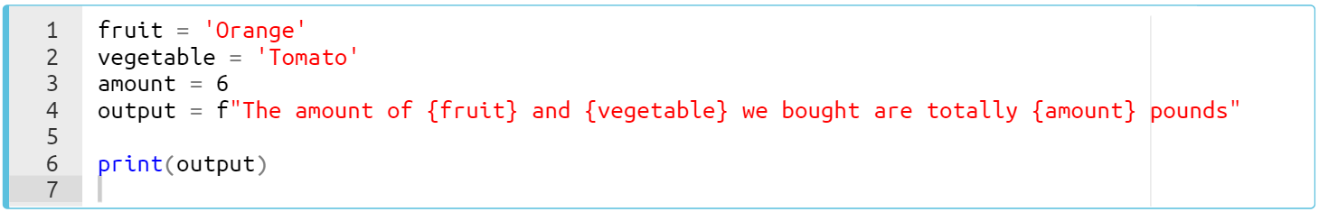
String Formatting with f-string
Take a look at the example 👇
Notes:
We couldn't get rid of that tomato.
the syntax is simple. the value of the variable goes to the allocated curly braces. that is all. it is very straightforward.
fruit = "Orange"
vegetable = 'Tomato'
amount = 6
print("The amount of {fruit} and {vegetable} we bought is {amount} pounds")

Slide 56
String Formatting with f-string
Take a look at the example 👇
Notes:
When we run it the output is

Slide 57
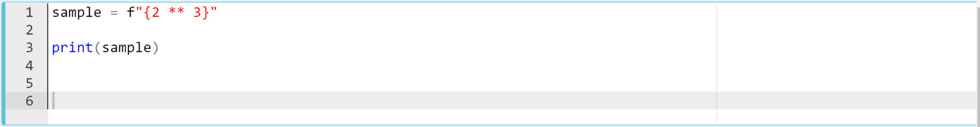
String Formatting with f-string
You can use all valid expressions, variables, and even methods in curly braces. 👇
Notes:
so you have an interactive practice on peardeck.
As I said just now that we can use some expression either. You can use all valid expressions, variables, and even methods in curly braces. in this example we have an expression two to power of three.
by the way, I emphasize again as this is important. let me explain something here. please listen to me carefully. my friend, when you see “try to guess or figure out in your mind” label or something like that then you should figure out the output in your mind. Do not use any idle, playground or jupyter etc. figure out the output by putting yourself in the place of python, thinking like it.
“””Believe me, you will strengthen your IT Part of your brain with This way. It allows you to think as python. when doing this you read the code line by line, calculate and extract some logic, some expressions etc. it is very important for your learning of the python and the logic of codes.””” ok. then you have a minute
sample = f"{2 ** 3}"
print(sample)

Slide 58
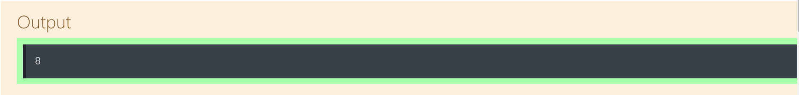
String Formatting with f-string
You can use all valid expressions, variables, and even methods in curly braces. 👇
Notes:
as you can see the output, we use this expression in curly braces and we did not use any variable here. since we don't need to use any variable, right?

Slide 59
String Formatting with f-string
Task :
Type a Python code to get the output of “My name is Mariam”, using .capitalize() and f-string methods with the name variable below.
name = "MARIAM"
You’re familiar with .capitalize() method from pre-class materials

Slide 60
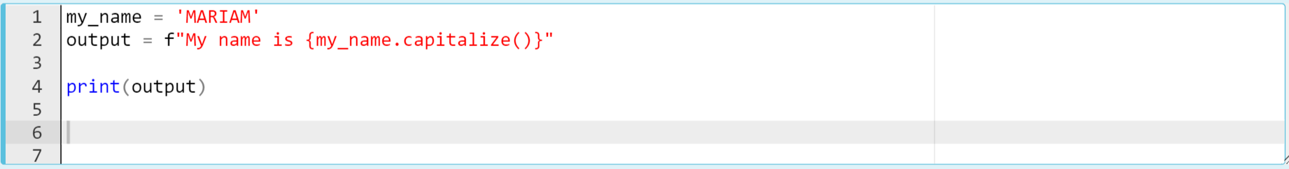
String Formatting with f-string
The code should be like :
Notes:
as i say just now we can use even methods which means functions inside the curly braces of the f formatting method. as usual we use curly braces for that. we put the method inside the curly braces. that is all. we do.
my_name = "MARIAM"
output = f"My name is {my_name.capitalize()}"
print(output)

Slide 61
String Formatting with f-string
Task :
Type a Python code to get the output of “Susan is a young lady and she is a student at the CLRWY IT university.”, using f-string in multiline with the variables below.
name = "Susan"
age = "young"
gender = "lady"
school = "CLRWY IT university"

Slide 62
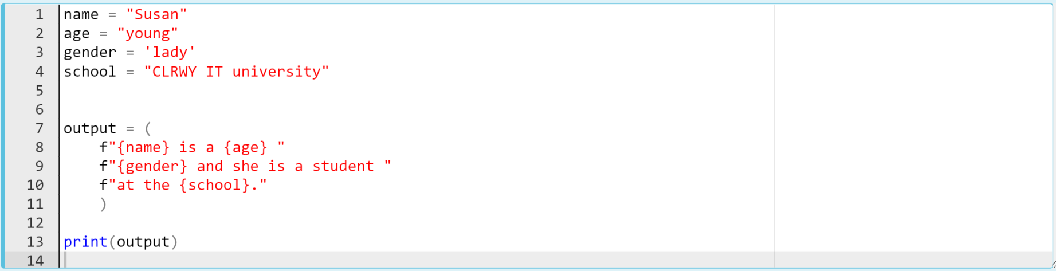
String Formatting with f-string
The code should be like :
Notes:
Here comes quiz
name = "Susan"
age = "young"
gender = "lady"
school = "CLRWY IT university"
output = {
f"{name} is a {age} "
f"{gender} and she is a student "
f"at the {school}."
}
print(output)

