Slide 1

Tuples
Notes:
yes. Up to this section of our lesson, you have learned the most used collection types of Python : lists. A tuple is another collection type that can hold multiple data very similar to the lists.

Slide 2
Table of Contents
Creating a Tuple
How can We Use a Tuple

Slide 3
Creating a tuple
We have two basic ways to create a tuple.
()
tuple()
Notes:
We used square brackets 👉🏻 [] to define the lists. as you can remember from the previous lessons. so. In the tuple, normal parentheses 👉🏻 () are used.
The same indexing rules for lists also apply to tuples. Tuples can also be nested and the values can be any valid Python types.
A tuple can be created by either parenthesis or calling the tuple() function as in creating a list using list function. this function also accepts iterable types. it takes the elements of the iterables and separates them and creates a tuple . so if there is no unclear point so far, let me move on.

Slide 4

Creating a tuple
A tuple can be created by enclosing values, separated by commas, in parentheses 👉🏻 ().
Another way to create a tuple is to call the tuple() function.
tuple_1 = ('h', 'a', 'p', 'p', 'y')
word = 'happy'
tuple_2 = tuple(word)
print(tuple_1)
print(tuple_2)
⚠ an iterable object can be converted into a tuple
()
tuple()
('h', 'a', 'p', 'p', 'y')
('h', 'a', 'p', 'p', 'y')
Notes:
when we run we see that the two output are the same. tuple function separates the elements of the iterable that we passed into. if we separate the string happy we it will end up with h,a,p,p,y
tuple_1 = ('h', 'a', 'p', 'p', 'y')
word = 'happy'
tuple_2 = tuple(word)
print(tuple_1)
print(tuple_2)

Slide 5
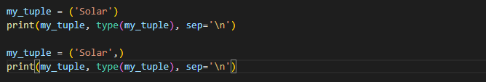
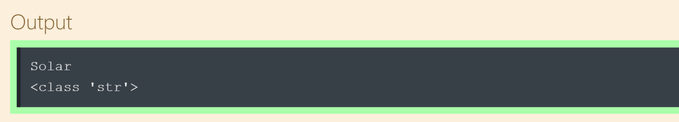
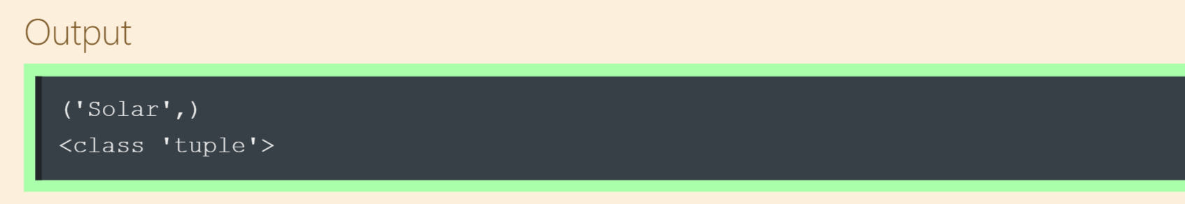
Creating a tuple
Single element tuple :
Notes:
it is string type. how can it be? what do you think. If you want to create a single element tuple, an error will probably rise, unless you do not use a comma:
my_tuple = ('Solar')
print(my_tuple, type(my_tuple), sep='\n')
my_tuple = ('Solar',)
print(my_tuple, type(my_tuple), sep='\n')
if we do not use parenthesis … let me put it in a different word. even though we do not wrap the values or elements by parenthesis, the python still accepts this syntax as a tuple. in this case we did not use parentheses and it still gives us a tuple type.

Slide 6
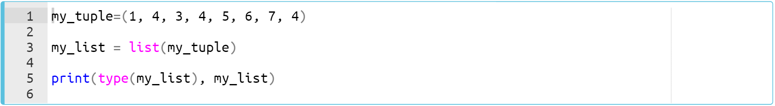
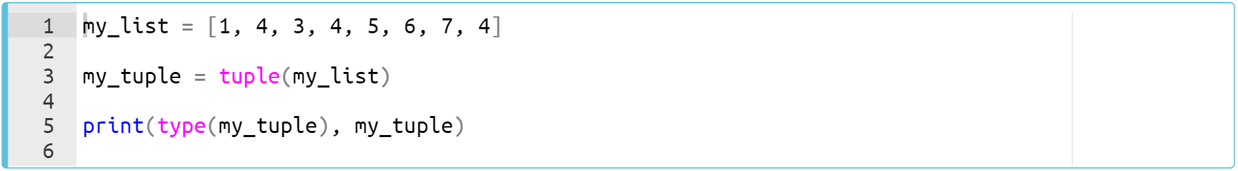
Creating a tuple
list to tuple, tuple to list
Notes:
and if we run it you can realize that we have a tuple.
my_tuple = (1, 4, 3, 4, 5, 6, 7, 4)
my_list = list(my_tuple)
print(type(my_list), my_list)
my_tuple = (1, 4, 3, 4, 5, 6, 7, 4)
my_list = list(my_list)
print(type(my_tuple), my_tuple)

Slide 7
How can We Use a Tuple?

Slide 8
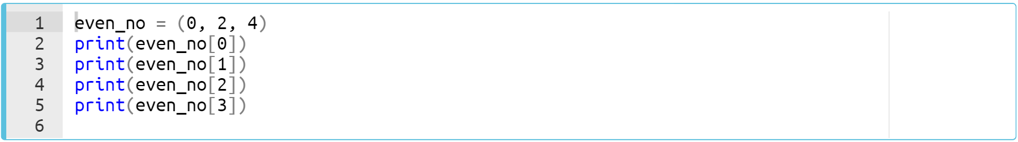
How can We Use a tuple?
(..Continued) (review of the pre-class)
Just like the lists, the tuples support indexing :
Notes:
what we have here is that the tuples are also indexable. so just as the list indexing methodology, we can index and access the elements of a tuple. ok. when it comes to the example on the screen, if we run it
even_no = (0, 2, 4)
print(even_no[0])
print(even_no[1])
print(even_no[2])
print(even_no[3])

Slide 9
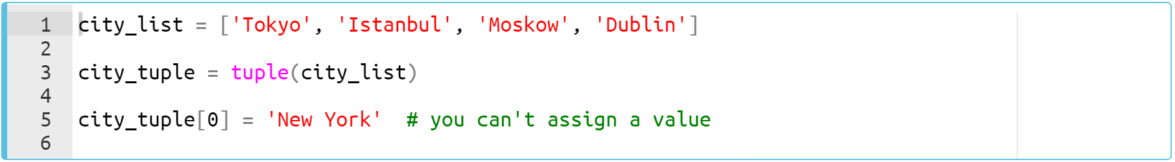
How can We Use a tuple?
(..Continued)(review of the pre-class)
tuple is immutable.
Notes:
And one of the most important differences of tuples from lists is that tuple object does not support item assignment. Yes, because tuple is immutable. did you remember what the immutable is. shoot on the class chat. as i stated before, immutable, just as string type, means unchangeable.
so. If we go back to our example here, we can not assign string new york to city tuple.
city_list = [‘Tokyo’, ‘Istanbul’, ‘Moskow’, ‘Dublin’]
city_tuple = tuple(city_list)
city_tuple[0] = ‘New York’

Slide 10
How can We Use a tuple?
(..Continued)(review of the pre-class)
And one of the most important differences of tuples from lists is that tuple object does not support item assignment. Yes, because tuple is immutable.
Notes:
when we run it, type error raises.
city_list = [‘Tokyo’, ‘Istanbul’, ‘Moskow’, ‘Dublin’]
city_tuple = tuple(city_list)
city_tuple[0] = ‘New York’

Slide 11
Dictionaries
Notes:
..and we came to the dictionaries. yess. we are covering and completing collection types one by one. you have learned lists, tuples and now it is time to learn dictionaries. dictionary is another collection types in python

Slide 12
Table of Contents
Definitions
Creating a Dictionary
Main Operations with Dictionaries
Notes:
the contents that i am gonna cover as shown on the screen

Slide 13

Definitions
Dictionaries
{key1 : value1,
key2 : value2}
Notes:
A dictionary is another collection type which stores item pairs. this is important. the biggest difference of dictionaries from the other collection types is that it composed of a pair of data. keys and values.
Think of a real dictionary. It contains words and their meanings. In Python, you can accept the words as key and the meaning of the words as value.
A dictionary in Python is a collection of key-value pairs. key-value pairs are called item of a dictionary.
The dictionary is enclosed by curly braces 👉🏻 {}. Each pair (item) is separated by a comma and the key and value are separated by a colon. how we do that is on my next slides. i am gonna start with creation of a dictionary

Slide 14
Creating a dict (review)
We have two basic ways to create a dictionary.
{}
dict()
Notes:
A dict can be created by enclosing pairs, separated by commas, in curly-braces 👉🏻 {}.
And of course we have a function to create a dictionary. to create a dict, we call the dict() function.

Slide 15
Creating a dict (review)
A dict can be created by enclosing pairs, separated by commas, in curly-braces 👉🏻 {}.
Another way to create a dict is to call the dict() function.
grocer1 = {'fruit':'apple', 'drink':'water'}
grocer2 = dict(fruit='apple', drink='water')
print(grocer1)
print(grocer2)
{}
dict()
{'fruit': 'apple', 'drink': 'water'}
{'fruit': 'apple', 'drink': 'water'}
Notes:
when we run it, as you can see on the screen, we have two same dictionaries.
grocer1 = {'fruit':'apple', 'drink':'water'}
grocer2 = dict(fruit='apple', drink='water')
print(grocer1)
print(grocer2)

Slide 16
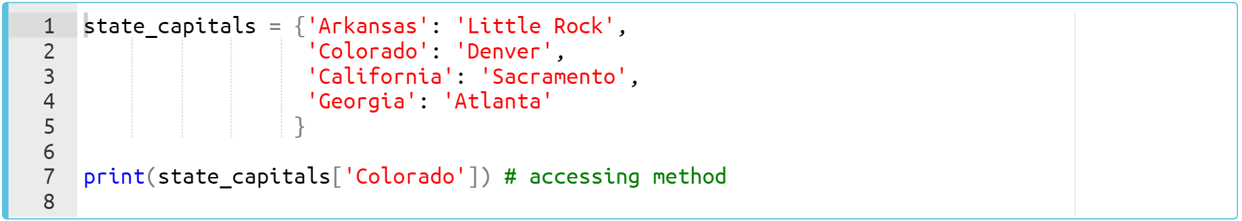
Creating a dict
Assigning a value to a key
Notes:
if we run it the result is denver. we can access the values by their keys.
state_capitals = {'Arkansas':'Little Rock',
'Colorado':'Denver',
'California':'Sacramento',
'Georgia':'Atlanta'
}
print(state_capitals['Colorado'])

Slide 17
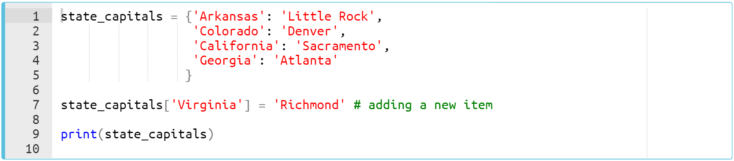
Creating a dict
Let’s add a new item into the dict.
Notes:
when it comes to assigning an item to dictionary we can use also the same syntax.
state_capitals = {'Arkansas':'Little Rock',
'Colorado':'Denver',
'California':'Sacramento',
'Georgia':'Atlanta'
}
state_capitals['Virginia'] = 'Richmond'
print(state_capitals)

Slide 18
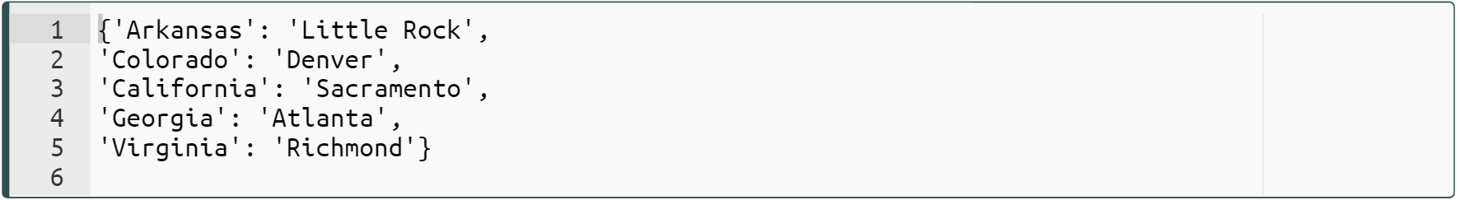
Creating a dict
Let’s add a new item into the dict.
Notes:
…… is it simple right? …. this is how we add a new item to a dictionary.
state_capitals = {'Arkansas':'Little Rock',
'Colorado':'Denver',
'California':'Sacramento',
'Georgia':'Atlanta'
}
state_capitals['Virginia'] = 'Richmond'
print(state_capitals)

Slide 19
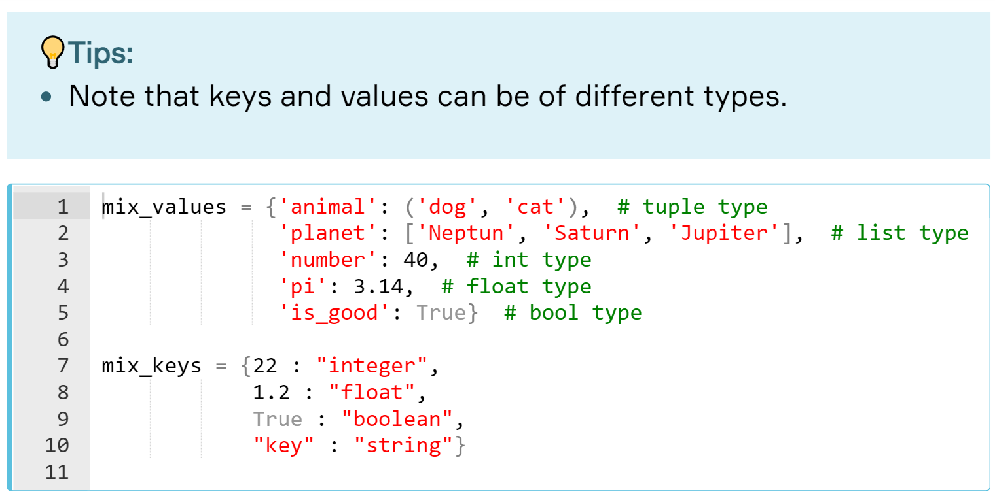
Creating a dict
Notes:
so. we continue to review pre-class and in this slide i am gonna show you that the values can be various data types.
mix_values = {'animal':('dog','cat'),
'planet': ['Neptun', 'Saturn', 'Jupiter'],
'number': 40,
'pi':3.14,
'is_good': True}
mix_keys = {22:'integer',
1.2:'float',
True:'boolean',
'key':'string'}

Slide 20
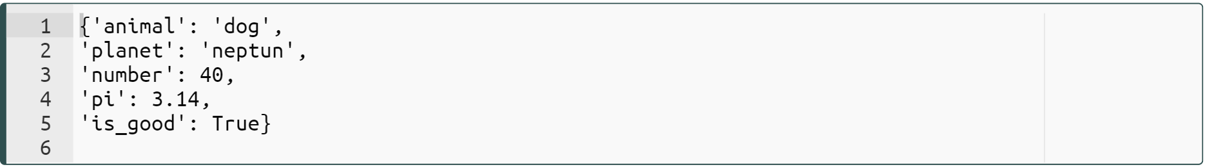
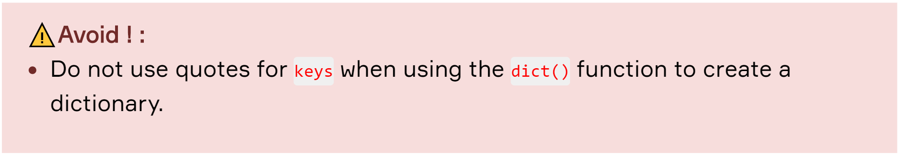
Creating a dict
Now, it's time to create a dict using dict() function :
Notes:
yes. this is important reminder. since it is important i am gonna underscore this point again. we do not use quotes for keys if we prefer to use dict function to create a dictionary. dict function accepts variables as keys.
dict_by_dict = dict(animal='dog', planet='neptun', number=40, pi=3.14, is_good=True)
print(dict_by_dict)

Slide 21
Main Operations with Dictionaries
Notes:
ok you have learned how we create a dictionary in detail throughout several examples. now, i would like to show you some operations used in dictionaries.

Slide 22
Main Operations with dicts (review)
You can access all;
items using the .items() method,
keys using the .keys() method,
values using the .values() method.
Notes:
There are several methods that allow us to access items, keys, and values. …. let’s consolidate these methods with several examples again.

Slide 23
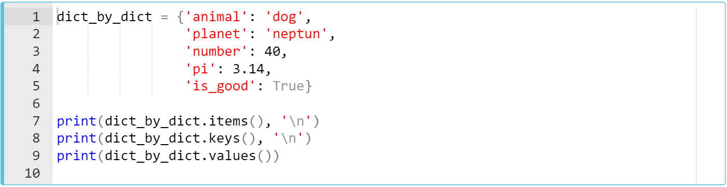
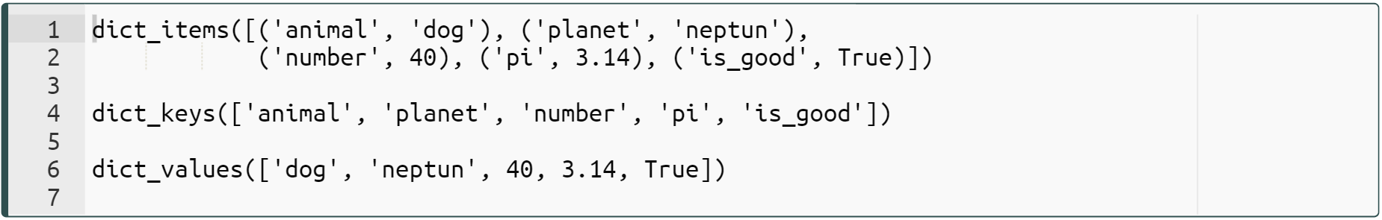
Main Operations with dicts (review)
Let’s take a look at this example :
Notes:
ok you see the output. let’s take a look at the codes line by line. so in first line we have items method. As the name of the method suggests, this method extracts items. as you can see, each tuple is an item of the dictionary. ….
when we come to the second line you can see that we have keys method. of course it extracts the keys…..
and the last one is extracts the values. these three methods are very very common use in dictionary operations in IT world. keep in mind. is there any question. if not let's move on your task
dict_by_dict = {'animal':'dog',
'planet': 'Neptun',
'number': 40,
'pi':3.14,
'is_good': True}
print(dict_by_dict.items(), '\n')
print(dict_by_dict.keys(), '\n')
print(dict_by_dict.values(), '\n')

Slide 24
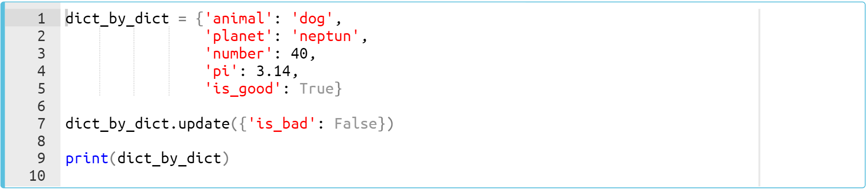
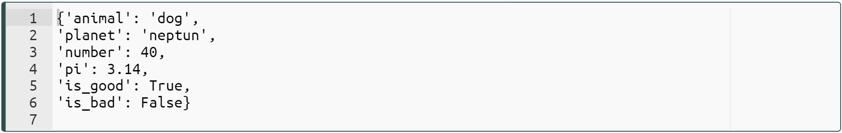
Main Operations with dicts (review)
Another way to add a new item into a dict is the .update() method.
Notes:
when we run it you can see that the items of the dictionary which is inside the update method is added to the other dictionary. besides, of course we can add more than one item using this method. == two items example need on idle ==
dict_by_dict = {'animal':'dog',
'planet': 'Neptun',
'number': 40,
'pi':3.14,
'is_good': True}
dict_by_dict.update({'is_bad':False})
print(dict_by_dict)

Slide 25
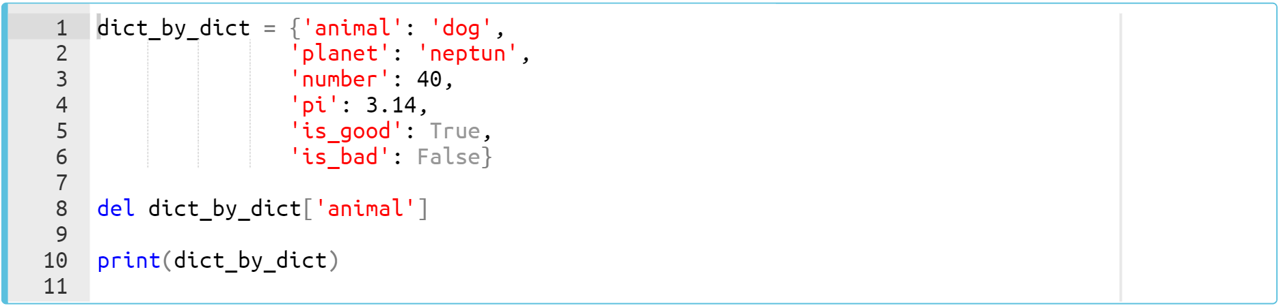
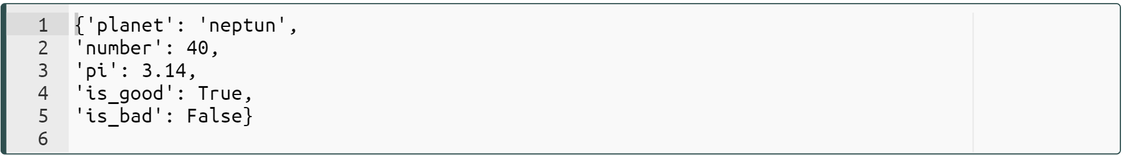
Main Operations with dicts (review)
Python allows us to remove an item from a dict using the del function.
Notes:
dict_by_dict = {'animal':'dog',
'planet': 'Neptun',
'number': 40,
'pi':3.14,
'is_good': True,
'is_bad':False}
del dict_by_dict['animal']
print(dict_by_dict)

Slide 26
Nested Dictionaries
Notes:
ok. we came closer to the end of the dictionary topic. i would like to show you nested dictionary, i mean dictionary in a dictionary as a last part of our topic.

Slide 27
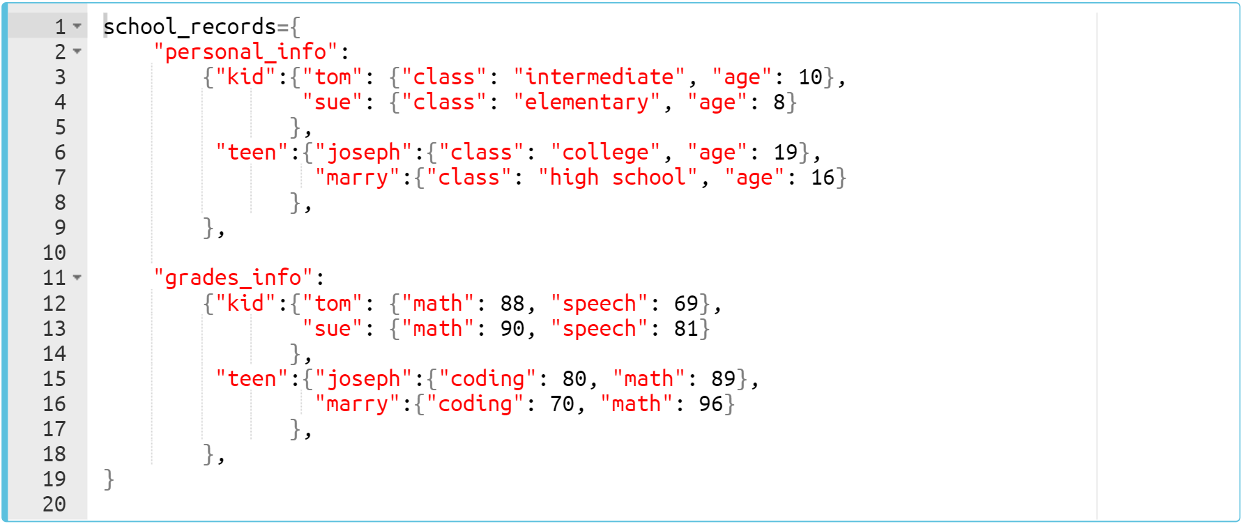
Nested dicts (review pre-class)
In some cases you need to work with nested dict. Consider the following pre-class example :
Notes:
ok. focus on my screen. this was already on your pre-class content, so you should familiar with it. and. what you see. by the way, the writing format of the dictionary is important. it is easy to read the dictionary with a format like on the screen, right? and i would like to say that the nested dictionaries are widely used in python. very often. …..
does it make sense? do you want me to repeat again. ok then let’s see the first item of this dictionary in a diagram.
school_records={
'personal_info':
{'kid':{'tom':{'class':'intermediate', 'age':10},
'sue':{'class':'elemantary', 'age':8}
},
'teen':{'joseph':{'class':'college', 'age':19},
'marry':{'class':'high school', 'age':16}
},
},
'grades_info':
{'kid':{'tom':{'math':88, 'speech':69},
'sue':{'math':90, 'speech':81}
},
'teen':{'joseph':{'coding':80, 'math':89},
'marry':{'coding':70, 'math':96}
},
}
}

Slide 28
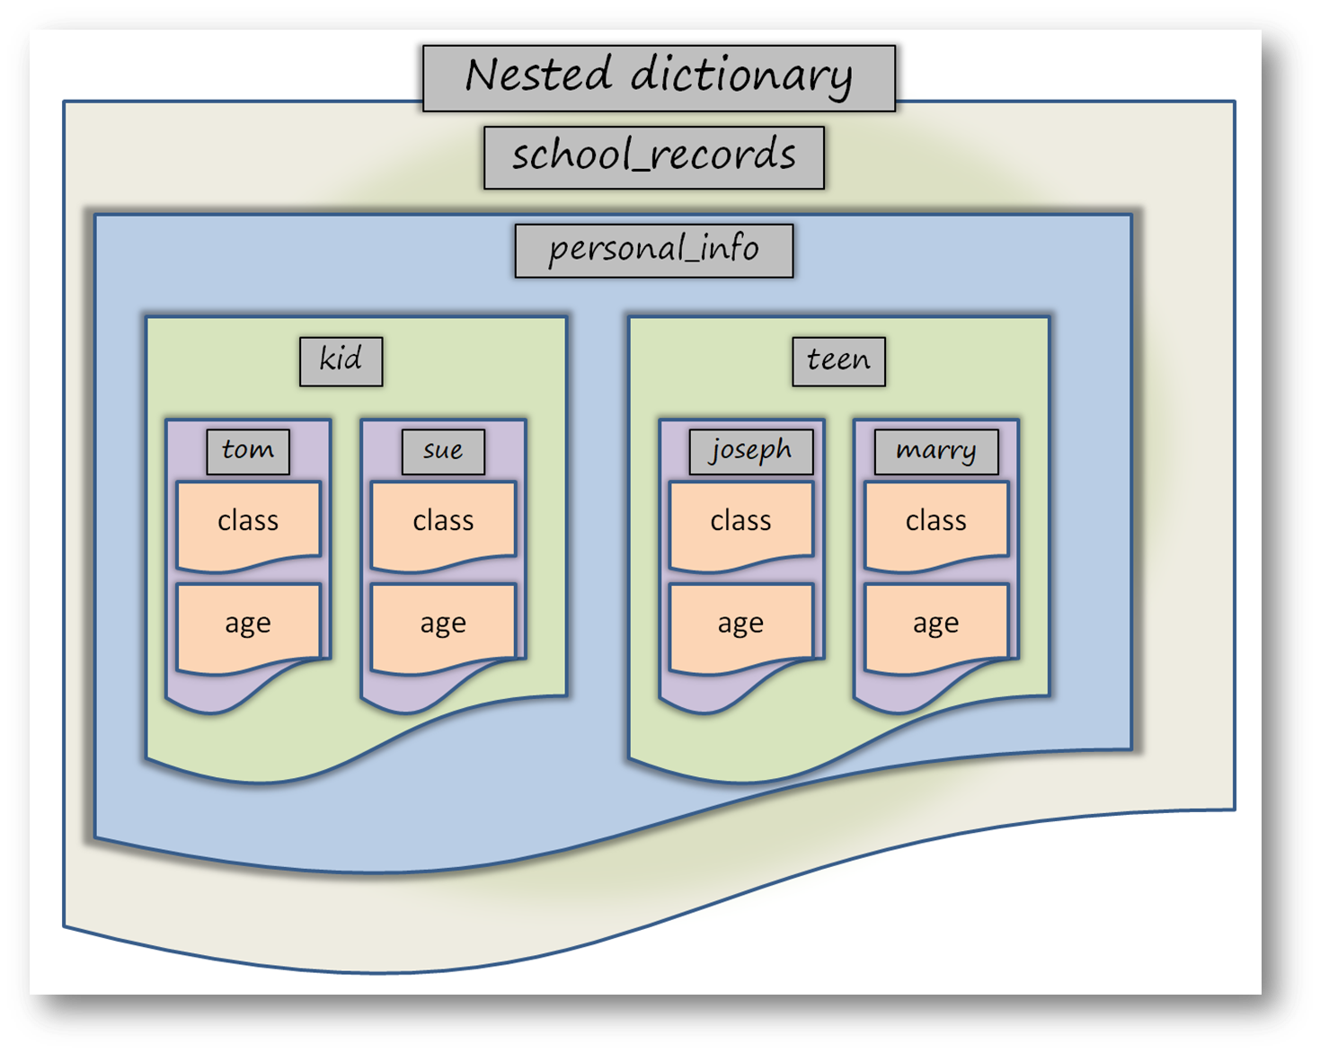
Nested dicts (review pre-class)
The first part of the nested dictionary.
Notes:
... personal info is our first key of the main dictionary…
… all labels are keys of their dictionaries. ..
… class and age are the two keys of the innermost dictionary.

Slide 29

Nested dicts (review pre-class)
You can use traditional accessing method - square brackets - also in the nested dictionaries.
Notes:
could you follow my explanation. did i make myself clear?
school_records={
'personal_info':
{'kid':{'tom':{'class':'intermediate', 'age':10},
'sue':{'class':'elemantary', 'age':8}
},
'teen':{'joseph':{'class':'college', 'age':19},
'marry':{'class':'high school', 'age':16}
},
},
}
print(school_records['personal_info']['teen']['marry']['age'])

Slide 30
Sets
Notes:
ok. we came to the last part of this topic. the last collection type that i would like to show you is SETS. As you can imagine, this topic is very similar to the same topic as in mathematics. so

Slide 31
Table of Contents
Definitions
Creating a Set
Main Operations with Sets
Notes:
what you will learn is that : - first we are gonna take a look at some basic definitions - then, as usual we are gonna review of how we create a set - and lastly i am gonna show you several basic operations of the sets which will be the best friend during your IT journey or your projects in the future.

Slide 32
Definitions
No repetition
Math operations
union
intersection
difference
Unordered elements
a
b
Notes:
A set is a collection of elements with no repeats. and it can hold multiple data in it, but only one of value. there is no repetition. you should remember and understand what i am talking about from your pre-class contents, righ?
It allows us to implement Basic uses such as membership testing and eliminating duplicate entries etc. it is key point and the most important specification of the sets.
Set objects also support mathematical operations like union, intersection, and difference that we are gonna see them in detail in this lecture.
And as a last thing that i would mention is that the order of the element can be changed whenever we call the set. The elements of the set are not in the same order as when we created the set. ok. i am gonna show you, let’s keep it as it is.

Slide 33
Creating a set
A set can be created by enclosing values, separated by commas, in curly braces 👉🏻 {}.
Another way to create a set is to call the set() function.
set_1 = {'red', 'blue', 'pink', 'red'}
colors = 'red', 'blue', 'pink', 'red'
set_2 = set(colors)
print(set_1)
print(set_2)
{}
set()
⚠
different order from the previous slide
{'red', 'blue', 'pink'}
{'red', 'blue', 'pink'}
Notes:
as you can see that we have created the same set using set function. and as in the previous collection functions, we pass iterable into the set function. in this case it is tuple. and you should realize that The elements of the set are not in the same order as previous slide. whenever we do some changes and run the code, the order of the elements might be changed. this is due to the unordered nature of the sets.
set_1 = {'red', 'blue', 'pink', 'red'}
colors = 'red', 'blue', 'pink', 'red'
set_2 = set(colors)
print(set_1)
print(set_2)

Slide 34
Creating a set
Creating an empty set
⚠
{}
To create an empty set, you can not use 👉 {}. The only way to create an empty set is set() function.
Notes:
in this slide, i would like to underscore an important point. ……
well then, what is an empty curly braces is used for? yess. it is for creating an empty dictionaries.

Slide 35
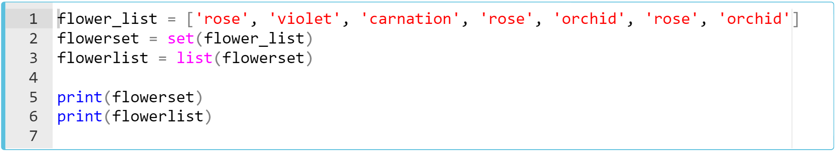
Creating a set(review of pre-class)
Notes:
ok
let’s take a quick look at the output. when we run it you can see that by creating a set from the list actually i have selected the unique element of the flower list…. orchid, carnation, violet and rose are the unique elements of the flower list. there is no repetition anymore.
flower_list = ['rose', 'violet', 'carnation', 'rose', 'orchid', 'rose', 'orchid']
flowerset = set(flower_list)
flowerlist = list(flowerset)
print(flowerset)
print(flowerlist)

Slide 36
Main Operations with Sets
Notes:
ok. from this part of this lecture, you will be learning basic operations with sets. let’s dive into these methods.

Slide 37
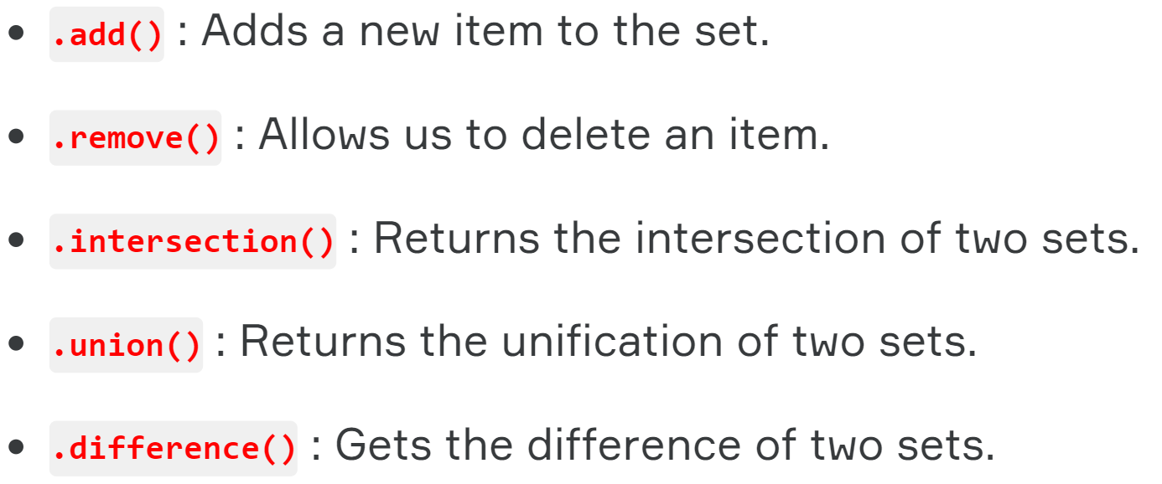
Main Operations with sets (review)
The methods that can be used with sets :
Notes:
…. we are gonna focus on the last three methods. you can simply implement add and remove methods. just be familiar with them, we are not gonna examine these two methods in detail in this lesson. ok let’s move on.

Slide 38
Main Operations with sets
Let’s take a look these two sets below :
a = set('philadelphia')
print(a)
b = set('dolphin')
print(b)
{'a', 'e', 'i', 'd', 'l', 'p', 'h'}
{'d', 'l', 'o', 'p', 'n', 'i', 'h'}
a
b
a
i
n
e
p
l
h
o
d
Notes:
first we create two sets here using set function. we use string type as an iterable. …. set a and set b.
a = set('philadelphia')
print(a)
b = set('dolphin')
print(b)

Slide 39
Main Operations with sets
Basic set operations :
.difference(arg)
print(a - b)
print(a.difference(b))
{'a', 'e'}
a
b
a
i
n
e
h
p
l
d
o
Notes:
the difference of set a from set b is marked by blue line. which are letter a and e. in the usage of these methods we also can use minus sign for difference method. … these are completely the same operations.
print(a - b)
print(a.difference(b))

Slide 40
Main Operations with sets
Basic set operations :
.difference(arg)
print(b - a)
print(b.difference(a))
{'n', 'o'}
a
b
a
i
n
e
h
p
l
d
o
Notes:
this time the difference of set b from set a is marked by brown line, as well. which are letter n and o.
at this point, I would like to emphasize an important thing : the difference method of the set is commonly used in business life. when you need to compare two collections to find out the unique elements of each collection data, you should use set and difference operation.
print(b - a)
print(b.difference(a))

Slide 41
Main Operations with sets
Basic set operations :
.union(arg)
print(a | b)
print(a.union(b))
{'p', 'h', 'i', 'l', 'd', 'o', 'n', 'a', 'e'}
a
b
a
i
n
e
h
p
l
d
o
Notes:
and union method. how this method works is that ; the entire unique elements of all sets make up the union operation. the unique elements of both set a and set b make up the union operation and the result is shown on the screen. by the way the pipe symbol or some call it vertical line is used for the union operation in sets.
print(a | b)
print(a.union(b))

Slide 42
Main Operations with sets
Basic set operations :
.intersection(arg)
print(a & b)
print(a.intersection(b))
{'p', 'h', 'i', 'l', 'd'}
a
b
a
i
n
e
h
p
l
d
o
Notes:
yes. the last method that we use in set operations is intersection method. it allows us to select common elements. which means it returns the Elements that belong to both sets. By the way, it is worth mentioning this as well. my friends, keep in mind that, all these methods always return a set again. this is important. whenever you use these method, you should know that you will get a set type again. from now on, i am gonna introduce several easy task to you.
print(a & b)
print(a.intersection(b))

