Slide 1

Loops
Notes:
ok. we continue to cover control flow statements. you have learned first part of it which is conditionals and now you are gonna learn loops which is the phenomenon in python. i would say that without loops we can almost do nothing in programming world.

Slide 2
Table of Contents
Definitions
while Loop
for Loop
Working with the Iterators
Operations with for Loop
Nested for Loop
Notes:
ok
let’s see what i am gonna cover…
so let’s start with some definitions and theoretical explanations.

Slide 3
Definitions
for i in iterator :
print(i)
Notes:
and before my explanation, i would like to see your explanations.

Slide 4
Definitions - Loops
Count the iterator
Check the condition
for loop
while loop
Execute the body
Execute the body
Notes:
When writing programs in Python, in some cases it is not enough to execute our block of code only once.
The loops are used to repeat (iterate) the execution of a block of code.
As one of the most main functions in programming, loops are an important part of almost every programming language.
Loops enable programmers to set certain sections of their code to repeat through a number of loops which are referred to as iterations.
… does it make sense. so let’s take a look at the loops world starting with while loop

Slide 5
while Loop

Slide 6
while Loop (review the pre-class)
The simple syntax 👇 of a while loop is :
while condition:
body
A colon
A 4-space indentation
Notes:
while loops have a boolean logic, similar to if statements. it is almost the same as if statement.
As long as the result of the condition returns True, the code block under while loop runs.
When the condition returns to False, the loop execution is terminated and the program control moves further to the next operation. that’s the main point of the while loop. we set our loop based on a condition.

Slide 7
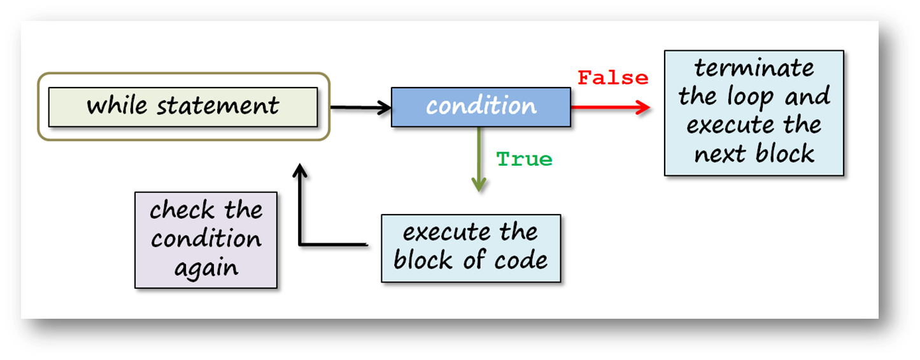
while Loop (review the pre-class)
The basic diagram 👇 of a while loop works as follows :

Slide 8
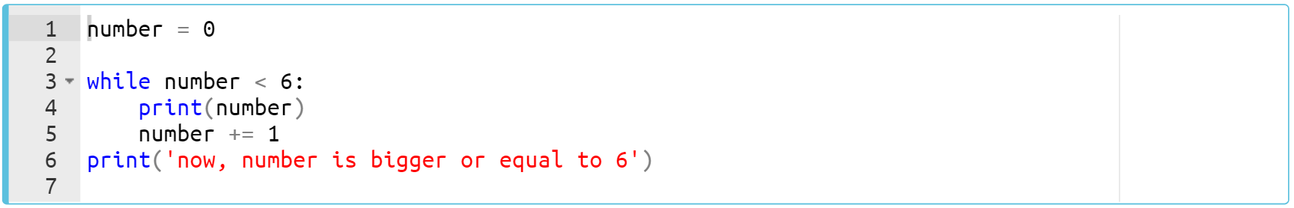
while Loop (review the pre-class)
Let’s take a look at the first while loop in the pre-class content :
Notes:
number = 0
while number < 6:
print(number)
number += 1
print('now, our number is bigger than or equal to 6')

Slide 9
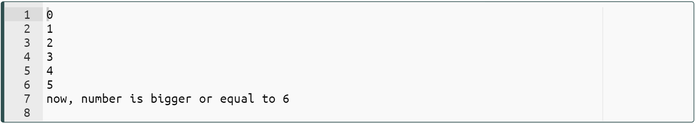
while Loop (review the pre-class)
The output :
Notes:
Regarding the previous example;
The variable number acts as a counter in this loop. This variable changes its value after each iteration.
When the value of a counter reaches to 6, the program control moves to the next operation and prints this text: now, number is bigger or equal to 6
number = 0
while number < 6:
print(number)
number += 1
print('now, our number is bigger than or equal to 6')

Slide 10

while Loop
Pay attention not to start an infinite loop.
If the condition is always True
Notes:
if we make a logical mistake in the loop variable (since you don’t increase your variable, a condition never becomes False and can work forever), we can start an infinite loop! For this reason, we have to specify a condition for the loop to give False to exit the loop. What i am trying to say is that; after setting the while loop condition, if it gives always true then we start an infinite loop. be careful about that.

Slide 11
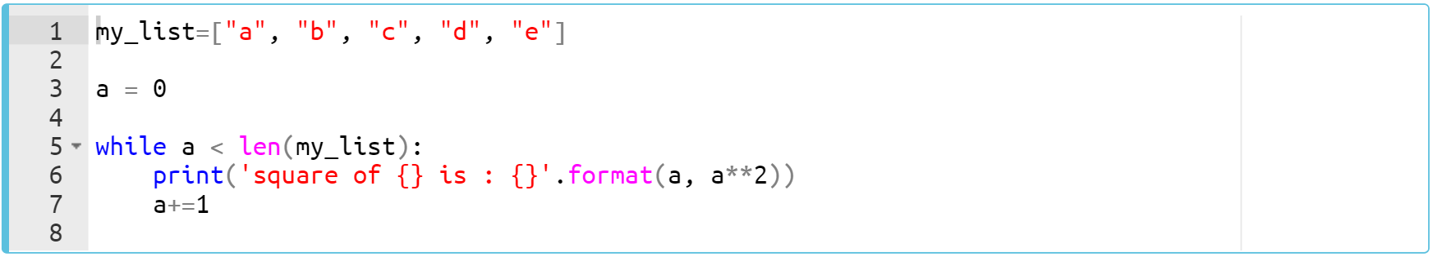
while Loop (review the pre-class)
We can use an iterator object in a while loop. Let’s call a list in this example :
Notes:
i am gonna review the pre-class content quickly. in this code we have an iterable. in this case we have a list named my_list. and using this list i can set a while loop. how we do that let’s take a look at this syntax carefully. …
my_list=['a', 'b', 'c', 'd', 'e']
a = 0
while a < len(my_list):
print('square of {} is : {}'.format(a, a**2))
a+=1

Slide 12
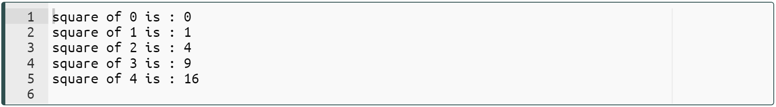
while Loop (review the pre-class)
The output :
Notes:
as you can see i should define a counter. after each iteration it will be increased by one so when it reaches to the length of the iterable it will stop. does it make sense. ok if you want let's follow the loop by focusing on each iteration.
my_list=["a", "b", "c", "d", "e"]
a = 0
while a < len(my_list):
print('square of {} is : {}'.format(a, a**2))
a+=1

Slide 13
while Loop (review the pre-class)
Task: Take the age of the user using input() and while loop.
Write a program that ;
Takes the age from user,
Check the age if it is correct numeric format.
Notes:
age = input('Enter your age please : ')
while not age.isdigit():
print ('You entered incorrectly!')
age = input('Enter your age please : ')
print('Great! You enter valid input : ',age)

Slide 14
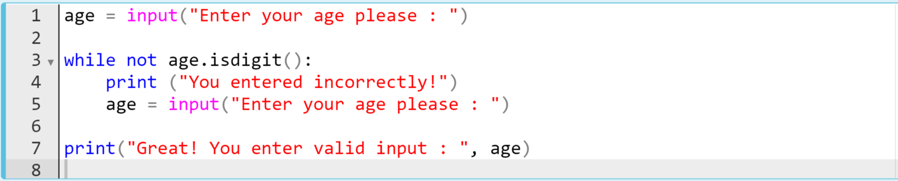
while Loop (review the pre-class)
The code can be like :
Notes:
and yes. you learn a new method which is “isdigit”. what the isdigit does? it checks the string type and if any characters is not a number then it returns false. all characters must be numeric. so if i enter 45.5 then due to there is a dot inside my string, it will return false. by using this method i can check the format of age which should be numerical. … suppose we entered 45.5 … ….. did i make myself clear.
age = input('Enter your age please : ')
while not age.isdigit():
print ('You entered incorrectly!')
age = input('Enter your age please : ')
print('Great! You enter valid input : ',age)

Slide 15
while Loop (review the pre-class)
Task: Let's play famous 'guessing a number game' using while loop.
Write a program that ;
Takes the numbers from user,
Compares the number the user entered with the number you assigned and then gives a message “Little lower” or “Little higher” till the user knows it.
Notes:
yes. in our second task i would like to review the pre-class example which is very good for better understanding. since it is a pre-class example let's jump to the solution code and follow the steps line by line. it is just for training to our brains
answer = 44
question = 'What number am I thinking of? '
print ("Let's play the guessing game!")
while True:
guess = int(input(question))
if guess < answer:
print('Little higher')
elif guess > answer:
print('Little lower')
else: # guess == answer
print('Are you a MINDREADER!!!')
break

Slide 16
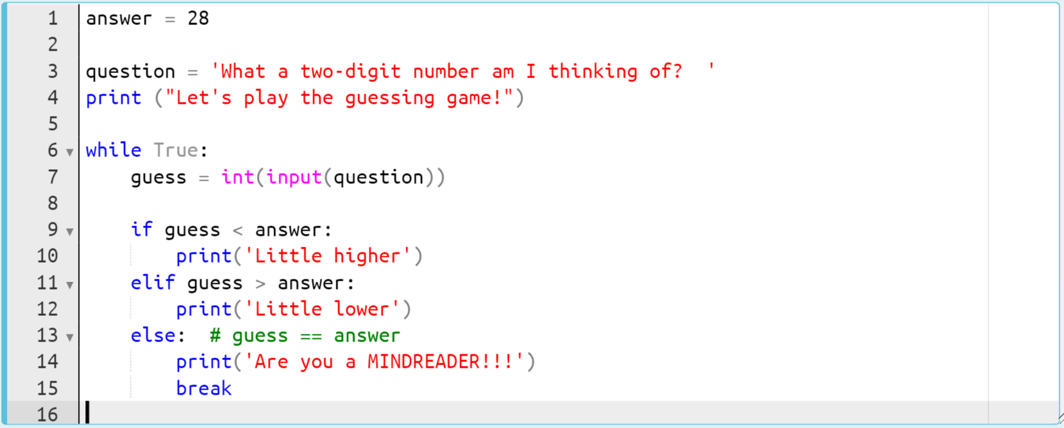
while Loop (review the pre-class)
The code can be like : In this case, we are trying to find number 28.
Notes:
this is the solution code. == explanation is on the other slide. go to there ==
answer = 44
question = 'What number am I thinking of? '
print ("Let's play the guessing game!")
while True:
guess = int(input(question))
if guess < answer:
print('Little higher')
elif guess > answer:
print('Little lower')
else: # guess == answer
print('Are you a MINDREADER!!!')
break

Slide 17
while Loop
Lastly, let's play famous 'guessing a number game' using while loop.
We have written a program that does not exit the while loop until you find the correct number.
When the user knows the answer (28) and enters input, it takes the value of 28 and assigns to variable guess, in the end, else works and breaks the loop.
When the user knows the answer (28) and enters input, it takes the value of 28 and assigns to variable guess, in the end, else works and breaks the loop.
When the user knows the answer (28) and enters input, it takes the value of 28 and assigns to variable guess, in the end, else works and breaks the loop.
We used break keyword in order to quit and exit the while loop.
Notes:
…. generally while loops are being used when taking inputs from the user. in any input. in any condition. you can control your program flow very effective by while loop. as you can see in this example we take two digit number from the user and if it is not acceptable then we ask user again to enter a new input. by doing so, we can take correct input or desired input from the user… so you have learned a new keyword which is break. break is used to stop and go out of the loop. it can be used either in while loop of for loop. so in this case , if the user find the correct number then we have to terminate the execution and go out of the loop.
infinite loop without “break”
using a var instead of True

Slide 18
while Loop
Task: Find and print the length of the longest word.
Write a program that ;
Takes a string sentence consisting of a couple of words from the user,
Compares and find out the longest word and prints the whole sentence and the length of the longest word as int type.
Use while loop.
Notes:
you have three minutes. I give you time, but of course I have to find a balance here. With these types of questions, it is absolutely essential that you think and try to write the code. But I have to set a limit as each student will do the questions and the time they will spend will be different. So now I'm giving you 3 minutes to think and roughly outline your code. then we will focus on the solution together.
sentence = input('Give me a sentence :')
words = sentence.split()
i=0
longest=0
while i < len(words):
if len(words[i]) > longest:
longest = len(words[i])
i += 1
print('the length of the longest word :', longest)

Slide 19
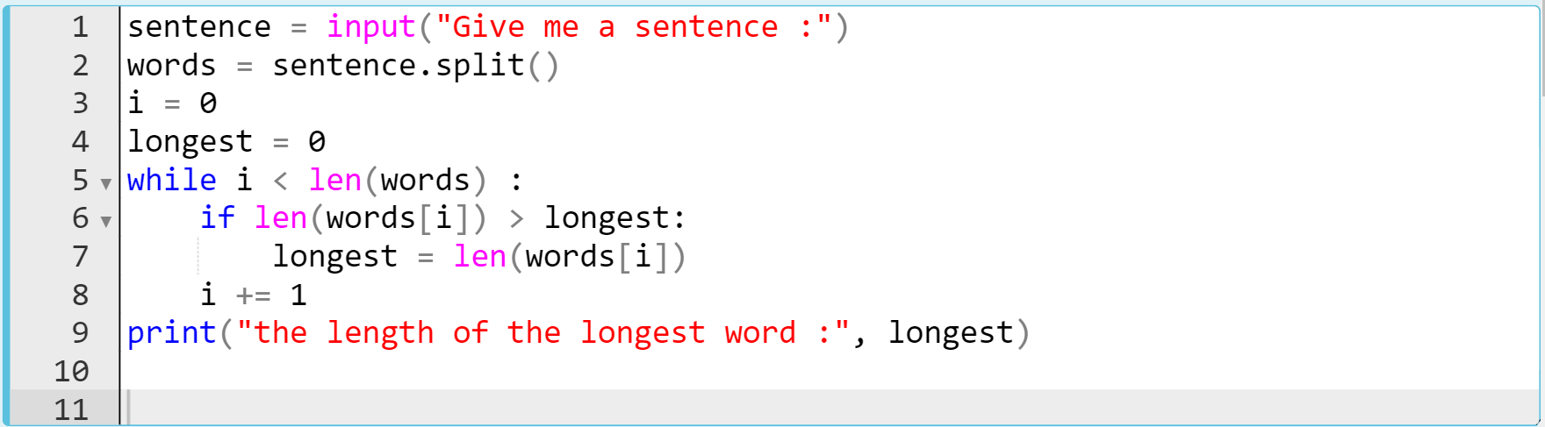
while Loop
The code can be like :
Notes:
sentence = input('Give me a sentence :')
words = sentence.split()
i=0
longest=0
while i < len(words):
if len(words[i]) > longest:
longest = len(words[i])
i += 1
print('the length of the longest word :', longest)

Slide 20
for Loop
the world and even life itself are nothing but loops.
Notes:
… do you agree with this statement. what do you think.? is life really composed of loops? Indeed, when we look back at the past, when we read it; we see that almost everything repeats in a cycle. The life cycle of living things, the life cycle of plants, nature .. The rotation of the earth around itself and the sun .. The rotation of stars and celestial bodies… The rotation of particles around the atom, etc. It is a cycle from the micro universe to the macro universe. Our cosmic system has been set up like this .. anyway.. Long story short; loop will be a part of our lives.

Slide 21
for Loop (review the pre-class)
The simple syntax 👇 of a for loop is :
A colon
for variable in iterable:
body
A 4-space indentation
Notes:
Now it’s time to learn the most common and useful syntax in Python. Yes we’re talking about the for loops.
When you want to iterate a block of code you should use the for loop…
In order to use for loop we need iterable. The keypoint here is the using of an iterable…..
...range function can also be used to generate an iterable object….

Slide 22
for Loop (review the pre-class)
To create a for loop, you need a variable and an iterable object.
Let's examine the subject through an example :
Notes:
let’s take a look at this simple pre-class example. in this example we use a list as an iterable. so let’s follow the each iteration process one by one.
for i in [1, 2, 3, 4, 5]:
print(i)

Slide 23
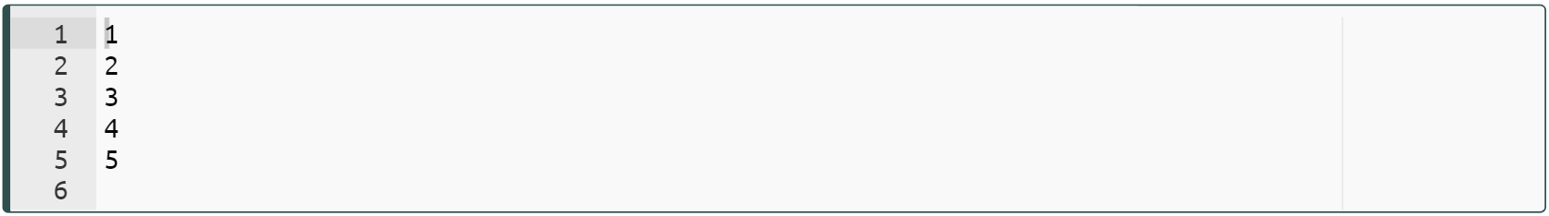
for Loop (review the pre-class)
To create a for loop, you need a variable and an iterable object.
Let's examine the subject through an example :
Notes:
…== explain yourself ==
ok. what the for loop does is that : it takes the elements from the iterable object one by one and assigns it to the variable. in this case the variable is i here. then execute the body. it prints one then it goes to the second iteration and it takes the number two which is the second element of the iterable and assigns it to the variable i and execute the body. which means it prints out the number two. and so on. it takes three then four then five… that’s how for loop works. it is simple, right?
for i in [1, 2, 3, 4, 5]:
print(i)

Slide 24
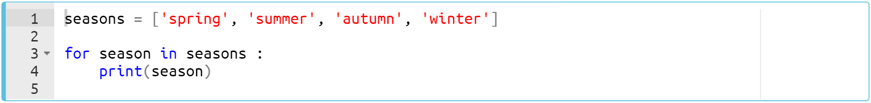
for Loop (review the pre-class)
Another example :
Notes:
Here is another pre-class example. In the structure of the for loop, you can use also a variable as an iterable. it is so clear, right? Just as we can use the iterable value itself, of course, we can use the variable to which this value is assigned.
seasons = ['spring', 'summer', 'autumn', 'winter']
for season in seasons:
print(season)

Slide 25
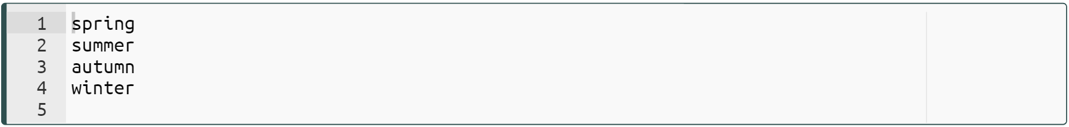
for Loop (review the pre-class)
In the structure of the for loop, you can use also a variable as an iterable.
Let's see it in an example :
Notes:
…== next slides == when we run, it print out the elements of the list. let’s follow the iterations one by one…
seasons = ['spring', 'summer', 'autumn', 'winter']
for season in seasons:
print(season)

Slide 26
for Loop
In the structure of the for loop, you can use also a variable as an iterable.
Let's see it in an example :
Notes:
seasons = ['spring', 'summer', 'autumn', 'winter']
for season in seasons:
print(season)

Slide 27
for Loop
In the structure of the for loop, you can use also a variable as an iterable.
Let's see it in an example :
Notes:
seasons = ['spring', 'summer', 'autumn', 'winter']
for season in seasons:
print(season)

Slide 28
for Loop
In the structure of the for loop, you can use also a variable as an iterable.
Let's see it in an example :
Notes:
seasons = ['spring', 'summer', 'autumn', 'winter']
for season in seasons:
print(season)

Slide 29
for Loop
In the structure of the for loop, you can use also a variable as an iterable.
Let's see it in an example :
Notes:
seasons = ['spring', 'summer', 'autumn', 'winter']
for season in seasons:
print(season)

Slide 30
for Loop
Task : Python Program to say “hello name”
Write a program to say “hello names” from the following list.
Print the result such as : “hello Samuel”
“hello Victor”
names = ["Ahmed", "Aisha", "Adam", "Joseph", "Gabriel"]
Notes:
ok. here is your first task to complete.
names = ["Ahmed", "Aisha", "Adam", "Joseph", "Gabriel"]
for i in names:
print('hello', i)

Slide 31
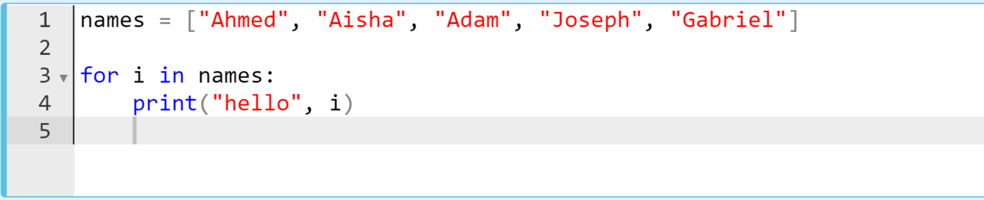
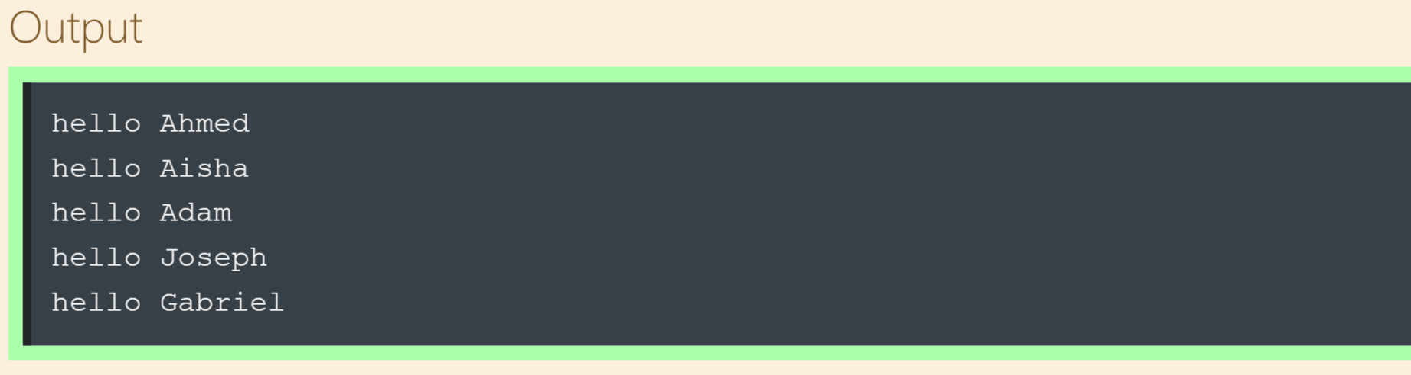
for Loop
The code might be like :
Notes:
yes. this is one of the option of the solutions. it is shown on the screen how i did….
names = ["Ahmed", "Aisha", "Adam", "Joseph", "Gabriel"]
for i in names:
print('hello', i)

Slide 32
for Loop
Task : Python Program to create numbers using range()
Write a program to create a list consisting of numbers from 1 to 5.
Print the result such as : [1, 2, 3, 4, 5]
Notes:
ok. this time we have a little bit complicated task for you…. you should know the range function from your pre-class. by the way i am gonna review the range function in detail in the next slides a little bit later. but let’s see whether you study pre-class or not.
numbers = []
for i in range(1,6):
numbers.append(i)
print(numbers)

Slide 33
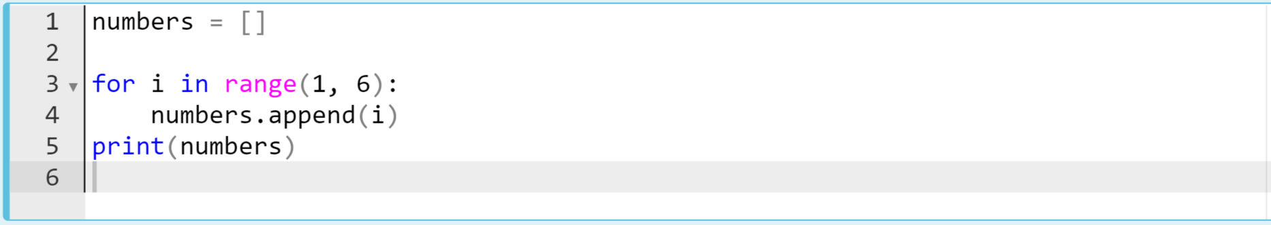
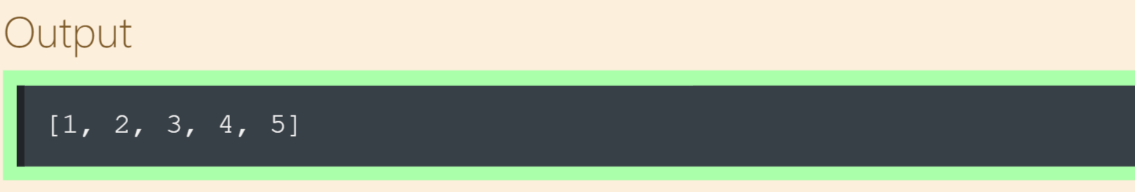
for Loop
The code might be like :
Notes:
ok. to print out the numbers in a list form i have to collect all elements into a list and print the all numbers at once in a list form. to do that i define an empty list then i set a for loop using range function then i collect the numbers taken from range function into the empty list named numbers. that’s the all process. as you can see, the arguments of the range function is one and six. it starts from one goes to the end minus one, in this case the end parameter is six so it goes to the number five. of course to collect all these numbers one by one, i use append method. does it make sense?
numbers = []
for i in range(1,6):
numbers.append(i)
print(numbers)

Slide 34
Working with the Iterators
Notes:
ok. let’s put an interval here and take a quick look at how we work with iterators. At this point, i would like to talk about a little more about the iterators.

Slide 35
Working with the Iterators
Can you iterate me? Huh?
. .
__
Notes:
is this man an iterable. what do you think. let’s remember the definition of the iterables. how we can basically define the iterable is that: The iterable object can be anything for which items are received one by one, forward only. in other words, if we are able to separate the elements of an object then it is an iterable. so this definition makes this man an iterable, right.? he is composed of circles. he is separable into circles. ok then what are the iterable types in python. let’s remember of those you have learned.

Slide 36
Working with the Iterators (review)
The most common iterable types :
str
list
tuple
dict
set
Notes:
The most commonly used iterable types of data are as follows . what can be added here?

Slide 37
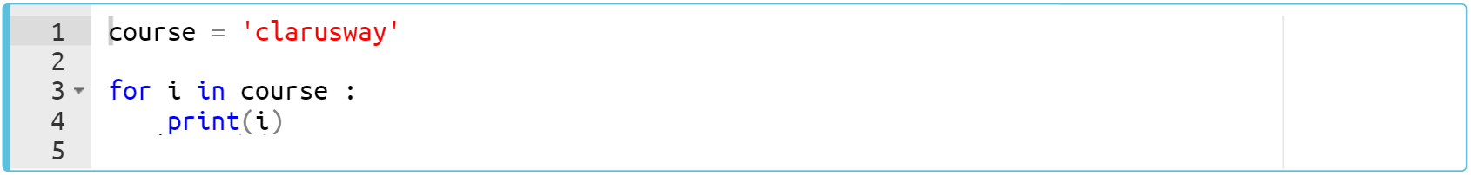
Working with the Iterators (review)
Consider this example of a str type.
Notes:
course = 'clarusway'
for i in course:
print(i)

Slide 38
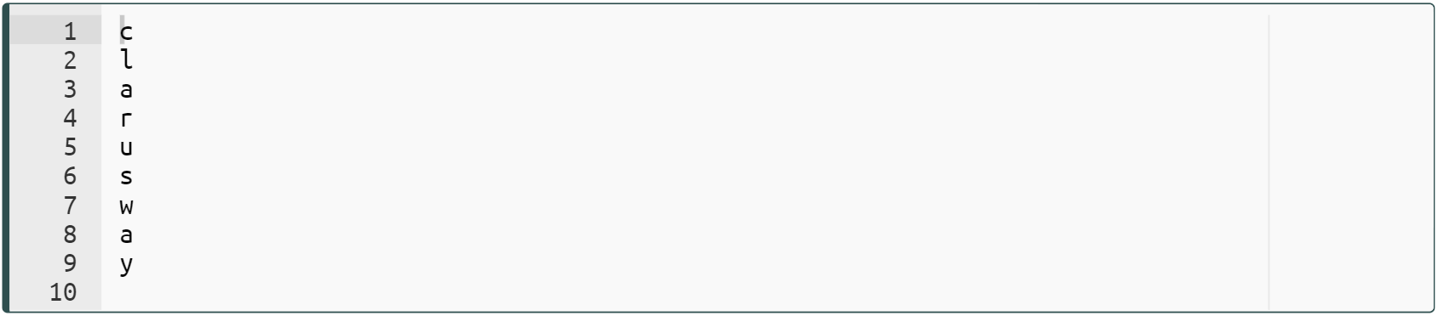
Working with the Iterators (review)
Consider this example of a str type.
Notes:
course = 'clarusway'
for i in course:
print(i)

Slide 39
Working with the Iterators
Task : Python Program to separate the string into its characters.
Write a program to separate the string taken from the user into its characters using for loop.
Print the result such as :
input : "Clarusway"
desired output : c-l-a-r-u-s-w-a-y
Notes:
… think sipmple.. maybe we should use one of the parameters of print function to do that… be careful. one thing is you should use for loop. the second thing is you have to print it out as shown on the screen. the letter are separated by spaces.
word = input('Give me a word :')
count = 0
for i in word:
count += 1
if count < len(word):
i = i + '-'
print(i, end='')

Slide 40
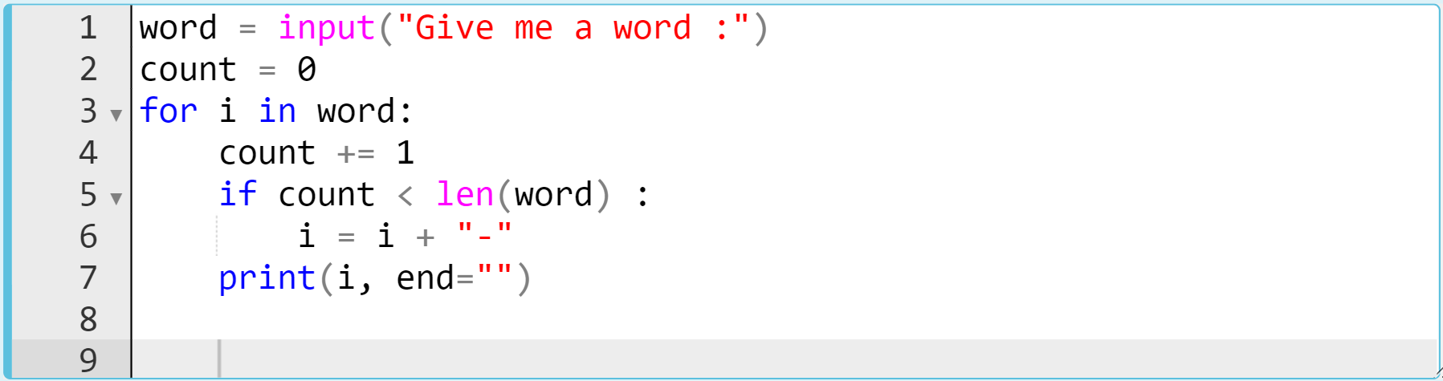
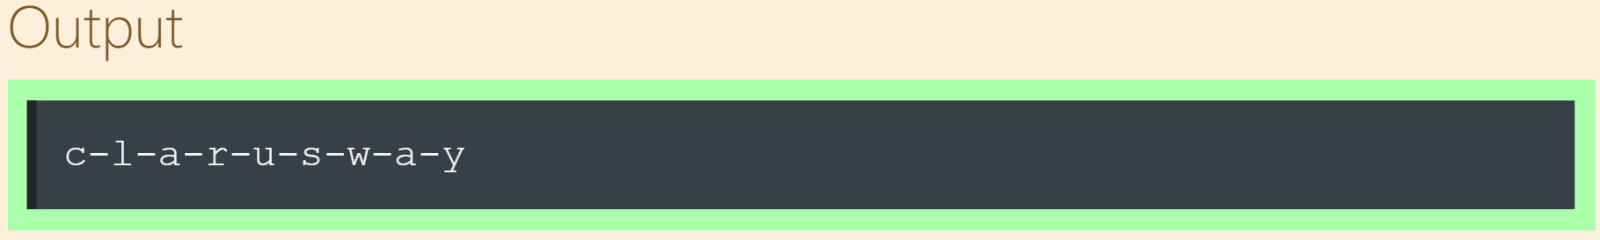
Working with the Iterators
The code might be like :
input : "Clarusway"
Notes:
….does it make sense? at this point i would like to ask a question to know which of you know another method or another way to do that without using for loop. i will show you how you can do that in the next lessons but now, i am expecting your opinion. Please let me know. shoot your responses on class-chat. ok i am not gonna explain that. just i wanted to draw your attention to existence such different method we have . anyway. keep going.
word = input('Give me a word :')
count = 0
for i in word:
count += 1
if count < len(word):
i = i + '-'
print(i, end='')

Slide 41
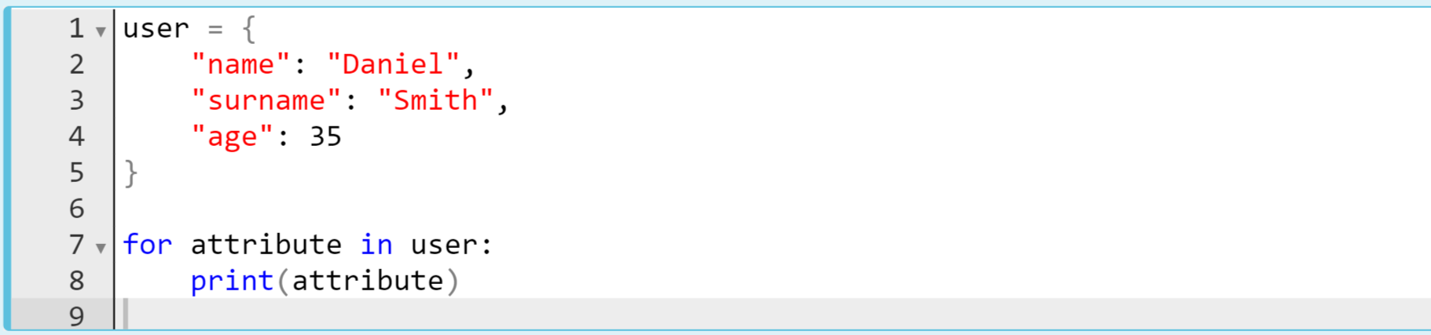
Working with the Iterators
Take a look at the other iterable type : dict.
What is the output? Try to figure out in your mind...
Notes:
...the critical question is that when we use dictionary as an iterable in for loop. then, will it take keys or values or both of them as the elements of the iterable.
user = {
'name':'Daniel',
'surname':'Smith',
'age':35
}
for attribute in user:
print(attribute)

Slide 42

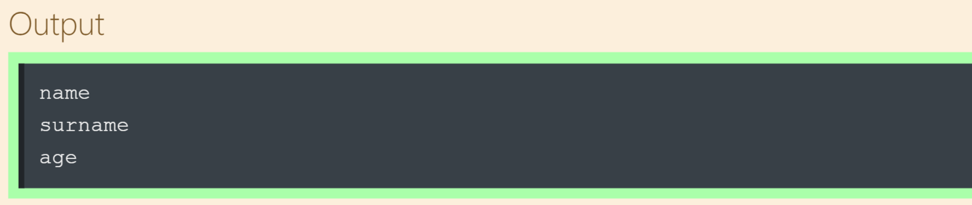
Working with the Iterators
The output :
Notes:
as you can see, if we use want to use dictionary as an iterable object in for loop, then it takes keys as the element of the dictionary. keep in mind. this is important and crucial knowledge for you.
user = {
'name':'Daniel',
'surname':'Smith',
'age':35
}
for attribute in user:
print(attribute)

Slide 43
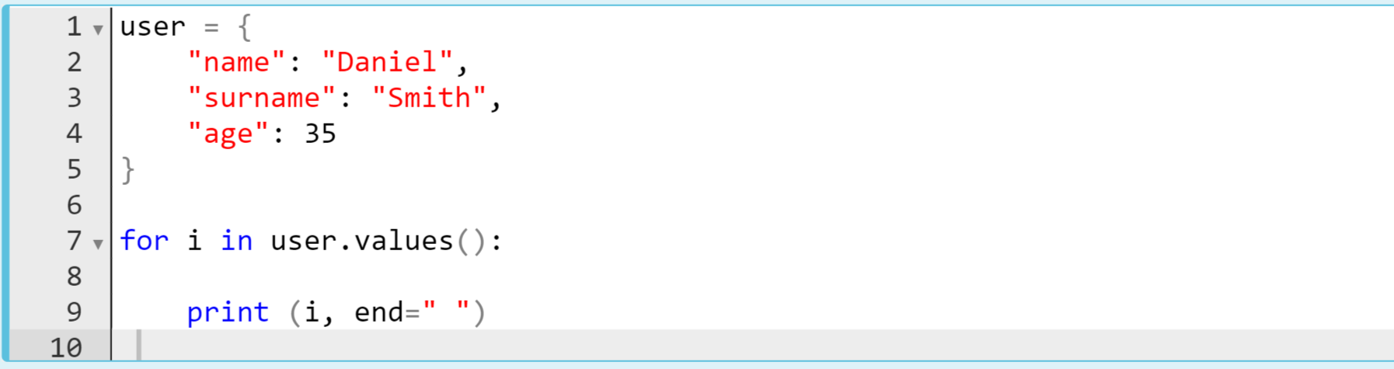
Working with the Iterators
Take a look at the other iterable type : dict.
What is the output? Try to figure out in your mind...
Notes:
this is very similar to the previous one. this time we use user dot values method. will it give an error or something different?
user = {
'name':'Daniel',
'surname':'Smith',
'age':35
}
for i in user.values():
print(i, end= ' ')

Slide 44
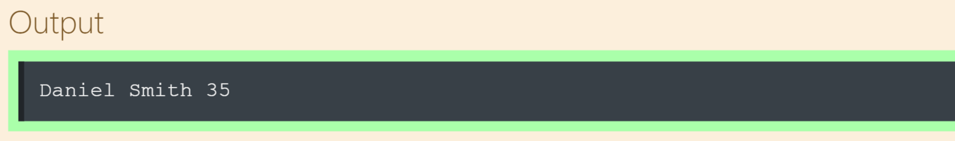
Working with the Iterators
The output :
Notes:
yes of course, this time it takes values of dictionary one by one and executes the body. which is printing out the values in a single line
user = {
'name':'Daniel',
'surname':'Smith',
'age':35
}
for i in user.values():
print(i, end= ' ')

Slide 45
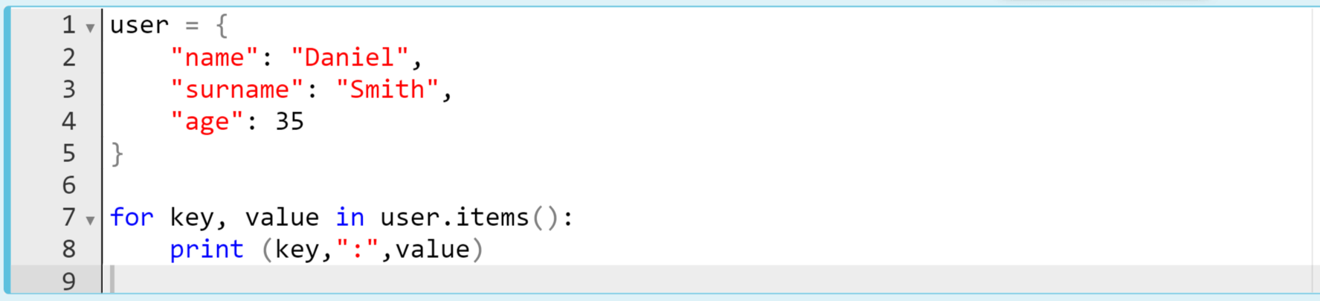
Working with the Iterators
Take a look at the other iterable type : dict.
What is the output? Try to figure out in your mind...
Notes:
this is something different, right? this time we use two variables here. what do you think. shoot your responses on pear-deck please.
user = {
'name':'Daniel',
'surname':'Smith',
'age':35
}
for key, value in user.items():
print(key, ':', value)

Slide 46
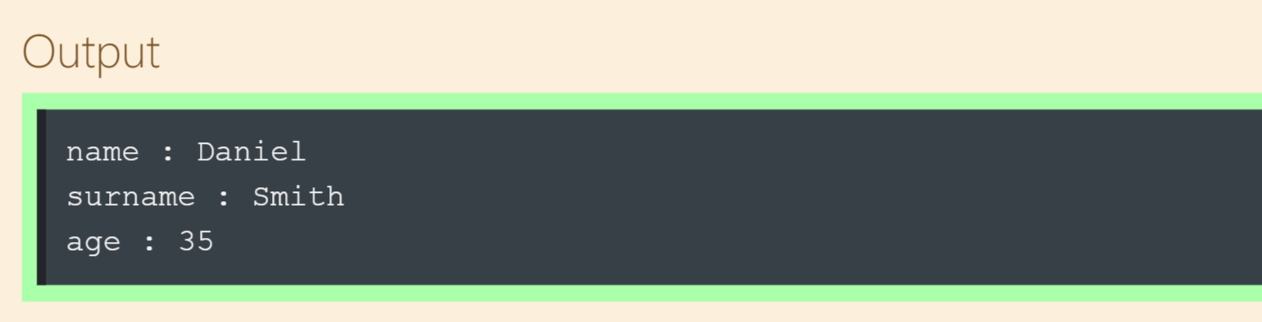
Working with the Iterators (review)
The output :
Notes:
here is the output. …. ..if there is not any unclear point i move on to next subtopic..
user = {
'name':'Daniel',
'surname':'Smith',
'age':35
}
for key, value in user.items():
print(key, ':', value)

