Slide 1
Operations with for Loop
Notes:
yes. operations with for loops. in this section of our lesson i am gonna show several basic and important operations using for loop. in this section, i would like to cover some useful methods and functions throughout several examples. lets begin.

Slide 2
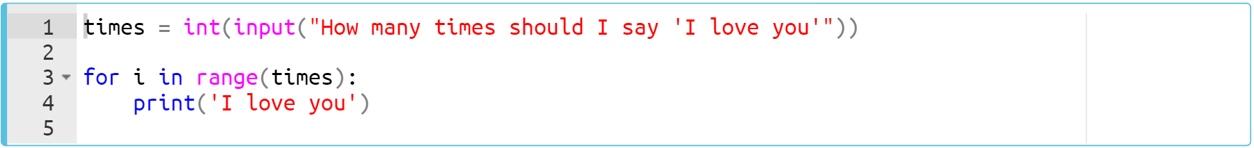
Operations with the for Loop(review)
In the following example, you'll get a number from the user and print a sentence the number of times we take from the user :
Notes:
Let’s take a look at several functions and methods used in for loop. you should take an integer number from the user. and print the sentence, in this case I love you, a number of times which the user entered.
times = int(input("How many times should I say ‘I love you’"))
for i in range(times):
print("I love you")

Slide 3
Operations with the for Loop(review)
In the following example, you'll get a number from the user and print a sentence the number of times we receive from the user :
Let's say the user enters 3.
Notes:
…. as you can see that we do not use variable i in the code body here. We do not have to use it inside our code block if we do not need it. in this case we don’t need it to use inside the code block. what we are want to do is just to print the sentence 3 times.ok
times = int(input("How many times should I say ‘I love you’"))
for i in range(times):
print("I love you")

Slide 4
Operations with the for Loop
Task : This time, write a code block that asks the user a number between 1 and 10 then puts that number into the multiplication table.
For example, the output for 5 should be as follows :
5x0 = 0
5x1 = 5
5x2 = 10
5x3 = 15
5x4 = 20
5x5 = 25
5x6 = 30
5x7 = 35
5x8 = 40
5x9 = 45
5x10 = 50
Notes:
…
nmbr = int(input('enter a number between 1-10'))
for i in range(11):
print('{}x{} = '.format(nmbr, i), nmbr * i)

Slide 5
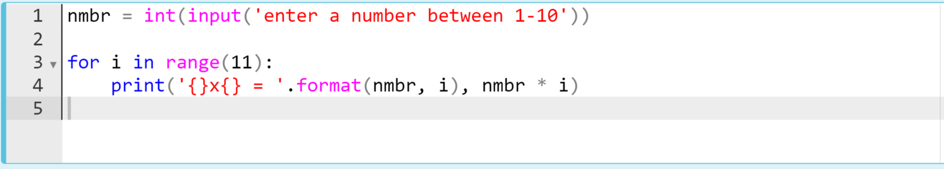
Working with the Iterators
The output can be like :
Notes:
burada isdigit fonksiyonu ile bir if yapısı kurup örneği geliştirebiliriz.
nmbr = int(input('enter a number between 1-10'))
for i in range(11):
print('{}x{} = '.format(nmbr, i), nmbr * i)

Slide 6
Operations with the for Loop(review)
Let’s take a close look at the range() function.
As we stated before, the formula syntax of the range() function is :
range(start, stop, step)
parameters
Notes:
up to now, we have used range function very often, right? it is very useful and important function, so if you want, let’s open a window to take a closer look at this function very quickly.
...It creates an iterable sequence of numbers. And it can be simply converted into the list, set, and tuple….

Slide 7
Operations with the for Loop(review)
(... continued)
Consider this example :
Notes:
b = list(range(11))
print(b)

Slide 8
Operations with the for Loop(review)
Let’s take a close look at the range() function.
It creates an iterable sequence of numbers. And it can be simply converted into the list, set, and tuple.
Consider this example :
Notes:
b = list(range(11))
print(b)

Slide 9
Operations with the for Loop(review)
(… continued)
Here’s the other examples :
Notes:
a = set(range(0, 10))
print(a)

Slide 10
Operations with the for Loop(review)
(… continued)
Here’s the other examples :
Notes:
a = set(range(0, 10))
print(a)

Slide 11
Operations with the for Loop(review)
(… continued)
Here’s the other examples :
Notes:
a = set(range(0, 10))
print(a)
c = tuple(range(11))
print(c)

Slide 12
Operations with the for Loop(review)
(… continued)
Here’s the other examples :
Notes:
a = set(range(0, 10))
print(a)
c = tuple(range(11))
print(c)

Slide 13
Operations with the for Loop(review)
An asterisk 👉🏻 * separates the elements of the iterables.
Let’s take a look at an example of the range() function with starred 👉🏻 * expression :
What is the output? Try to figure out in your mind...
Notes:
ok. let’s take a look at another useful method. Besides, you can use asterisk expression 👉🏻 * before range() function to separate its elements.
print(range(5))
print(*range(5))

Slide 14
Operations with the for Loop(review)
(… continued)
Let’s take a look at an example of the range() function with starred 👉🏻 * expression :
Notes:
...it is closed, it is secretive.. we can’t see the result which range function generates. in order to see or display the sequence of the number we have to do something. what did we do on the previous slides. we use collection functions to display the elements. and in the same way we can either use asterisks to display the elements separately of the range function. The important point I'm trying to explain to you is that: asterisk separates the elements of any iterable type. when we put an asterisk just before an iterable type it separates its elements.
print(range(5))
print(*range(5))

Slide 15
Operations with the for Loop(review)
(… continued)
Here’s another example of the range() function with starred 👉🏻 * expression :
What is the output? Try to figure out in your mind...
Notes:
print(*range(5, 25, 2))

Slide 16
Operations with the for Loop(review)
(… continued)
Here’s another example of the range() function with starred 👉🏻 * expression :
Notes:
print(*range(5, 25, 2))

Slide 17
Operations with the for Loop(review)
(… continued)
Starred 👉🏻 * expression can also be used to separate the other iterable objects. Such as str :
Notes:
print(*('seperate'))

Slide 18
Operations with the for Loop(review)
(… continued)
Starred 👉🏻 * expression can also be used to separate the other iterable objects. Such as str :
Notes:
print(*('seperate'))

Slide 19
Operations with the for Loop(review)
(… continued)
You can create reverse sequence numbers using a negative step.
What is the output? Try to figure out in your mind...
Notes:
… yes my friends. it is something that we use rarely. we don’t use it often. but i would say that it is very useful either. i am talking about negative step parameter….
print(*range(10,0,-2))

Slide 20
Operations with the for Loop(review)
(… continued)
You can create reverse sequence numbers using a negative step.
Notes:
it reverses the sequence of the numbers which range function generates.
print(*range(10,0,-2))

Slide 21
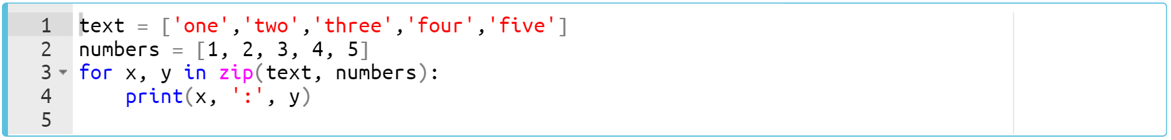
Operations with the for Loop(review)
Multiple variables in for loop.
Examine this example carefully :
zip(iterator1, iterator2, ...)
Use your IDEs
Notes:
In some cases, you will need to set up the for loop with multiple variables and the iterables. as you can remember we have used two variables when we iterates a dictionary using for loop…….
... and in this example on the screen, we have two lists “text” and “numbers” and we combine them together using zip function.. ...what actually zip function does is that : it takes the elements from each iterable one by one in order and create tuples from these elements….
text = ['one', 'two', 'three', 'four', 'five']
numbers = [1, 2, 3, 4, 5]
for x, y in zip(text, numbers):
print(x, ':', y)

Slide 22

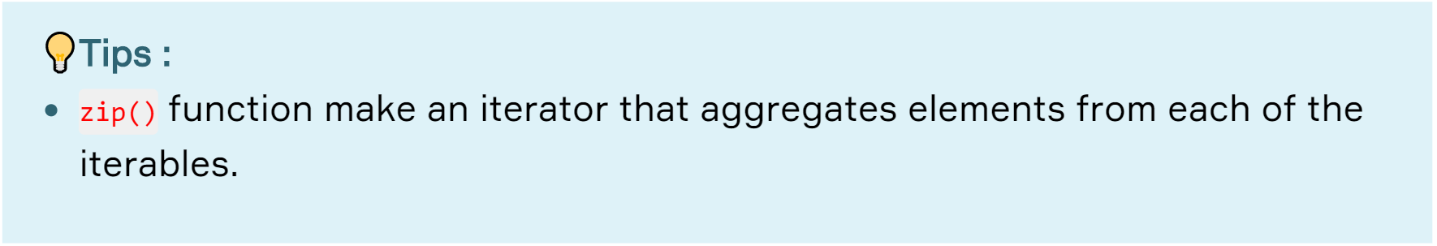
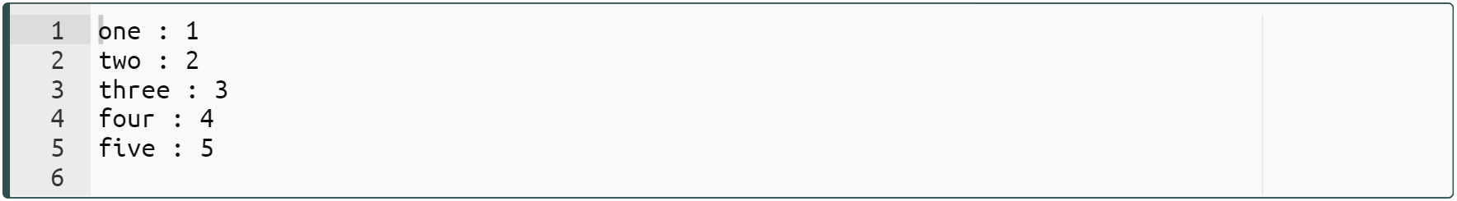
Operations with the for Loop(review)
In some cases, you will need to set up the for loop with multiple variables and the iterables.
Examine this example carefully :
Notes:
and when we run it, as you can see the element pairs are located in the variables we define in the for loop x and y.
it takes the elements from each iterable and matches them in order one by one. first to first, second to second, third to third and so on.
text = ['one', 'two', 'three', 'four', 'five']
numbers = [1, 2, 3, 4, 5]
for x, y in zip(text, numbers):
print(x, ':', y)

Slide 23
Operations with the for Loop
Task : Python Program to collect the odd and even numbers in two different lists.
Write a program to choose and collect the even and odd numbers (1 to 10) in two different list.
Print the result such as :
evens: [0, 2, 4, 6, 8]
odds : [1, 3, 5, 7, 9]
Notes:
and here is your first task in this topic. …. think simple. it may not be related to zip function. you should think in general for loop operations. you can either use zip function but in my solution i don’t use it. ok let’s see my solution.
evens = []
odds = []
for n in range(10):
if n % 2 == 0:
evens.append(n)
else:
odds.append(n)
print(evens)
print(odds)

Slide 24
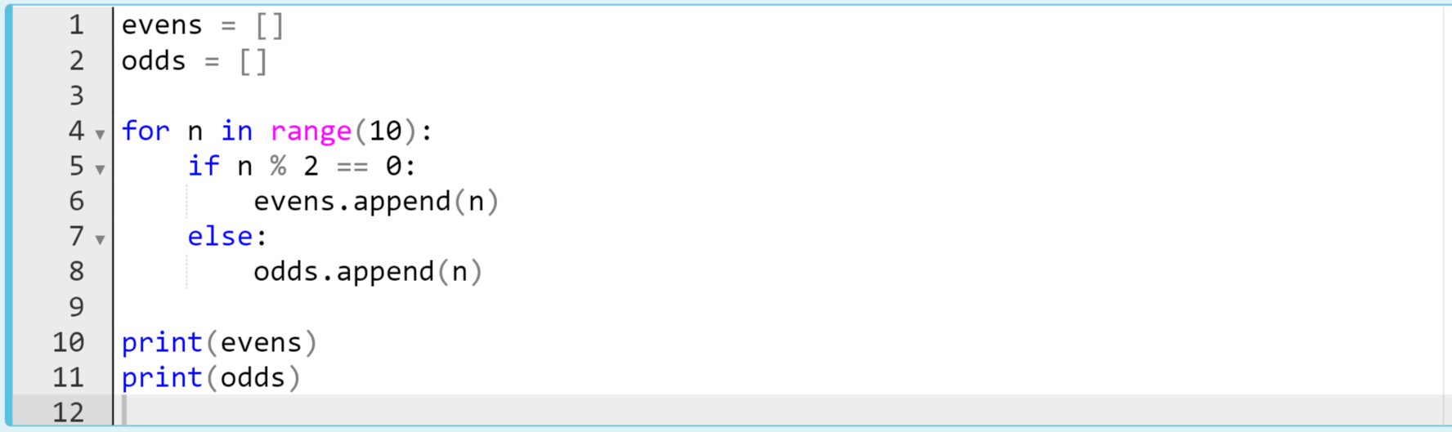
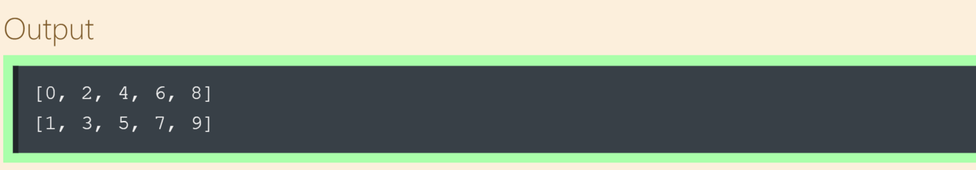
Operations with the for Loop
The code might be like :
Notes:
yes first of all, if we collect some data into a list, firstly, we have to create an empty list. i have mentioned this point before, right. in this case, if we want to collect even and odd numbers in two different list we should create two empty lists. as you can see… and the magic syntax we have here, right? this is how we select even and odd numbers. we use modulus, right? if we divide any number by two and it returns no reminder which means zero then, this number is even otherwise it is odd.
in this example we use both if statements and loops in the same code block. actually it is exact basic example of control flow statements, right?..... does it make sense?
evens = []
odds = []
for n in range(10):
if n % 2 == 0:
evens.append(n)
else:
odds.append(n)
print(evens)
print(odds)

Slide 25
Operations with the for Loop
Task : Python Program to sum the amount of odd and even numbers in a tuple/list.
Write a code that counts the odd and even numbers in a given list or tuple.
Print the result such as :
example list: [11, 2, 24, 61, 48, 33, 3]
example output : The number of even numbers : 3
The number of odd numbers : 4
Notes:
let’s jump into another task. …. in this task you have to count the even and odd numbers in a given collection. list or tuple. how can you count these number. think simple. you should use if statements and you should use loops. i am giving you clues.
numbers = (11, 36, 33, 66, 89, 21, 32, 16, 10)
odds = 0
evens = 0
for i in numbers:
if not i % 2:
evens+=1
else:
odds+=1
print('The number of even numbers :',evens)
print('The number of odd numbers :',odds)

Slide 26
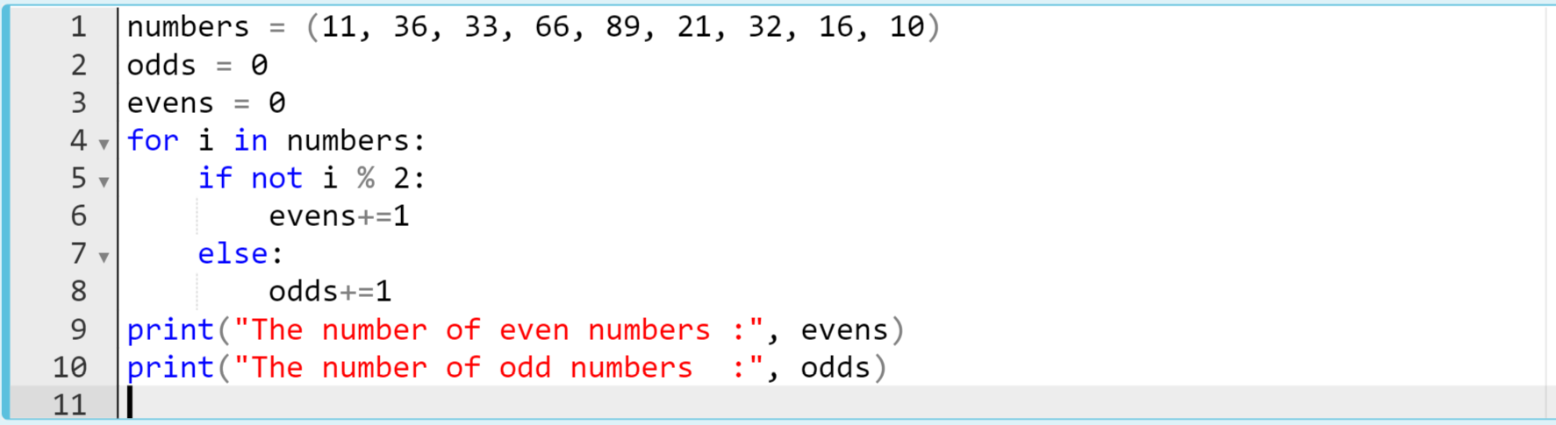
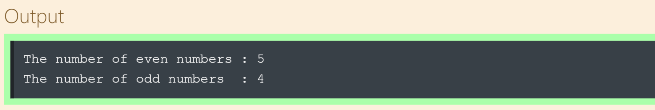
Operations with the for Loop
The code might be like :
Notes:
…. this method almost becomes traditional in pythonic world. if we count something we do it like this way. we define variables and initialize its value, it is zero commonly and increase it by one. that’s how we do it. ok?
numbers = (11, 36, 33, 66, 89, 21, 32, 16, 10)
odds = 0
evens = 0
for i in numbers:
if not i % 2:
evens+=1
else:
odds+=1
print('The number of even numbers :',evens)
print('The number of odd numbers :',odds)

Slide 27
Operations with the for Loop
Task : Python Program to print out the numbers.
Using the for loop, print the numbers from 1 to 9 as many as it is and get the following output.
1
22
333
4444
55555
666666
7777777
88888888
999999999
Notes:
.. how can you get this output using for loop in two lines of codes. what do you think.
for i in range(1, 10):
print(str(i) * i)

Slide 28
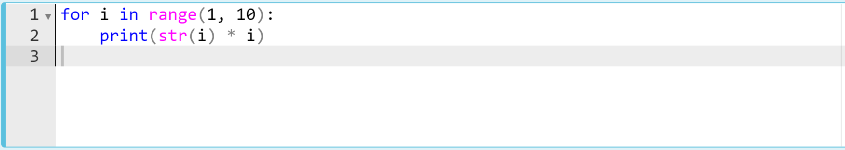
Operations with the for Loop
The code might be like :
Notes:
and my solution, here it is. …. == use jupyter to show the output string “1” and int 1 are the same ==
for i in range(1, 10):
print(str(i) * i)

Slide 29
Operations with the for Loop
Task : Python Program to sum of the numbers from 1 to 74
Get the output of 2775 as a sum of the numbers between 1 - 74 (including).
Use for loop to make this calculation.
Notes:
sum_num = 0
for i in range(1, 75):
sum_num += i
print(sum_num)

Slide 30
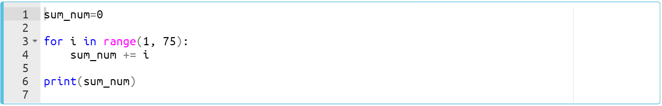
Operations with the for Loop
The code might be like :
Notes:
4’e kadar iteration yaparak anlat.
sum_num = 0
for i in range(1, 75):
sum_num += i
print(sum_num)

Slide 31
Nested for Loop
Notes:
yes we came to the nested for loop. loop in a loop.

Slide 32
Nested for Loop (review)
Simple structure of the nested for loops look like :
for variable1 in iterable1:
for variable2 in iterable2:
body
Notes:
As a programmer, you may sometimes need to interact with a single element of an iterable data and all other elements simultaneously, that is, your code block in a loop can also contain a loop.
Yes, we're talking about the nested loops.

Slide 33
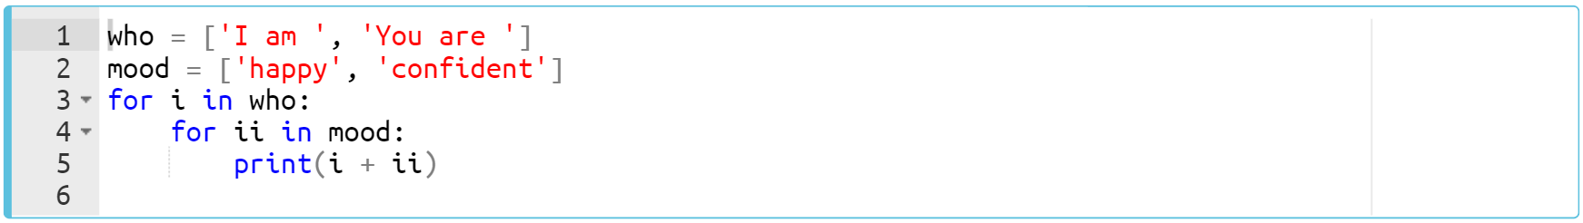
Nested for Loop (review)
Consider this example of the nested for loop :
Notes:
who = ['I am ', 'You are ']
mood = ['happy', 'confident']
for i in who:
for ii in mood:
print(i + ii)

Slide 34
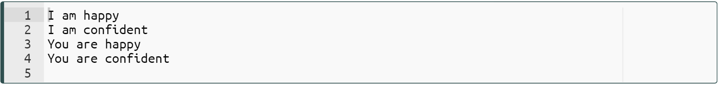
Nested for Loop
Consider this example of the nested for loop :
First outer then inner loop runs.
First outer then inner loop runs.
Notes:
who = ['I am ', 'You are ']
mood = ['happy', 'confident']
for i in who:
for ii in mood:
print(i + ii)

Slide 35
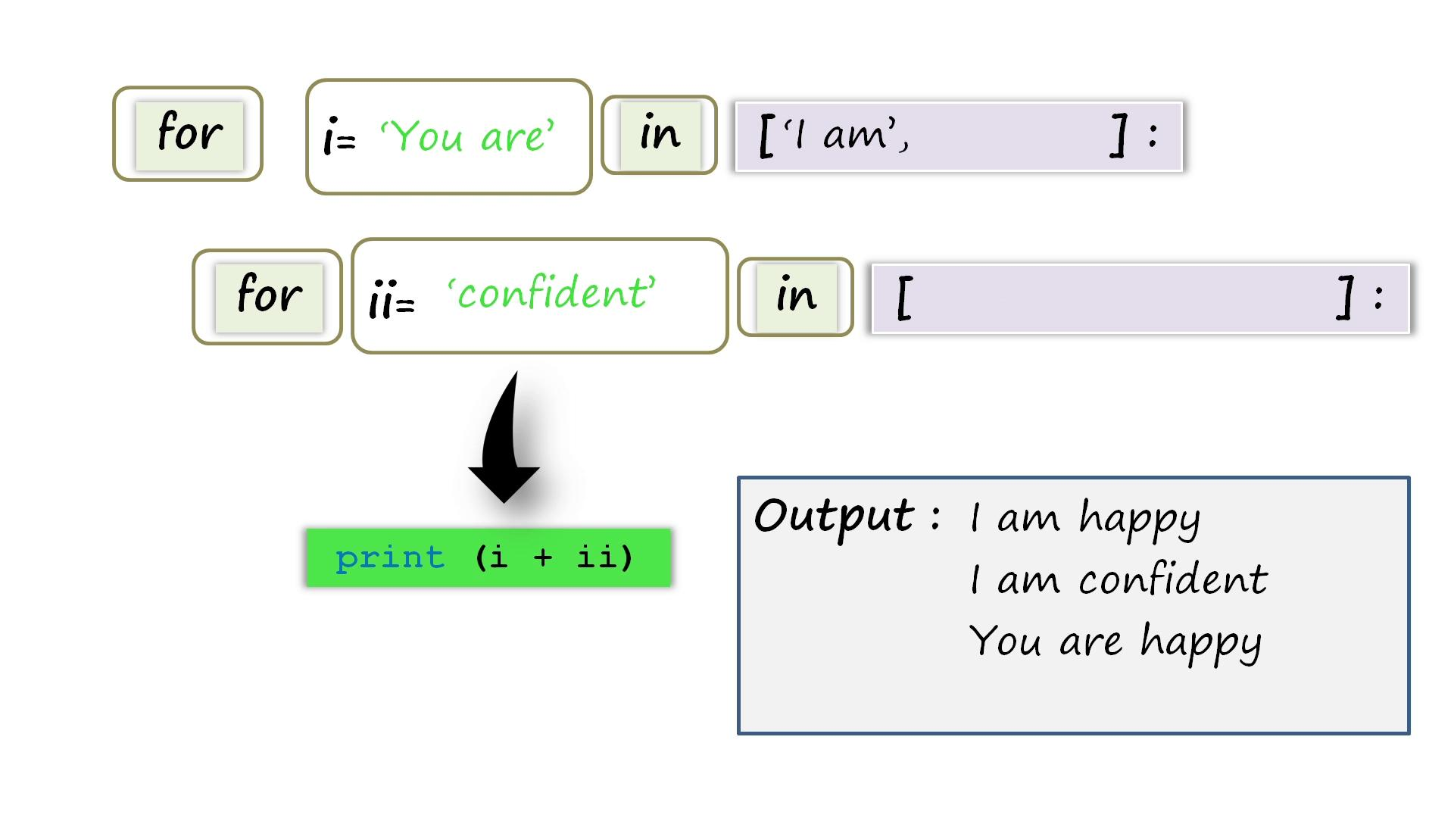
Nested for Loop (review)
You can follow the animated diagram of this nested for loop for a better understanding.

Slide 36
Nested for Loop
Task : Concatenation string elements from two separate lists.
Write a code that takes string elements one by one and prints a sentence using nested for loops :
The given lists and sample outputs are :
names = ["susan", "tom", "edward"]
mood = ["happy", "sad"]
example output : susan is happy
susan is sad
tom is happy
.
.
Notes:
names = ["susan", "tom", "edward"]
mood = ["happy", "sad"]
for i in names:
for ii in mood:
print(i + ' is ' + ii)

Slide 37
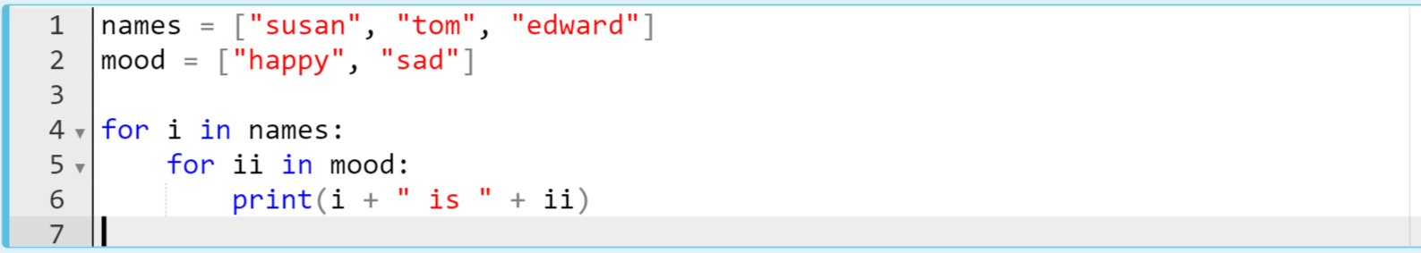
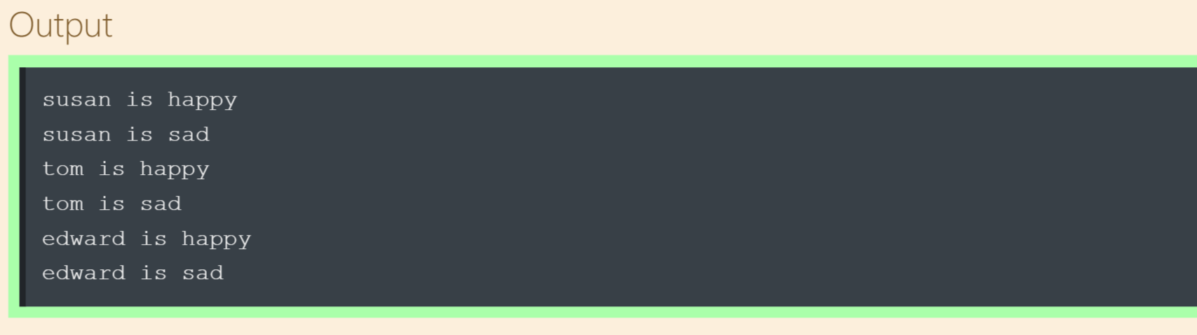
Nested for Loop
The code might be like :
Notes:
names = ["susan", "tom", "edward"]
mood = ["happy", "sad"]
for i in names:
for ii in mood:
print(i + ' is ' + ii)

